Slide 1
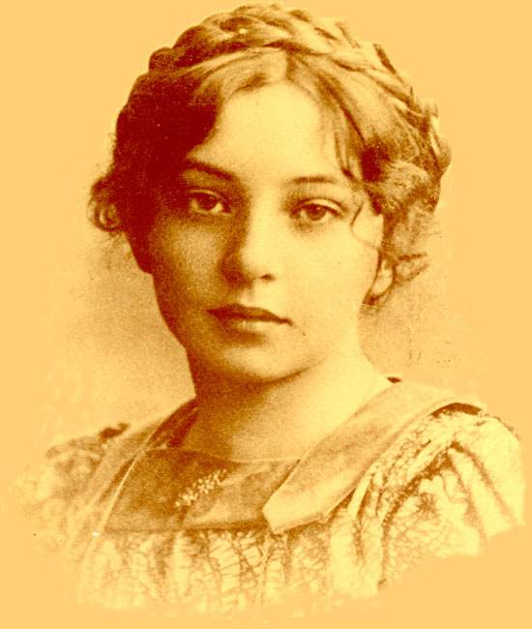
Sigrid Undset (1882 - 1949 Noble Laurate 1928

Slide 2
The historical landscape
Nostalgia for the past
Making a national identity
The Norse past as the national foundation
Making a spiritual identity – the Catholic past as an ideal
Mountains, rivers, fjords and forests rather than the cultivated landscape of Europe

Slide 3
Norwegian female author and Noble Laurate
Strongly attached to the land
Main authorship connected to the Norse past
Converted to Catholisism
Female emanicipation
The fight against totalitarism (refugee from Norway during the Second World War
The fight against racism and particularly the attrocities against the Jewish population of Europe

Slide 4
References (Selected titles translated to English)
The Master of Hestviken series (1925 -1927) (Translated the Master of the Horsebay); The Snake Pit: The Master of Hestviken, In the Wilderness: The Master of Hestviken and The Son Avenger: The Master of Hestviken.
Kristin Lavransdatter (A triology) (1920 – 1922) (Translated Kristin the daughter of Lavrans); Kristin Lavransdatter: The Wreath, Kristin Lavransdatter: The Wife and Kristin Lavransdatter: The Cross.
Catherine of Siena (re-published in 2009)

Slide 5
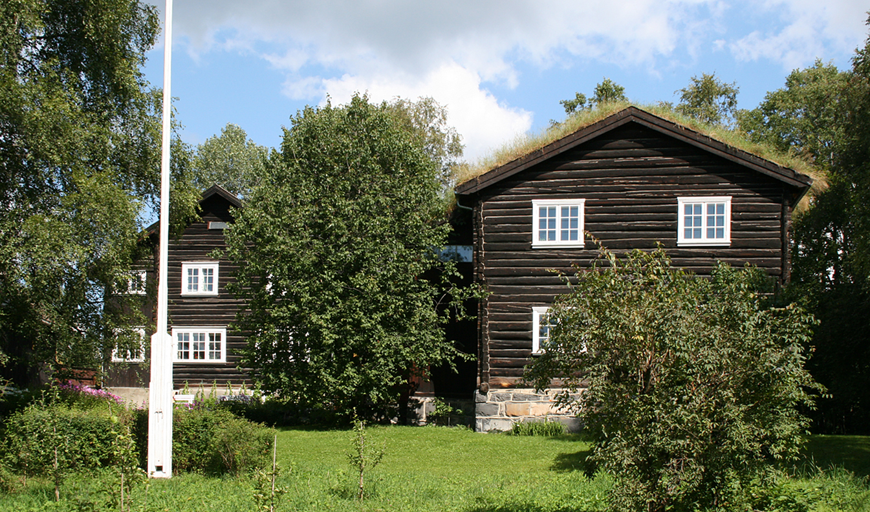
Sigrid Undsets home –Bjerkebæk ( a museum of the Noble Laurate)

Slide 6
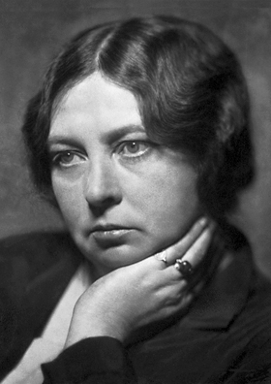
Sigrid Undset in later years – as a famous author

