Slide 1

Class 1
Introduction: capitalist natures
Masters in Environmental Studies
Masaryk University, Brno, Czech Republic
November 2018
Christos Zografos, PhD
JUH-UPF Public Policy Centre, Department of Political and Social Sciences, Pompeu Fabra University, Barcelona, Spain
christos.zografos@upf.edu

Slide 2
Introductions
Introduce myself
Students introduce themselves
  Name
  Course you are doing in Masaryk University
  Place of origin
  First degree in … from … University
Notes:
INTRODUCE MYSELF
Profile: a bit about me
Current post
Background: studies
Professional record (work)
Areas of research interest

Slide 3
Class outline
Introduction to course:
  Logistics
  Evaluations, etc.
Introduction to some key terms for the course
  Fields and sub-disciplines used in the course
  Terms/ concepts: politics, power, political ecology, etc.
Class: Capitalism and environmental transformation
  “Capitalism inevitably produces environmental degradation”
  “Resource exhaustion is a condition for capitalism”

Slide 4
1. Introduction to the course

Slide 5
Course structure
Course aims
  How power influences environmental change and governance
  Environmental social science: political ecology + environmental history
  Develop critical understanding of environmental change and relevance of power and politics in producing it
Course logic
Structure of classes
  Reading and assignment (bring printed in class; marked)
  Answer assignment in class (individually, small groups, whole class)
  Classroom activities
  Lecturing: expand points from reading; summarise class
  * Notes pages of ppt
Notes:
COURSE AIMS
How power influences environmental change and governance, from an environmental social science perspective.
The classes draw on disciplines of political ecology and environmental history that explain how environmental change is produced and what are its social implications.
COURSE LOGIC
Based on a political ecology explanation of environmental transformation (will describe what this means later in this class), the logic of this short course is:
The political economy is a major force in producing environmental change. Class 1 explains how this is
The exercise of power mediates, implements, facilitates that political economy-driven environmental change. Class 2 presents a mainstream understanding of how power works (power imposed from the outside), and Class 3 presents a more nuanced, less obvious way in which power operates to facilitate the political economy-driven production of environmental change
Of course this is political ecology at its ‘barest’, i.e. its most essential; missing are: power as agency; agency of nature (materiality); hybridity and marginalisation as opportunity; etc.
STRUCTURE OF CLASSES
Classes based on 1 reading (i.e. article or chapter) done by students before the class
Students will answer a question (max. 500 words) based on the reading and bring their answers printed in class where they are asked to discuss their answers individually, in small groups, or collectively (whole class) in the classroom.
The class is complemented with classroom activities
and a more ‘traditional’ lecture format in I explain further points related to the topic and concludes with a summary of main points raised with the class.
Participation in class: very important. I want the class to be participatory (not any type of participation☺)

Slide 6
Course evaluation
Essay (70%)
Max 1,000 words (excluding references)
Deadline: Friday 14 December 2018
  Late submissions: ‘Fail’
  If you get less than 50% overall mark, then chance for another short essay (couple of weeks approx.)
Individual or Collective essay
  Collective: maximum 2 students per group
  Group will produce one essay
  I mark the essay, i.e. both students get same mark
Topic: Klein, N. 2016. Let Them Drown. The Violence of Othering in a Warming World.
Performance criteria:
Explain in your own words (i.e. without copy-pasting Klein’s text) (i) what Klein means by “othering” as a source of clim change vulnerability that is violent, and (ii) what she suggests as a way of dealing with climate change risks and hazards
Evaluate Klein’s argument: do you agree/ disagree with Klein, and why?
  State your opinion and support it with arguments and evidence from other studies (e.g. from our course) or data/ examples (e.g. info from media)
Using class bibliography to support your answers
Attending all 3 classes: obligatory
Class participation (30%)
Student commitment and performance in answering class assignment: 10% per assignment
You should hand in each assignment printed at beginning of class
Also: eager to participate and constructive comments in classroom
Will provide written feedback to each class assignment and you can also ask me in person after the class
Grades:
I personally mark all assignments from a scale of 1 to 10
    1-5 = FAIL
    9 and 10 = DISTINCTION
But: for MUNI system purposes I only assign ‘Pass’ or ‘Fail’
i.e. if you want to know more about your mark, email me
Erasmus students: need grades before? Contact me
Evaluation tool | % of final mark
Assignments and participation in classroom | 30%
Final Essay | 70%
6

Slide 7
A note on answering assignments
File name of your assignments
  Your_name_assignmentnumber
  E.g. Christos Zografos 3. Christos Zografos ESSAY
NOTHING ELSE PLEASE!
How to answer your assignment:
  First, answer the question, e.g. in one sentence
  Then, substantiate, support your answer with arguments and evidence from the text
    Avoid being descriptive: don’t answer by simply describing a situation and don’t re-state what the question says!
    Will use answer to today’s assignment (later in class) to explain what I mean – give you a ‘model’ answer to use both for assignments and the essay
7

Slide 8
Other
Can reach me through my email christos.zografos@upf.edu
Help with English (unknown words): http://dictionary.cambridge.org/
Do you have any questions re: course programme, structure, outputs, etc.?
8

Slide 9
2. Introduction to key terms
Notes:
I will introduce those terms in a bit of a piecemeal way without linking them directly to something we will look at immediately in the course
But later on you will (hopefully) see why they are useful, as you will need to understand what I mean when I’m using them (e.g. environmental governance), and how I use some of them (e.g. politics, power)

Slide 10
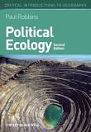
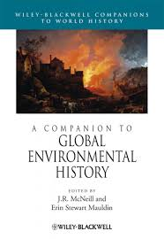
Fields and disciplines
Interaction: humans – environment
Political ecology (next)
Environmental history
Notes:
Main ones used in course. Both study: interaction humans – environment
Environmental History
Study of human interaction with natural world over time.
In contrast to other historical disciplines, it emphasizes the active role nature plays in influencing human affairs (nature’s agency).
Environmental historians study how humans both shape their environment (WORSTER) and are shaped by it (MCNEILL). –
Examples of studies and books
Donald Worster ‘Dust Bowl’ – tells story of the Dust Bowl in ecological as well as human terms. A story on the subject of the land and how humans interact with it.
Worster links the American livestock industry's exploitation of the Great Plains, and the on-going problem of desertification (Google books)
Worster argues that the logic of maximum productivity and desire to replicate the material landscape of the industrial east prevented farmers from adopting soil conservation measures that might have spared their farms and families. (L. Kennedy, https://www.amst.umd.edu/Research/cultland/annotations/Worster1.html)
John McNeil ‘Mosquito Empires’ (we’ll see) – how mosquitoes have helped defend and then overthrow Spanish Empire in the Caribbean
Sam White ‘Climate of Rebellion’ - how imperial systems of provisioning and settlement that defined Ottoman power in the 1500s came unraveled in the face of ecological pressures and extreme cold and drought, leading to the outbreak of the destructive Celali Rebellion (1596–1610). This rebellion marked a turning point in Ottoman fortunes, as a combination of ongoing Little Ice Age climate fluctuations, nomad incursions, and rural disorder postponed Ottoman recovery over the following century, with enduring impacts on the region’s population, land use, and economy
Three components; study:
Nature itself and its change over time
Includes physical impact of humans on the Earth's land, water, atmosphere and biosphere
How humans use nature
the environmental consequences of increasing population, more effective technology and changing patterns of production and consumption
transition from nomadic hunter-gatherer communities to settled agriculture in the neolithic revolution
effects of colonial expansion and settlements, and the environmental and human consequences of the industrial and technological revolutions
3. Study how people think about nature - way attitudes, beliefs and values influence interaction with nature especially in form of myths, religion, science

Slide 11
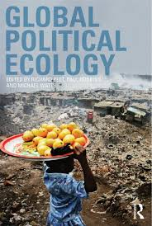
Political ecology (Simsik, 2007)
Field: to understand relationship human societies – nature
Environmental change is intrinsically political
  Decisions (environmental governance)
  Consequences (e.g. environmental conflict)
Environmental change: unqueal distribution of ‘goods’ (benefits) and ‘bads’ (costs)
  Winners and losers -> generation of conflict
Notes:
Instead of apolitical explanations of environmental change (e.g. there are conflicts around natural resources, because those resources are scarce)
Use political ecology to study environmental change
Academic field that seeks to understand relationship human societies – nature
Posits that environmental change is intrinsically political
And so are the decisions taken to produce environmental change (environmental governance)
And the implications or consequences of environmental change, e.g. conflict

Slide 12
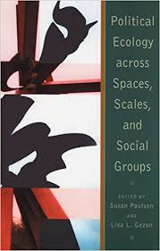
What do we mean by “political” in PE?
  Politics as power
  Power as a key analytical term for studying politics
In political ecology:
  Power as a social relation built on asymmetrical distributions of resources and risks (Hornborg, 2001)
  So, we study: practices and processes through which power is yielded and negotiated (Paulson et al., 2005)
Notes:
Yield: “give up control or responsibility of something” (Cambridge Dictionary)

Slide 13
Two Detours
At this stage, I need to make two detours (pause for a minute) to highlight two conceptual issues relevant before moving on
  Definition of “politics”
  Definition of “power”
Notes:
This is part of “introduction to key concepts”
Will then move on (next hour) to presenting a political understanding of environmental change

Slide 14
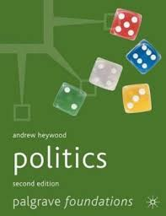
Detour 1: defining politics in political science
Politics: the study of power (Heywood, 2002):
  Politics: the art of government
  Politics: public affairs
  Politics: compromise and consensus
  Politics as power (“4th definition” of politics)
Simply present these to situate you
  not comment on strengths and limitations
Notes:
Let me make a detour for a minute, in what I see as an effort to try and link this course (and its approach to the ‘political’) to the rest of your degree
Politics: the study of power (Heywood, 2002):
Politics: the art of government
Politics: public affairs
Politics: compromise and consensus
Politics as power: the 4th definition of politics: Power as a key analytical term for studying politics
Simply present these to situate you
not comment on strengths and limitations of each

Slide 15
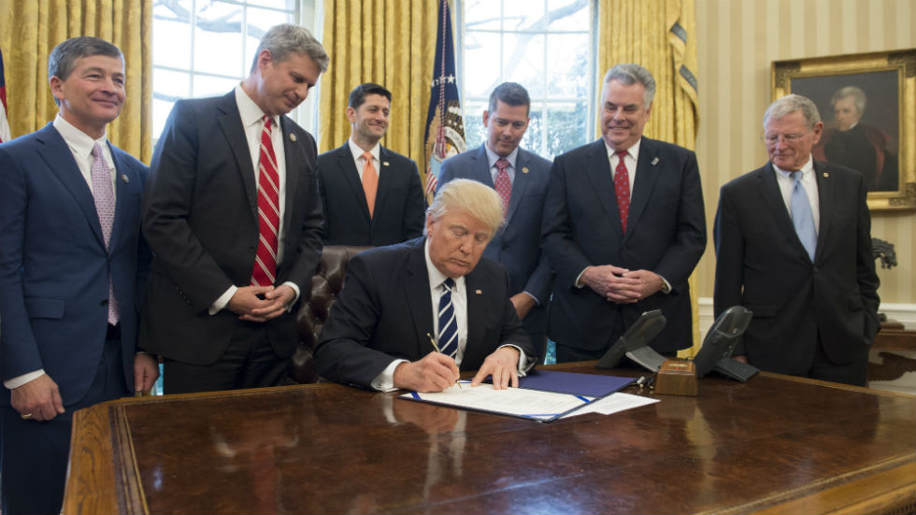
  Politics: the art of government
Notion that politics = 'what concerns the state'
  Traditional view of discipline
To study politics = to study government, or the exercise of authority
Politics associated with 'policy’
Source: https://thehill.com
Notes:
TO STUDY POLITICS = TO STUDY GOVERNMENT OR THE EXERCISE OF AUTHORITY
Study processes through which government responds to pressures from larger society
By allocating benefits, rewards/penalties
Which are accepted in society, and considered binding by mass of citizens
POLITICS ASSOCIATED WITH 'POLICY’:
i.e. with formal decisions that establish a plan of action for the community
FULL TEXT
In many ways, the notion that politics amounts to 'what concerns the state' is the traditional view of the discipline, reflected in the tendency for academic study to focus upon the personnel and machinery of government. To study politics is in essence to study government, or, more broadly, to study the exercise of authority. This view is advanced in the writings of the influential US political scientist David Easton (1979, 1981), who defined politics as the 'authoritative allocation of values'. By this he meant that politics encompasses the various processes through which government responds to pressures from the larger society, in particular by allocating benefits, rewards or penalties. 'Authoritative values' are therefore ones that are widely accepted in society, and are considered binding by the mass of citizens. In this view, politics is associated with 'policy' (see p. 400): that is, with formal or authoritative decisions that establish a plan of action for the community.
Focus of study on: personnel and machinery of government
FOTO: President Trump on Thursday signed legislation ending a key Obama administration coal mining rule. The bill quashes the Office of Surface Mining's Stream Protection Rule, a regulation to protect waterways from coal mining waste that officials finalized in December. The legislation is the second Trump has signed into law ending an Obama-era environmental regulation. On Tuesday, he signed a Congressional Review Act (CRA) resolution undoing a financial disclosure requirement for energy companies (https://thehill.com/policy/energy-environment/319938-trump-signs-bill-undoing-obama-coal-mining-rule)

Slide 16
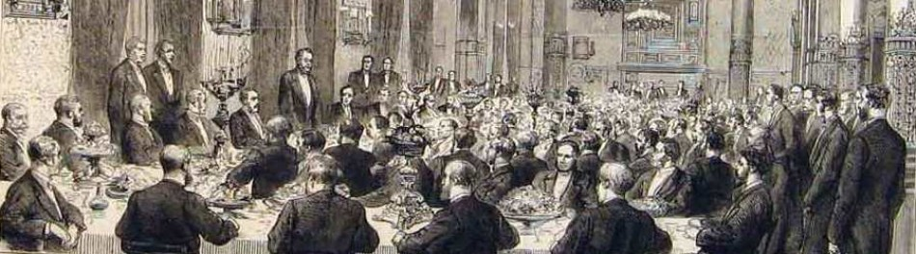
Politics as public affairs
Source: alexandramitchell.wordpress.com
Beyond the narrow realm of government: ‘public life’ or ‘public affairs’
    'the political' – ‘the nonpolitical' = public vs. private spheres of life
State (=the public) – Civil Society (=the private) distinction
Politics: activities +responsibilities exercised by public bodies
Notes:
BEYOND THE NARROW REALM OF GOVERNMENT: POLITICS ARE ABOUT THE ‘PUBLIC LIFE’ OR ‘PUBLIC AFFAIRS’
Distinction between 'the political' – ‘the nonpolitical’ corresponds to a division between the public sphere of life vs. the private sphere
This translates to a (traditional) distinction between the public and the private realm of life that => division state – civil society
STATE = PUBLIC (‘THE POLITICAL’)
institutions of state: government, courts, police, army, social-security system
Public: responsible for collective organisation of life, because funded at the by public’s expenses (taxes)
CIVIL SOCIETY = PRIVATE (‘THE NON-POLITICAL’)
Institutions: family/ kinship groups, private businesses, trade unions, clubs, community groups, NGOs, social movements, etc.
Set to: satisfy own (private) interests, rather than those of larger society
POLITICS = RESTRICTED TO THE ACTIVITIES OF STATE ITSELF AND THE RESPONSIBILITIES EXERCISED BY PUBLIC BODIES
Areas of life that individuals can and do manage for themselves (the economic, social, domestic, personal, cultural and artistic spheres, etc.) are 'nonpolitical’

Slide 17
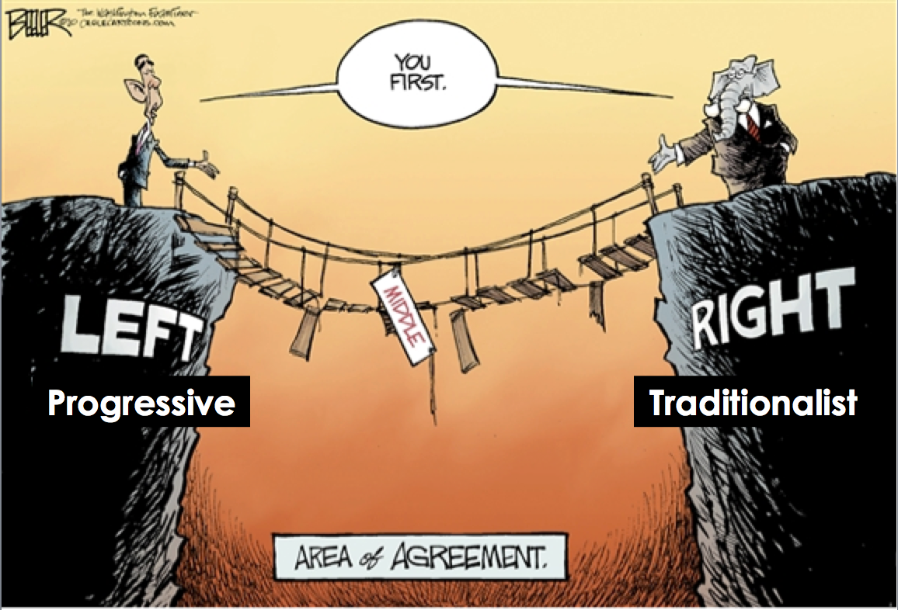
Politics as compromise and consensus
Beyond arena where politics conducted
Politics: way in which decisions are made
  particular means of resolving conflict: by compromise, conciliation and negotiation, rather than via use of force and violence
  ‘art of the possible’: a “political solution”
  Crick (1962): “a conciliation solution to the problem of order”
Source: http://www.learningspy.co.uk
Notes:
NOT SO MUCH ARENA WITHIN WHICH POLITICS IS CONDUCTED BUT WAY IN WHICH DECISIONS ARE MADE
Politics = a particular means of resolving conflict: by compromise, conciliation and negotiation, rather than through force
POLITICS = 'THE ART OF THE POSSIBLE’
Also everyday use of term, e.g. when we say that a solution to a problem is a 'political' solution = through debate and arbitration, as opposed to e.g. a 'military' solution
CRICK 1962:
Conflict is inevitable so when social groups and interests possess power they must be conciliated, cannot merely be crushed
Politics = 'that solution to the problem of order which chooses conciliation rather than violence and coercion’
*NOTE: The Problem of Order = question how and why it is that social orders exist at all (Hobbes formulated the question, to answer that it is because of the Social Contract)
KEY TO POLITICS = WIDE DISPERSAL OF POWER
View based on resolute faith in the efficacy of debate and discussion, as well as on belief that society is characterized by consensus rather than by irreconcilable conflict
Disagreements that exist can be resolved without resort to intimidation and violence

Slide 18
Politics as power
Politics:
Not confined to a particular sphere (government, state or 'public‘ realm)
At work in all social activities and every corner of human existence
  Leftwich (1984): at heart of all collective social activity, formal and informal, public and private, in all human groups, institutions & societies
Concerns production, distribution and use of resources in the course of social existence
  is power: ability to achieve a desired outcome through whatever means
Takes place at every level of social interaction within families, amongst small groups of friends just as much as amongst nations and on the global stage
Radical feminist assertion: 'the personal is the political’
Notes:
FULL TEXT
The fourth definition of politics is both the broadest and the most radical. Rather than confining politics to a particular sphere (the government, the state or the 'public‘ realm) this view sees politics at work in all social activities and in every corner of human existence. As Adrian Leftwich proclaimed in What is Politics? The Activity and Its Study (1984:64), 'politics is at the heart of all collective social activity, formal and informal, public and private, in all human groups, institutions and societies'. In this sense, politics takes place at every level of social interaction; it can be found within families and amongst small groups of friends just as much as amongst nations and on the global stage.
At its broadest, politics concerns the production, distribution and use of
resources in the course of social existence. Politics is, in essence, power: the ability
to achieve a desired outcome, through whatever means.
This notion was neatly that 'the personal is the political'. This slogan neatly encapsulates the radicalfeminist
belief that what goes on in domestic, family and personal life is intensely
political, and indeed that it is the basis of all other political struggles. Clearly, a more
radical notion of politics underlies this position. This view was summed up by Kate
Millett in Sexual Politics (1969:23), in which she defined politics as 'powerstructured
relationships, arrangements whereby one group of persons is controlled
by another'. Feminists can therefore be said to be concerned with 'the politics of
everyday life'. In their view, relationships within the family, between husbands and
wives, and between parents and children, are every bit as political as relationships
between employers and workers, or between governments and citizens.
BP TEXT: RADICAL FEMINIST ASSERTION: 'THE PERSONAL IS THE POLITICAL’ means:
what goes on in domestic, family and personal life is intensely political - and indeed is the basis of all other political struggles
'the politics of everyday life’: relationships within family, between husbands and wives, and between parents and children, are every bit as political as relationships between employers and workers, or between governments and citizens

Slide 19
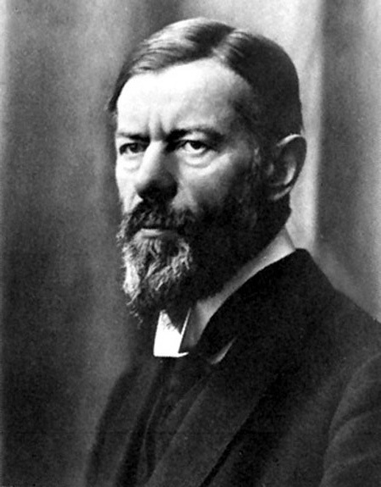
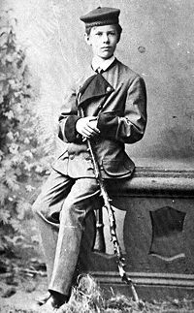
Detour 2: defining Power
  The 4th definition of politics
  Power as a key analytical term for studying/ understanding politics
But what exactly is/ do we mean by power?
  Max Weber: “chance of a man or a number of men to realise their own will in a social action even against the resistance of others”
In political ecology:
  Two ways of understanding and studying power (how it operates)
Source: Public Domain

Slide 20
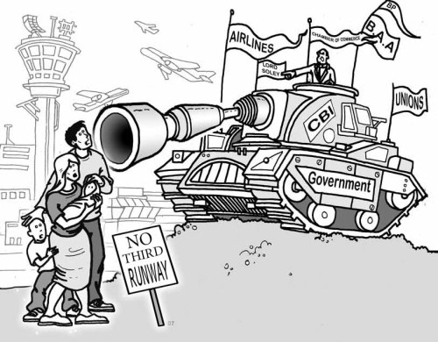
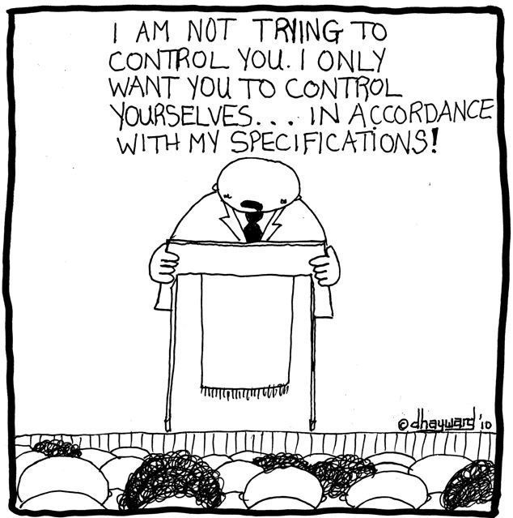
Two types of power
Sovereign power
Internalised power
  Capacity (of state and its institutions) to legitimately impose will; e.g. enclose resources for conservation
  Note 1: multiplies/ controls degradation
  Note 2: non-legitimate force as well
Power also expressed on how individuals come to obey and take things as natural (e.g. enclosure; property)
Internalising control and authority as normal and natural
How power is exercised within individuals
Source: mechanicsofpower.wordpress.com
Copyright: David Hayward (source: geotimes.co.id)
Notes:
Classes 2 and 3 will show examples of both sovereign and internalised power

Slide 21
3. Capitalist natures: capitalism and environmental degradation

Slide 22
CLASS ASSIGNMENT 1
Robbins explains that “[f]or materialists, environmental degradation is... inevitable in capitalism” (p. 46).
Explain in your own words why is this the case, and how does such degradation occurs.
Do you agree or disagree? And, why?

Slide 23
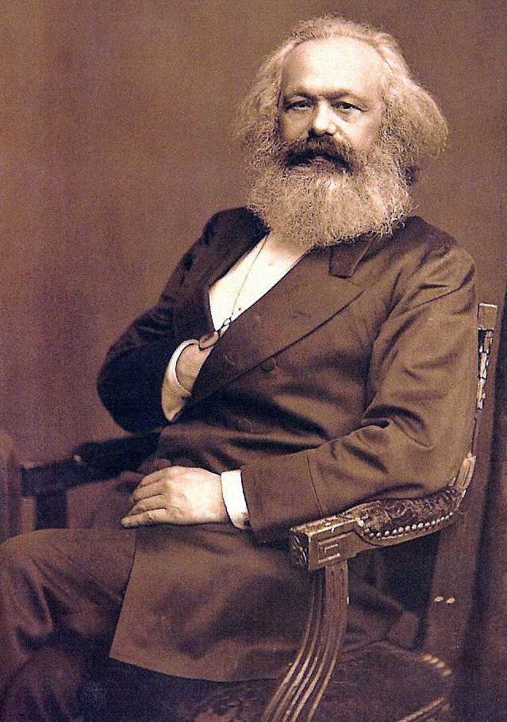
Answer: the green materialist claim
Robbins, 2004, p.51: because
“all progress in capitalistic agriculture is the progress in the art, not only of robbing the labourer, but of robbing the soil; all progress in increasing the fertility of the soil for a given time, is a progress towards ruining the lasting sources of that fertility” (Marx, 1967)
Notes:
Because capitalism requires the extraction of value surplus from labour and nature
which involves extracting more than what you re-invest in nature (and compensate labour)

Slide 24
Detour 3: Answering assignments by explaining claims
Claim/ argument:
  The class question (Robbins’ assertion)
Reasoning (reasons)
  Marx’s “because…”
  Simply said: Because capitalist accumulation, a central aspect of capitalism, requires the degradation of the environment in order to keep the system (Km) going
Evidence
  With examples
C. Then: your evaluation/ view
  But again: claim, reasoning, evidence

Slide 25
A. Reasons (LOGICAL EXPLANATION)
Value surplus
Capital accumulation and why it works
How capital accumulation degrades the environment
Why degradation is inevitable
Notes:
ELEMENTS TO THE ANSWER:
Value surplus (with labour example)
Capital accumulation (with labour e.g.)
Extracting surplus from nature
WHY DEGRADATION IS INEVITABLE: The second contradiction of capitalism

Slide 26
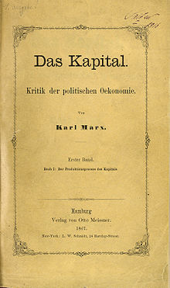
Value surplus: what is it?
Marx (1867)
  “Yield, profit or return on production capital invested, i.e. amount of the increase in the value of capital…”
  …after it goes through the production process
  General formula for Capital (Marx): M-C-M’
Notes:
Surplus value = new value created by workers in excess of the cost of their own labour in the production process; excess: appropriated by capitalist as profit when products are sold
GENERAL FORMULA FOR CAPITAL (Spark Notes)
Marx says that capital's starting point is with the circulation of commodities. The ultimate product of this commodity circulation is money. We see this every day, when capital enters various markets in the form of money. Marx distinguishes two kinds of circulation. C-M-C (commodities transformed into money which is transformed back into commodities) is the direct form of circulation. In this case we sell commodities in order to buy more, and money acts as a kind of middle-man. However, there is also another form, M-C-M. In this case, we buy in order to sell; money is capital. The first phase transforms money into a commodity, the second transforms a commodity into money. Ultimately, then, we exchange money for money.
Use-value is the purpose of C-M-C, while exchange-value is the purpose of M-C-M. Money is indistinguishable, and it seems absurd to exchange it for itself. It is distinguishable only in amount. Thus, in M-C-M what really occurs is M-C-M', where M' = M + excess. This excess is called surplus-value. The original value adds to itself and converts the surplus value to capital.
In the end, money is again the starting point, and from M' we go to M'' and so on. Thus, the possessor of money becomes the capitalist. He is a capitalist in so far as the increase of wealth is the sole force behind his actions—in this role he is "capital personified and endowed with consciousness and a will." His aim is boundless enrichment. M-C-M' is the general formula for capital, as it appears in the sphere of circulation.

Slide 27

How is it generated?
Owner (shoe in mkt) = 40€
4 pairs (produced in 1h)= €160
Operational costs = 20€/ h
Worker prod (machine): 10€/ 15min = 40€/ hour
or: 4 pairs/ hour
Invest (put in prod) = 50€/ hour
Worker labour (wage) produces one shoe in 1h worth = 10€/ hour
Source: http://utama.info/
Profit (above value investment) = 80€/ hour
Notes:
Example: shoe production with a machine that produces shoes
Worker wage: 10 €/ hour
Worker produces product worth = 10 € every 15 min = 40 €/hour
Because worker is productive, can produce an output value > what it costs to hire him
i.e. capitalist is paid 40 € when trading final product in market
Operational costs (e.g. machine depreciation, materials) = 20 €/ h
i.e. Investor puts 50 € in process (includes depreciation), e.g. to buy the factory buildings, machinery, etc. and gets 80 € out of process
Profit for capitalist: 80 €/ hour; i.e. has made 30 €> than value of his investment

Slide 28
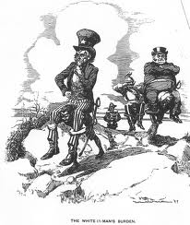
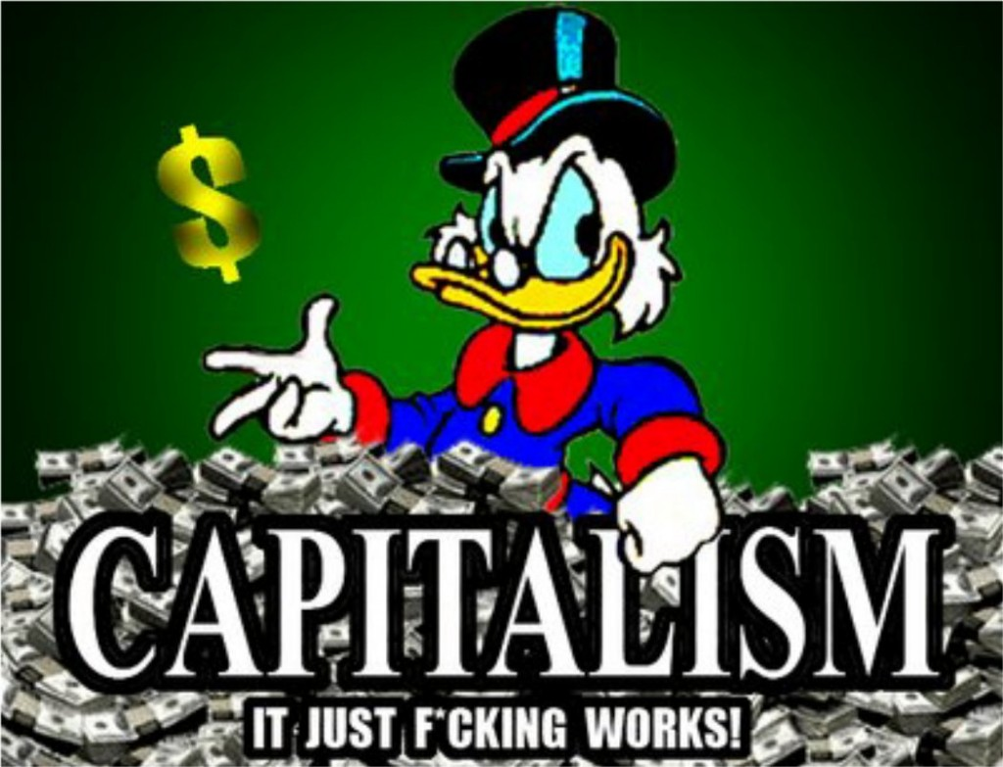
Why is it necessary?
Capital accumulation
http://weknowwhatsup.blogspot.com.es
Source: http://freedombunker.com
“Accumulate, accumulate! This is Moses and the Prophets!” (Marx, Capital, Vol 1)
Notes:
Value surplus 3/4
Making such easy money (appropriating work of others) is attractive for capitalist
But is also necessary for maintaining system (Kism)
It leads to capital accumulation = net addition to existing wealth + a re-distribution (from labourer to capitalist) of (created) wealth
New K is used to accumulate more K by re-investing in production process, financial assets, non-productive assets (e.g. works of art), human K, infrastructure, etc., i.e. on assets that permit creating more K
K accumulation is motor in engine of capitalist economy

Slide 29
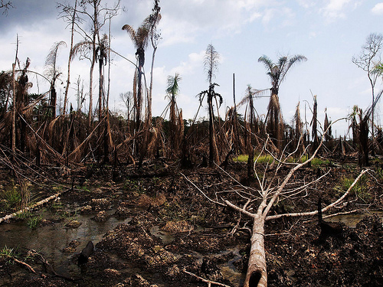
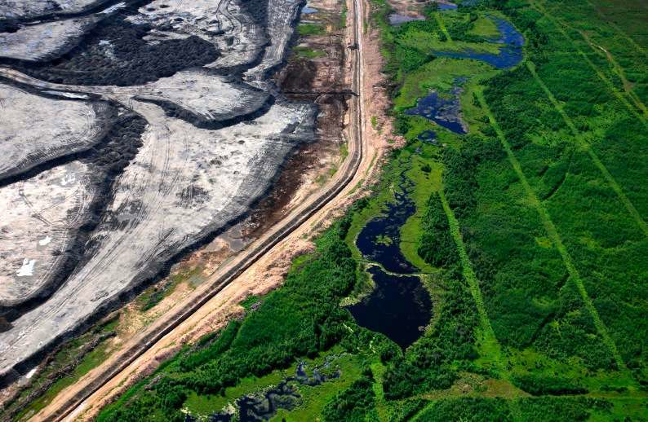
Extracting surplus from nature
Niger Delta (Nigeria) (Image: Sosialistisk Ungdom – SU/Flickr)
Tar Sands from space (source: http://stephenleahy.net)
Intensity of extraction > restoration
Notes:
rate and intensity of extraction > restoration
By expropriating nature’s capital and underinvesting in restoration or repair of impacted ecological systems
To make necessary profit (i.e. at the level needed for surplus accumulation):
Capitalist firm squeezes surplus from ecology – just as it squeezes surplus from labour (workers)
i.e. degradation is inevitable result of capital accumulation, when it becomes (as it regularly does) a necessary condition to achieve surplus (profit), and capital accumulation

Slide 30
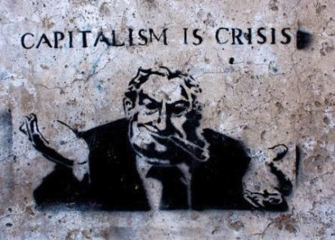
Second contradiction of capitalism
Capitalism degrades the material basis upon which it depends
James O’Connor (1988): contradiction capital accumulation vs. production conditions
Degrading production conditions is inevitable
Source: http://sovietrussianow.blogspot.com.es/
Notes:
What James O’Connor called second contradiction of capitalism
Which is a contradiction between K accumulation and production conditions
Marx says that there are THREE TYPES OF PRODUCTION CONDITIONS:
External physical conditions: viability of eco-systems, the adequacy of atmospheric ozone levels, the stability of coastlines and watersheds; soil, air and water quality
Labourpower: physical and mental well- being of workers; the kind and degree of socialization; toxicity of work relations and the workers' ability to cope; and human beings as social productive forces and biological organisms generally
Communal conditions: social capital," "infrastructure”
The contradiction: Capitalism degrades the material basis (production conditions) upon which it depends
Acid rain; soil erosion; pesticide overuse; climate change, etc.
The health of workers, social K (e.g. community relation cohesion)
K makes use of those conditions, but it doesn’t produce them. The state either produces (e.g. infrastructure) or maintains (e.g. viability of ecosystems) them
Without those conditions in place, K cannot be accumulated.
Two implications
Capitalism carries within it, seeds of own destruction
Degrading production conditions is inevitable
Why K degrades those conditions, WHY INEVITABLE? (Spence 2000)
It is driven by individual capitals seeking to shore up their profitability through cost-cutting which degrades, or fails to maintain, the material and social conditions of their own production
But these conditions are common to capitalist production as a whole, so capital-in-general is confronted with higher costs further down the road, in order to repair the damage done to the shared conditions of production by the short-termism of individual capitals (O'Connor, 1998d) – DESCRIBES A‘TRAGEDY OF COMMONS’ LOGIC
NOTE:
As concerns the system, i.e. capitalism, the second contradiction is thus a challenge of under-production (not producing enough to accumulate K) vs. the first contradiction which is a contradiction of over-production and over-accumulation
1st contradiction: not being able to realise (i.e. pocket) the surplus value which you have already extracted from workers
A problem, because (as a capitalist) you stay with K which you cannot put into ‘productive’ use, i.e. invest into something that will provide you with more K and so keep the treadmill (system) going
E.g. so the question (basic question in Km) becomes: where to find extra demand to sell product you need to extract in order to squeeze surplus of labour/ nature/ infrastructure, in a way that permits reproducing K?

Slide 31
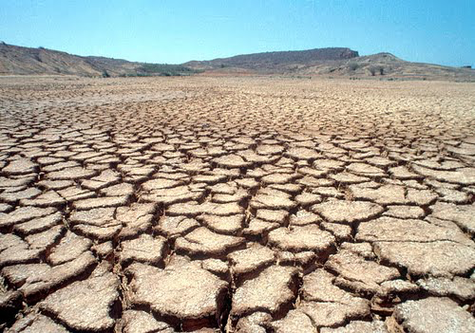
B. EVIDENCE: The case of soil erosion
https://www.youtube.com/watch?v=s0F2c1ECuo4
Soil erosion (www.omafra.gov.on.ca): the wearing away of a field's topsoil
  By natural physical forces of water and wind
  or through forces associated with farming (e.g. tillage)
Impacts:
  Food production; famine risk
  Diffuse water pollution
Source: www.newsecuritybeat.org
Notes:
Food production
Soil erosion makes farming impossible -> famine, large migration, etc.
Approximately 40% of the world's agricultural land is seriously degraded
In Africa, if current trends of soil degradation continue, the continent might be able to feed just 25% of its population by 2025 (UN Institute for Natural Resources in Africa)
Diffuse water pollution
Soil erosion (especially from agricultural activity) is considered to be the leading global cause of diffuse water pollution, due to the effects of the excess sediments flowing into the world's waterways. The sediments themselves act as pollutants, as well as being carriers for other pollutants, such as attached pesticide molecules or heavy metals

Slide 32
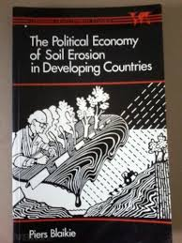
Policy failure
Blaikie (1985) ‘The political economy of soil erosion in developing countries’
The problem (RQ):
Techniques to deal with soil erosion may be successful
But policies have failed
Notes:
Blaikie (1985) ‘The political economy of soil erosion in developing countries’
Techniques may be successful
Techniques: mechanical (e.g. terracing) or agronomic (i.e. farming practices that provide stable yields, e.g. plant trees) methods applied to deal with erosion
But policies have failed
i.e. soil conservation programmes implemented over wide areas and numbers of people that try to have considerable effects in reducing erosion and improving food production

Slide 33
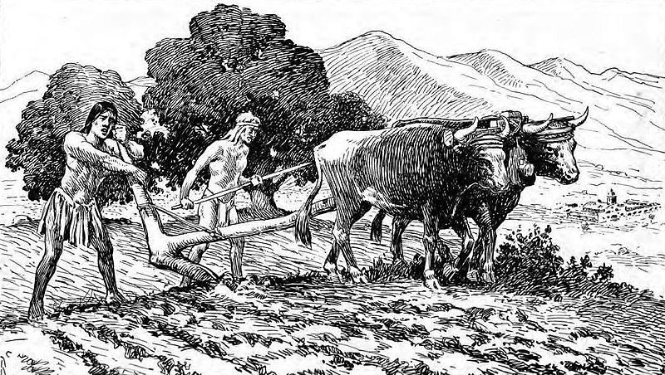
Why do policies fail 1?
Classic model of soil conservation
* Blaikie identifies 3 major problems
Erosion = environmental problem
  Ignores social problems leading to erosion
  Coercion and force
Laying blame on land-users
  Including: overpopulation
The solution: link users to market economy
Source: commons.wikimedia.org
Notes:
Classic (colonial) model of soil conservation that persists
[there are] implicit assumptions on which policies are based have only slowly evolved from a colonial, Euro-centric and messianic intellectual frame of reference which has endured the waning of empire and the regaining of political independence of most former colonies.
Environmental problem
Therefore there is a logical tendency to preclude from view the social reasons why people are using the land in such a way as to cause excessive soil erosion, and so most conservation policies do not address them at all.
Problems of a lack of alternative sources of fuelwood for poor people, unequal landholdings, political constraints placed upon the pastures of nomads, poor prices imposed by the state for the produce of rural areas and so forth, tend to lie outside the terms of reference of most conservation policies.
When purely environmentally-dictated policies (such as forest closure or forcible destocking of pastures) do not work because the social context has been analysed insufficiently, force is often contemplated. This frequently ends up with the state attempting to protect the environment from the majority of the people who use it. For example, the Agricultural Department of what was then British Kenya, when faced with the Wakamba who had marched on Government House as a protest against compulsory destocking in 1938, said:
... unless some pressure is applied to urge improved methods and practices, and unless such pressure is continuously applied .. .it will not be possible to save the fertile areas of Kenya from deterioration ... without the application of compulsion under legislation to enforce improved agricultural practices. (Clayton E. (1964)
A more up-to-date but similar sentiment advocating a tough approach:
Admonition alone does not appear to be enough. A strict legal regime of soil conservation must be established. (MacAndrews and Chia Lin Sien 1979:30)
Policy 'solutions' of this kind tended to favour erosion works (often paid for by labout inputs on the part of farmers themselves), terracing, reafforestation and pasture closure, implemented by compulsory destocking or exclusion from certain vulnerable areas. They were frequently imposed by colonial regimes using force where necessary. In colonial Ruanda-Burundi, several weeks of free labour had to be given each year by the commune to build up terraces, bunds and other erosion works. The paysannat system in the (then) Belgian Congo had similar compulsive elements (Dumont 1970: 36).
Laying blame on locals
The problem is blamed on the land users themselves, who are seen to have mismanaged the environment because of lack of environmental awareness, ignorance, apathy and just plain laziness.
The more pejorative epithets have disappeared in the post-colonial literature, except for one or two extreme examples like Kon Muang Nan (1978) who holds the view that the shifting cultivation practised by tribal people in northern Thailand is the most dangerous national problem and one which undermines national security. The practice should be eliminated or the people expelled from Thailand altogether, he claims.
Market economy solution
The last problem identified in the classic or colonial model is that cultivators and pastoralists who cause soil erosion are insufficiently involved in the market economy.
Involvement in the production of surpluses for sale in the market implies modern methods of cultivation and improved productivity, so alleviating the 'population problem' , and the awareness of financial inducements, and incentive to undertake soil conserving agronomic practices and/or erosion works.
The policy implication of this view is a programme to help those farmers who can help themselves to grow cash crops.

Slide 34
Why do policies fail 2?
How about some fundamental assumptions?
  The causes of soil erosion: outside afflicted area
  The state is not neutral
  Always winners and losers from erosion and conservation
Root causes of soil erosion: effect of capitalist economy
  Farmers forced to degrade the land in order to delay their own destruction
  Capitalist production encourages mining of soils
Notes:
So, the root causes of soil erosion are not to be found only at the site where land degradation occurs (Hertford, 1985):
Farmers forced to degrade the land in order to delay their own destruction
By those who exploit them (the “haves”) within int’l system of production
Capitalist production tends to encourage mining of soils (Robbins 2012):
Farmers produce for int’l competitive markets, many times because of state-sponsored programmes (e.g. Malian cotton farmers, or intro crash crops, or agri modernisation programmes) promoted by int’l agencies (e.g. WB), or introduced by colonial powers
In int’l competitive markets, when economic (profit) margins decline, costs and risks are passed downwards to individual producers, who try to extract as much as possible in order to balance their losses
This is why they will more readily use pesticides, follow shorter fallowing (time left land to rest) periods, etc. to ensure they have a crop to sell
Similarly: this is why they will go deeper into the forest (encroach), to increase production and offset tighter prices for agricultural produce
Lost value of (degraded) forest (e.g. biodiversity lost) = extracted from its location to be accumulated in distant commodity markets (e.g. cotton market in London, NY, etc.)
David Simon (ed) (2006) Fifty Key Thinkers in Development: "A principal conclusion of this book is that soil erosion in lesser developed countries will not be substantially reduced unless it seriously threatens the accumulation possibilities of the dominant classes" (p147).

Slide 35
4. Types of capital accumulation

Slide 36
Types of capital accumulation
Two types of capital accumulation with adverse environmental impacts (degradation):
  Primitive/ Original accumulation
  Accumulation by dispossession
Notes:
Let’s now look at evidence of the link capital accumulation – environmental degradation
The second contradiction “in action”
Go through the two ways of accumulating capital (and their ecological implications)
Primitive/ Original Accumulation; evidence: the enclosure of the English Commons (16th – 19th century)
Accumulation by dispossession; evidence: NNL policy for conservation of US wetlands (early 21st century)

Slide 37
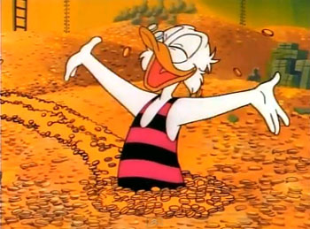
1. Primitive accumulation
Source: http://pixgood.com
The question: how did some people managed to accumulate capital in the first place?
Notes:
The question: how did some people managed to accumulate capital in the first place?
And become (the class of) capitalists, i.e. those who have amassed capital?
Harvey (2005) summarising Marx: PA entailed
taking land, e.g. enclosing it
expelling a resident population (creating landless proletariat, who became cheap industrial workers)
releasing land for private owners to buy and use it to accumulate K
Preferred materialist example of PA: European (English) enclosures

Slide 38
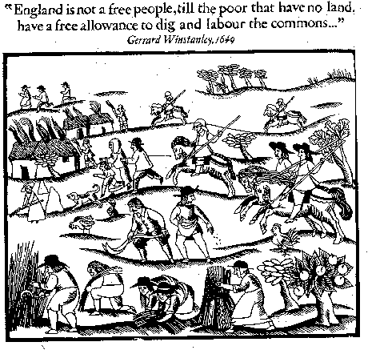
Primitive accumulation: example
Source: https://theliberi.wordpress.com
English 15th – 19th century enclosures
Notes:
English 15th – 19th century enclosures – although some formally-endorsed enclosure activity since 13th century (Wikipedia: Enclosure of manorial common land was authorized by the Statute of Merton (1235) and the Statute of Westminster (1285).
Currently, in our ʺproperty‐owning democracyʺ, nearly half the country is owned by 40,000 land millionaires, or 0.06 per cent of the population (Fairlie 2009)
Common lands: privately owned, commonly used
Based on tradition of common rights
Arable farming in open fields (subsistence farming)
Fencing (enclosing) land entitled to private owners
Either buying common rights or law-and-use-of-force to enclose
Dispossessed commoners become landless working force (class) used in industrial revolution (north England)
ENGLISH ENCLOSURES
Replacement of common lands by private property in England (Clark &Clark 2001)
Enclosure, also spelled Inclosure, the division or consolidation of communal elds, meadows, pastures, and other arable lands in western Europe into the carefully delineated and individually owned and managed farm plots of modern times. (Britannica)
Taha Sutarhwala: Half of available agricultural land in England enclosed (1604-1914): 27,500 km2 (size = > 1/3 of Czech Republic (or) > ½ of Slovakia)
Land use system: right to use ‘common lands’
Formally: smallholders
Informally: landless peasants
The losers in the process of enclosure were of two kinds. First there were the landless, or nearly so, who had no ownership rights over the commons, but who gained a living from commons that were open access, or where a measure of informal use was tolerated. These people had few rights, appeared on no records, and received nothing in compensation for the livelihood they lost. But there was also a class of smallholders who did have legal rights, and hence were entitled to compensation. However, the amount of land they were allocated ʺwas often so small, though in strict legal proportion to the amount of their claim, that it was of lile use and speedily sold.ʺ Moreover, the considerable legal, surveying, hedging and fencing costs of enclosure were disproportionate for smaller holdings. And on top of that, under the ʺSpeenhamlandʺ system of poor relief, the taxes of the small landowner who worked his own land, went to subsidize the labour costs of the large farmers who employed the landless, adding to the pressure to sell up to aggrandizing landowners. (Fairlie, 2009)
Enclosing land: concentration of land to richer farmers
Transforming common land (wastes, etc.) into private property through enclosing it (fences) = obligatory
High costs of fencing
High taxes (preexisting poor relief system that practically subsidised large landowners for employing landless as farmhands/ hired labourers) (Fairlie)
Impossible for small farmers to retain land: sell it

Slide 39
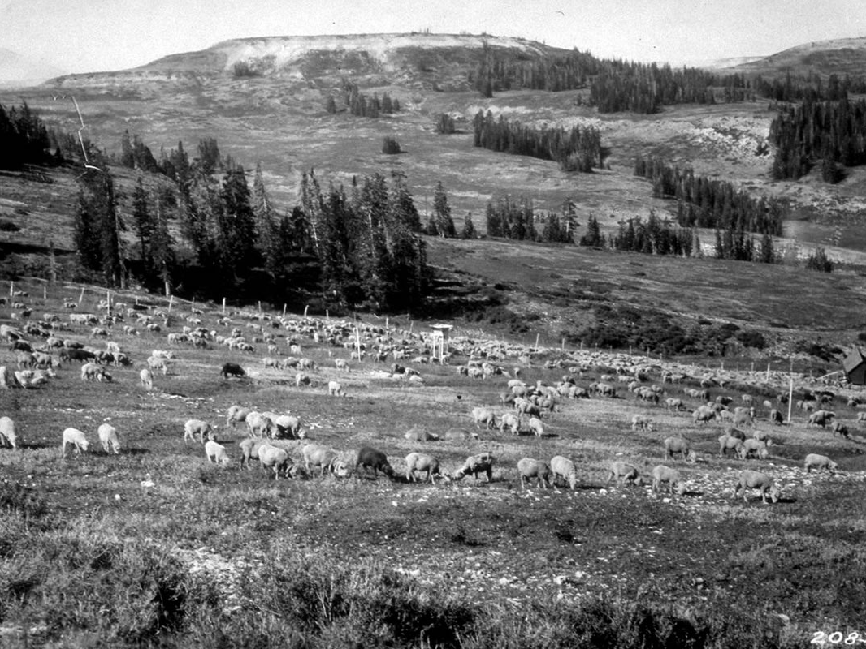
Ecological effects of sheep overgrazing
Source: www.fs.fed.us
Ecological degradation: widespread soil erosion and deforestation
Notes:
ENCLOSED LAND: ADOPTION OF PRACTICES THAT GENERATED MORE PROFIT (INCREASED PROFITABILITY OF LARGE FARMS)
Sheep that paid better for their wool (demand for English wool in 16th cent), tallow (fat for candles, etc.), and meat
When sheep prices declined (1650s): improved agricultural practices (fertilisers, new crops) and economies of scale (higher individual farmer profit from land concentration – although according to economists at the time, no higher land productivity see: Fairlie 2009)
But those land practices generate environmental impact:
(Intensive) Sheep (farming for profit in competitive markets) destroy soil: overgrazing -> deforestation, i.e. destruction of trees, forest ecology, and forest services (e.g. soil erosion, landslide barriers, etc.)
CONSIDER: “OVERGRAZING TYPICALLY INCREASES SOIL EROSION.
Reduction in soil depth, soil organic matter and soil fertility impair the land's future natural and agricultural productivity.
Soil fertility can sometimes be mitigated by applying the appropriate lime and organic fertilizers.
However, the loss of soil depth and organic matter takes centuries to correct. Their loss is critical in determining the soil's water-holding capacity and how well pasture plants do during dry weather”.[desertification and drought]
Also consider: substitution of coal for wood (lack of wood) as fuel->smoke and soot in London (1578: Queen Elizabeth asks brewers to swap back to wood which they cannot)
Overgrazing reduces usefulness, productivity, and biodiversity of land and is one cause of desertification and erosion
Desertification (Princeton University Dictionary): “process of fertile land transforming into desert typically as a result of deforestation, drought or improper/inappropriate agriculture”
Fairley (2009): The main arguments of those against enclosure were:
(i) that the common pastures and waste lands were the mainstay of the independent poor; when they were overgrazed, that was often as a result of overstocking by the wealthiest commoners who were the people agitating for enclosure

Slide 40
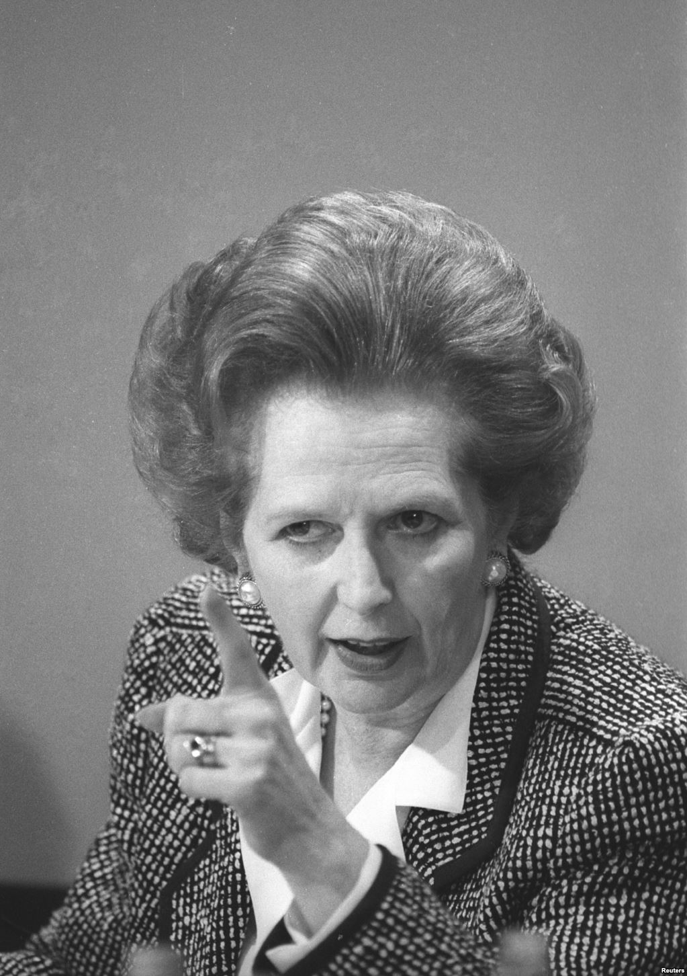
2. Accumulation by dispossession
David Harvey (2004):
  Neoliberal policies in western nations from 1970s onwards…
  …result in centralization of wealth and power in the hands of a few…
  …by dispossessing the public of their wealth or land (publicly-owned assets, e.g. water, forests, etc.)…
  …that pass to become private property
Privatisation: main practice
Reuters: Roy Letkey (source: www.abc.net.au)
Notes:
Harvey, 2004: …
Four practices:
Privatization (major practice)
financialization
management and manipulation of crises
state redistributions
E.g. Thatcher’s privatisation of social housing UK
Idea: pass from rental to ownership-> control assets-> increase wealth (increase your assets = a house)
Housing speculation for central location housing
Poorer populations in the periphery (long – and at cases: expensive – commuting to work, makes their lives more difficult)
New homeowners: borrowing money (bank)-> increased profits (housing prices) transferred to banks
COSTS: for both poorer populations + new homeowners (debt); BENEFITS banks (increased profits)
David Harvey sees this as "the wholesale commodification of nature in all its forms," a "new wave of ‘enclosing the commons’"[24] that employs environmentalism in the service of the rapid expansion of capitalism.[25] This "accumulation by dispossession" releases assets at very low or zero cost, providing immediate profitability and counteracting overaccumulation.[26]

Slide 41
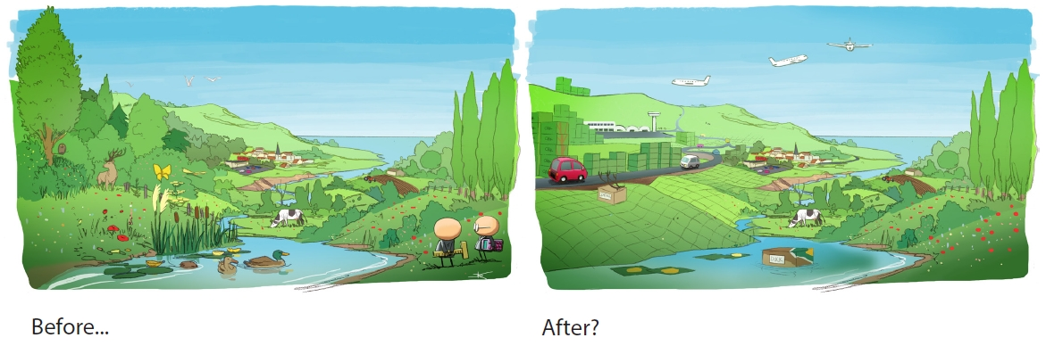
Robertson, 2000: privatising wetlands
Source: http://www.biodiversityoffsets.net/
“No Net Loss”: George Bush Senior
When wetlands stand in the way
Solution: restoration wetlands
Accumulation by dispossession
  Privatising public assets
  Dispossessing public of ecological wealth
Restored wetlands: a biodiversity and ecosystem perspective
Notes:
Exploitation of urban land (e.g. building malls, housing, etc.), a very lucrative (highly profit-making) economic activity
Capital accumulation opportunity of high value
Case of wetlands: loss of many million acres more, the extinction of species, the disappearance of wilderness and wildlife
THE NO NET LOSS POLICY
The solution (George HW Bush): restoration/ mitigation wetlands!
Need to sacrifice wetlands for K accumulation project
Urban development (malls)
Substitute natural wetlands with artificial ones
You buy (from state) wetland to use as land to build your mall
(I argue that) this is a case of both
Privatisation of public assets (wetlands)
But also: dispossession of wealth (ecological) from public
The first is relatively straightforward: with the justification of restoration, wetlands pass from being public property to become private (land to sell to e.g. build malls)
The second is a bit more complicated, and has to do with the ecological implications of restored vs. original wetlands
From a biodiversity and ecosystem perspective
Policies may not be working because restored or created wetlands are often very different from natural wetlands
Many restoration projects are fail to recognize that wetlands are parts of LARGER LANDSCAPES
Use design parameters that exclude important features of natural wetlands
E.g. invertebrate species assemblages different in coastal constructed vs. natural wetlands
Differences due to the fact that the SUBSTRATES in the constructed wetland were COARSER AND HAD LOWER ORGANIC MATTER, which resulted in a LOWER RATE OF COLONIZATION BY PLANTS [lower NUTRIENT CYCLING-> ECOL DEGRADATION]
Wetland protection policies may be inadequate to preserve and restore ecological processes such as NUTRIENT CYCLING
because they mostly focus on individual wetlands and ignore the fact that wetlands are integral parts of landscapes
Wetland mitigation projects often result in the exchange of one type of wetland for another and result in a loss of wetland FUNCTIONS AT THE LANDSCAPE LEVEL
No Net Loss: now with EU as well (“to a theatre near you”)!

Slide 42
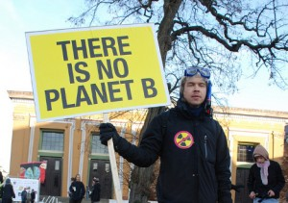
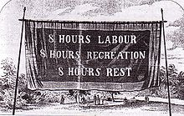
Implications: environmental movements
Labour movement
Environmental movement
Image credit: america.gov/Flickr
Notes:
Pillage of nature must [inevitably] result in political response
As labour movement = result of capital squeezing surplus out of labour’s work (worker’s exploitation)
Environmental movement = result of exploitation of nature
Paradox: in capitalism’s excesses lie the seeds of more sustainable and equitable practices

Slide 43
5. Degradation as a condition for capitalism
Notes:
Up until now, we saw link between capitalism and environmental transformation (degradation) as capitalism producing degradation due to its main activity (quest for capital accumulation)
Now we want to advance a second claim re: relationship between capitalism and environmental transformation (degradation):
Environmental degradation is a condition for capitalism in order to exist, i.e. that ecological degradation is not only an effect of capitalist economy expansion, but is also a condition for its existence – capitalism needs/ requires degradation in order to exist/ maintain itself

Slide 44
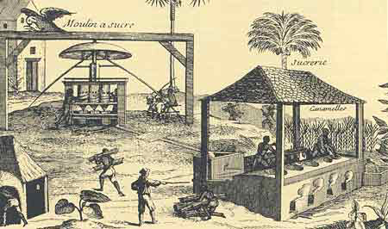
Classroom activity
Read: “Sugar and early modern world-economy” (J. Moore, 2000)
Split into groups of 5 persons
Discuss and decide:
  Who did what to whom and where?
  How did they do it and why?
Source: www.dansukker.co.uk
Notes:
10-15 min READ
15-20 min work into groups to generate this
30 min: feedback
6 groups present their findings in 5 min each
10-15 min: Discussion
My answer
10-15 min: The commodity frontier thesis
Explanation
Reason (logical support)
Evidence: Madeira
Nevertheless: not all explanation Marxist, but need to keep focus…
SUGGESTION: each looks for answer to 1 question in the text
1 looks for answer to question: who did it AND to whom
1 at: why; 1: how; 1: what? 1: where

Slide 45
Who does what, etc.: my mindmap
WHO? Capital
WHO? Planters
WHO?
Portuguese empire
WHAT? Exhaustion
Slaves
WHY?
Increase imperial strength (gunpower and political influence, via more wealth from colony)
Ecology
Forests
Soils
Water
Wildlife (BR)
WHY?
Get wealthy/ make a living (“sell to survive”)
Mentalities
  “all that mattered”
  belief: forest soil better for sugar
WHY?
K accumulation -> (Need for relocation)
HOW?
Introducing pigs, rabbits, etc.
Forest clearance
Irrigation works
Cultivating practices (e.g. terracing)
Boiling houses
HOW?
Slave provision (trade)
HOW?
Financing plantations (Genovese, Flemish K)
Debt system (upon planters)
Market competition (upon planters)
WHERE? Madeira -> Brazil -> Barbados
Crisis (exhaustion) of soil and slaves lowers productivity (hence profitability) which leads to relocation of activity
Notes:
ALL THAT MATTERED
Slaves typically lived long enough to recoup the original cost, and then some
Who:
Does what:
To whom:
Madeira’s ecology
African slaves
Where:
How:
And, why:

Slide 46
Commodity frontiers
Claim: “it is easier to imagine the end of the world than the end of capitalism” (Jameson, 2003)
Because the capitalist economy is inherently expansionary, and so are its – unavoidable – adverse ecological effects (degradation)
Evidence: Madeira and the expansion of “the sugar commodity frontier” to Brazil (and Barbados)
Notes:
Frederic Jameson (2003): Someone once said that it is easier to imagine the end of the world than to imagine the end of capitalism
REASON
Because capitalist expansion has a frontier mode
The capitalist economy is inherently expansionary
And so (EXPANSIONARY) are its – unavoidable – ecological effects (degradation)
Because of this, it constantly generates new ‘commodity frontiers’
Sites of incorporation of new ‘nature’ and labour resources
Frontiers (vs. borders)
Why inherently expansionary?
Because it needs to commodify more and more, in order to respond to the Law of Value (M-C-M’: must find more C to produce and then produce M’)
Particularly, because when faced with degradation (it produces) in one place, it needs to expand in order to continue accumulating, via incorporating new ‘nature’ and labour resources (otherwise no input)
*NOTE: important to look at world-economy as unit of analysis vs. nation-state or empire
EVIDENCE: 16th cent. Madeira and the shift to Brazil (and then Barbados, etc.)

Slide 47
Commodity frontiers
Why inherently expansionary?
“Recurrent waves of socio-ecological exhaustion – understood as the inability of a given bundle of human/extra-human natures to deliver more work to capital – implicate recurrent waves of geographical expansion” (Moore, 2014)
The necessity of (constant) frontier making
  Sites of incorporation of new resources
Notes:
The necessity of frontier-making.
Recurrent waves of socio-ecological exhaustion – understood as the inability of a given bundle of human/extra-human natures to deliver more work to capital – implicate recurrent waves of geographical expansion.
[The commodity frontier strategy has been so decisive not because of the extension of commodity production and exchange as such – a common misunderstanding of commodity frontier theory (Moore, 2000, 2013c, 2013d). Rather, commodity frontiers were so epoch-making because they extended the zone of appropriation (of natures’ unpaid work) faster than the zone of commodification. ]
This was the crucial dialectic that Marx put his finger on in addressing the contradictions of the working day, the tendency towards manifold “industrial patholog[ies],” and the necessity of incorporating “physically uncorrupted” human natures into the world proletariat (1977). In sum, not only does capitalism have frontiers; it is a frontier civilization.
NECESSITY OF CONSTANT FRONTIER-MAKING
K and (K accumulation) needs to constantly expand commodity frontiers
Commodity Frontiers are sites where new labour (Madeira: slaves) and NRs (forests, land, water) are “incorporated” in (become part of/ input for) the capital accumulation process, which happens elsewhere (Genovese and Flemish capital)
NOTE: those resources are incorporated at no (e.g. Madeira) or very low cost -> profitability
Why Capitalist/ capital accumulation?
Madeira case as a case of Genovese and Flemish capital investment
Incorporating new supplies of land and labour
New Land: Frontier vs. border
New labour (slaves)
Heavy K inputs
Rationalised labour process
WHEN: Ecological and labour exhaustion: soil erosion and slave exhaustion -> Shift sugar production to Brazil

Slide 48
Significance of commodity frontiers
Importance: how ecological exhaustion in one place drives quest for new spaces/ ecologies and labour resources elsewhere to exhaust
  In order to accumulate more K to invest for producing more K
  Ecological degradation is not only an effect of capitalist economy expansion, but is also a condition for its existence
  Moore 2003: “Without the Americas there was no capitalism; without capitalism, there were no Americas” [as we know them]
The world as an integrated economy
  World-systems analysis
Term also used to describe conflicts today: https://ejatlas.org
Notes:
Importance of this (THE ARGUMENT): ecological degradation is not only an effect of capitalist economy expansion, but is also a condition for its existence
Quijano & Wallerstein 1992: “The Americas were not incorporated in an already existing capitalist world-economy. There could not have been a capitalist world-economy without the Americas"
Moore 2003: “Without the Americas there was no capitalism; without capitalism, there were no Americas” [as we know them]
THE WORLD AS INTEGRATED ECONOMY
World-systems analysis: the unit of analysis is the = world economy vs. nation-state (empire) (favoured more traditionally to understand colonialism, empire, etc. and their economics)
“Amsterdam is standing on Norway”
TERM USED TO DESCRIBE CONFLICTS TODAY
Check the Environmental Justice Atlas project:

Slide 49
6. Summarising

Slide 50
Take away points
Environmental change is political
  Winners and losers from environmental change
  Political economy: role in producing change and injustice
  Asymmetrical power relations (more, next classes)
Political economy of capitalism (capitalist natures)
  Capital accumulation and the quest for value surplus produce environmental degradation
  But also: environmental degradation is itself a condition for K accumulation (surplus value)
Notes:
ENVIRONMENTAL CHANGE IS POLITICAL
And so are environmental governance and the conflicts that ensue around it
Despite apolitical narratives of change and solutions
Political analysis of environmental change looks for aspects made invisible by apolitical explanations:
Winners and losers from environmental change
Political economy: its role in producing change and injustices
Asymmetrical (yet: not immutable) power relations facilitate environmental transformations according to the needs of the political economy (more on this – i.e. how this occurs – in next two classes)
Green governance: diverse mechanisms of power
BUT ALSO: ENVIRONMENTAL DEGRADATION IS ITSELF A CONDITION FOR K ACCUMULATION (SURPLUS VALUE)
Commodity frontiers: when ecology (and manpower) are exhausted, capital moves on to use and exhaust those resources in other places
Note: a simple definition of what term political economy means/ involves (wikipedia):
Political economy is the study of production and trade and their relations with law, custom and government; and with the distribution of national income and wealth.
In the late 19th century, the term "economics" gradually began to replace the term "political economy" with the rise of mathematical modelling coinciding with the publication of an influential textbook by Alfred Marshall in 1890.
use of the term "economics" began to overshadow "political economy" around roughly 1910, becoming the preferred term for the discipline by 1920
Today, the term "economics" usually refers to the narrow study of the economy absent other political and social considerations while the term "political economy" represents a distinct and competing approach.

