Slide 1
International security - ire107
Fall 2018
Causes of war
dr. Martin Chovančík
dr. Petr Suchý
dr. Maya Hadar

Slide 2
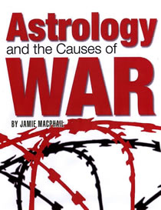
Starting discussion
What caused World War I ?
How crucial is the leader to the decision of going to war?
What are your best arguments for the impact of the Military-Industrial-Complex?

Slide 3
definition
Literature on the causes of war does not only talk about WAR as defined here, but WAR as the general phenomenon
-use of force
-contention/response
-reciprocity
-intensity/duration
-not for private gain
-fought for an aim outside of fighting itself
CONFLICT –
  at least 2 actors, mutual incompatibility expressed by at least 1 actor
  natural part of societal and international interactions
ARMED CONFLICT –
  contested incompatibility that concerns government and/or territory where the use of armed force between two parties, of which at least one is the government of a state, results in at least 25 battle-related deaths in one calendar year (UCDP)
WAR –
  a state-based armed conflict or dyad which reaches at least 1000 battle-related deaths in a specific year
varying typologies according to issue, actors, goals, and of course classifying entities

Slide 4
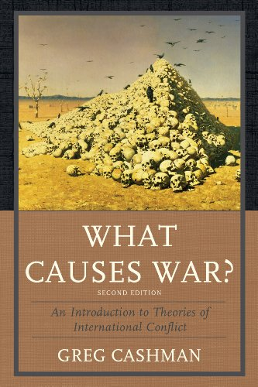
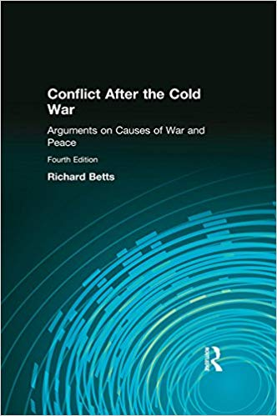
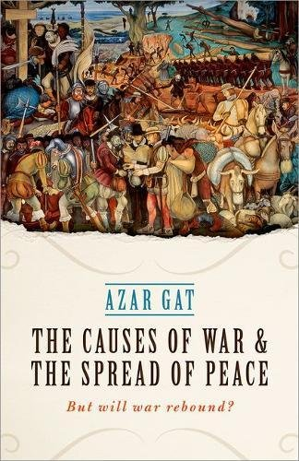
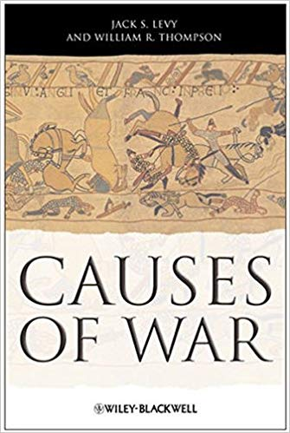
Authoritative books

Slide 5
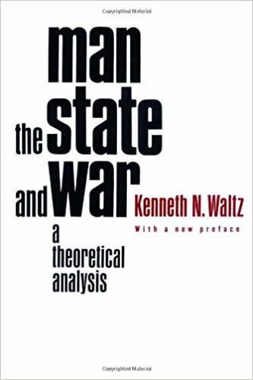
Levels of analysis
How to think analytically about the varying causes of war?
Kenneth Waltz
  Man, the State, and War (1959)
  3 images (individuals, states, system)
  now levels
Now 5 level
  Multiple authors have added State Dyads and Group analysis

Slide 6
Levels of analysis
System
anarchic nature of system
National
regime type
Individual
human nature
distribution of power
alliances and trade
system-wide norms
policymaking process
societal factors
economic system
public opinion standing
interest group positions
ethnicity, ideology
number of players
predisposition to aggression
leader personalities
brinkmanship
perception and misperception
cyclical theories
Dyadic
contiguity
Group
groupthink
rational actor model
bureaucratic model
rivalry and balance
shared ethnicity

Slide 7
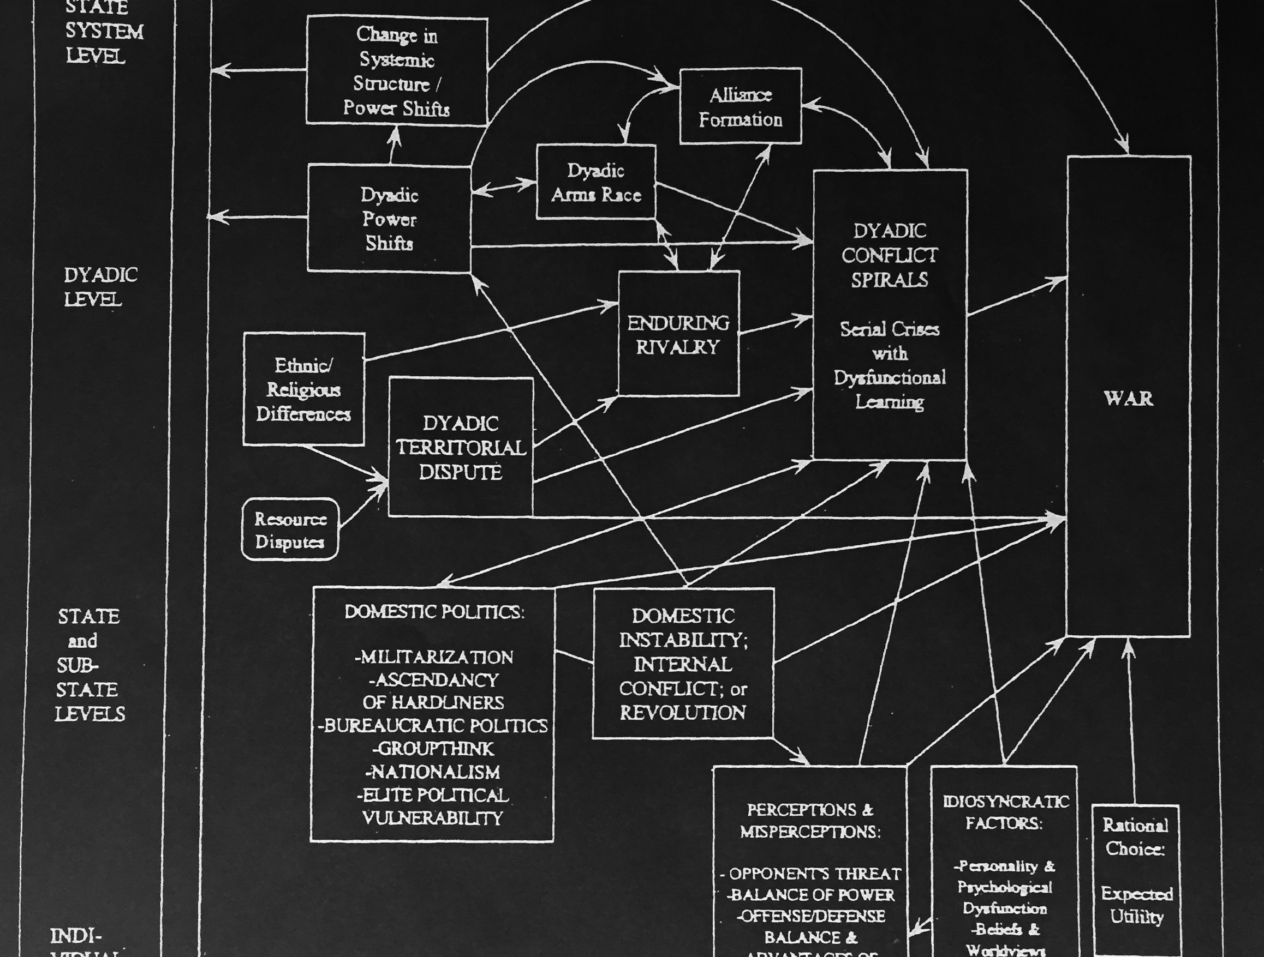
Making connections between the levels
Cashman & Robinson
Introduction to the causes of war
2007

Slide 8
Any one cause is insufficient?
constants cannot explain a constant
  if wars continue, but are rare their onset cannot be explained by static variables
  human nature, anarchy of the international system, ancient hatred between groups
grievances are present everywhere, yet conflict is rare - overprediction
same is true for many other variables/conditions/causes

Slide 9
System level
Security dilemma
  versus deterrence model (war occurs because deterrence failed)
  Deterrence theorists argue that the more conciliatory policies advocated by spiral theorists increase the probability of war by undermining deterrence, and spiral theorists argue that the hardline policies advocated by spiral theorists only provoke conflict spirals and war. (Levy 2014: 31)
Cycle theories
  explaining global wars in cycles
  1494 – 1516, 1588 – 1608, 1688 – 1713, 1792 – 1815, and 1914 – 1945
  rebalancing of world economic equilibrium
Balance of power theory
  Preventing hegemony by balancing (military focus)
Hegemonic stability?
  Power transition – broader definition of power

Slide 10
System level
Polarity
  What makes countries more prone to war? A bipolar or multipolar system?
  Neorealism: bipolar stability prevents collective action and free ride problems
  Defensive and offensive versions of realism
Bipolarity
  Forces both sides to measured responses, clear intentions, policing other actors in the system
  Absence of mediator, chance of any conflict growing out of proportion, rational calculation might encourage war
Multipolarity
  More actors in power balances and alliances, more mediators, less concentration on one adversary, limited conflicts
  Higher incidence of conflict, more pronounced incompatibilities, more misperceptions of intentions, limited policing

Slide 11
dyadic
examines relations between 2 states, rather than the whole system
  also applicable to state and non-state actor if such is well defined (Angola/UNITA)
Rivalry (accounts for up to 75% of interstate wars)
  impact of contiguity
Steps-to-war model
  bears similarities to security spiral but is purely issue-based
  explains that issue resolutions have a cumulative effect on the likelihood of war
  under this assumption – realist responses (deterrence, coercion, arms buildup) actually increase chances of war
Economic interdependence as cause
  both cause and prevention depending on standpoint

Slide 12
State / societal
Paradigm dependent views
  Liberalism sees representative states, realism militarily strong states, and Marxism egalitarian states as the solution to war
Marxist imperialism theory
  surplus capital generates pressures for external expansion, drive for raw materials.
Liberal democratic peace theory
Realists present many theories, such as:
  Diversionary theory (rally around the flag effect)
    Bodin (1576) “the best way of preserving a state, and guaranteeing it against sedition, rebellion, and civil war is … to find an enemy against whom they can make common cause.”
  Strategic culture
  Clash of civilizations

Slide 13
Group / organization
Bureaucratic politics model
  disposes of black box/state-as-unit approach to examine the dynamics between key decision-makers
  either government based or process based
  both serve to underline internal tensions and bargaining and thus serve to both escalate conflict (through for example incrementalism) or prevent its escalation through checks and balances
  focuses heavily on role of military in state politics
Groupthink
  societal conformity within smaller defined groups limits maneuvering space – lack of criticism
Rational actor model (RAM)
  investigates deviation from the RAM
  broadly investigated by de Mesquita (The War Trap)

Slide 14
INdividual
Hobbes vs. Locke
  is natural man predisposed to war?
  furthermore is it nature or nurture that predisposes or dissuades him?
Bound rationality
  balancing between acquisition of goals and prevention of negative escalation
  even if rationality in the decision-making process is assumed, uncertainty/incomplete information/fog of war prevails
Misperception
  contrary to bargaining model of war where rational adversaries with shared knowledge of capabilities should come to prefer a negotiated settlement over armed conflict
  overstating or understating (own capabilities and intentions) might both lead to war
  hard to draw a causal link

Slide 15
INdividual
Prospect theory
  oversensitivity to any loss and willingness to take extreme risk to avoid any loss
  loss aversion
Images and beliefs
  personal worldview and persuasion heavily impacts decisions in brinkmanship
Cognitive and motivated biases
  Capacity based, or emotionally bases exclusion or oversensitivity to threats and data
Poly-heuristic theory of decision-making
  2-step decision-making process – 1st step outright eliminates option which weaken domestic position (extreme loss aversion) and second steps seeks to be rational according to the highest expected utility

Slide 16
Civil wars
far harder to use 3 or even 5 levels of analysis
  most approaches use organizational and group level up to national level (rather than systemic or individual)
  i.e. state weakness against rebels and opportunity, or group motivation and ease of recruitment
  analysis on systemic level limited to colonialism, patronage, and weak/strong states
greed and grievance has transformed into motivation and opportunity
Motivation – hard to establish clearly, but clearly impactful
Opportunity – allows for clearer analysis and produces most configurational outputs
Onset / Duration debate

Slide 17
Cause indicators
Structural
Indicators
Regime type,
Regime performance,
Current conflict situation,
History of conflict,
Social cohesion and diversity,
Public security and health,
Development and distribution,
Provisions and Employment,
Geographic challenge,
Demographics
Indicator, Regime Type, Lack of Democracy, Government Effectiveness, Level of Repression, Empowerment Rights,
Recent Internal Conflict, Neighboring with HVC, Years since HVC, Corruption,
Ethnic Power Change, Ethnic compilation, Transnational Ethnic Bonds,
Homicide Rate, Infant Mortality, GDP per capita, Income inequality, Openness,
Food Security, Unemployment, Water Stress, Oil Production, Structural Constraints, Population Size, Youth Bulge

Slide 18
What to do with this multi-causal dilemma
Design early warning, conflict prevention, conflict management, and conflict resolution tools around EACH
Across all levels of analysis – corresponding tools exist and are being further developed
  Can you list any prevention tools? (think direct phone line between Moscow-Washington)
Tools are informed not only by levels-of-analysis but also the CHANGING NATURE OF WAR
Next week we study the changing nature of war to combine into the study of conflict management and resolution tools

Slide 19
JUST War
3 limits to just war Jus ad bellum, Jus in bello, Jus post bellum
Just cause - Just defense or correcting a wrongdoing
2. Legitimate authority - Initially only granted to monarchs and heads of state
3. Right intent - Achieving a better peace
4. Proportionality - Benefits outweigh overall cost
5. Fair chance of success
6. Last resort
1. Discrimination
2. Proportionality of means

