Slide 1
International security - ire107
Fall 2018
Has war changed?
dr. Martin Chovančík
dr. Petr Suchý
dr. Maya Hadar

Slide 2
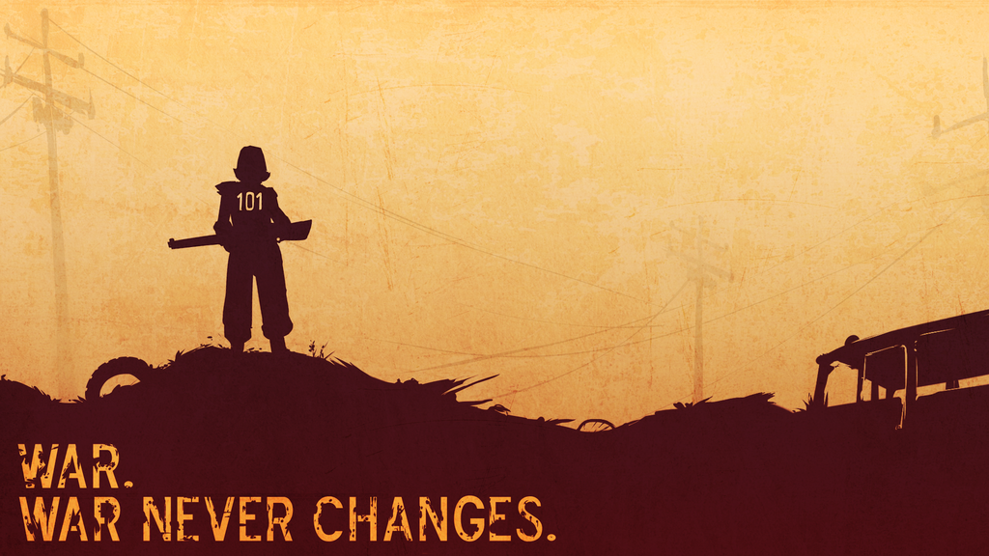
Are we better off just re-reading Clausewitz?
If you’ve read Mary Kaldor, how has war changed?
Are we less bellicose than our ancestors?
Why do we need to know?

Slide 3
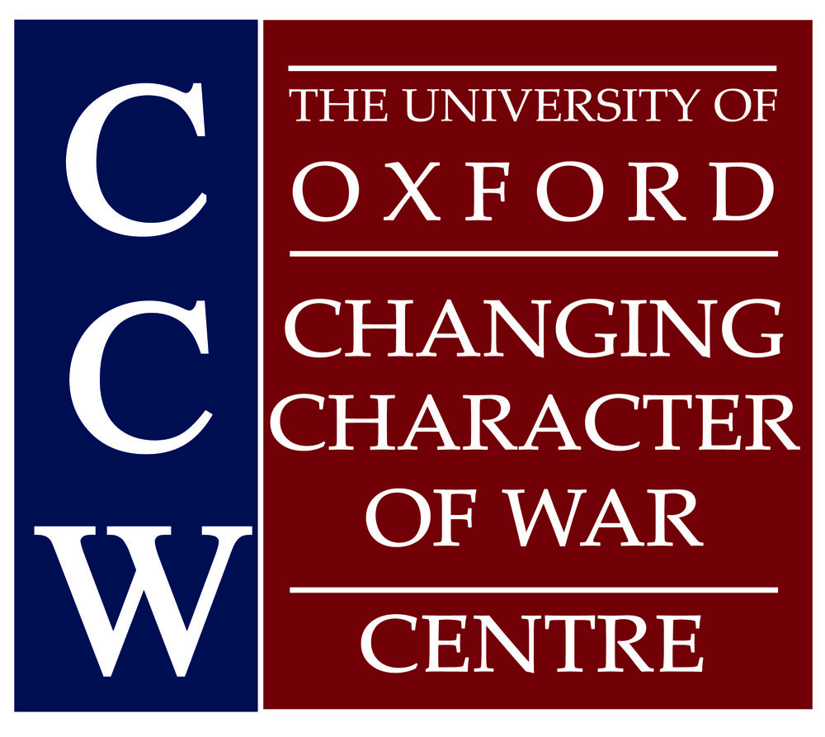
terms
War
  Clausewitz: an act of violence to compel our opponent to fulfil our will
  continuation of politics by other means
  absolute or real
  exact definitions abound
Warfare
  the actual acts of waging war, acts undertaken to destroy or undermine the strength of the adversary
Revolution in Military Affairs (RMA)
  concept of major changes in military doctrine and technology, which fundamentally alters the character of warfare
  is not our focus

Slide 4
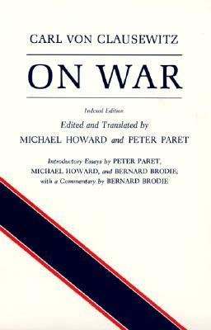
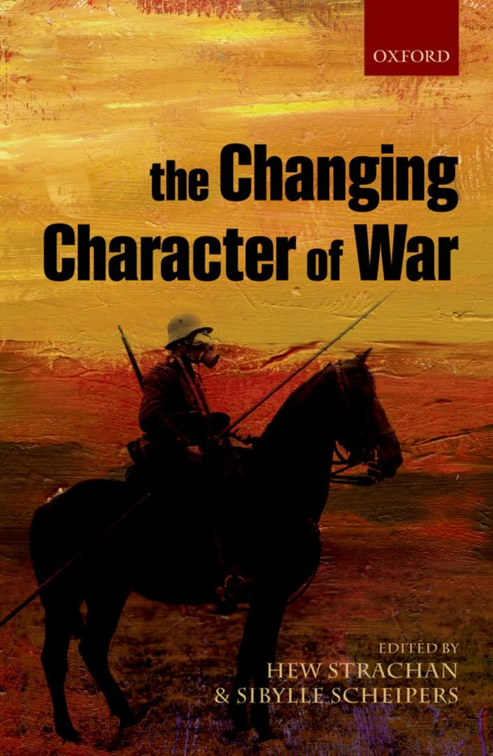
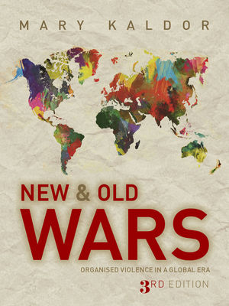
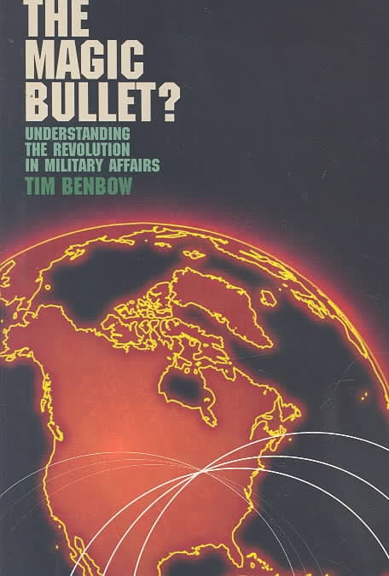
Authoritative books

Slide 5
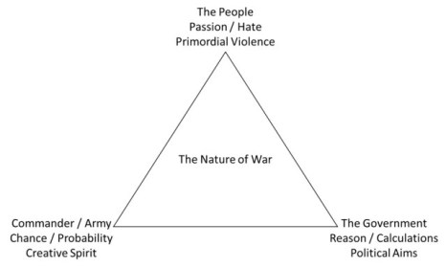
Classical/old/traditional war
There is absolutely no avoiding Carl von Clausewitz’s ON WAR (Prussia, 1832)
War is a combination of two trinities under the fog of war:
  hatred/emotionality – the people
  chance/creativity – the commanders
  reason/rationality – the state
War exist in two forms, one ideal one real world:
  absolute: “to introduce the principle of moderation into the theory of war itself would always lead to logical absurdity,” (a prevalence of the emotional aspect without limitations)
  real: “from the abstract to the real world . . . the whole thing looks quite different.” (limited in reality by rationality)
  the combination is most visible in HOW wars are waged (chance/creativity)
  Clausewitz’s investigation of absolute war lead to criticism of his support for total war
    total war: war waged with the mobilization and therefore legitimization of all military, economic, and societal resources

Slide 6
Old wars tenets
war aims are political goals: control of state or territory
political goals (i.e. rationality) dictate or limit the destructive nature by diplomacy
states have monopolies on authorized violence and they are the primary if not only actors in war (interstate war)
wars reflect political declarations and therefore enable and are supported by national mobilizations
soldiers are the primary targets on a defined battlefield
civilians are not primarily targeted as the objective is the defeat of military might and this would invite reciprocity
proportionality should be strictly observed as well as legality restrictions
battlefield outcomes tend to be more decisive
wars are financed from public sources according to their intensity
the trinity is pronounced and tends toward rationality limitations
Notes:
Territory must be controlled in order to derive profit from it (no longer true)

Slide 7
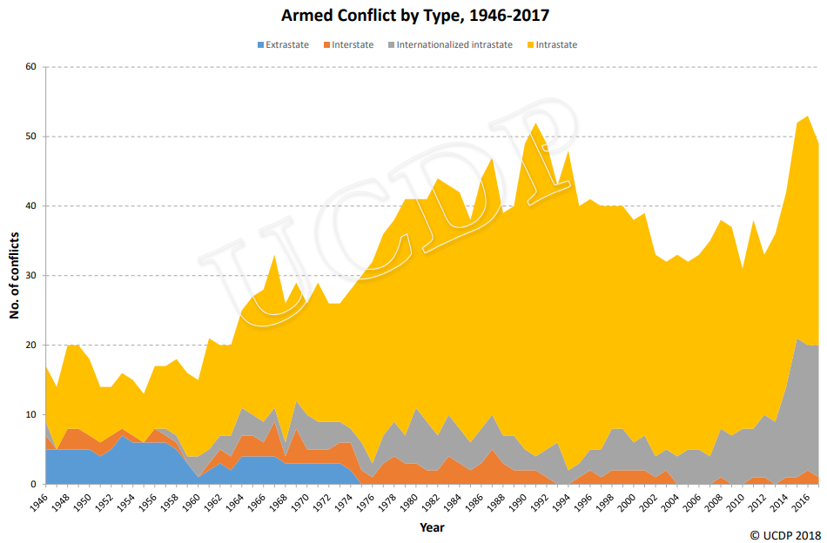
Old wars critique
insufficient explanation for modern conflict dynamics, especially after the end of the Cold War
cannot hold equal value when proportion of civil war is so dominating
weak and failing states do not provide the crucial element of rationality
in those states, and in fact around them, political aims of war are elusive and serve to further disintegrate the state (warlordism)
combatants are no longer being distinguished from non-combatants with the latter accounting for the majority of battle and battle-related deaths

Slide 8
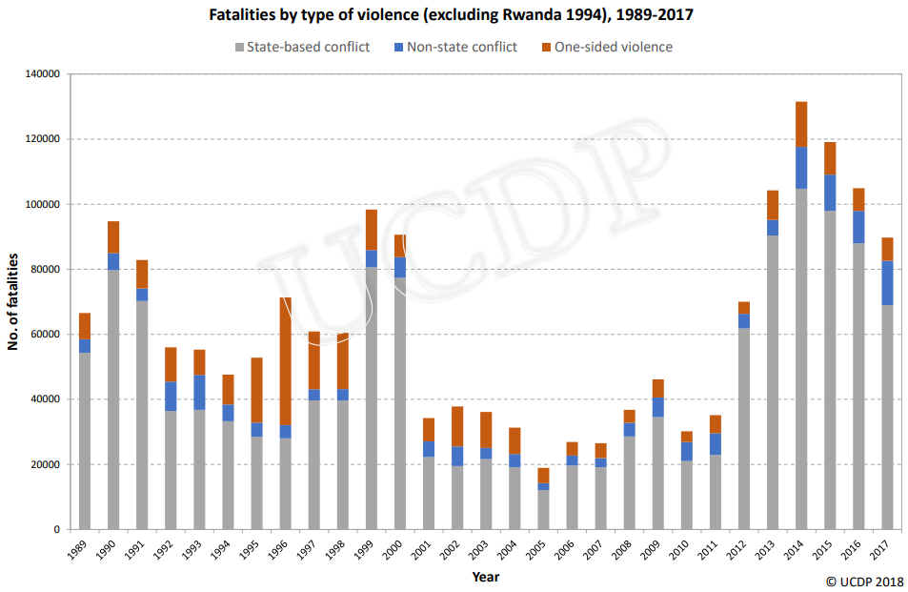
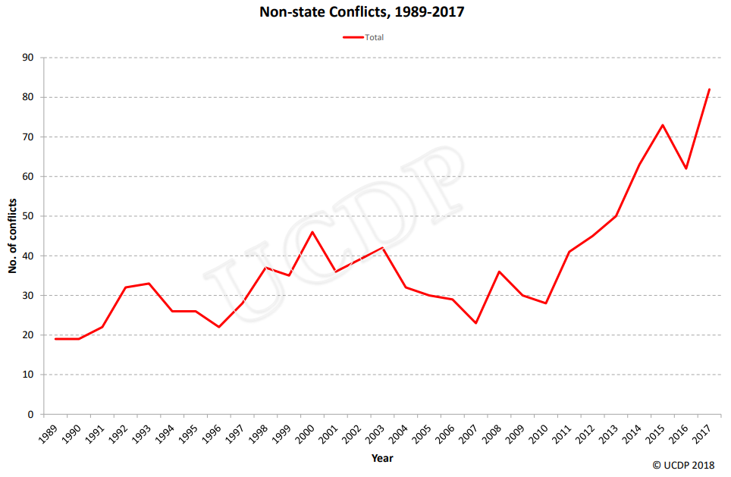
Structure of conflicts

Slide 9
new wars tenets
war aims do not need to have political aims
the goals are less about ideologies, territory, and state than about identity politics
less so a continuation of policy by other means than an end in itself
states are no longer the primary actors, the primary actors are groupings defined by a common belonging which is informed by hostility toward another grouping
maintained with high-levels of destruction even at low-intensity, without clear battlefield outcomes
mobilization of support is key, therefore the population becomes a target
civilian base is the primary target while avoiding military confrontation (not guerilla tactics)
disregard for legal restrictions of warfare
utilization of terror tactics, sexual violence, exploitation, methodic starvation
undefined battlefield and actors, blurring of civilians and fighters
aims sometimes completely absent, local or overall perpetuation is motivated by gains
financing doesn’t come from public sources but via globalization (diasporas, external support, aid)
MAIN CHANGES
Aims
Targets
Methods
Conflict utility
Intensity
Financing

Slide 10
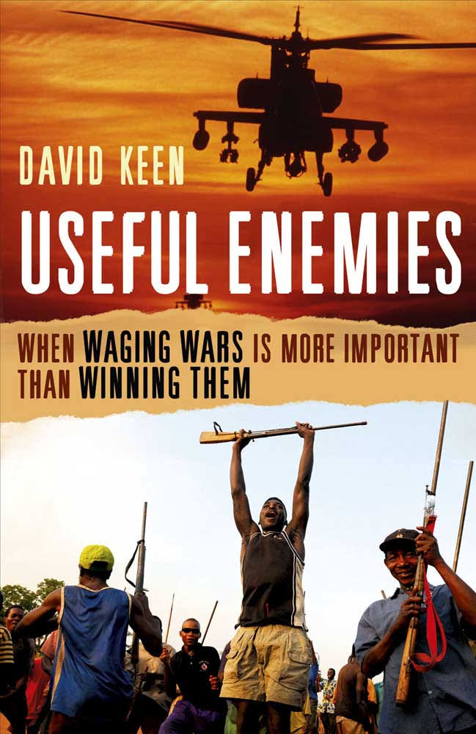
New war critique and synthesis I
Ratios
  original claim says that while old wars average a 8:1 (soldier to civilian) death ratios, new wars are reversed with 1:8
  Cambodia 1:9; Bosnia 1:3; Iraq 1:5; Sri Lanka 1:1
  But is this the whole story? direct vs. indirect deaths
Identities
  lesser value assigned to actual political aims remains controversial
  actual mix contains both but happens more often along identity lines
Methods
  the increase in targeting civilians with terror tactics is tangible, while not new, the prevalence is visible
Financing
  perhaps among the key and actually new dynamics
  global connection far simpler and protraction actually feasible
  diasporas, organized crime, rebel governance, aid diversion

Slide 11
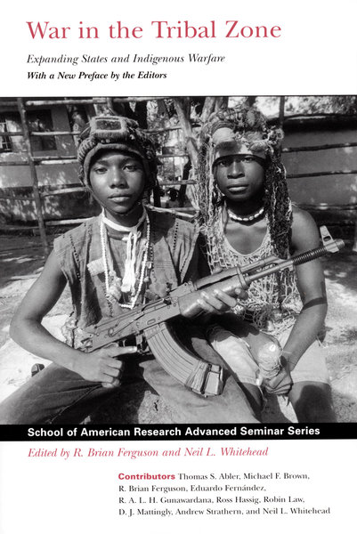
New war critique and synthesis II
overlooks for example colonial wars or the “barbarization” of war during WWII
“Call it what you will— new war, ethnic war, guerrilla war, low-intensity war, terrorism, or the war on terrorism—in the end, there is only one meaningful category of war, and that is war itself.” (Smith in Schuurman Clausewitz and the “New Wars” Scholars, 2010:97)
while all three elements of the trinity can be found in every armed conflict, the relative prevalence of one or the other can strongly influence a particular conflict’s character
profound implications for addressing conflict (prevention, management, resolution, post-conflict reconstruction)
  military superiority only has limited use
  influencing popular support is far more effective
  isolating the opponent from support within his identity group
  conflicts are complex political emergencies

Slide 12
Complex political emergency
“A major emergency is a humanitarian crisis in a country, region or society where there is a dramatic disruption in the political, economic and social situation, resulting from internal or external conflict or natural disaster, seriously disrupting the population’s capacity to survive and the national authorities’ capacity to respond, and which requires a consolidated multi-sectoral international response” (IASC of the United Nations)
Revised by OHCA – POLITICAL ELEMENT – above renamed to ‘major emergency’ where local capacities are inadequate (drought)
Major humanitarian crises of a multi-causal nature requiring a system-wide response
Modern INTRA-STATE CONFLICTS are the primary source of COMPLEX POLITICAL EMERGENCIES

Slide 13
Intra-state wars development
3 main eras of civil war
  civil war: armed conflict in the confines of a sovereign state between parties previously under the same authority
Until the first half of the 20th century – conventional wars
  irregular warfare/asymmetric warfare was a feature of colonial rather than civil wars
  even revolutions considered irregular warfare of unworthy for the struggle (Lenin, Trotsky, initially even Zedong)
Cold War – insurgencies and irregular wars
  as much as 70% of civil wars were based around irregular warfare (where guerrilla tactics were only a part of the strategy – outside support and highly structured political organizations)
  national liberation movements (mix of nationalism and communism)
Post-CW – predominantly low-tech symmetric wars and conventional wars (as much as 70% now)
  a decline in irregular warfare, but a persistence and development of low-tech low-intensity high-destruction wars coupled with internationalization
  weaker states fall prey to rebellion more easily which results in internationalization, which in turn leads to conventional wars over protracted irregular warfare

Slide 14
Our better angels – so is war declining?
multiple theses exemplified by thinkers such as Steven Pinker, John Mueller, Joshua Goldstein
the central argument revolves around a systemic decrease in violence over millennia
  focused on wars, homicide rates, genocide, death penalty, torture, slavery, etc.
  tolerance is increasing
  wars are less deadly and becoming obsolete
  wars can and will be eliminated – like polio
Reasons? - we are smarter, more empathic, more tolerant, more democratic, more liberal, etc. than before
How true is this hypothesis?
Notes:
Early 19th century thinking was the same (Auguste Comte)
Enlightenment’s dark side

Slide 15
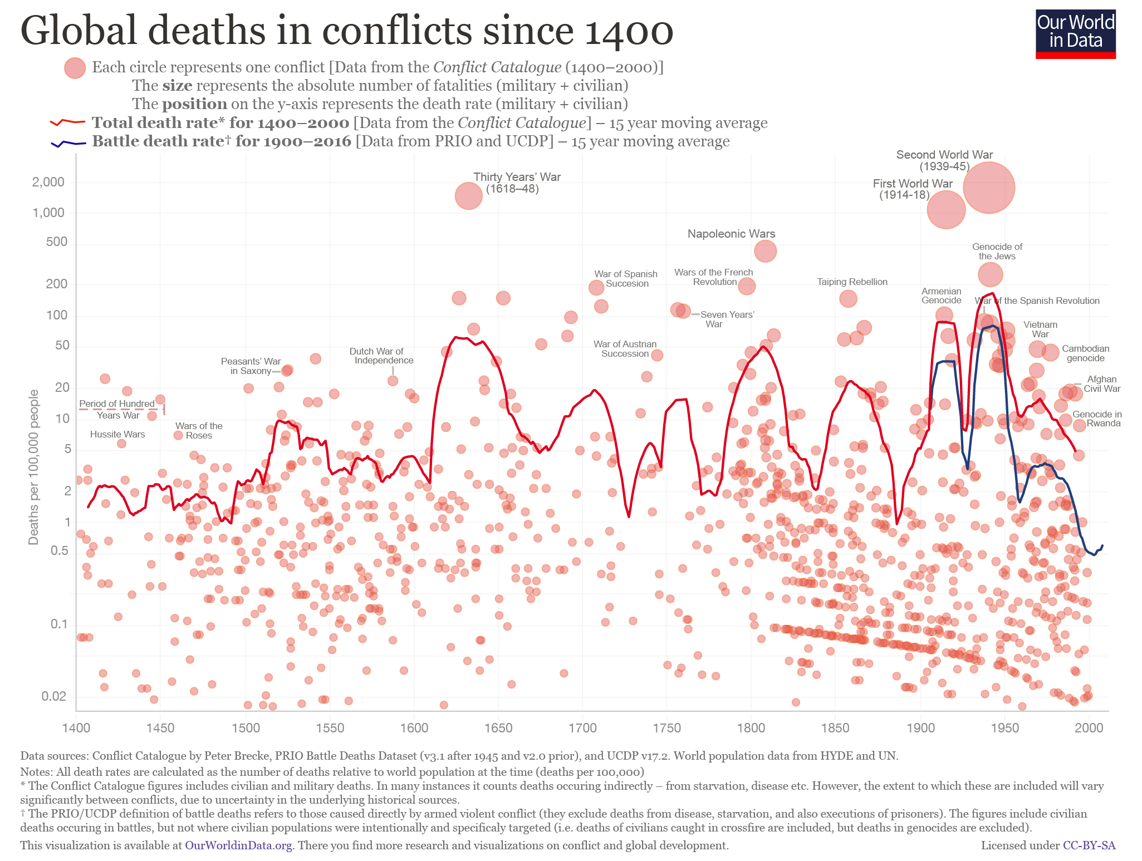

Slide 16
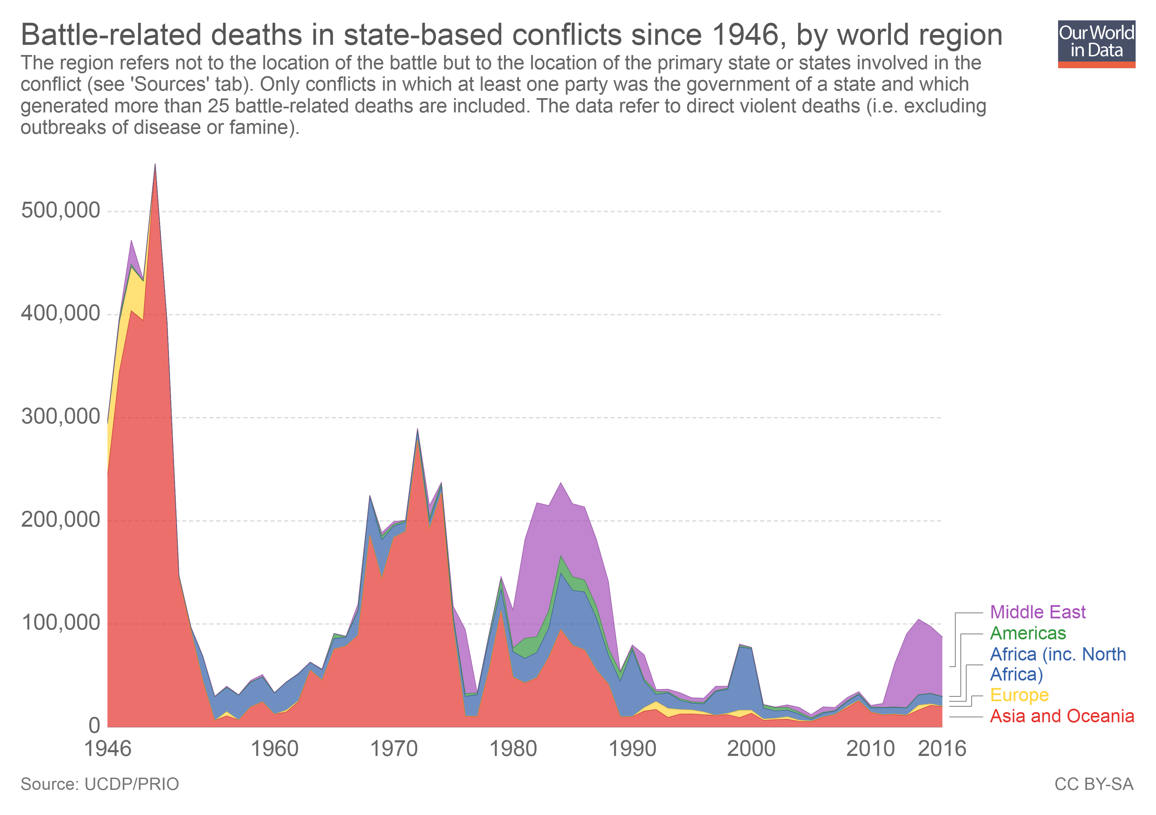

Slide 17
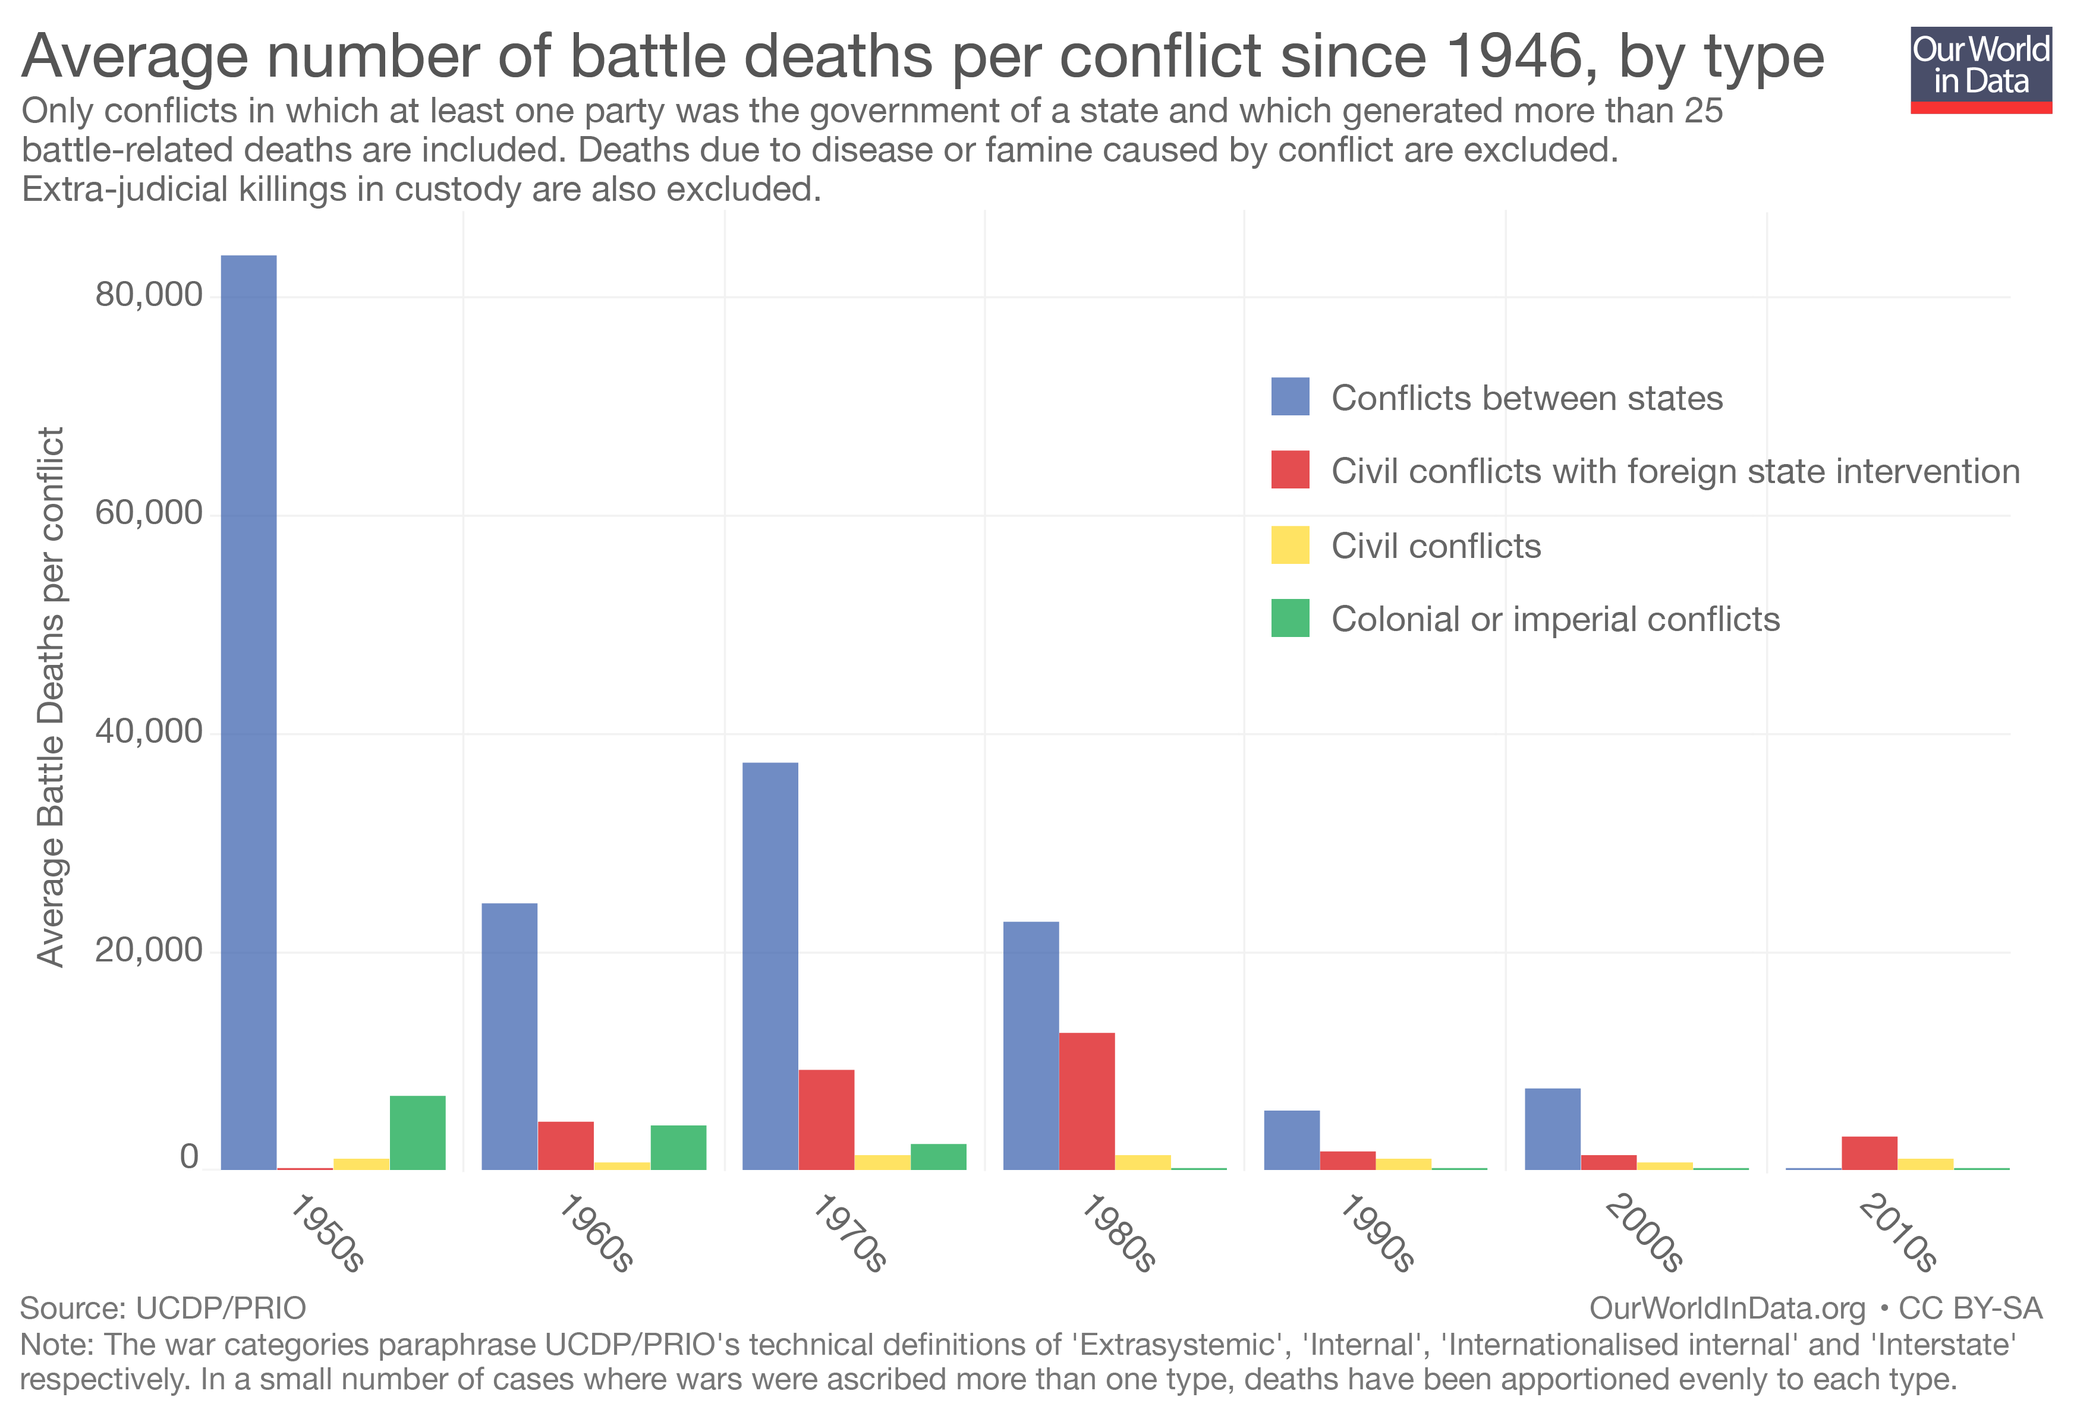
Is war declining?
What can you tell from this graph?
What does Fazal say about it and what does Gray?
Notes:
Average battle deaths falling, but number of conflicts increasing
Long or short peace? Cyclical
Nuclear war? Fossil fuel depletion?

Slide 18
Is JUST War becoming a staple marker?
3 limits to just war Jus ad bellum, Jus in bello, Jus post bellum
Just cause - Just defense or correcting a wrongdoing
2. Legitimate authority - Initially only granted to monarchs and heads of state
3. Right intent - Achieving a better peace
4. Proportionality - Benefits outweigh overall cost
5. Fair chance of success
6. Last resort
1. Discrimination
2. Proportionality of means

Slide 19
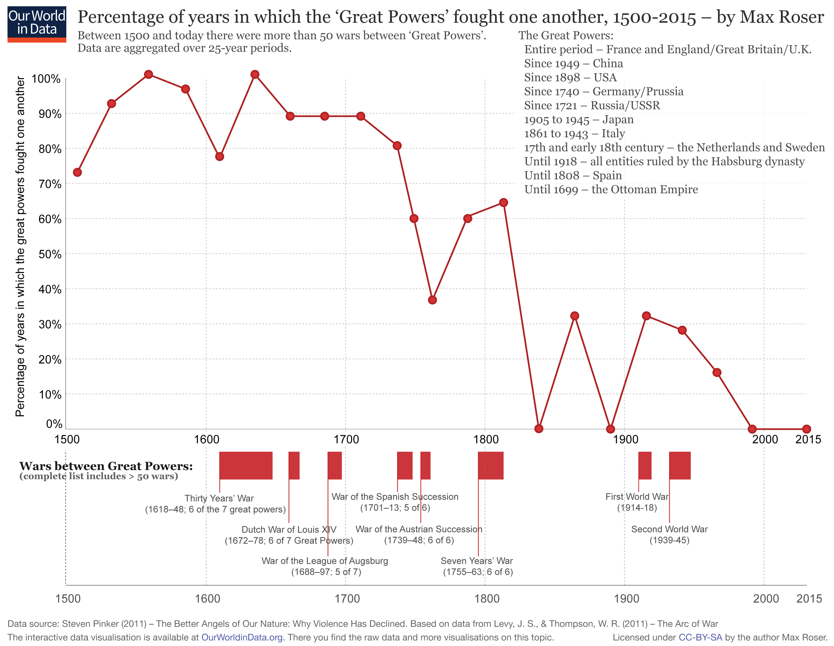
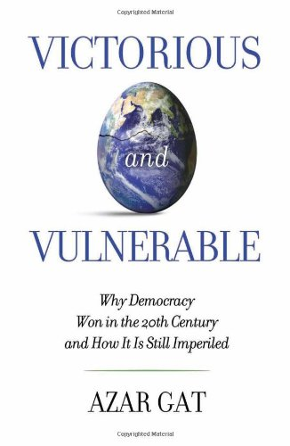
Democracy presupposed
Democratic peace theory
  prone to no war amongst them, less war outside, less destructive, less violent
  coupled with liberalism and capitalism
  the ultimate antidote to war?
  the necessary end-state?
Authoritarian capitalism
  a more than viable alternative
  often revisionist versus the status quo
  China and Russia at the least
  Short-lived democratic peace?

