Slide 1
International security - ire107
Fall 2018
Conflict management
dr. Martin Chovančík
dr. Petr Suchý
dr. Maya Hadar

Slide 2
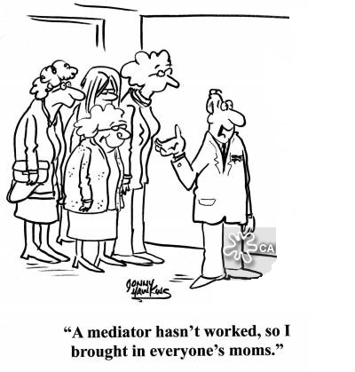
Starting discussion
How have the causes of war and changing character of war impacted on conflict management/resolution?
What makes conflicts intractable / harder to manage?
Notes:
Victimization over time
Incompatibility of belief systems
Extreme fractionalization
War profiteering
Loss-of-face incentive
Acknowledging legitimacy and sovereignty

Slide 3
Collective security
or why we should care about managing conflict (addressing conflict to be more precise)
the necessary assumption of collective security is simply that war are likely occur and that they ought to be prevented
collective security is not a design for organizing coalition warfare in the twentieth-century sense, but a plan for organizing international police action in an unprecedented sense
  the conflicts may be the fruit of unreflective passion or of deliberate planning; they may represent efforts to settle disputes. effects of undefinably broad situations of hostility, or calculated means to realize ambitious designs of conquest. They may be launched by the irresponsible dictate of cynical autocrats or the democratic will of a chauvinistic people-although the champions of collective security have frequently evinced the conviction that most wars are likely to stem from the former type of initiative. The point is that the theory of collective security is not invalidated by the discovery that the causes, functional purposes and initiatory mechanisms of war are varied. (Claude 1984)

Slide 4
The spectrum of tasks
conflict prevention:
    Activities aimed at preventing the occurrence and escalation of conflicts into their armed stage.
conflict management:
    Activities aimed at the armed aspects of crises with the objective of stopping active combat, containing crisis spillover and minimizing destructive impacts.
conflict resolution:
    Activities aimed at achieving a voluntary mutual peaceful solution to common incompatibilities and a cessation of hostilities.
post-conflict reconstruction:
    Activities aimed at rebuilding the socioeconomic structure and conditions for stable peace.

Slide 5
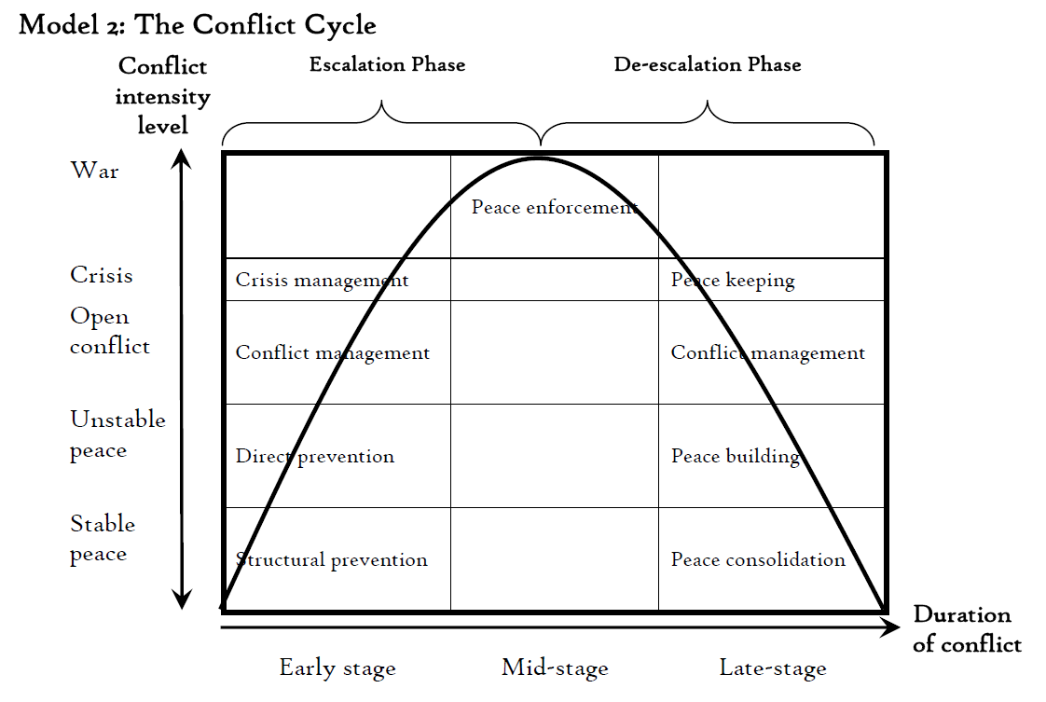
Conflict cycle

Slide 6
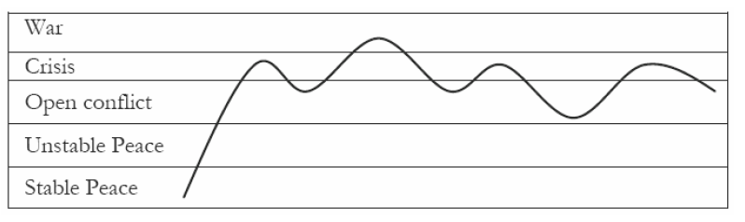
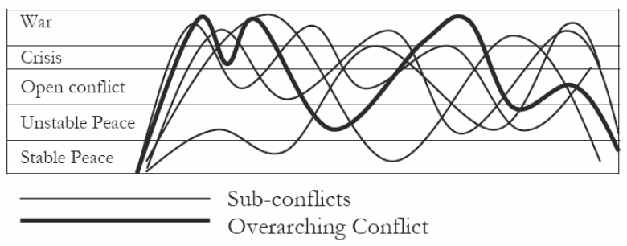
Actual conflict cycles

Slide 7
resolution
(mediation, negotiated settlement)
post-conflict reconstruction
(DDR, SSR)
structural prevention
(stabilization projects, HR support)
direct prevention
(crisis diplomacy)
management
(peacekeeping, arms embargo)
ceasefire
peace
develop
instability
violence
escalation

Slide 8
Conflict prevention
Structural prevention
    Long-term efforts on political, economic, developmental, cultural, civil society level
    Emphasis on the indivisibility of security
    IO membership, association agreements, cooperation, development programmes
Direct prevention
    Immediate efforts during initial crisis phases
    Early warning, mediation and shuttle diplomacy
    Lackluster in practice
Early warning systems
  Global and regional initiatives to identify crises prior to potential escalation
  UN – 1998 primary initiative, 2000 Prevention team
  IGAD – 2002 – CEWARN in the Horn of Africa
  AU – 2009 – CEWS Continental EWS
Indicators to watch (WB):
  past conflict, low income, high export dependence, political instability, human rights, militarization, ethnic dominance, regional conflict, unemployment rate among young adults, distribution of access to natural resources

Slide 9
Conflict prevention - Preventive diplomacy
Problem with precise definition
Could possibly encompass all of diplomacy (in the structural segment) by way of “building stable societies/states” argument
Pre-emptive diplomacy might suit as a better term, but is disused
Definition:
  Action taken in vulnerable places and times to avoid the threat or use of armed force and related forms of coercion by states or groups to settle the political disputes that can arise from the destabilizing effects of economic, social, political, and international change. (Lund 1996)
Instruments:
  International appeals – suasion, Fact-finding missions, on-site monitoring, Good offices, Early warning systems, Official diplomacy, Two-track diplomacy, Conciliatory gestures, Mediation, Incentive offerings, Negotiation forums
  Note that they do not contain coercive measures

Slide 10

Conflict management
Conflict management de-escalation strategies
GRIT graduated reciprocation in tension-reduction
  One-sided announcement of conciliatory measures, which continues even without immediate reciprocity
TFT Tit for Tat
  Simulation and game theory based
  Initiate cooperative stance, and then reciprocate consistently depending adversary’s response (positive or negative)
Mutually enticing opportunity
  Third party creation of conditions with pull-factor from current deadlock or Mutually Hurting Stalemate

Slide 11
Conflict management - mediation
Mediation
Defined as negotiation facilitated by third, presumably impartial, parties, to help seek a solution the direct parties cannot find themselves
Voluntary
  in selecting mediation, mediator, presence, progress, and most of all propositions and results
Dynamic process
concession, compensation, and construction OR positive-sum negotiations and bargaining negotiations
Cheap
  cheaper than any other form of third party involvement
Absence of coercion
  Although possibility of “mediation with muscle”
the process of combining conflicting positions into a joint agreement… and is the most common (although not the only) way of preventing, managing, resolving, and transforming conflicts
(Zartman 2009: 322).

Slide 12
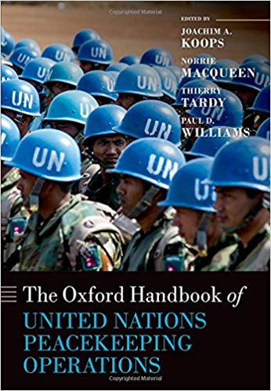
Military Conflict management
intervention by mainly military, usually multinational force
activities aimed at creating/maintaining a secure environment in order to end a crisis and/or enable peace to be established/maintained
MCM includes:
  peacekeeping missions
  conflict prevention missions
  stabilization and reconstruction missions
  humanitarian missions

Slide 13
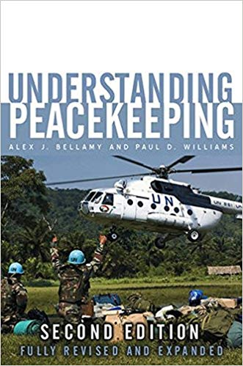
Military Conflict management
first, the spectrum of tasks has expanded
from traditional peacekeeping (containment and reduction of military escalation) to social, political, and economic transformation (conflict resolution)
from consenting states to hostile environments
from buffer zones to active engagement
from single actors to multinational coalitions and IOs in cooperation to cover the spectrum
“Comprehensive Approach” to complex political emergencies

Slide 14
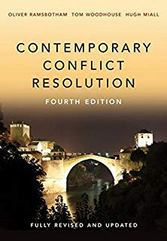
Conflict resolution
Peacemaking in the narrow definition
unless victory is achieved stems from negotiation
resolution options revolve around
  Priority change
  Division of subject of contention (part in the executive)
  Barter exchange
  Joint control (coalition)
  Delegated control
  Arbitrage
  Deferral
employed instruments involve ALL deployed instruments - MULTITRACK

Slide 15
Conflict resolution - negotiation
1. pre-negotiation
  our dominant field today, where mediation comes into play the most often
  aims to frame a possible acceptance of a negotiated settlement or even meeting for negotiations
2. agreement formula
  within the negotiation or mediation processes this phase entails the establishment of major agreement framework such as recognition, need for concessions, shared rule, or third party assistance
3. agreement details
  perhaps the longest phase delivers the specifics
actors readjust their strategies ‘phase by phase’ according to their subjective consideration of three factors:
  the contents of the peace proposal,
  the resources under their control
  the strength of the incentives and pressures from external interveners.

Slide 16
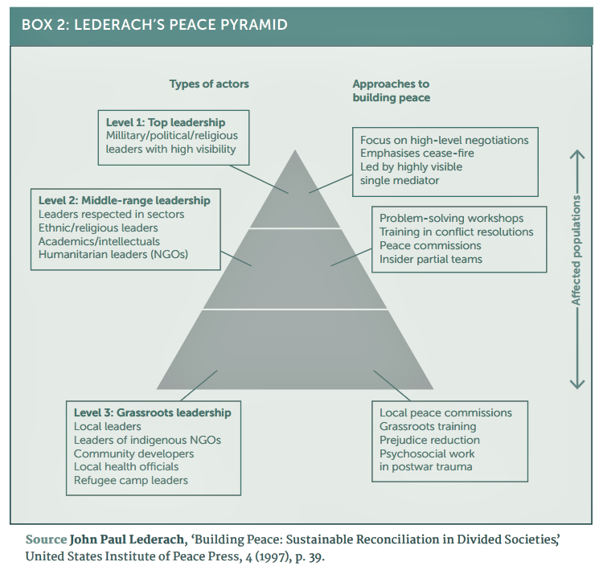
Conflict resolution
Dilemmas include:
Negotiated settlement vs. Victory
  strenuous debate over more stable and lasting peace
Inclusivity vs. Spoilers
  negotiation dilemma of including relevant stakeholders
Guarantees vs. Non-intervention
  peace agreement guarantor and guarantees

Slide 17
Post-conflict reconstruction
Activities aimed at renewing the socio-economic structure of the society and the establishment of adequate conditions for the secure and peaceful development of society
Key concepts:
  System inclusion
  External assistance
  Sustainability after self reliance
Reconstruction serves as structural prevention
Nation building – synonym for post-conflict reconstruction? Or for democratization and westernization? – only a part of post-conflict reconstruction

Slide 18
Post-conflict reconstruction
4 pillars
  Security – crucial to any success
    Civilian security, DDR, buffer zones, civilian control over armed forces, training
  Justice and Reconcilliation – establishment of rule of law
    Preventing reprisals, interim justice, human right legislation, police training
  Social and economic well-being – aid and resources distribution
    Elementary food and water security, repatriations, infrastructure reconstruction, requalification training, subsidies and investments
  Governance and participation – transitive authority support
    NGO cooperation, interim government support, election preparations, legislation expertise transfer, civil society support
2002 Post-Conflict Reconstruction (CSIS/AUSA)

