Slide 1
EU and Middle east

Slide 2
Soft Power
Term opposed to „hard power“ (power to coerce)
EU tries to spread its own values and ideas (democracy, human rights) in the world
Crucial for close neighbours because of stability
Some EU states disagreed with US intervention to Iraq

Slide 3
Copenhagen Criteria
Set of conditions the candidate states would have to fulfil to become members
Political – democracy, stable institutions, rule of law, respect to human rights
Economic – market economy, ability to sustain competition in the internal market
Aquis communitaire– to transport all EU law into national legal orders (including EMU)

Slide 4
Membership Conditionality
For many countries EU membership is very attractive
„Power of attraction“ can turn soft power into a power of coercion
The possibility of membership has to be credible
For many European countries nowadays EU membership is a „far shot“

Slide 5
Candidate Countries
Turkey
Macedonia
Montenegro
Serbia
Island (stopped)
Since 2014 Albania

Slide 6
Turkey
Associate member since 1963
Partner country in NATO
Application in 1987, candidate country since 1999
Negotiations opened in 2004, but are very slow
Islamic country
Poor country (but with huge GDP growth)
Large agriculture
Does it lie in Europe?
Common history
Current political problems in Turkey

Slide 7
European Neighbourhood Policy
Established in 2004 as a framework of relations with neighbouring countries
First idea was to capitalize on the relations of the new member states with EECs
The southern countries wanted to include also Mediterrean countries
Includes altogether 16 countries
In fact bilateral relations between the EU and a given country

Slide 8
Functioning of ENP
Action Plans are the most important tools – program of concreate reforms in the area of democracy, access to EU markets, JHA
Monitoring of progress
ENPI as a main financial instrument of cooperation

Slide 9
EU and Mediterrean
One of the first regions where the then EC established deeper ties
1995 as a breaking point – Barcelona Process signed
Multilateral platform of cooperation
Political, security, economic, cultural and social level of cooperation

Slide 10
Union for Mediterranean
Follows the former Barcelona Process established in 1995
Was created in 2008, idea of Nicolas Sarkozy – at first it should have been a much closer union of states
Turkey opposed – no alternative to EU membership
Contains EU countries, Maghreb and Mashriq countries, Bosna, Montenegro, Albania and Mauritania

Slide 11
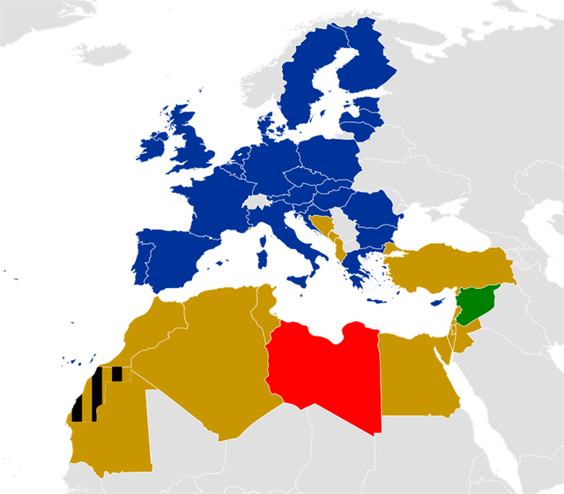
Unie pro středomoří

Slide 12
EU and Maghreb
Countries that are important for EU countries as regards resources
Lybian oil (25% for Italy in 2009) and gas from Algeria (ITA 42%)
Cooperation in migration
Cooperation on terrorism – potentialy problematic countries

Slide 13
EU and the „Arab Spring“
EU supports democratic changes in the region
Substantional amounts of money have been provided through the Support to Partnership, Reform and Inclusive Growth Policy (SPRING)
Syria – EU was only able to agree on sanctions – lowest common denominator

Slide 14
Neighbouring Countries and Migration Issues
Cooperation of neighbouring countries is crucial for tackling illegal migration
These countries should protect their border and not to let transit
Existence of readmission treaties
Most problematic border is Turkey-Greece – FRONTEX action needed – Treaty with Turkey

Slide 15
Migration Crisis
Start in 2015 – sharp increase in the number of migrants – over a million people came
EU response was quite slow
Treaty with Greece sealed the Meditterean route
Pressure moved to Italy – cooperation with Lybia
Currently most people come through Spain, but the numbers are much smaller

Slide 16
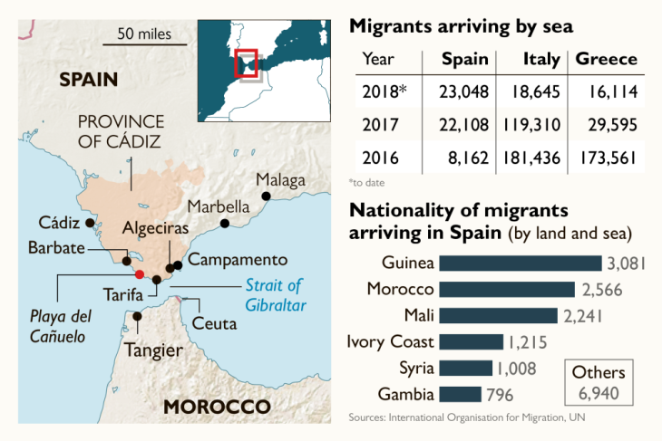

Slide 17
Solutions?
New rules?
Current rules put burden at some particular states
Difficult to find consensus in Europe
Asylum quotas?
Cooperation with African/Northern African states??
Migration/development nexus?

Slide 18
EU and Izrael and Palestine
EU supports the idea of two states
EU criticizes Izraeli settlements
EU part of the Quartet (together with U.S., Russia and UN)
Member states divided on recognition of Palestine (CZE against, UK and DE abstained)

