Slide 1
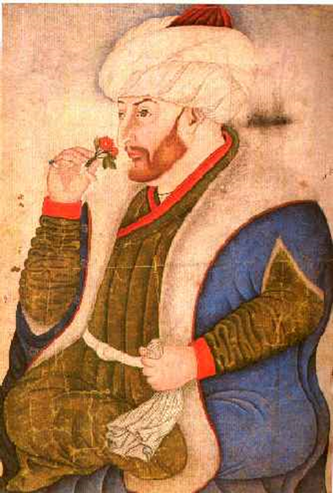
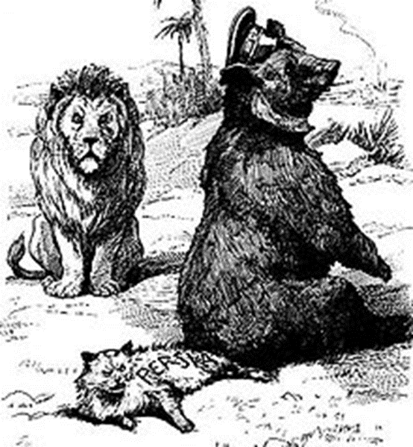
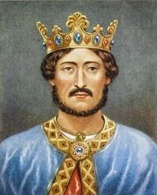
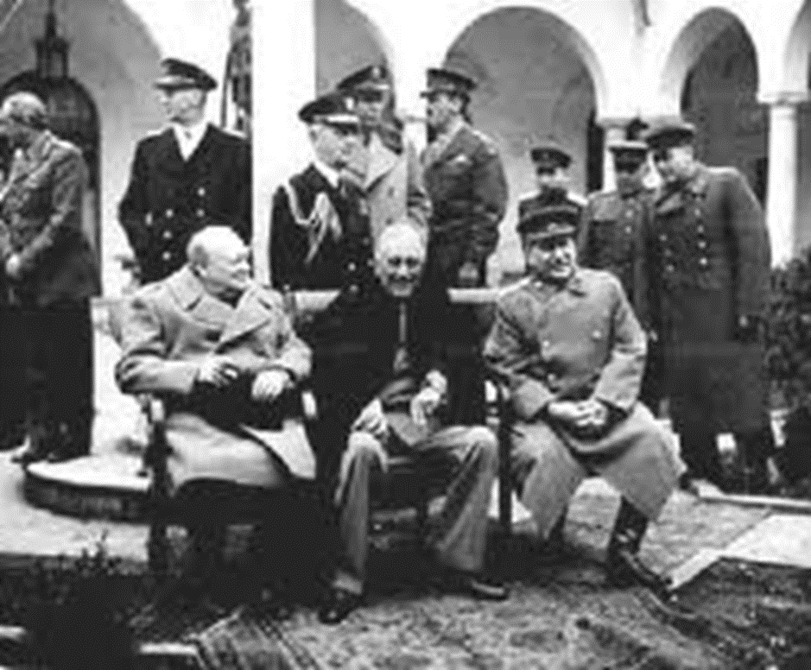
HISTORY OF MIDDLE EAST BEFORE 1945
Mgr. Eva Taterova, M.A., Ph.D.
Faculty of Social Studies
Masaryk University

Slide 2
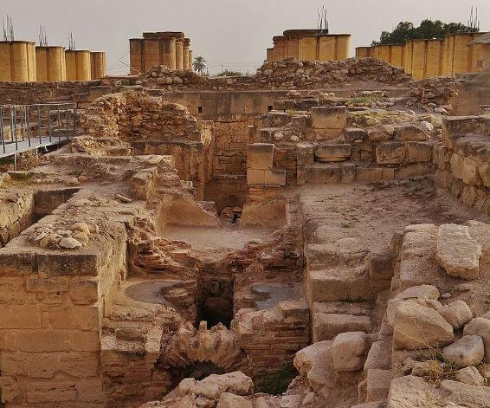
ANCIENT HISTORY OF MIDDLE EAST
Convenient climate, generally good living conditions for the first men.
First agricultural settlement in 9th century BC (Jericho 8,000 BC, Byblos 5,000 BC).
Many influential and developed civilizations in the region (Mesopotamia, Babylonia, Ancient Egypt, Persian Empire, Jewish kingdoms, Roman Empire etc.)

Slide 3
EMPIRES OF THE WORLD
http://www.youtube.com/watch?v=YwEE4YFZkpw

Slide 4
HISTORY OF THE REGION BEFORE THE CRUSADES
1st century: birth of Christianity.
2th century: Jewish diaspora.
6th century: birth of Islam in Arabic peninsula (Mecca, Medina).
Palestine/Holy Land – important for Islam, Judaism, Christianity (Jerusalem, Hebron, Sea of Galilee).
7th century: migration of Arabic tribes to Middle East and northern Africa.

Slide 5
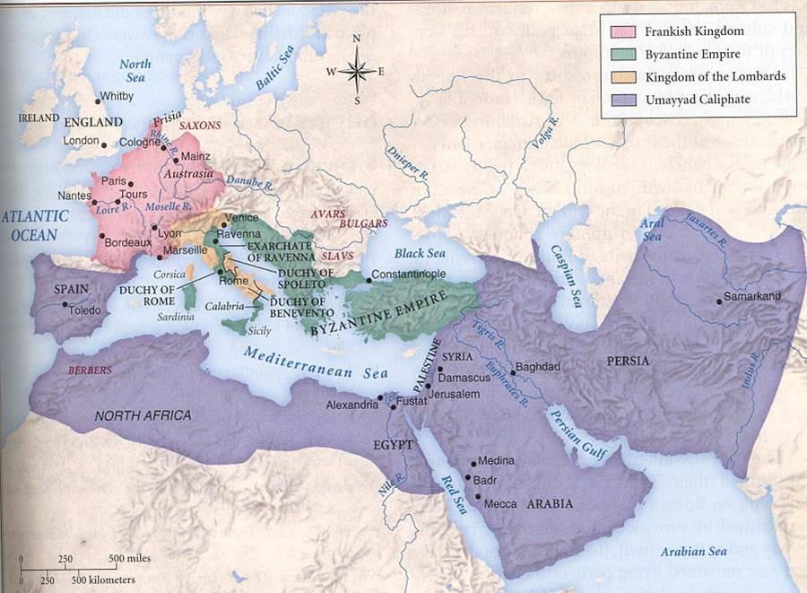
GOLDEN AGE OF ISLAM (8-13th CENTURY)

Slide 6
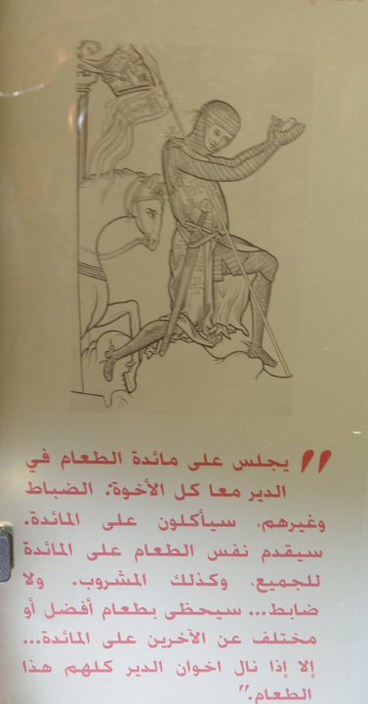
CRUSADES TO THE HOLY LAND
First crusade was initiated by pope in 1095
with a declared goal to liberate the Holy Land and Jerusalem (Holy Sepulcher).
Altogether 9 crusades, some of them were more successful than the others (Richard the Lionheart).
Motivation of the crusaders:
  Religious.
  Economic.
  Political.
Temporary Christian states established in the area (Kingdom of Jerusalem, Principality of Antioch, County of Edessa) – fall of Akko in 1291, end of crusaders presence in the Middle East.

Slide 7

RISE OF OTTOMAN EMPIRE
In 13th century the Turkish tribes led by Osman I got to Anatolia and started to compete with
the Byzantine Empire.
1453 – the conquest
of Constantinople (Istanbul) by sultan Mehmed the Conqueror.
During the next centuries territorial expansion to Europe, Middle East, and northern Africa.
Sultan Mehmed

Slide 8
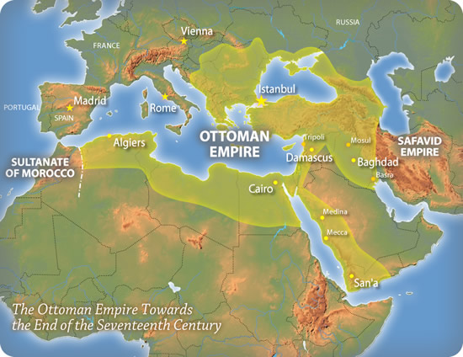
TERRITORIAL EXPANSION OF OTTOMAN EMPIRE

Slide 9
DECLINE OF THE OTTOMAN EMPIRE
During the time the power status of Ottoman Empire had been weakening (economically: inability to follow the trends of industrial revolution; corruption; political instability: frequent palace coups; lack of military reforms) → "sick man of the Bosporus" (1853-56 Crimean War: confirmation of growing weakness of the Ottoman Empire).
1798: Napoleon's invasion to Egypt – sometimes interpreted as a milestone regarding the growth of Arab nationalism (Egypt: pasha Muhamad Ali; turmoil in Syria and Palestine in 19th century).
19th century: „Race for Africa“ – European powers attempted to get control over territories in Africa, since 1830s growing influence of France in northern Africa (Algeria, Tunisia, Morocco), since 1870s consolidation of British power in Egypt.

Slide 10
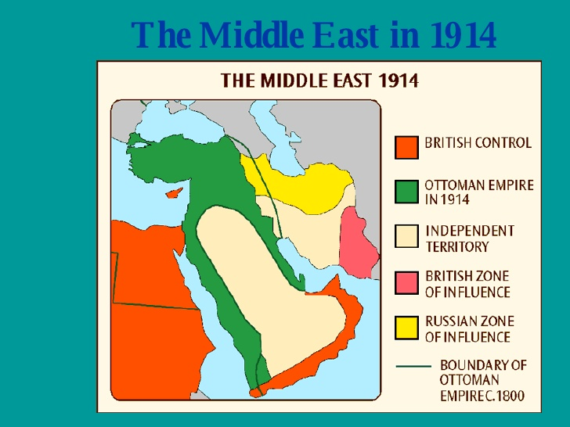

Slide 11
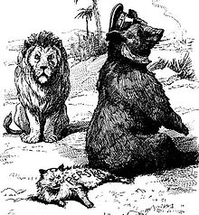
POLITICAL DEVELOPMENT OF THE REGION TO WW1
19the century: the birth of Zionism = Jewish nationalism (Theodor Herzl: Der Judenstaat), 1897 founding of Zionist organization in Basel → more and more European Jews emigrate to Palestine – first clashes and disputes with local people.
Deepening crisis of the Ottoman Empire – in WW1 Ottoman Empire joined the coalition of the Central Powers.
The region had become the center of interests of European colonial powers (Great Britain claimed Egypt as her protectorate in 1914, competition of Russia and Great Britain in Persia).

Slide 12
WW1 AND THE MIDDLE EAST
Both Jews and Arabs (Lawrence of Arabia) supported the Triple Entante with a hope that after the collapse of Ottoman Empire that would be granted independence or at least authonomy.
Military operations in the region: Palestinian Front, Mesopotamian Front, Caucasian front → armistice October 30, 1918
The goals and ambitions of both groups were obviously contradictory: European great powers had the negotiations with both of them (Balfour Declaration 1917, correspondence of Henry McMahon and Sharif Hussein 1915-16).
Concurrently secret negotiations between Great Britain and France in order to divide the Middle East: Sykes-Picot Agreement 1916 – violation of all pledges given to Arabs and Jews.

Slide 13
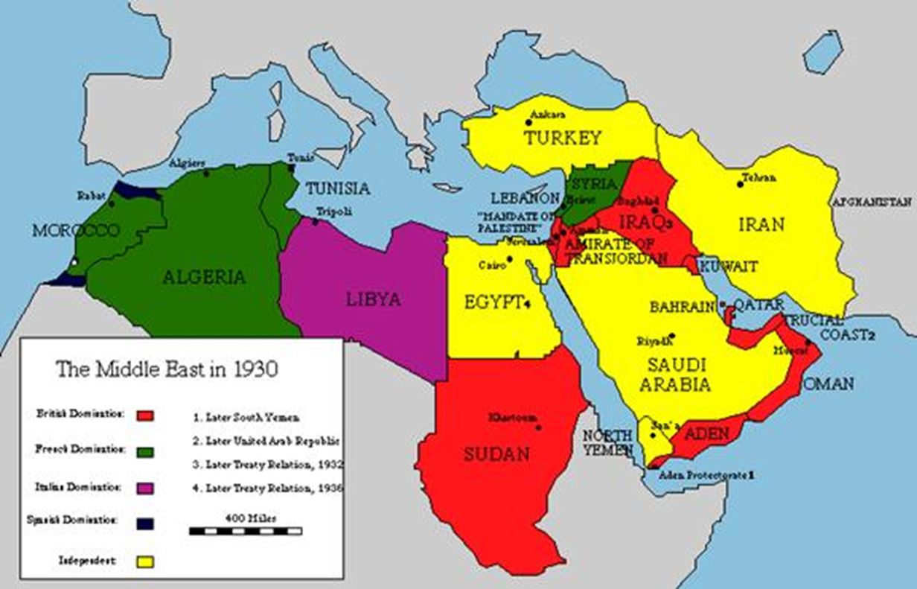
VERSAILLES PEACE CONFERENCE 1918-1919
Discussion of the future settlement
of territories of Ottoman Empire (Ottoman Empire in turmoil → civil war → 1923 Republic of Turkey).
The negotiations were to continue
in follow-up conferences in San Remo and Sèvres (1920).
The regional delegations had very limited options, France and Great Britain made the crucial decisions → modern map of Middle East.

Slide 14


Slide 15
POSTWAR MIDDLE EAST
In fact, the distribution of power and territories in accordance with Sykes-Picot Agreement.
Officially, the leading role had newly established League of Nations →A League of Nations mandate: Palestine (Israel/Palestine + Jordan), Mesopotamia (Iraq), Syria (later Lebanon was excluded as separate territory).
Egypt and Persia became officially independent but under heavy British influence + British political and economic interest in Arabic peninsula (city of Aden; Oman, Qatar and Bahrain were British protectorates).
Turkey since 1923 a republic, significant territorial losses.
European great powers were not that much interested in most of Arabic peninsula – leading figure king Ibn Saud.

Slide 16
1920s in MIDDLE EAST
Postwar settlement of the region was a deep disappointment for the hopes of local nationalists.
Very problematic situation in Palestine (escalation of conflict) as well as in other parts of the region (coup in Iran → rise of Reza Khan – new royal dynasty), instability in Syria.
The borders with lack of respect to distribution of local population (Kurds and the others).

Slide 17
WW2 AND THE MIDDLE EAST
Growth of Nazi Germany in Europe: Nazi diplomacy was seeking for the allies in the Middle East (negotiations with Persia, Saudi Arabia, Grand Mufti of Jerusalem).
Most of the countries of the region preferred to claim political neutrality or a support the Allies.
Some groups more or less secretly cooperated with the Axis powers (some movements in French colonies, Grand Mufti of Jerusalem).
Strategic importance of the region: natural resources, crucial transport routes (Suez Chanel, Mediterranean Sea, Aden etc.).
Open fights in northern Africa (Egypt, Libya, Tunisia, Morocco) – Afrikakorbs led by Erwin Rommel (victory of the Allies in 1943).
1943 conference in Tehran (Churchill, Stalin, Roosevelt).

Slide 18
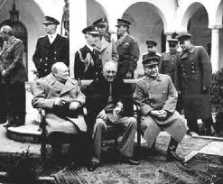
BIG THREE IN TEHRAN 1943

Slide 19
THANK YOU FOR YOUR ATTENTION

