Slide 1
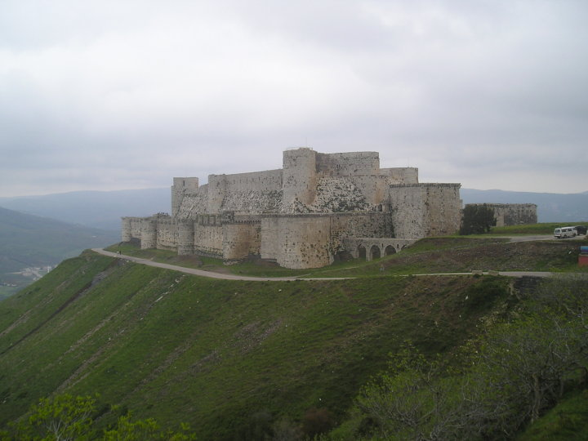
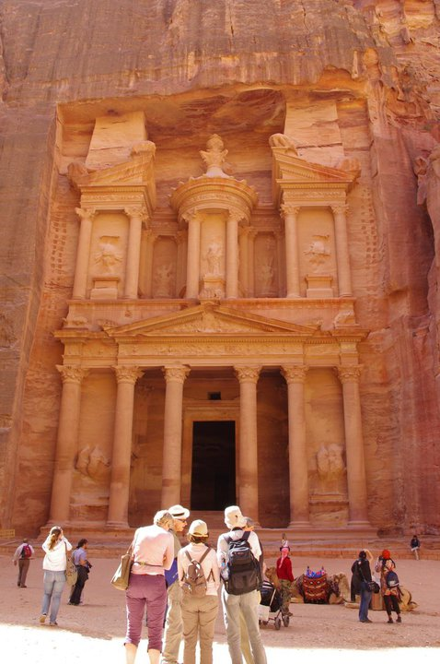
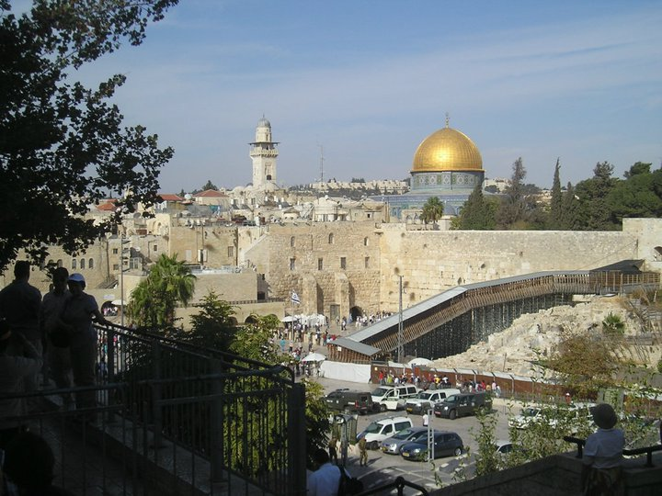
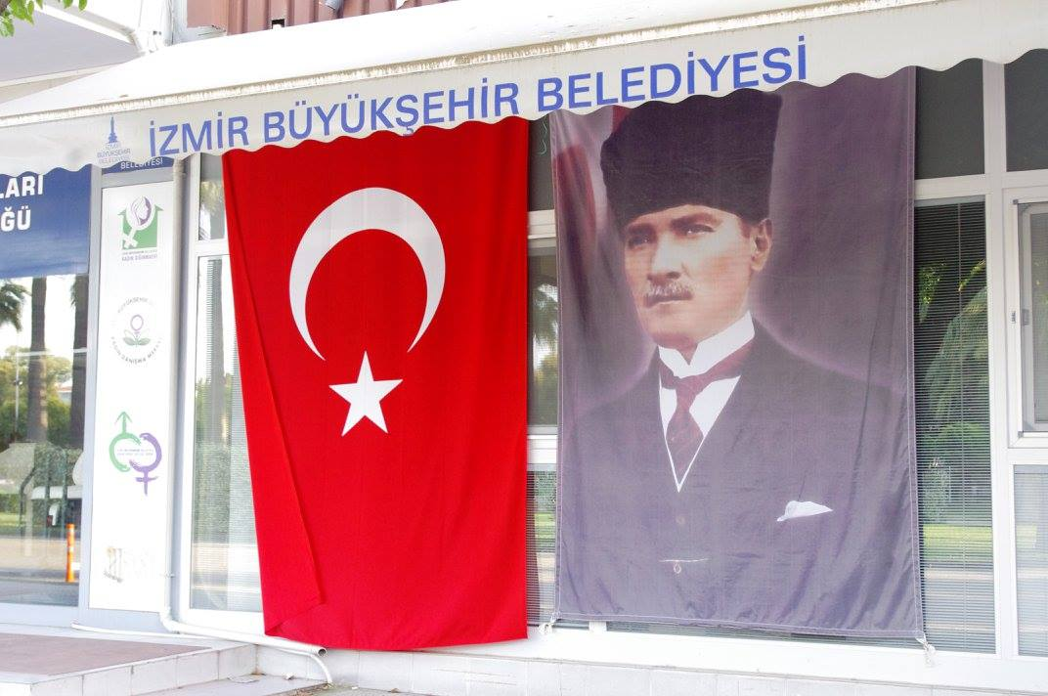
POLTICS AND SOCIETY
IN THE MIDDLE EAST
Mgr. Eva Taterova, M.A., Ph.D.
Faculty of Social Studies
Masaryk University

Slide 2
COURSE OVERVIEW
Credits: 4 ECTS
Lecturer: Mgr. Eva Taterova, M.A., Ph.D. (evataterova@gmail.com)

Slide 3
COURSE SCHEDULE
September 17: Introduction. scope of the course, organization of the course, and course requirements
September 24: Middle East: the basic terminology, geography, demography
October 1: History of Middle East before 1945
October 8: Arab-Israeli Conflict I
October 15: Reading week – no class
October 22: Arab-Israeli conflict II
October 29: Midterm exam

Slide 4
COURSE SCHEDULE
November 5: Iran: From Western Ally to Islamic Republic
November 12: Political Development of Lebanon and Syria
November 19: Post Cold War Conflicts in the Middle East
November 26: EU and the Mediterranean region
December 3: Documentary movie – screening followed by a discussion
December 10: Final exam

Slide 5
COURSE ACTIVITIES
Midterm: October 29, 3 open questions, 30 points
Final Exam: December 10, 5 open questions, 50 points
Essay: deadline November 30, 20 points

Slide 6
ESSAY
Topic: Personal portrait of one leading Middle East individual
The purpose of the essay is to engage with the respected authors in the field, and provide a critical assessment of the perspectives presented in the articles. The students are expected to integrate the readings in a thoughtful way, not just summarize them. Be sure to reference the readings properly. The papers should be up to 6 (1.5-spaced) pages.
Lenght: 6 pages (1 page = 1,800 letters)
Deadline: November 30, midnight (Submit it to “Odevzdávárna” application in university information system).

Slide 7
GRADES
A 92 - 100
B 84 - 91
C 76 - 83
D 68 - 75
E 60 - 67
F less than 60 points

Slide 8
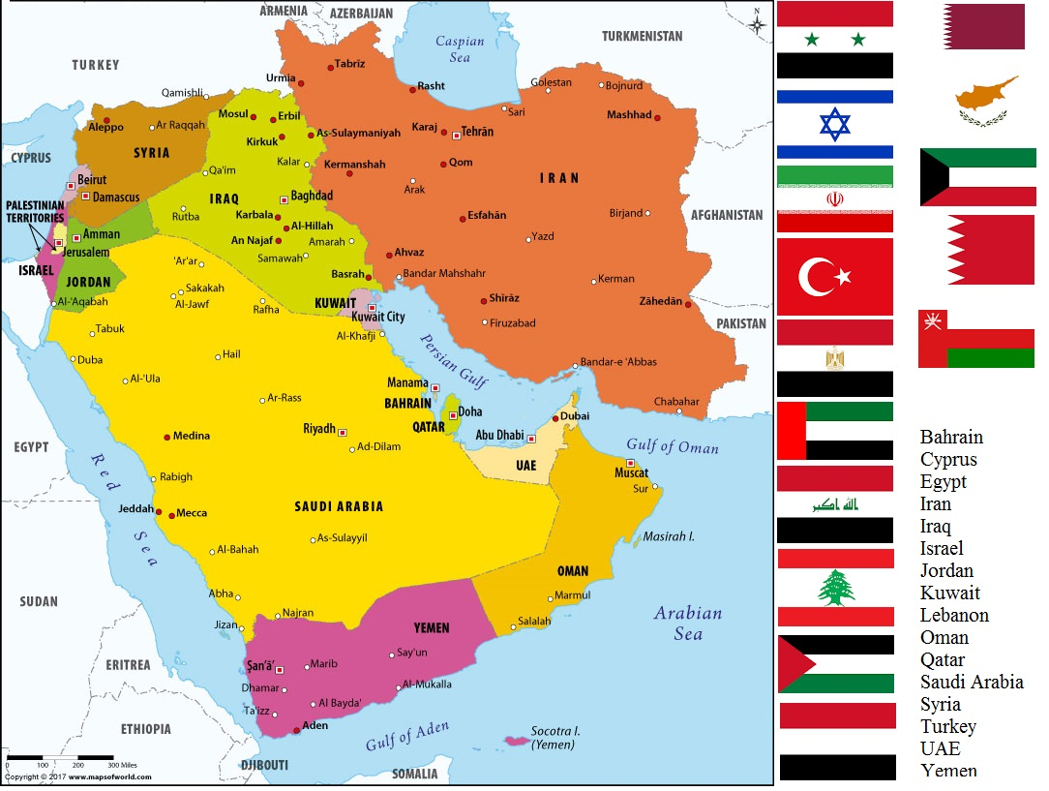

Slide 9
THANK YOU FOR YOUR ATTENTION

