Slide 1
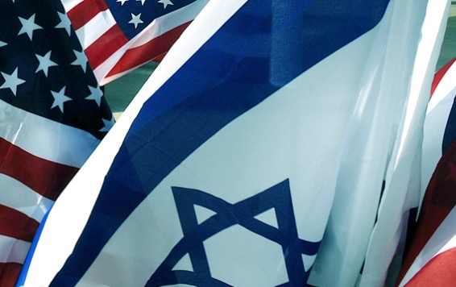
The Future
U.S.-Israeli Foreign Relations

Slide 2
Signs
First, change on the international scene
Second, large wave of Jewish immigration
  Russia and Africa
  Europe
Third major event of recent times, the on-going crisis in the Middle East
  Arab ‘winter’
  Syrian civil war
  IS

Slide 3
Bilateral Relations
First and foremost, there must be an element of trust, of frankness in the relationship at the top levels
History of distrust and acrimony
History of special and strategic partnership regardless of ideology and politicians

Slide 4
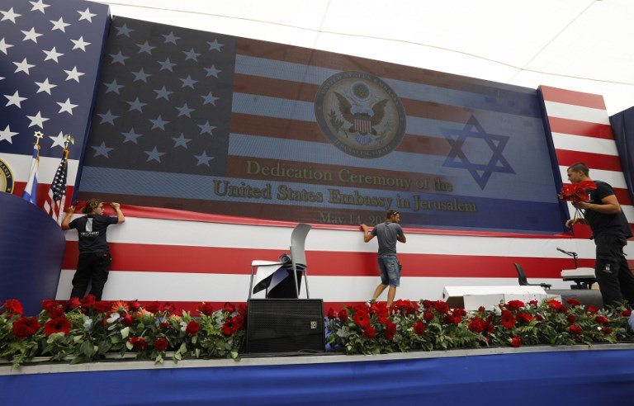
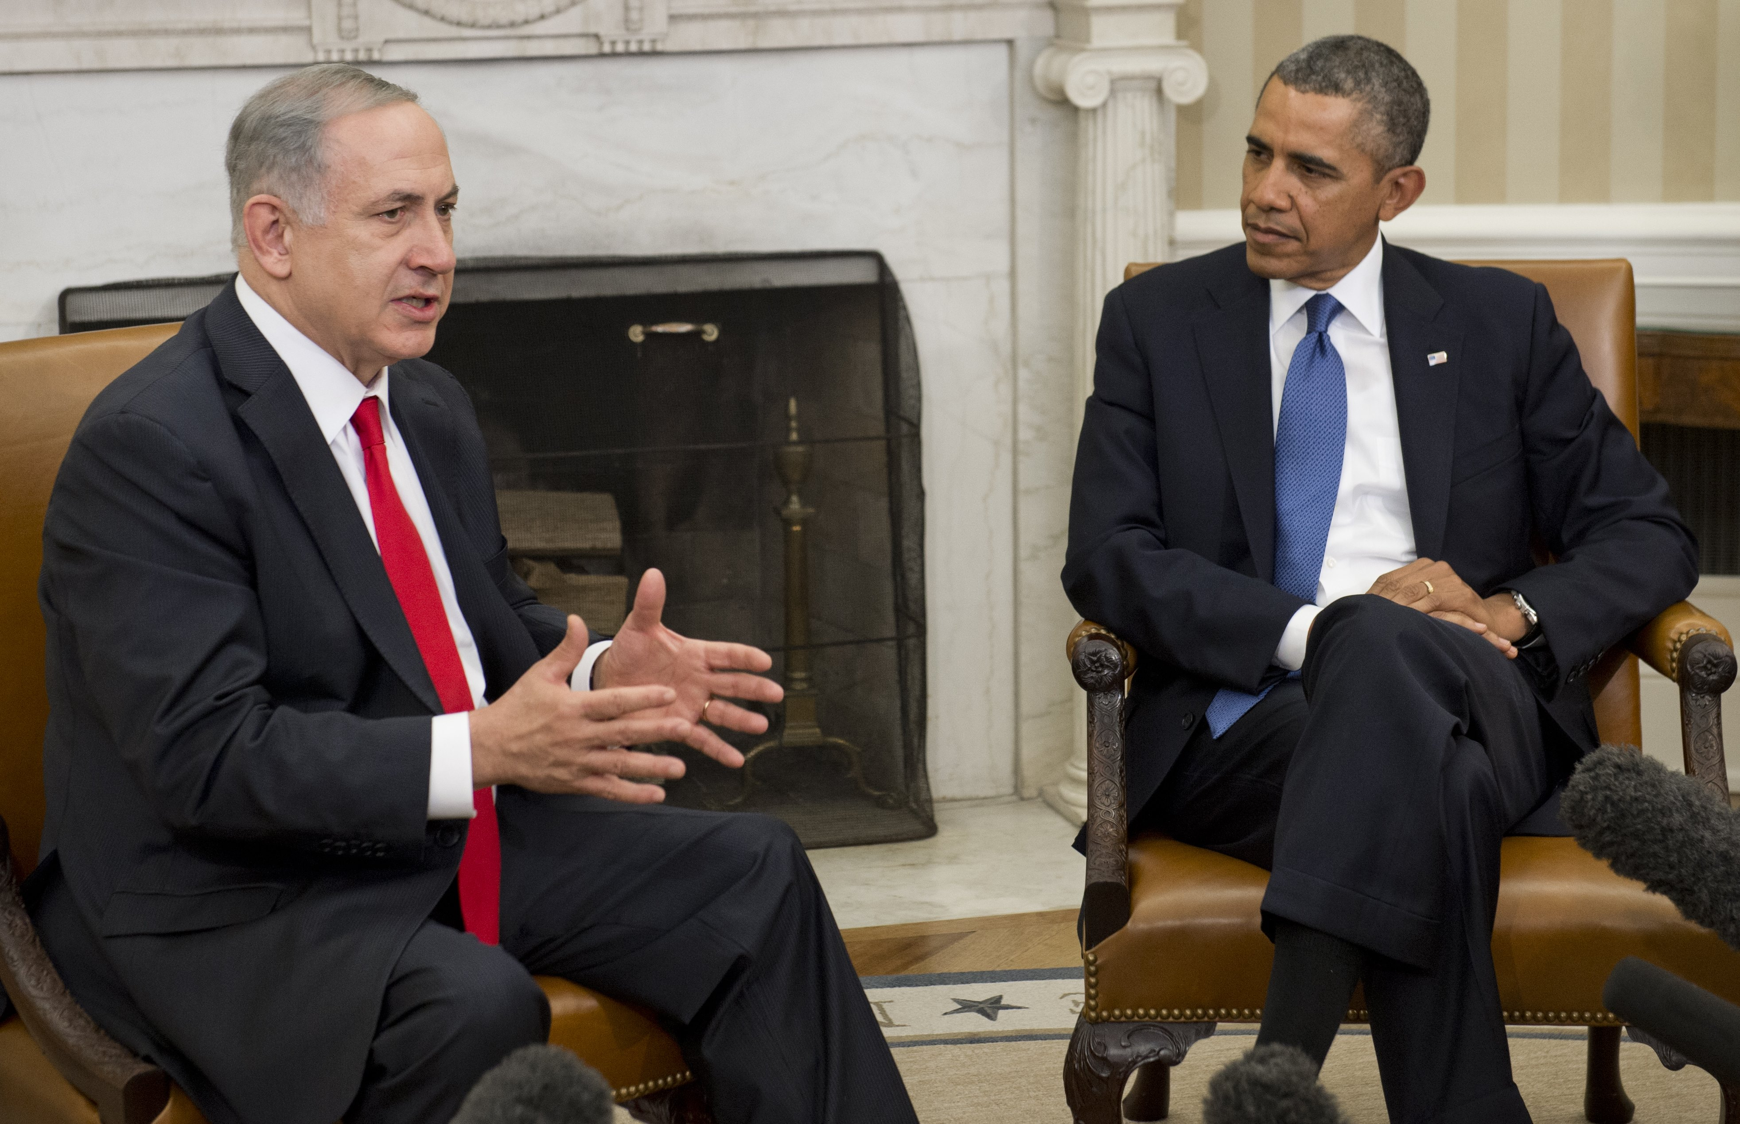
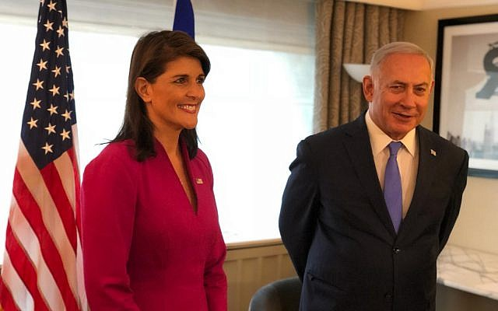
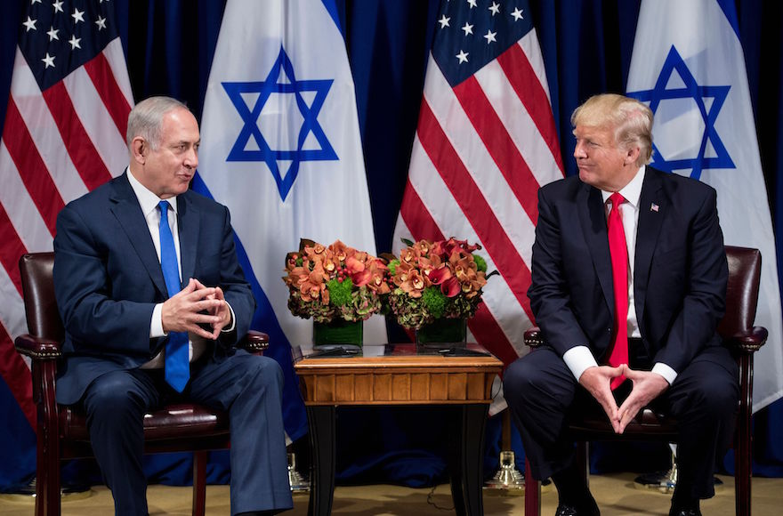


Slide 5
Bilateral Relations
The relationship between the U.S. and Israeli leaderships today is bad, perhaps as bad as this upper level of the relationship has ever been.
President Obama and Benjamin Netanyahu dislike each other as well as disagree with each other over significant strategic portfolios
  peace process issues,
  Syria,
  Gaza and Hamas, and above all
  Iran

Slide 6
History of problems?
The Eisenhower-Dulles relationship with Ben-Gurion and Moshe Sharett 1955-1957 was difficult.
The first two years of the Reagan Administration, as its senior officials encountered Menachem Begin and Yitzhak Shamir, were arguably as troubled.1
The Begin-Carter years before and Shamir-Bush 41 years were dreadful, too.

Slide 7
Internal Interference
Despite this history, interfering in each other’s domestic politics is not a good idea.
But the interference keeps happening anyway.
  bipartisan nature of support remains
What is different now is how simultaneously mutual the interference has become, and how polarized politics in both countries have encouraged it.

Slide 8
Siblings
U.S.-Israeli relationship still healthy
MOU’s
Bilateral relations

Slide 9
Long-Short Term
A “pivot” speech does not make a strategic readjustment.
Even if, as the Obama Administration contends, the United States is “overinvested” in the Middle East, the U.S. government can not just stop and start something else.
Longer-term trends point to gradual U.S. disinvestment
the level of dysfunction with the decay of state-level institutions
U.S. can hold disinterest because global energy production and consumption patterns are changing, and, changing fast.

Slide 10
Long-short Term
Perception will reinforce the foregoing reasons for the U.S. government to keep a maximally feasible distance from the region
Other major powers will gain more efficacy and interest there.
  China and India
  Russia and,
  the European Union.

Slide 11
America
The Middle East will become less important within the overall balance of U.S. interests.
  Israel will become less central too.
The United States will likely attempt to do less that is positive in the region, and it will not be able to use Israeli to help in preventing the negative.

Slide 12
America
Israel will become still less important to U.S. policy, if
  the Arab-Israeli conflict, including its Palestinian aspect, improves.
Also, if other potential existential threats to Israel are managed astutely and resolutely.
  Iran

Slide 13
Israel
Israel’s conventional security well within its own grasp, arguably still needs the United States to deal with
  unconventional threats
Growing security problems that Israel cannot readily handle without help.
In this mounting imbalance of shifting needs a tender, if not difficult, future relationship is probable

Slide 14
Conclusion
It is easy to be pessimistic, don’t.
  the idea of peace between Israel and Egypt, and Israel and Jordan, once looked equally as far-fetched.
  A settlement is possible, and indeed is likely—it is simply not possible yet to know when.

Slide 15
