Slide 1
Contemporary Antisemitism
Week 11

Slide 2
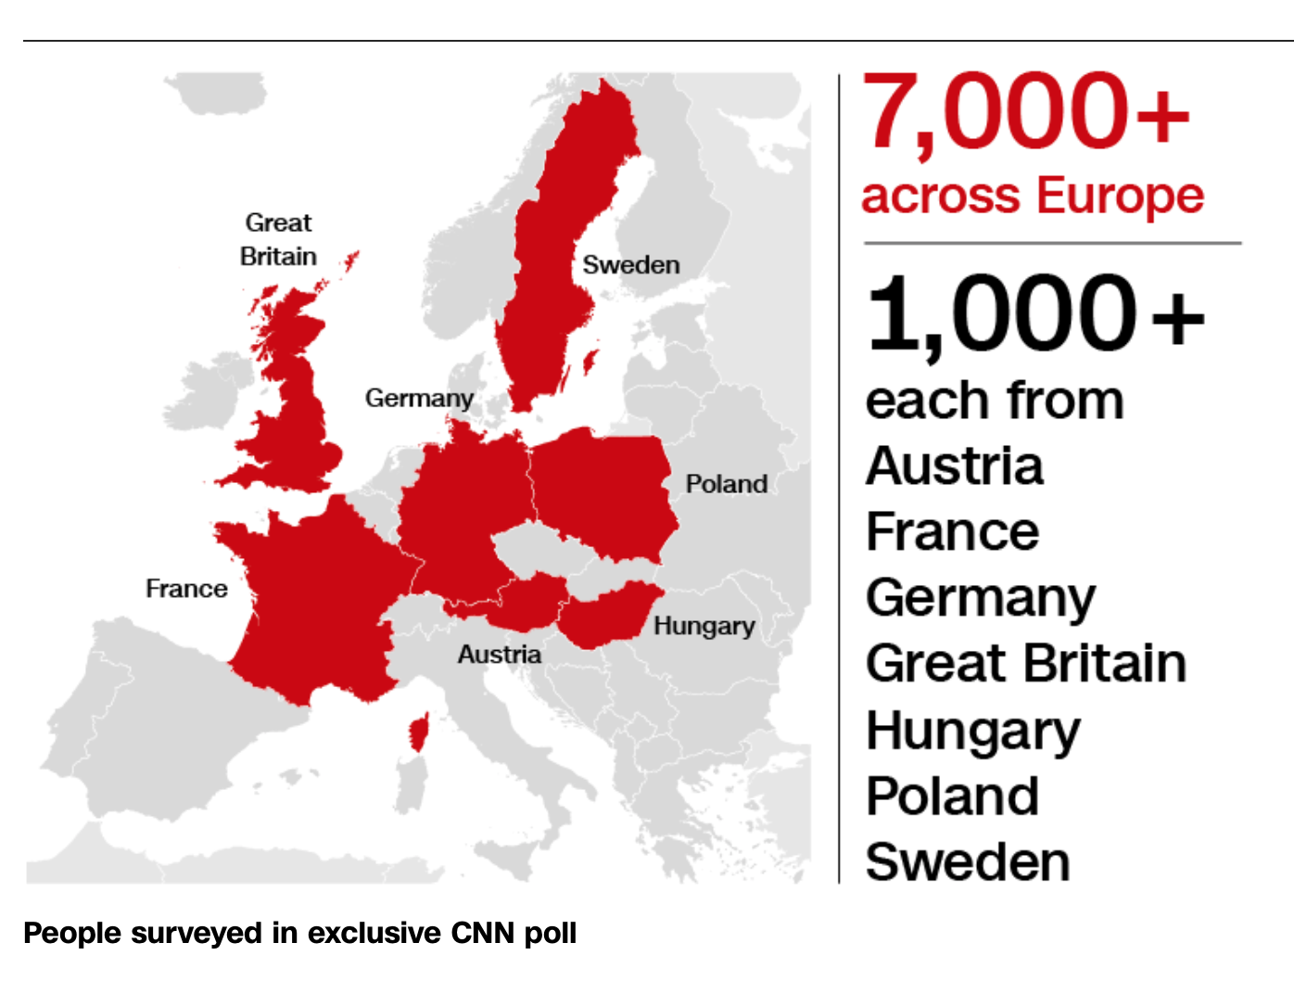
CNN poll
The CNN/ComRes poll interviewed more than 7,000 people across Europe, with more than 1,000 respondents each in Austria, France, Germany, Great Britain, Hungary, Poland and Sweden.

Slide 3
History Fades
More than a quarter of Europeans polled believe Jews have too much influence in business and finance.
Nearly one in four said Jews have too much influence in conflict and wars across the world.
1-20 in the countries surveyed never heard of the Holocaust (75 years since end of WWII) and thousands survivors alive today.
Lack of Holocaust knowledge amongst youth 1-5 (18-34) never heard of it.
In Austria -- the country where Hitler was born -- 12% of young people said they had never heard of the Holocaust!

Slide 4
Criticism
Anti-Semitism is a growing problem in EU countries -- to the extent that 40% said Jews were at risk of racist violence in their countries and half said their governments should do more to fight anti-Semitism -- substantial minorities blamed Israel or Jews themselves for anti-Semitism.
More than a quarter of respondents (28%) said most anti-Semitism in their countries was a response to the actions of the state of Israel.
And nearly one in five (18%) said anti-Semitism in their countries was a response to the everyday behavior of Jewish people.

Slide 5
New or Old “I am not antisemitic, but…”
Europeans that openly admitting negative attitudes towards Jews was relatively low, BUT traditional anti-Semitic stereotypes still resonate across the continent with clear evidence that they do.
In Poland and Hungary, about four out of 10 people said Jews have too much influence in business and finance around the world.
Roughly one out of three people there said Jews were too influential in political affairs around the world, and more than a quarter of Poles and Hungarians said they had too much influence on the media.

Slide 6
Liberal Europe?
In France, Jews have increasingly faced attacks and insults from members of the country’s large Muslim community.
In March, an 85-year-old Holocaust survivor, Mireille Knoll, was knifed to death in her apartment by a young man who shouted “Allahu akbar.” Prosecutors classified it as an anti-Semitic hate crime.
In a 2015 study, 42 percent of French Jews surveyed said that they had suffered insults or aggressive acts at the hands of Muslims.
In Germany, anti-Semitism remains a daily occurrence, sometimes taking on the form of criminal attacks on Jews or Jewish institutions, but often in more casual insults or the questioning of the country’s post-World War II commitment to “never again” repeat the Nazi Holocaust.
One of the most prominent anti-Semitic attacks this year, in which a young Syrian struck a man wearing a skullcap on the street of a trendy Berlin neighborhood, prompted the head of Germany’s main Jewish organization to warn Jews against openly wearing skullcaps, or other public displays of their religion.

Slide 7
The same ‘old’ story
A third of Austrians said Jews have too much influence in finance, a quarter of French and German respondents said so.
About one in five people in all three countries said Jews had too much influence in media, and a quarter said they had too much influence on wars and conflicts.
The belief in Jewish power runs in parallel with enormous overestimates of the number of Jews in the world.
About two-thirds of the respondents in the survey guessed too high when asked what percentage of the world is Jewish, and similar numbers got the answer wrong for their own countries.
A quarter of Hungarians estimated that the world is more than 20% Jewish, and a fifth of British and Polish respondents said so.
About 0.2% of the world’s population is Jewish, according to the Pew Research Center’s Global Religious Landscape study.
Four out of ten respondents in the survey thought their own countries were between 3% and 10% Jewish. In fact, Israel is the only country in the world where more than 2% of the population is Jewish.

Slide 8
No country safe...USA
Until recent years, many Jews in America believed that the worst of anti-Semitism was over there, in Europe, a vestige of the old country.
American Jews were welcome in universities, country clubs and corporate boards that once excluded their grandparents. They married non-Jews, moved into mixed neighborhoods and by 2000, the first Jew ran for vice president on a major party ticket.
Jews were feeling unprecedented acceptance in the United States, the climate was growing increasingly hostile, intensifying in the two years since President Trump was elected. And it comes at a time when attacks on Jews are on the rise in Europe as well, with frequent anti-Semitic episodes in France and Germany.
The hate in the United States came into full view last year as white supremacists marched in Charlottesville, Va., with lines of men carrying torches and chanting, “Jews will not replace us.”
Swastikas and other anti-Semitic graffiti have been cropping up on synagogues and Jewish homes around the country. Jews online are subjected to vicious slurs and threats.

Slide 9
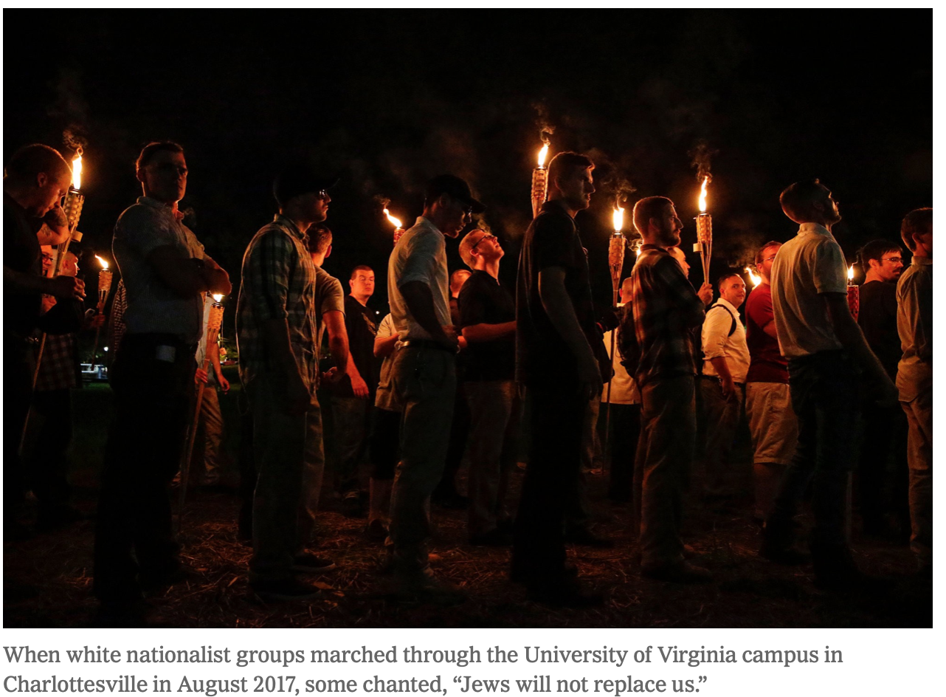
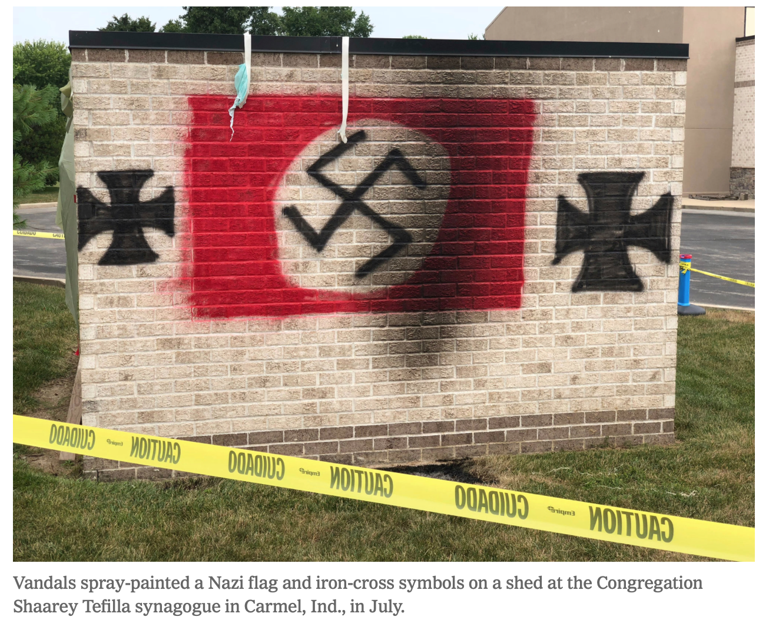

Slide 10
HATE in USA
The Anti-Defamation League logged a 57 percent rise in anti-Semitic incidents in the United States in 2017, compared to the previous year — including bomb threats, assaults, vandalism, and anti-Semitic posters and literature found on college campuses.
Conspiracy theories and “dog whistles” that resonate with anti-Semites and white supremacists are being circulated by establishment sources, including the president and members of Congress.
Bizarre claims about Jews have moved from the margins to the establishment.

Slide 11
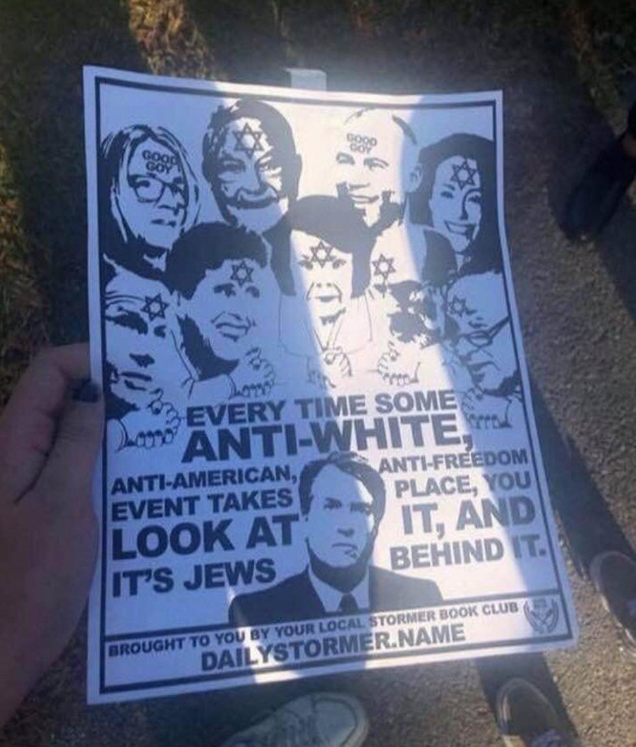
Bizarre
Margins to the Establishment

