Slide 1
Politics of Influence
Unity governments and the Reagan and Bush administrations

Slide 2
Background
Israel has had several national unity governments, in which major rival parties formed a ruling coalition.
Such a coalition was notably formed after the 1984 elections.
  Inconclusive
    domestic politics
      South Lebanon
      Bus 300 Affair

Slide 3
Inconclusive
On 23 July 1984 national vote.
Voter turnout was 78.8%.
The results saw the Alignment (old labor bloc) return to being the largest party in the Knesset,
  a status since 1977.
However, the party could not form a government with any of the smaller parties.
  Result was a national unity government with Likud,
  both party leaders, Shimon Peres and Yitzhak Shamir, holding the post of Prime Minister for two years each.

Slide 4
Both the Alignment (44) and Likud (41) won over 40 seats each, but neither side could form a stand-alone coalition.
The resulting national unity government was together with the
National Religious Party, (religious Zionist movement)
Agudat Yisreal, (‘Union of Israel’/Hasidic/Haredi)
Shas, (‘Guards of the Torah’/Haredi Sephardic and Mizrahi)
Morasha, (‘Heritage’/religious)
Shinui (‘Change’/secular and liberal economic)
Ometz, (‘Courage’/right-wing)
Together they held 97 of the 120 seats in the Knesset.

Slide 5
Is this anyway to run a nation?
Shamir. His failure to stabilize Israel's inflationary economy and to suggest a solution to the quagmire of Lebanon led to an indecisive election in 1984, after which a national unity government was formed between his Likud party and the Alignment led by Shimon Peres.
As part of the agreement, Peres held the post of Prime Minister until September 1986, when Shamir took over.
Shamir remained reluctant to change the status quo in Israel's relations with its Arab neighbors, and blocked Peres's initiative to promote a regional peace conference as agreed in 1987 with King Hussein of Jordan in the London Agreement.
Re-elected in 1988, Shamir and Peres formed a new coalition government until “the dirty trick" of 1990, when the Alignment left the government, leaving Shamir with a narrow right-wing coalition.

Slide 6
Is this anyway to run a nation?
Simon Peres finally succeeded Rabin as Labor party leader prior to the 1977 elections.
Peres led the Alignment to its first ever electoral defeat, when Likud won sufficient seats to form a coalition that excluded the left.
After only a month on top, Peres assumed the role of opposition leader.
After turning back a comeback bid by Rabin in 1980 Peres led his party to another, narrower, loss in the 1981 elections. In the 1984 elections, the Alignment won more seats than any other party
  However, they failed to achieve the majority of 61 mandates needed to form a left-wing coalition.
Alignment and Likud agreed to a rather unusual "rotation" arrangement.
  Unity government, that had Peres as Prime Minister and Likud leader Yitzhak Shamir would be Foreign Minister. This rotated after two years.
    ‘Peace with Palestinians and with Jordan affected by this arrangement’.
    George Schultz memoir “Turmoil and Triumph”

Slide 7
More unique to this agreement was the creation of a ten-seat inner cabinet divided equally between Labor and Likud.
Ensured that each party could block, if necessary, the initiative of the other.
In September 1984, the new government assumed office with 97 MKs.
The government addressed important issues as
  withdrawing Israeli troops from most of southern Lebanon to a narrow "security zone" along the border and
  an economic crisis that included 500 percent annual inflation.

Slide 8
The November 1988 elections resulted once again in a political deadlock.
  Labor won 39 seats -- down 5 from the previous Knesset.
  Likud won 40-seats and held just one fewer seat than in the previous Knesset.
Labor and Likud blocs both made abortive attempts to construct coalitions with the religious parties (Shas, NRP, Degel Hatorah, and Tehiya) who collectively held 18 seats, almost enough to give either bloc the required majority.
Ultimately, Labor and Likud chose to adopt another power-sharing arrangement, but unlike in 1984, the poll results enabled Shamir to become prime minister with Peres as foreign minister without rotation.

Slide 9
Is this anyway to run a nation?
In May 1989, the Shamir government presented plans to proceed with negotiations concerning Palestinian autonomy, and the fabric of the coalition began to unravel.
Labor Party leader Peres -- upset that Shamir would not comply with U.S. secretary of state James Baker's more ambitious peace initiative -- toppled the government with the support of religious parties disgruntled by domestic and finance issues.
On March 15, 1990, they together executed the first --and to date, only successful -- no-confidence motion against a national unity government, a maneuver later named by Peres rival Yitzhak Rabin "the stinking trick.” (dirty trick)
Israeli President Chaim Herzog nominated Peres to succeed Shamir, but Peres failed to form a narrow Labor-religious coalition.
Instead, Shamir received the approval from Herzog and swiftly assembled his own government comprising Likud, Party for Advancing the Zionist Idea, and the religious parties (NRP, Shas, Agudat Yisrael, and Degel Hatorah).
On June 11, 1990, a narrow majority of 62 Knesset members approved of the new Shamir government, which lasted two years until the required elections in 1992.

Slide 10
Crisis At The Top
Finances
  1985 stabilization plan
    Peres from 1988 Finance Minister
Internal conflicts
  fractured Left parties
  hard-line image of Likud and Shamir
Intifada (uprising)
  December 1987 lasting till 1991
External Issues
  Lebanon
  Iraq

Slide 11
Prospect Theory
Describes the way people choose between probabilistic alternatives involving risk.
  Especially where the probabilities of outcomes are known (elections).
The theory states that people make decisions based on the potential value of losses and gains rather than the final outcome.
Also that evaluation of these losses and gains occur using heuristics.
  Heuristics are how people often use judgments and make decisions. Otherwise understood as mental shortcuts usually focusing on one aspect of a complex problem and ignoring others.
The model is descriptive trying to model real-life choices, rather than optimal decisions, as normative models do.
    Kahneman, Daniel; Tversky, Amos (1979). "Prospect Theory: An Analysis of Decision under Risk" (PDF). Econometrica 47 (2): 263

Slide 12
Rational Choice
Choice alternatives allow leaders to state which option they prefer.
These preferences are assumed to be complete (which alternatives they consider preferable) and transitive (if option A is preferred over option B and option B is preferred over option C, then A is preferred over C).
A rational agent takes into account available information, probabilities of events, potential costs and benefits in determining preferences, and chose the self-determined best choice.
For rational choice theorists, history and culture are irrelevant.
To understand political behavior, sufficient to know the actors’ interests and to assume that they pursue them rationally.

Slide 13
Making A Deal
Probability of staying/returning to power
Heuristics = power (seats) in government
Choice of arch-political enemy or other options

Slide 14
Relations with US
Remarks of President Reagan and Prime Minister Shimon Peres of Israel, Following Their Meetings, October 9, 1984
“I want to pay special tribute to the leadership qualities of Prime Minister Peres and Foreign Minister Shamir. Both have shown courage and determination to put aside partisan politics and join together in a government of national unity in order to deal with Israel’s most pressing problems. This demonstration of unity reminds us of democracy's great strength and the hope it offers for all the people of the world.”
    Jewish Virtual Library: jewishvirtuallibrary.org

Slide 15
Relations with US
Remarks Following Discussions With Prime Minister Shimon Peres of Israel September 15, 1986
“We have just witnessed an auspicious event: the meeting between Prime Minister Peres and President Mubarak of Egypt following successful negotiations on a formula for resolving the Taba dispute. Egypt and Israel have once again demonstrated that Arab-Israeli differences can best be resolved through direct negotiations. We're also heartened by the continued efforts of King Hussein of Jordan as well as the historic meeting between King Hassan of Morocco and Prime Minister Peres. There is reason for optimism and hope. Prime Minister Peres and I have agreed that a steady, determined effort is needed by all if the remaining obstacles to direct negotiations are to be surmounted. So, our two governments today reiterate our pledge to keep pushing toward a lasting peace.”
    Ronald Reagan Presidential Library. reaganlibrary.archives.gov

Slide 16
Relations with U.S.
Remarks Following Discussions With Prime Minister Yitzhak Shamir of Israel, March 16, 1988
“The President. It's been a pleasure to meet with Prime Minister Shamir again and to have this opportunity to review with him the important issue of peace in the Middle East. We have a unique relationship with Israel, a relationship of trust, friendship, and shared ideals. I think we can be proud of the achievements that we've made over the last 7 years in giving more substance and dimension to the strong ties between Israel and the United States. In the remainder of my term, we'll continue to work to strengthen those ties.”
    The American Presidency Project. presidency.usb.edu

Slide 17
Relations with U.S.
News Conference With Israeli PM Yitzhak Shamir April 6, 1989
“Prime Minister Shamir and I have had a very productive meeting. My message to him and, through him, to the Government and the people of Israel was clear: We are friends, strategic partners, and allies. And the mutual interests that bind together the people of the United States and Israel are broad and deep. The Prime Minister and I dedicated ourselves to maintaining and, where possible, improving the relationship between our two countries. Both of us are committed to this goal.”
    Jewish Virtual Library

Slide 18
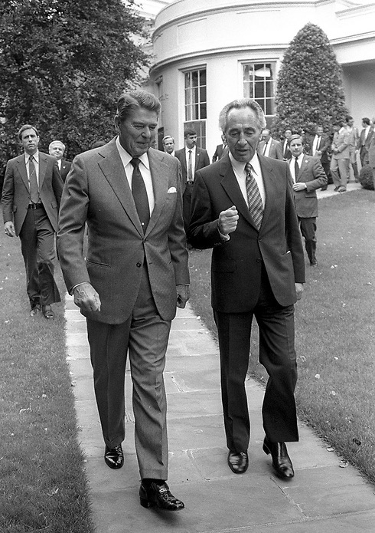
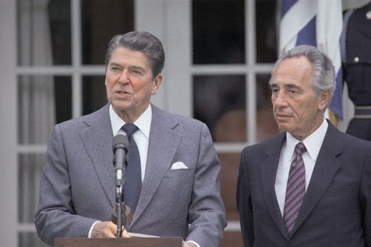
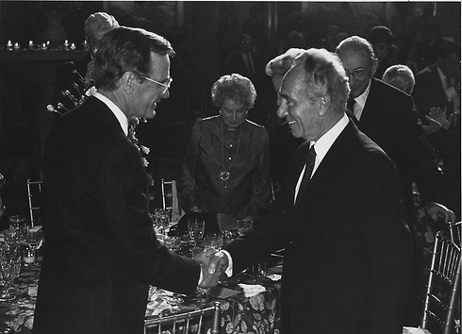

Slide 19
