Slide 1
Oslo
Dream and Death

Slide 2
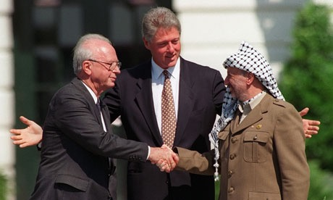
High Hopes
Holy Grail

Slide 3
Prelude
Madrid
  From 30 October to 1 November 1991 hosted by Spain and co-sponsored by the United States and the Soviet Union.
  It was an attempt to revive the Israeli-Palestinian peace process through negotiations, as well as Arab countries, including Jordan, Lebanon and Syria.

Slide 4
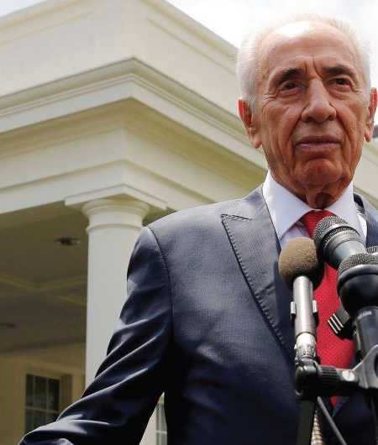
Decisions-Misjudgments
Rabin knew of Pere’s efforts.
Labor-led government faced scandal.
Concluded negotiations perhaps sooner than planned.
U.S. did not believe process because did not believe Peres.
  Rabin ONLY conduct F.P. of Israel
PLO’s repeated promise to subdue and control Hamas and Islamic Jihad = terrorism.

Slide 5
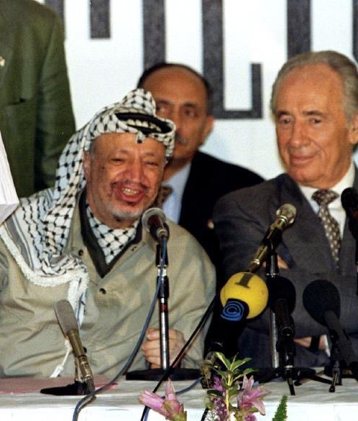
Decisions-Neoclassical
PLO, Israeli recognition paramount for Arafat = domestic support amongst Arabs
Rabin outmaneuver Peres
Fit the agreed “Gaza First” (interim) policy of Israeli negotiation
  Self-interest

Slide 6
Crisis Sought Solution
PLO, largely ignored by Arab states seeking ‘legitmacy’ especially Arafat who is fighting internal (Abbas) and (Hamas) attacks on leadership.
Rabin facing scandal (soon after election victory of 1992), fighting Labor rival Peres for influence.
Israeli public “tired” of status quo and hopeful since Madrid.

Slide 7
Mediation
U.S. late actor (September 1993/January 1)
  Madrid 1991
Norway change agent
  neutral and private
Pursuit of “holy grail”
  Clinton = Don Quixote

Slide 8
Hope
In late August 1992, Israeli Foreign Minister Shimon Peres briefed American Secretary of State Warren Christopher about a ‘breakthrough’ in Oslo.
Israel and the Palestinian Liberation Organization (PLO), through Norwegian mediation, were on the brink of signing an agreement ‘on principles’.
Since early 1992, the new Labour government in Israel looked for alternatives after Madrid stagnated. It found a willing partner in the once again diplomatically marginalized PLO leadership in Tunis.
In accompanying letters, the PLO recognized ‘the right of the State of Israel to exist in peace and security’, while Israel recognized the PLO as ‘the representative of the Palestinian people’. The Declaration of Principles was followed by a series of agreements, referred to as the Oslo Accords.

Slide 9
Historic Moment
On September 13, 1993, on the White House lawn, the two former enemies, flanked by President Bill Clinton, signed a historic "declaration of principles" (DOP) pledging to pursue a peaceful resolution to the nearly century-old conflict between their two peoples.
  “All Too Human” by George Stephanopoulos
  “Making Peace with the PLO: The Rabin Government’s Road to the Oslo Accord” by David Makovsky”

Slide 10
The Accords
The Paris Protocol of 29 April 1994 (detailed economic arrangements)
The Gaza-Jericho Agreement of 4 May 1994 (establishment of an interim Palestinian government: the Palestinian National Authority, PNA)
The Interim Agreement of 28 September 1995 (including a timetable for a phased Israeli withdrawal, creation of three types of administrative zones, A, B, and C, with exclusive or shared Israeli/Palestinian military and administrative powers, elections for a Palestinian Legislative Council, the Parliament of the PNA, and for a PNA President)
  Source: http://www.mfa.gov.il/mfa/foreignpolicy/peace/guide/pages/the%20israeli-palestinian%20interim%20agreement.aspx

Slide 11
Public Opinon
Israel has a multitude of opinions and views of the peace process that vary across time as well as across society.
  Right-wing opinions (both secular and religious) which believe Israel should not concede to Palestinian demands and instead should maintain the original Zionist vision of Israel.^{[10]}
  Then there are those that hold left-wing viewpoints that believe Palestinians should have a sovereign state and Israel needs to go further in compromising to create peace;
  and there is a spread of people in between with varied views
  “Scars of War, Wounds of Peace: The Israeli-Arab Tragedy” by Shlomo Ben-Ami

Slide 12
The issue of settlements throws up the particular and fairly extreme view of the religious-right in Israel at the time that believed negotiating over territory and the possibility of Palestinian self-rule in the religiously symbolic territories undermined what it meant to be Israeli.
Settlers also viewed the peace process at this point as a threat due to the possibility that their homes and livelihoods would be at risk.
Citizens outside the nationalist right the period around the Oslo Accords represented a time when negotiation over territory became acceptable on the understanding that the alternative was the probability that Israel would have to lose either its liberal democracy or Zionist identity.

Slide 13
When the agreement was first publicized in September, 1993, it won increasing support for eight months, until April, 1994.
With the publication of the accords, support reached 53%, with 45% opposed.
  That support rose to 61% (31 % opposed) after the actual signing of the agreement.
  Two months later (19-11-93), with an increase in terrorist activities, support was down to 48% and it fell even lower, on 25-6-94, to 35% in support, 63% against, after Yasser Arafat's "Jihad" speech in Johannesburg and the killing of two Israeli soldiers in Gaza.
  Source: Palestine-Israel Journal ‘Israeli Public Opinion Polls on the Peace Process’

Slide 14
Criticism
Edward Said: “Palestinian capitulation”
  http://www.lrb.co.uk/v15/n20/edward-said/the-morning-after
Avi Shlaim: “redrawn the geopolitical map”
  http://www.lrb.co.uk/v15/n20/avi-shlaim/arafats-camel
“Is the Peace Process a Process for Peace? A Retrospective Analysis of Oslo” By Elaine Hagopian, Elaine Arab Studies Quarterly (ASQ), Vol. 19, No. 3, Summer 1997

Slide 15
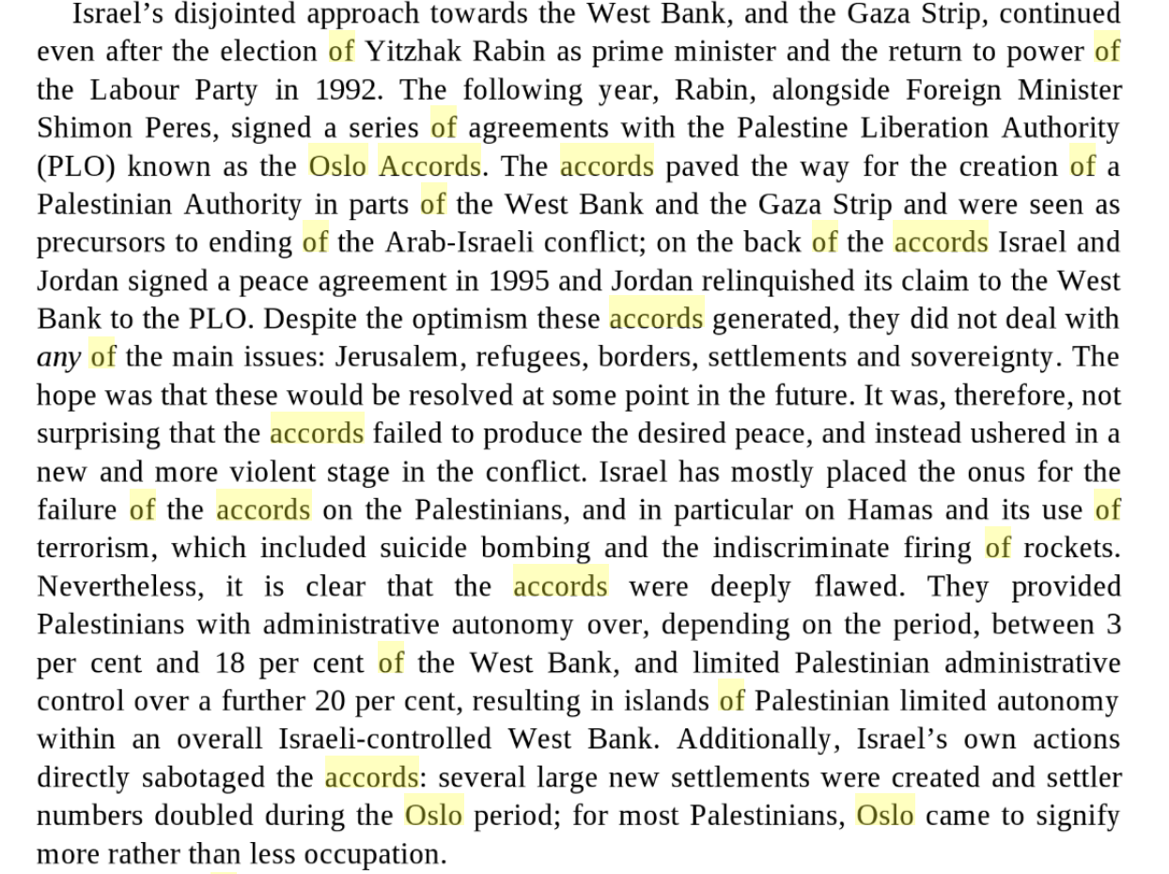

Slide 16
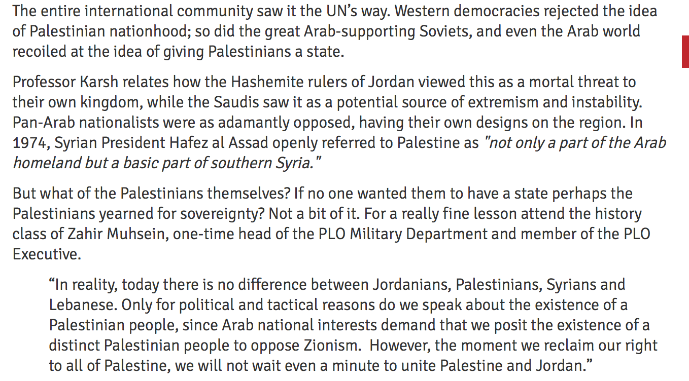

Slide 17
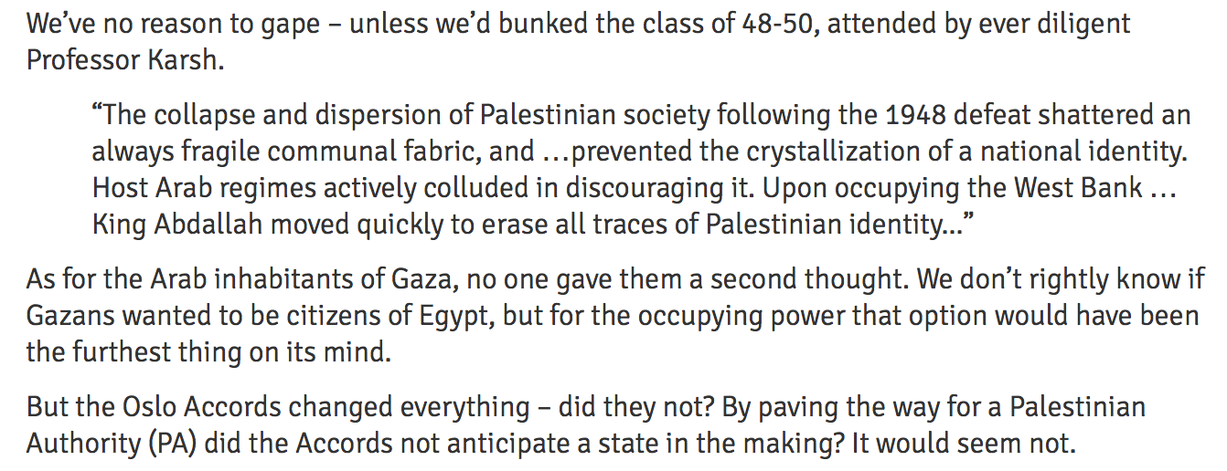

Slide 18
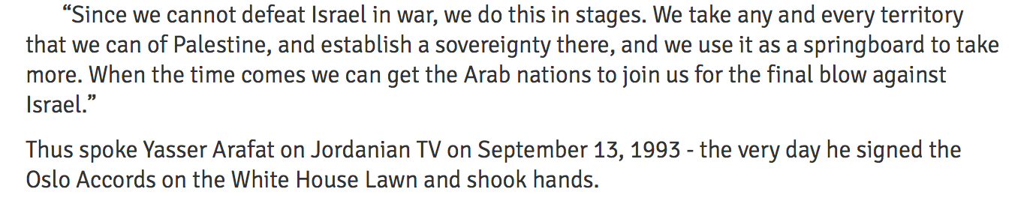

Slide 19
Conclusions
The Oslo Accords, along with the many successive initiatives derived from it, has defined virtually all aspects of Israeli-Palestinian relations ever since.
Oslo also came to define America's approach to the conflict. Yet, its remarkable longevity stands as a testament not to Oslo's utility, but to its failure.

Slide 20
Palestinian territory was further fragmented by the elaborate network of Israeli checkpoints and internal closures that proliferated throughout the West Bank in the wake of the Palestinian uprising that began in 2000.
The 2001 intifada, marked a new phase in the Oslo process.
The violence associated with the intifada — including numerous suicide bombings that both hardened Israelis and isolated the Palestinian leadership diplomatically — along with Israel's violent response to it, helped to accelerate the PA's demise.
In addition to the heavy human toll on both sides, the second intifada witnessed the physical destruction and dismantling of the PA's infrastructure and governing institutions.

