Slide 1
Social cognition in schizophrenia
Contemporary topics in cognitive neuroscience
FSS
Martin Jáni
martinjani@mail.muni.cz

Slide 2
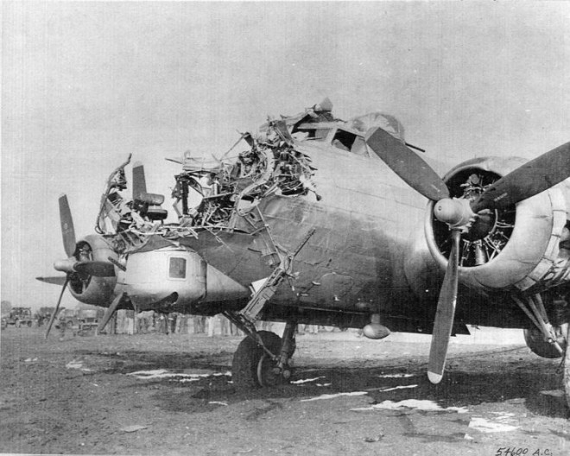
About me

Slide 3
Outline
Schizophrenia
Social cognition
Networks
Self

Slide 4


Slide 5



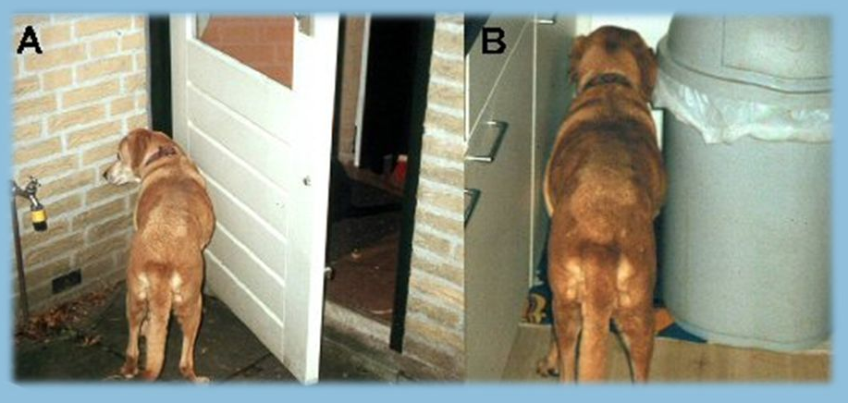

Slide 6
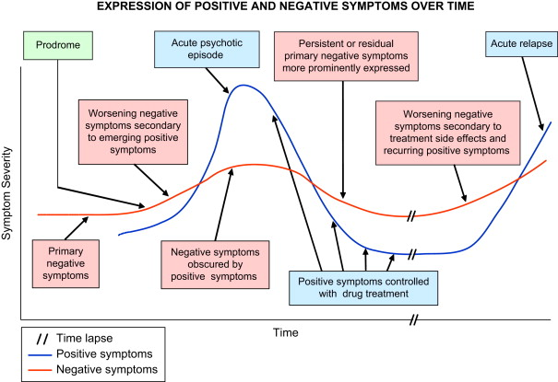
Schizophrenia =/= psychosis

Slide 7
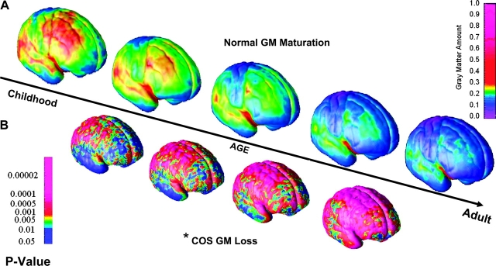
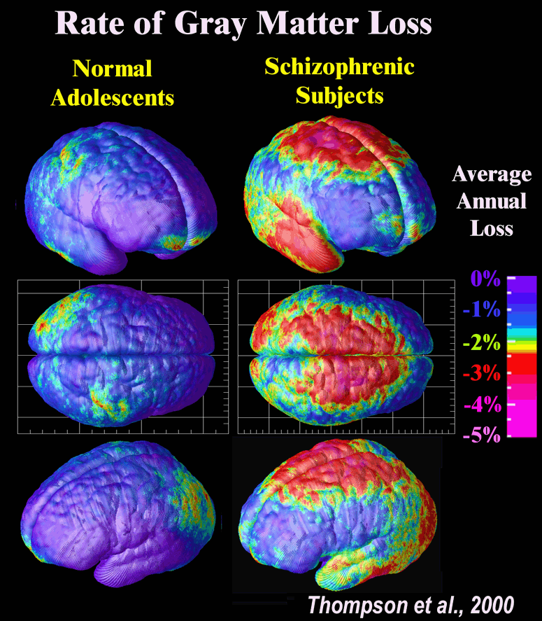
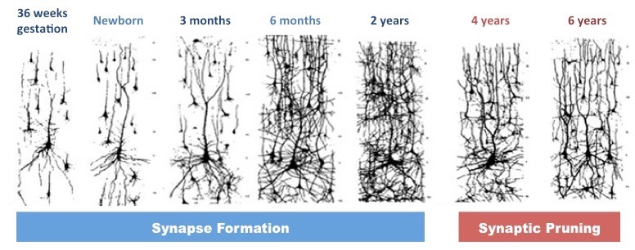

Slide 8
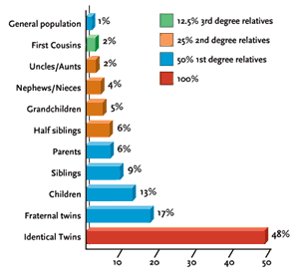
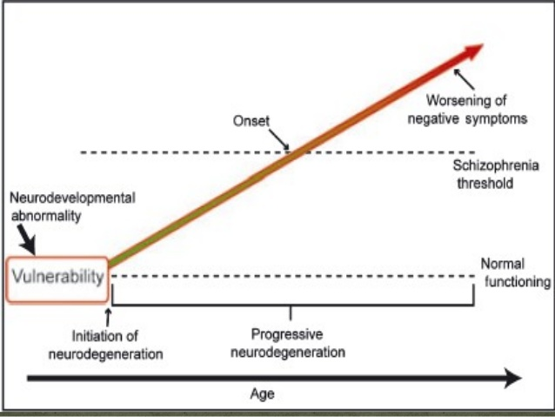
Gottesman 2001

Slide 9
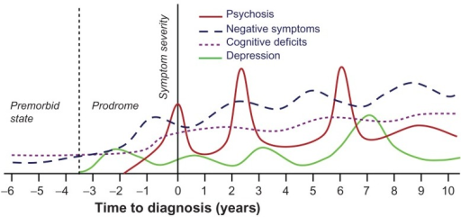
Cognition as endophenotype

Slide 10


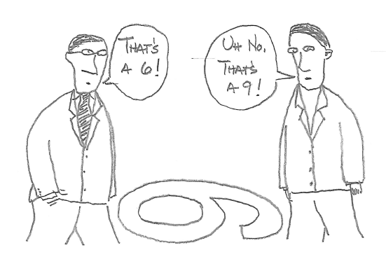
Functional outcome
General cognition
Social cognition

Slide 11

Social cognition / isolation

Slide 12

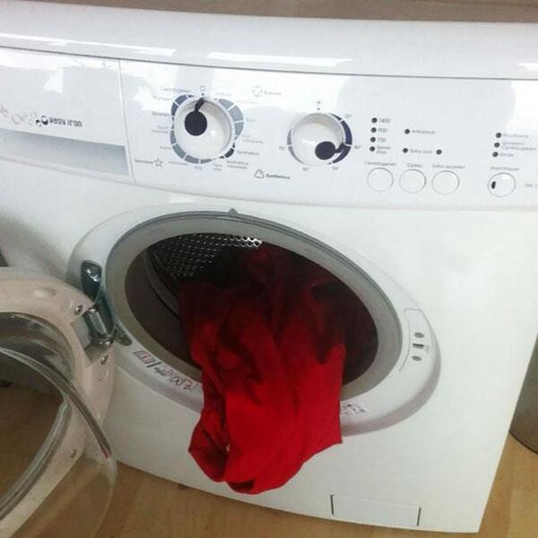


Slide 15
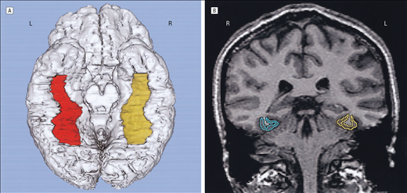
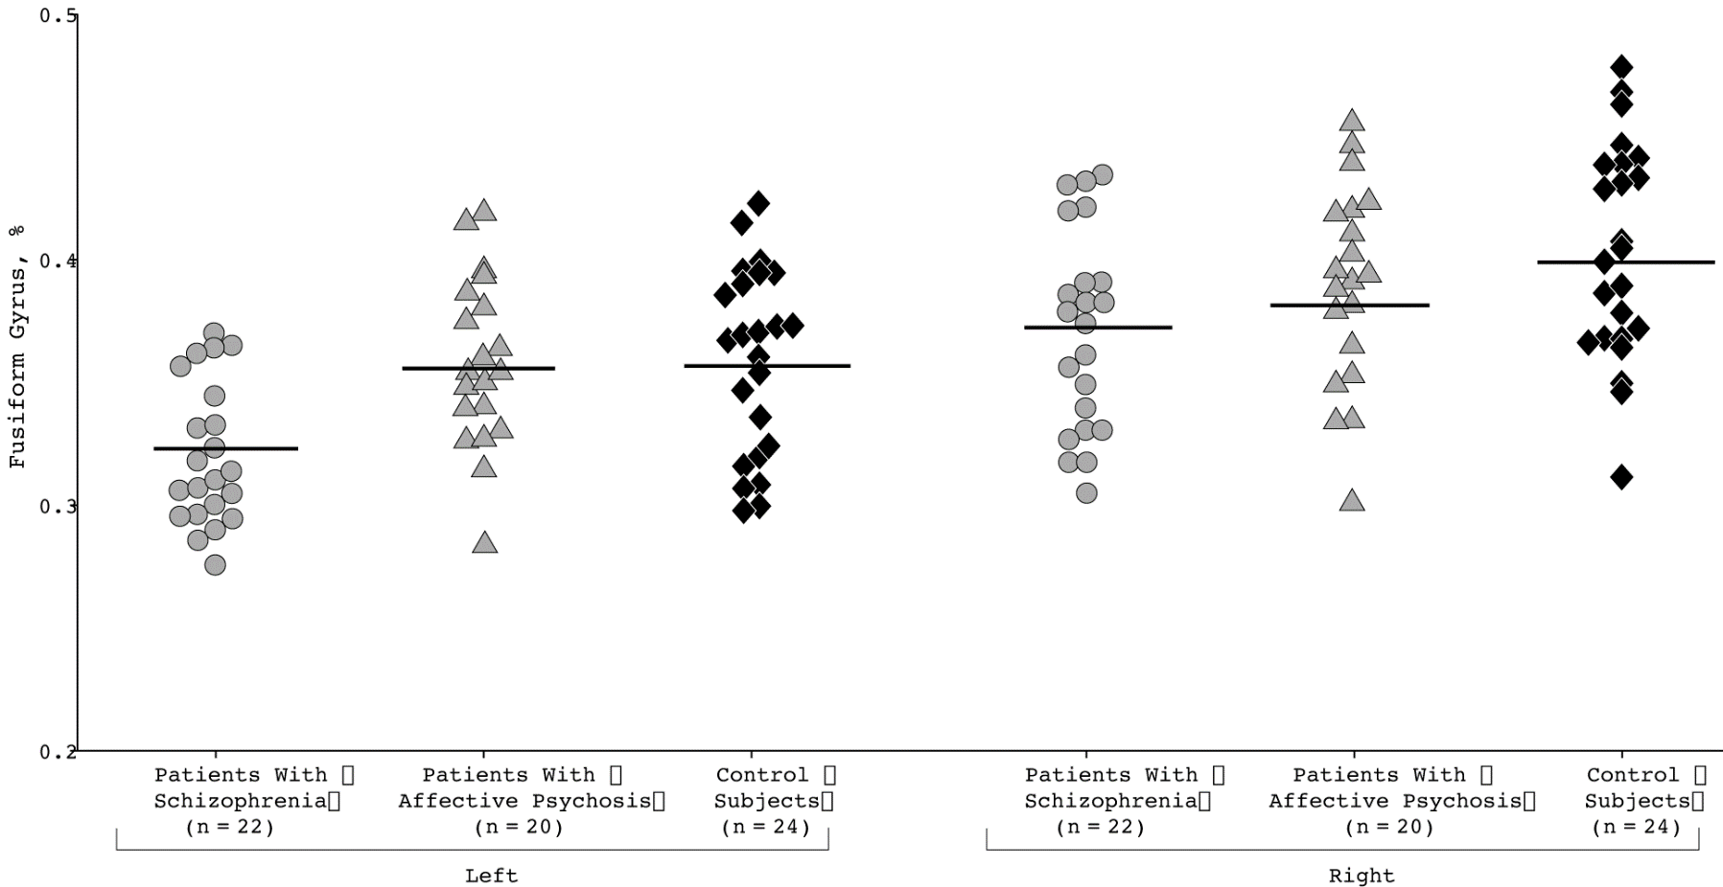
Fusiform gyrus
GM volume reduction
Face identification
Lee et al. 2002

Slide 16
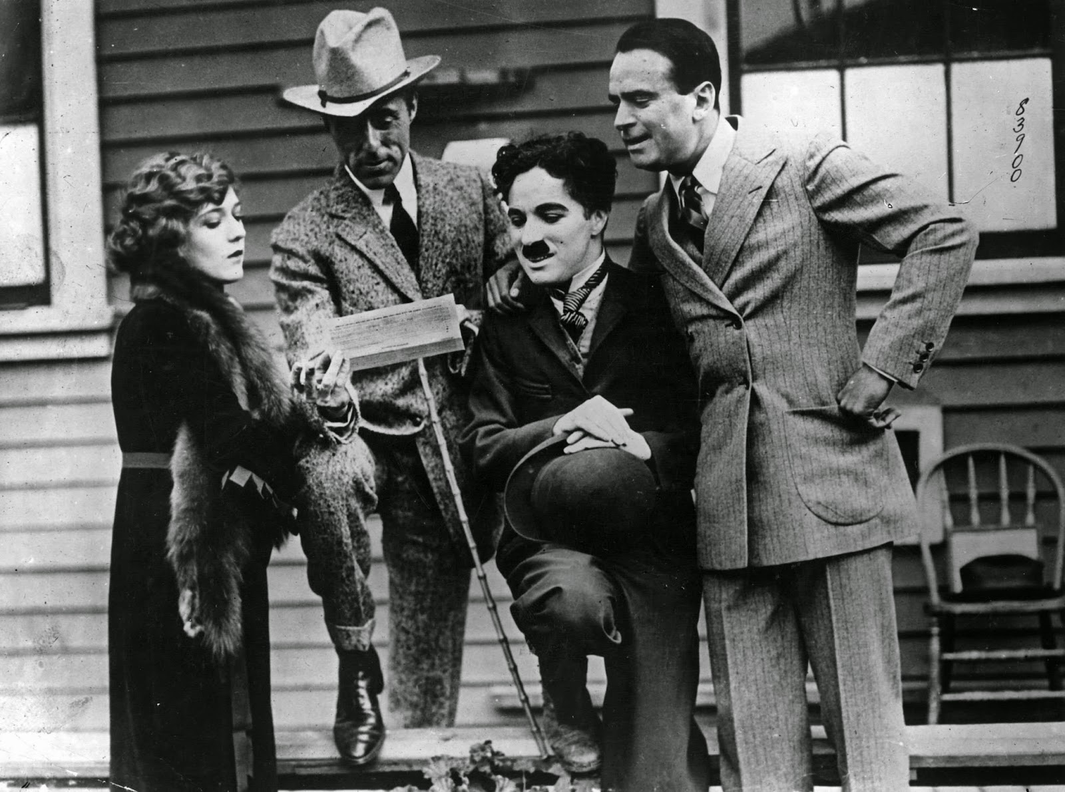
Face detection
Age/sex identification
Identity discrimination

Slide 17
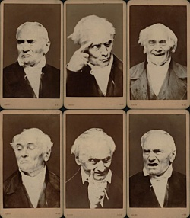
Facial emotion recognition

Slide 18
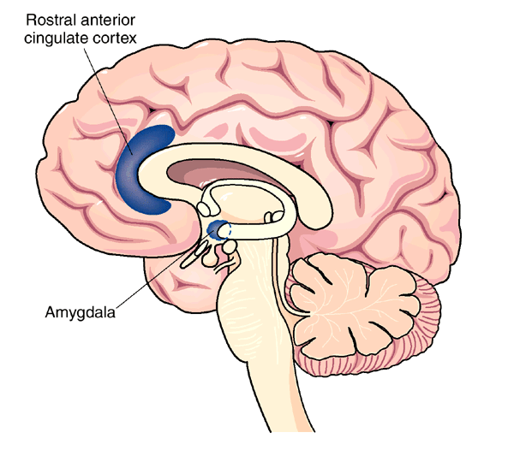
positive / negative emotion
specific emotions
neutral faces
misattribution
role of context

Slide 19
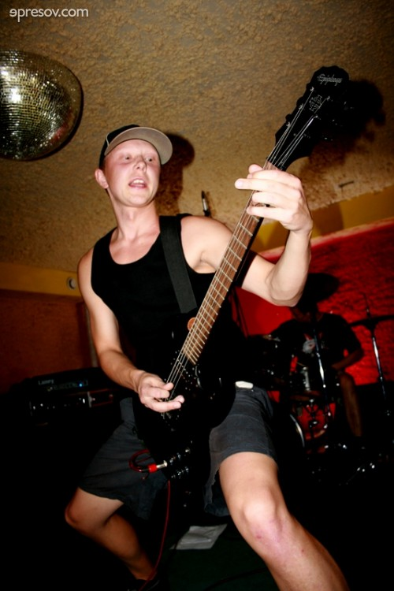
How does the person feel?

Slide 21
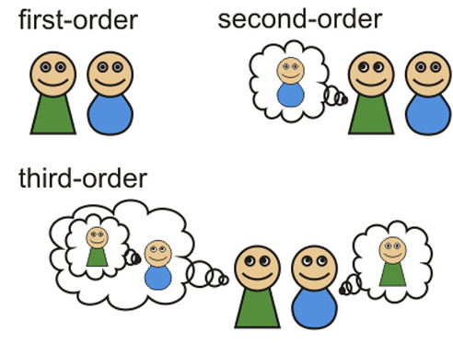
Theory of mind
https://www.youtube.com/watch?v=LUN2YN0bOi8

Slide 22
Animated shapes
https://vimeo.com/51243376
https://www.youtube.com/watch?v=f8TFi6qvPbc

Slide 23
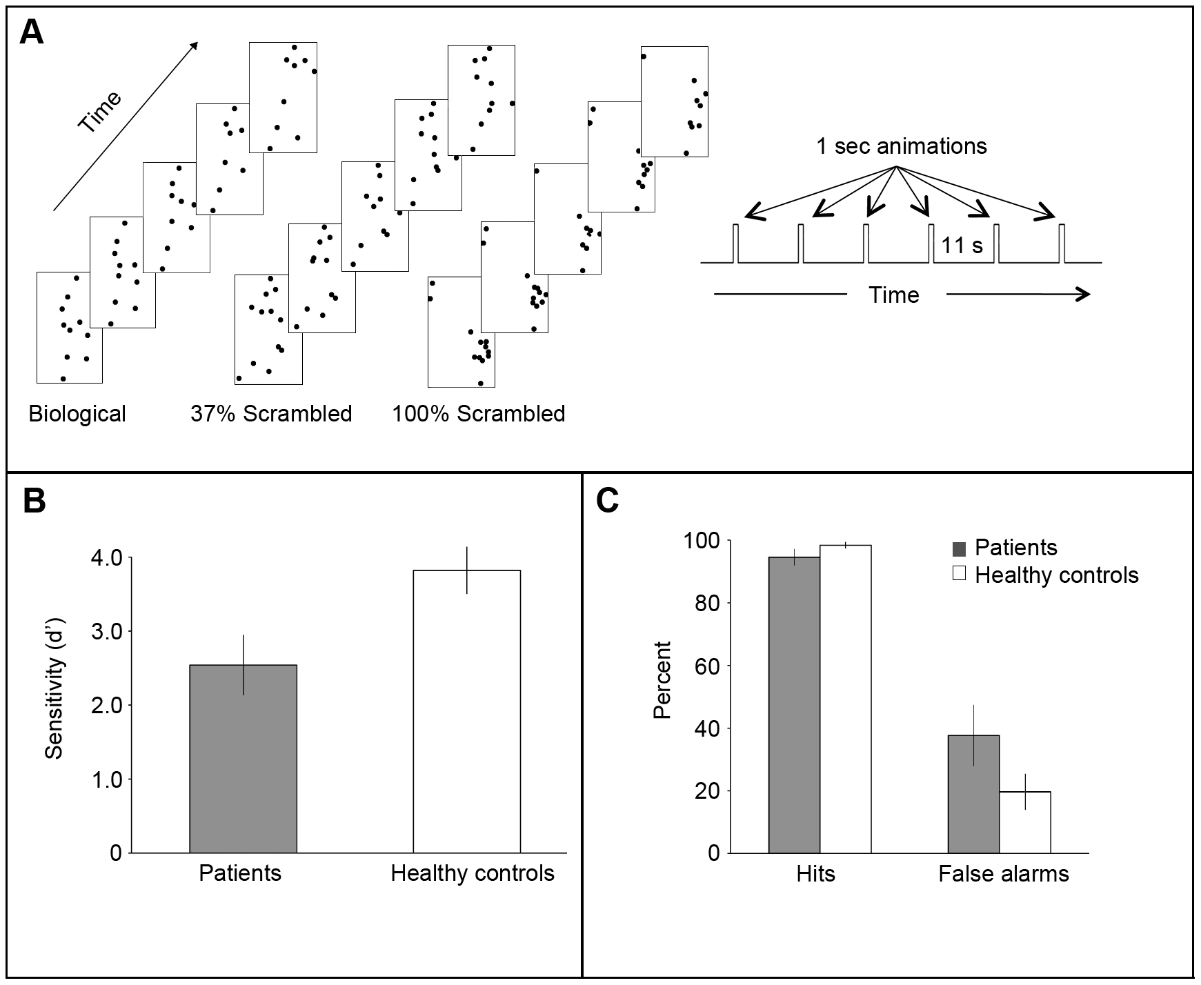
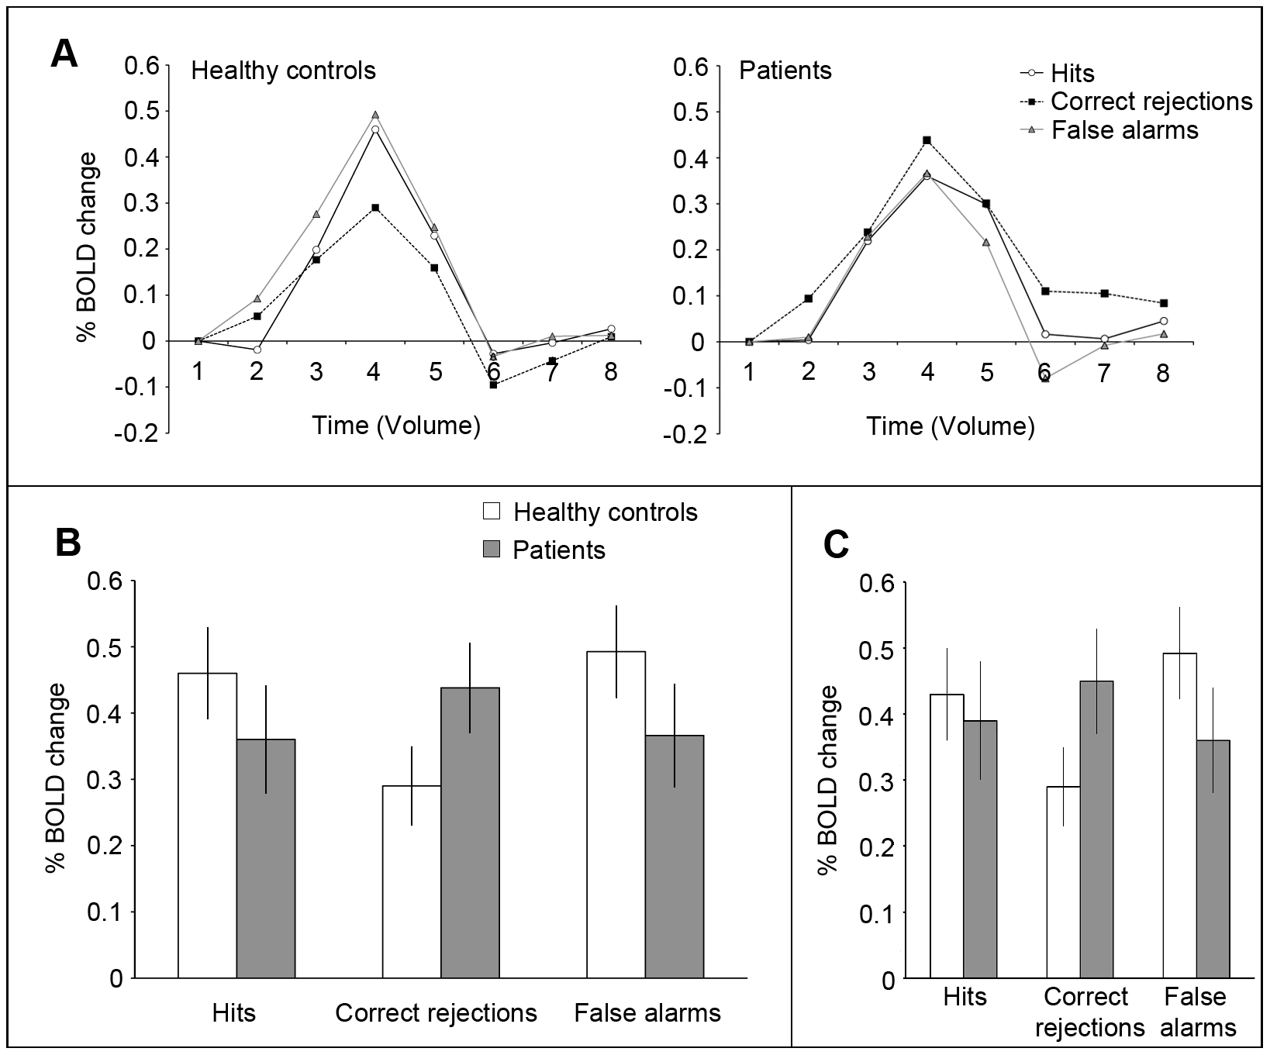
Kim et al. 2011

Slide 24
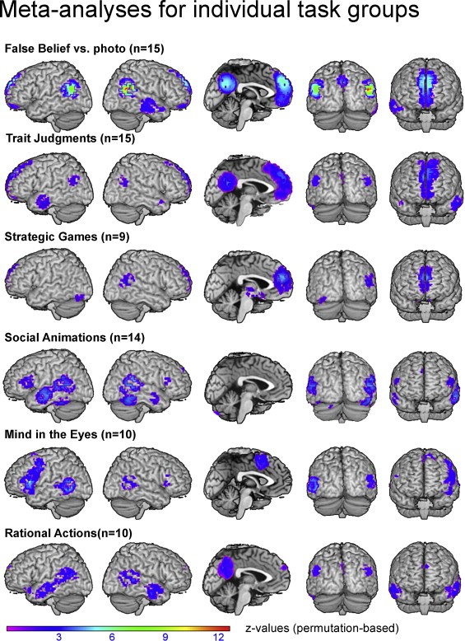
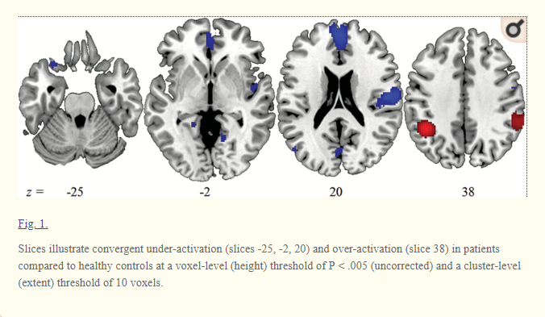
Schizophrenia vs healthy group
Kronbichler et al. 2017
Schurz et al. 2013

Slide 25
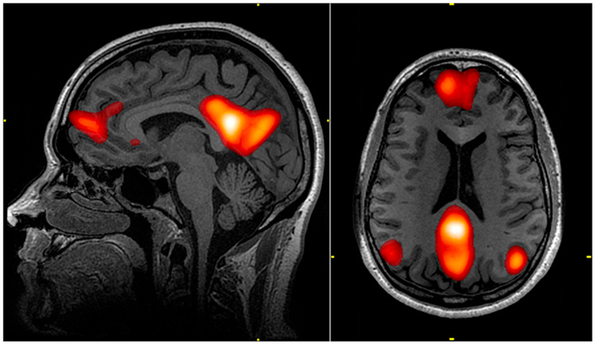
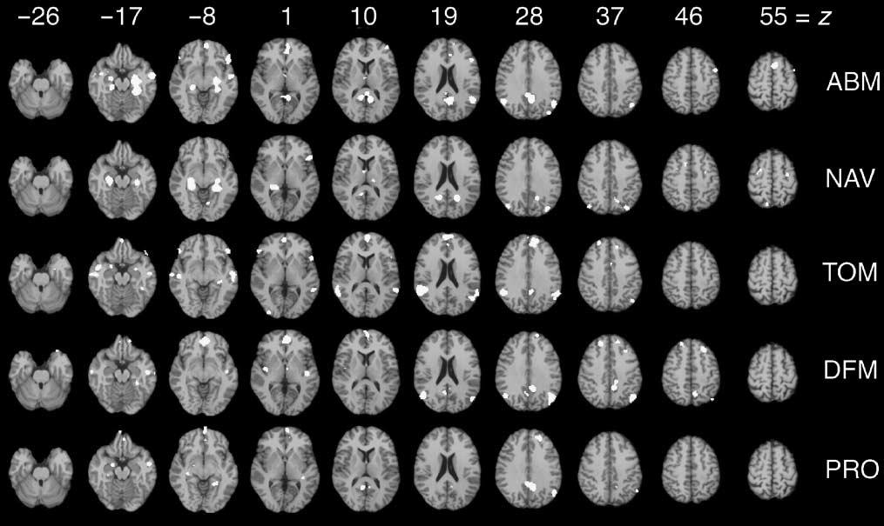
Default mode / task negative network
(Raichle et al. 2001)
Autobiographical memory
Navigation
Theory of Mind
Default mode
Prospective thinking
Spreng et al. 2008

Slide 26
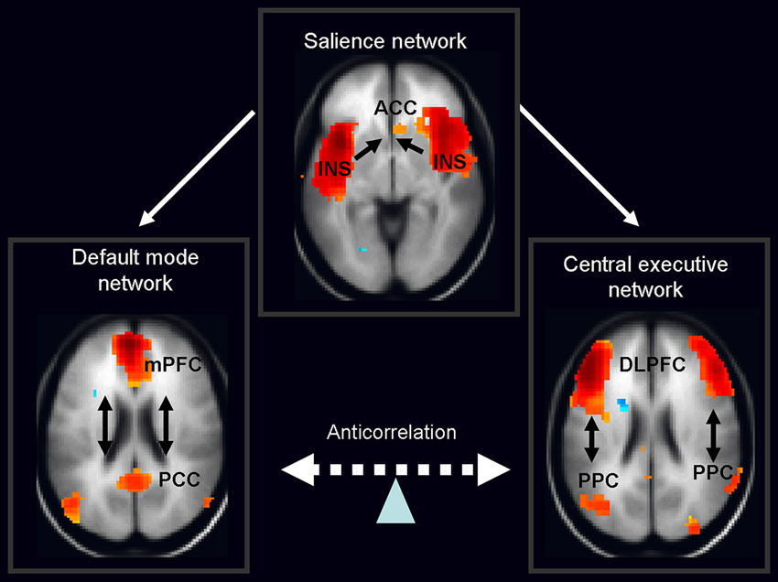
Self
Minimal self / ipseity
Autobiographical self
Internal vs external stimuli
Nekovarova et al. 2014

Slide 27

Self monitoring
Sense of agency
Anomalous self experience

Slide 28
thank you for your attention

Slide 29
Literature
Gottesman II, Erlenmeyer-Kimling L. Family and twin strategies as a head start in defining prodromes and endophenotypes for hypothetical early-interventions in schizophrenia. Schizophr Res [Internet]. 2001 Aug 1;51(1):93–102. Available from: http://www.ncbi.nlm.nih.gov/pubmed/11479071
Jáni M, Kašpárek T. Emotion recognition and theory of mind in schizophrenia: A meta-analysis of neuroimaging studies. World J Biol Psychiatry [Internet]. 2017 May 30;1–11. Available from: https://www.tandfonline.com/doi/full/10.1080/15622975.2017.1324176
Kim J, Park S, Blake R. Perception of Biological Motion in Schizophrenia and Healthy Individuals: A Behavioral and fMRI Study. Op de Beeck HP, editor. PLoS One [Internet]. 2011 May 20;6(5):e19971. Available from: http://dx.plos.org/10.1371/journal.pone.0019971
Lee CU, Shenton ME, Salisbury DF, Kasai K, Onitsuka T, Dickey CC, et al. Fusiform gyrus volume reduction in first-episode schizophrenia: a magnetic resonance imaging study. Arch Gen Psychiatry [Internet]. 2002 Sep;59(9):775–81. Available from: http://www.ncbi.nlm.nih.gov/pubmed/12215076
Nekovarova T, Fajnerova I, Horacek J, Spaniel F. Bridging disparate symptoms of schizophrenia: a triple network dysfunction theory. Front Behav Neurosci [Internet]. 2014 May 30;8:171. Available from: http://journal.frontiersin.org/article/10.3389/fnbeh.2014.00171/abstract
Raichle ME, MacLeod AM, Snyder AZ, Powers WJ, Gusnard DA, Shulman GL. A default mode of brain function. Proc Natl Acad Sci U S A [Internet]. 2001 Jan 16;98(2):676–82. Available from: http://www.ncbi.nlm.nih.gov/pubmed/11209064
Shamay-Tsoory SG, Aharon-Peretz J, Levkovitz Y. The neuroanatomical basis of affective mentalizing in schizophrenia: comparison of patients with schizophrenia and patients with localized prefrontal lesions. Schizophr Res [Internet]. 2007 Feb;90(1–3):274–83. Available from: http://www.scopus.com/inward/record.url?eid=2-s2.0-33846614078&partnerID=tZOtx3y1
Schurz M, Radua J, Aichhorn M, Richlan F, Perner J. Fractionating theory of mind: A meta-analysis of functional brain imaging studies. Neurosci Biobehav Rev [Internet]. 2014;42(0):9–34. Available from: http://www.sciencedirect.com/science/article/pii/S0149763414000128
Spreng RN, Mar R a, Kim ASN. The Common Neural Basis of Autobiographical Memory, Prospection, Navigation, Theory of Mind, and the Default Mode: A Quantitative Meta-analysis. J Cogn Neurosci [Internet]. 2009 Mar;21(3):489–510. Available from: http://www.mitpressjournals.org/doi/10.1162/jocn.2008.21029
Thompson PM, Vidal C, Giedd JN, Gochman P, Blumenthal J, Nicolson R, et al. Mapping adolescent brain change reveals dynamic wave of accelerated gray matter loss in very early-onset schizophrenia. Proc Natl Acad Sci U S A [Internet]. 2001 Sep 25;98(20):11650–5. Available from: http://www.ncbi.nlm.nih.gov/pubmed/11573002

