Slide 1




rTMS and neurofeedback
Pavla Linhartová
pavla.linhartova@gmail.com
Department of Psychiatry, Faculty of Medicine, Masaryk University and University Hospital Brno
Czech Republic

Slide 2
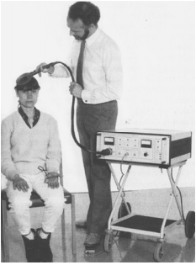
TMS
Transcranial magnetic stimulation
Non-invasive method of brain stimulation
1985, Anthony Barker
Electromagnetic induction based on Faraday
principle: magnetic field induced electrical
current in the cortex

Slide 3
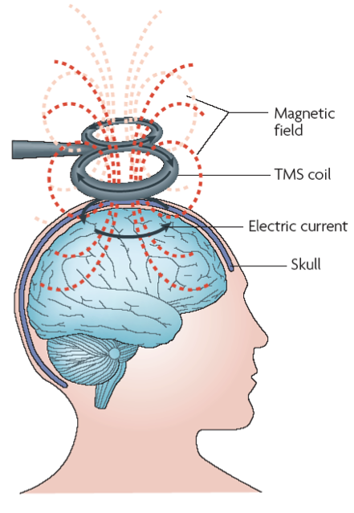
TMS

Slide 4
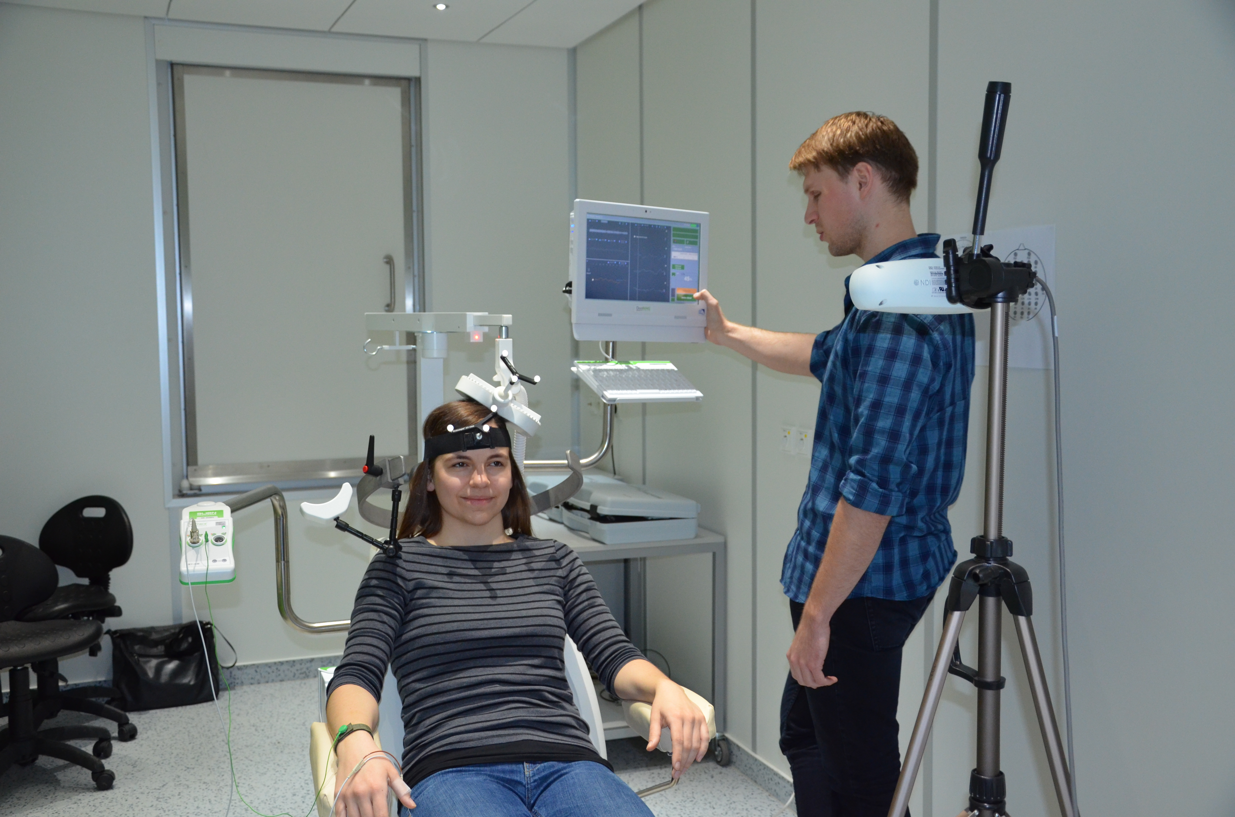

Slide 5


Slide 6
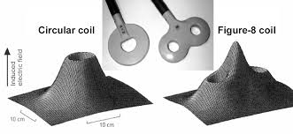
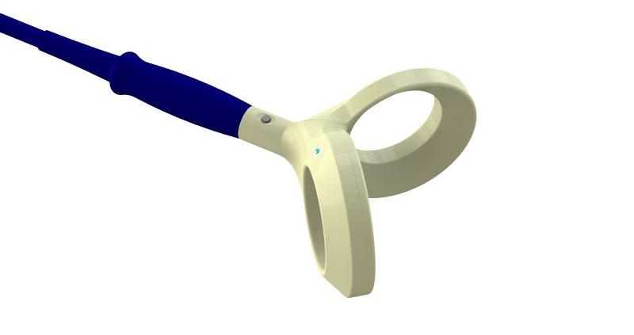
TMS coils

Slide 7
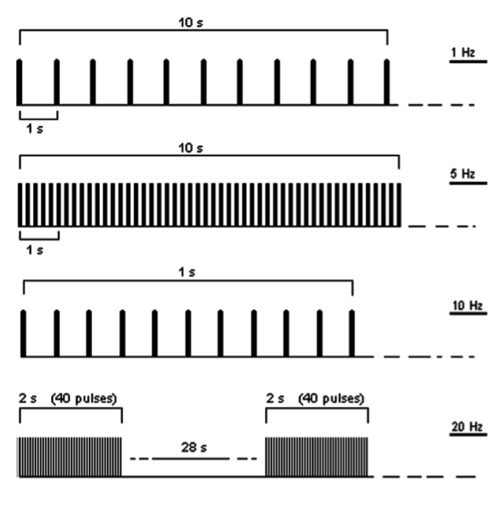
rTMS
Repeptitive transcranial magnetic
stimulation: therapeutical use
Modulation of cortical excitability
Modulation of metabolic activity

Slide 8
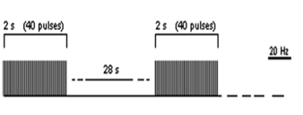
rTMS parameters
Frequency (low, high)
Number of pulses
Length of train and inter-train
Number of sessions and time between sessions
Coil type, stimulated area

Slide 9
rTMS contraindication
Epilepsy
Pregnancy
Alcohol
Intracranial metal objects
Pacemaker

Slide 10
rTMS in psychiatry
Depression
Obsessive compulsive disorder
ADHD
Addictions (cravingu)
Auditory halluctionations
Other...

Slide 11
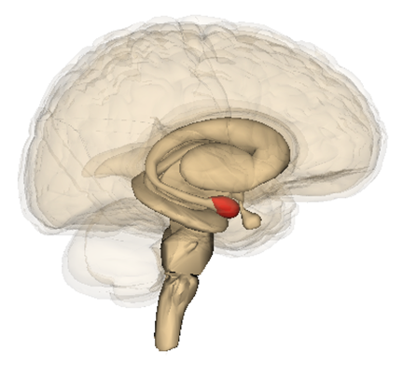
Neural substrates of emotion regulation
Volitional „top-down“ cognitive emotion regulation:
amygdala activity regulation by prefrontal cortex
Petients with impaired emotion regulation:
  Amygdala hyperactivity during emotion processing
  Decreased lateral prefrontal activity during emotion processing
  Impaired connectivity between amygdala and prefrontal cortex
  Phillips, M.L., Ladouceur, C.D., Drevets, W.C. (2008). A neural model of voluntary and automatic emotion regulation. Molecular Psychiatry, 13(9), 829-857.
  Schulze, L., Schmahl, C., Niedtfeld, I. (2016). Neural correlates of disturbed emotional processing in borderline personality disorder: A multimodal meta-analysis. Biological Psychiatry, 79(2), 97-106.

Slide 12
rTMS for emotion regulation

Slide 13

Targeting emotion regulation in BPD by rTMS
INCREASE IN
EMOTION AWARENESS
EMOTION REGULATION
DECREASE IN
DISSOCIATION
IMPULSIVITY

Slide 14
Previous studies of rTMS in BPD
Arbabi et al. (2013). Asian Journal of Psychiatry, 6(6), 614–617.
  Case study, 22 year-old-patient
  10 Hz rTMS over lDLPFC, 10 sessions, 1500 pulses per session, 100% of RMT
  Decrease in symptoms of depression (DBI-II), negative affect (PANASS) and impulsivity
  (BIS-11) directly after the treatment and one month after the treatment
Cailhol et al. (2014). Psychiatry Research, 216(1), 155–157.
  10 BPD patients, 5 in active and 5 in sham group
  10 Hz rTMS over rDLPFC, 10 sessions, 2000 pulses per session, 80% of RMT
  Response rate defined as 30% reduction on Borderline Personality Severity Index and was reached
  by 2 patients in the active group
  Lower scores in affective instability and anger after 3 months in the active group compared to sham group

Slide 15
Previous studies of rTMS in BPD
De Vidovich et al. (2016). Frontiers in Human Neuroscience, 10, 1–11.
  8 BPD patients and 8 controls
  rTMS over left cerebellum based on cerebellar projections to prefrontal cortex through ventral striatum
  1 Hz rTMS for 10 minutes, 80% of RMT
  Effect measured by an affective Go/NoGo Task, no difference was found between the groups after
  the stimulation as comapred to results before the stimulation
Feffer et al. (2017). Brain Stimulation, 10, 716–717.
  3 women with BPD and commorbid major depression
  iTBS of DMPFC, 20 session, 600 pulses to each hemisphere per session
  Reduction in BDI-II scores after the treatment

Slide 16
Previous studies of rTMS in BPD
Reyes-López, J. et al. (2017). Revista Brasileira de Psiquiatria, 40, 97–104.
  29 BPD patients, 2 stimulation designs
  1 Hz rTMS over the rDLPFC, 15 sessions, 900 pulses per session, 100% of RMT (15 patients)
  5 Hz rTMS over lDLPFC, 15 sessions, 900 pulses per session, 100% of RMT (14 patients)
  Reduction in Clinical Global Impressions scale for BPD, BIS-11, BDI and Hamilton Anxiety Scale
  in both groups

Slide 17
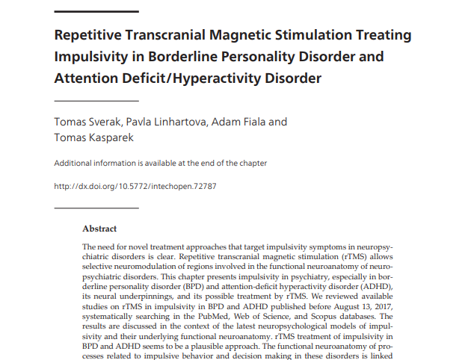

Slide 18
rTMS protocol
fMRI based navigation using Brainsight within rDLPFC
10 Hz rTMS, 15 sessions, 1 session per day, 1500 pulses per session, 110% of RMT, 10 s trains and 30 s inter-train intervals
Evaluation protocol:
  Emotion awareness and regulation: DERS
  Impulsivity: UPPS-P
  Depression, anxiety: MADRS, Zung anxiety inventory
  Borderline symptoms: BSL-23
  ADHD symptoms – attention: Adult ADHD Symptoms Rating Scale (ASRS)
  MR: T1, T2*, resting state, fMRI Go/NoGo Task, DTI
Current sample: 14 patients, 2 men, mean age 23.4 years (SD = 5.4)

Slide 19
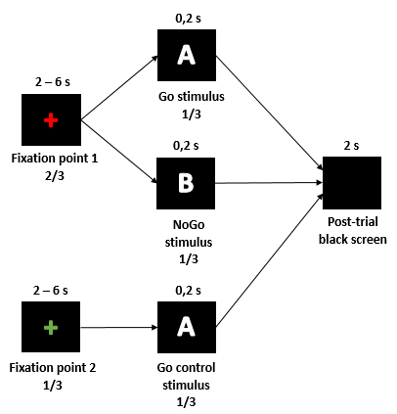
fMRI of behavioral inhibition in healthy people
Healthy people, N = 32, 59% of men,
age 18 to 33 years
3-T Siemens Prisma, Ceitec Brno
BOLD sequences: res. 3x3x3 mm,
TR=2280 ms, TE=35 ms
RESULTS
Manipulation check:
  Go stimuli RT: M=376,4; SD=47,2
  Go Control stimuli RT: M=308,0; SD=47,1
  paired t-test: t(31)=13,126; p<0,001; d=1,45
Behavioral results:
  NoGo commissions: M=8,6%, SD=6,7%

Slide 20
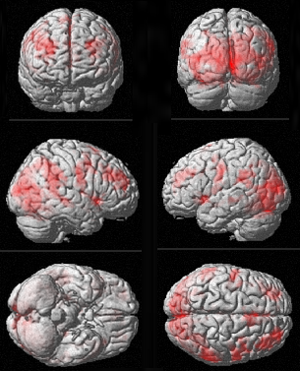
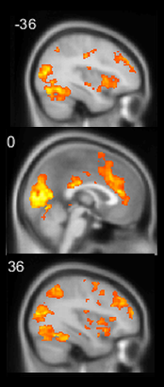
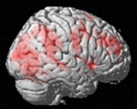
Current study: fMRI navigated rTMS
Neutral Go/NoGo Task: NoGo > Go
N=32, healthy subjects, p < 0.001 FDR corrected
Task activated area within DLPFC used as a mask (through Freesurfer using Destrieux atlas)
Individual peak of NoGo > Go contrast taken as rTMS target

Slide 21
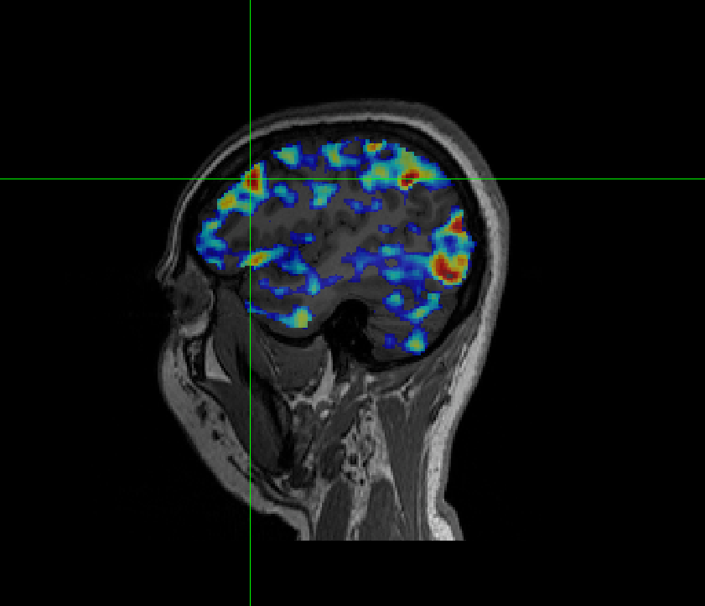
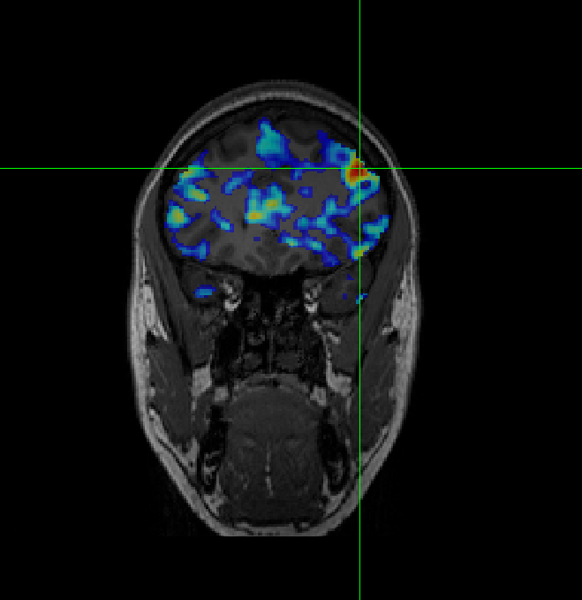
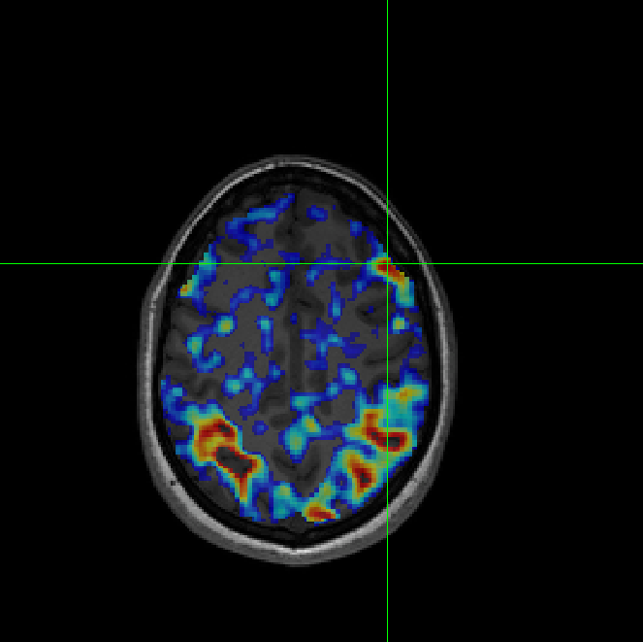
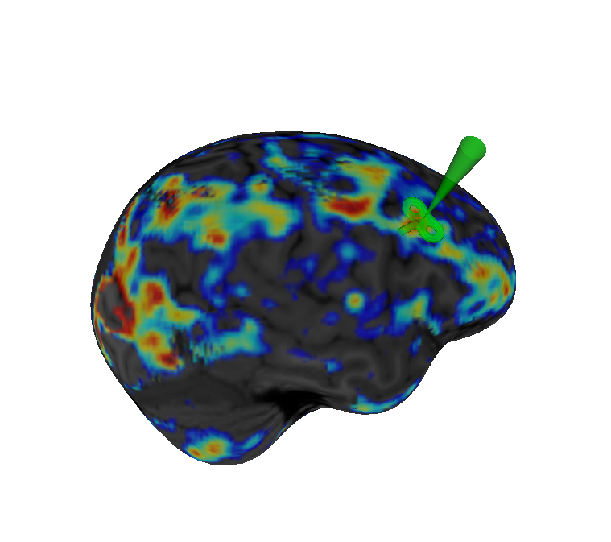
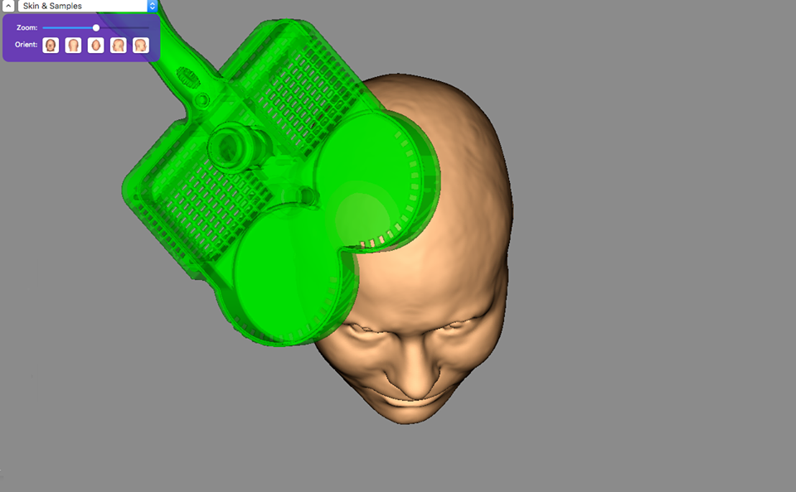

Slide 23
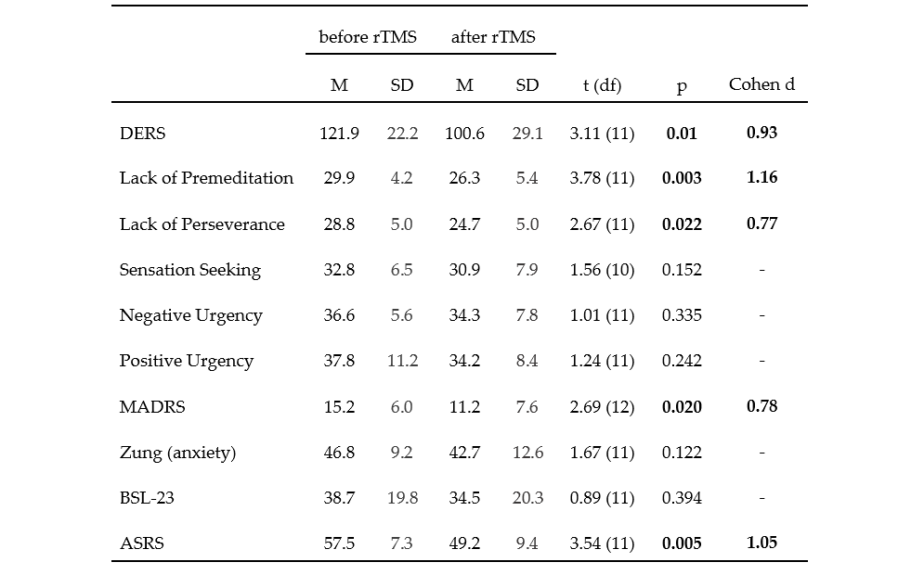
Current results: before and right after rTMS

Slide 24
Current results: subjective reports
Positive effects reported by most patients
  increased attention, improved mood and anxiety
  less overwhelming emotions, „more time to think“ before acting in stressful situations
  improved ability recognizing and describing emotion, less emotional outbursts
Positive effects reported by some patients
  less dissociative experiences
  reduction of self-harm
Adverse effects
  increased anxiety in approx. 10% patients

Slide 25
Future directions
Analysis of the neural effects
Placebo effect: RCTs – problems with sham stimulation
Intensive rTMS protocols
Combination with other forms of treatment: neurofeedback, psychotherapy

Slide 26
Real-time fMRI neurofeedback
Pavla Linhartová
Department of Psychiatry, Faculty of Medicine and University Hospital Brno
Tomáš Slavíček, Martin Lamoš
MAFIL CEITEC MU Brno

Slide 27
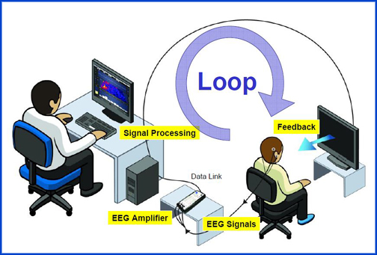
Neurofeedback

Slide 28
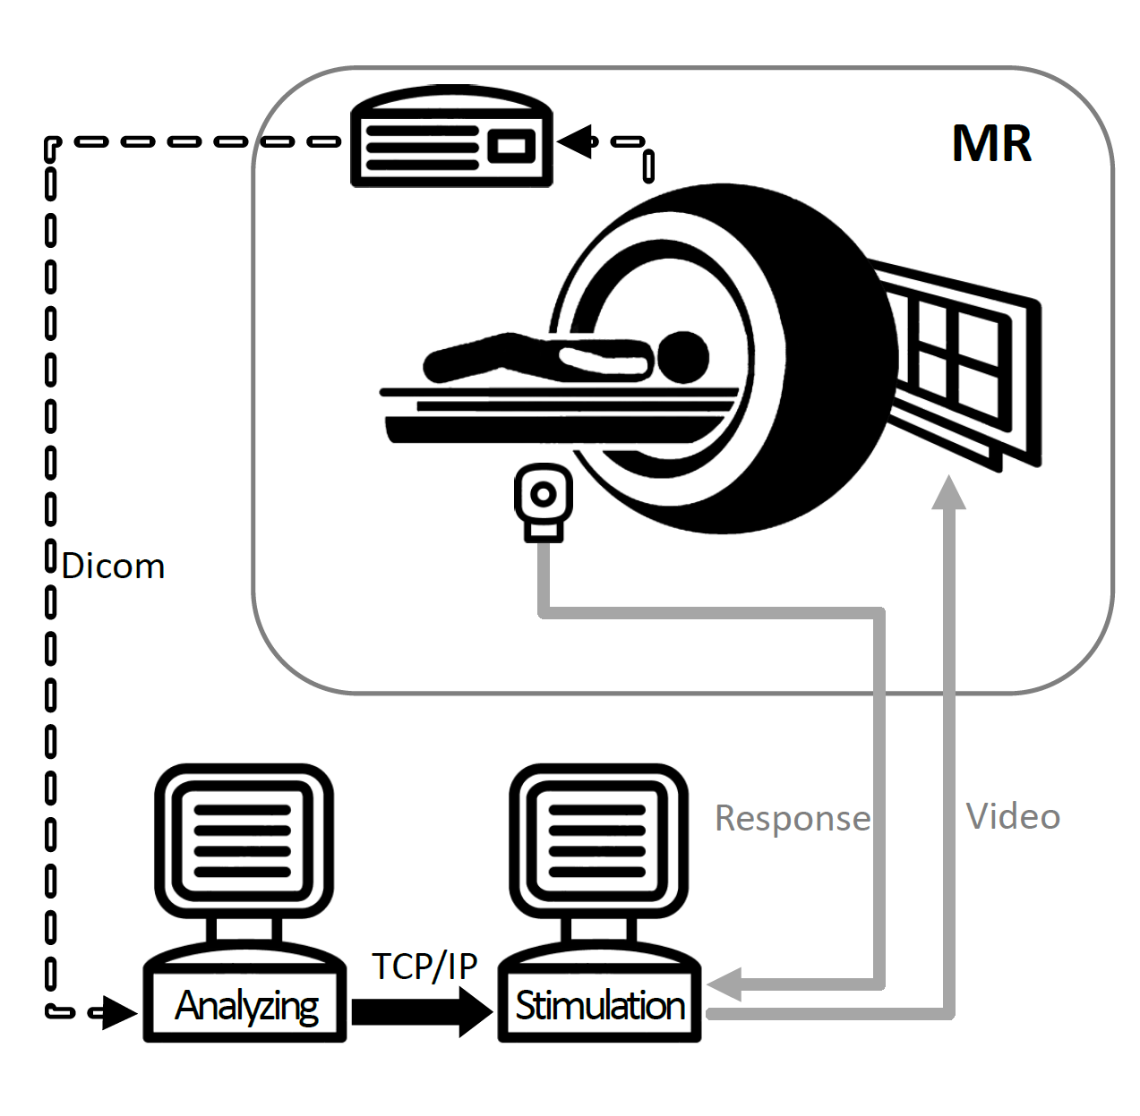
Real-time fMRI neurofeedback
dicom to nifti, realigment
Selection of ROI and control region based on masc
BOLD signal extraction
Filtering (Kalman filter)
Subtraction of the signals
Results evaluation

Slide 29
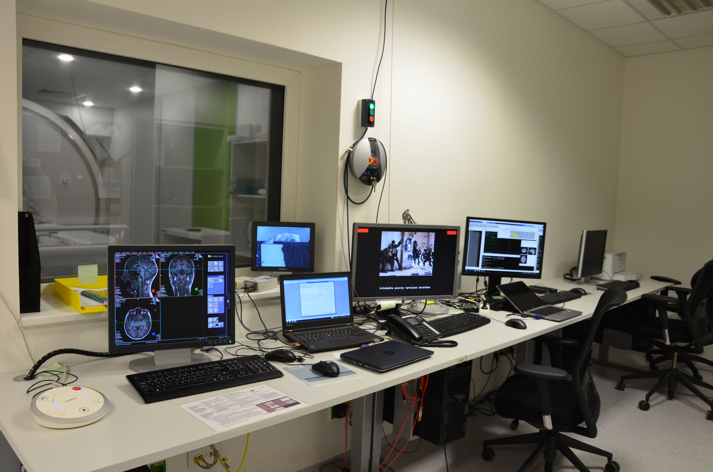

Slide 30
fMRI neurofeedback application areas
In the existing studies, fMRI neurofeedback was successfuly used
for improvement of:
  Tinnitus (Emmert K, Kopel R, Koush Y, et al. NeuroImage Clin. 2017;14:97-104 etc.)
  Verbal hallucinations (Dyck MS, Mathiak KA, Bergert S, et al. Front Psychiatry. 2016;7:1-14 etc.)
  Chronic pain (Guan M, Ma L, Li L, et al. Ismrm. 2014;22:5889 etc.)
  Craving in nicotinism (Hartwell KJ, Hanlon CA, Li X, et al. J Psychiatry Neurosci. 2016;41(1):48-55 etc.)
  Motor skills in Parkinson‘s disease (Subramanian L. et al. Park Relat Disord. 2016;22:e70 etc.)
  Cognitive functions in healthy people and patients with schizophrenia (Ruiz S, Lee S, Soekadar SR, et al. Hum Brain Mapp. 2013;34(1):200-212 etc.)

Slide 31
Stimulation parameters
Stimulation type: visual, auditory, pain, memories, imagination
Neurofeedback presentation: visual, auditory
Brain area for real-time processing: depends on our goal
Type of control group: sham, different region, no feedback
Localizer type: anatomical, functional
Instructions for signal change:
  Signal change direction (upregulation and downregulation)
  Signal change strategy

Slide 32
fMRI neurofeedback of amygdala for emotion regulation training

Slide 33
fMRI neurofeedback of amygdala
Zotev et al., 2011, 2013 (PloS One), Young et al., 2014 (PloS One): fMRI NF effect on amygdala upregulation during retrieving positive autobiographical memories in healthy people and patients with depression (as compared to sham fMRI NF)
Paret et al., 2014 (NeuroImage) a Paret et al., 2016 (Soc Cogn Affect Neurosci): fMRI NF effect on amygdala downregulation during watching aversive pictures and increase of amygdala-prefrontal cortex connectivity in healthy people and patients with borderline personality disorder (as compared to sham fMRI NF)
Nicholson et al., 2017 (HBM): fMRI NF efect on amygdala downregulation and increase of amygdala-prefrontal cortex connectivity during processing of individualized trauma-related words in patients with PTSD

Slide 34
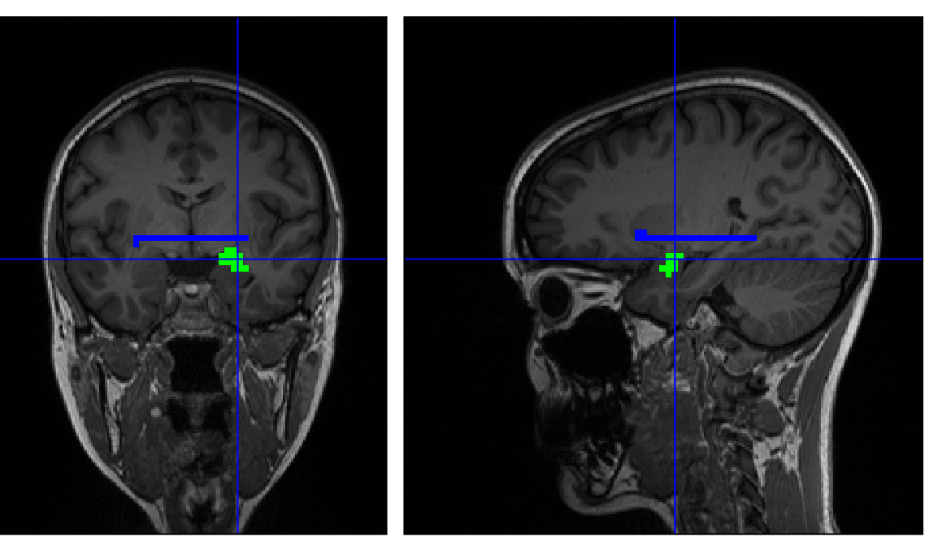
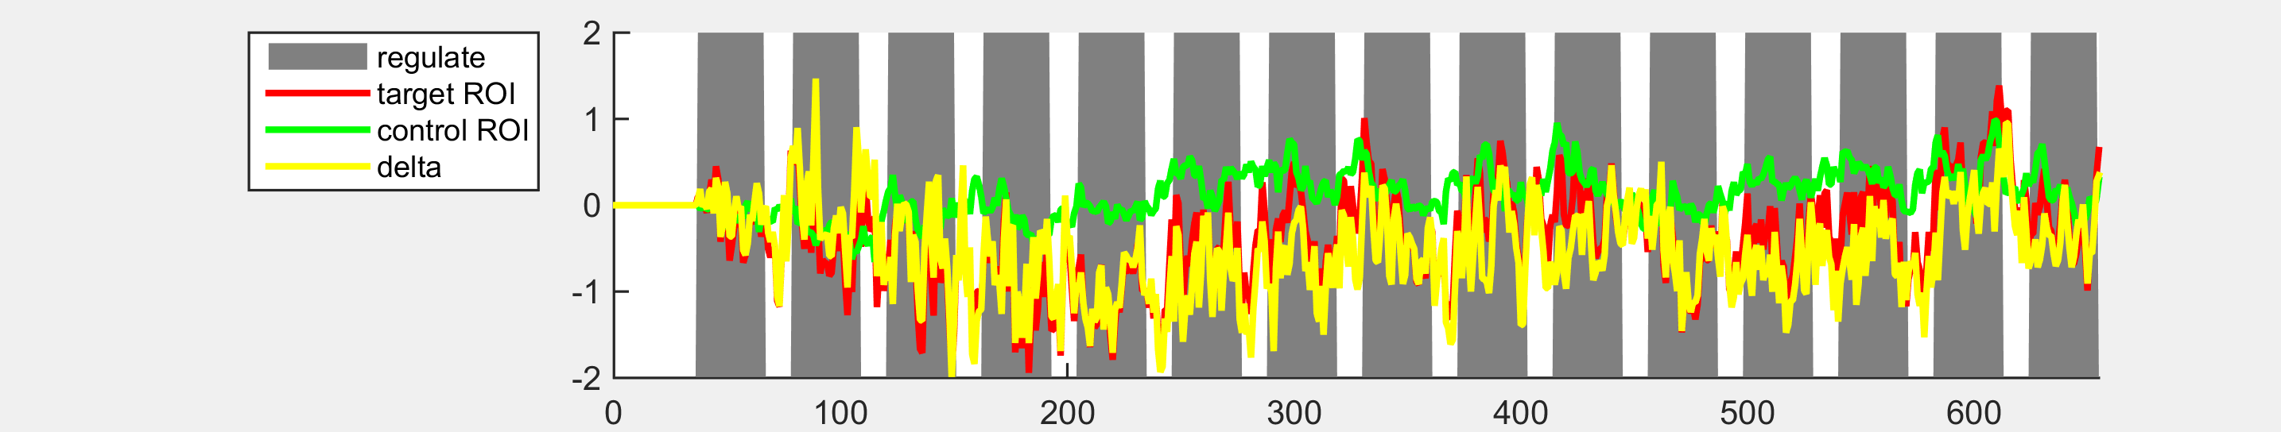

Slide 35
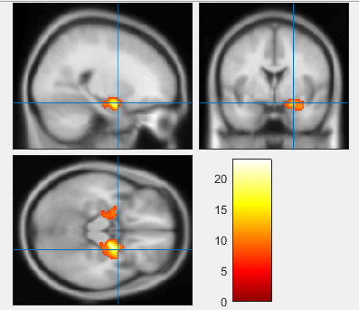
Corresponding brain activation
N = 17
FWE = 0.05

Slide 36
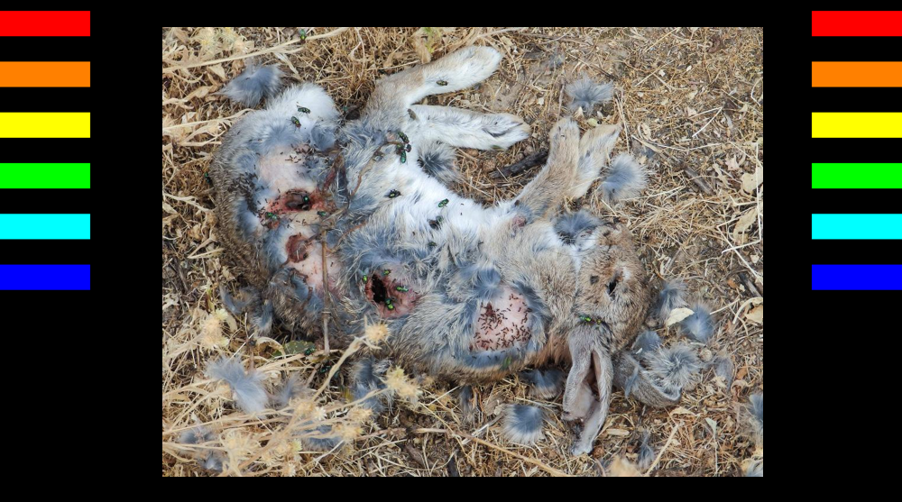
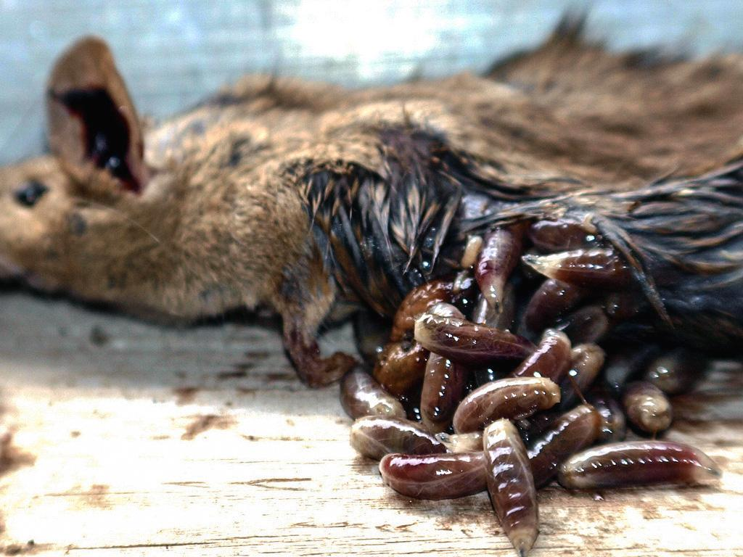
amygdala downregulation

Slide 37
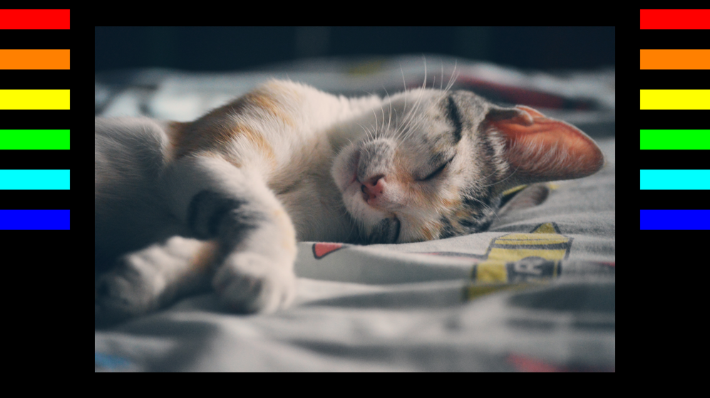
amygdala upregulation

Slide 38

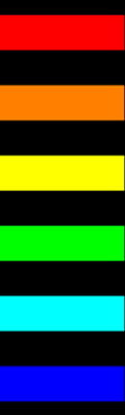

Slide 39
Effect analysis
Amygdala regulation during neurofeedback vs. without neurofeedback
Amygdala regulation with active neurofeedback vs. sham neurofeedback
Correlation with physiological parameters (skin conductance etc.)
Neural effects of neurofeedback training
Feedback on regulation success from the subject
Behavioral and clinical changes

Slide 40
fMRI neurofeedback of amygdala and the current project
Patients with borderline personality disorder
Looking for and training in different emotion regulation strategies
Use of individualized stimuli
Different strategies for emotion regulation have different neural correlates (e.g. cognitive reapraisal, acceptance, supression, distraction… např. Murakami et al., 2015, PLoS One; Smoski et al., 2014, Soc Cogn Affect Neurosci)

Slide 41
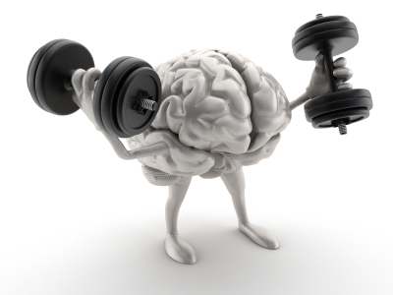
Thanks for your attention

