Slide 1
Connectivity and Networks in the Brain
Mgr. Beáta Špiláková
Selected topics from contemporary neuroscience
16.11.2017
beata.spilakova@ceitec.muni.cz

Slide 2
Overview
Historical perspective
Motivation
Levels and types of connectivity
Methods
Graph theory and network elements
Selected brain networks in humans
Altered connectivity
2/28

Slide 3
Historical perspective
Phrenology (up until 1808)
Lesion studies, electrical stimulation experiments
Fritsch, Hitzig (1870), and Ferrier (1873-75)
Broca, Wernicke
Localization of Function in the Cortex Cerebri (1881)
Golgi & Ramón y Cajal (1888-)
Early applications of network science to the brain (90’s-00’s)

Slide 4
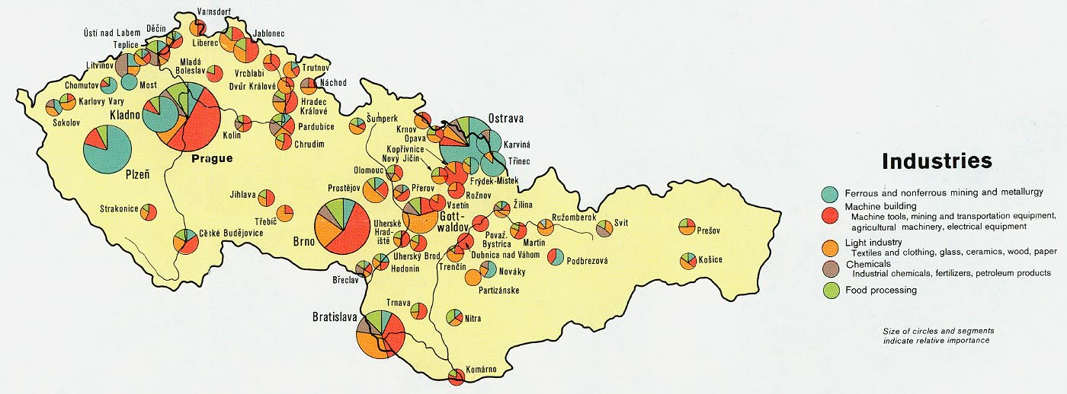
Motivation
Segregation & functional localisation approach is reductionistic

Slide 5
Levels and types of connectivity
Three basic levels:
MICROSCALE
MESOSCALE
MACROSCALE
Specific techniques for each of them

Slide 6
MICROSCALE
Single neurons and synapses
Electron or light microscopy
Optogenetics
https://www.youtube.com/watch?v=I64X7vHSHOE

Slide 7
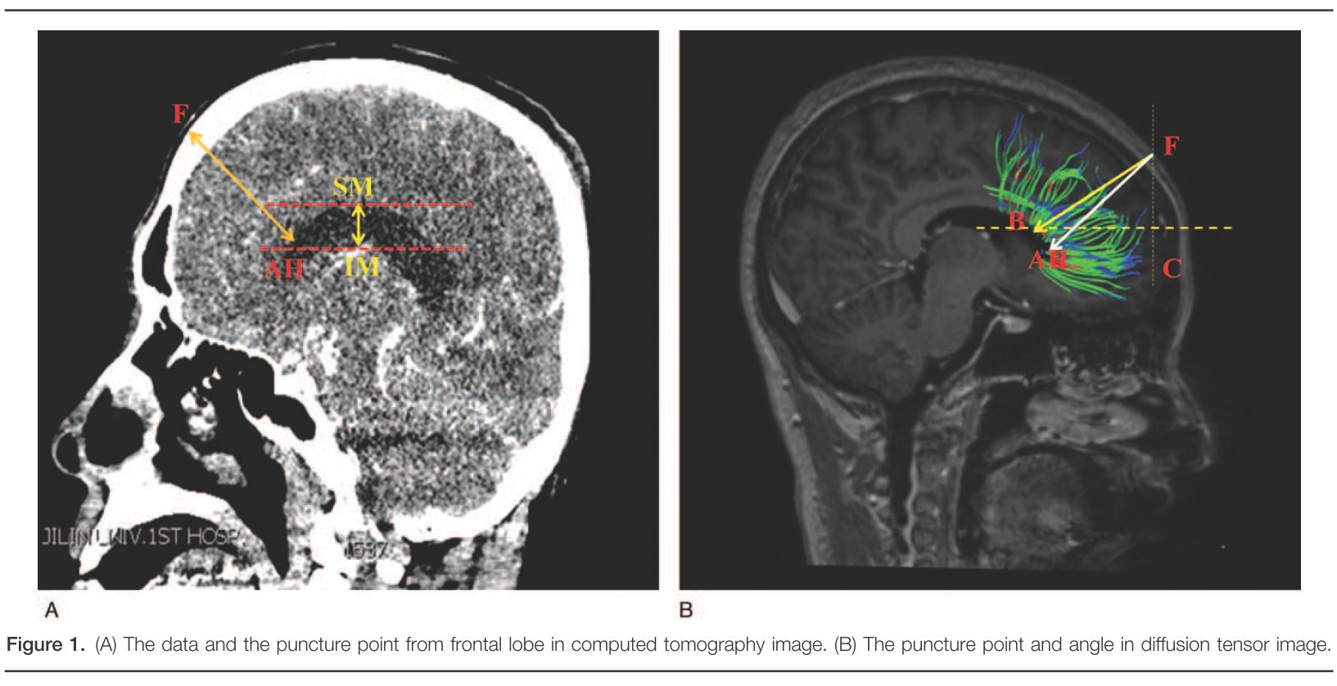
MESOSCALE
Neuronal populations and their interconnecting circuitry
Tracing of axonal projections, histological sectioning

Slide 8
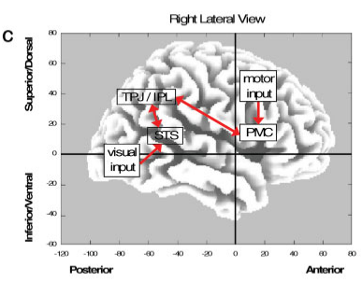
MACROSCALE
Anatomically distinct brain regions and pathways
Non-invasive, whole brain imaging techniques

Slide 9
Types of Connectivity
Structural
Functional
Effective

Slide 10
Methods
Histology
DTI
Functional imaging + subsequent analysis:
Correlations/coherence
ICA, gICA
Phase-locking value
PPI, DCM
…

Slide 11
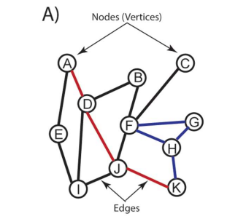
Graph theory
Need to describe the network
Graphs=models of real systems, their elements and their links
Elements → NODES
Links → EDGES

Slide 12
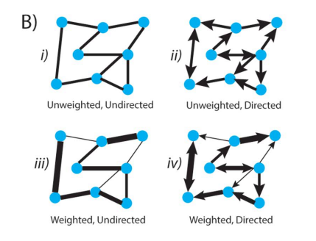
Graph theory
Edges:

Slide 13
Graph theory
Local metrics
Degree
Clustering coefficient
Path length
…
Global metrics
Rich club

Slide 14
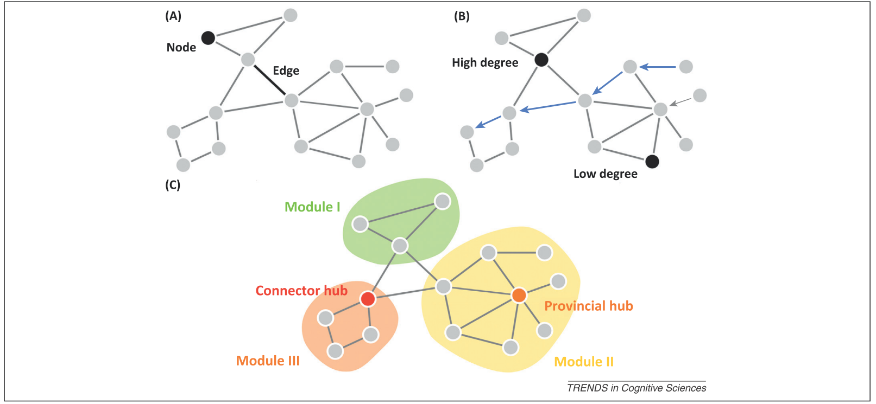
Graph theory
Nodes:

Slide 15
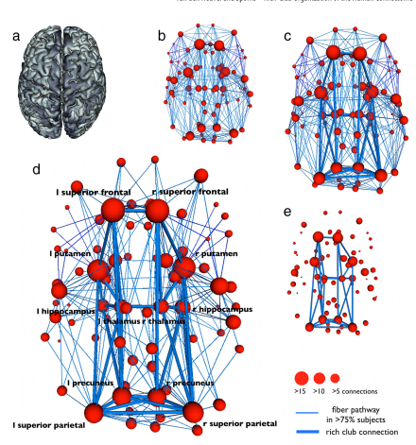
Graph theory
Rich club:

Slide 16
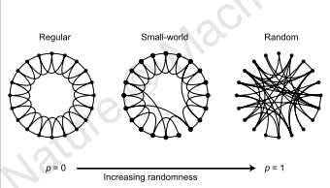
Graph theory
Small world networks:
High clustering coefficients, similar to regular graphs, and short average path lengths, similar to random graphs

Slide 17
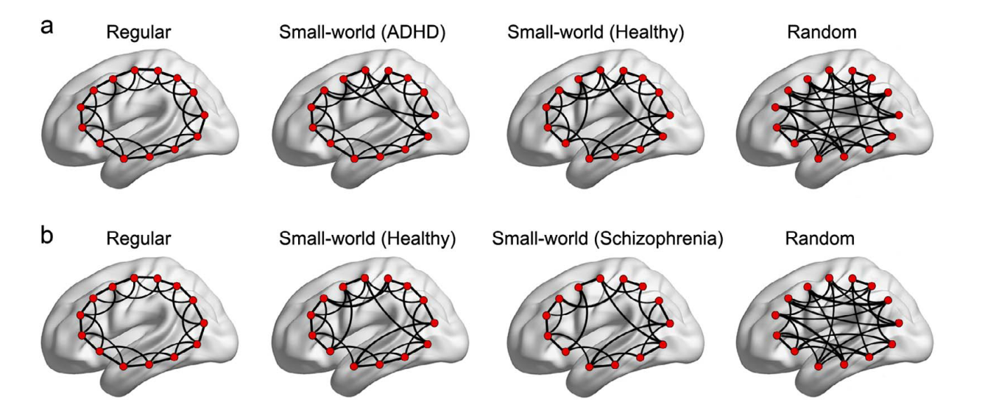
Graph theory
Milgram’s experiment (no, not THAT one)
Many real world phenomena (social, biological, technological)
…and in brain as well

Slide 18
Selected brain networks
Default mode network
Salience network
Reward network

Slide 19
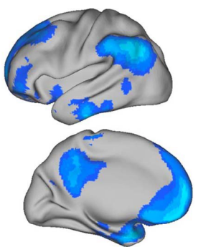
Default mode network
Freethinking, remembering the past, envisioning future events…
Consistent set of regions in different methodologies
Brain areas:
Ventral medial prefrontal cortex
Posterior cingulate cortex
Inferior parietal lobule
Lateral temporal cortex
Dorsal medial prefrontal cortex
Hippocampal formation

Slide 20
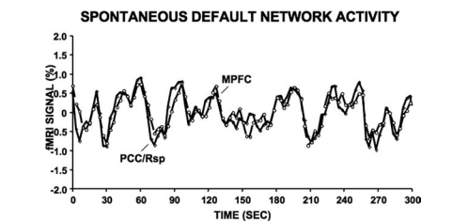
Default mode network
Infants do not show the structured interactions between the default network regions
Disrupted in autism, schizophrenia, and Alzheimer’s disease and at old age

Slide 21
Default mode network
Function?
Constructing dynamic mental simulations based on personal past experiences
Supporting exploratory monitoring of the external environment when focused attention is relaxed

Slide 22
Salience network
Anterior insulae ventrolateral prefrontal cortex, dorsal anterior cingulate cortex
Responds to behaviourally important events
Identifies the most relevant stimuli to guide behaviour
Switching between the CEN and the DMN

Slide 23
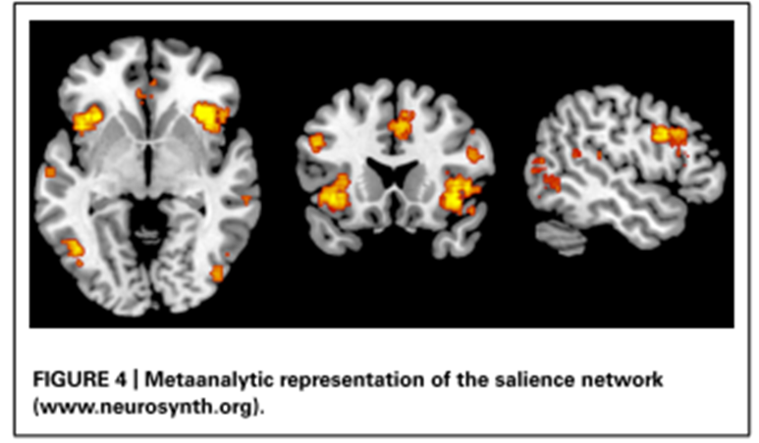
Salience networok
Connected to IQ
Disrupted in fronto-temporal dementia

Slide 24
Reward system
Driving incentive-based learning, appropriate responses to stimuli, and the development of goal-directed behaviours

Slide 25
Reward system
Dopamine neurons
Linked to addiction
Schizophrenia
Mood disorders

Slide 26
Altered connectivity in LSD

Slide 27
Thank you for listening! Questions?

Slide 28
Sources
Buckner, R.L., Andrews-Hanna, J.R., Schacter, D.L. (2008). The brain’s default network: Anatomy, function, and relevance to disease. Annals of the New York Academy of Sciences, 1124, 1–38
Chand, G.B., Dhamala, M. (2016). The salience network dynamics in perceptual decision-making. NeuroImage, 134, 85–93
Cooper, S., Robison, A.J., Mazei-Robison, M.S. (2017). Reward Circuitry in Addiction. Neurotherapeutics, 14, 687–97
Goulden, N., Khusnulina, A., Davis, N.J., et al. (2014). The salience network is responsible for switching between the default mode network and the central executive network: Replication from DCM. NeuroImage, 99, 180–90
Haber, S.N., Knutson, B. (2010). The Reward Circuit: Linking Primate Anatomy and Human Imaging. Neuropsychopharmacology, 35, 4–26
van den Heuvel, M.P., Sporns, O. (2013). Network hubs in the human brain. Trends in Cognitive Sciences, 17, 683–96
van den Heuvel, M.P., Sporns, O. (2011). Rich-Club Organization of the Human Connectome. Journal of Neuroscience, 31, 15775–86
Keren, H., O’Callaghan, G., Vidal-Ribas, P., et al. (2018). Reward Processing in Depression: A Conceptual and Meta-Analytic Review Across fMRI and EEG Studies. American Journal of Psychiatry, appi.ajp.2018.1
Krill, A.L., Platek, S.M. (2012). Working together may be better: Activation of reward centers during a cooperative maze task. PLoS ONE, 7, 1–7
Liao, X., Vasilakos, A. V., He, Y. (2017). Small-world human brain networks: Perspectives and challenges. Neuroscience & Biobehavioral Reviews, 77, 286–300
Liechti, M.E. (2017). Modern Clinical Research on LSD. Neuropsychopharmacology, 42, 2114–27
Mears, D., Pollard, H.B. (2016). Network science and the human brain: Using graph theory to understand the brain and one of its hubs, the amygdala, in health and disease. Journal of Neuroscience Research, 94, 590–605
Müller, F., Dolder, P.C., Schmidt, A., et al. (2018). Altered network hub connectivity after acute LSD administration. NeuroImage: Clinical, 18, 694–701
Van Overwalle, F. (2009). Social cognition and the brain: A meta-analysis. Human Brain Mapping, 30, 829–58
Smith, K.S., Tindell, A.J., Aldridge, J.W., et al. (2009). Ventral pallidum roles in reward and motivation. Behavioural Brain Research, 196, 155–67
Sporns, O. (2011). The human connectome: a complex network. Annals of the New York Academy of Sciences, 1224, 109–25
Vanes, L.D., Mouchlianitis, E., Collier, T., et al. (2018). Differential neural reward mechanisms in treatment-responsive and treatment-resistant schizophrenia. Psychological Medicine, 48, 2418–27
Watts, D.J., Strogatz, S.H. (1998). Collective dynamics of ‘small-world’ networks. 393, 440–42
Yuan, Z., Qin, W., Wang, D., et al. (2012). The salience network contributes to an individual’s fluid reasoning capacity. Behavioural Brain Research, 229, 384–90
Zhong, S., Li, W., Wang, B., et al. (2018). Selection of the best point and angle of lateral ventricle puncture according to DTI reconstruction of peripheral nerve fibers. Medicine, 97, e13095

