Slide 1
Selected topics from contemporary neuroscience
Intro to the organization of the course
Mgr. Beáta Špiláková,
Mgr. Pavlína Hlavatá, Mgr. Martin Jáni, Mgr. Pavlína Linhartová, Klára Marečková, Ph.D., M.Sc., Mgr. Lenka Sakálošová, MSc. Miguel Salazar, Mgr. Petra Zemánková,

Slide 2
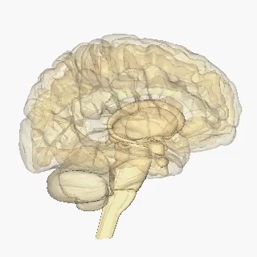
WELCOME!

Slide 3
Lecturers and important people
doc. Mgr. Lenka Lacinová, Ph.D.: lacinova@fss.muni.cz
Mgr. Beáta Špiláková: beata.spilakova@ceitec.muni.cz, 54949 7469
Mgr. Pavlína Hlavatá: 397885@mail.muni.cz
Mgr. Martin Jáni: 217488@mail.muni.cz
Mgr. Pavlína Linhartová, pavla.linhartova@gmail.com
Klára Marečková, Ph.D., M.Sc.: klara.mareckova@ceitec.muni.cz
Mgr. Lenka Sakálošová, lenka.sakalosova@ceitec.muni.cz
MSc. Miguel Salazar: miguel.salazar@ceitec.muni.cz
Mgr. Petra Zemánková: petra.zemankova@ceitec.muni.cz

Slide 4
Lecturers and important people
doc. Mgr. Lenka Lacinová, Ph.D.: lacinova@fss.muni.cz
Mgr. Beáta Špiláková: beata.spilakova@ceitec.muni.cz, 54949 7469
Mgr. Pavlína Hlavatá: 397885@mail.muni.cz
Mgr. Martin Jáni: 217488@mail.muni.cz
Mgr. Pavlína Linhartová, pavla.linhartova@gmail.com
Klára Marečková, Ph.D., M.Sc.: klara.mareckova@ceitec.muni.cz
Mgr. Lenka Sakálošová, lenka.sakalosova@ceitec.muni.cz
MSc. Miguel Salazar: miguel.salazar@ceitec.muni.cz
Mgr. Petra Zemánková: petra.zemankova@ceitec.muni.cz

Slide 5
Lecturers important people
doc. Mgr. Lenka Lacinová, Ph.D.: lacinova@fss.muni.cz
Mgr. Beáta Špiláková: beata.spilakova@ceitec.muni.cz, 54949 7469
Mgr. Pavlína Hlavatá: 397885@mail.muni.cz
Mgr. Martin Jáni: 217488@mail.muni.cz
Mgr. Pavlína Linhartová, pavla.linhartova@gmail.com
Klára Marečková, Ph.D., M.Sc.: klara.mareckova@ceitec.muni.cz
Mgr. Lenka Sakálošová, lenka.sakalosova@ceitec.muni.cz
MSc. Miguel Salazar: miguel.salazar@ceitec.muni.cz
Mgr. Petra Zemánková: petra.zemankova@ceitec.muni.cz

Slide 6
Lectures
Today
Klára Marečková: Introduction to Contemporary Neuroscience
Klára Marečková: Biomarkers and underlying mechanisms of psychiatric diseases
Miguel Salazar: Inhibition
Pavlína Hlavatá: Impulsivity

Slide 7
Lectures
26.10., 8:00, CEITEC
Lenka Sakálošová: Introduction to imaging techniques and brain stimulation
Petra Zemánková: Magnetic resonance imaging
Pavlína Linhartová: Repetitive transcranial magnetic stimulation & fMRI biofeedback
EEG, TMS & MRI demonstrations
University Campus at Brno-Bohunice, building A35, room 2S087
buses 50, 60, 61, E56, trolleybuses 25, 37
bus stop Univerzitní kampus

Slide 8
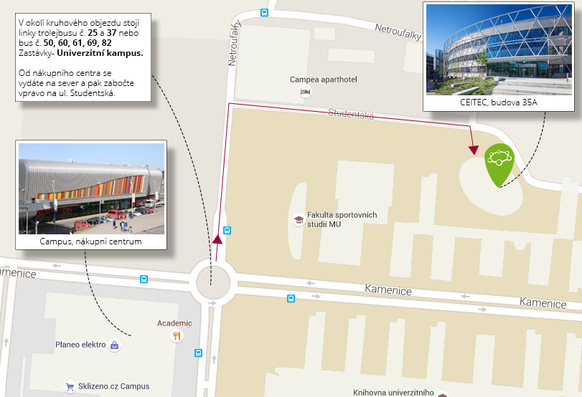

Slide 9
Lectures
26.10., 8:00, CEITEC
Lenka Sakálošová: Introduction to imaging techniques and brain stimulation
Petra Zemánková: Magnetic resonance imaging
Pavlína Linhartová: Repetitive transcranial magnetic stimulation & fMRI biofeedback
EEG, TMS & MRI demonstrations
University Campus at Brno-Bohunice, building A35, room 2S087
buses 50, 60, 61, E56, trolleybuses 25, 37
bus stop Univerzitní kampus

Slide 10
Lectures
16.11., 8:00, FSS M117
Petra Zemánková: Ambiguity in social cognition
Beáta Špiláková: Connectivity and network neuroscience
Martin Jáni: Social cognition in schizophrenia
Martin Jáni: Meta-analysis in neuroscience

Slide 11
Lectures
7.12., 8:00 FSS, U32
Beáta Špiláková: Altruism, cooperation & competition
Lenka Sakálošová: Consciousness
3. + 4. Presentations & Discussions

Slide 12
Assignments
Neuroscience research proposal
No need to present but more hustle to write
OR
Presentation on a neuroscientific topic
Easier to write, but you will have to present in front of your peers on the 7th of December
Deadline 4.11. (IS-> Study materials-> Homework Vaults-> Assignments) you will get feedback by 25.11., and you will have a chance to resubmit by 5.12.

Slide 13
Requirements to pass the course
Reading: 1-3 papers prior to each block; fill in an online questionnaire on each paper
Writing:
a neuroscience research proposal: knowledge of the topic, relevance, feasibility and methodology will be evaluated
presentation of a neuroscientific topic: knowledge of the topic, clarity, information value and the presentation skills will be evaluated
Attendance: absence on 1 lecture is allowed, if you need to skip an entire block, you will be asked to write an additional assignment, let me know in advance!

Slide 14

Want to get more involved?
Become a participant in neuroscientific research!
OR
Help us with recruitment

Slide 15
Any questions?

Slide 16
And enjoy the presentations
Thank you

