Slide 1
Research methods in neuroscience
Lenka Sakálošová

Slide 2
Contents
Overview and approaches to measurement
Electrophysiology: EEG, iEEG...
MRI & fMRI (Petra Zemánková, PhD)
TMS & rTMS (Pavlína Linhartová)
MAFIL lab visit: practical demonstration

Slide 3
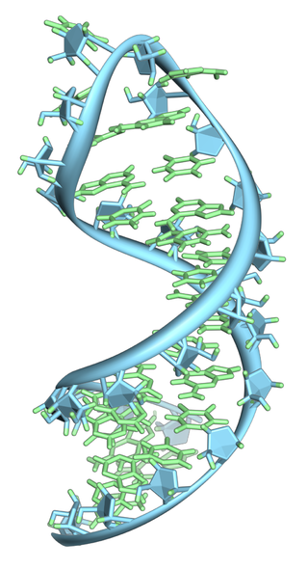
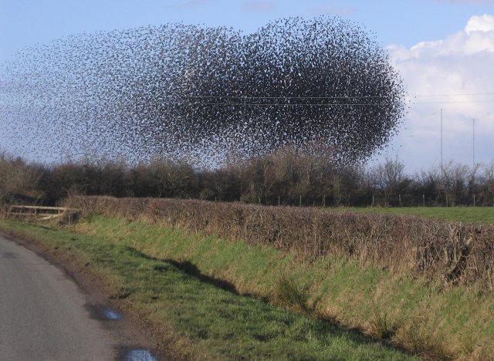
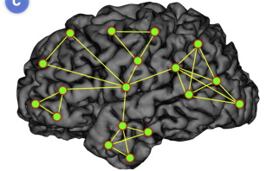
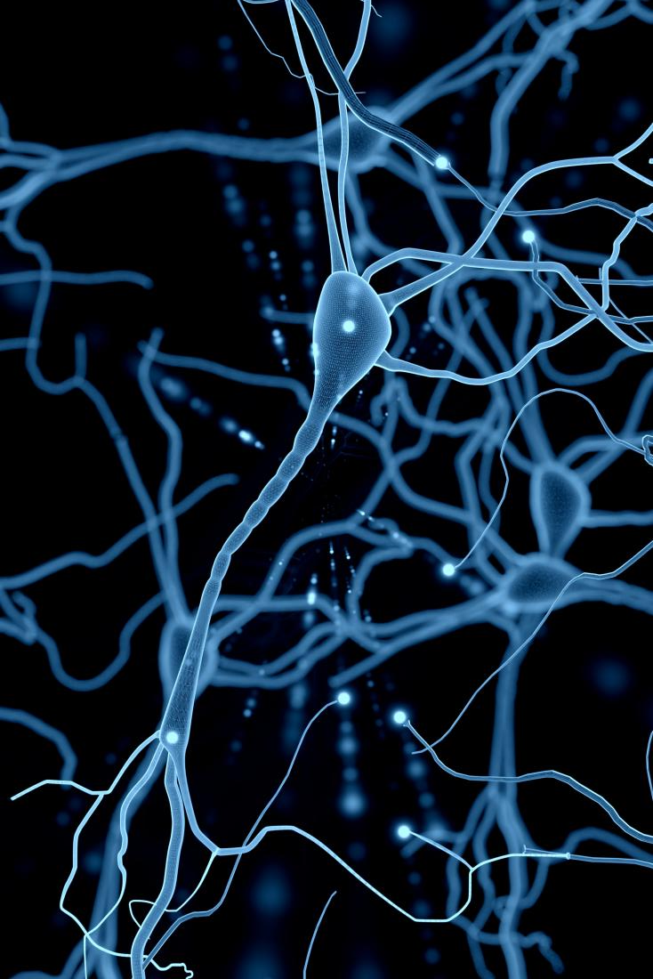
Breadth of neuroscience

Slide 4
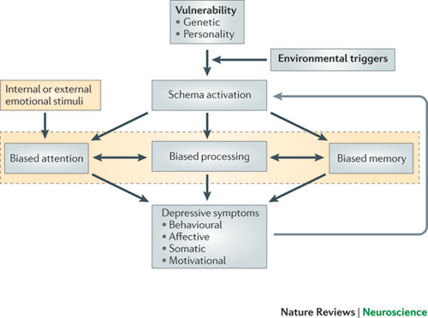
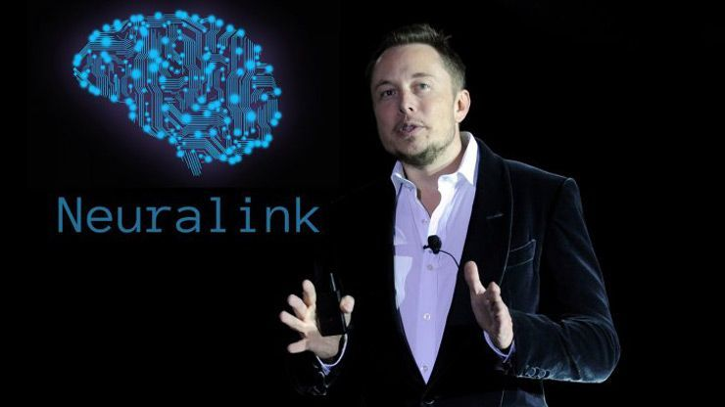
Questions we can ask
Basic research
Applied research
What does it do? How does it work?
What can we influence? How?
e.g. cognitive modelling
e.g. Brain-computer interface, cognitive enhancement

Slide 5
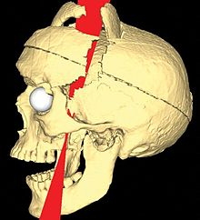
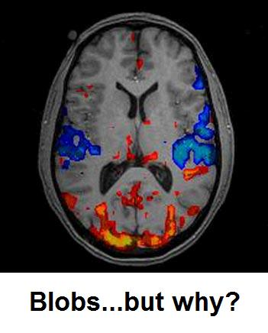
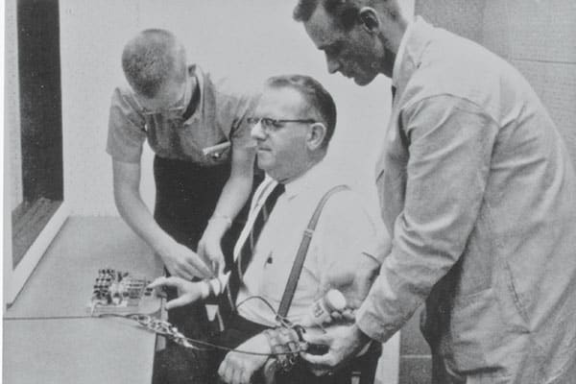
Methods of studying the nervous system
(how we get answers)
1. Examining case studies—identifying interesting events that have occurred naturally and using these events to develop hypotheses that can be tested in future experiments
2. Screens—performing unbiased searches for anatomical structures, neurons, proteins, or genes that could play a role in a subject of interest
3. Description—using techniques that allow a scientist to observe the nervous system without manipulating any variables
4. Manipulation—testing hypotheses by determining the effect of an independent variable on a dependent variable
  loss-of-function (also called “necessity”')
  gain-of-function (also called “sufficiency”)

Slide 6
Techniques we use to get the answers
Structural / functional
Invasive / non-invasive
Task-dependent / resting-state
In vivo / post mortem
Observation/manipulation(perturbation)
Fast event or long-therm development
Microscopic to whole-brain scale

Slide 7
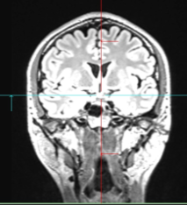
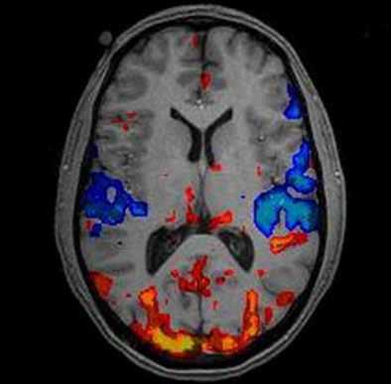
Structure
Function
structural MRI
Functional MRI (fMRI)

Slide 8
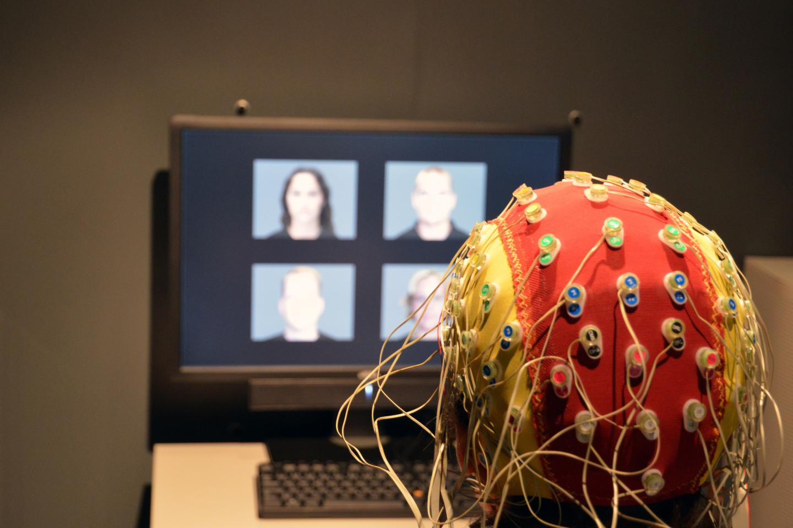
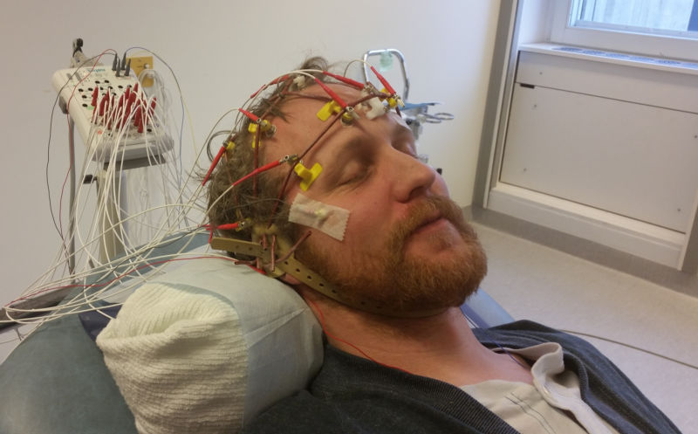
Task-dependent
Resting state

Slide 9
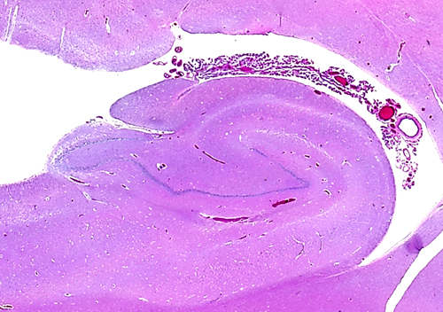
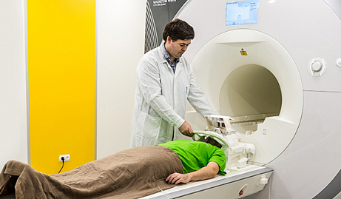
In vivo
Post mortem
fMRI
histology

Slide 10
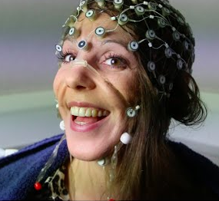
Invasive
Non-invasive
ECoG: electrocorticogram
Scalp EEG

Slide 11
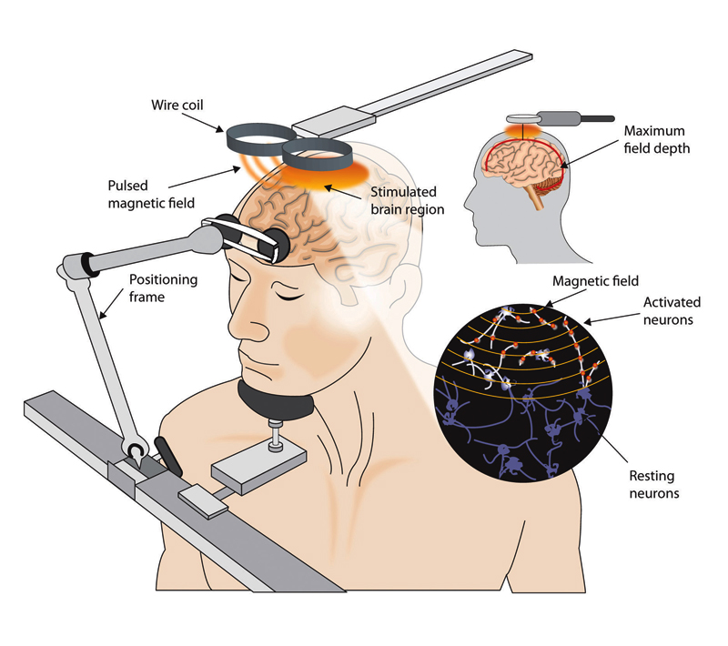
Observation
Manipulation

Slide 12
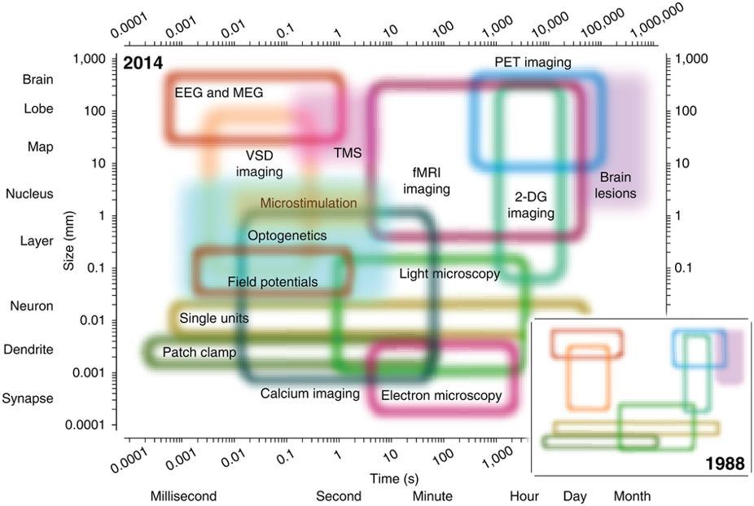
Spatial scale
Temporal scale

Slide 13
Whole-brain neuroimaging methods in human cognitive neoroscience
Electrophysiology (EEG, MEG)
MRI (fMRI, DTI, spectroscopy),
PET and SPECT
Perturbation (TMS, TCS)

Slide 15
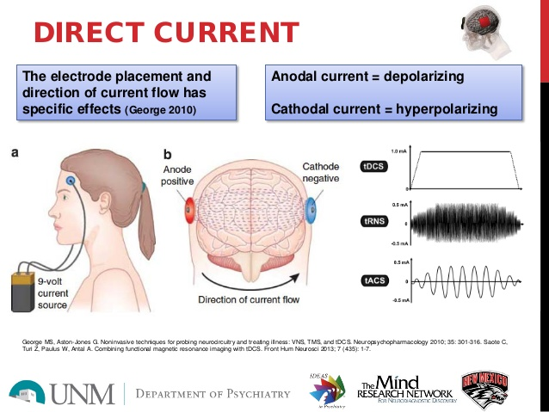
Stimulation: non-invasive
Transcranial direct current stimulation

Slide 16
Stimulation: non-invasive
Transcranial magnetic stimulation

Slide 17
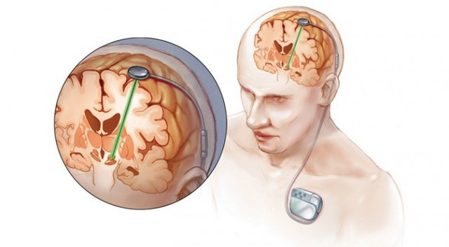
Deep brain stimulation
https://www.youtube.com/watch?v=wZZ4Vf3HinA

Slide 18
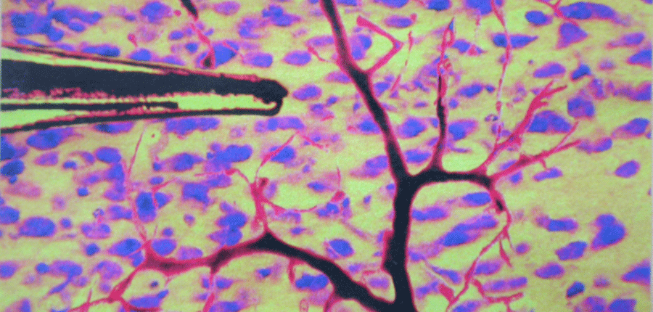
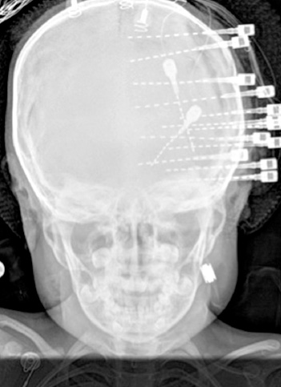
Neurophysiology methods
a. Neuron (unit) activity
  Single-unit: spike trains from single isolated neurons in the brain
  Multi-unit: spike trains from multiple neurons in the brain b.Population (field potential or field) activity
Electroencephalogram (EEG): recording of cortical electrical activity from extracranial sensors
Magnetoencephalogram (MEG): recording of cortical magnetic activity from extracranial sensors
Local Field Potential (LFP): recording of cortical electrical activity from microelectrodes in cortex
Intracranial EEG (iEEG): recording of cortical electrical activity from macroelectrodes in cortex
Electrocorticogram (ECoG): recording of cortical electrical activity from macroelectrodes on surface of cortex

Slide 19
Neurophysiology: „brainvawes“
Electrical activity recorded via electrodes (mostly)
Excellent temporal resolution, bad spatial

Slide 20
Neural basis

Slide 21
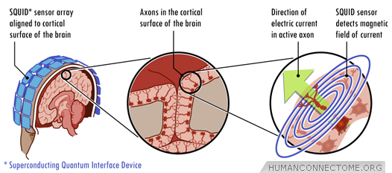
Neural basis

Slide 22
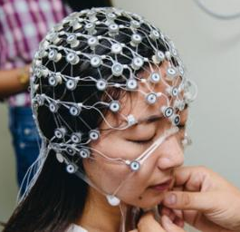
Recording

Slide 23
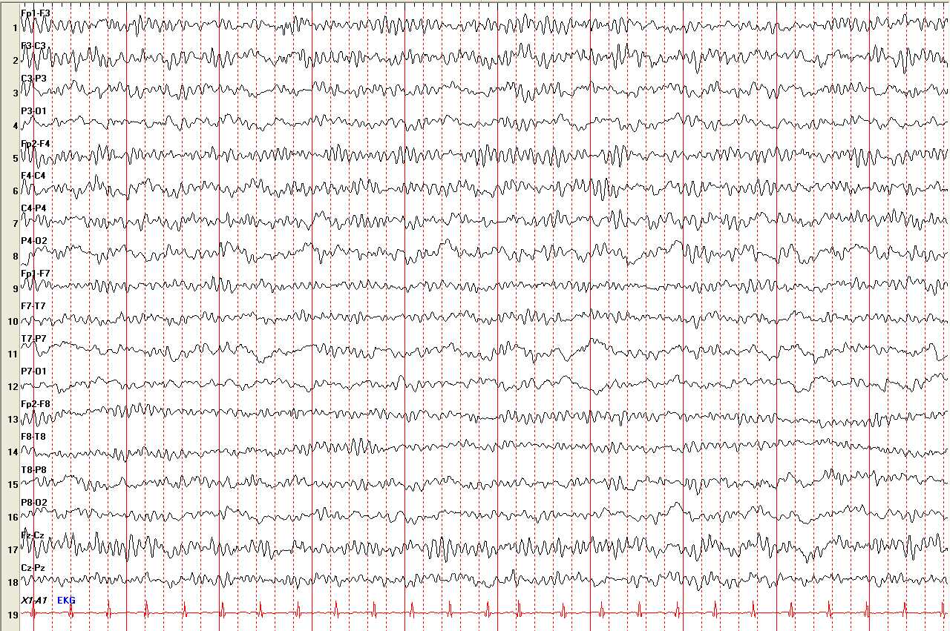
EEG data

Slide 24
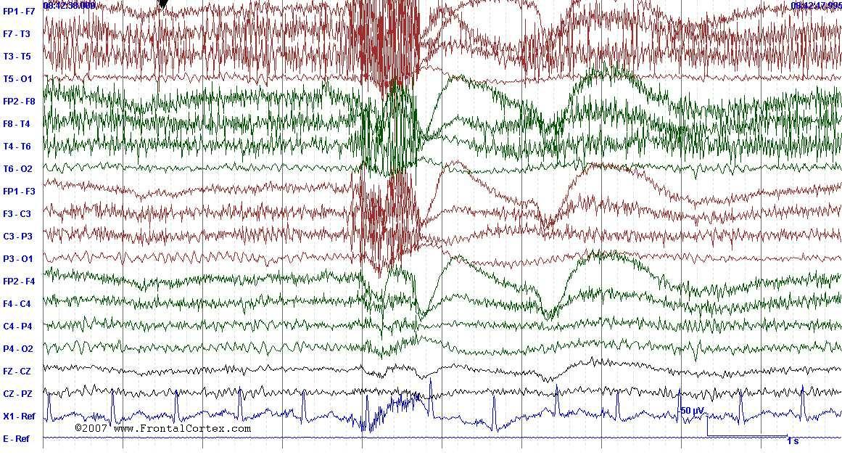
Nothing beats clean data

Slide 25
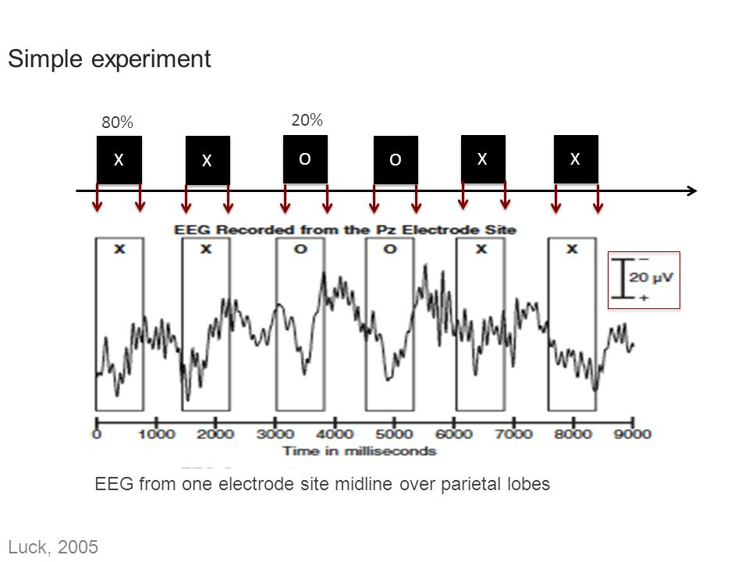
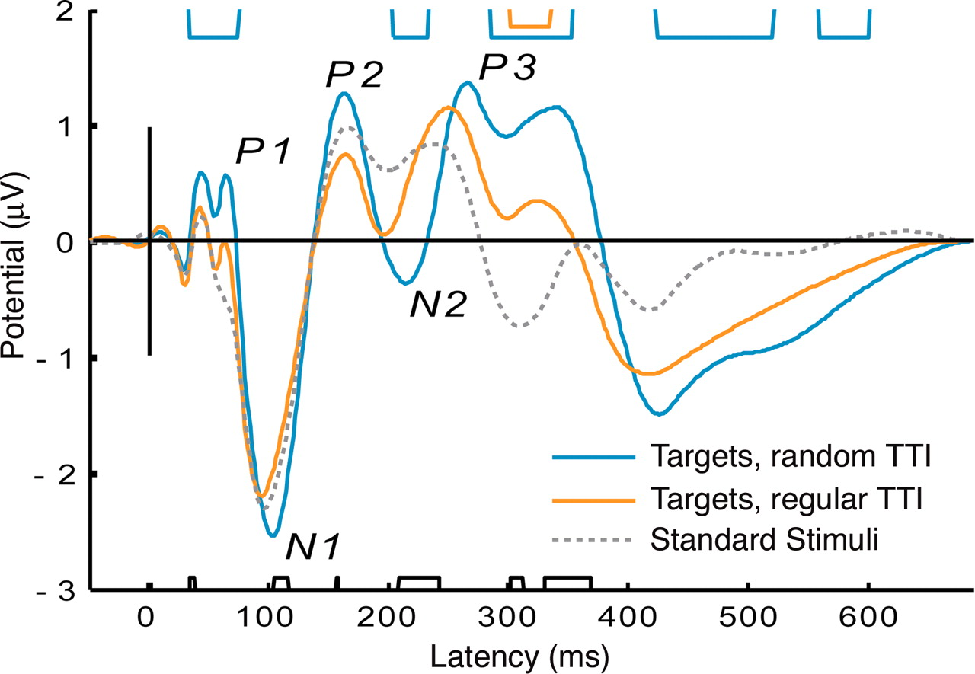
Event-related potentials

Slide 26
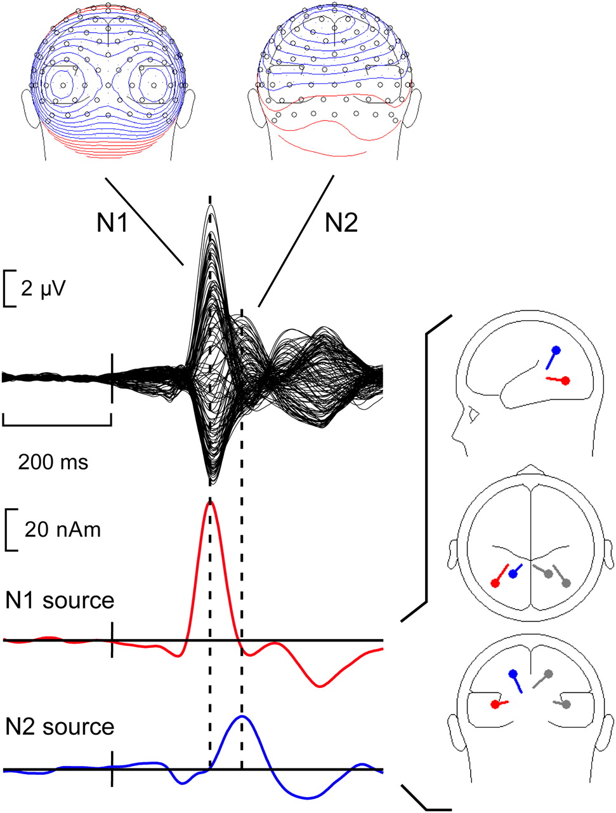
Event-related potentials

Slide 27
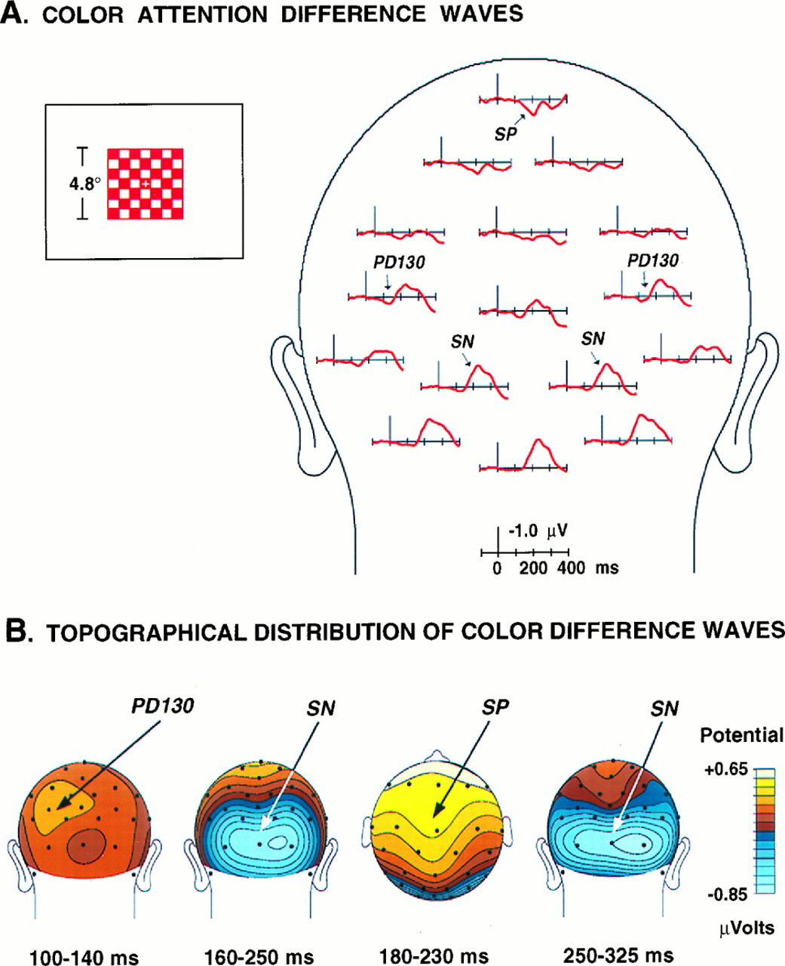
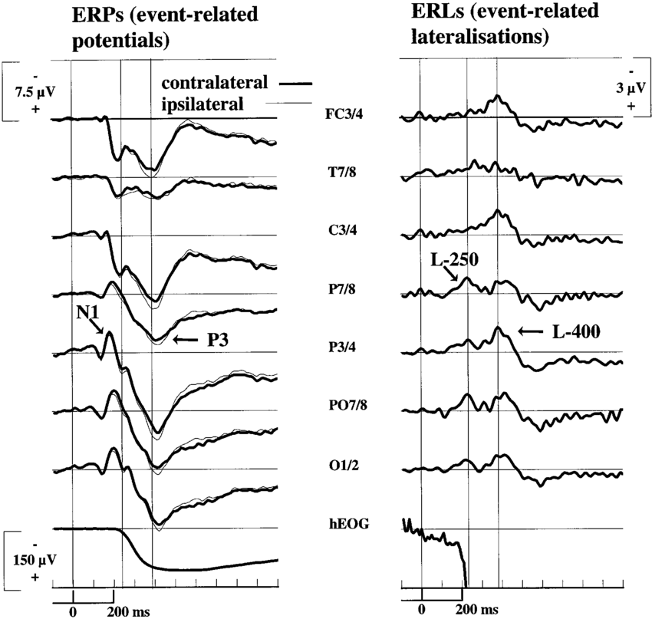
Topography

Slide 28
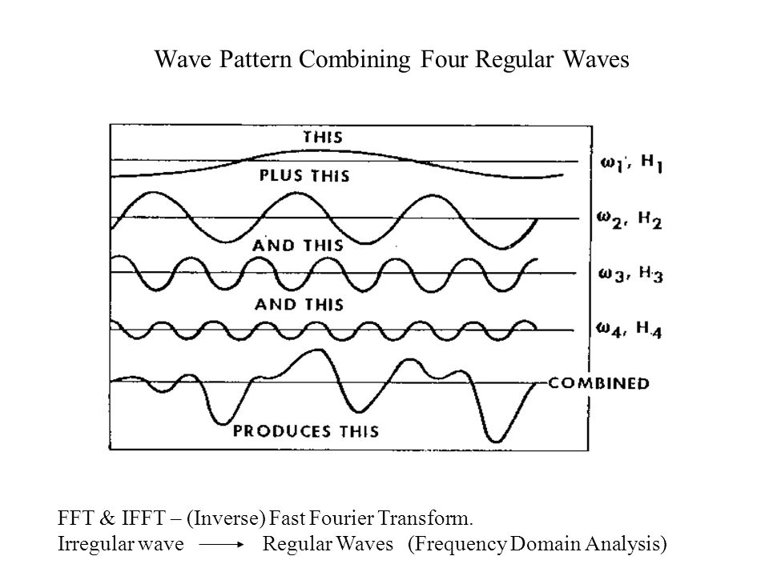
Power spectrum analysis

Slide 29
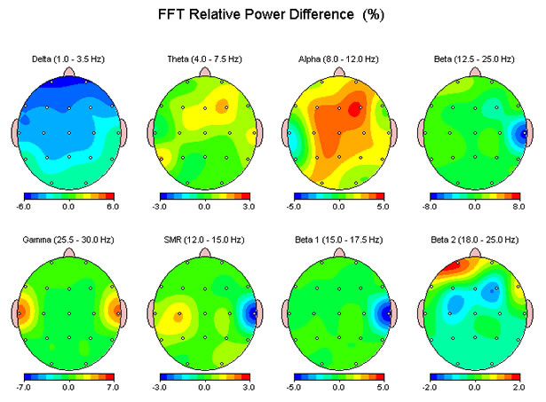

Slide 30
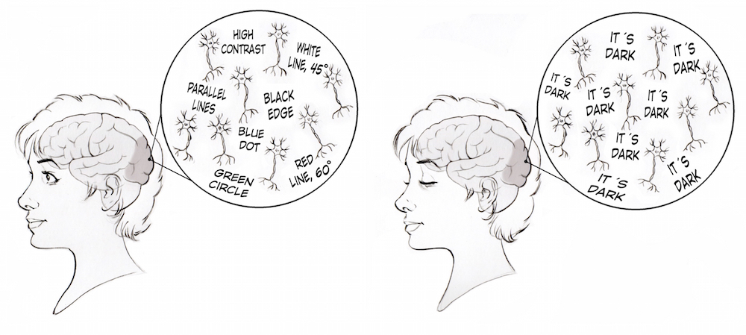
Contrast problem

Slide 31
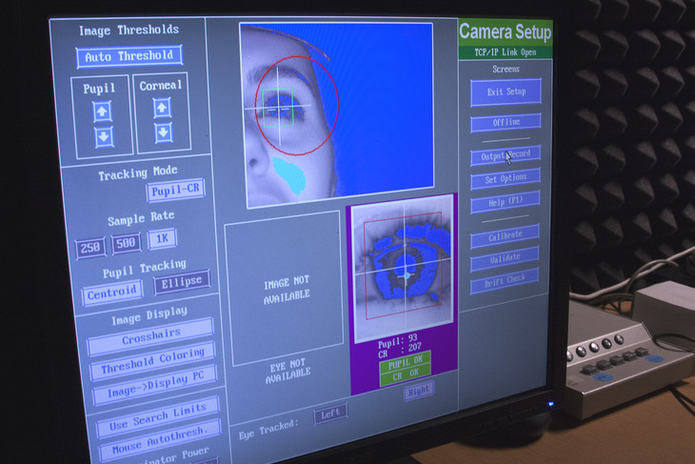
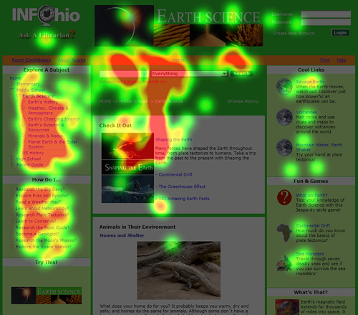
Not-so-much-neuro neuroimaging
  Heart rate
  Respiratory rate
  Skin conductance
  Eyetracking

Slide 32
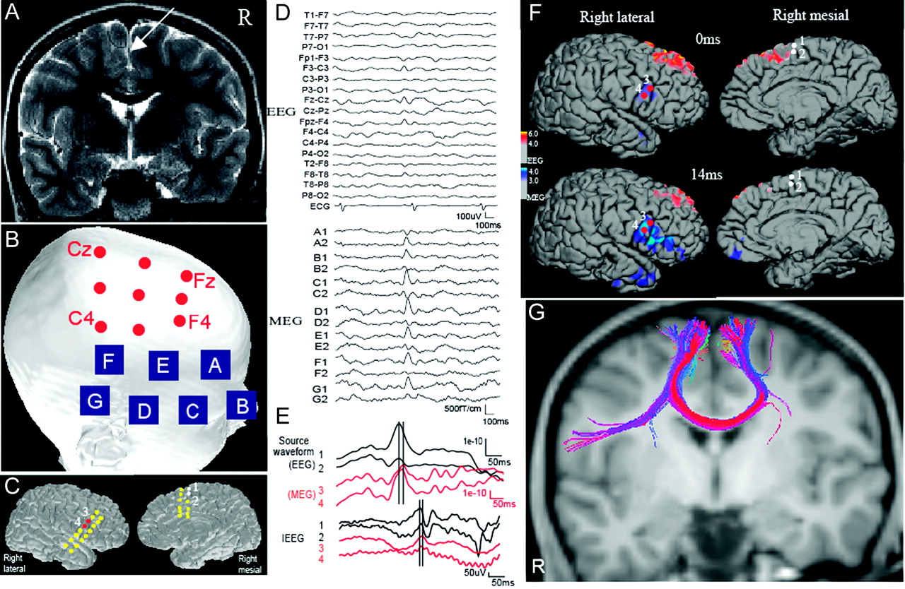
Solution to limitations...
Multimodal approach

Slide 33
Most important things:
Great question
Well-selected measurement method(s)
Meticulous experiment administration
Clean data
Honest and robust statistics
Reasonable interpretation

