Slide 1
Media Literacy
Pavel Sedlacek
pavelsedlacek@mail.muni.cz

Slide 2
Lecture content
1. Advertisement as a social memento
2. Photo as a social memento
3. Music video as a social memento

Slide 3
Importance of Media and Visual Literacy
Media literacy builds an understanding of the role of media in society as well as essential skills of inquiry and self-expression necessary for citizens of a democracy.
Visual literacy can improve one's creativity, critical thinking, educational achievement, empathy towards others, and ability to decipher technology.
Sources:
https://www.medialit.org/reading-room/what-media-literacy-definitionand-more
https://www.opencolleges.edu.au/informed/features/why-visual-literacy-is-more-important-than-ever-10-ways-to-cultivate-it/

Slide 4
1. Advertisement as a social memento
NIKE has a history of responding to topical issues.
NIKE chose Colin Kaepernick as the face of its 30th anniversary „Just Do It“ campaign.
September, 2018
Former US NFL player Kaepernick has been well known since Aug 2016, for kneeling during the national anthem.

Slide 5
Kaepernick knelt in protest of police shootings of unarmed black men.
2016, NFL
Colin Kaepernick at the press conference, 2016
2016, NFL

Slide 6
And he started a trend…

Slide 7
Massive protests led to the debate about privilege, pride and patriotism.
2016
2016

Slide 8
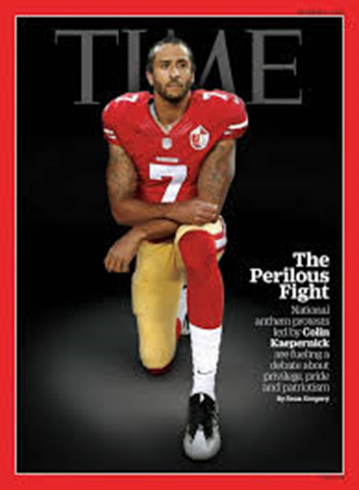
Colin KAEPERNICK received death threats.
Donald TRUMP, Sept 25, 2017:
„He is fired!“ Says Trump about NFL player
Source: https://www.youtube.com/watch?v=694d8BAcLug

Slide 9
NIKE „Just Do It“ campaign, 2018:
Motto: „Believe in something. Even if it means sacrificing everything.“
Source: https://www.youtube.com/watch?v=-grjIUWKoBA

Slide 10
NIKE campaign prompted a backlash by some on social media.
NIKE protests include people destroying company goods and posting about boycotts.
Donald TRUMP, The Daily Caller, Sept 2018:
„I think it´s a terrible message and message that shouldn´t be sent.“
Source: https://dailycaller.com/2018/09/04/trump-interview-nike-kaepernick-deal/
NIKE lost conservative customers and gained the others.

Slide 11
Sexist piggy (Sexistické prasátečko)
2018, winner – public
2018, winner – experts
2018, 2nd place – public

Slide 12
2. Photo as a social memento
During their medal ceremony in the Olympic Stadium in Mexiko City on October 16, 1968, African-American athletes Tommies SMITH and John CARLOS each raised a black-gloved fist during the playing of the US national anthem.
This event became one of the most iconic sports images of the 20th century.

Slide 13
Black Power Salute, 1968
Black Power Salute, 1968
Black Power Salute, 1968

Slide 14
For this Power Salute (Black Power Salute), they were banned from further Olympic activities.
The event was one of the most overtly political statements in the history of the modern Olympic Games.
Tommie Smith stated in his autobiography, "Silent Gesture", that the salute was a human rights salute.
Source:
http://www.sportmyway.eu/2017/12/01/70sportways-32-tommy-smith-john-carlos-human-rights-salute/

Slide 16
Being gay is ok campaign
Ronaldo Schemidt, AFP, 05/2017, Venezuela Crisis
Tyler Hicks, The New York Times, 10/26/2018, Starving Jemen, Amal Hussejn (†11/3/2018)
Nilufer Demir, Reuters, 2015, Drowned Syrian Boy from Syria, Refugee Crisis

Slide 17
Lukáš Zeman, Czech Press Photo, 2018, Borneo, National Park Tanjung Puting, female orangutan and its dying child
Robert Clark, 9/11/2001, United Airlines Flight 175 aproaches the World Trade Center
Richard Drew, AP, 9/11/2001, The Falling Man
Kevin Carter, 03/1993, The vulture and the little girl, South Sudan, Pulitzer Prize

Slide 18
3. Music video as a social memento
Music Video: Childish Gambino - This Is America
Source: https://www.youtube.com/watch?v=VYOjWnS4cMY
Analysis: The Hidden Meanings Behind Childish Gambino´s ´This Is America´ Video
Source: https://www.youtube.com/watch?v=kWTBTRGfKew

Slide 19
Ads, photos, videos are the part of the mirror of the society and current social events.

