Slide 1
Modern Technologies and Conflicts
Information Technology and Society
2.10. 2019
Jakub Drmola

Slide 2
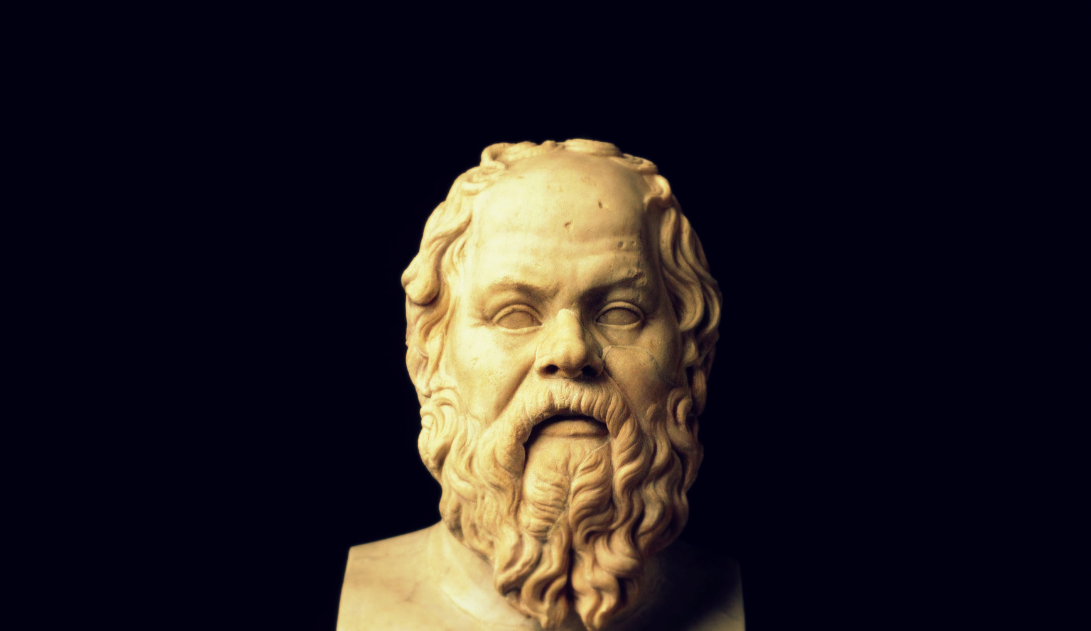

Slide 3
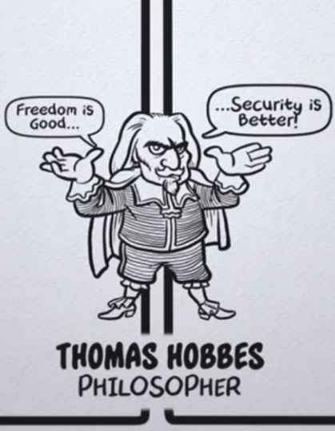
Freedom versus security
or privacy versus security
ongoing massive debate over this question in cyberspace
no good solution in sight

Slide 4
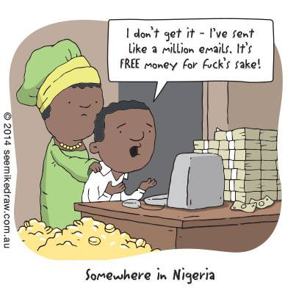
Cybercrime
anything from phishing, to ransomware, RATs and black market
evolves with technology itself
key role of anonymity
lack of user awareness and good security practices
less anonymity online would make it harder for perpetrators to get away with it

Slide 5
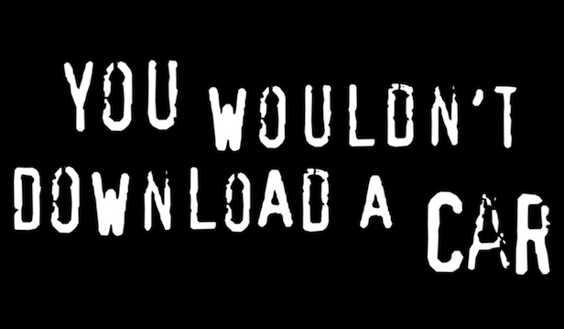

Piracy
unauthorized distribution of intellectual property
printing press > magnetic tapes > floppy discs > CDs/DVDs > internet > ???
securitization (ethics, economy and hard security)
lacking/slow adaptation of businesses
stronger IP protection laws might serve as a deterrence
Notes:
premonition: https://www.youtube.com/watch?v=DvQFnSnhg7U
gaben: https://youtu.be/pLC_zZ5fqFk?t=1m5s
piratske strany

Slide 6
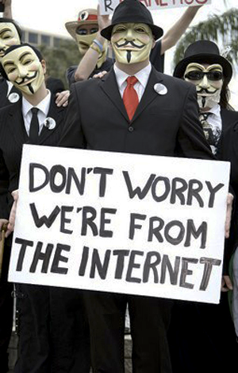
Hacktivism
political and ideological activism in cyberspace, using direct hacking, DDoS, disclosing secrets, propaganda, doxing, defacements, etc.
beginnings in 2008
grows strong from 2010
currently a well established modus operandi
stricter laws and sentencing could discourage perpetrators
Notes:
tom cruise
https://www.youtube.com/watch?v=bUm5seVCpf4

Slide 7
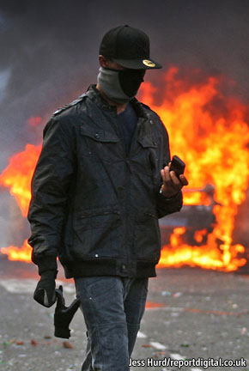
Organizing protests
using social media to organize and coordinate protests, looting, riots, rallies etc.
first seen in Iran 2009
visible issue since 2011
London riots, Arab spring, India, USA
shutting off the service during the events would stop people from using it to self-organize

Slide 8
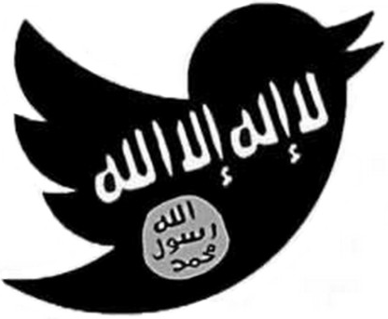
Terrorism online
promotion of violence, extremism, intolerance, dissemination of guides, recruitment, inciting hatred and fear
gradual development from 90s
became major force in 2010s
dominant issue with ISIS
demands for stricter censorship by content curators

Slide 9
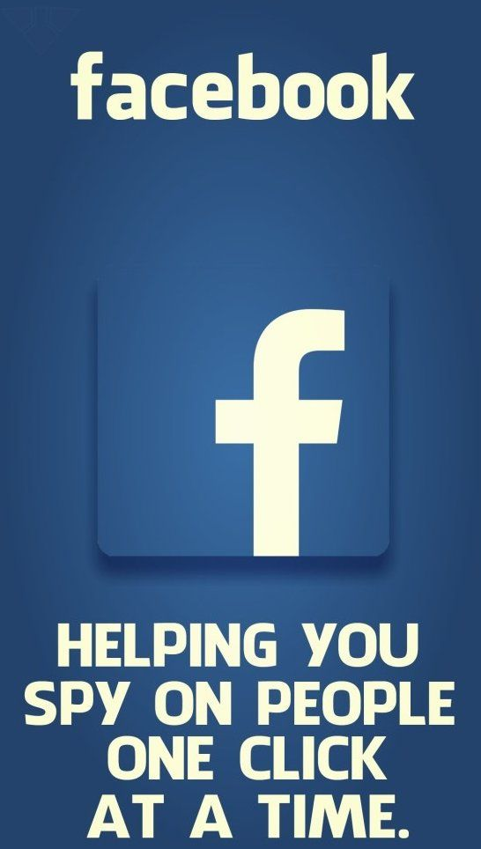
Privacy and corporations
accumulation of personalized data for advertising and other purposes, interconnected platforms, ecosystems
mainstream boom circa 2007-2012
social networks of all sorts (facebook, twitter, ...)
access to their service in exchange for private data
is it a problem?
or just a matter of personal choice and responsibility?

Slide 10
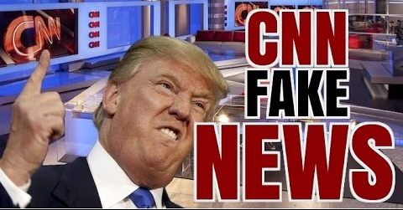

Slide 11
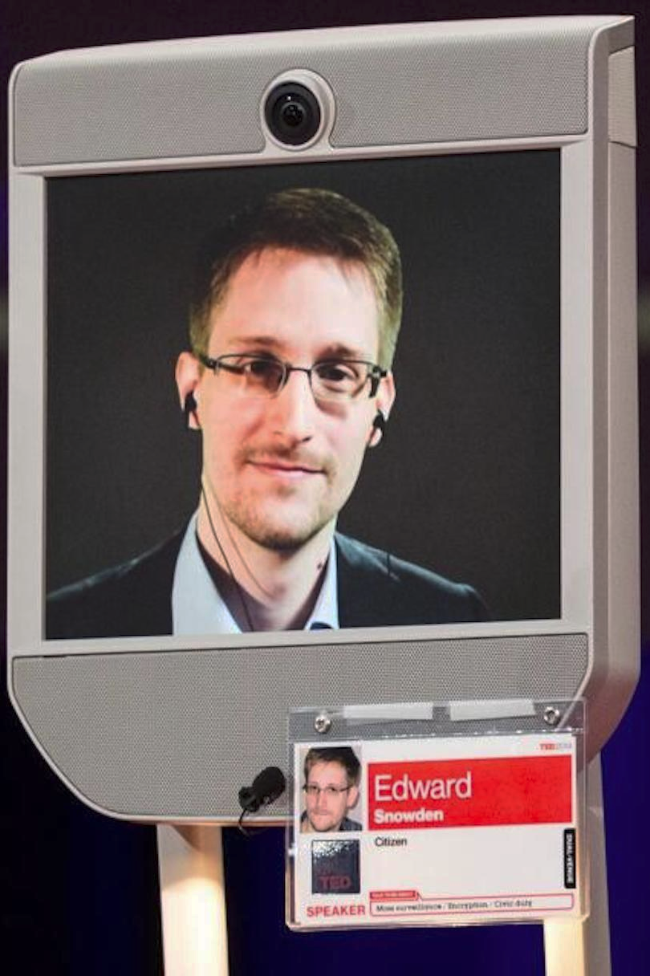
Surveillance
metadata collection, intrusion into company systems, weakening of protections, dragnet collection
roots in WW2 and Cold War, all in the name of security, many conspiracy theories
Snowden and NSA PRISM reveal, 2013
intensive and extensive data collection might serve to prevent security threats such as terrorism, etc.
Notes:
UK engima

Slide 12
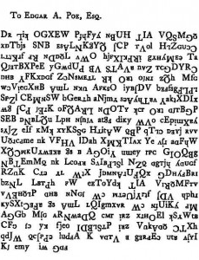
Encryption
runs through all the issues above, typical double-edged technology (TOR, crypto$)
long history, today absolutely indispensable and ever-present
ongoing fight for weak/strong encryption: states vs. corporations vs. people
“catching terrorists, endangering users”
case: San Bernardino iPhone
“solved” by forcing backdoors and masterkeys
Notes:
1109*463=513 467
569*1171=666 299

Slide 13
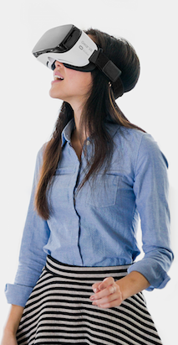
VR/AR
very probable and very close proliferation of virtual/augmented reality technology in society
entertainment, communication, traveling, education, training, therapy… anything else?
health risk (nausea, injuries, eyesight?, psychology?)
societal and security risks?

