Slide 1
Research Basics and Research Design II
Methodology of Conflict and Democracy Studies
September 30

Slide 2
Aim of this lecture
Empirical part of the research
Research design – main components
How to present your design

Slide 3
Step by Step
1. Topic and goals (+ reading)
2. Research questions (+ reading)
3. Hypotheses (+ reading)
4. Methods (+ reading)
5. Data collection
6. Data analysis
7. Results

Slide 4
After the Planning is Done
What comes next:
Data collection
Data analysis
Applies to both qualitative and quantitative research
Data and methods link your ambitions with your results

Slide 5
Before we Start
Validity
We measure what we aim and are supposed to measure
Invalid measure – measuring something different than originally intended
Importance of operationalization
Any thoughts of bad examples?
Reliability
A measure of a concept is reliable to the extent that it is repeatable
If we use same measurement under same conditions, we should gain identical results
Important for checking and repeating previous research
Importance of transparency

Slide 6
A Few Tasks
What to measure if we aim to measure:
Trust of people towards government
Whether a person is concerned with environmental issues
Power of a country
How to provide enough reliability to such measure:
A person aims to weigh himself/herself by standing on a scale
Estimation how newspapers inform about Brexit (positive/negative/neutral)

Slide 7
Strategy of Your Research
How to search for causality?
Methods always depend on your aims and ambitions
Two main strategies:
Experiments
Observational studies

Slide 8
Experiment
Consider the following:
You own a media company. You made a contract with a clothing producer that hires you to increase its sales. You prepare four different commercials. What should the clothing producer do to maximize its profit?
The answer – the producer should run an experiment

Slide 9
Experiment
Estimation of effect of IV on DV by effective controlling for effects of all other confounding variables
The researcher manipulates with the independent variable
Experimental (at least one) and control group
Random assignment as a necessity
Random assignment vs. random sampling

Slide 10
Experiment
Several types:
Laboratory experiment
Field experiment
Natural experiment (quasi-experiment)
Strengths:
Effective isolation of other variables
Reliability, internal validity
Weaknesses:
External validity (vs. experiments based on population sample)
Not always applicable in social sciences
Not all independent variables are subject of manipulation
Need of replication

Slide 11
Transparency at the Local Level
Topic: Reactive provision of information by local governments
Effect of Freedom of Information (FOI) requests on responsiveness of local governments compared to less formal requests
Experimental study on 2,926 municipalities in Slovakia
Requests on information about local elections

Slide 12
Preparation of Experiment
Random assignment of municipalities into three groups
All municipalities obtained an information request
Control group – baseline version
Experimental group 1 – baseline + moral paragraph
Experimental group 2 – baseline + FOI paragraph
All requests sent via e-mail on Monday

Slide 13
Results
FOI requests double responsiveness of municipalities
Higher response rate found among larger towns and towns with independents and female mayors
The effect of content of requests strongly moderated by population size

Slide 14
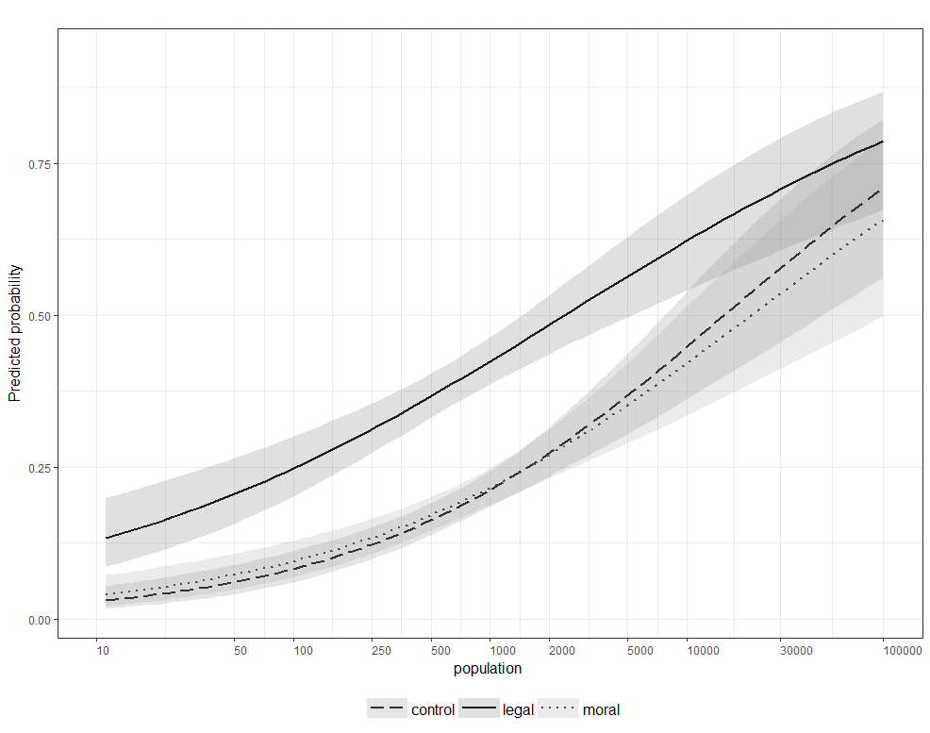

Slide 15
Experiment with Oranges and Discrimination

Slide 16
Observational studies
It does not mean that the researcher stands and physically observes the research object with a binocular
Researchers observe the reality as it is - they do not manipulate with any variables and they have no control over the values of variables
Lesser control over other confounding variables (compared to experiment)
Time-series and cross-sectional studies

Slide 17
Qualitative and Quantitative Research
Both have their strengths and weaknesses
None is superior to the other (although opinions vary)
Different methods and approaches, but the same aims

Slide 18
Qualitative and Quantitative Research
Case study:
Typically research of a single case
Aim is to gain deep and detailed knowledge of the phenomena
Statistical Analysis:
Large N studies
A variety of techniques that allow testing hypotheses on relations between variables
Comparative Method:
Somewhere in between, when you lack enough cases for a statistical analysis
Example - QCA

Slide 19
Work with Data
Large number of techniques and approaches
The choice depends on research aims and data availability
Interview vs. survey:
Deep understanding vs. standardized questionnaire
Number of cases
Length of data collection
Differences in data analysis
Content analysis, discourse analysis, QCA, regression analysis (linear, logistic, multilevel, polynomial…)

Slide 20
Research Ethics
Always be aware of potential problems with ethics
Milgram’s experiment with false electricity shocks
Character of questions in a questionnaire
Informed consent of research participants

Slide 21
Limits of Your Research
There is no “one research to rule them all”
Every research contains limits:
What cannot be analyzed
Is the found relationship between variables important in the real world?
Are there any obstacles that limit your research?
Be transparent on limits

Slide 22
Research Design
Basic points:
Selection of the topic and your aims
Previous theory
What is already known
Gaps in the literature
Questions (and hypotheses)
Data and Methods
Ethics and limits
Always explain – Why do you have such a research question? Why is it important to study your case? What is added value of your research?

Slide 23
Some Good Rules to Follow
1. Well set goals (and the topic) spare you time and energy
2. Methods are not your goals, but the tools to achieve your aims
3. Proper reading is a must
4. Research design and planning is essential

