Slide 1
Descriptives, Crosstabs, Correlation
Methodology of Conflict and Democracy Studies
December 2

Slide 2
Aim of this lecture
How to obtain basic information about your data
Control of the assumptions
Association of two variables:
  Crosstabs (Contingency tables)
  Correlation

Slide 3
Descriptive Statistics
Basic measures to summarize the characteristics of your data
Various types:
  Central tendencies – mean, median, modus
  Dispersion – standard deviation, variance, minimum, maximum
Not all descriptives are suitable for all types of variables
We use them to describe and explore your data

Slide 4
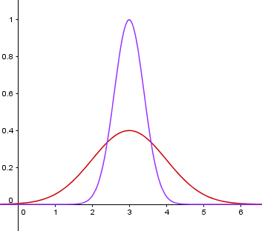

Slide 5
 | Variable | Mean | Std. Dev. | Minimum | Maximum
Reelection | Nominal | 0.75 | 0.43 | 0 | 1
Number of grants | Scale | 1.33 | 1.52 | 0 | 10
Grant in election year | Nominal | 0.36 | 0.48 | 0 | 1
Incumbent terms | Scale | 2.19 | 1.21 | 1 | 6
Unemployment | Scale | 19.41 | 13.15 | 0.00 | 94.94
Number of challengers | Scale | 2.18 | 1.38 | 1 | 7
Grants in EUR (per capita) | Scale | 77.74 | 209.62 | 0.00 | 5,331.82
Mayor from governing party | Nominal | 0.41 | 0.49 | 0 | 1

Slide 6
How to Obtain Descriptives in SPSS
Analyze > Descriptive Statistics > Frequencies
Move variables of interest to the right
In ‘Statistics’ choose all measures you require

Slide 7
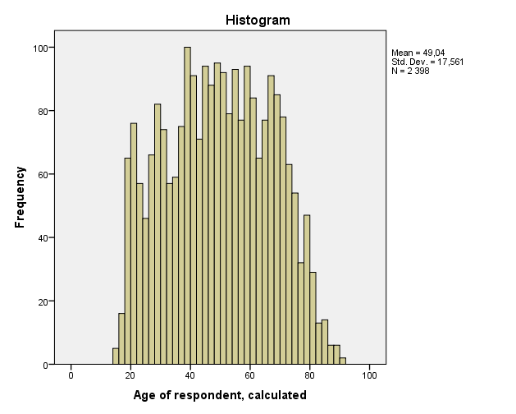
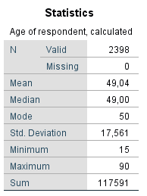

Slide 8
Assumptions of Data
Not all data are suitable for all statistical tests
Parametric and Non-parametric tests
Parametric tests as a preference v. higher requests on data

Slide 9
Parametric Data
Scale data (at least interval)
Independence
Normally distributed data
Homogeneity of variance

Slide 10
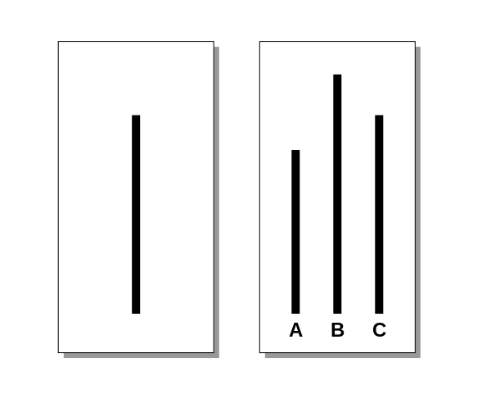
Independence

Slide 11
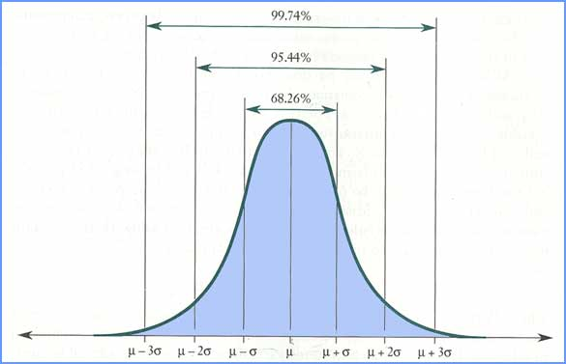
Normal Distribution

Slide 12
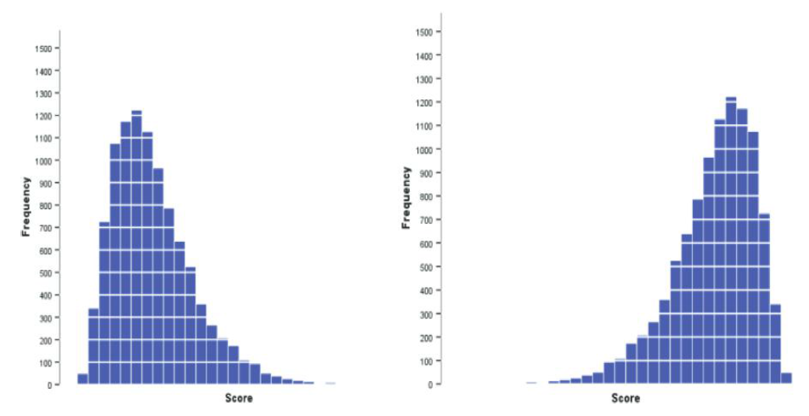
Skewness

Slide 13
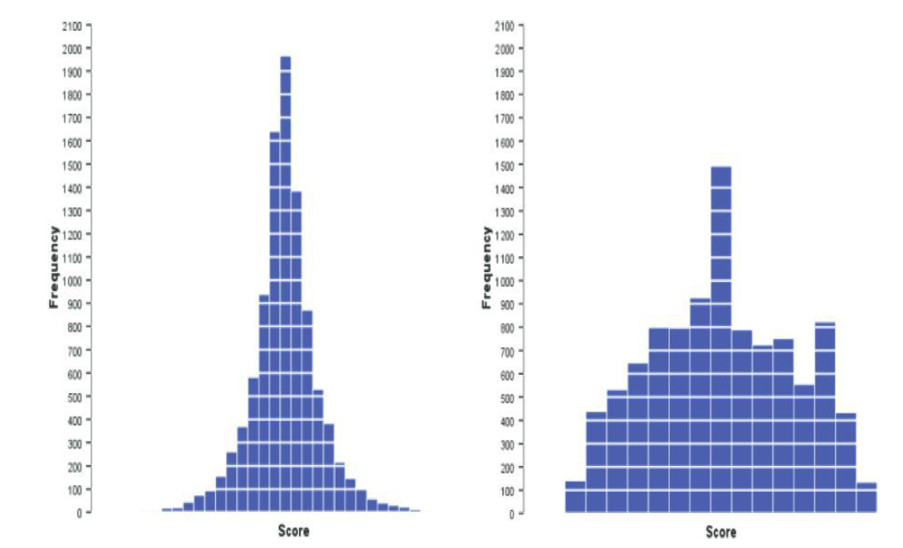
Kurtosis

Slide 14
How to Check the Distribution
Visual control – Histogram
Calculation of skewness and kurtosis
Statistical tests:
  Kolmogorov-Smirnov
  Shapiro-Wilk

Slide 15
Histogram
Analyze > Descriptive Statistics > Frequencies
In ‘Charts’ choose ‘Histogram’
Select ‘Show normal curve on histogram’ to draw a line corresponding to normal distribution

Slide 16
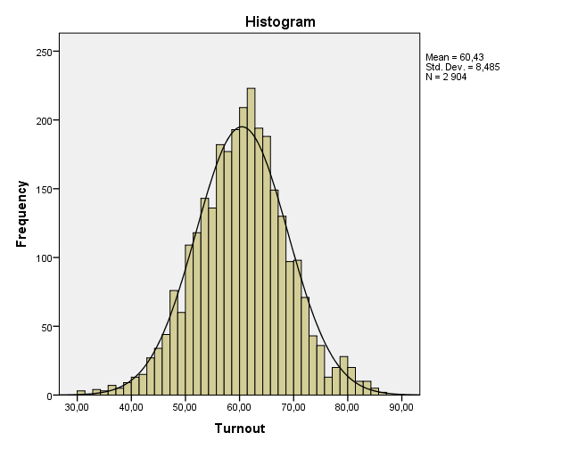

Slide 17
Skewness and Kurtosis
Analyze > Descriptive Statistics > Frequencies
In ‘Statistics’ choose these two options
The values are only informative – you have to divide them by their standard error
Acceptable values:
  Small sample – between -1.96 and 1.96
  Medium sample – between -2.58 and 2.58
  Large samples – do not use it

Slide 18
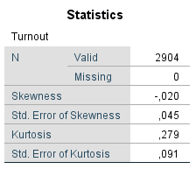
Skewness:
  -0.020 / 0.045 = -0.44
Kurtosis:
  0.279 / 0.097 = 3.07

Slide 19
Statistical Tests
Kolmogorov-Smirnov (Shapiro-Wilk)
  Both test the null hypothesis that your data are normally distributed
Results:
  Significant (p <= 0.05) – we reject the null hypothesis
  Not significant (p > 0.05) – we keep the null hypothesis
With large samples the tests tend to lead to significant results without meaningful reason

Slide 20
Statistical Tests
Analyze > Descriptive Statistics > Explore
Place variable of your interest into ‘Dependent List’
In ‘Plots’ select ‘Normality plots with tests’

Slide 21
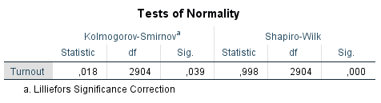

Slide 22
Parametric Data
Scale data (at least interval)
Independence
Normally distributed data
Homogeneity of variance

Slide 23
Homogeneity of Variance
Assumption that the variances in various levels of data are equal
The levels are defined by other (categorical) variable
We use only a single test for this assumption
Levene test

Slide 24
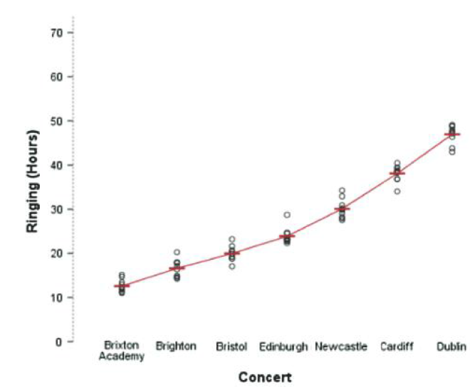
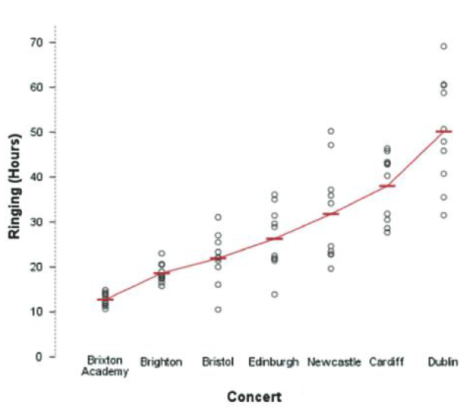
Homogeneity of Variances

Slide 25
Levene Test
Tests the null hypothesis that variances are equal
Results:
  Significant (p <= 0.05) – we reject the null hypothesis
  Not significant (p > 0.05) – we keep the null hypothesis
With large samples the tests tend to lead to significant results without meaningful reason

Slide 26
Levene Test
Analyze > Descriptive Statistics > Explore
Place variable of your interest into ‘Dependent List’
Place second variable that defines the levels of data into ‘Factor list’
In ‘Plots’ select ‘Spread vs Level with Levene Test’ and ‘Untransformed’

Slide 27
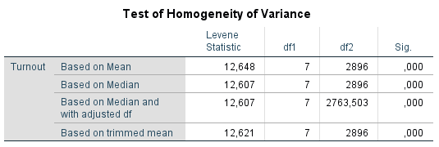

Slide 28
Association of Two Variables
Depends on types of variables
Crosstabs:
  Suitable for two categorical variables
  Low amount of categories in your variables (but at least two per variable)
Correlation:
  Two scale variables, scale and ordinal, two ordinal variables
  Specific case – scale and binary variable

Slide 29
Crosstabs
Contingency tables
Describe interaction of two categorical variables
Age groups of people v. turnout in election (yes/no)
Allows generalization to population

Slide 30
Crosstabs
Analyze > Descriptive statistics > Crosstabs
Select variables for Columns and Rows
Features:
  Cells – counts, percentages, residuals
  Statistics – Chi-square, Cramer’s V
Try not to fill your crosstab with too many features

Slide 31
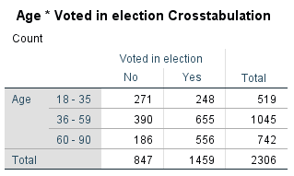
Counts: Observed

Slide 32
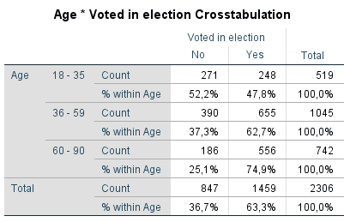
Counts: Observed
Percentages: Row

Slide 33
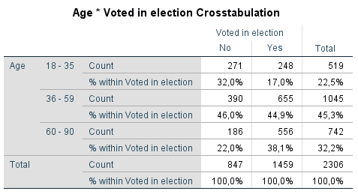
Counts: Observed
Percentages: Column

Slide 34
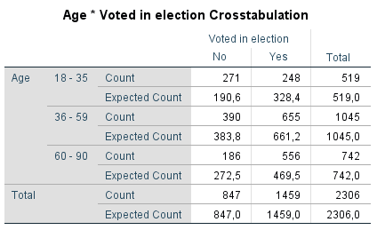
Counts: Observed + Expected

Slide 35
Counts: Observed
Percentages: Row
Younger people do not vote to the same extent than older people
But can we apply this to the whole population?

Slide 36
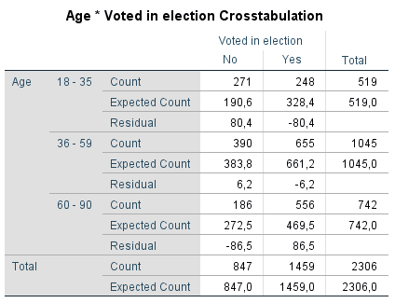
Counts: Observed + Expected
Residuals: Unstandardized

Slide 37
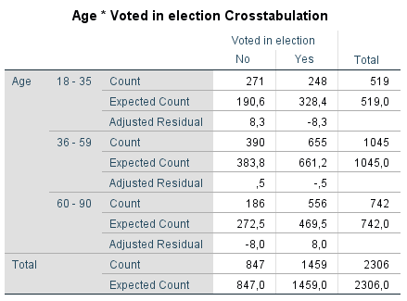
Counts: Observed + Expected
Residuals: Adjusted standardized

Slide 38
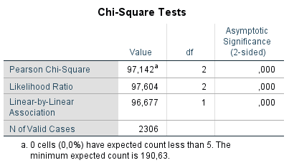
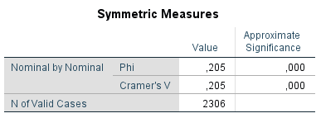
Counts: Observed + Expected
Residuals: Adjusted standardized
Chi-square, Cramer’s V

Slide 39
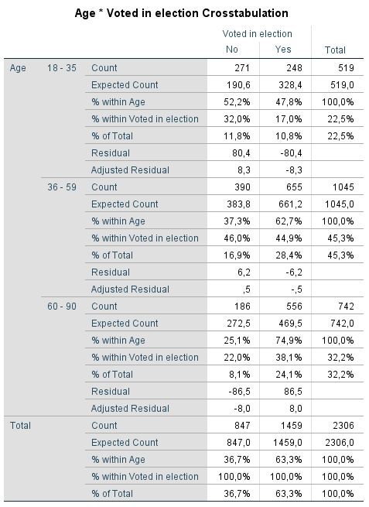
Why Not Make It Too Complicated?

Slide 40
Adding Layers

Slide 41
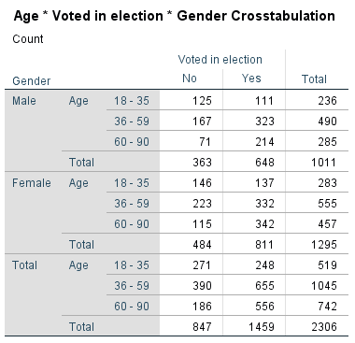
Adding Layers

Slide 42
Correlation
Association between two variables (for other cases than crosstabs)
Examples: two scale variables, scale and ordinal, two ordinal variables
Three coefficients:
  Pearson
  Spearman
  Kendall

Slide 43
Correlation
Results vary on a scale between -1 and 1
Interpretation:
  Zero means no association between the variables
  Rising distance from zero show rising association (regardless the direction – negative or positive)
  -1: perfect negative association
  1: perfect positive association
Beware of false absence of association
Always good to visualize data before calculating correlations

Slide 44
Pearson’s Correlation Coefficient
Parametric operation
Requirements:
  Scale data (exemption – scale and binary)
  If we aim to apply the findings to population we need normally distributed data (or a large sample)
Sensitive to outliers

Slide 45
Pearson’s Correlation Coefficient
Visualize the data
  Graphs > Chart Builder
  Select Scatter/Dot a variables of your interest
Correlation
  Analyze > Correlate > Bivariate
  Select variables and the proper coefficient (PCC is set by default)
  For significance select ‘Flag significant correlations’

Slide 46
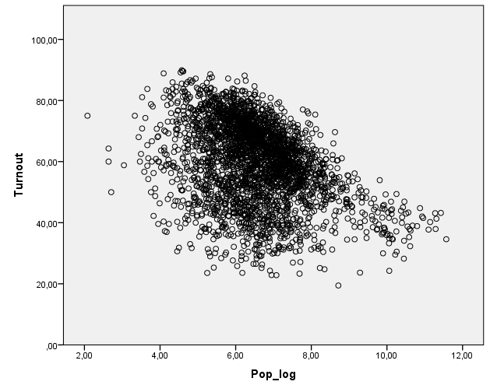

Slide 47
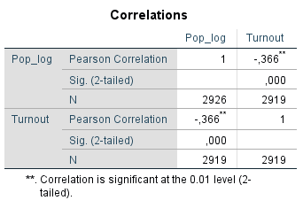

Slide 48
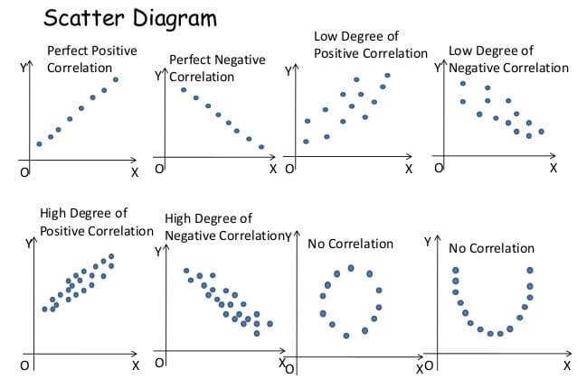

Slide 49
Pearson’s Correlation Coefficient
Scale variable and binary variable
Works the same as for two scale variables
Beware of coding of the binary variable (you provide codes for each value)

Slide 50
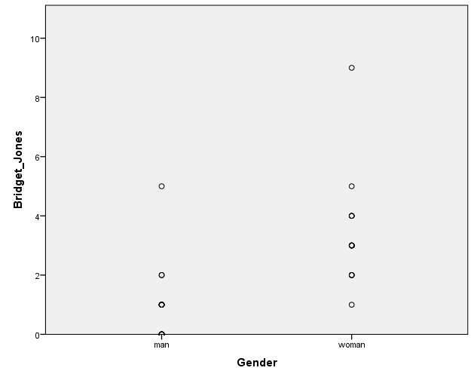
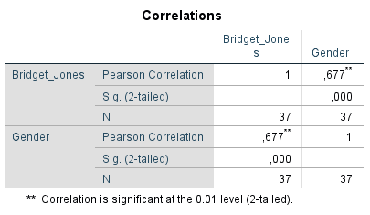

Slide 51
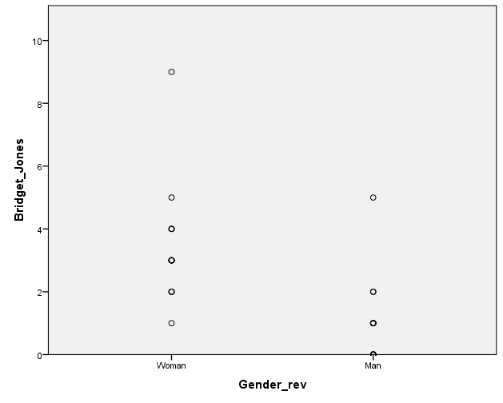
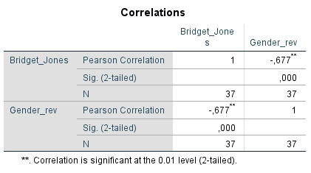

Slide 52
Non-Parametric Correlation
Spearman’s Rho and Kendall’s Tau
  Correlation for other cases than two scale variables (or scale and binary)
  Same interpretation as in Pearson’s CC
  Preference of Kendall’s Tau if variables contain less categories and for smaller samples
Analyze > Correlate > Bivariate
  Select variables and Spearman/Kendall
  For significance select ‘Flag significant correlations’

Slide 53
Interpretation
Correlation does not imply causality
  No control of other variables
  No independent and dependent variable
You cannot tell that one variable affects the other even in cases when such relationship seems to be meaningful and logical
Keep the interpretation of effects of IVs on DV for the regression analysis

