Slide 1
Regression Analysis
Methodology of Conflict and Democracy Studies
December 9

Slide 2
Aim of this lecture
How to do regression analysis
Which regression analysis to choose:
  Linear (OLS – Ordinary Least Squares) regression
  Logistic regression
Interpretation of the results

Slide 3
Regression Analysis
A variety of techniques with the same aim
Identification of effects of one or more IVs on DV
What it allows:
  Identify effect of each independent variable
  Control of effects of other independent/control variables
  Predict values of DV based on specific values of IVs

Slide 4
Which Regression?
Everything depends on your dependent variable
Linear (OLS) regression:
  Scale variable (or long ordinal)
Logistic regression:
  Binary variable (0/1) – binary logistic regression
  Nominal (0/1/2/3) – multinomial logistic regression
No limits on independent variables (all types allowed)

Slide 5
Examples
OLS regression:
  How do age, gender and education affect income of people?
  Does attendance on lectures increase % amount of obtained points in your courses?
Logistic regression:
  Do men have higher chances to end up in jail than women?
  Does attendance on lectures increase your chances of avoiding F in a course?

Slide 6
OLS Regression - Requirements
Dependent variable:
  Exactly one variable, normal distribution
Independent variable:
  One or more variables, all types without limits
Further requirements:
  Independence of observations
  No collinearity between independent variables
  Linear relationship between IVs and DV
  Homogeneity of distribution of residuals

Slide 7
What is OLS Regression about?
Basically OLS regression is about searching for ideal lines that best describe the relationship between independent and dependent variable
The best line is the one that is the least inaccurate of all possible lines
Accuracy measured using sum of squares of vertical differences between predicted and observed data

Slide 11
The Outcomes of OLS Regression
OLS regression estimates:
  Intercept
  Effects of each independent variable
y = b₀ + b₁*x + b₂*y + b₃*z + …
y stands for predicted value of dependent variable
b₀ stands for intercept
b₁, b₂, b₃ etc. stand for slopes of independent variables x, y, z etc.

Slide 12
R square
Provides information about the overall fit of the model
How well our model (= our IVs) explain the dependent variable
Comparison of improvement of regression line compared to mean
Ranges from 0 to 1 (zero to hundred per cent)
Show how much of the variance of dependent variable we are able to explain using our set of independent variables
Use Adjusted R square to control for inflation of number of IVs

Slide 13
Intercept (Constant)
The predicted value of dependent variable if the values of all independent variables are zero
y = b₀ + b₁*x + b₂*y + b₃*z
If x, y, z etc. = 0 then
y = b₀ + b₁*0 + b₂*0 + b₃*0
y = b₀

Slide 14
Outcomes Concerning Independent Variables
Unstandardized B coefficient:
  Shows how the value of dependent variable changes if the value of an independent variable increases by one unit
  For example if IV is measured in hours – the B coefficient shows how the DV changes if the value of IV increases by one hour
y = b₀ + b₁*x + b₂*y + b₃*z

Slide 15
Outcomes Concerning Independent Variables
Unstandardized B coefficient:
  Shows how the value of dependent variable changes if the value of an independent variable increases by one unit
  For example if IV is measured in hours – the B coefficient shows how the DV changes if the value of IV increases by one hour
Standardized Beta coefficient:
  Compares the importance of IVs
  Higher distance from zero shows higher importance of IV
Significance:
  Shows whether the found effect of IV can be applied to population

Slide 16
Example
Is turnout in local elections affected by town population?
Hypothesis: Turnout decreases as population increases
Null hypotheses: There is no relation between population size and turnout
Dependent variable:
  Turnout – turnout in % (scale)
Independent variable:
  Population_th - town population in thousands of people (scale)

Slide 17
How to Perform the OLS Regression
Analyze > Regression > Linear
Select the variables:
  Turnout into ‘Dependent’
  Population_th in the section for independent variables

Slide 18
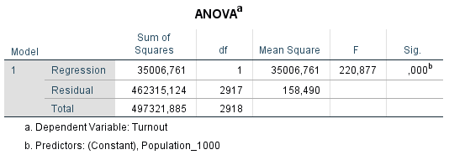
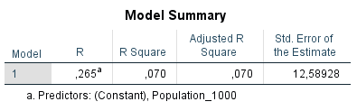
Model Summary:
  Our model explains 7 per cent (0,07 * 100) of variance of dependent variable
ANOVA:
  Our model is a significant improvement in predicting the dependent variable and our results can be applied to the population

Slide 19
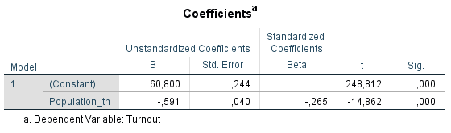
Intercept (Constant):
  Predicted value of dependent variable if all independent variables = 0
  In a (non-existing) town with zero population the turnout in local election is predicted as 60.8 per cent
y = b₀ + b₁*x
y = 60.8 + b₁*x

Slide 20
Unstandardized B:
  Shows how the value of DV changes if the value of an IV increases by one unit
  Population_th is measured in thousands of people
  Interpretation – for each thousand people living in a town the turnout drops by 0.591 percentage points
  This effect is significant at 99.9 % and so it can be applied to population (we reject the null hypothesis about absence of relationship between IV and DV)
y = b₀ + b₁*x
y = 60.8 + (-0.591)*x
y = 60.8 – 0.591*x

Slide 21
Predictions Based on Results
y = b₀ + b₁*x
Turnout = 60.8 – 0.591*Population_th
 | Population | Population in thousands | Formula | Predicted turnout
Town 1 | 500 | 0.5 | 60.8 – 0.591*0.5 = 60.8 – 0.296 | 60.5
Town 2 | 1,000 | 1 | 60.8 – 0.591*1 = 60.8 – 0.591 | 60.2
Town 3 | 5,000 | 5 | 60.8 – 0.591*5 = 60.8 – 2.955 | 57.8
Town 4 | 10,000 | 10 | 60.8 – 0.591*10 = 60.8 – 5.91 | 54.9
Town 5 | 25,000 | 25 | 60.8 – 0.591*25 = 60.8 – 14.775 | 46.0

Slide 22
Example 2
Is turnout in local elections affected by town population, the local financial situation and whether there is a true competition?
Dependent variable:
  Turnout – turnout in % (scale)
Independent variables:
  Population_th - town population in thousands of people (scale)
  Fin_Index – indicator of financial situation in town (1-6; 1 = worst, 6 = best) (scale)
  Competition – 1 for at least two competitors or 0 for only one competitor (binary)

Slide 23
How to Perform the OLS Regression
Analyze > Regression > Linear
Select the variables:
  Turnout into ‘Dependent’
  Population_th in the section for independent variables
Because we have more than one IV:
  Statistics > Collinearity Diagnostics

Slide 24
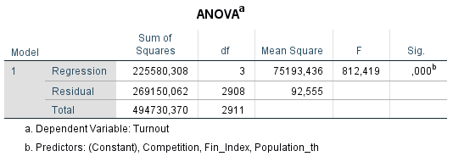
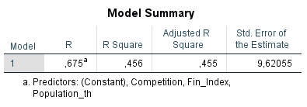
Our model explains 45.5 per cent of variance of dependent variable
Substantial improvement compared to model that included only one independent variable
Our model is a significant improvement in predicting the dependent variable and our results can be applied to the population

Slide 25
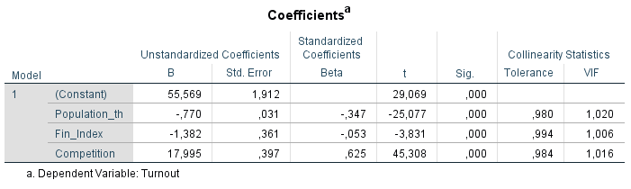
Intercept (Constant):
  Predicted value of dependent variable if all independent variables = 0
  In a (non-existing) town with zero population, financial index of 0 and with only a single competitor the turnout in local election is predicted as 55.569 per cent
y = b₀ + b₁*x + b₂*y + b₃*z
y = 55.569 + b₁*x + b₂*y + b₃*z

Slide 26
Unstandardized B:
  Shows how the value of DV changes if the value of an IV increases by one unit
  Population_th is measured in thousands of people
  Interpretation – for each thousand people living in a town the turnout drops by 0.77 percentage points
  This effect is significant at 99.9 % and so it can be applied to population (we reject the null hypothesis about absence of relationship between IV and DV)
y = b₀ + b₁*x + b₂*y + b₃*z
y = 55.569 – 0.77*x + b₂*y + b₃*z

Slide 27
Unstandardized B:
  Shows how the value of DV changes if the value of an IV increases by one unit
  Fin_Index is measured on a scale from 1 to 6
  Interpretation – for each increase on the financial scale by one the turnout drops by 1.382 percentage points
  This effect is significant at 99.9 % and so it can be applied to population (we reject the null hypothesis about absence of relationship between IV and DV)
y = b₀ + b₁*x + b₂*y + b₃*z
y = 55.569 - 0.77*x - 1.382*y + b₃*z

Slide 28
Unstandardized B:
  Shows how the value of DV changes if the value of an IV increases by one unit
  Competition is a binary variable (0 = no competition; 1 = at least two candidates)
  Interpretation – if there is a competition, the turnout in town increases by 17.995 percentage points
  This effect is significant at 99.9 % and so it can be applied to population (we reject the null hypothesis about absence of relationship between IV and DV)
y = b₀ + b₁*x + b₂*y + b₃*z
y = 55.569 - 0.77*x - 1.382*y + 17.995*z

Slide 29
Unstandardized B Coefficient
Scale v. Binary Variables
Same definition for scale and binary variables:
  Shows how the value of DV changes if the value of an IV increases by one unit
BUT
Binary (dummy) variables have only two values – 0 and 1
  Unlike scale variables, there is only one possible increase by one unit
  The estimated effect is thus completely exhausted by this one increase

Slide 30
Competition:
  0 – no competition (only one candidate)
  1 – competition (at least two candidates)
  Shift from 0 to 1 means that towns with competition are predicted to have a nearly 18 percentage points higher turnout than towns without competition
Population_th:
  Shift of population from 1 thousand to 2 thousand leads to drop of turnout by 0.77 percentage points
  Shift of population from 1 thousand to 5 thousand leads to drop of turnout by 3.08 percentage points (4 times decrease of 0.77)
  Shift of population from 5 thousand to 12 thousand leads to drop of turnout by 5.39 percentage points (7 times decrease of 0.77)

Slide 31
Standardized Beta Coefficient
Provide information about importance of independent variables
Measured in standard deviation units → allow to easily compare the IVs
Higher distance from zero (both positive and negative) indicates higher importance of the independent variables

Slide 32
Results show that Competition is the most important predictor of all three independent variables
Population_th is less important and Fin_Index is the least important

Slide 33
Predictions Based on Results
y = b₀ + b₁*x + b₂*y + b₃*z
Turnout = 55.569 – 0.77*Population_th – 1.382*Fin_Index + 17.995*Competition
 | Population | Fin_Index | Competition | Formula | Predicted turnout
Town 1 | 1,000 | 3 | 0 | 55.569 – 0.77*1 – 1.382*3 + 17.995*0 | 50.7
Town 2 | 1,000 | 3 | 1 | 55.569 – 0.77*1 – 1.382*3 + 17.995*1 | 68.6
Town 3 | 5,000 | 3 | 0 | 55.569 – 0.77*5 – 1.382*3 + 17.995*0 | 47.6
Town 4 | 10,000 | 6 | 1 | 55.569 – 0.77*10 – 1.382*6 + 17.995*1 | 57.6
Town 5 | 25,000 | 6 | 0 | 55.569 – 0.77*25 – 1.382*6 + 17.995*0 | 28.0

Slide 34
Control of Assumptions
Outliers – cases with extreme values
Heteroscedasticity – variance of residuals
Collinearity – association between independent variables
How to do that:
  Analyze > Regression > Linear
  Statistics > Collinearity diagnostics + casewise diagnostics (2.5)
  Plots > Y: ZRESID, X: ZPRED

Slide 35
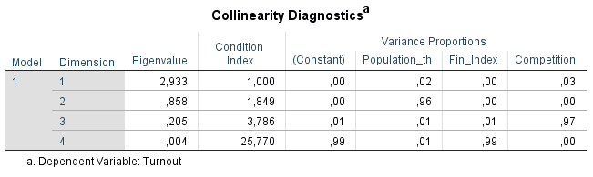
VIF above 5 (10) or Tolerance below 0.2 (0.1) constitutes a problem
Similarly more higher values on same dimensions indicate collinearity
Solution – more models or dropping one of the variables

Slide 36
Outliers
The data should contain up to:
  5 % of cases with residual above 2 (below -2)
  1 % of cases with residual above 2.5 (below -2.5)
If we find outliers we can rerun the model without these cases and compare whether the results change

