Slide 1
Reconnection of Eurasia
Tomáš Šmíd, PhD.

Slide 2
Ancient Silk Road and Tea Horse Road
Silk Road land route passed through the Gansu (or Hexi) Corridor, extended westwards to Xinjiang, and then split into several routes;
Tea Horse Road started from Yunnan and Sichuan and crosses Tibet;
Around 300 BC, civilizations active in the Silk Road trade included Ancient Greece, Persia, Yuezhi, and the Qin State that controlled the eastern part of the Gansu Corridor - this corridor is a huge very long valley that extends from Luoyang to Xinjiang;
important and famous in Silk Road History was Sogdian Empire;

Slide 3

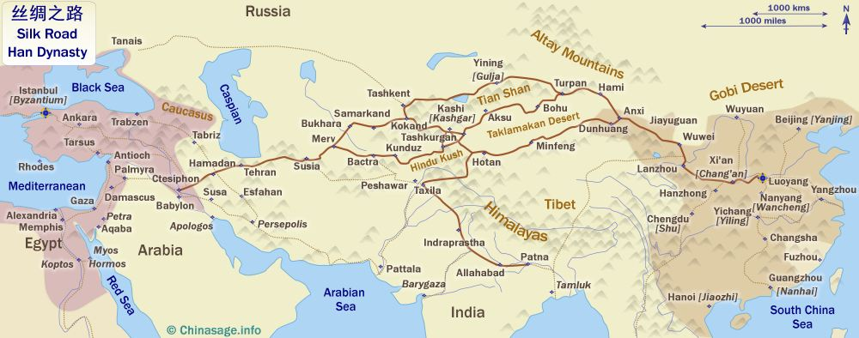
SILK ROAD

Slide 4
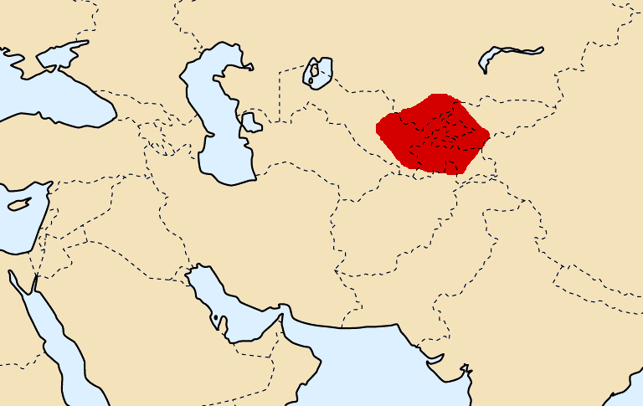
Sogdian territories

Slide 5
Silk Road and Han Dynasty
Silk Road trade commenced in a great fashion through the work mission of General of Han Dynasty Zhang Qian (200–114 BC);
Zhang was an envoy to build relationships with the Central Asian states and to find their former allies, the Yuezhi people, who had left Xinjiang and the Gansu Corridor;
Yuezhi founded famous Kushan Empire in Central Asia;

Slide 6
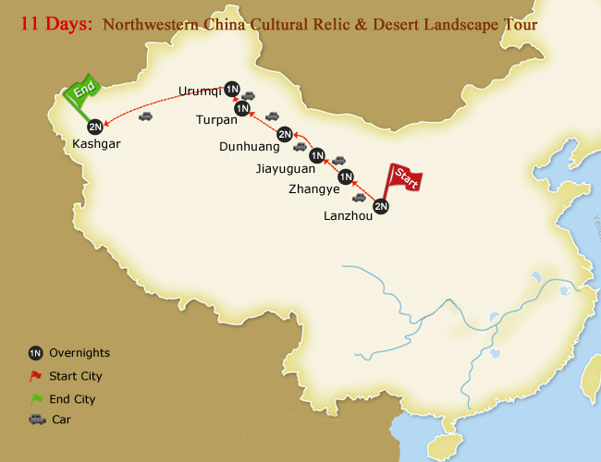
Gansu Corridor

Slide 7
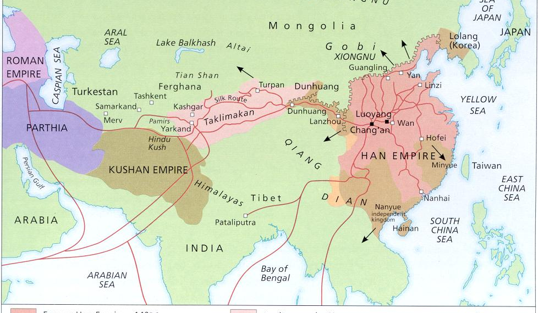

Slide 8
Silk Road and Tang Dynasty
In the early Tang Dynasty (618–917) era, the Silk Road route in Xinjiang was controlled by Turkic tribes. They allied with small states in Xinjiang against the Tang;
The Tang Dynasty later conquered the Turkic tribes, reopened the route, and promoted trade. Trade with the West boomed;
The Tang Empire ended in 907, and there followed some decades of warfare until the Song Empire arose. The Song Empire was powerful, but they didn't have control of the Gansu Corridor;

Slide 9
Silk Road and Mongols
Then, in 1127, the Song court was forced south of the Yangtze River, and the remaining Southern Song Empire was even further from the Silk Road route. Then in 1200s, the Mongols attacked them;
However, as the Mongol Empire expanded in Central Asia and Europe before the fall of the Southern Song Empire, they promoted and protected the trade on the western Silk Road routes;
Trade on the Silk Road revived and reached its zenith during the Yuan Dynasty (1271–1368), when the Mongols promoted trade in their huge empire that stretched across Eurasia. Genghis Khan conquered all the small states, unified China, and built a large empire under his rule;

Slide 10
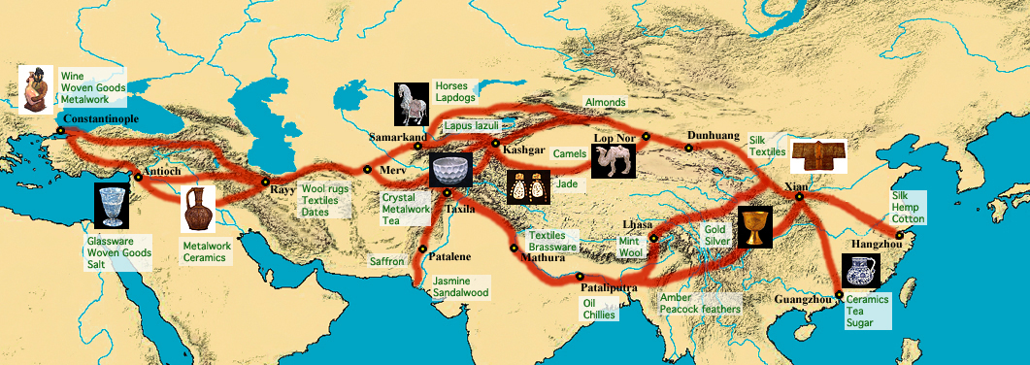
Classical Silk Road

Slide 11
End of Ancient Silk Road
By the 1500s, European trading ships were regular plying Ming Empire coastal waters, and as travel by sea became easier and more popular, trade along the Silk Road declined. At the same time, it became more difficult to travel overland. Ship transportation was faster and more economical;
The conquest of the Byzantium Empire and the Ottoman control of western Asia kept Europe and the empires of the Ming and Qing separated from the West, and overland travel became dangerous. While trade of silk for furs with the Russians north of the original Silk Road continued, by the end of the fourteenth century, trade and travel along the route had decreased significantly;
After this, some of the Central Asian Silk Road routes, especially those in high-mountain areas in Tajikistan, Afghanistan, China, Pakistan and India continued to be used until the beginning of the 20th century

Slide 12
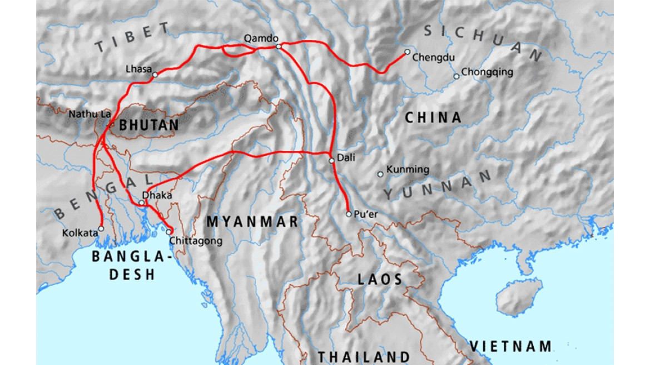
Tea Horse Road
the empires of the Ming and Qing dynasties continued trade in silk, but especially of tea, with Tibet and southern Asia via the very old Tea Horse Road (Chama in Chinese) trade routes. This trade route is also called the "Southern Silk Road.";
Yunnan and Sichuan were big exporters of tea for more than a thousand years to the Tibetan Empire. In return, the Tibetans exported horses and various products;
However, during modern times, maritime trade and the availability of Indian and Ceylon tea made the Tea Horse trade route obsolete;

Slide 13
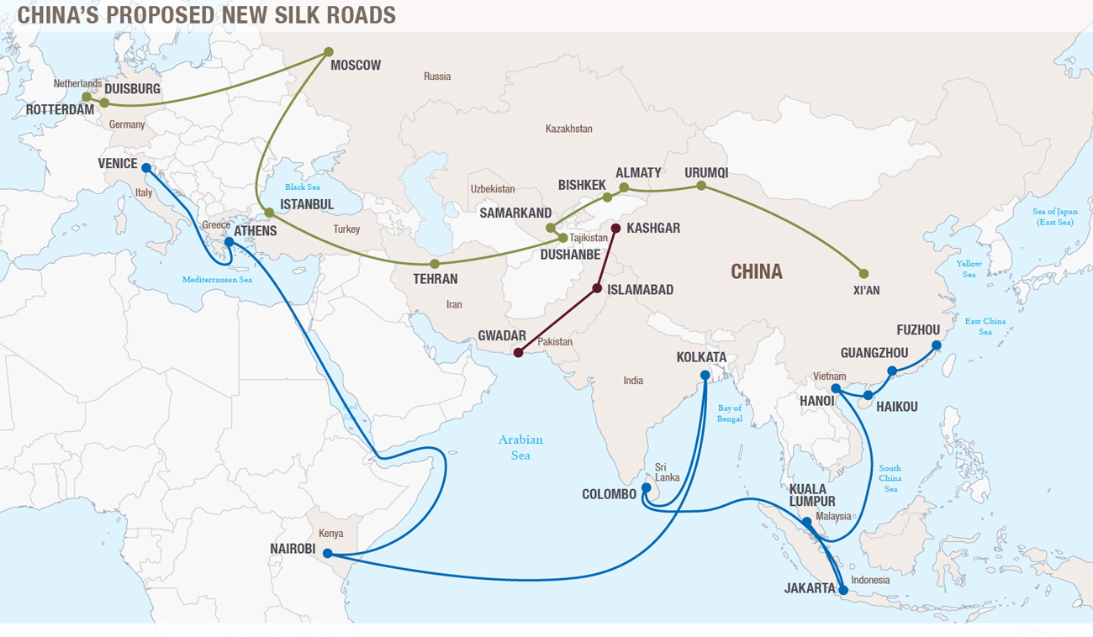
New Silk Road
Silk Road Economic Belt;
21st Century Maritime Silk Road;
More generally Belt and Road Initiative;

Slide 14
Silk Road Economic Belt
Silk Road Economic Belt has several directions. On the one side, it aims to promote better connections between China, Central Asia, Russia and the northern part of Europe. It also strives to connect China through Central Asia with the Persian Gulf, West Asia, the Mediterranean and Central and Eastern Europe. Thirdly, it aims at improving linksbetween China and South East Asia, South Asia and the Indian Ocean;

Slide 15
21st century Maritime Silk Road and String of Pearls
21st century Maritime Silk Road tends to bring together (eastern) coast of China and Europe via the South China Sea and the Indian Ocean, as well as the (southern) China’s coast with the Pacific across the South China Sea;
Part of this strategy is String of Pearls;

Slide 16
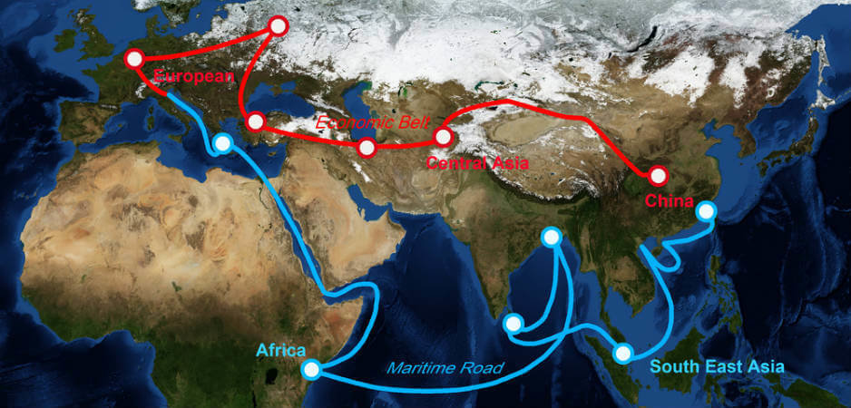
String of Pearls

Slide 17
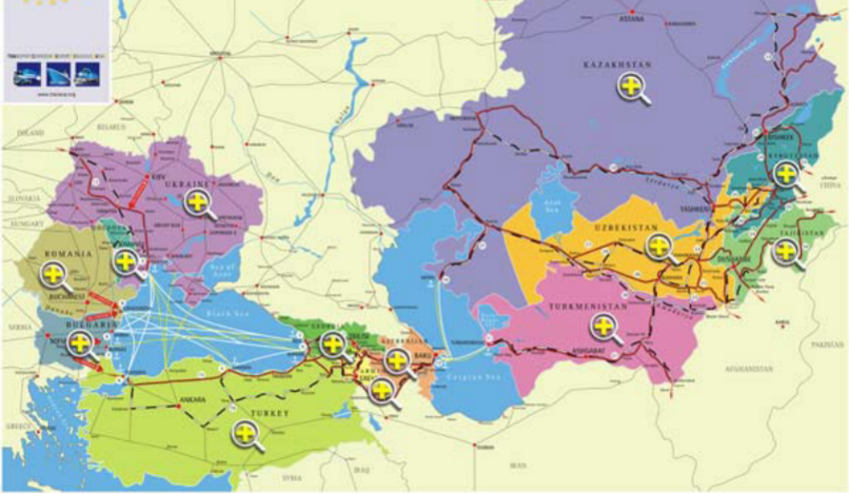
TRACECA - Transport Corridor Europe-Caucasus-Asia
13 member-states of the “Basic Multilateral Agreement on International Transport for Development of the Europe-the Caucasus-Asia Corridor” (MLA TRACECA): Armenia, Azerbaijan, Georgia, Iran, Kazakhstan, Kyrgyzstan, Moldova, Romania, Tajikistan, Turkey, Ukraine and Uzbekistan;

Slide 18
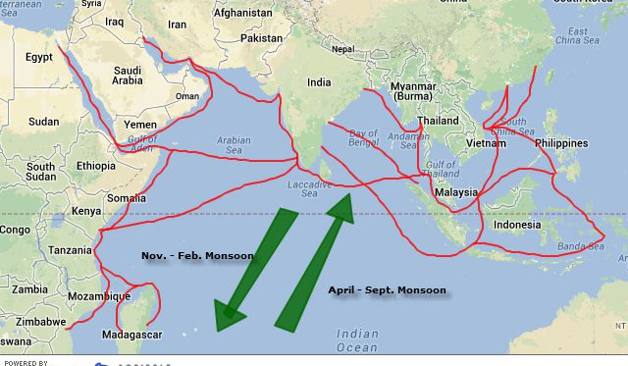
Cotton Route
New Delhi is now looking to counter Beijing influence in the Indian Ocean region by reviving the Cotton Route to boost relations and exploit trade potential with nations across the Indian Ocean region;
Apart from Cotton Route, India will also launch Project Mausam to expand ancient maritime route linkages and cultural links with neighbouring nations

Slide 19
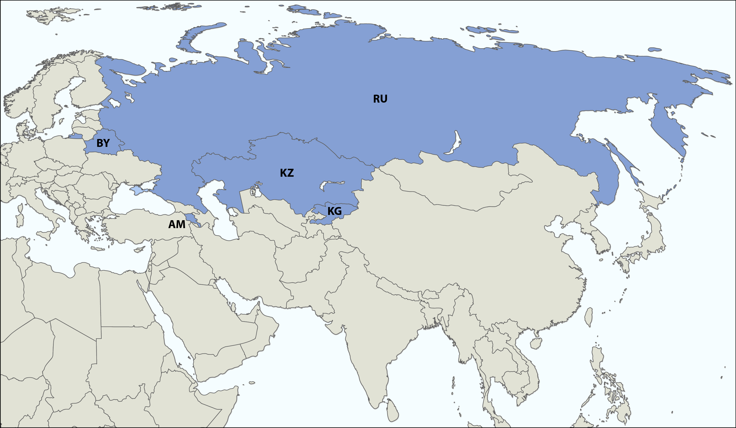
Eurasian Economic Union

Slide 20
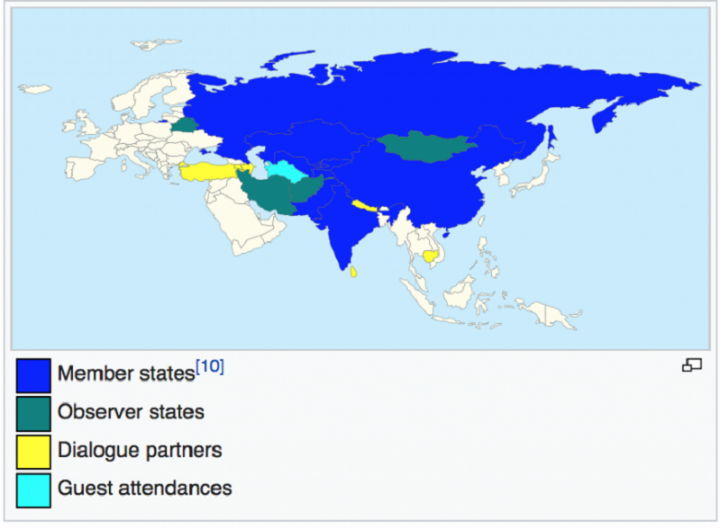
Shanghai Cooperation Organisation

