Slide 1
Lecture 1: Systems thinking, system diagrams, systems analysis
Lecture 2: Ecosystems, Succession, Dynamics, Complex systems cycle (Holling)
Lecture 3: Human population
Lecture 4: Agriculture
Lecture 5: Energy basis for socio-ecological development: from solar to fossil fuels back to solar
Lecture 6: Global Climate Change
Lecture 7: Ecological Economics and Ecosystem Services
Lecture 8: Urban systems
Lecture 9: Sustainability and Sustainable Development Goals

Slide 2
Lecture 1: Systems thinking, system diagrams, systems analysis

Slide 3
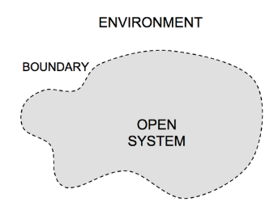
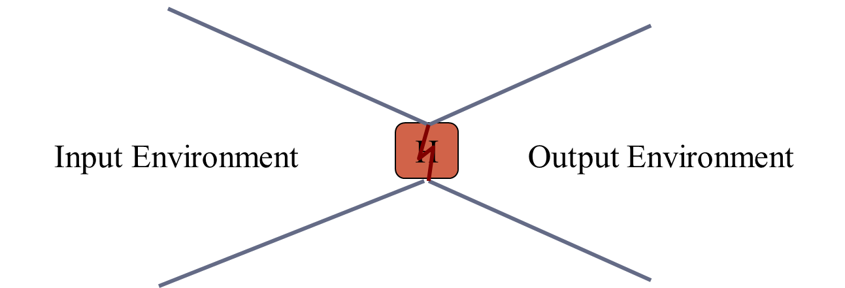
System boundaries
What is part of your question and what is not?
How you determine this first part largely determines the answers the question
Every system is a process

Slide 4
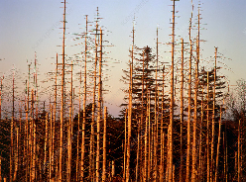
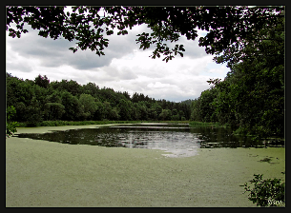
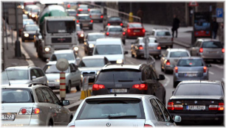
Unintended consequences
Acid precipitation/rain
Ozone depletion
Eutrophication
Global climate change
Automobile dependency
…
All of today’s major environmental problems emerge from yesterday’s solutions.

Slide 5
Key systems concepts
Input-Output models
Feedback
Time lags
Exponential growth
Irreversibility

Slide 6
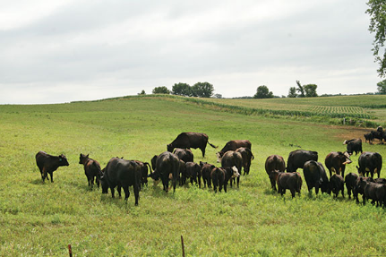
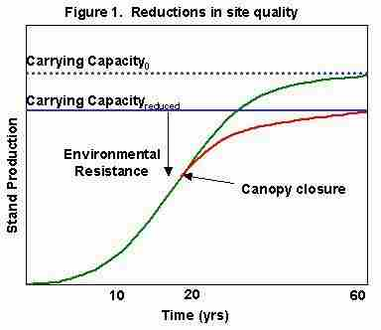
Carrying Capacity
max number of individuals of a species that can be sustained by an environment without decreasing the capacity of the environment to sustain that same amount in the future.

Slide 7
Lecture 2: Ecosystems, Succession, Dynamics, Complex systems cycle (Holling)

Slide 8
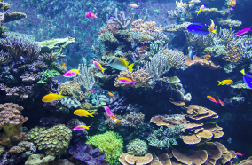
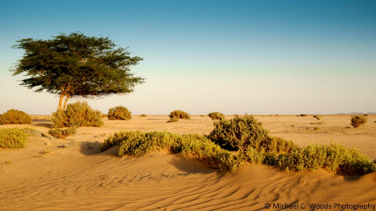
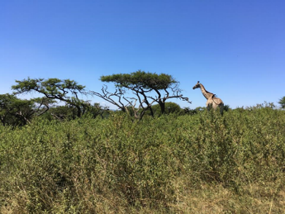
Ecosystem has
structure (parts) and
function (processes) and is
dynamic (orderly change called succession)
Two main functions are
Transfer/Exchange of energy
Cycling of material (particularly nutrients)

Slide 9
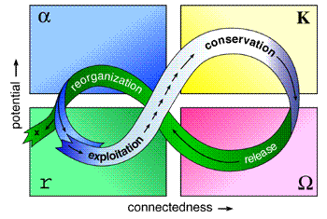
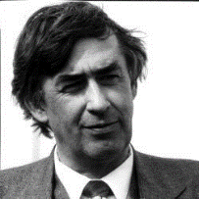
Complex Systems Cycle: Holling’s 4-stage model of ecosystem dynamics
Logistic growth only captures part of the cycle
complexity

Slide 10
Lecture 3: Human population

Slide 11
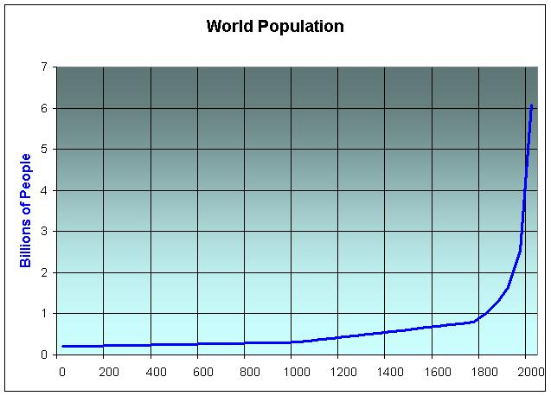
Human Population
World 7,679,302,210

Slide 12
Growth rate = Birth rate – Death rate
Population
Birth/year
Death/year
Crude Growth Rate = Crude Birth Rate – Crude Death Rate
Crude = # Per 1000

Slide 13
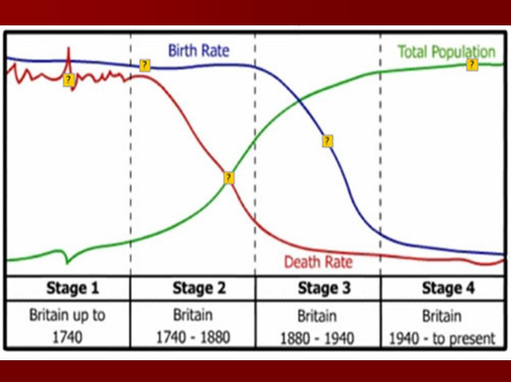
Demographic Transition
50/1000
10/1000

Slide 14
Lecture 4: Agriculture

Slide 15
5 ways that agro-ecosystems differ from ecosystems
Stop ecological succession – requires energy
Large areas of a single species – monoculture, reduces soil fertility because the specific requirements of that species
Planted in neat rows makes it easier for pests (real systems are complex)
Food chains are greatly simplified – competitors and pests eliminated box and arrow
Plowing – erosion, damage to the physical structure of the soil

Slide 16
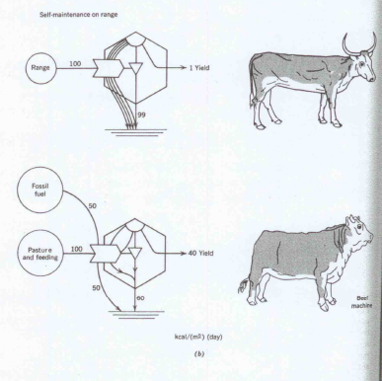
Environment, Power, and Society
Role of thermodynamics and energetics in human society (HT Odum, 1971)

Slide 17
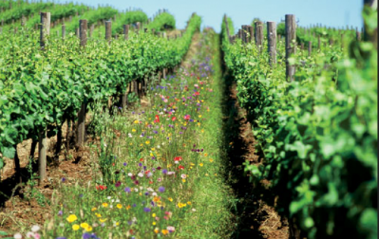
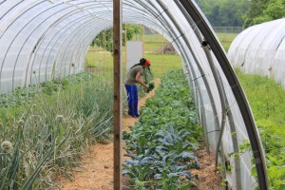
Alternatives to conventional agriculture
Ways to reduce erosion
Contour plowing
Terracing
Strip cropping
No till farming
Ways to maintain soil fertility
Strip cropping
Crop rotation
Cover crops
Leaving land fallow
Polyculture
Permaculture
Urban farming
Organic farming

Slide 18
Lecture 5: Energy basis for socio-ecological development: from solar to fossil fuels back to solar

Slide 19
Energy is the ability to do work
1st Law of Thermodynamics:
energy cannot be created or destroyed
2nd Law of Thermodynamics:
energy goes from a high quality to a lower quality during each energy transformation; while energy is conserved, it’s ability to do work decreases
Forms of energy: potential, kinetic, thermal, chemical, electrical, etc.

Slide 20
Energy is key to Sustaining system structure and complexity
Natural and human systems build and maintain order and organization by taking in high quality energy, using it, and passing degraded energy outside of the system boundary.
Our society is dependent on the energy flows that support it AND having a sink for the waste.
High quality
Energy Input
Low quality
Energy output (waste heat)
System
(human or
natural)

Slide 21
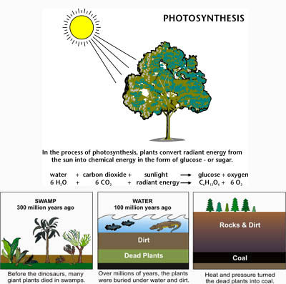
Fossil Fuels are derived from partially decomposed organic materials transformed in Earth’s crust by pressure, heat and bacterial processes. It takes millions of years for these organisms to chemically change into fossil fuels.

Slide 22
Electricity Generation
whether from fossil fuels, nuclear, renewable fuels, or other sources - is usually* based on the fact that:
"When copper wire is moving through a magnetic field, an electric current is generated in that wire."
www.hawaii.gov/dbedt/ert/electgen.html
* exceptions are electrochemistry (batteries) and photovoltaic effect

Slide 23
Energy use in daily life
(Ecological Footprint – measuring your impact)
Household consumption
Transportation
Diet

Slide 24
TABLE 1. Global installed capacity in 2003 (MW)
Energy Future
Transition to Renewables
(cleaner and sustainable)
Increased Efficiency and Conservation in all sectors
Reduce need for transportation through wise development decisions

Slide 25
Lecture 6: Global Climate Change

Slide 26
Three Climate Basics
Earth and Sun are at different temperatures, therefore radiate energy at different wavelengths
Earth – long-wave – infrared radiation
Sun – short-wave – visible light radiation
Certain gases (GHG) in the atmosphere respond to energy at different wavelengths (passing short, absorbing long)
The concentration of greenhouse gases in the atmosphere is increasing

Slide 27
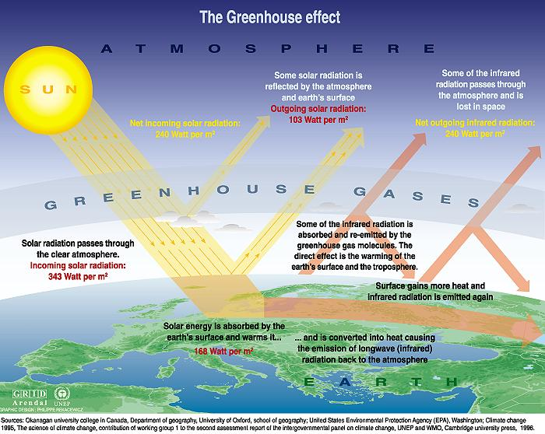

Slide 28
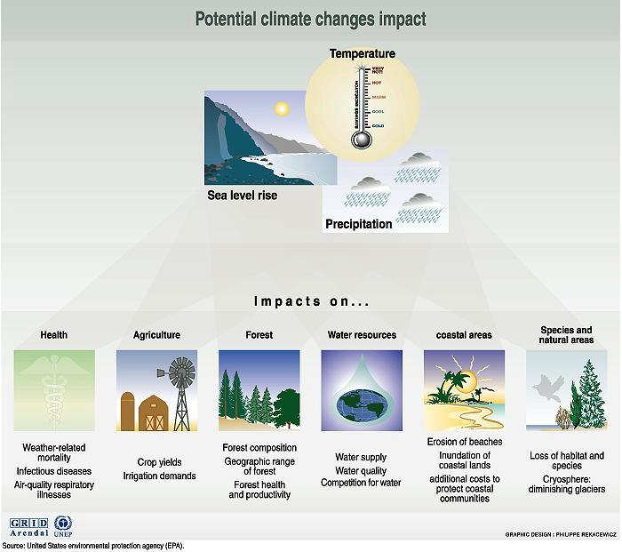

Slide 29
Mitigation Measures
More efficient use of energy
Greater use of low-carbon and no-carbon energy • Many of these technologies exist today
Improved carbon sinks • Reduced deforestation and improved forest management and planting of new forests • Bio-energy with carbon capture and storage
Lifestyle and behavioural changes
AR5 WGIII SPM

Slide 30
Lecture 7: Ecological Economics and Ecosystem Services

Slide 31
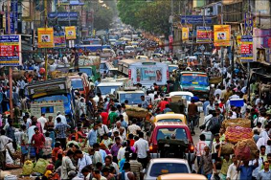
Drivers of Unsustainability
HUMAN POPULATION INCREASE
Agriculture
Shelter
Mobility
Stuff
Use Energy and
Material Resources
causes
Land use change
Habitat loss
Deforestation
Alter biogeochemical cycles
Climate Change
Eutrophication
Acid precipitation
Ozone Depletion
Smog
…
Leads to

Slide 32
Why environmental resources have been poorly conserved in the past?
Nature’s rate of return of ecosystem services leads us to over exploitation
Living off the flow is too slow, how we want to grow
Poor understanding of growth, exponential growth
Externalities
Indirect cost not paid for by producer and consumer as part of a transaction
When a decision (for example, to pollute the atmosphere) causes costs or benefits to individuals or groups other than the person making the decision
Pressure for resource consumption
Economic and institutional growth paradigm
Victor Lebow (1955): our enormously productive economy demands that we make consumption our way of life, that we convert the buying and use of goods into rituals, that we seek our spiritual satisfactions, our ego satisfactions, in consumption
Marketing

Slide 33
Steps forward
Market corrections for externalities
Ecosystem Services now guiding policy decisions
Consider other “quality of life indicators”
Genuine Progress Index
Index of Sustainable Economic Welfare
Human Development Index
Gross Happiness Index
Development of Steady State Economics
Change the growth oriented mindset

Slide 34
Lecture 8: Urban systems

Slide 35
Urban Ecosystems
Socio-ecological-economic systems
Three issues:
understanding a city as a system
understanding specific environmental impacts of cities
understanding a city as a sense of space (human niche)

Slide 36
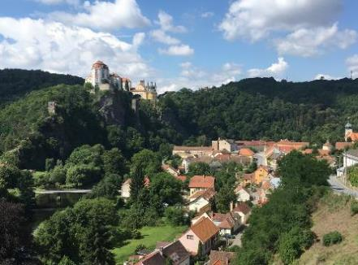
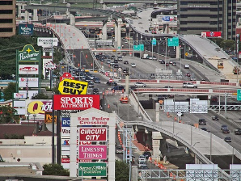
Importance of place
Protection and investment in place
Finding the balance of what the environment offers: sustaining (and enhancing) those flows
Place worth protecting
Geography of Nowhere

Slide 37
Lecture 9: Sustainability and Sustainable Development Goals

Slide 38
Sustainable Development vs Sustainability
Sustainable Development: “development that meets the needs of the present generation without compromising the ability of future generations to meet their own needs” – Our Common Future/ Brundtland Report, 1987
Sustainability: “the capacity to endure; how systems remain diverse and productive over time” – wikipedia
What are our “needs”?

Slide 39
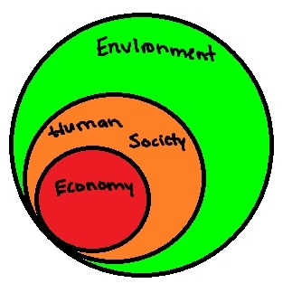
Environment is foundation for all aspects, others are subsets

Slide 40
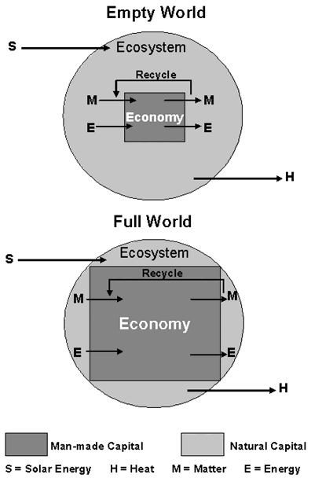
Emergence of humans, from a minor component of natural system to predominant occupant
Scale of humanity has increased greatly putting pressure on all natural resources
The changes have come so fast our customs, ethics, and religious patterns may not have adapted to them.

Slide 41
Conclusions: Sustainability is a property of interaction networks
Reliable Inputs
Healthy Outputs
Recycling of material – my output is your input
Processes functionally linked together - my useful byproducts happen in the act fitting into the network
System
Input
A
Output
+
+
C
+
B

