Slide 1
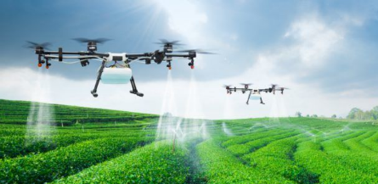
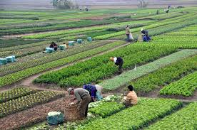
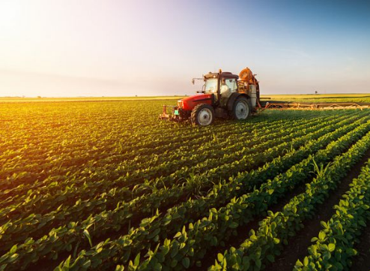
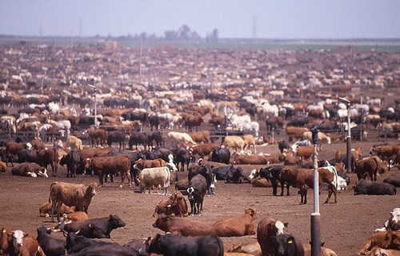
Agriculture
A way of living: What we eat and how we raise it

Slide 2
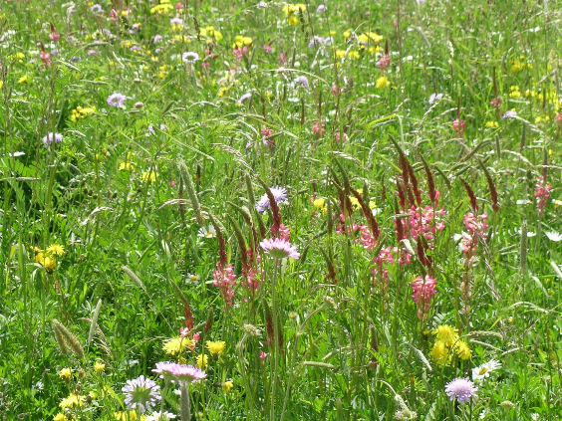
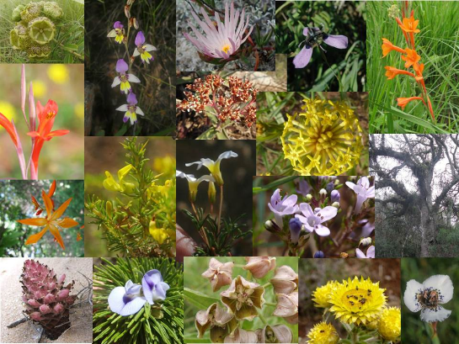
Plant diversity:
~400,000 species of plants,
3,000 tried in agriculture
150 cultivated on large scale
14 crops provide most of the world’s food - ???

Slide 3
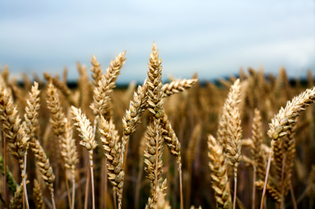
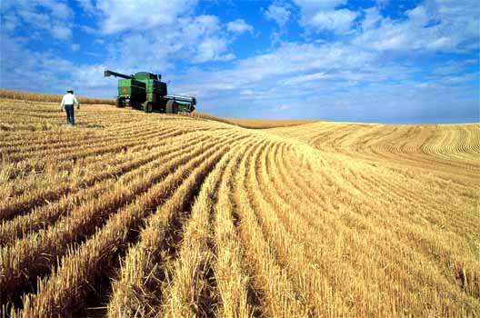
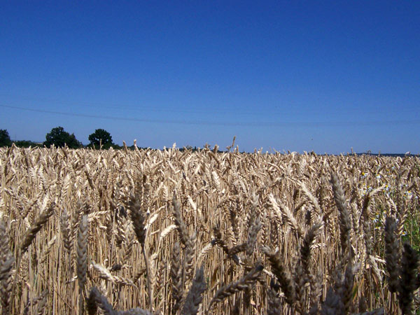
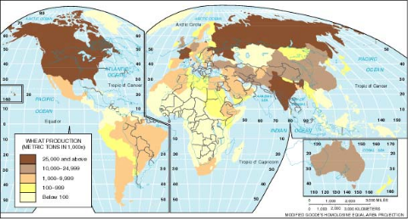
Wheat

Slide 4
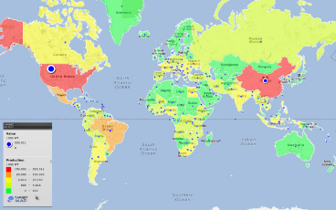
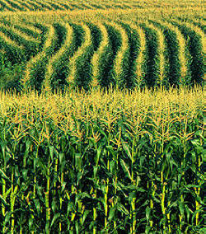
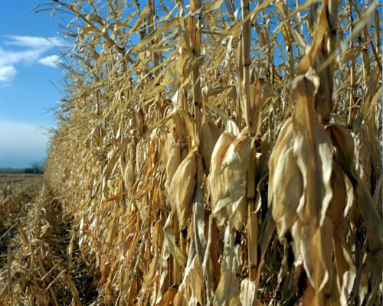
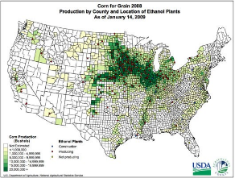
Corn

Slide 5
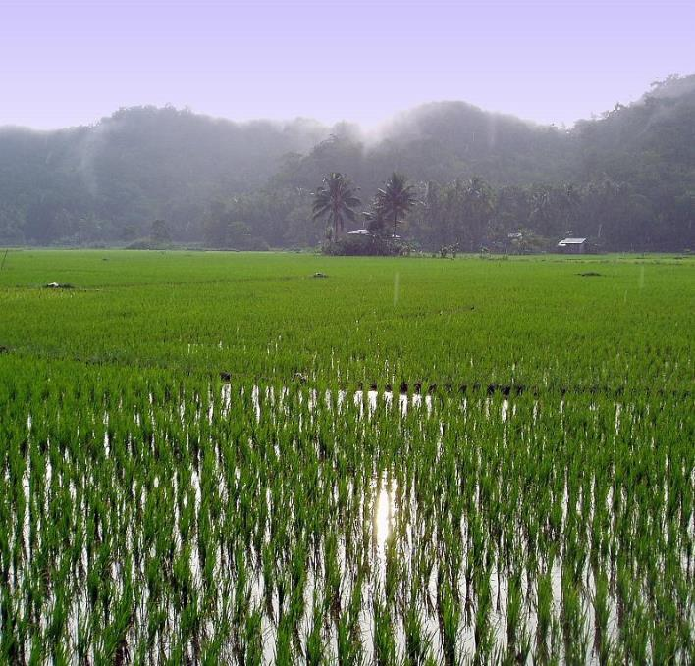
Rice

Slide 6
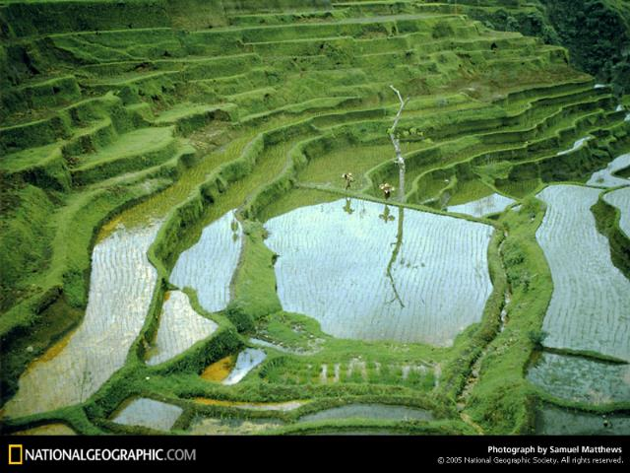
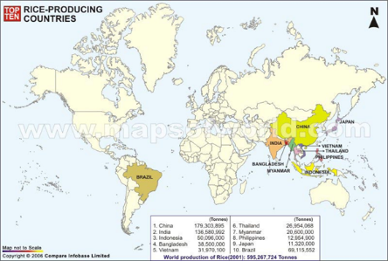

Slide 7
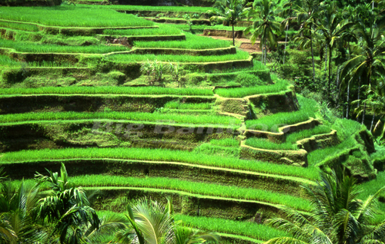
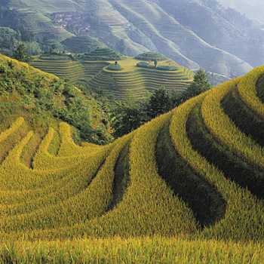
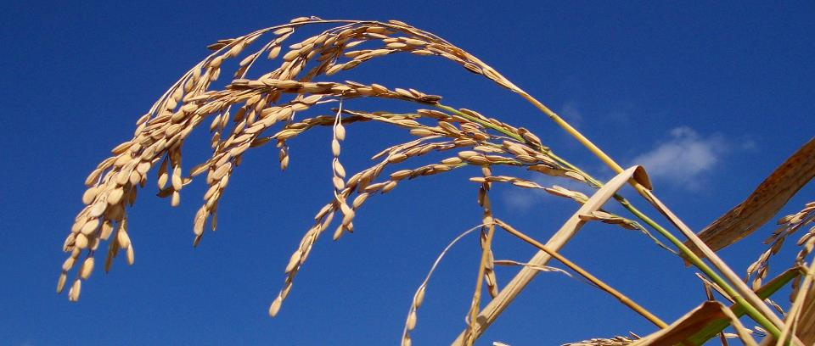

Slide 8
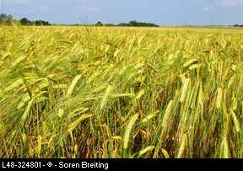
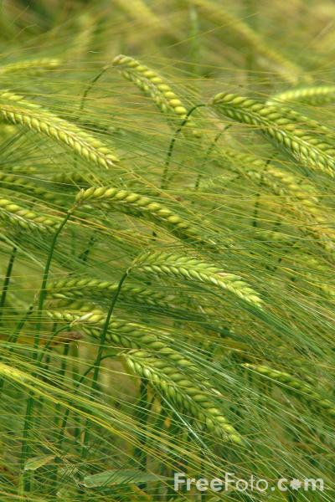
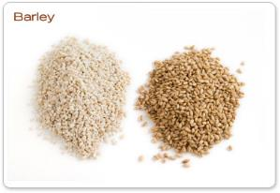
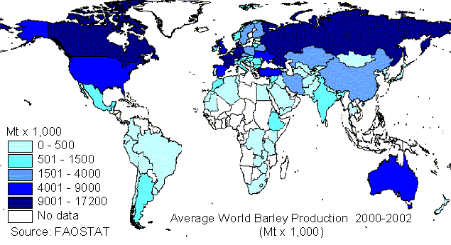

Slide 9
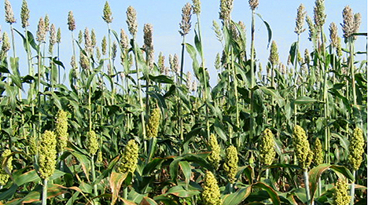
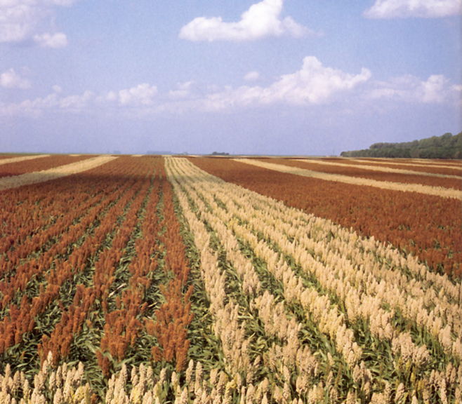
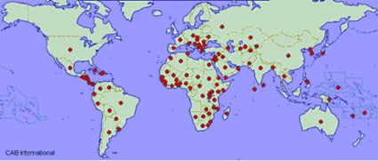
Sorghum

Slide 10
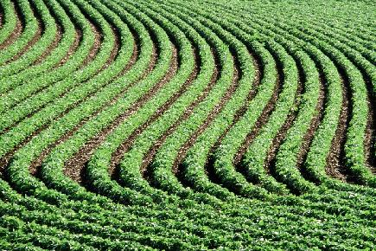
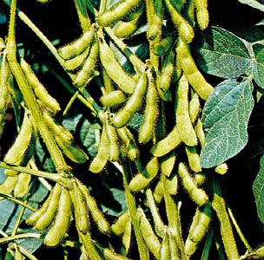
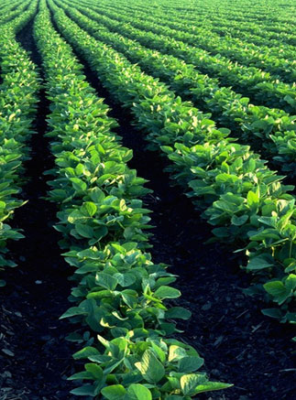
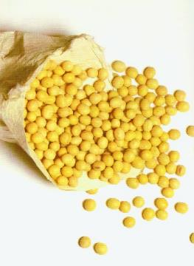
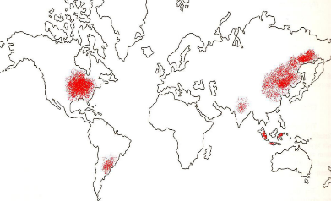
Soy Beans

Slide 11
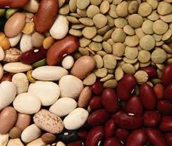
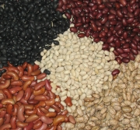
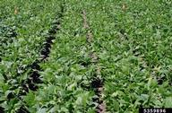
Beans

Slide 12
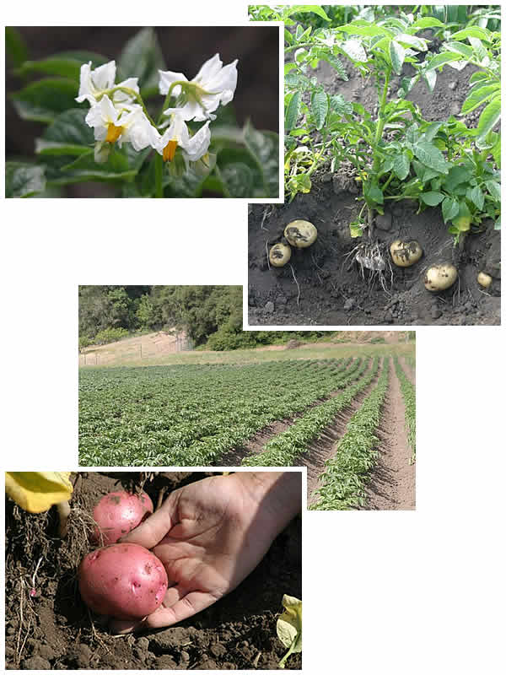
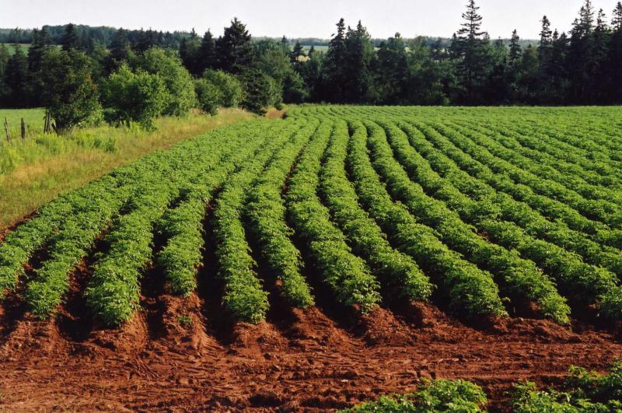
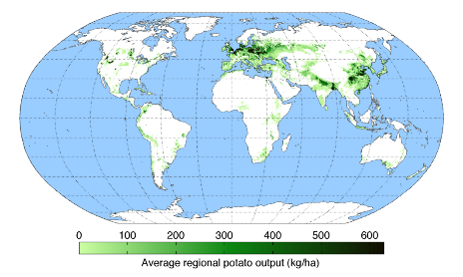
Potatoes

Slide 13
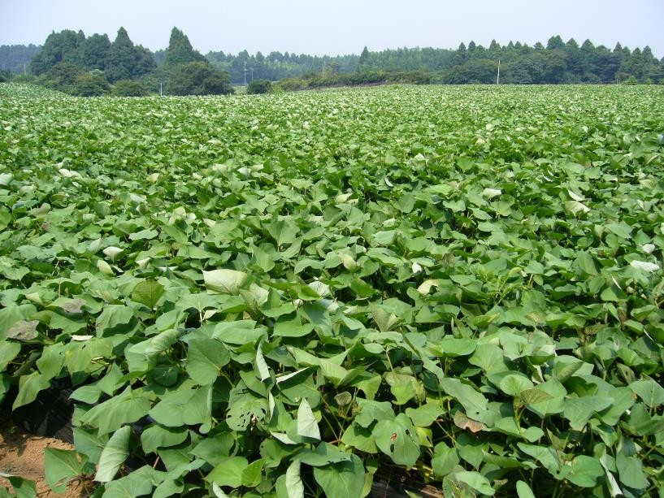
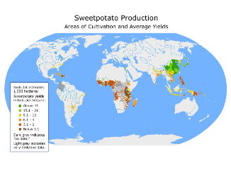
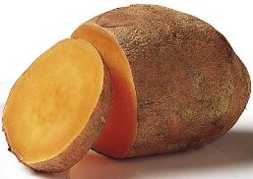
Sweet potato

Slide 14
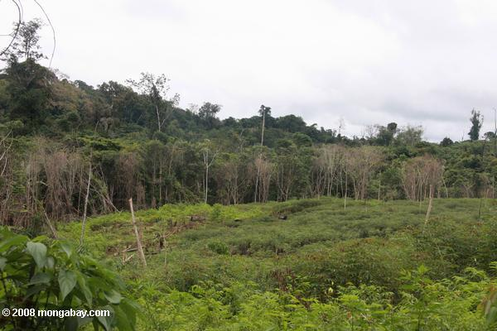
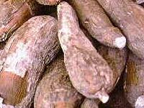
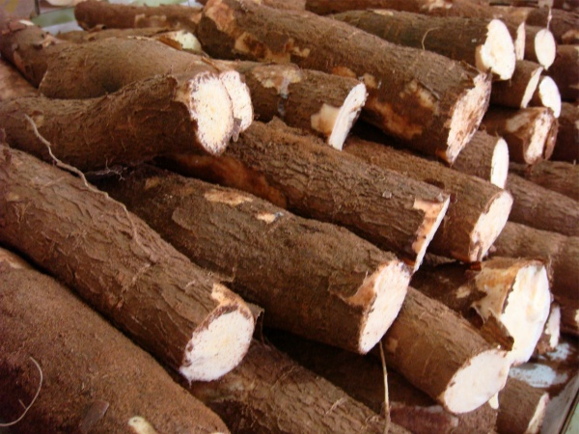
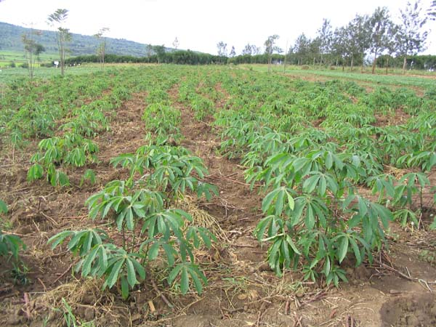
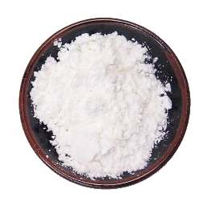
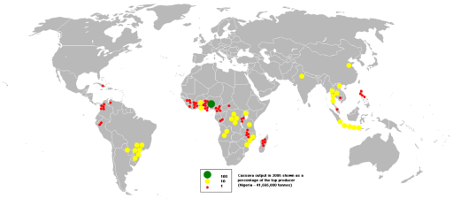
Manioc (cassava, yuca)

Slide 15
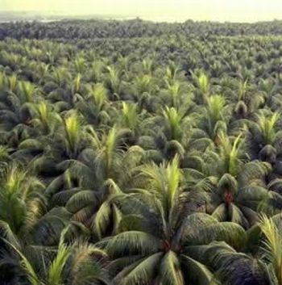
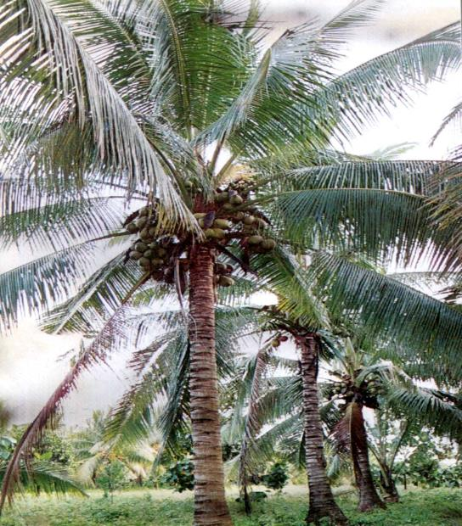
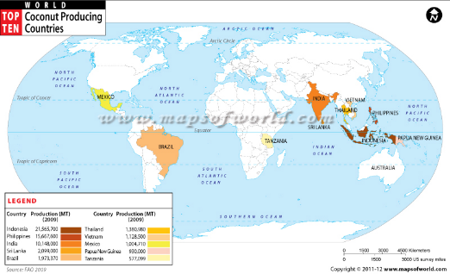
Coconuts

Slide 16



Banana

Slide 17



Sugar Cane

Slide 18




Sugar Beets

Slide 19



Slide 20



Food supply is mostly based on annual plants – early successional species that produce an amazing amount of biomass in a short time by capturing the sun’s energy through photosynthesis. The sun’s energy is stored in the chemical bonds of the plant material and is both structural and functional (both in terms of plant processes and energetics).
after
before

Slide 21
5 ways that agro-ecosystems differ from ecosystems

Slide 22


Agro-ecosystems
1. Stop ecological succession – requires energy

Slide 23


Agro-ecosystems
2. Large areas of a single species – monoculture, reduces soil fertility because the specific requirements of that species

Slide 24

Agro-ecosystems
3. Planted in neat rows makes it easier for pests (real systems are complex)

Slide 25



Agro-ecosystems
4. Food chains are greatly simplified – competitors and pests eliminated box and arrow

Slide 26



Agro-ecosystems
5. Plowing – erosion, damage to the physical structure of the soil

Slide 28

Food waste: Forty percent of the food in the United States is never eaten.
Roughly 50 percent of all produce in the United States is thrown away—some 60 million tons (or $160 billion) worth of produce annually, which is about $1,600 per four person family.
WHY?
We are conditioned to only buy perfect looking produce
We can afford to throw food away
We are not self-aware
people should sort their trash to find out how much they waste
We don’t know a lot about food safety
Expiration dates are not tied to food safety

Slide 29
Food waste solutions
Consumer education that leads to behavioral changes
Systemic changes that make food waste less likely/more expensive
France to force big supermarkets to give unsold food to charities
Germany Has An Ambitious Strategy To Halve Food Waste By 2030
USDA and EPA Join with Private Sector, Charitable Organizations to Set Nation's First Food Waste Reduction Goals

Slide 30




Role of livestock in agriculture
Synergy between the plants, animals, and humans
Animal manure fertilizes, hooves aerate soils
Ruminants can consume plants we can’t
Can survive on areas not amenable for row crops
Extra food source, available all year
Where there is grassland there is hoofed mammal – co-evolved together
Gun, Germs, and Steel – Jared Diamond

Slide 31


Ways of farming meat
Pastureland

Slide 32


Ways of farming meat
Rangeland

Slide 33



Ways of farming meat
Factory farming

Slide 34


Environment, Power, and Society
Role of thermodynamics and energetics in human society (HT Odum, 1971)

Slide 35


Slide 36


Livestock and poultry production

Slide 37



Concentrated/Confined Animal Feeding Operations (CAFOs)
What is a CAFO?
Agricultural operations where animals are kept and raised in confined situations. CAFOs congregate animals, feed, manure and urine, dead animals, and production operations on a small land area. Feed is brought to the animals rather than the animals grazing or otherwise seeking feed in pastures, fields, or on rangeland

Slide 38

2017 Poultry slaughtered: Chickens: 9,050,716,000; Turkeys: 241,677,000; Ducks: 26,628,000
National Agricultural Statistics

Slide 39

U.S. egg production in 2017: Total 105.7 billion; 92.1 billion table eggs and 13.6 billion hatching eggs

Slide 40


Slide 41




Poor agricultural practices lead to:
  soil erosion (potentially desertification),
  nutrient depletion,
  biodiversity loss (habitat loss and introduced chemicals),
  overuse of fertilizers (eutrophication),
  high energy use,
  unhealthy labor conditions,
  animal abuse,
  high use of antibiotics (leading to resistant strains),
  climate change,
  …

Slide 42

What that Mud in Our Rivers Adds up to Each Year
"the top soil which goes swirling by in our rivers at flood stage may look like mud to you but it is beefsteak and potatoes, ham and eggs and homemade bread with jam on it."
Erosion and soil loss

Slide 43


Alternatives to conventional agriculture
Ways to reduce erosion
  Contour plowing
  Terracing
  Strip cropping
  No till farming
Ways to maintain soil fertility
  Strip cropping
  Crop rotation
  Cover crops
  Leaving land fallow
  Polyculture
  Permaculture
Urban farming
Organic farming

Slide 44


No till farming

Slide 45


Slide 46



Contour planting and strip cropping
Farming with row patterns nearly level around the hill—not up and down hill.

Slide 47



Landscape terracing

Slide 48


Urban farming
Vegetables and greens

Slide 49
Organic Farming is a system to produce agricultural products to:
maintain long-term soil fertility
increase soil biological activity (decomposers)
recycle wastes to return nutrients to the land
ensure effective pest management
provide attentive care to farm animals, and
create conditions that do not require extraneous synthetic additives.
It relies on crop rotation, green manure, compost, and biological pest control to maintain soil productivity and control pests, excluding or strictly limiting the use of synthetic fertilizers and synthetic pesticides, plant growth regulators, livestock feed additives, and genetically modified organisms

Slide 50




Free range – organic chickens and pigs

Slide 51



Slide 52

Agroecology is the study of ecological processes applied to agricultural production systems.

Slide 53






Community Supported Agriculture consists of people who buy shares from a farm operation, sharing the risks and benefits of food production. In return, they receive produce throughout the growing season, as well as satisfaction gained from reconnecting to the land and participating directly in food production.
onestrawfarm
realfoodfarm

Slide 54



Three sisters planting - combines corn, squash, and beans

Slide 55
Cultural and Ecological aspects of Agriculture

Slide 56

Fragmentation
“The concept of country, homeland, dwelling, place becomes simplified as ‘the environment’—that is, what surrounds us. Once we see our place, our part of the world, as surrounding us we have already made a profound division between it and ourselves.” p.24
- Berry 1977

Slide 57


Crisis of agriculture
With pressure from growing urban populations and in a losing effort to keep up with the city, the countryside abandoned its connection to cycles of growth and decay and turned the land into a production machine.
This left both the land and the people poorer

Slide 58


Isolation of food and body
“Our system of agriculture, by modeling itself on economics rather than biology, thus removes food from the cycle of its production and puts it into a finite, linear process that in effect destroys it by trans-forming it into waste.” p.142
“By regarding [ourselves] merely a consumer of food, we reduce the function of the body to that of a conduit which channels the nutrients of the earth from the supermarket to the sewer.” p.141

Slide 59


Agricultural revolution
“Establish agriculture upon the same unifying cycle that preserves health, fertility, and renewal in nature by which ‘Death supersedes life and life rises again from what is dead and decayed’ ”
“Soil is the great connector of lives, the source and destination of all. … It is alive itself. It is a grave, too, of course.” p.90
Soil is place

Slide 60

In the current economic market there is competition for crops

Slide 61

Crop use varies greatly by region

Slide 62


www.environmentreports.com/change-your-diet-change-our-destiny/#section2
Great global food gap

Slide 63

Protein production has different efficiencies in terms of energy
(more input is less efficient)
Feed conversion ratios (kg feed protein required per kg of animal protein produced)

Slide 64

…and water

Slide 65





Aquaponics
GMOs
Lab grown meat
Vertical farming
Detritus farming
…

