Slide 1
Global Climate Change
Introduction and Implications

Slide 2
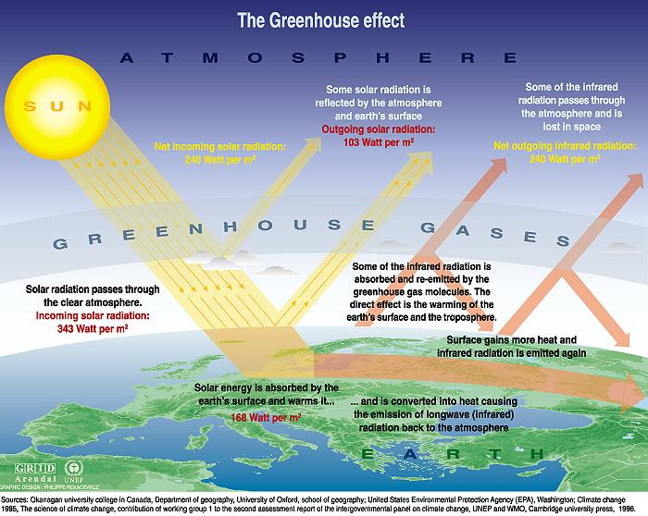

Slide 3
Energy Balance
Input
Atmosphere
Output
Earth
system

Slide 4
Energy Balance
More energy in the system leads to warming
Solar energy
Atmosphere
Infrared radiation
Earth
system
Energy In > Energy out
Not because E_{in} is ↑,
but because E_{out} is ↓

Slide 5

Atmosphere is thin layer encircling the earth – Troposphere ~10Km

Slide 6
Three Climate Basics
Earth and Sun are at different temperatures, therefore radiate energy at different wavelengths
  Earth – long-wave – infrared radiation
  Sun – short-wave – visible light radiation
Certain gases (GHG) in the atmosphere respond to energy at different wavelengths (passing short, absorbing long)
The concentration of greenhouse gases in the atmosphere is increasing

Slide 7
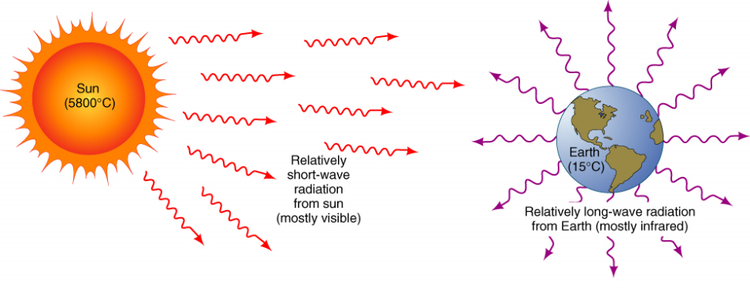
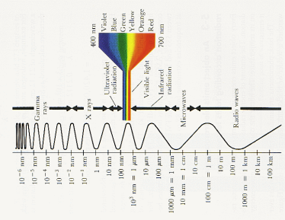
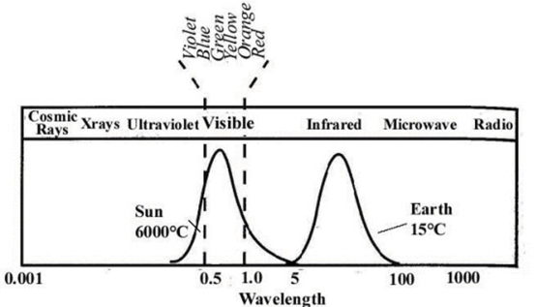
1) Earth and sun radiate energy at different wavelengths

Slide 8
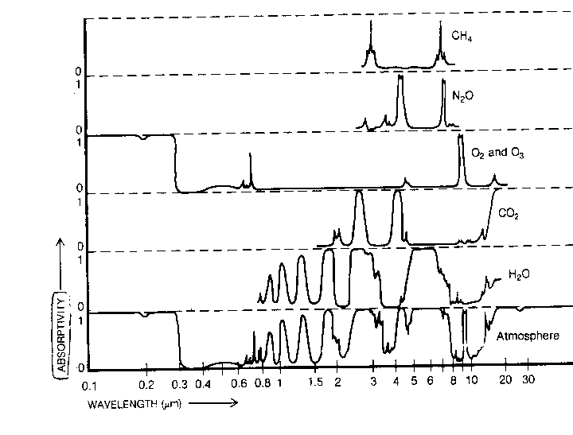
Methane
Nitrous oxide
Ozone
Carbon dioxide
Water vapor
2) Certain gases in the atmosphere respond to energy at different wavelengths

Slide 9
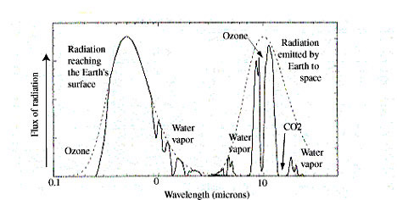
Carbon Dioxide Demonstration

Slide 10
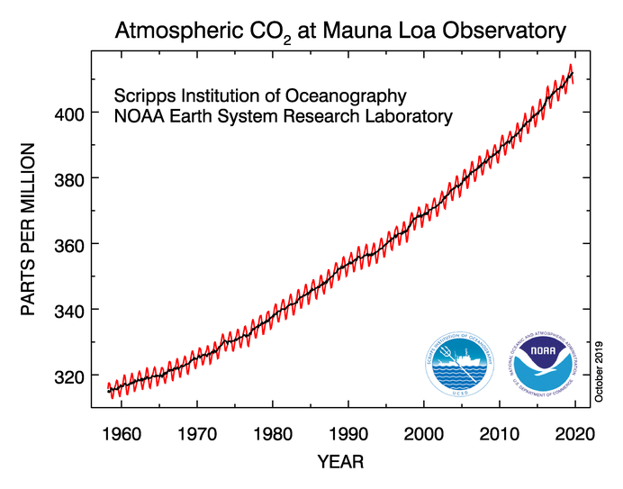
3) The concentration of greenhouse gases in the atmosphere is increasing
Carbon Dioxide increases measured in Mauna Loa, Hawaii

Slide 11
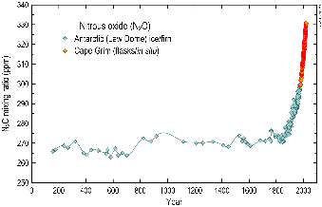
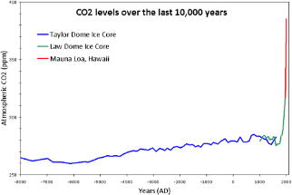
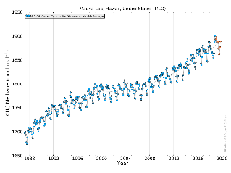
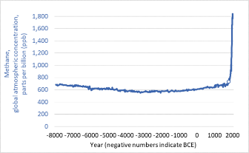
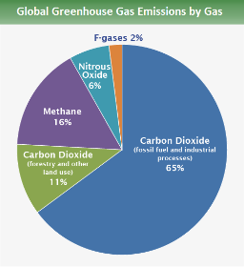
Four main anthropogenic GHGs:
1) Carbon Dioxide (CO₂) – 76%
2) Methane (CH₄) – 16%
3) Nitrous Oxide (N₂O) – 6%
4) F-gases – 2%
Hydrofluorocarbons, perfluorocarbons, sulfur hexafluoride didn’t exist pre-industrial

Slide 12
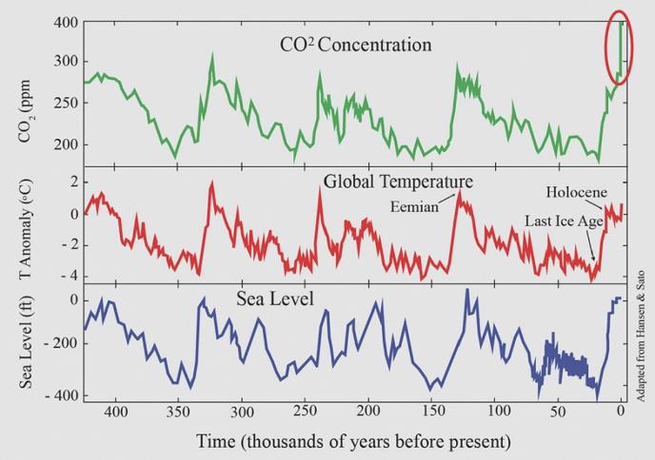
Correlation between CO₂ concentration, temp, and sea level over the past 400,000 years
CO₂ is now higher than at any time during that period

Slide 13
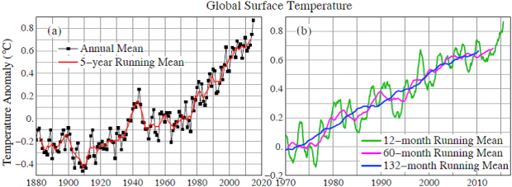
These facts together lead to the climate change observed

Slide 14
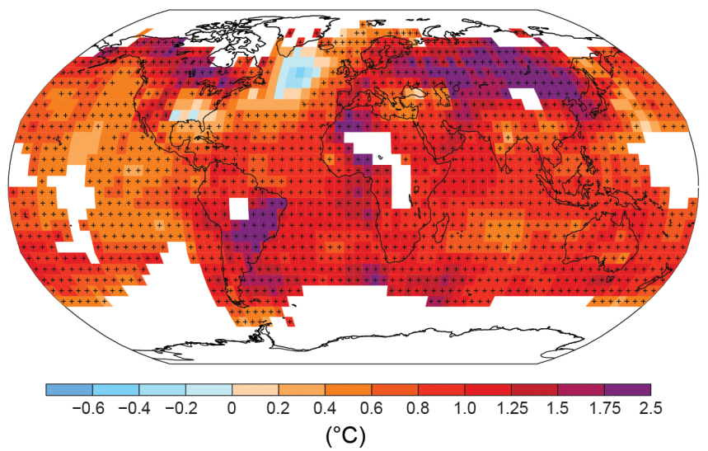
Figure SPM.1b
Observed change in surface temperature 1901-2012
All Figures © IPCC 2013
Notes:
Figure SPM.1, Panel b
Complete caption of Figure SPM.1:
Figure SPM.1 | (a) Observed global mean combined land and ocean surface temperature anomalies, from 1850 to 2012 from three data sets. Top panel: annual mean values. Bottom panel: decadal mean values including the estimate of uncertainty for one dataset (black). Anomalies are relative to the mean of 1961−1990. (b) Map of the observed surface temperature change from 1901 to 2012 derived from temperature trends determined by linear regression from one dataset (orange line in panel a). Trends have been calculated where data availability permits a robust estimate (i.e., only for grid boxes with greater than 70% complete records and more than 20% data availability in the first and last 10% of the time period). Other areas are white. Grid boxes where the trend is significant at the 10% level are indicated by a + sign. For a listing of the datasets and further technical details see the Technical Summary Supplementary Material. {Figures 2.19–2.21; Figure TS.2}

Slide 15
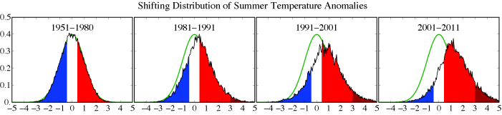
Extreme heat events are becoming more common

Slide 16
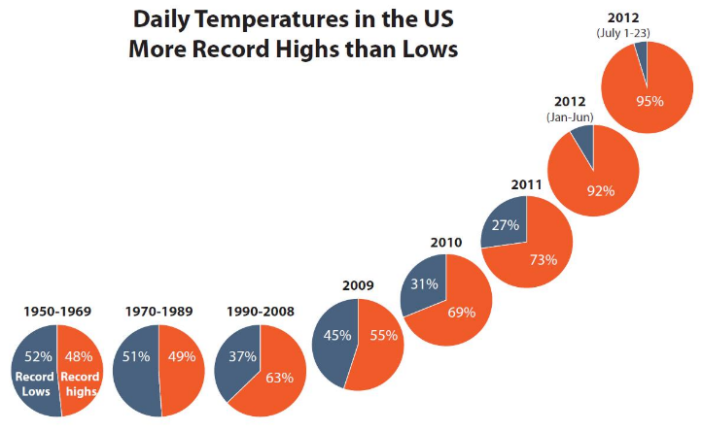

Slide 17
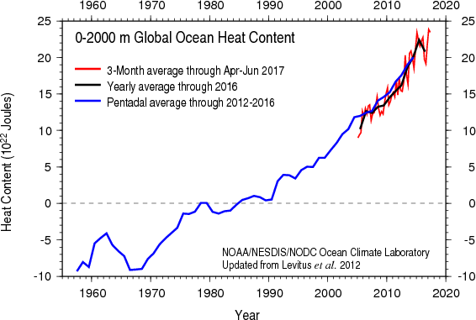
Heat capacity of water is higher than that for air so most of the additional energy is going to heat the oceans (>90%)
https://climate.nasa.gov/climate_resources/40/video-oceans-of-climate-change/

Slide 18
Is this human (anthropogenic) or natural?

Slide 19
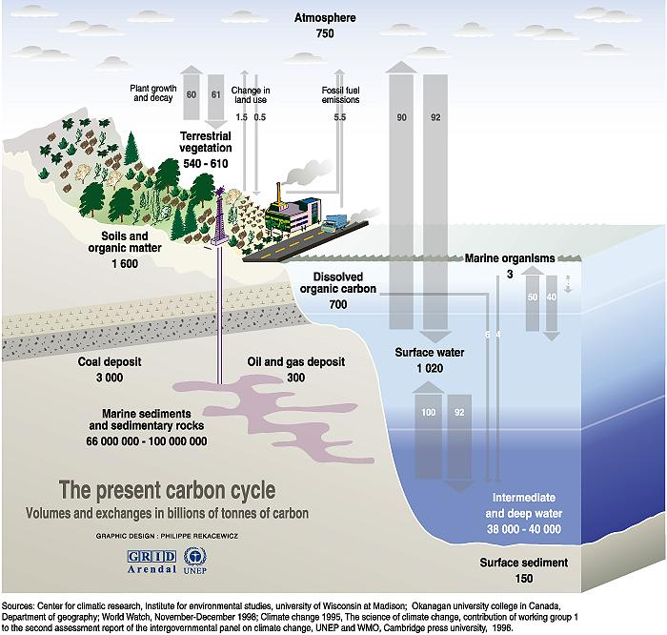

Slide 20
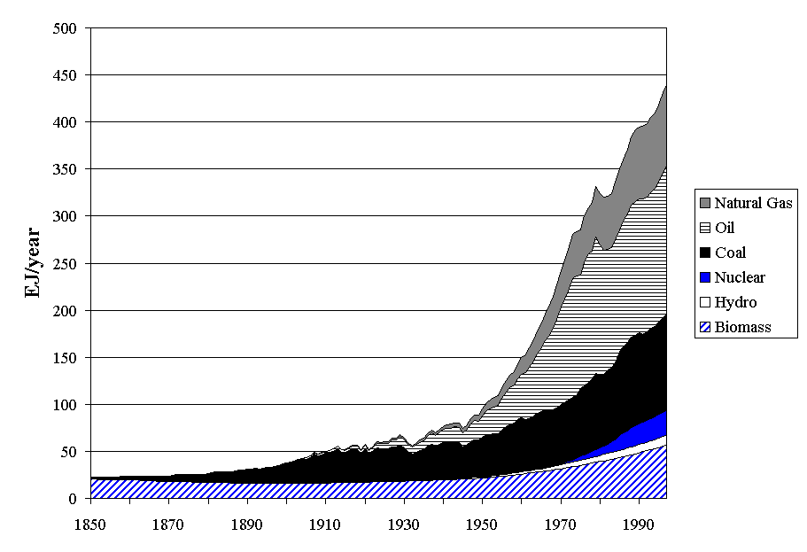
World Primary Energy Supply by Source, 1850-2000

Slide 21
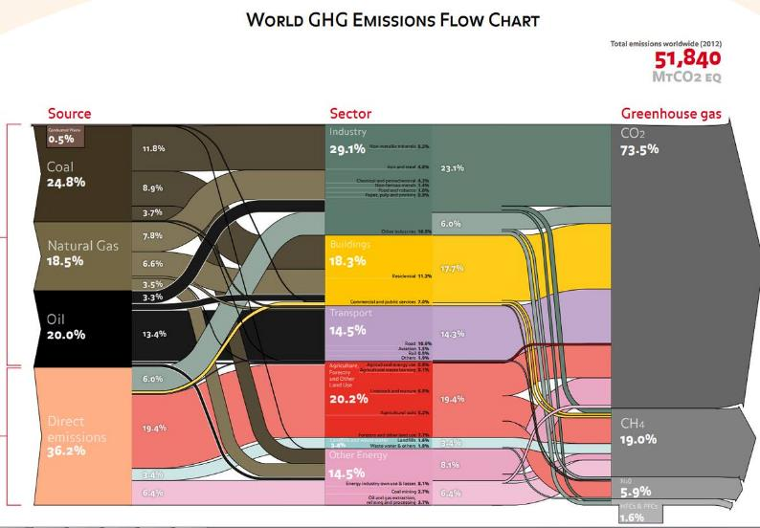

Slide 22
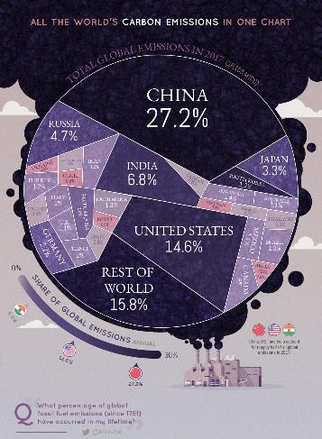
Which country emits the most CO₂ in 2017?

Slide 23
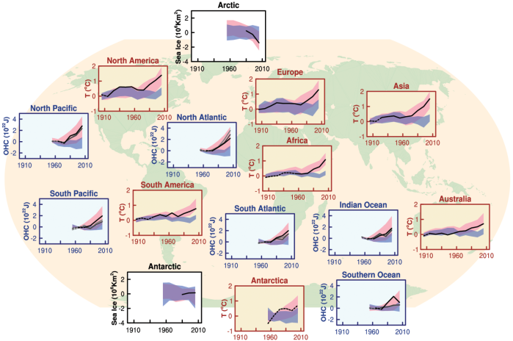
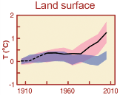
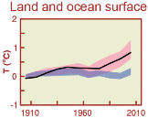
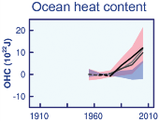
Figure SPM.6
Comparison of observed and simulated climate change
All Figures © IPCC 2013
Computer models match observed ∆T on all continents
Notes:
Figure SPM.6 | Comparison of observed and simulated climate change based on three large-scale indicators in the atmosphere, the cryosphere and the ocean: change in continental land surface air temperatures (yellow panels), Arctic and Antarctic September sea ice extent (white panels), and upper ocean heat content in the major ocean basins (blue panels). Global average changes are also given. Anomalies are given relative to 1880–1919 for surface temperatures, 1960–1980 for ocean heat content and 1979–1999 for sea ice. All time-series are decadal averages, plotted at the centre of the decade. For temperature panels, observations are dashed lines if the spatial coverage of areas being examined is below 50%. For ocean heat content and sea ice panels the solid line is where the coverage of data is good and higher in quality, and the dashed line is where the data coverage is only adequate, and thus, uncertainty is larger. Model results shown are Coupled Model Intercomparison Project Phase 5 (CMIP5) multi-model ensemble ranges, with shaded bands indicating the 5 to 95% confidence intervals. For further technical details, including region definitions see the Technical Summary Supplementary Material. {Figure 10.21; Figure TS.12}

Slide 24
WHAT DOES ALL THIS MEAN?

Slide 25
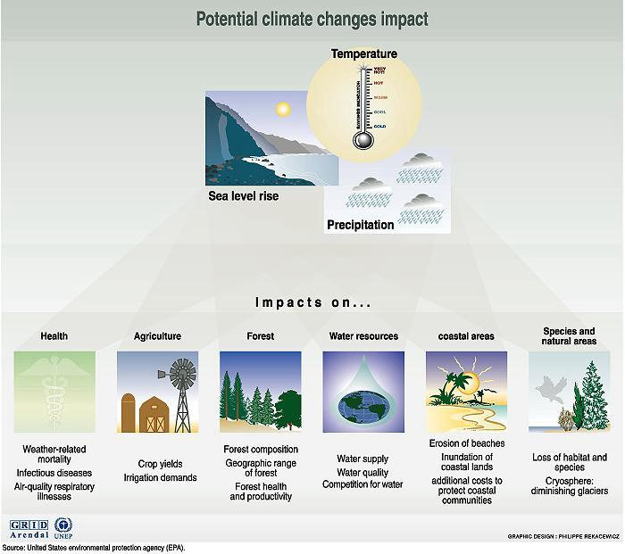

Slide 26
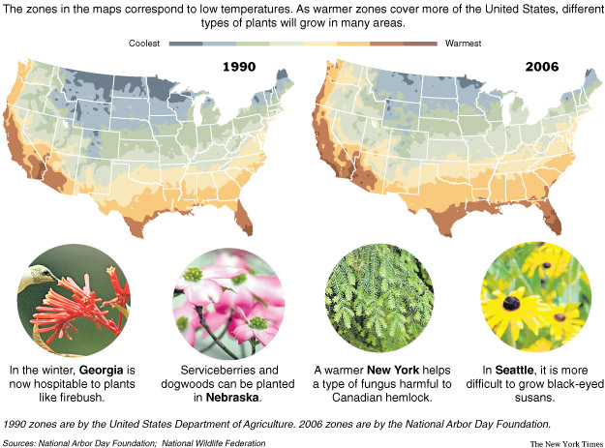
From: Feeling Warmth, Subtropical Plants Move North
Source: New York Times, May 3, 2007

Slide 27
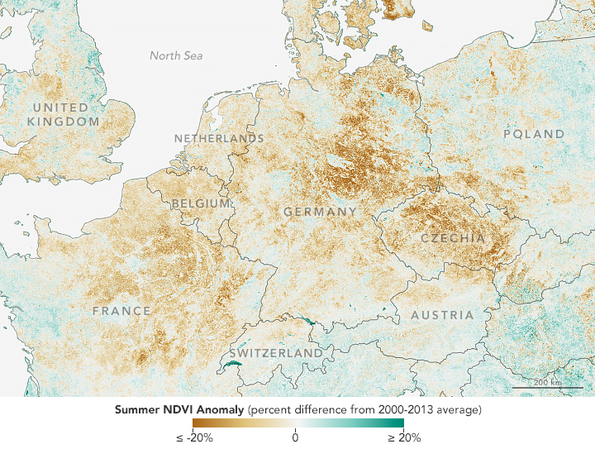
Impact of 2018 heat wave on vegetation

Slide 28
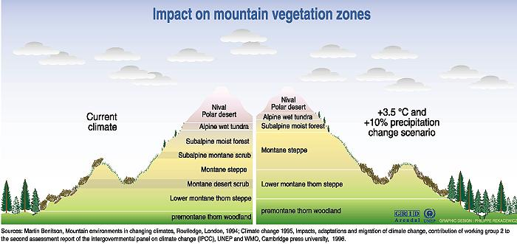

Slide 29
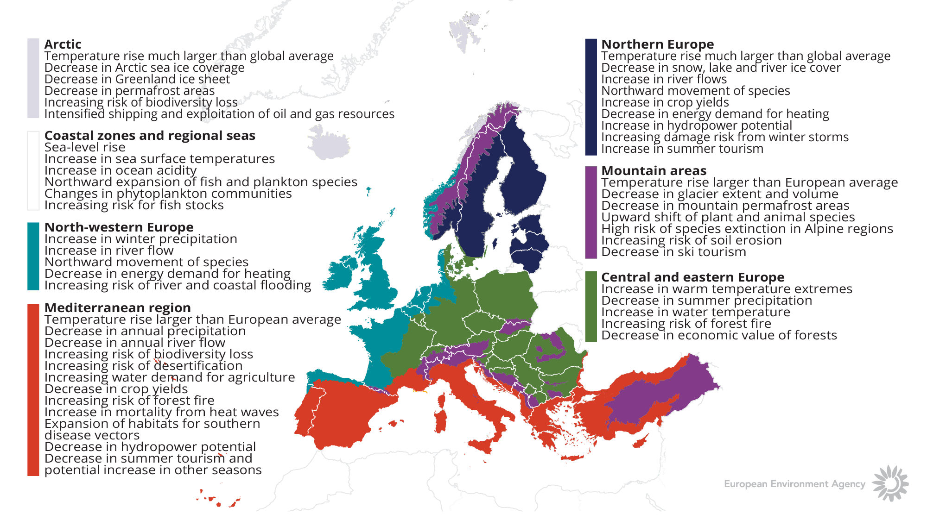
Climate change impacts on Europe

Slide 30

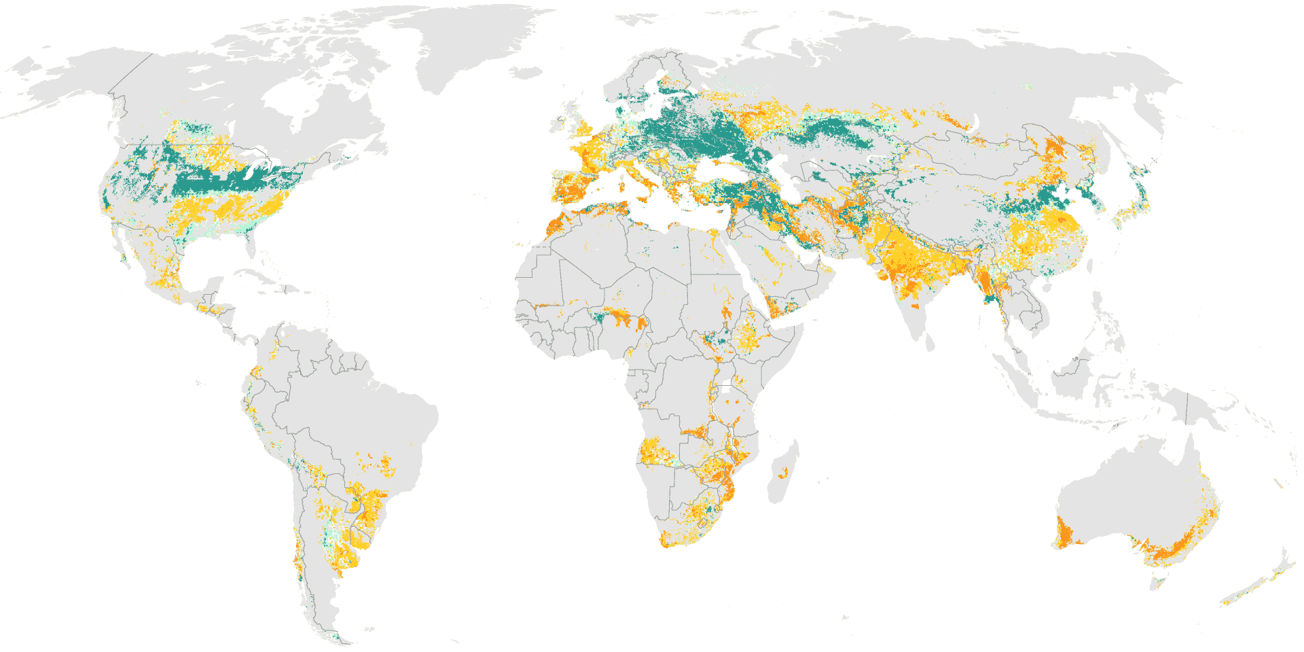
Projected wheat yield to 2050

Slide 31
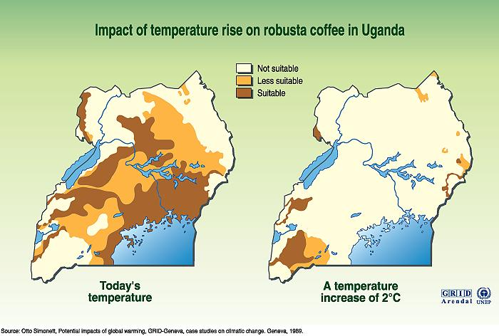

Slide 32
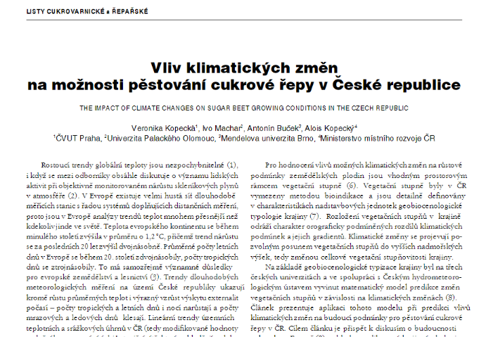

Slide 33
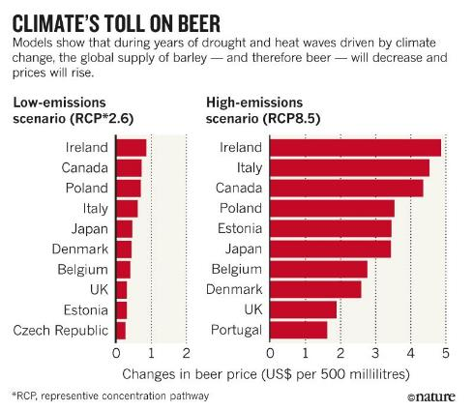

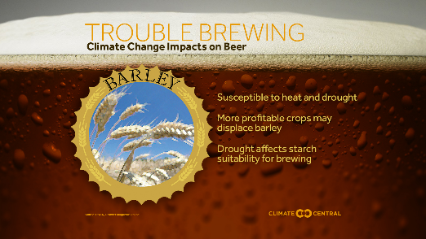

Slide 34
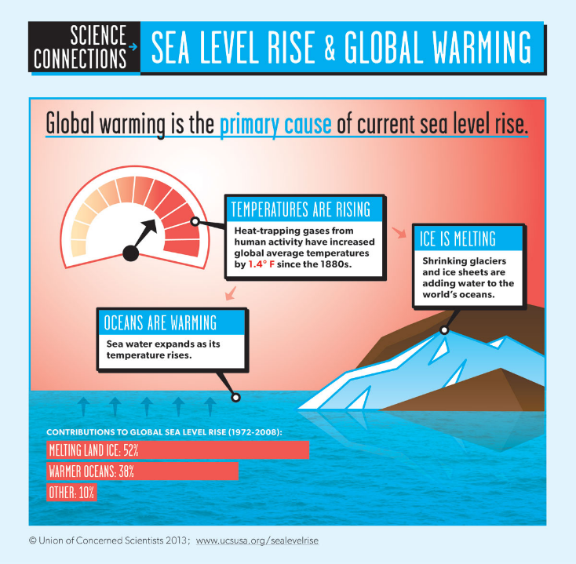

Slide 35
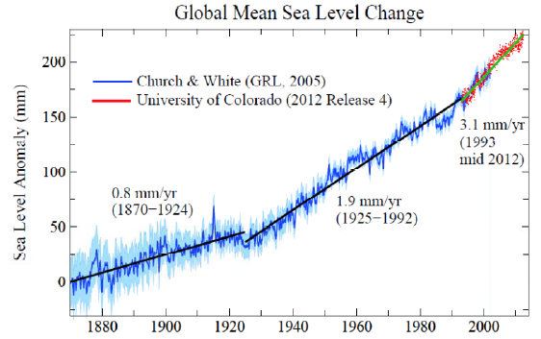

Slide 36
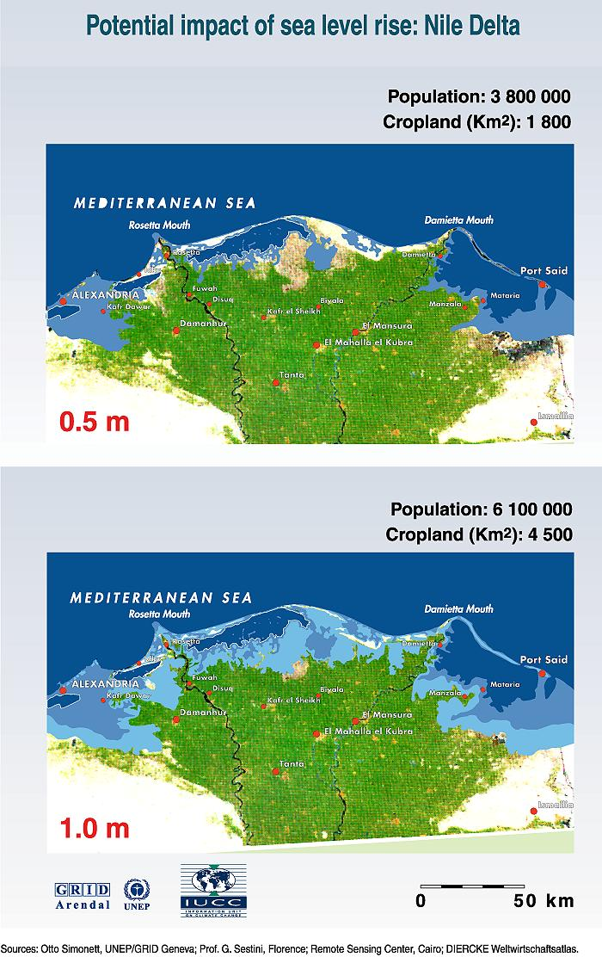

Slide 37
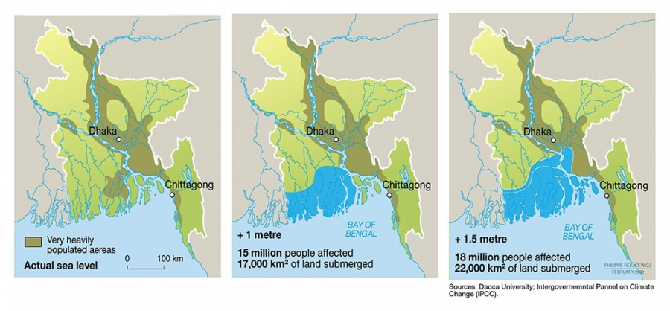

Slide 38
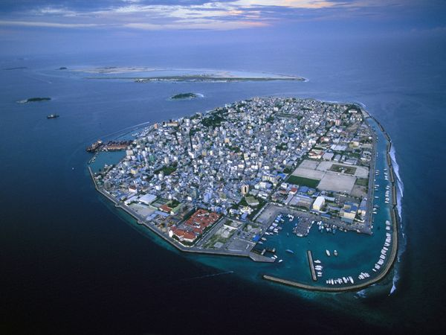
Male, Maldives
Photograph by Peter Essick, Aurora Photos
The island of Male, capital of the Maldives Islands in the Indian Ocean, is at ground zero in Earth's sea level rise dilemma. With a maximum elevation of only 8 feet (2.4 meters), even a modest increase in ocean heights would submerge a majority of its territory. To combat the threat, the government erected a seawall around the entire island.

Slide 39
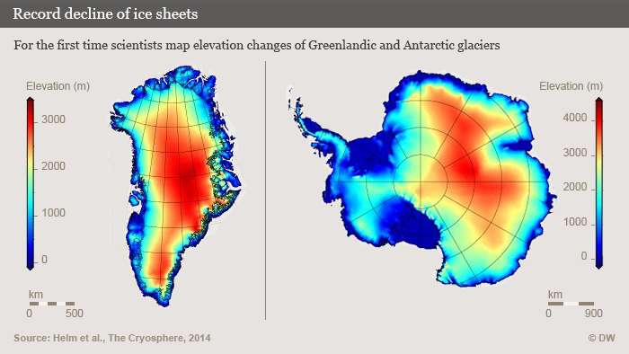
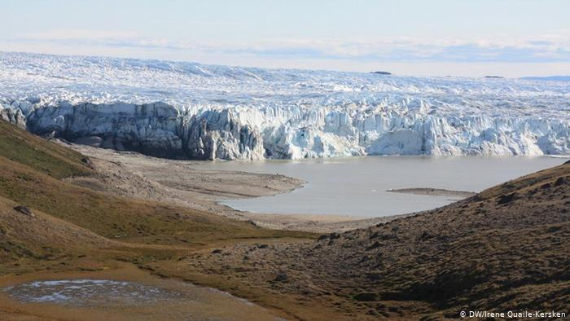
Two major glaciers in the world:
Greenland
Antarctica

Slide 40
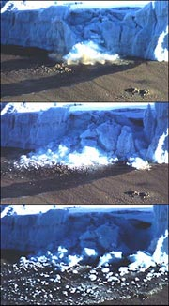
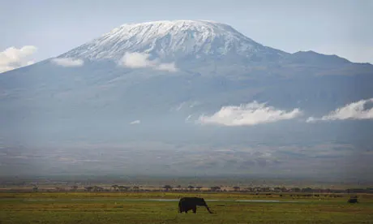
The snows of Kilimanjaro, Tanzania
http://news.nationalgeographic.com/news/2003/09/0923_030923_kilimanjaroglaciers.html

Slide 41
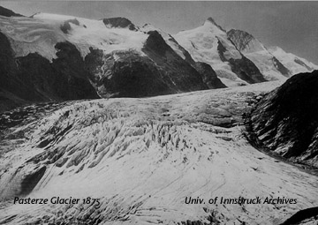
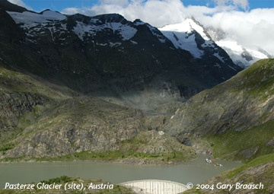
The Pasterze, Austria'a longest glacier, was much longer in the 19th C. but is now completetely out of sight from this overlook on the Grossglockner High Road.

Slide 42
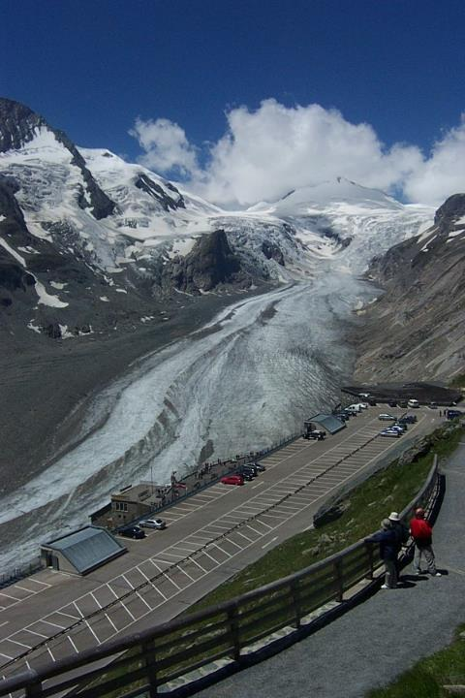
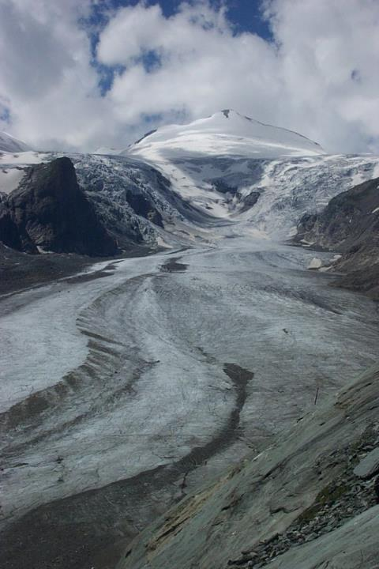

Slide 43
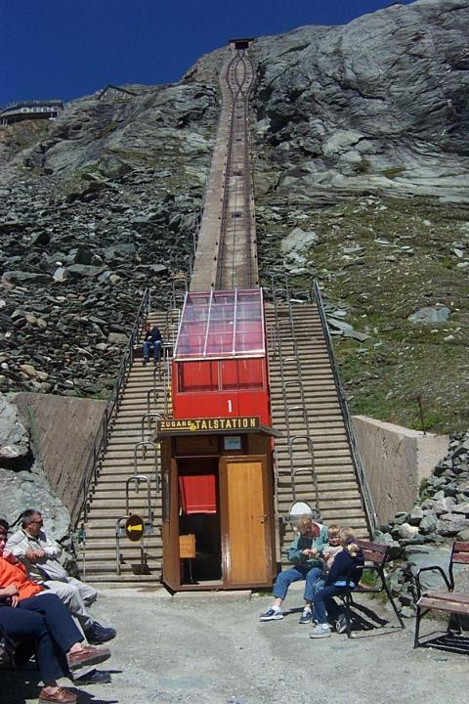

Slide 44


Slide 45


Slide 46


Slide 47


Slide 48

2003

Slide 49

2014

Slide 50


Slide 51


Slide 52


Slide 53



Slide 54



Slide 55



Slide 56



Slide 57


Portage Glacier, near Anchorage, Alaska, in about 1914 and in 2004.
https://www.youtube.com/watch?v=JMwneiXMzo0
http://www.worldviewofglobalwarming.org/pages/glaciers.html

Slide 58
Videos!
https://climate.nasa.gov/climate_resource_center/earthminute

Slide 59

1000 years of Earth temperature history…and 100 years of projection
IPCC (2001) scenarios to 2100
Time lag for re-equilibrium of elevated CO₂

Slide 60

Stabilization of atmospheric concentrations requires moving away from the baseline – regardless of the mitigation goal.
~3°C
Based on Figure 6.7
AR5 WGIII SPM

Slide 61

Figure SPM.10
Temperature increase and cumulative carbon emissions
All Figures © IPCC 2013
Notes:
Figure SPM.10 | Global mean surface temperature increase as a function of cumulative total global CO2 emissions from various lines of evidence. Multi-model results from a hierarchy of climate-carbon cycle models for each RCP until 2100 are shown with coloured lines and decadal means (dots). Some decadal means are labeled for clarity (e.g., 2050 indicating the decade 2040−2049). Model results over the historical period (1860 to 2010) are indicated in black. The coloured plume illustrates the multi-model spread over the four RCP scenarios and fades with the decreasing number of available models in RCP8.5. The multi-model mean and range simulated by CMIP5 models, forced by a CO2 increase of 1% per year (1% yr–1 CO2 simulations), is given by the thin black line and grey area. For a specific amount of cumulative CO2 emissions, the 1% per year CO2 simulations exhibit lower warming than those driven by RCPs, which include additional non-CO2 forcings. Temperature values are given relative to the 1861−1880 base period, emissions relative to 1870. Decadal averages are connected by straight lines. For further technical details see the Technical Summary Supplementary Material. {Figure 12.45; TS TFE.8, Figure 1}

Slide 62

Figure SPM.8a,b
Maps of CMIP5 multi-model mean results
All Figures © IPCC 2013
Notes:
Figure SPM.8, Panels a and b
Complete caption of Figure SPM.8:
Figure SPM.8 | Maps of CMIP5 multi-model mean results for the scenarios RCP2.6 and RCP8.5 in 2081–2100 of (a) annual mean surface temperature change, (b) average percent change in annual mean precipitation, (c) Northern Hemisphere September sea ice extent, and (d) change in ocean surface pH. Changes in panels (a), (b) and (d) are shown relative to 1986–2005. The number of CMIP5 models used to calculate the multi-model mean is indicated in the upper right corner of each panel. For panels (a) and (b), hatching indicates regions where the multi-model mean is small compared to natural internal variability (i.e., less than one standard deviation of natural internal variability in 20-year means). Stippling indicates regions where the multi-model mean is large compared to natural internal variability (i.e., greater than two standard deviations of natural internal variability in 20-year means) and where at least 90% of models agree on the sign of change (see Box 12.1). In panel (c), the lines are the modelled means for 1986−2005; the filled areas are for the end of the century. The CMIP5 multi-model mean is given in white colour, the projected mean sea ice extent of a subset of models (number of models given in brackets) that most closely reproduce the climatological mean state and 1979 to 2012 trend of the Arctic sea ice extent is given in light blue colour. For further technical details see the Technical Summary Supplementary Material. {Figures 6.28, 12.11, 12.22, and 12.29; Figures TS.15, TS.16, TS.17, and TS.20}

Slide 63


Slide 64

Participatory Climate Change Impact Assessment in Three Czech Cities: The Case of Heatwaves 2018. Lorencová, et al.
Brno in-city comparison of potential climate change impacts of heatwaves for the baseline (2015) and RCP 4.5 and RCP 8.5 (2030).

Slide 65
WHAT TO DO ABOUT IT?
Scientific, policy and people response

Slide 66
The Intergovernmental Panel on Climate Change (IPCC)
Scientists sound the alarm
It fell to scientists to draw international attention to the threats posed by global warming. Evidence in the 1960s and '70s that concentrations of carbon dioxide in the atmosphere were increasing first led climatologists and others to press for action. It took years before the international community responded.
1988, IPCC was formed (World Meteorological Organization and the UN Environment Programme).
  first report in 1990 reflecting views of 400 scientists stating that global warming was real and urged that something be done about it.

Slide 67





IPCC Assessment Reports since 1990: WGI Contribution
1990
1995
2001
2007
2013
Notes:
All IPCC Assessment Reports are available at www.ipcc.ch

Slide 68
IPCC
The Panel's findings spurred governments to create the United Nations Framework Convention on Climate Change. It was ready for signature at the 1992 UN Conference on Environment and Development -- the "Earth Summit" -- in Rio de Janeiro.
The IPCC's findings, because they reflect global scientific consensus and are apolitical, form a counterbalance to the highly charged political debate over what to do about climate change. IPCC reports played a major role in the negotiations leading to the Kyoto Protocol, in 1997 a second, more far-reaching international treaty on climate change.

Slide 69

Kyoto Protocol had 192 countries – entered into force 16 February 2005 and ended in 2012
set legally binding targets and timetables for cutting GHG emissions –
industrialized countries agreed to reduce GHG emissions by 5.2% compared to 1990 by 2012
got the world’s attention but largely failed to make change

Slide 70


Slide 71


Slide 72


Slide 73

Politics of climate change – who’s responsible?

Slide 74




Politics of climate change – who’s responsible?
Estimates there are $27 Trillion of proved fossil fuel reserves, yet to keep climate change below 2C, 80% of that must stay in the ground: stranded assets

Slide 75


Slide 76




Mitigation Measures
More efficient use of energy
Greater use of low-carbon and no-carbon energy
• Many of these technologies exist today
Improved carbon sinks
• Reduced deforestation and improved forest management and planting of new forests
• Bio-energy with carbon capture and storage
Lifestyle and behavioural changes
AR5 WGIII SPM

Slide 77

The Choices We Make Will Create Different Outcomes
With substantial mitigation
Without additional mitigation
AR5 WGI SPM

Slide 78

United Nations Climate Change Conference was in Paris, Nov 30 to Dec 11, 2015.
Bottom-up approach based on “intended nationally determined contributions" (INDCs)

Slide 79


195 have signed and 169 Parties have ratified of 196 Parties to the Convention
On 5 October 2016, the threshold for entry into force of the Paris Agreement was achieved. The Paris Agreement entered into force on 4 November 2016.
In June 2017, U.S. President Donald Trump announced his intention to withdraw the US. Under the agreement, the earliest effective date of withdrawal for the U.S. is November 2020.

Slide 80

Local efforts at Global Climate Change

Slide 81


March 15, 2019 – student protest
May 12, 2019 – family protest

Slide 82
Discussion questions
How to convince the world that action is needed?
  How to align international support for developing countries?
What are the synergies between climate change mitigation and energy and agricultural crises?
  What are bottlenecks to implementation?
How have local people responded to climate change?
  Adaptation
  Mitigation

Slide 83
Homework #3
What are some things that Brno has done to address Climate Change?
  What else do you recommend?
What can you personally do to affect climate change?

Slide 84

THANK YOU FOR YOUR ATTENTION

