Slide 1
Combating sexual violence and exploitation: adopting policies that work? UN Interim Administration Mission in Kosovo
Notes:
Brief societal context.
Three dimensions of sexual violence in Kosovo
Identification of Key Players UNMIK policies
Conclusion

Slide 2
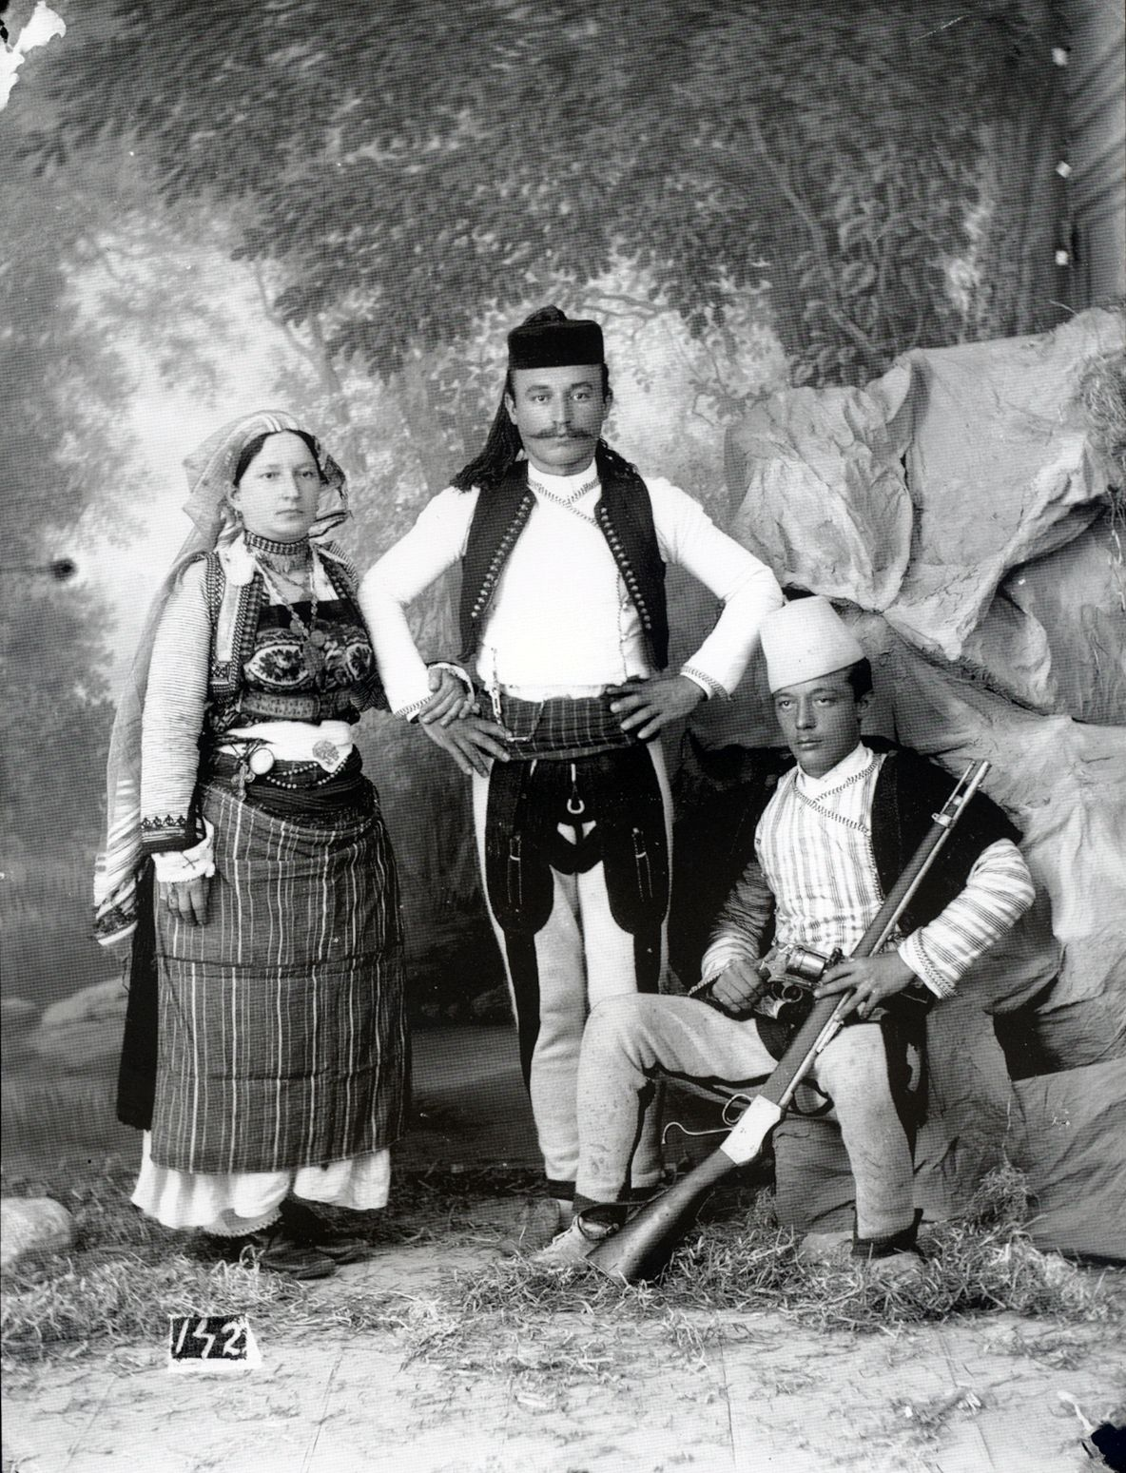
traditionalist and fundamentalist society
authoritarianism and patriarchy
tribalistic legacy
Notes:
Socio-economic background of the society.

Slide 3
sexual violence as a tool of war
sex trafficking and forced prostitution
domestic violence and abuse
Notes:
Three main topics of focus.

Slide 4
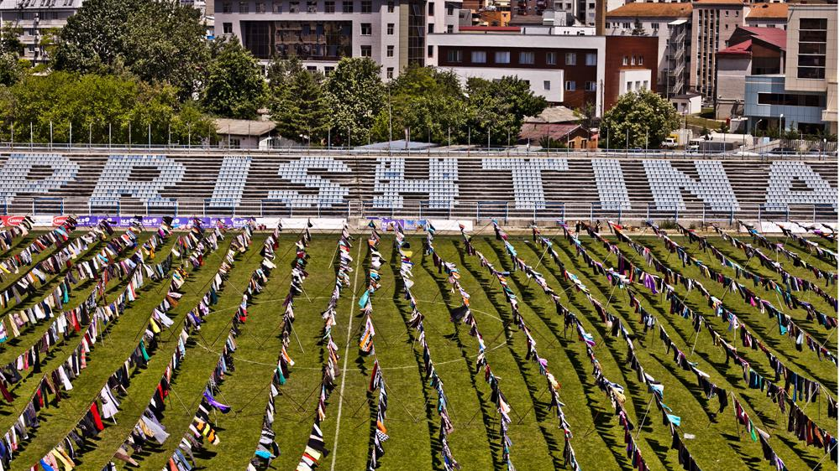
20 000 men and women from all communities
status of war survivor adopted in 2014/2018
demanding process of application
low interest, insufficient health care and lacking protection
Notes:
Sexual violence as a tool of war.

Slide 5
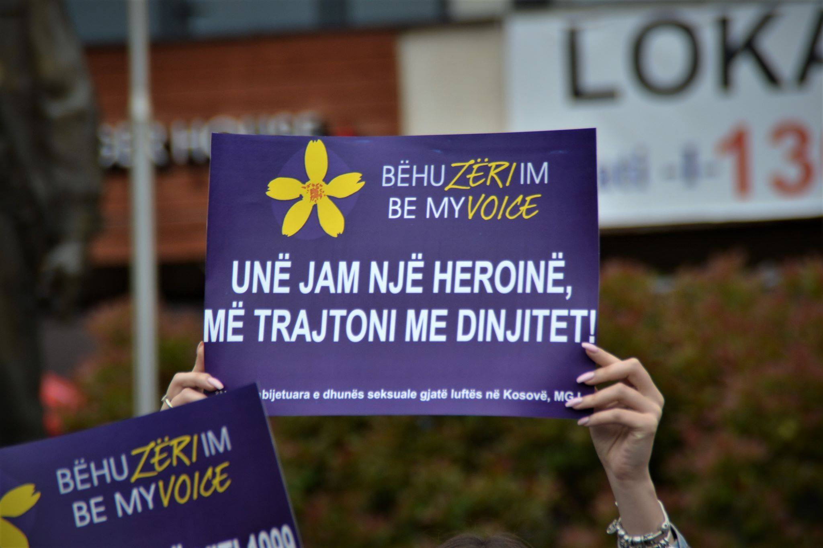
decrease in identified victims – contradictory causes
mushrooming local businesses due to intl. presence
trafficking from Moldova, Ukraine, Bulgaria and Russia
trafficking within Kosovo
Lacking legislation, low punishments for perpetrators & low govt’s interest
Notes:
Sex trafficking and forced prostitution
Obrázek: I am a heroine, treat me with dignity!

Slide 6
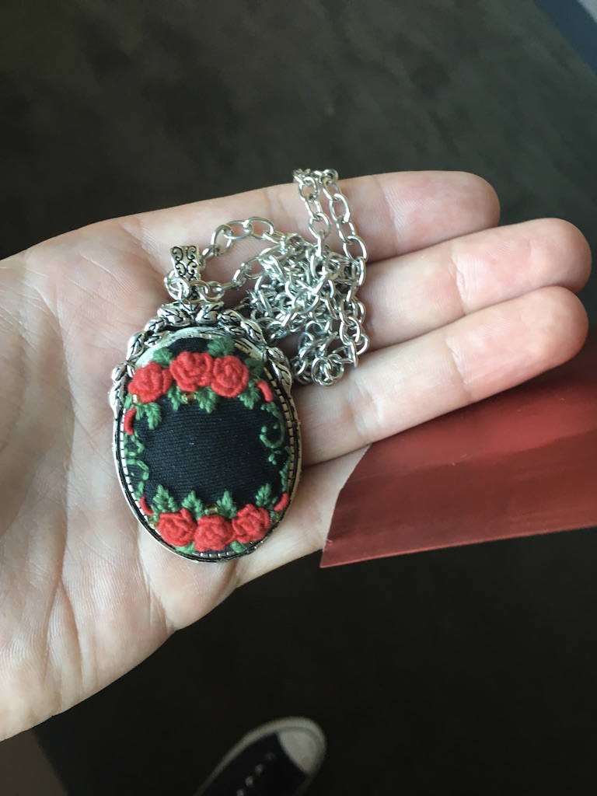
underreported cases due to weak legislation
failed protection orders
high dismission rates
Notes:
Gender based violence including sexual assault and harrasment.
Vražda devítileté dcery a manželky minulý rok.

Slide 7
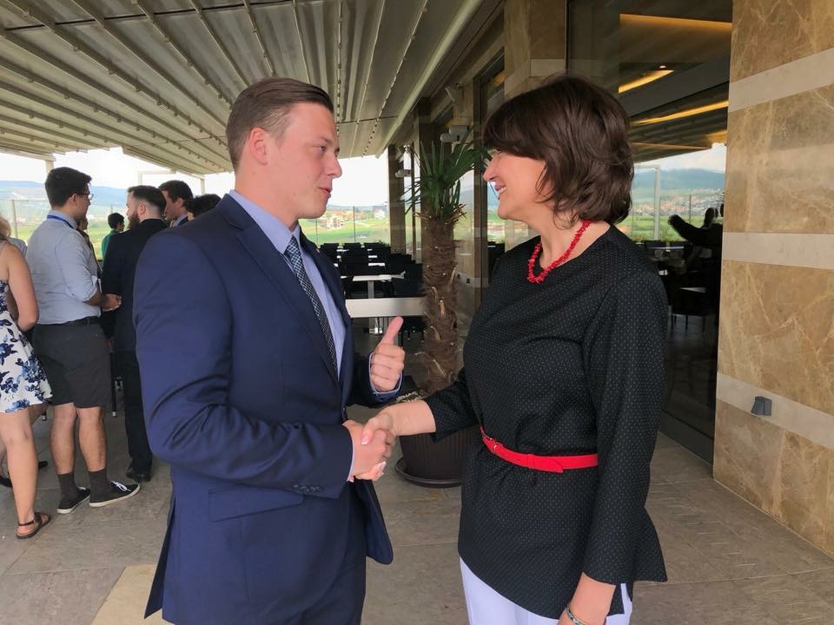
EU mission to Kosovo
OSCE
NGOs / CSOs
UNMIK / UNKT
Notes:
Key players

Slide 8
no office of SRSG on Sexual Violence in Conflict
no autonomous CO of UN Women
UN Kosovo Team (2016+) + UNMIK

Slide 9
strong rhetorical support -> pressure
financial support and funding opportunities
technical support (Verification Commission, police trainings)

Slide 10
“from neglect to emphasis”
universal approach of the Mission vs. particular of the Agencies
public opinion towards intl. presence
Notes:
Approach of and towards the mission.

Slide 11
introduced standard should continue
UN should adopt more factual instruments and should be more assertive in support of bottom-up approach
UN should brand itself more positively within the society
restructuralization of chain of Agencies?
status of Kosovo erodes both intl. and domestic efforts, govt’s obstructions

Slide 12
Faleminderit për vëmendjen!
Hvala na pažnji!
Albania / Bosnia and Herzegovina / Kosovo
jiri.nemec@mail.muni.cz

