Slide 1
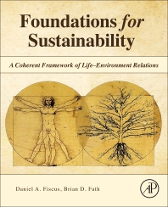
Foundations for Sustainability
Brian D. Fath & Dan Fiscus
Fulbright Distinguished Chair, Masaryk University, Brno, Czech Republic
Professor, Towson University, Maryland, USA
Senior Research Scholar, International Institute for Applied Systems Analysis, Austria

Slide 2
Chapter 7: A bridge not too far: spanning theory to science to application
Your reaction
What are some main elements of the machine metaphor?
What “animates Earth’s thin surface layer of congealed matter-as-informed-energy”? (p. 201)
  -- What is a key aspect of this process in terms of the functional organization?
What parts were most difficult in this chapter?

Slide 3
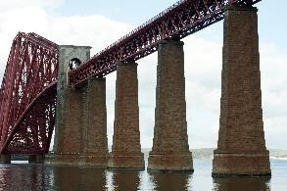

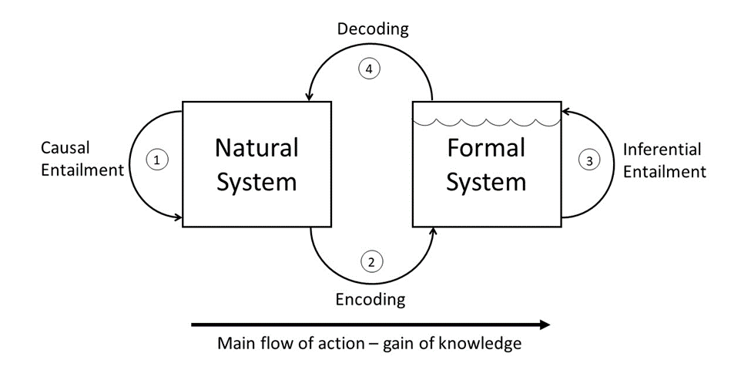
Bridge supports
How we know the world (encoding, reading, observing)
Our mental models change the world (decoding)
  - Making the world into a machine, that runs down and wears out.
Leads to fabrication
leads to mental models

Slide 4
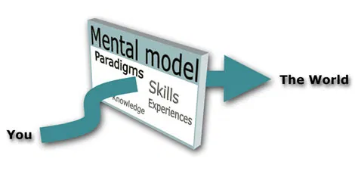
Main thesis of the book
The dominant mental model of the mainstream science paradigm works to alter the environment in detrimental ways and blocks progress toward true sustainability (p. 170).

Slide 5
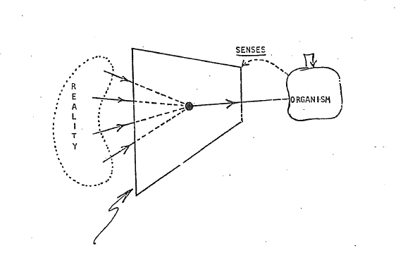
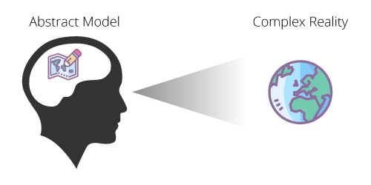
Modelling Function
The filter or “corruption”
Patten - Systems Ecology lecture notes

Slide 6

Constructing Reality
“From the constructivist perspective of system theory, reality is not something given, but an effect of cognitive construction. Cognition produces reality by producing system/ environment distinctions. Reality thus emerges as an effect of the operational closure of the systems.” Mueller p. 70

Slide 7
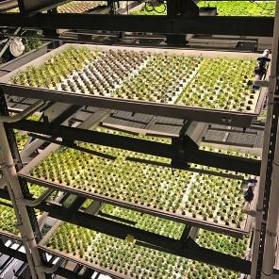
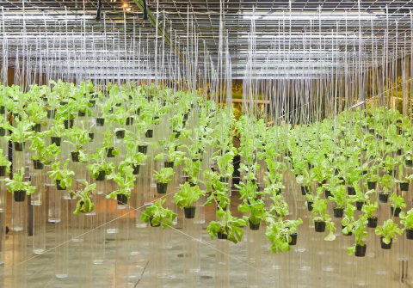
Co-creating down a wrong path
When we forget we are working with a model (metaphor) the encoding and decoding becomes projecting, fabricating, and actuating (p.175).
How many contrived control loops do you observe? How many do you observe in nature?
Treating plants as though they are machines

Slide 8
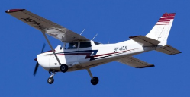
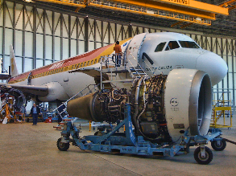
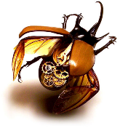
Determinism and propensities
I have often joked about how I go from my office, where I rant against the idea of nature as machine, to the cockpit, where I pray I am seated in the most finely-tuned clockwork that ever existed!
My appraisal of the two airways is different from Bernie’s however: Newtonian Airways believes their machines are guaranteed by law to fly. Popperian Airways, chastened by the conviction that their machines only have a strong propensity to fly, invest in much redundancy so as to increase the probability that, when novel and threatening circumstances do arise, their planes will fail-safe. (p. 343)
gajitz.com/insectvention-steampunk-bugs-blend-nature-machine/

Slide 9

clockwork beliefs
“simplistic approaches to complex problems create dysfunctional answers and these dysfunctional answers are coming home to roost in societies the world over. This is creating pressure to find something better” (Goerner 1999, p. 181).
Scientists have known that the world is interwoven for a very long time. The problem is that the interwoven nature of the world can be overwhelming.

Slide 10
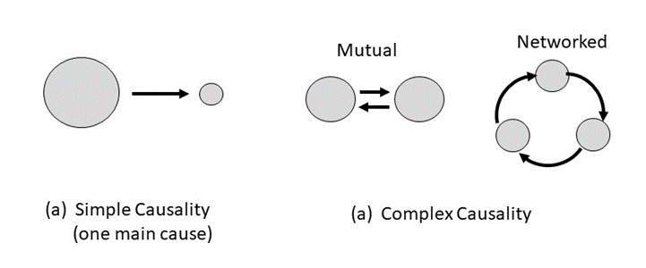
Tools and ecology
. . .it is increasingly obvious that most causality in complex systems such as the body, economies, societies and the weather, causes blend and loop back on themselves. (p. 91)

Slide 11
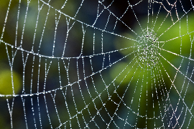

Ecological Perspective
webs don’t work like machines.
Ecologists have been the most successful at this which is why people the world over are beginning to recycle and green movements are a force to be reckoned with. (p. 91)
Now we are realizing that ecology is not merely a particular field of science; it is a new way of understanding life that frees us from the failing mechanical worldview’s assumptions of separateness and scarcity. (p. 174)

Slide 12

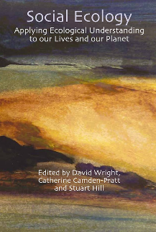
Ecological Understanding
There is clearly a basis toward ecology and the ecological mind. How to reach people from other backgrounds? (Is one approach eco-literacy training for everyone?)

Slide 13
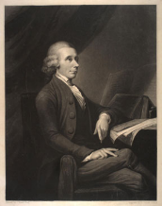
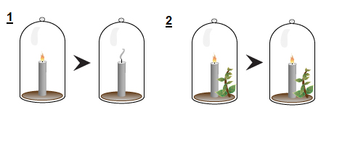
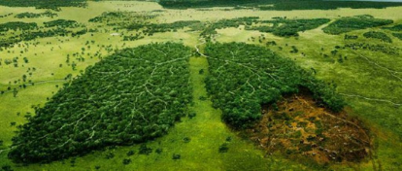
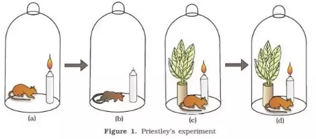
Sustained Life
Joseph Priestley discovered oxygen in 1774
www.acs.org/content/acs/en/education/whatischemistry/landmarks/josephpriestleyoxygen.html

Slide 14
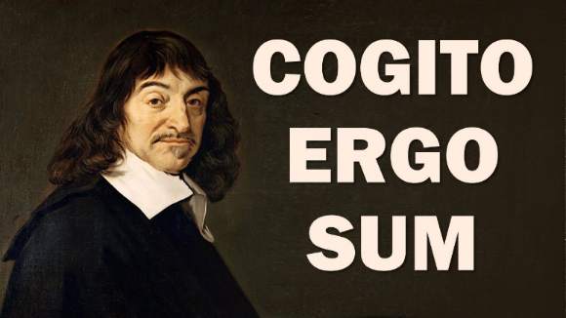
Rene Descartes Discourse on the Method (1637).
I think, therefore, I am
Founder of the “Cartesian” worldview

Slide 15
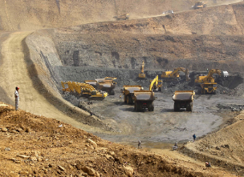
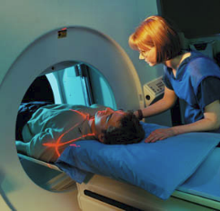
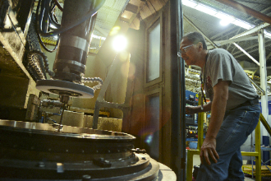
“To Descartes the material universe was a machine and nothing but a machine... This mechanical picture of nature became the dominant paradigm of science in the period following Descartes.
The Cartesian view of the universe as a mechanical system provided a “scientific” sanction for the manipulation and exploitation of nature that became typical of modern civilization.
The Cartesian approach has been very successful, especially in biology, but it has also limited the directions of scientific research. The problem has been that many scientists, encouraged by their success in treating living organisms as machines, tended to believe that they are nothing but machines.” (p. 25-26)
Capra and Luisi (2015). Systems View of Life
https://www.mmtimes.com/news/growth-mining-industry-expected-investments-rise.html
www.fda.gov/radiation-emittingproducts/radiationemittingproductsandprocedures/medicalimaging/medicalx-rays/ucm115317.htm
www.tinker.af.mil/News/Article-Display/Article/ 845655/grinding-it-out-no-job-is-too-big-or-small-for-548th-pmxs-machine-shop/

Slide 16
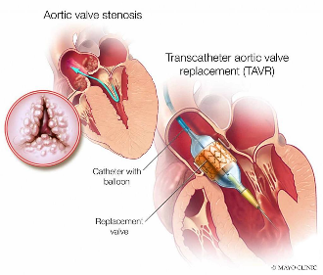
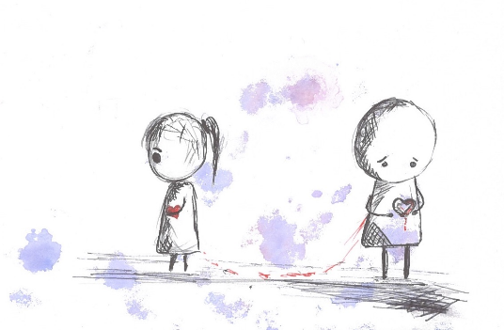
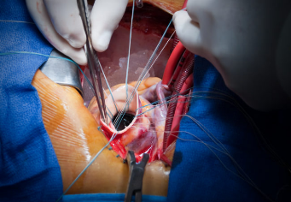
The human heart as machine
and much more

Slide 17
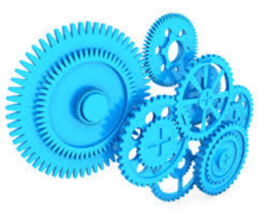
One major barrier is the dominant idea in mainstream science now – to treat the fundamental working unit of Nature as a “mechanism” – we have turned the world into the machine we have pictured it to be.
The suite of systemic problems listed above – showing a world and natural life support ecosystems literally “running out of gas” and “breaking down” in myriad ways – is not typical behavior of natural living systems.

Slide 18
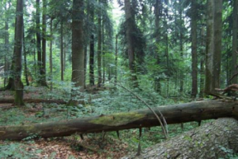
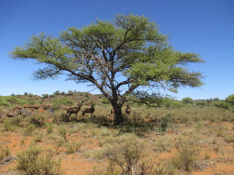
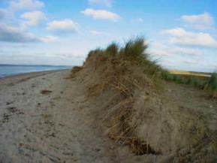
On the contrary, natural living systems normally self–organize continually and self–repair after disturbance. They grow, develop and improve in environmental quality over time (O₂ atmosphere, O₃ layer, soils, water purification, etc.)
These demonstrate the normal behavior of healthy Life systems is a win–win where life and environment both improve over time.

Slide 19
Rene Descartes Discourse on the Method (1637).
Discrete Thought
Founder of the “Cartesian” worldview

Slide 20

“I think, therefore I exist.
That is, I think now, therefore I exist now. But I think only as long as I have a steady input of oxygen, water, and food to sustain my thinking via my life. And, after I am done thinking with aid of these vital materials, they are transformed and expelled not so much as waste but as food for the plants and other living beings that in turn create and supply my material needs.”
“I think, therefore, I am... we are... an ecosystem” Fiscus & Fath 2019
Sustained Thought
https://wmtllp.com/tax-advisory/trusts/woman-sitting-on-bench-by-the-lake-contemplating-nature/

Slide 21
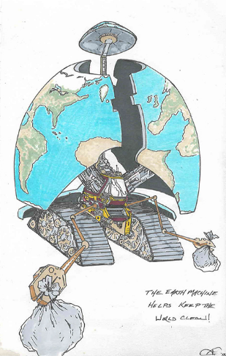

We have mistaken our favorite model for the thing itself
“Based on the dominant root metaphor at the foundation of the mainstream science paradigm, which prioritizes reductionism over holism, we are accidentally manifesting that model, and, via the fabrication channel of Rosen’s bridge, transforming the world through our mechanism-like technologies and industrial cultures, breaking the cycles of nature and fragmenting humans into an adversarial role with each other and the environment.
We now realize that the world is breaking down, suffering stress and strain, and grinding to a halt like the mechanism we have unconsciously treated it to be for hundreds of years.” p. 189

Slide 22
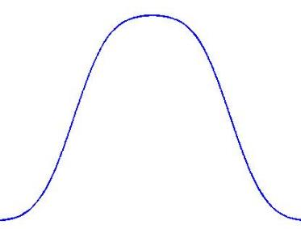

Infinite regress of control loops
Collapse follows when the apparatus overtakes the purpose
“More complex societies are more costly to maintain than simpler ones… as societies increase in complexity, more networks are created among individuals, more hierarchical controls are created to regulate these networks, more information is processed … increasing need to support specialists not directly involved in resource production, and the like” (Tainter 1988).”
Benefit from Complexity
1988
Complexity

Slide 23
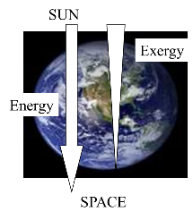
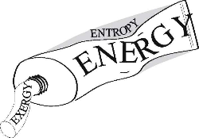
Work↔dissipation coupling
Total energy is conserved (first law), its capacity to do further work is not conserved and in fact diminishes (second law), as evident in a decrease in exergy.
Viewed on one extreme, this is the origin of the dreaded heat death scenario, but that angle omits the beauty and complexity of the Life-environment organization that arises out the work that is done.

Slide 24
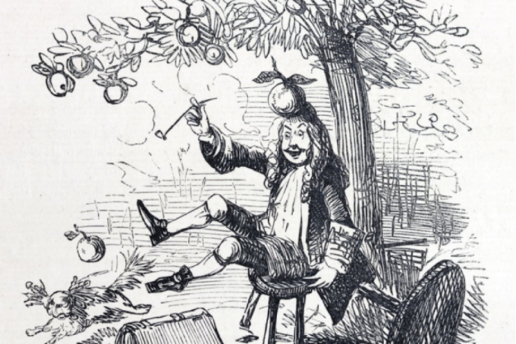
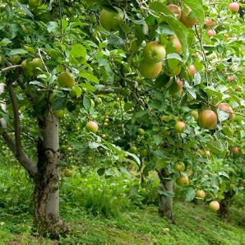
Newton’s Apple
He didn’t answer the corollary question:
How did the apple get above the ground in the first place?
https://history.howstuffworks.com/history-vs-myth/10-false-history-facts10.htm

Slide 25
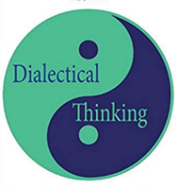
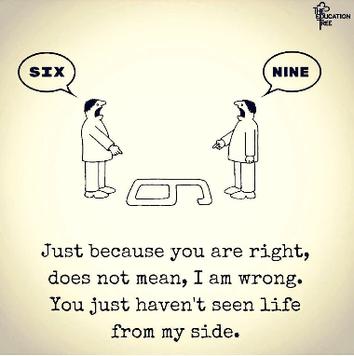
Dialectical thinking
We tend to throw away or distort material that does not fit our model. We need to learn to embrace the opposite and reverse the model.
In this manner we can we and think more (p. 194)

Slide 26
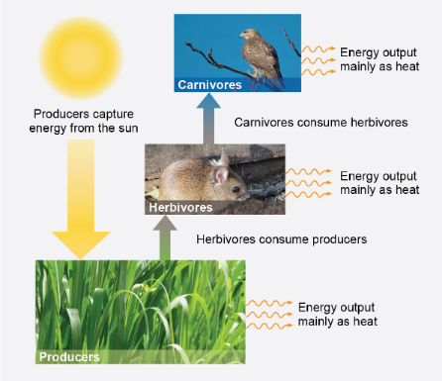
Gradient dissipation and gradient formation through coupled complementary processes
An ecosystem is a conduit through which energy passes, with many or few transformations of energy/matter during its trip through the conduit.
An apple tree takes the energy to build new gradients, putting the apples above Newton’s head

Slide 27
Alternative root metaphors
Life
Network, web, or ecosystem
Community
Family
Mind
System
Sacred
Let’s discuss these

Slide 28
Discussion questions
The biosphere: “a momentary, whirlpool-like by-product of the irreversible dissipation of the sun.”
  Is it running up or running down? At what scale?
What is meant by the difference between instrumental and intrinsic value?
  Can a machine have intrinsic value?

Slide 29
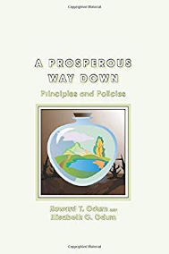
Explain some of the control loops that make these systems sub-optimal, especially over the long-term
Industrial agriculture
Industrial food system
Industrial medicine
Inudstrial education and media
Can we bridge the gap between sustainers and transcenders?

