Slide 1
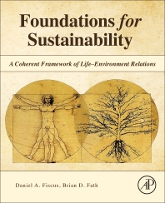
Foundations for Sustainability
Brian D. Fath & Dan Fiscus
Fulbright Distinguished Chair, Masaryk University, Brno, Czech Republic
Professor, Towson University, Maryland, USA
Senior Research Scholar, International Institute for Applied Systems Analysis, Austria

Slide 2
Chapter 8: Technology and Applications in the context of holistic Life–Environment
Your reaction
Why did M.K. Hubbert depict the fossil fuel era as a very brief event in human history?
What is a disadvantage of adding control loops?
  Why are autocatalytic ones preferred?

Slide 3




Holistic technologies
net increase in the orderliness of the natural and built environment and thus increase syntropy
is anticipatory and serves long-term goals by protecting Life and its essential environmental context
is self-referential and uses an internalist orientation to account for its own impacts on the environment

Slide 4
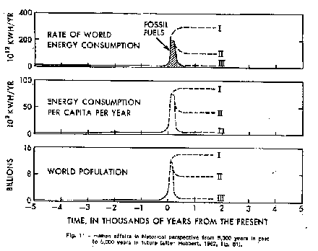
Energy futures
  Is there an energy shortage? What would we do with more energy?
  M.K. Hubbert: Our principal constraints are cultural.

Slide 5
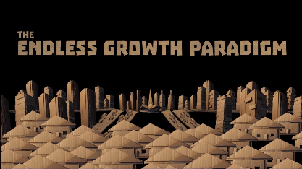
Growth is as dominant a paradigm as the machine
During the last two centuries we have known nothing but exponential growth and in parallel we have evolved what amounts to an exponential-growth culture, a culture so heavily dependent upon the continuance of exponential growth for its stability that it is incapable of reckoning with problems of non-growth. (p. 210).

Slide 6
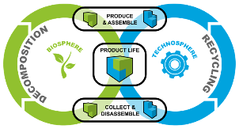
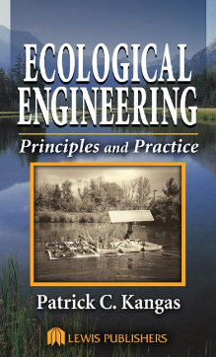
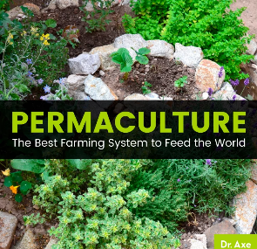
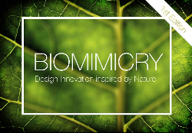
Case studies compatible with Holistic Life Science
Cradle-to-cradle design
Biomimicry
Permaculture
Ecological engineering

Slide 7

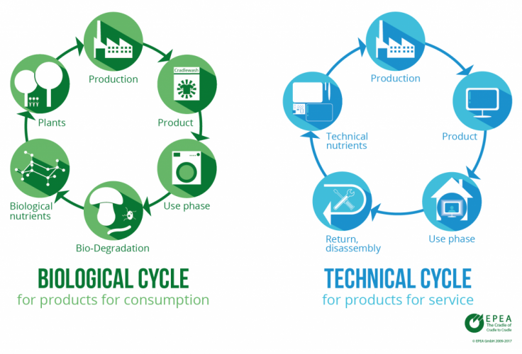
Cradle to cradle

Slide 8
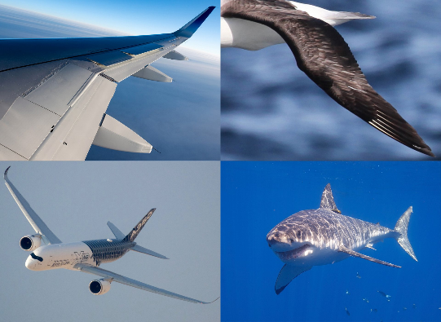
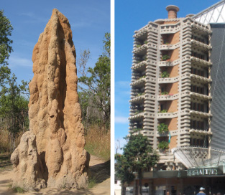
Biomimicry
Nature inspired design

Slide 9
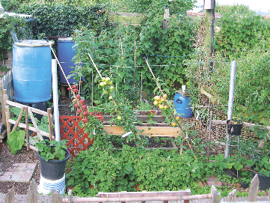
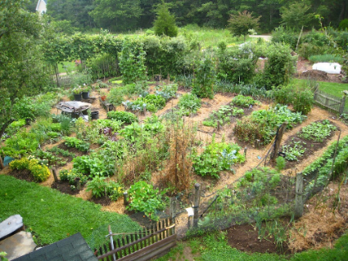
Permaculture
Permanent (Agri)culture:
Observe and interact
Catch and store energy
Obtain a yield
Apply self-regulation and accept feedback
Use and value renewable resources and services
Produce no waste
Design from patterns to details
Integrate rather than segregate
Use small and slow solutions
Use and value diversity
Use edges and value the marginal
Creatively use and respond to change

Slide 10
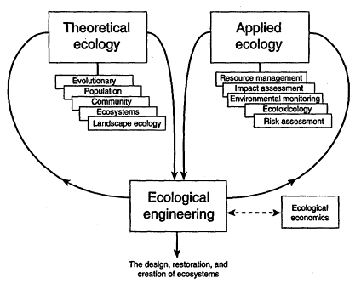
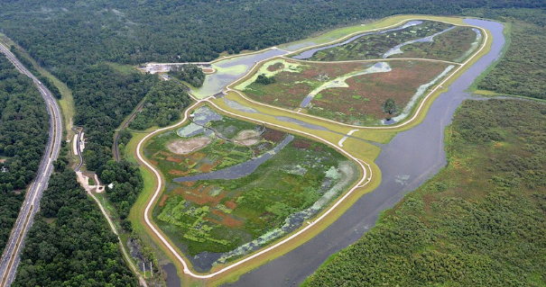
Ecological Engineering
Wetland water treatment

Slide 11
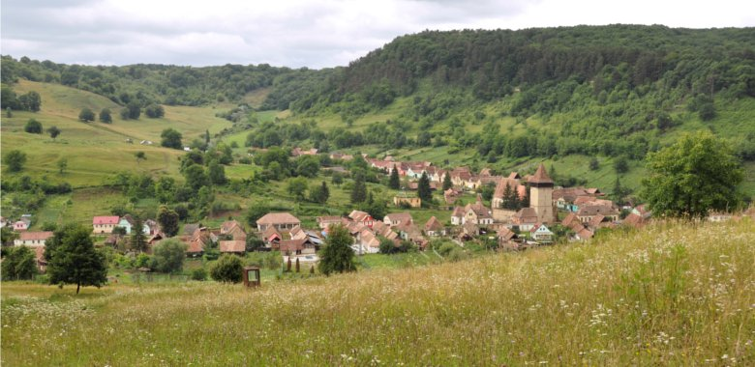
Holistic Land Development
How to add more life capacity and support to a site?
Scale and carrying capacity
www.pecs-science.org/ research/publications/publications/ aholisticapproachtostudyingsocialecologicalsystemsanditsapplicationtosoutherntransylvania.5.144972a51495db7dbc812f3.html

Slide 12
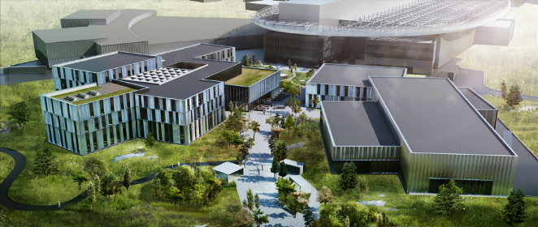
Practice what we preach
Science facilities
Sustainable Masaryk – what would that look like?
European Spallation Source
europeanspallationsource.se/building-project/site-architecture-energy

Slide 13
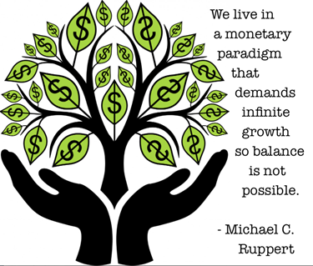
Challenges
Why reductionism wins
  Need an answer now
  Need to look like we are doing something
  People are hungry
  People need a job
  People need something to do (Closure of efficient cause)

Slide 14
Discussion questions
How much of the fossil dividend do we allocate to Sustainers or transcenders?
  None of the scenarios in Figure 8.1 involve continued growth
  What does success look like?
Human sense of self evolves to embrace both a discrete self and sustained self. Is that crazy talk?
Is the best we can do with sustainability to be “less bad”?
Is there a common aspect of the counter technologies?
  Other examples?

