Slide 1
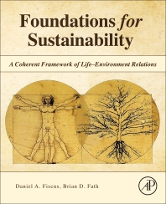
Foundations for Sustainability
Brian D. Fath & Dan Fiscus
Fulbright Distinguished Chair, Masaryk University, Brno, Czech Republic
Professor, Towson University, Maryland, USA
Senior Research Scholar, International Institute for Applied Systems Analysis, Austria

Slide 2
Chapter 9: Sustainability: A goal for all
Your reaction
Have we made the case that our current view of discrete life imposes an ‘us’ versus ‘them’, and ‘object’ versus ‘subject’ fragmentation that makes it easier to not see the dependency we have on the environment and therefore degrade it?
Is simply knowing this enough to change our behavior?

Slide 3
Recap
Life as the primary basis for value
six founding principles of holistic Life science
seven Life lessons and methods developed from past work
described several existing allied works and innovative leaders who are already implementing technology and applications
the systemic environmental degradation we now experience has been caused largely by the dominant mechanistic root metaphor at the heart of science

Slide 4


It is not a new discovery that a functioning dialectic—where two sides continually oppose each other—can be stable particularly when there is balance in ascendency of the two sides.
The environmental crisis is one manifestation of the asymmetric imbalance toward Transcenders and away from Sustainers, and toward reductionism away from holism.
Our book aims to reposition and stimulate the role of Sustainers and holism, but not to eliminate the opposites.

Slide 5
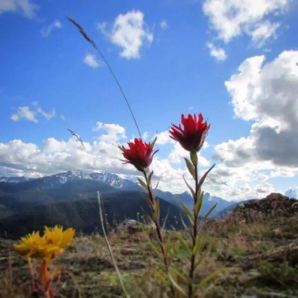
Inter-being
looking into a flower, you can see that the flower is made of many elements that we can call non-flower elements
  Embodied
  Embedded
  Enfolded
life–environment =
{environment{ecosystems{organisms{environment}}}}

Slide 6
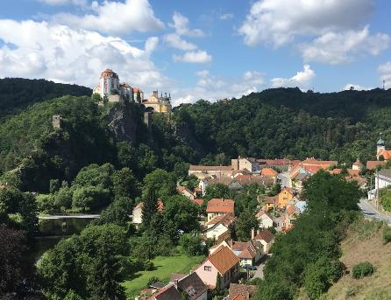
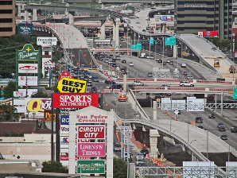
Importance of place
Protection and investment in place
Finding the balance of what the environment offers: sustaining (and enhancing) those flows
Geography of Nowhere

Slide 7
Adaptive cycle – growth, conservation, disruption, reorganization

Slide 8
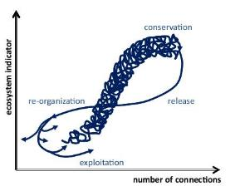
Key features of success
(entry points)
Capacity to grow (r)
  * Activation energy
Capacity to develop (K)
  * Self organized to store information and capital
Capacity to survive (Ω)
  * Improvise to maintain vital functions
Capacity to renew (α)
  * Learn and forgive to reorient

Slide 9
Pathologies in succession
 | Entry | Exit
r-stage | Poverty trap – no activation energy, no scaling | Overshooting („forever young“), relentless resource acquisition
K-stage | Lack of internal complexity (right buffers, redundancies, connections) | Perpetuation of status quo through cannibalism Rigidity trap (loss of connection to the outside)
Ω-stage | Subsidize rigid systems | Inability to improvise
α-stage | Self-victimization mentality | Lack of direction (no scale, no new orientor)

Slide 10
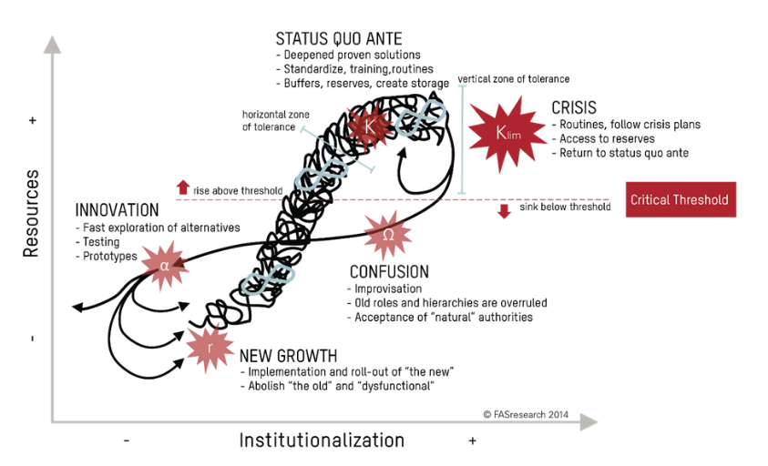
Applied to business management

Slide 11
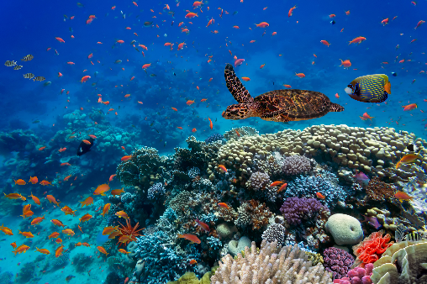
No organism is separate from its surroundings.
Hyperset formulation
life–environment =
{environment{ecosystems{organisms{environment}}}}

Slide 12
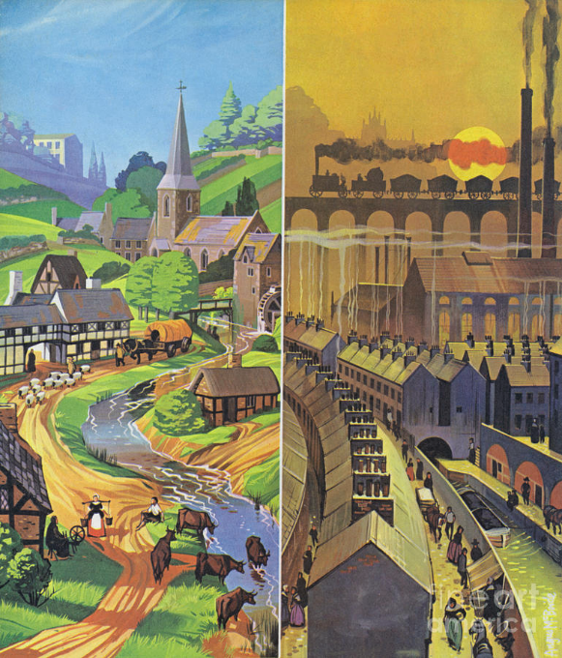
“If the landscape has changed since the time your map was made, then by following it you may end up somewhere you did not intend to go.”

Slide 13
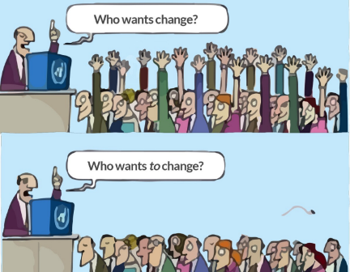
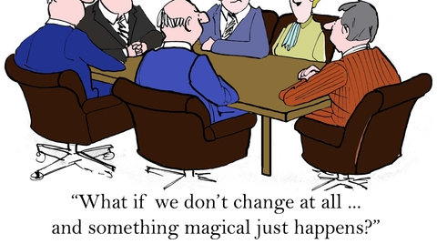
Change the course
being prepared and adaptive to changes that inevitably come
there is a right time to grow, but it is not always

Slide 14
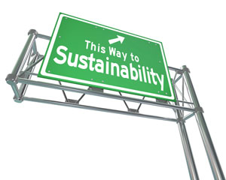
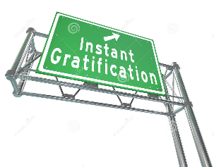
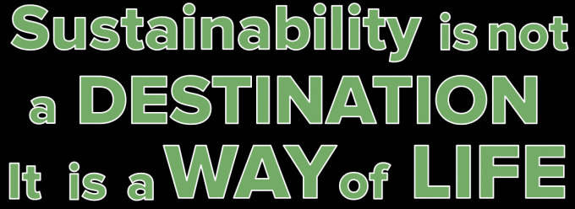
There is no way to sustainability;
sustainability is the way

Slide 15
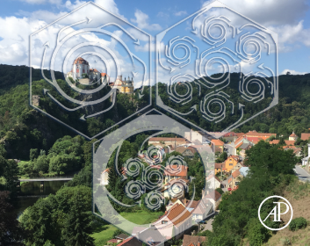
Discussion questions
Counter argument – place matters, ours, not yours, role of nativism and tribalism in Sustainability
Can you see the overlapping systems balanced across scales?

Slide 16
Discussion questions
What does sustainability mean to you?
How is that different after reading the book?
What things could you do differently now?
What could the book do differently?

