Slide 1
Biophysical Limits to Growth
Brian D. Fath
Professor, Biology Dept, Towson University, USA
Senior Research Scholar, IIASA, Austria
Editor-in-Chief, Ecological Modelling
Editor-in-Chief, Current Research in Environmental Sustainability

Slide 2
Biophysical Limits to Growth
Brian D. Fath
Professor, Biology Dept, Towson University, USA
Senior Research Scholar, IIASA, Austria
Editor-in-Chief, Ecological Modelling
Editor-in-Chief, Current Research in Environmental Sustainability

Slide 3
We witness unsustainable human-ecosystem interactions
How could people make such serious mistakes in the past and why does society continue to repeat such mistakes today?
Is it inevitable that the environment must be degraded to satisfy human needs?

Slide 4
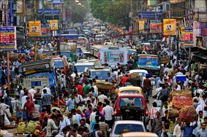
Drivers of Unsustainability
HUMAN POPULATION INCREASE
  Agriculture
  Shelter
  Mobility
  Stuff
Use Energy and
Material Resources
causes
Land use change
Habitat loss
Deforestation
Alter biogeochemical cycles
Climate Change
Eutrophication
Acid precipitation
Ozone Depletion
Smog
…
Leads to

Slide 5
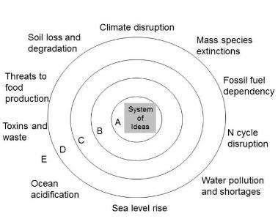


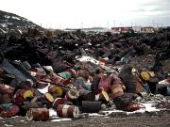

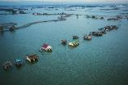
Environmental (and Social) problems are symptoms of deeper failures
Soil erosion
Toxins and waste
Water pollution
Sea level rise

Slide 6

Economics
Economics is one the main organizing forces in society
Many decisions are made based on cost-benefit analysis but true costs (direct + indirect) to individual, society, or environment are often not known

Slide 7
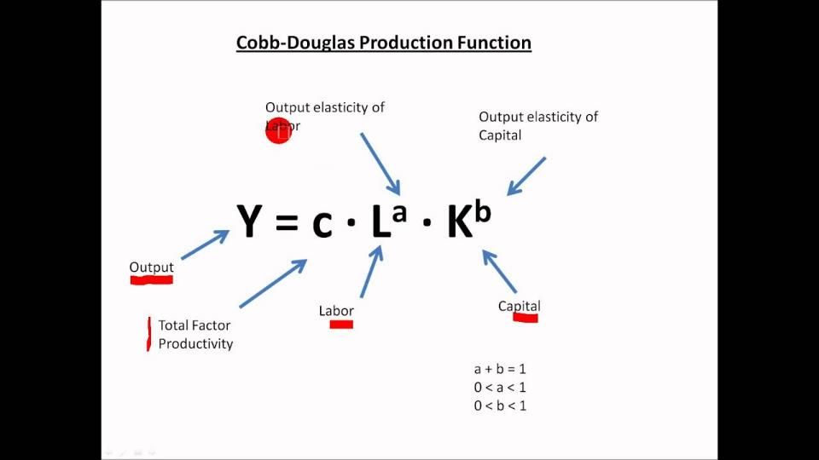
Economic Growth Models
WHERE IS ENVIRONMENT?

Slide 8
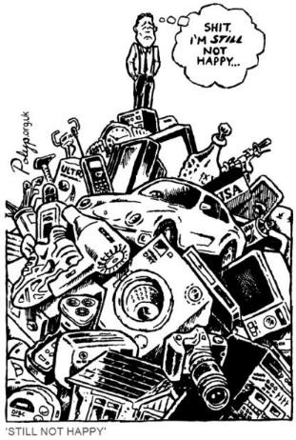
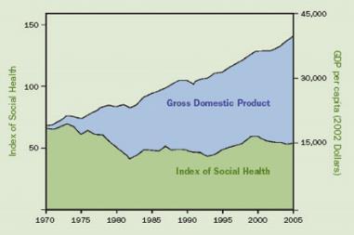
What is the purpose of growth?
Does bigger always mean better?
Alternative well-being indicators tell a different story

Slide 9
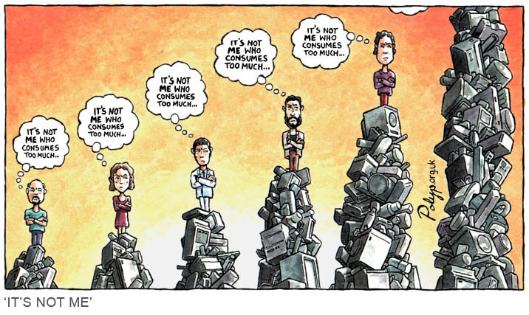
Humans are social animals, measuring in terms of others, not absolutes

Slide 10
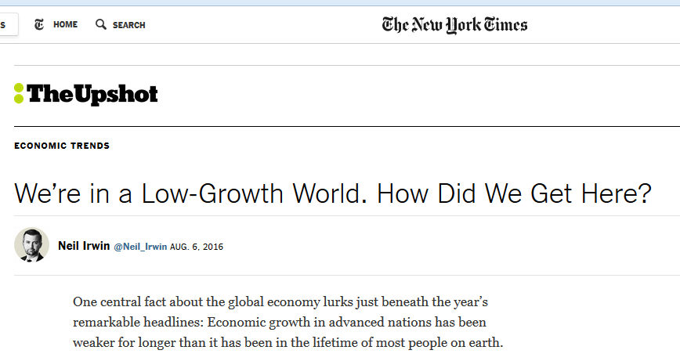
No mention of natural resources or environment
It increasingly looks as if something fundamental is broken in the global growth machine — and that the usual menu of policies, like interest rate cuts and modest fiscal stimulus, aren’t up to the task of fixing it (though some well-devised policies could help).
www.nytimes.com/2016/08/07/upshot/were-in-a-low-growth-world-how-did-we-get-here.html?hp&action=click&pgtype=Homepage&clickSource=story-heading&module=first-column-region&region=top-news&WT.nav=top-news&_r=0

Slide 11
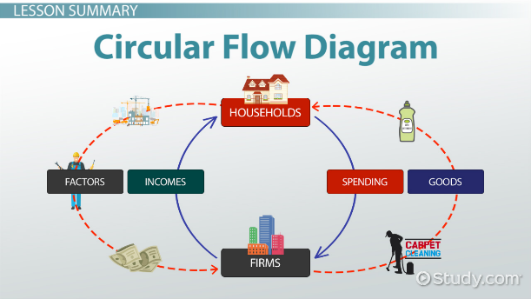
Assumption error:
Economy as an isolated system

Slide 12
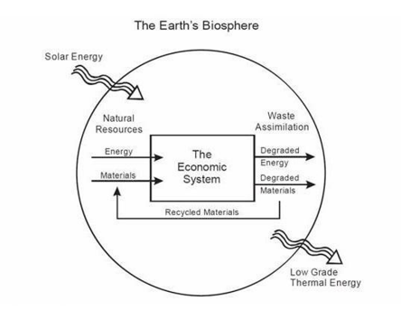
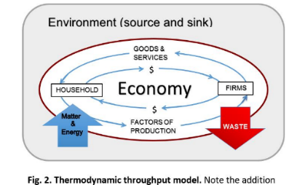

A better model:
Economy as an open system

Slide 13
A look back at the history recognizing limits

Slide 14
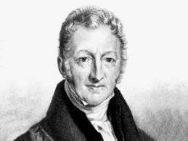
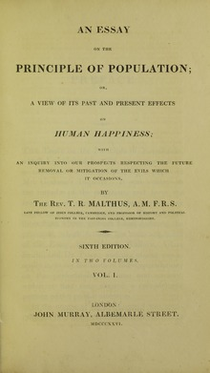
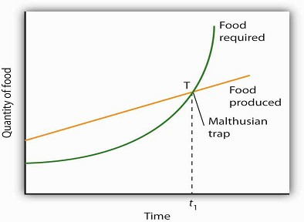
Thomas Malthus
Predicts eventually food and resources will run out as populations explode
1798

Slide 15
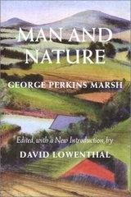
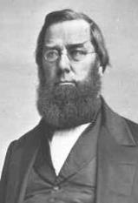
George Perkins Marsh
1864
“A certain measure of transformation of terrestrial surface, of suppression of natural, and stimulation of artificially modified productivity becomes necessary. This measure man has unfortunately exceeded.”
“The ravages committed by man subvert the relations and destroy the balance which nature has established…; and she avenges herself upon the intruder by letting loose her destructive energies…”

Slide 16
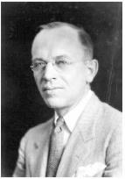
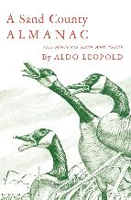
Aldo Leopold
A Sand County Almanac – regarded as the most influential book on conservation ever written.
The land ethic:
"A thing is right when it tends to preserve the integrity, stability, and beauty of the biotic community. It is wrong when it tends otherwise."
Enlarges the boundaries of the community to include soils, waters, plants, and animals, or collectively: the land.
1949

Slide 17
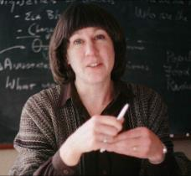
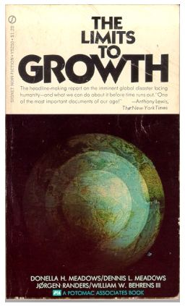
Donella Meadows and Club of Rome
1972

Slide 18
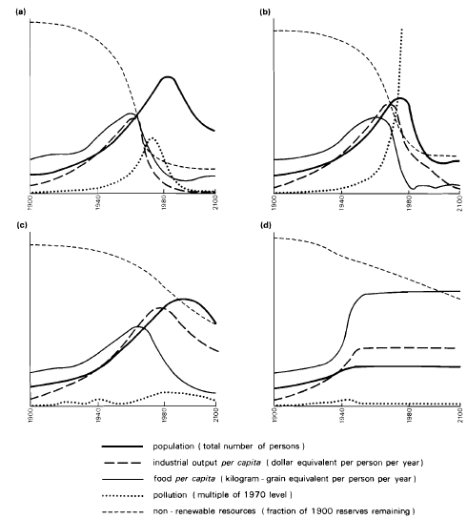
Forrester-Meadows world model
(a) A standard computer simulation based on 1970 values.
(b) Pollution-induced collapse even when known natural resource reserves are 2x.
(c) Collapse due to population growth even though resources are set as unlimited and pollution controls are assumed.
(d) Stabilized model producing a sustainable future. Assumptions: birth rate= death rate, capital investment= capital depreciation, and technological policies are implemented, e.g., resource recycling, pollution control, and restoration of eroded and infertile soils.
(After Meadows, 1971)

Slide 19
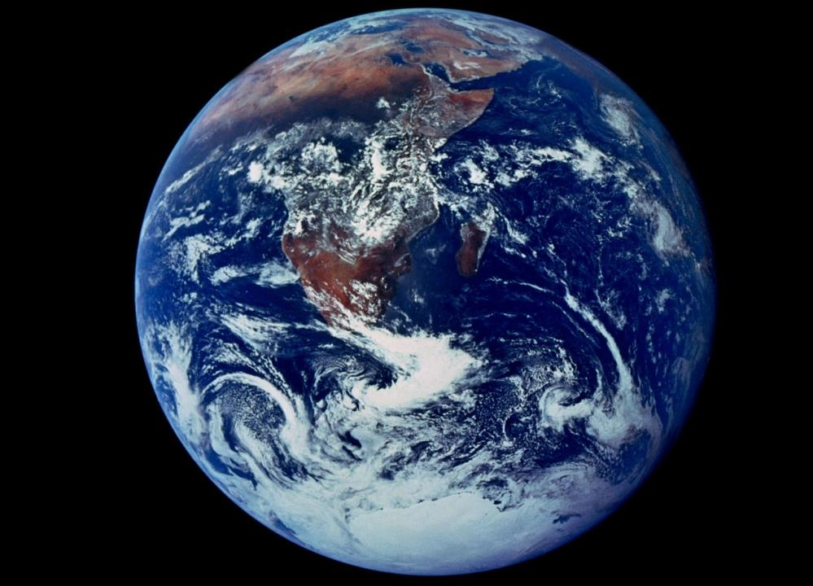

Slide 20
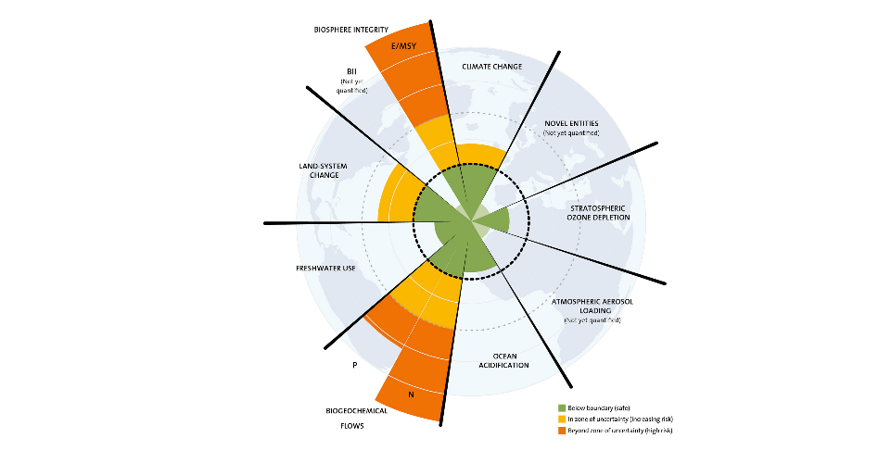
Planetary Boundaries – Stockholm Resilience Centre

Slide 21
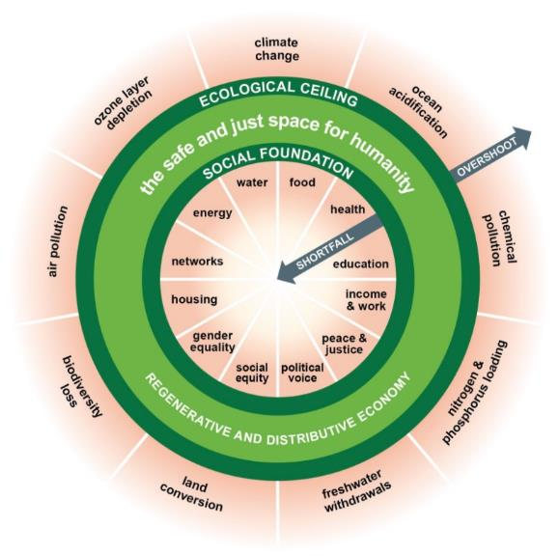
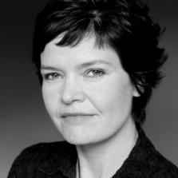
Donut Economics – Kate Raworth

Slide 22
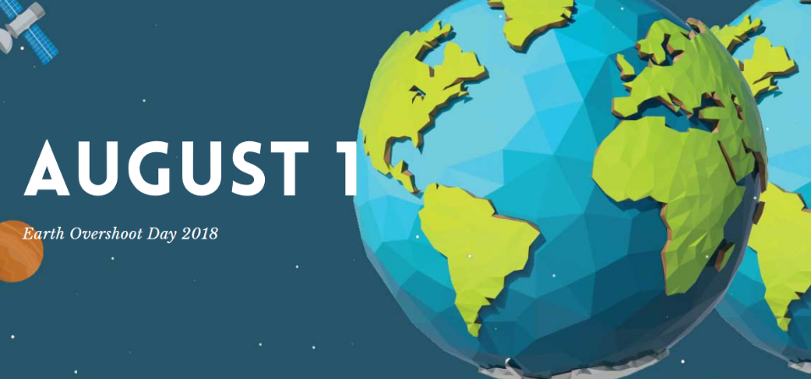
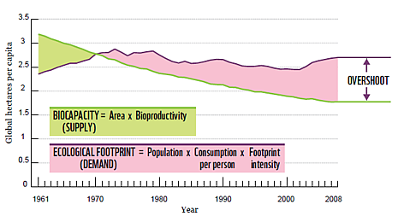
Overshooting the limits

Slide 23
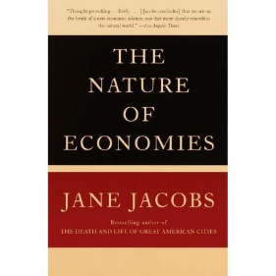
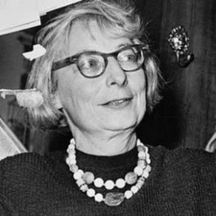
Limits to Growth
“Natural principles of chemistry, mechanics and biology are not merely limits. They’re invitations to work along with them.”
Jane Jacobs
2000

Slide 24

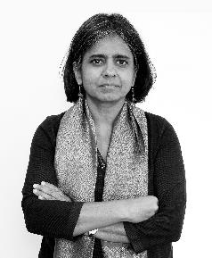

“There are limits. Let’s celebrate the limits, because we can reinvent a different future.”
Sunita Narain
This Changes Everything 2015

Slide 25
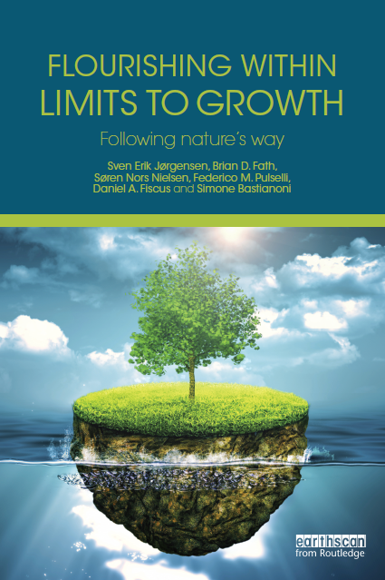
Ecosystems do quite well under constraints, let’s learn from them
2015
clubofsiena.eco-soft.dk

Slide 26
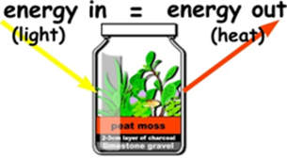
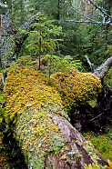
9 properties of ecosystems
Material constraints
Ecosystems conserve matter and energy – 1st law
All processes are dissipative – 2nd law
All life uses largely the same biochemical constituents and processes
Ontological properties
An ecosystem uses surplus energy to move further away from thermodynamic equilibrium (physically driven biological aspect) – centripetality
Ecosystems co-evolve and adapt to prevailing conditions (biologically driven biological aspect)
Phenomenological properties
Ecosystems have diversity of structure and function
Ecosystems work together in networks that improve the resource flow utilization
Ecosystems are emergent hierarchically
Ecosystems have an enormous amount of genetic, biochemical, and process information
Understand these and apply to socio-economic systems

Slide 27
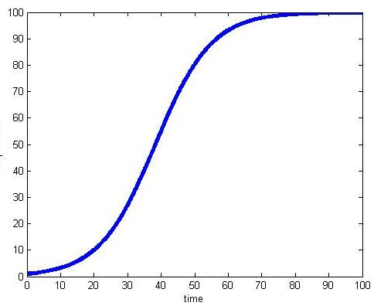
Ecosystem growth and development follows a logistic curve from early to late successional stages
Late stage
Biomass or complexity
Early stage

Slide 28
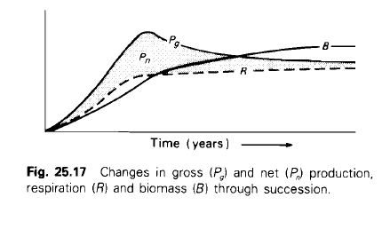
Bioenergetic model of succession
In early stages of succession, P>R and excess is channeled into growth and accumulation of biomass.
Increase capacity and complexity of the energy storage compartments (total biomass of all species and trophic levels) as well as the complexity of energy transfer pathways.
In late stages of succession, P=R as maintenance costs increase respiration
Negative feedback maintains steady state, with little or no change in biomass (network, feedback, cycling).

Slide 29
Four types of Ecosystem Growth and Development
0. Boundary Growth: How much energy enters the system.
I. Structural Growth: Increase in biomass quantity in the number & size of components in the ecosystem.
II. Network Development: Change in system connectivity, which results in more cycling.
III. Information Development: Qualitative change in system behavior to more energetically efficient ones.
Bigger
Better
Fath BD, Jørgensen SE, Patten BC, Straškraba M. 2004. Biosystems 77, 213–228.

Slide 30
Growth → Quantitative increase
Development → Qualitative increase
"We must realize that growth and development are two very different things. You can develop without growing and vice versa.“
Tibor Vasko, 2009, www.solon-line.de/interview-with-tibor-vasko.html

Slide 31
Alternative Economic Systems…

Slide 32
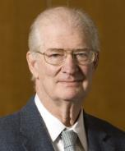
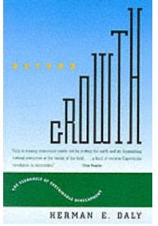
Herman Daly
Beyond Growth: the economics of sustainable development
  The first and second laws of thermodynamics must be the starting point of economics
  Neither the sources of useful inputs nor the sinks for polluting waste outputs are infinite.
1996

Slide 33
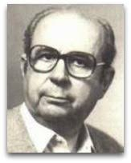
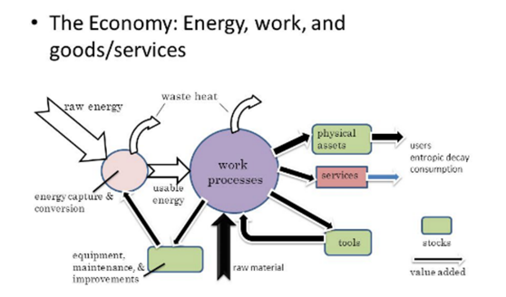
Nicolas Georgescu-Roegen
The Entropy Laws and the Economic Process (1971)
  Wealth is an open system, a structure maintained in the midst of throughput
  It begins with the depletion of useful matter/energy and ends with the return of an equal quantity of spent matter/energy back to the environment.

Slide 34
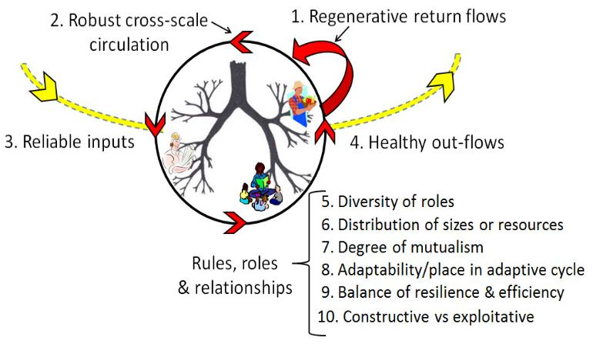
Regenerative economy
Input, Output, and System Dynamics
4.
3.
1.
2.
Fath et al. 2019. Global Transitions. 1, 15–27.

Slide 35
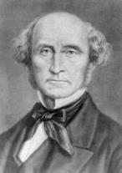
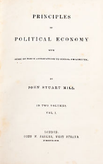
John Stuart Mill
British philosopher, political economist and civil servant (1806-1873)
Considered “the most influential English-speaking philosopher of the nineteenth century"
“Perpetual growth in material well-being is not possible or desirable.”
Mill argued that the logical conclusion of unlimited growth was destruction of the environment and a reduced quality of life. He concluded that a stationary state could be preferable to unending economic growth
1848
WHY HAVE WE NOT LEARNED THIS LESSON?

Slide 37
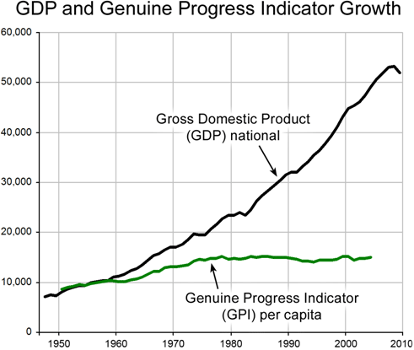
How we measure progress matters
GPI accounts for 26 indicators including economic, environmental, and social factors to determine if we are well off.
GDP measures the circulation of money
Maryland was first state to adopt GPI as official indicator

Slide 38
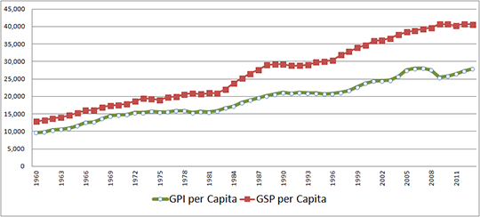
Maryland’s Genuine Progress Indicator compared with Gross State Product

Slide 39

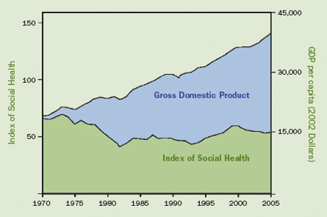

Slide 40
Measuring environmental impact
I=PAT
Impact = Population * Affluence * Technology
Affluence ~ consumption per person
Technology ~ impact per consumption

Slide 41
Ecological Footprint
the impact of human activities measured in terms of the area of biologically productive land and water required to produce the goods consumed and to assimilate the wastes generated.
Transportation,
Diet,
Household/lifestyle choices

Slide 42
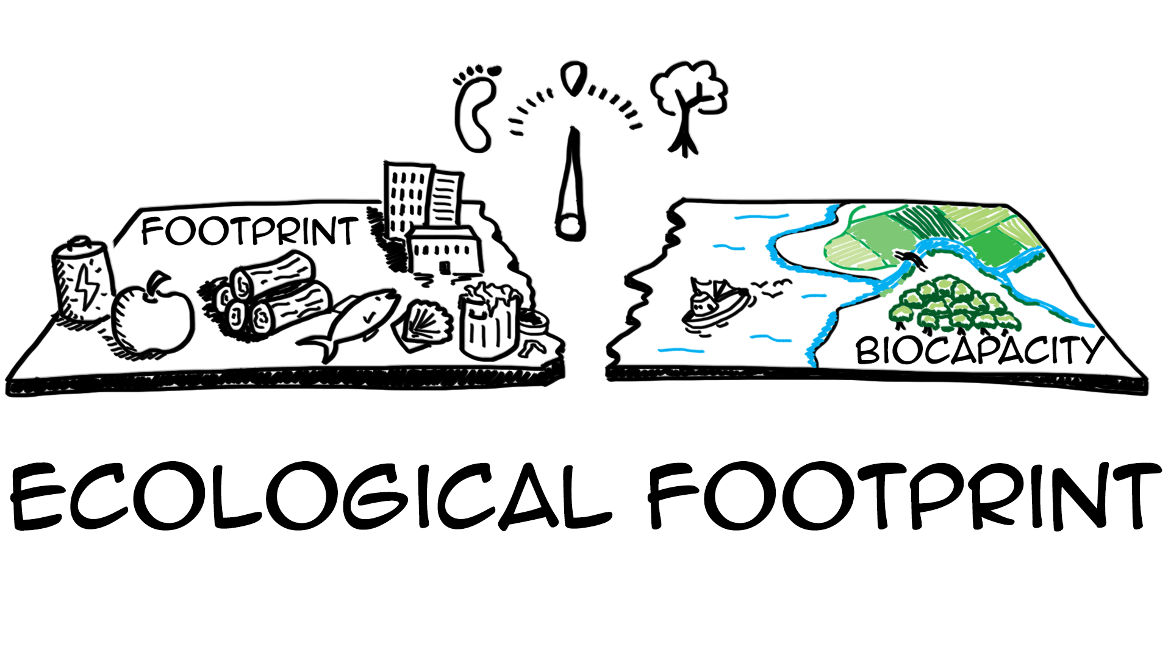
Ecological Footprint Calculator
https://www.footprintcalculator.org/
world-average ecological footprint in 2012 was 2.84 global hectares per person. world-average biocapacity of 1.73 global hectares per person

Slide 43
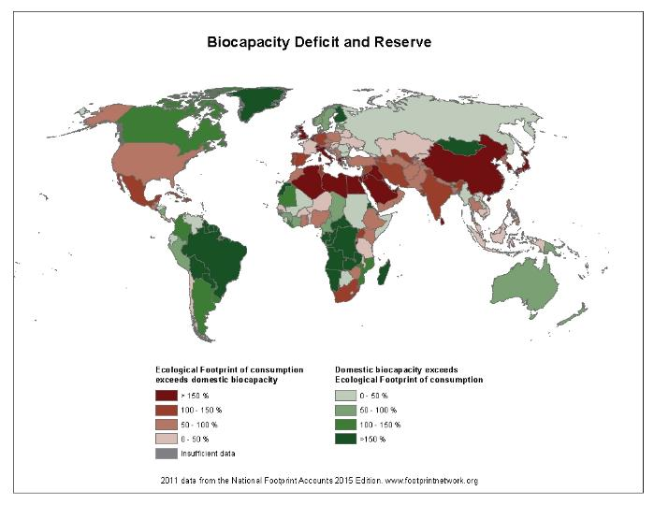

Slide 44
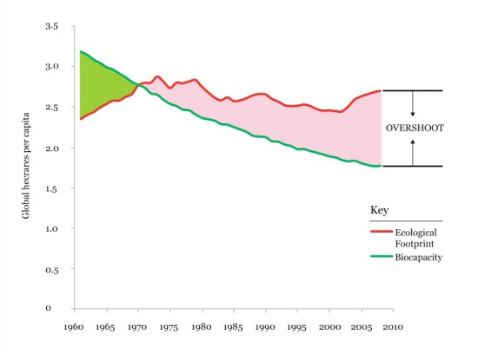
Overshoot!

Slide 45
Discussion questions
Should biophysical limits be considered in economics?
  How?
Is it mostly a matter of getting the prices right – internalize extranalities?
How to differentiate between productive work and exploitative work?
How to move away from growth as a goal function?
Give an example of increased efficiency leading to increased consumption. How can we account for this in reducing environmental impacts?

Slide 46
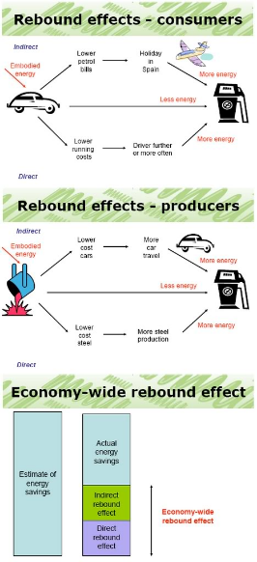

Decoupling –greater resource efficiency
Do more with less

Slide 47




degrowth
Reduce scale to fit within planetary boundaries
Do less

Slide 48
Thank you for your attention!
2019

