Slide 1
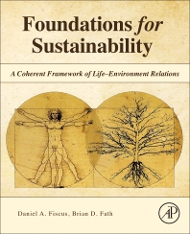
Foundations for Sustainability
Brian D. Fath & Dan Fiscus
Fulbright Distinguished Chair, Masaryk University, Brno, Czech Republic
Professor, Towson University, Maryland, USA
Senior Research Scholar, International Institute for Applied Systems Analysis, Austria

Slide 2
Chapter 1: To solve a difficult problem, enlarge it
Your reaction:
What is, in your opinion, the main message of Chapter 1?
What part was most confusing or most difficult to understand?

Slide 3
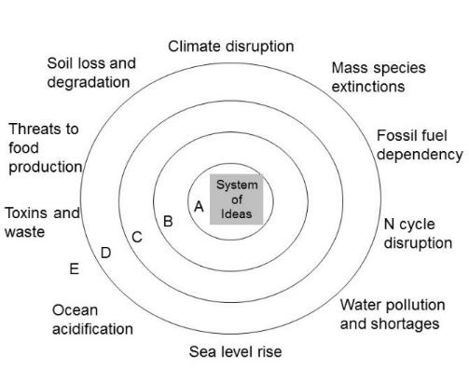
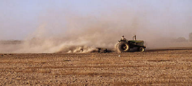
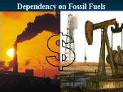

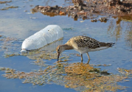

Environmental Challenges
Soil erosion
emerge from our core way of knowing
Toxins and waste
Water pollution
a new paradigm
Sea level rise

Slide 4
Reality of win-win
Switch from a paradigm that see a fragmented and antagonistic relation between life and environment, and humans and environment
To one that recognizes that ecosystem interdependencies promote mutualism and synergism
The fundamental, net human-environment relationship is mutualism or win-win

Slide 5
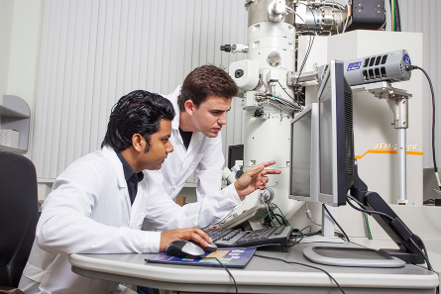

All education is environmental education
By what is included or excluded students are taught that they are part of or apart from ecological systems – disciplines separate people from nature

Slide 6
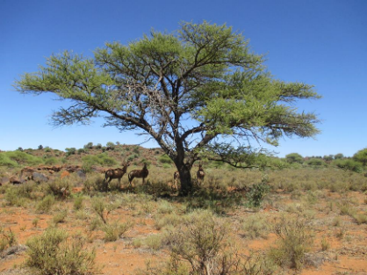
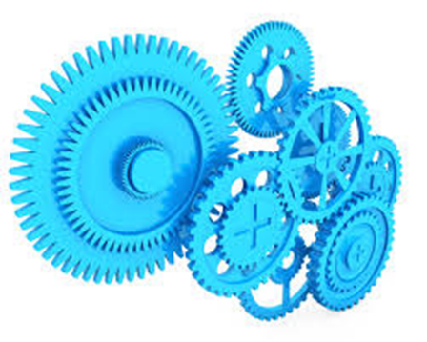
Getting the metaphor right
Switching from a machine view
To ecosystem/web/network view
More on this later

Slide 7
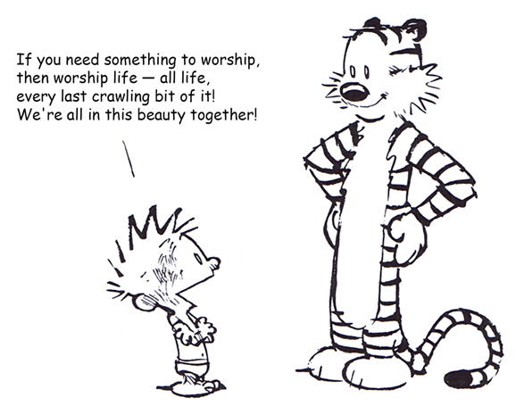
Reverence for life
Schweitzer
Leopold
Chapter 2

Slide 8
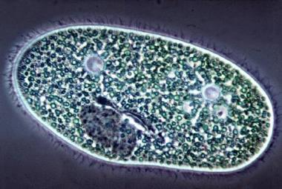
What is life?
A single cell possesses all the necessary aspects to be alive

Slide 9
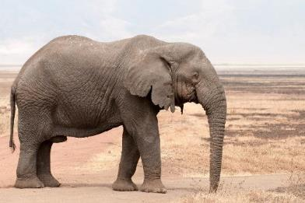
What is life?
Discrete Life
A single organism possesses all the necessary aspects to be alive

Slide 10


Mental models and outcomes
Real impacts of choice of system boundaries
Tragedy of the Commons
Humans win, environment degrades
Inherent in this paradigm, life is separate from environment in mind and action
Once fragmented, it is possible and likely that the value of environment is seen and treated as less than the value of life
Environment is consumed and degraded as manifest in many symptoms of ecological crisis
Life
Environment
Figures by Dan Fiscus

Slide 11
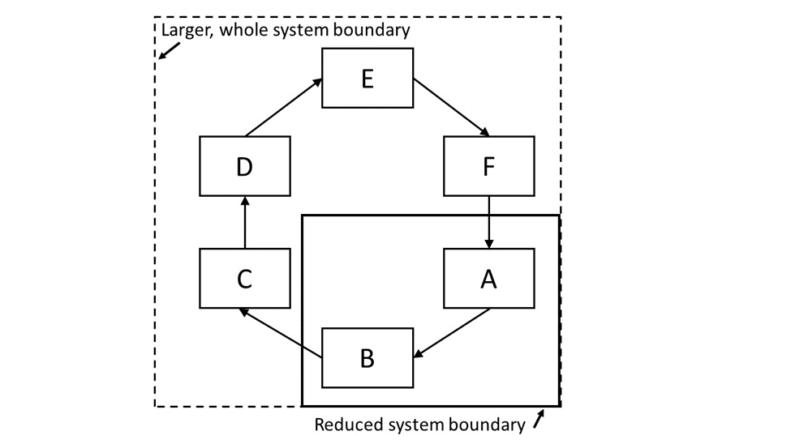
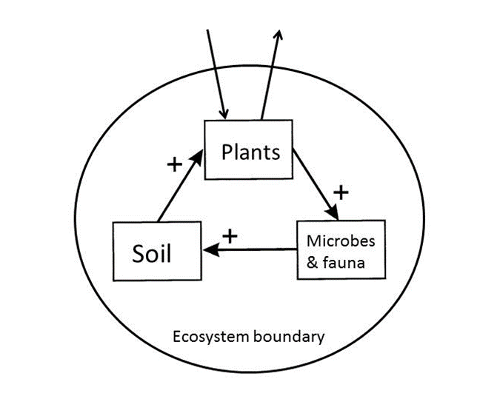

Slide 12
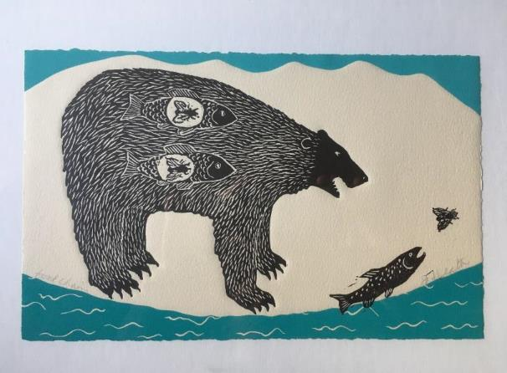
Ecosystem is full of
Interconnections and Interdependencies
Art work of Jan Heath, entitled “food chain”

Slide 13
A bottom up re-visioning is vital:
A new holistic paradigm for life
Contrary to the dominant mainstream view, the basis of all current biology and life science education, it now is becoming clear that life is not only (or even primarily) an organismal property.
In the view actively emerging, life is not centered on or emanating from organisms, nor is it primarily a localized, objectified or material phenomenon.
Life is inherently relational, distributed, and non-localized

Slide 14


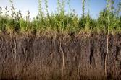
Abiotic and ecological interactions
Discrete Life
A single organism possesses all the necessary aspects to be alive

Slide 15
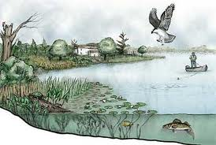
Interacting ecological community and its environment is an ecosystem
Sustained Life
An ecosystem possesses all the necessary aspects to sustain life

Slide 16
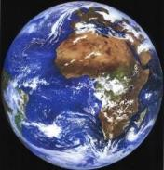

Recursive nature of nature
Bounty of the Commons
Humans win, environment improves
Life and environment are best understood and modeled as unified as a single “Life–Environment” system.
Fiscus D, Fath BD, Goerner S. 2012. E:CO 14(3), 44–88.

Slide 17
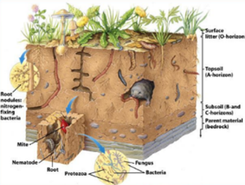
Sustained life depends on death
In an energy economy appropriate to the use of biological energy, all bodies, plant and animal and human, are joined in a kind of energy community. . . .
They are indissolubly linked in complex patterns of energy exchange. They die into each other’s life, live into each other’s death. (Berry 1977, p. 90)

Slide 18
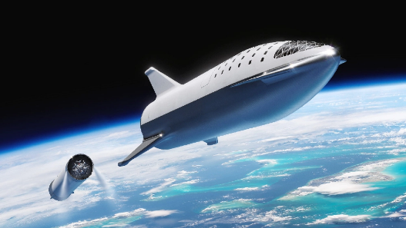

Sustainers and Transcenders
Change themselves/lifestyle
Work with nature
Break barriers
Innovate
Are there environmental limits?
Are both sides aware of them?

Slide 19
Cultural Theory Solidarities (Thompson 1997)
Fatalist/Capricious
Hierarchist/Reasonable within limits
Hermit
group
Individualist/Durable
Egalitarian/Fragile
grid
transcenders
sustainers

Slide 20
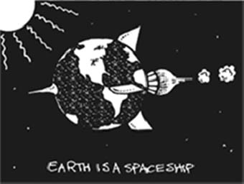
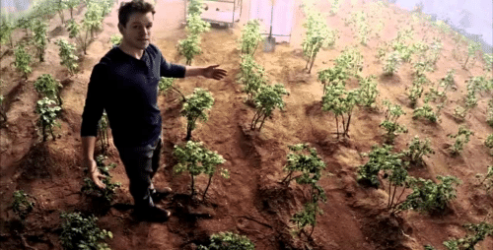
Why sustainers and transcenders need to work together
We need to know how to take the life support with us
NASA has programs to recycle biological and other wastes of astronauts
But not yet to recycle astronauts themselves…

Slide 21
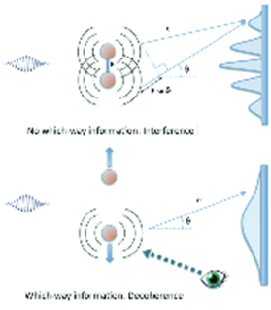
Deep truths
Are statements in which the opposite also contains a deep truth
Complementarity of discrete life and sustained life
Meadow’s leverage points
  Power to transcend paradigms

Slide 22
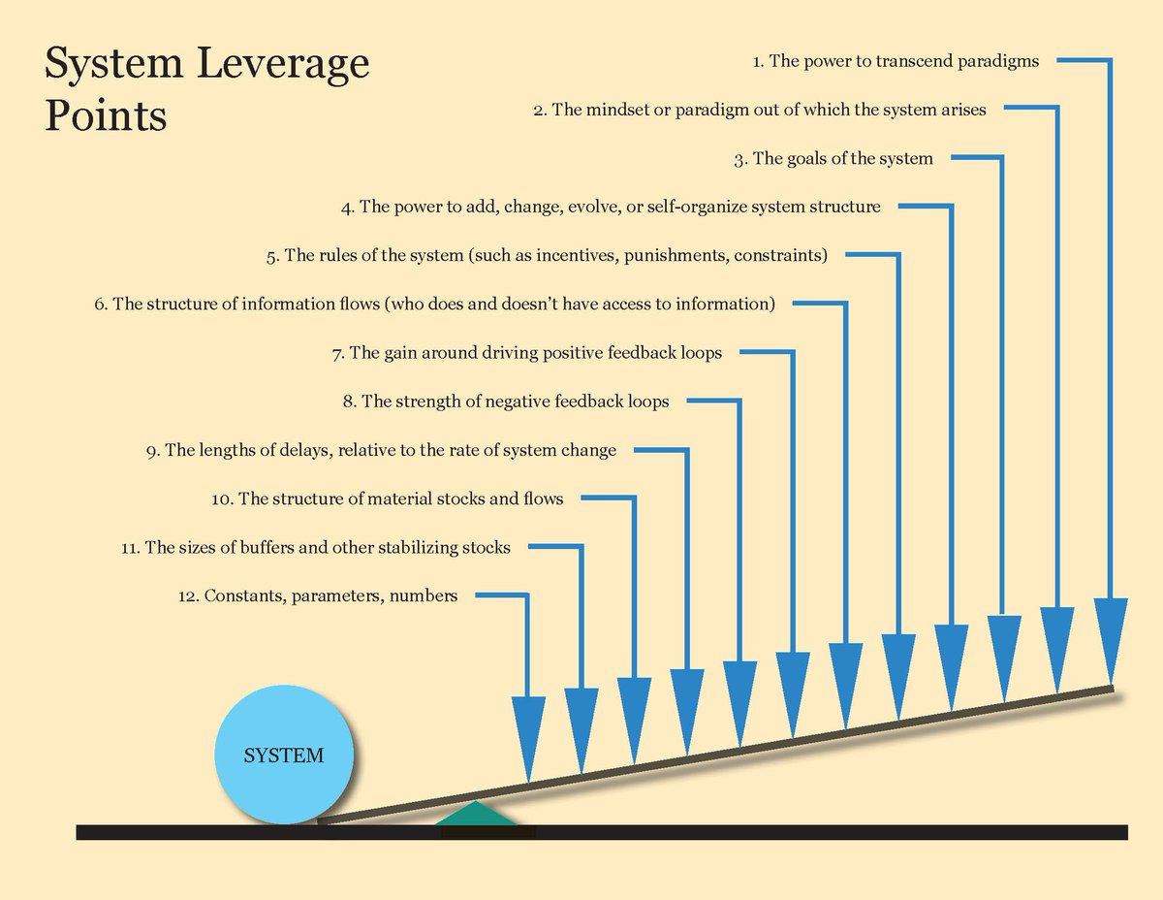
What if we are wrong? What if this is all wrong?

Slide 23
Key message: Avoid fragmentation
This is wrong!
object
Environment
Input Environment
H
Output Environment
Object is inseparably part of its environment

Slide 24
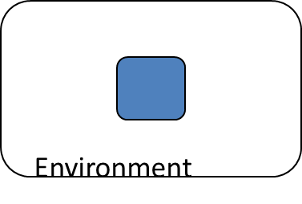
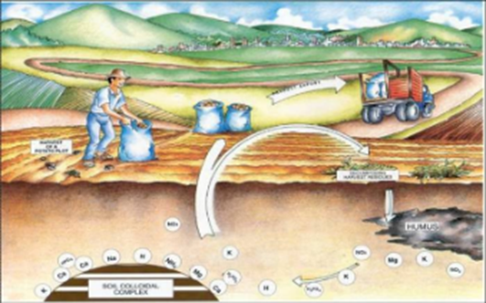
Avoid fragmentation
The concept of country, homeland, dwelling place becomes simplified as ‘the environment’—that is, what surrounds us. Once we see our place, our part of the world, as surrounding us, we have already made a profound division between it and ourselves. We have given up the understanding—dropped it out of our language and so out of our thought—that we and our country create one another, depend on one another, are literally part of one another; that our land passes in and out of our bodies just as our bodies pass in and out of our land; that as we and our land are part of one another, so all who are living as neighbors here, human and plant and animal, are part of one another, and so cannot possibly flourish alone; that, therefore, our culture must be our response to our place, our culture and our place are images of each other and inseparably from each other, and so neither can be better than the other. Berry (1977, p. 24).

Slide 25
Discussion questions
https://vimeo.com/212281432
What does the title of the chapter have to do with the content?
Why don’t biology textbooks teach about two kinds of life (discrete and sustained)?
  Can this be changed? How?
How to tap into the existing forces of the system to create change? i.e., work alongside transcenders not against them.

Slide 26
Discussion questions
A lot of the discussion comes back to scale – short term versus long term or global versus local. How to instill more long term, holistic approaches in a “present-oriented” society?
We propose that when you avoid fragmentation that: The fundamental, net human-environment relationship is mutualism or win-win
  Is there evidence for this?
Other questions?

