Slide 1
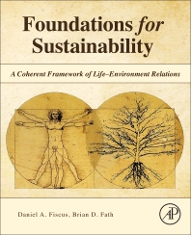
Foundations for Sustainability
Brian D. Fath & Dan Fiscus
Fulbright Distinguished Chair, Masaryk University, Brno, Czech Republic
Professor, Towson University, Maryland, USA
Senior Research Scholar, International Institute for Applied Systems Analysis, Austria

Slide 2
Chapter 3: Holistic science of Life–Environment
Your reaction
What is meant by conbiota?
Are the examples of win-win convincing? Can you think of other examples?
What part was most confusing or most difficult to understand?

Slide 3
a new paradigm
Environmental concerns have become of paramount importance.
Certain global problems may soon be irreversible (e.g., deforestation, extinction, soil loss, climate change).
These are systemic problems that cannot be understood in isolation but rather are interconnected and interdependent.
Solutions may be simple but will require a radical shift in our perceptions, our thinking, and our values.

Slide 4
Humans unwittingly express and incorporate their paradigmatic priorities – their societal organizing principles – in their surroundings

Slide 5
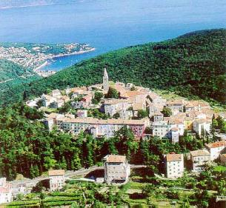
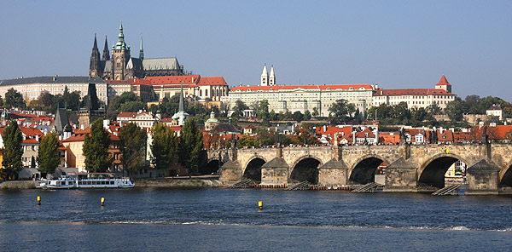
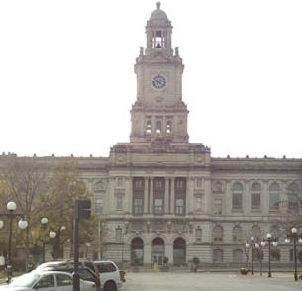
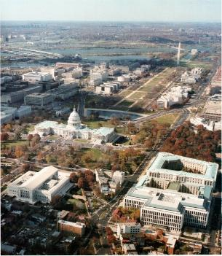
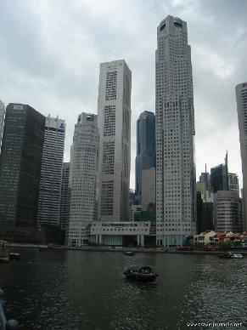
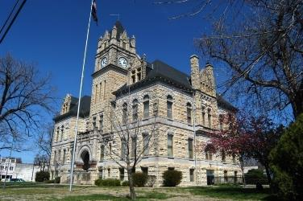
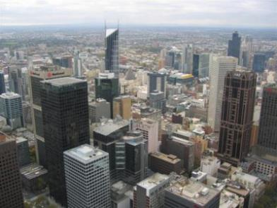
Medieval cities dominated by churches
19th and early 20 century cities dominated by governance
21st century cities dominated by business

Slide 6
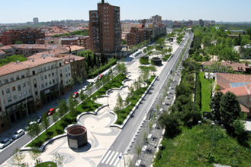
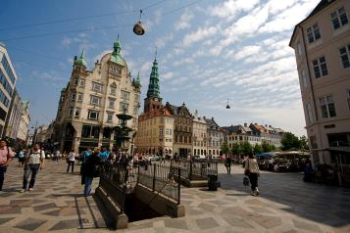
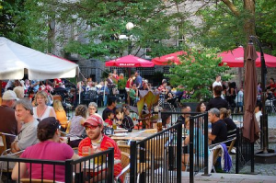
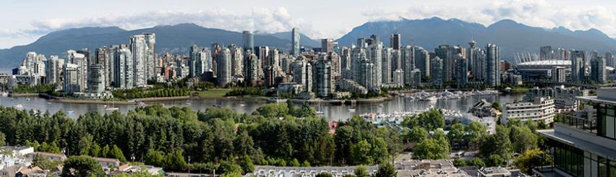
A new paradigm that includes ecological principles and livability?

Slide 7
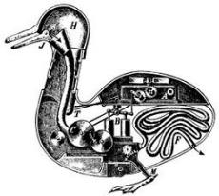
Dominant paradigms in science
Reductionism (analysis) taking apart to see the parts
  domains - atmosphere, lithosphere, hydrosphere, biosphere
  disciplines - ecology, economics, politics, sociology, etc.
Holism (synthesis) - putting the pieces back together again

Slide 8
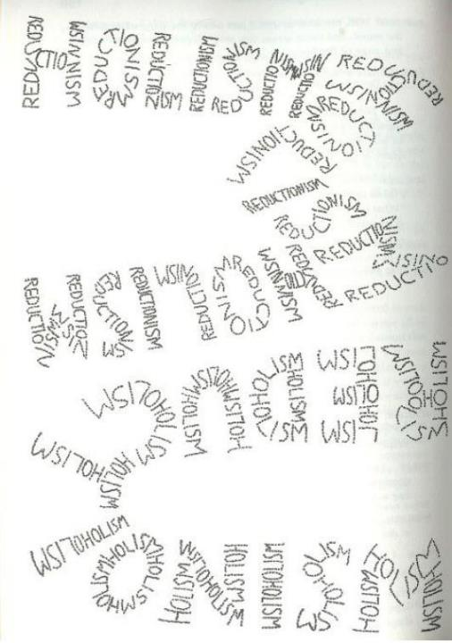
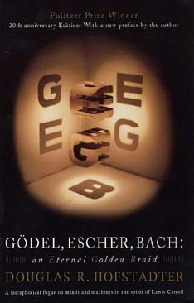
Aside on holism/reductionism
Gödel, Escher, Bach
Douglas Hofstadter

Slide 9
mechanism and reductionism
Cartesian mechanism – study of phenomena that could be measured and quantified
Analytic thinking – breaking up complex phenomena into pieces to understand the behavior of the whole from the properties of the parts.
VERY SUCCESSFUL APPROACH!!
…but

Slide 10
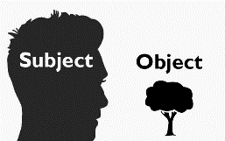
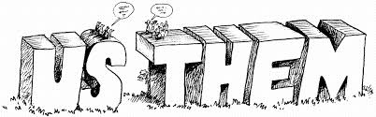
Fragmentation
“A minor problem, perhaps, is the tendency of materialism to objectify the world, dividing it from the ‘objective observer’ who studies it. The world thus becomes ‘the environment,’ . . . which means ‘surroundings,’ a place that one is in but not of. The question raised by this objectifying procedure and its vocabulary is whether the problems of conservation can be accurately defined by an objective observer who observes at an intellectual remove, forgetting that he eats, drinks, and breathes the so-called environment.”
Berry (2001, pp. 25-26)

Slide 11
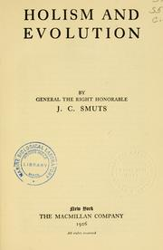
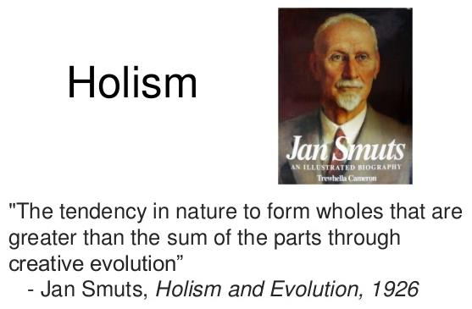
In 1920s (biology, gestalt psychology, quantum physics)
Premature, no tools to formulate and investigate wholeness – Systems analysis and networks

Slide 12
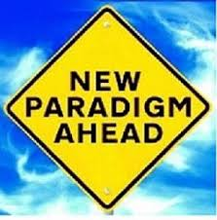
New norm? – lesson from holism
Fundamental, net human–environment relation is mutualistic or win-win
A scientific theory is declared invalid only is an alternative candidate is available to take its place

Slide 13
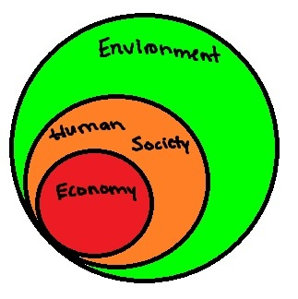
Part of that change is recognition that environment is foundation for all aspects, others are subsets

Slide 14

Evidence of directional change in ecosystems (p. 57)
Ecological goal functions to measure
  Diversity
  Energy density
  Structural complexity
  Functional complexity
  Total energy flowing
  Total energy stored

Slide 15
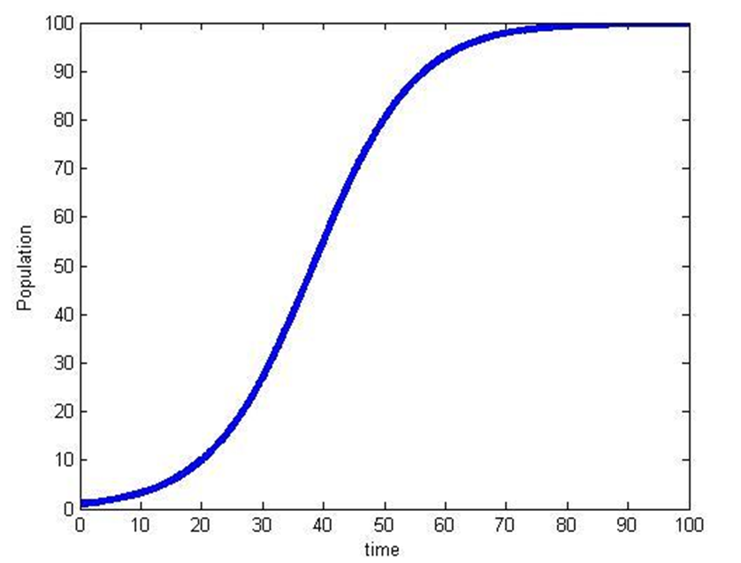
Trends to be expected in ecosystem development (Odum 1969)
Ecosystem Attribute Developmental Mature
Stage Stage
Community energetics
Gross production/community respiration (P/R ratio) >1 ~1
Gross Production/standing crop biomass (P/B ratio) high low
Biomass supported/unit energy flow (B/E ratio) low high
Food chains linear weblike
Nutrient cycling
Mineral cycles open closed
Nutrient exchange rate rapid slow
Nutrient conservation poor good
Overall homeostasis
Stability (resistance to external perturbations) poor good
Entropy high low
Information low high

Slide 16
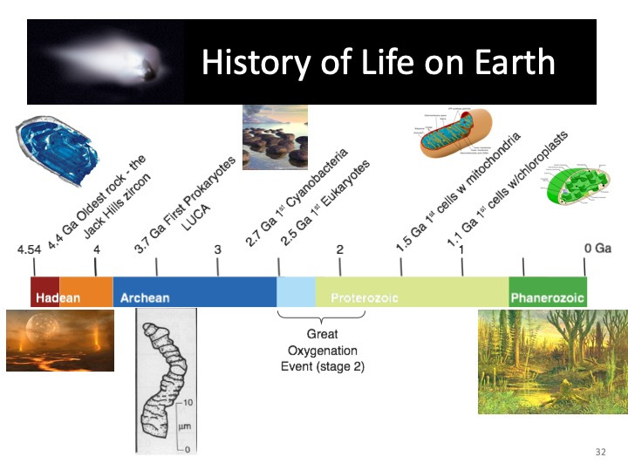
Origins of life covered in Chapter 4; brief intro here for win-win examples

Slide 17
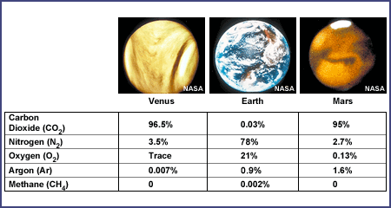
Life impacts the atmosphere

Slide 18
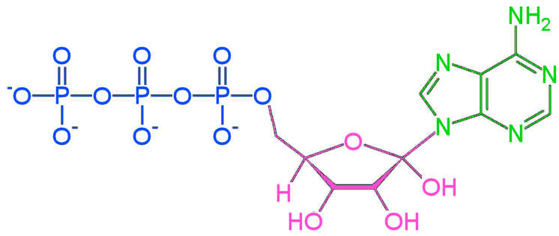
"molecular currency" of intracellular energy transfer: ATP
ATP (Adenosine triphosphate ) is able to store and transport chemical energy within cells.

Slide 19
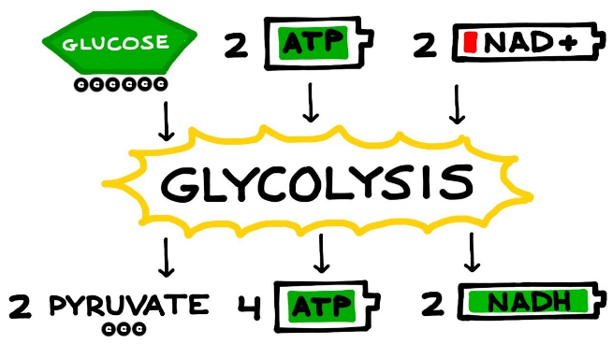
Without oxygen
Glycolysis produces 2 ATP, 2 NADH, and 2 pyruvate molecules

Slide 20
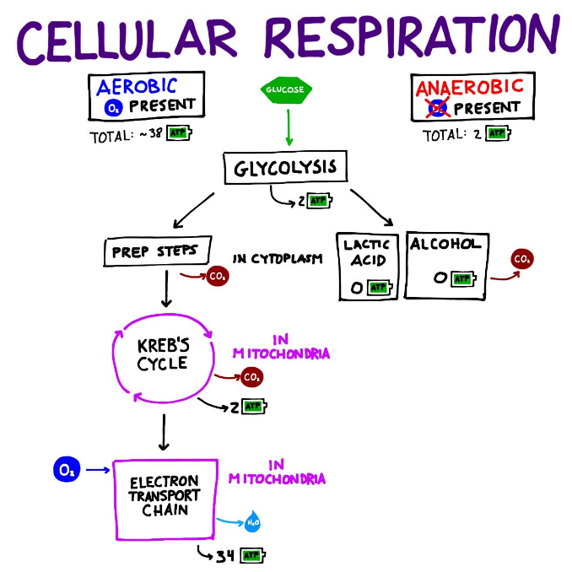

Slide 21
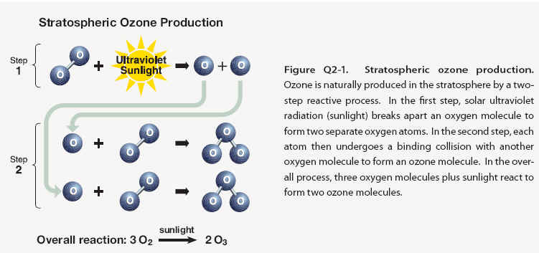
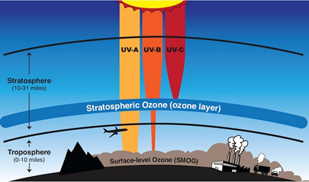
Oxygen in the atmosphere leads to the ozone layer

Slide 22
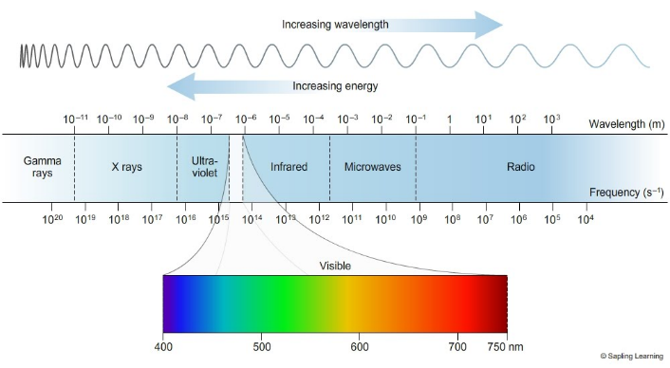
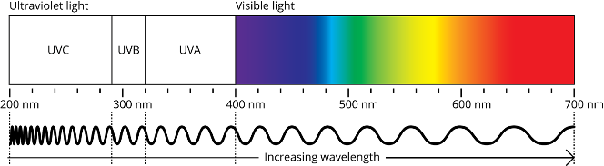
Electromagnetic spectrum

Slide 23
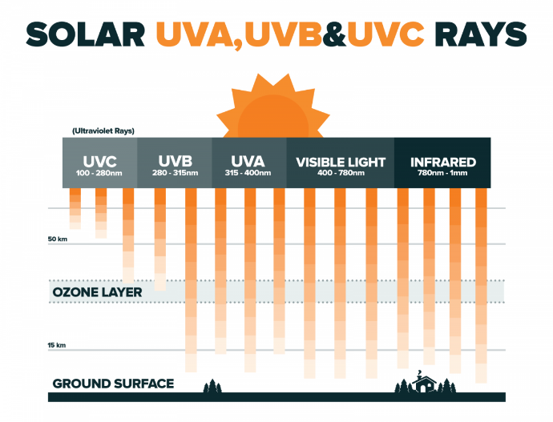

Slide 24
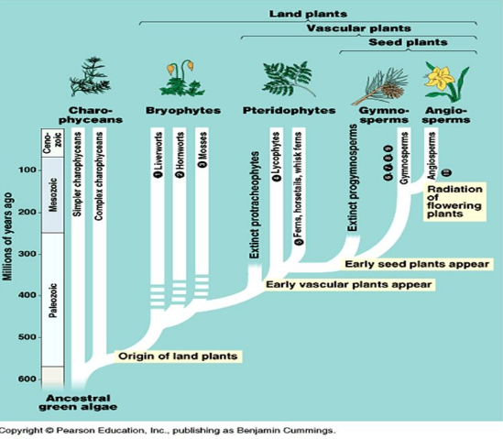
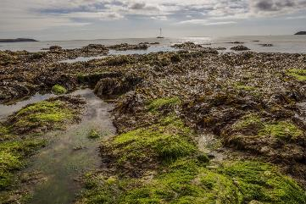

The ozone layer
Protected life to move from the seas and colonize land around 600M years ago

Slide 25
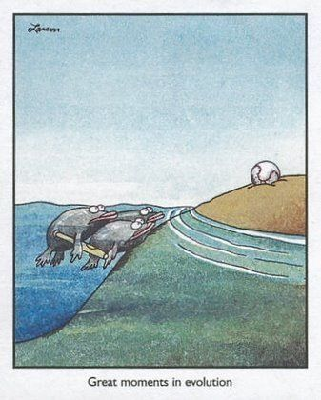
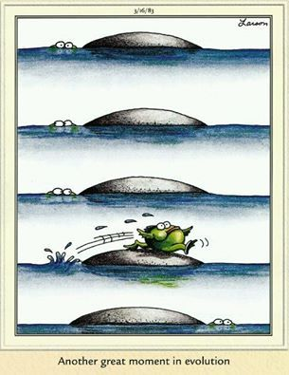
Other theories of land colonization
Homage to Gary Larson

Slide 26
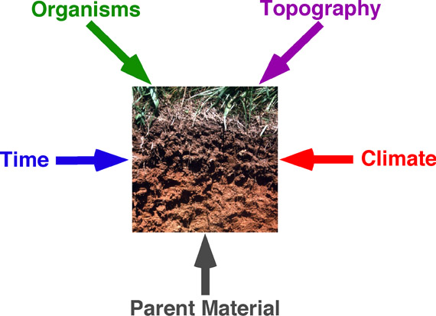
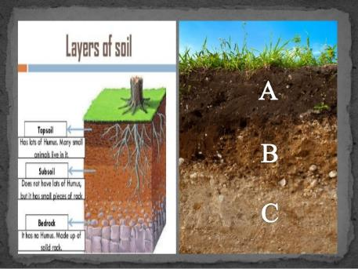
Soil formation

Slide 27
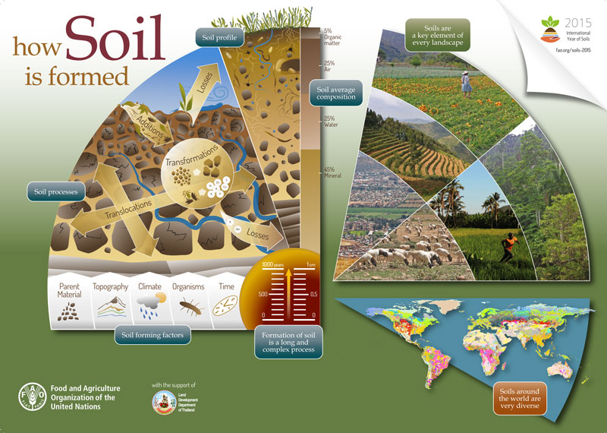

Slide 28
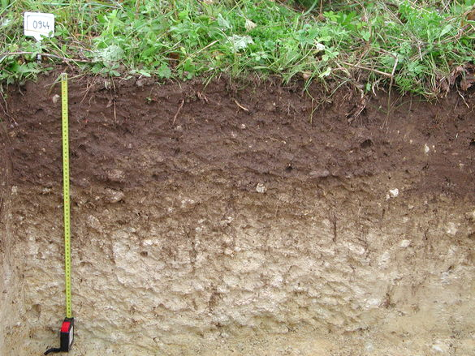
Soils
1. absorb, store, and release water in ways that aid plant, animal, and microbial life locally;
2. play a role in the purification of water and the global hydrological cycle;
3. absorb, store, and release organic and inorganic nutrients aiding myriad life forms locally;
4. play significant roles in global carbon, nitrogen, and other elemental cycles;
5. recycle wastes and dead organisms and regenerate key inorganic nutrients via decomposers;
6. provide habitat for diverse biotic organisms; and
7. provide a physical basis for anchoring plants, particularly large trees.

Slide 29
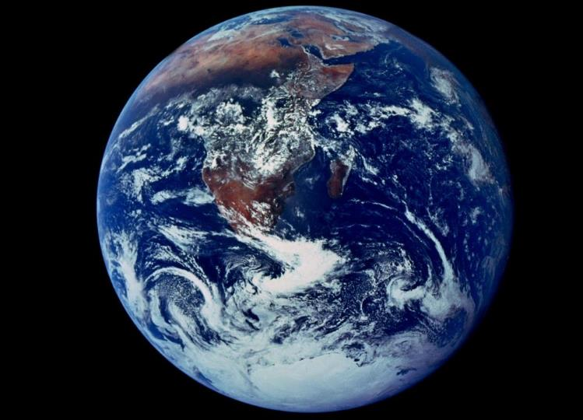
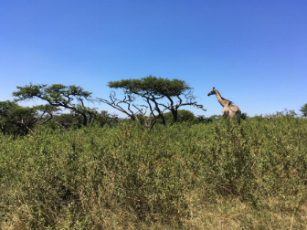
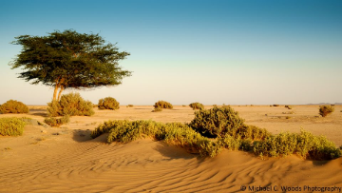
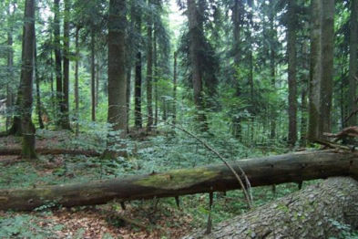
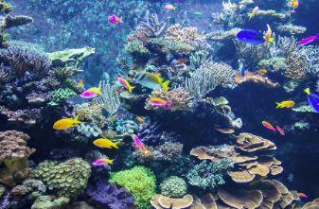
We live in a world full of life.
Nothing on Earth is entirely abiotic
Rather it is
With Life – conbiotic

Slide 30
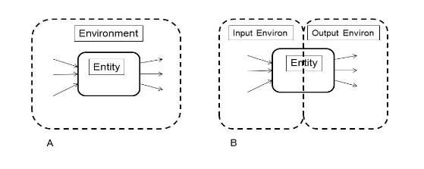
What is environment?
Before Darwin (1859) environment was considered an organic whole. Everything in it made some contribution and had some meaning with respect to everything else. Darwin subscribed to this view, but his emphasis, and that of his followers, on the evolving organism struggling to survive, suppressed the exploration of holistic aspects of the origin of species that might have been developed.
After Darwin, the organism came into great focus.
The result was two distinct things (dualism), organism and environment, supplanting the original organism-environment whole (synergism).

Slide 31
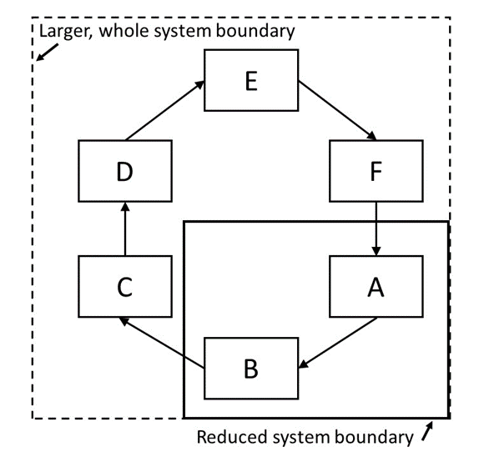
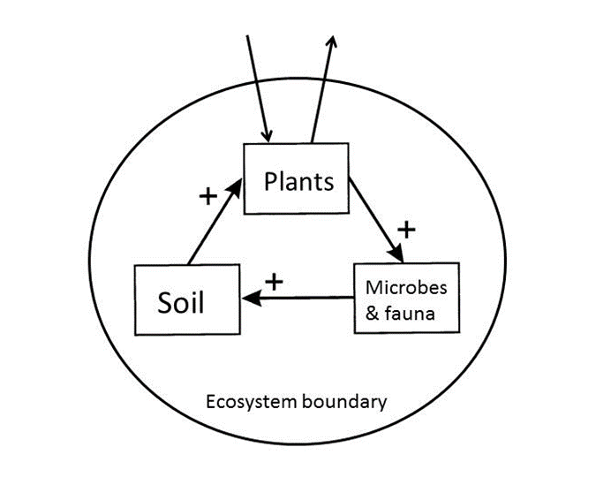
Autocatalysis
Increase in the activity of any participant will tend to increase the activities of all the others as well.

Slide 32
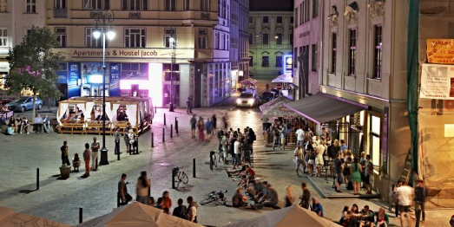
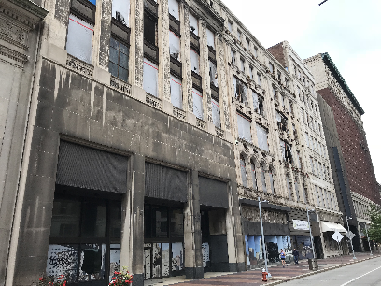
Coherence
“Each center is (recursively) dependent on other coherent centers for its own coherence” Alexander (2012) referring to urban planning
Spiral down – lack of coherence
Spiral up

Slide 33

Coupled transformers
Most basic sustainable system requires a producer/composer and consumer/decomposer in an autocatalytic process
composer
context
decomposer
“It may be that all self-sustaining systems are reciprocating”
Jacobs, 1969, p. 126

Slide 34

Kafka ecosystem… Hmmm

Slide 35
Discussion questions
What is something that is not conbiotic?
Can we be truly objective/separate from any experiment or observation?
  Why do we believe that we can be?
What are the advantages of “failure to last”?
How does autocatalysis induce competition?

Slide 36

As the community assembly process forms a food web, it selects only species that fit into the existing web

Slide 37

Discussion questions
Is this too simplistic?

Slide 38
Which one fits your dissertation?
1. Your mission is to make an incremental advance in scientific understanding of life and/or environmental process and to produce a pragmatic” (as based on social norms) contribution to science in the short term.
2. Your mission is to synthesize existing knowledge and to make an anticipatory contribution to science that has the potential to yield true human environmental sustainability in the long term.

