Slide 1
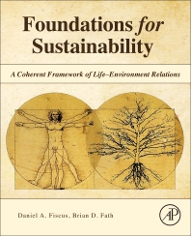
Foundations for Sustainability
Brian D. Fath & Dan Fiscus
Fulbright Distinguished Chair, Masaryk University, Brno, Czech Republic
Professor, Towson University, Maryland, USA
Senior Research Scholar, International Institute for Applied Systems Analysis, Austria

Slide 2
Chapter 4
Life: From origins to humans destiny
Your reaction
It may be that we cannot know and achieve sustainability on Earth until we know and achieve colonization of Life beyond Earth.
  What does this mean and do you agree?
What part was most confusing or most difficult to understand?

Slide 3
Ecosystemic Life hypothesis
Which came first the organism or the ecosystem?

Slide 4
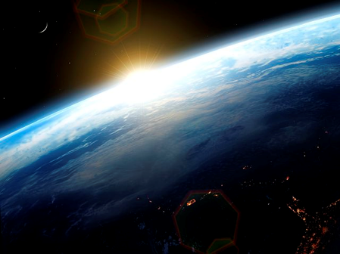
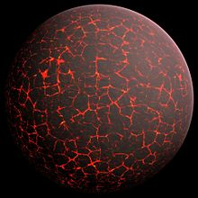
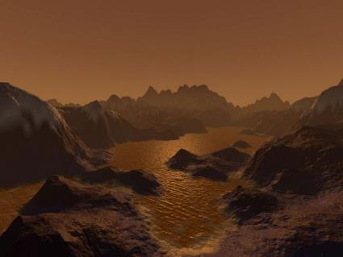
Earth before Life

Slide 5
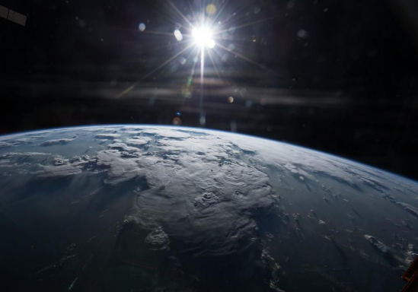
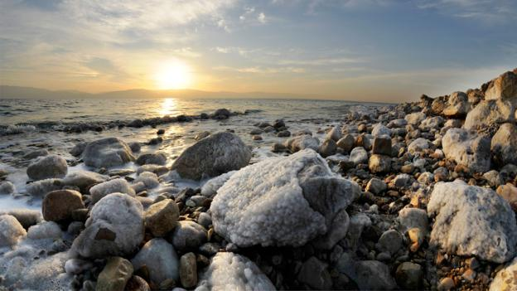
Solar energy

Slide 6
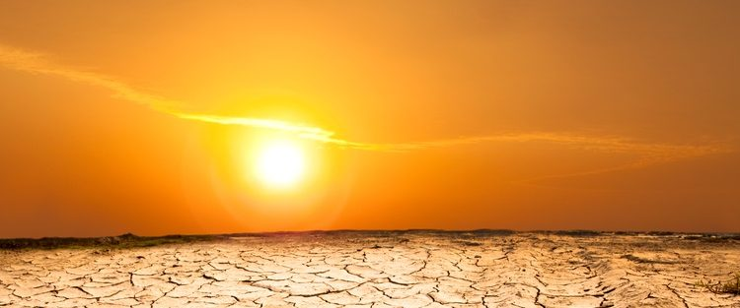
Relentless input of energy – something must be done with it
Diurnal, annual, and latitudinal cycles and variation

Slide 7
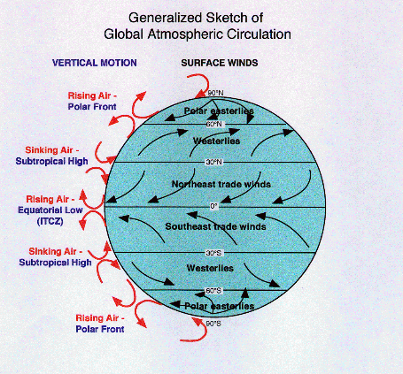
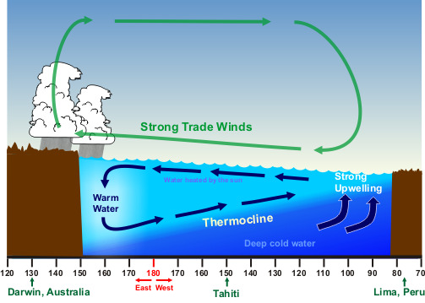
Energy gives rise to gradient formation
In air and sea together

Slide 8
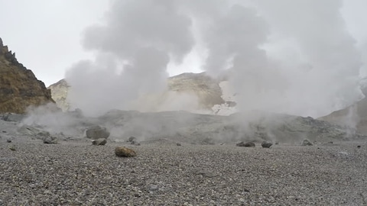
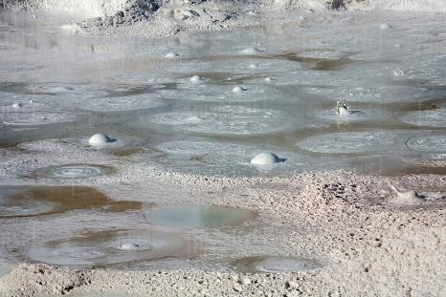
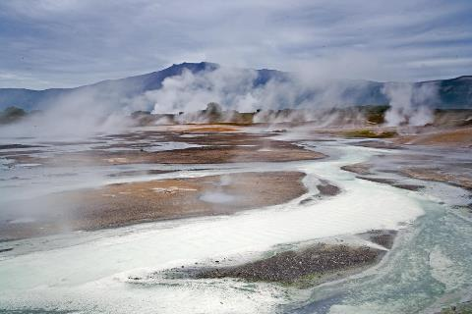
Geothermal energy
Also gives rise to gradients and flow

Slide 9
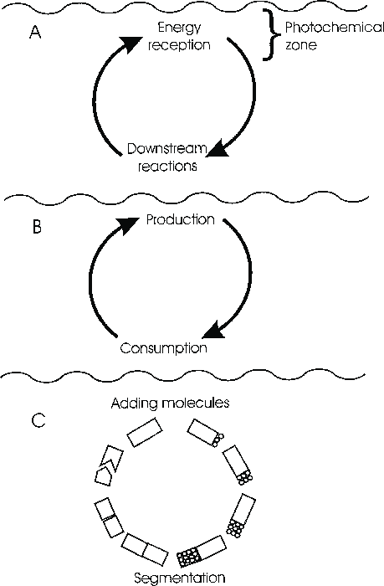
Ecological Origin of Life
HT Odum
Prebiotic coupled complementary processes
Production
Consumption
The ecological cycle generated
cells
organisms

Slide 10
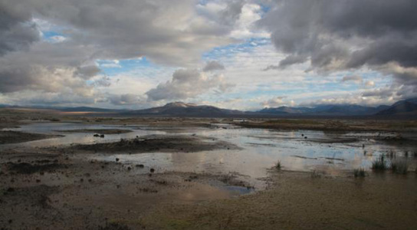
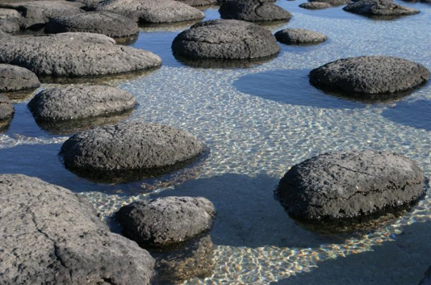
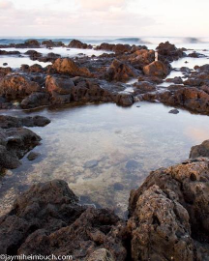
Encapsulation of the processes
In the seas and at the margins of land
Estuarine turbidity maximum

Slide 11
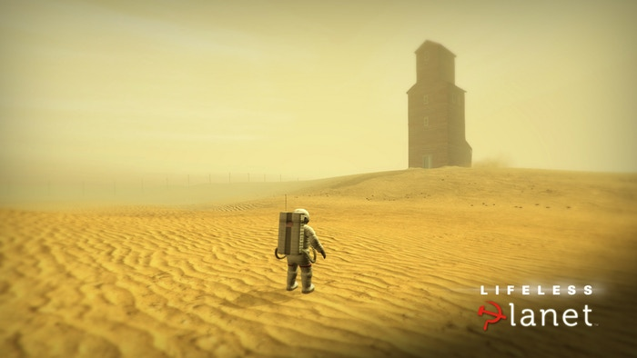
An alternative – the first organism
I’m here
What’s for dinner?
An organism without an ecosystem?

Slide 12

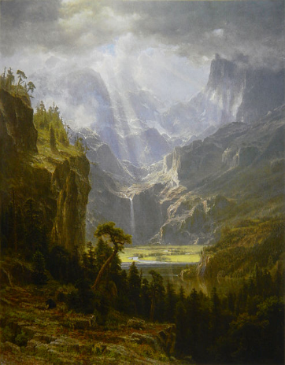
Undifferentiated wholeness
A time before a distinction of life and non-life
Only one relation: environment-environment
Two new relations were created inside the former undifferentiated system:
  Life-Environment relations
  Life-Life relations

Slide 13
Life-Environment relation is inherently good
Survival of life (sustained life) is value basis
Environment can be good toward Life, and
Life can be good for the environment
Relations can squeeze more value out of the energy gradients, i.e, by being more complex can do more work, persist longer
Life must be working with, augmented by Environment, else would have perished long ago

Slide 14
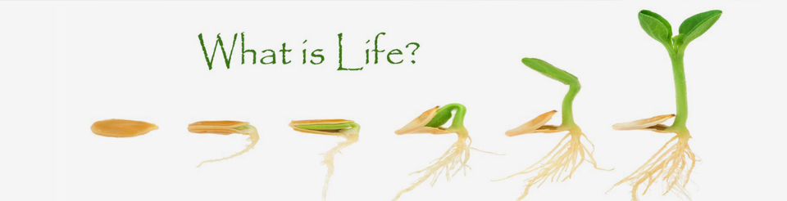
Life has a metabolism, where it harvests energy/resources from an external source for its own use.
Life can grow, adapt to its environment, or can otherwise evolve from its present form into a different one.
Life responds to external stimuli from its environment, and alters its behavior accordingly.
And life can reproduce, creating viable offspring that arise from its own internal processes.

Slide 15
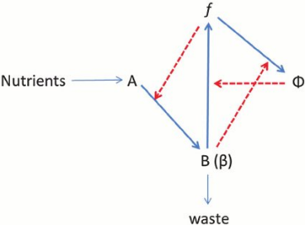
Robert Rosen’s (M,R)-system
Metabolism and Repair
Why is an organism different than a machine?
  Organisms are self-making and self-causing
  Closed to efficient cause

Slide 16

To understand how life persists on Earth, we have to understand ecosystems
“We tend to think about life in terms of individuals, because individuals are alive. But sustaining life on Earth requires more than individuals or even single populations or species...
Living things require 24 chemical elements, and these must cycle from the environment into organisms and back to the environment. Life also requires a flow of energy...
Although alive, an individual cannot by itself maintain all the necessary chemical cycling or energy flow. Those processes are maintained by a group of individuals of various species and their non-living environment…
Sustained life on Earth is a characteristic of ecosystems, not of individual organisms or populations.” (Keller and Botkin 2008, p. 66)

Slide 17
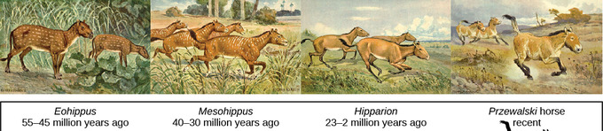
Unit of selection
Could an ecosystem provide a robust unit of selection?
  Discrete construction of life
  Sustained construction of life
Life selects its environment as much as Environment selects Life
Grazing
Fertilizing
Aerating
Compacting

Slide 18
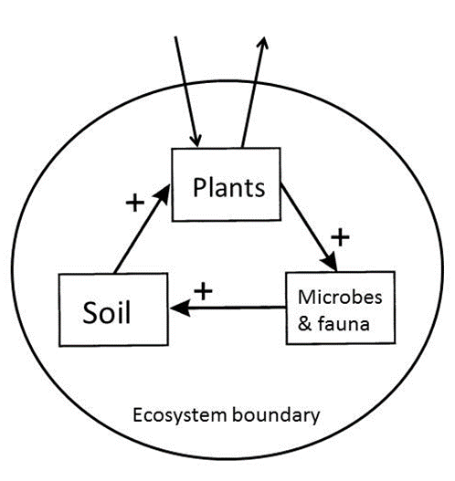
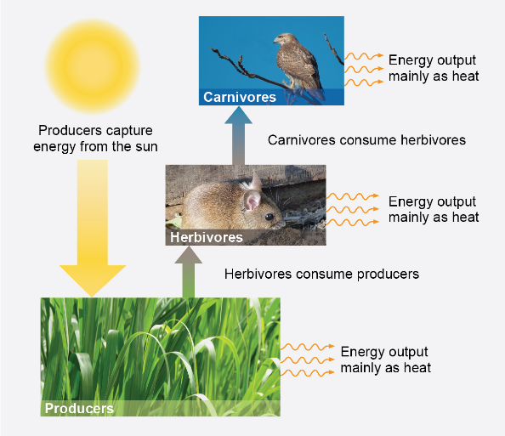
Gradients
The build up of gradients
  Through autocatalytic processes
    Non-random structures
    Amounts or concentrations of energy and matter
The pace of release, use, or dissipation of the gradients
an ecosystem can be thought of as a conduit through which energy passes, with many or few transformations of energy/matter during its trip through the conduit. The interesting question is what happens in the conduit.

Slide 19
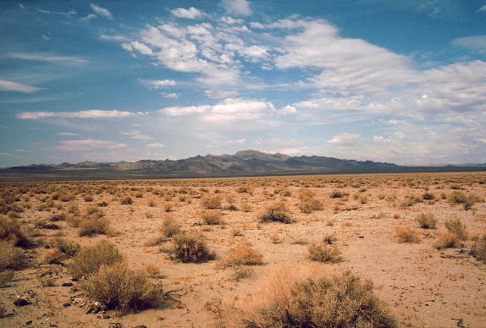
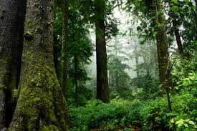
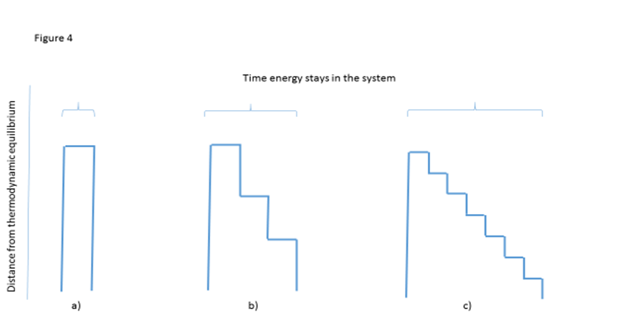
Organization matters
Desert – energy passage is swift and simple leaving little traces of its passage
In the forest, energy flow is anything but swift and simple, because of the diverse and roundabout way that the system’s web of teeming, interdependent organisms uses energy.
charge
discharge
Is the driver 1) the structure, 2) the dissipation, 3) the process, or something else?

Slide 20
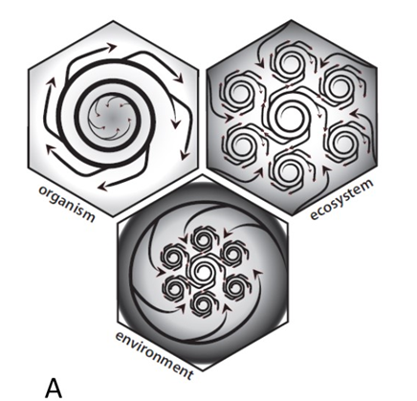
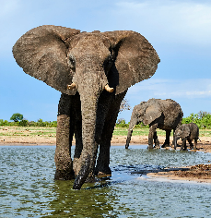
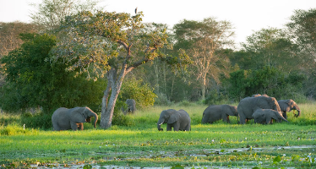
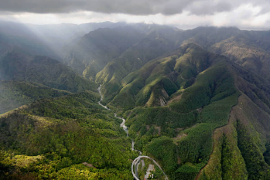
Definition of Life requires at least three unit-models

Slide 21
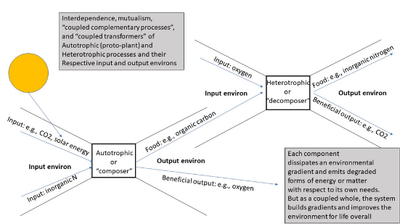
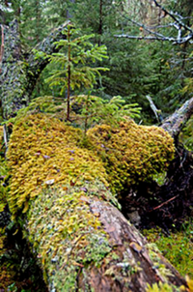
Closure of efficient cause
Life emerges and self-sustains through a type of self-organization such that each participant “thing” is “doing its own thing” and “doing its own thing to fit together”
“The function of each task is its role in the reproduction of this Kantian whole.” Kaufman 2011

Slide 22
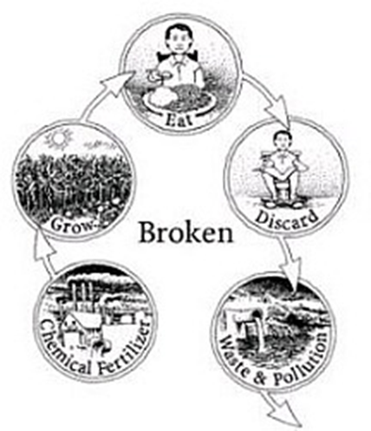
Ecological self
Discrete self (bounded by skin)
Extended self (including environmental context)
Remain healthy in a holistic + context fashion, caring for the Life-support systems we depend on

Slide 23
Discussion questions
What is the role of water in the origins of life?
Which came first the organism or the ecosystem?
What does it mean to say relations are not material and need not be conserved?
  Life: a novel emergence of relations

Slide 24
Discussion questions
What is the relevance of Hierarchy in the hexaflexagon?
Is the whole idea of autocatalysis and closure making sense?
  The result of systemic operations are once more systemic operations
  Can there be circular hierarchies?

