Slide 1
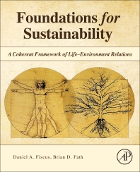
Foundations for Sustainability
Brian D. Fath & Dan Fiscus
Fulbright Distinguished Chair, Masaryk University, Brno, Czech Republic
Professor, Towson University, Maryland, USA
Senior Research Scholar, International Institute for Applied Systems Analysis, Austria

Slide 2
Chapter 6: Life science lessons from ecological networks and systems ecology
Your reaction
What do you think is a main conclusion from using network analysis? Why?
What questions do you have?

Slide 3
Ecological Network Analysis provides holistic tools
Discrete versus sustained life
Developmental tendencies of ecosystems are complementary
Indirect impacts are often greater than direct ones
All Life is connected—via ENA, we can quantify the connections
Ecosystems show mutualism between species
Ecosystems and networks naturally balance order and flexibility
A hypothetical new formalism prohibits fragmentation of life from environment and of life from life

Slide 4
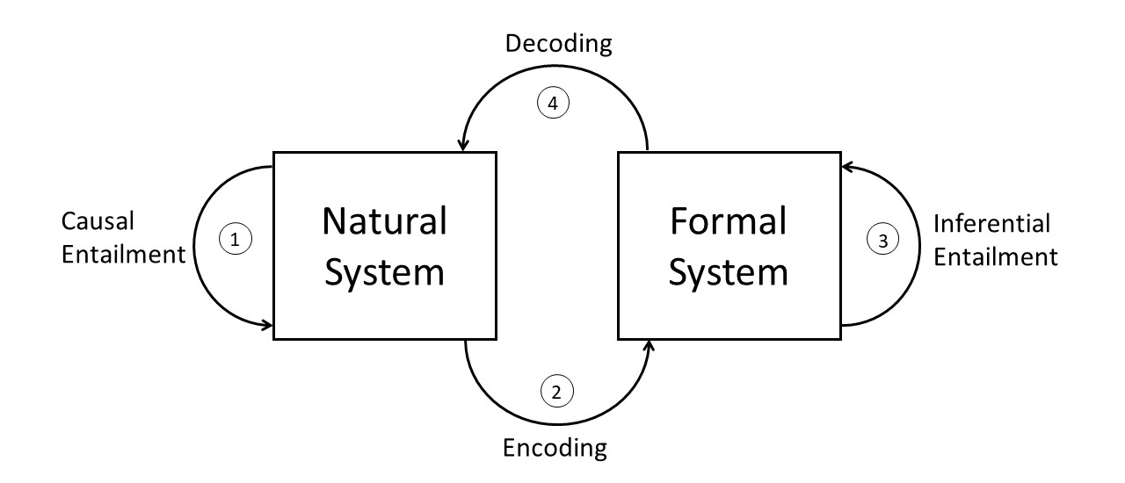
Knowing what we know
Rosen’s (1991) modeling relation: An elegant representation of the scientific process as heavily entangled with the real world it seeks to understand
Life’s great advance as a complex adaptive system was to emerge as differentiations from and using the stuff of the background and simultaneously develop ways to interact and make sense of this background.

Slide 5
Network Primer
Networks are everywhere!

Slide 6
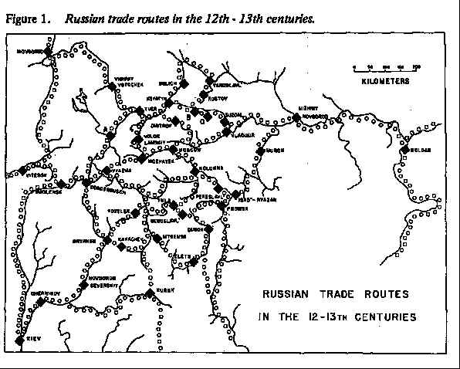

Slide 7
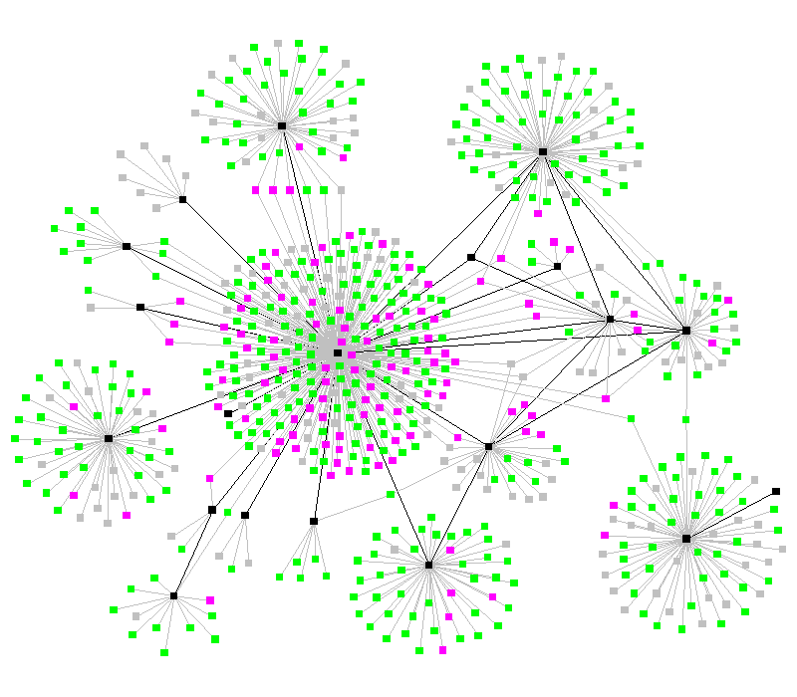
Communicable disease

Slide 8
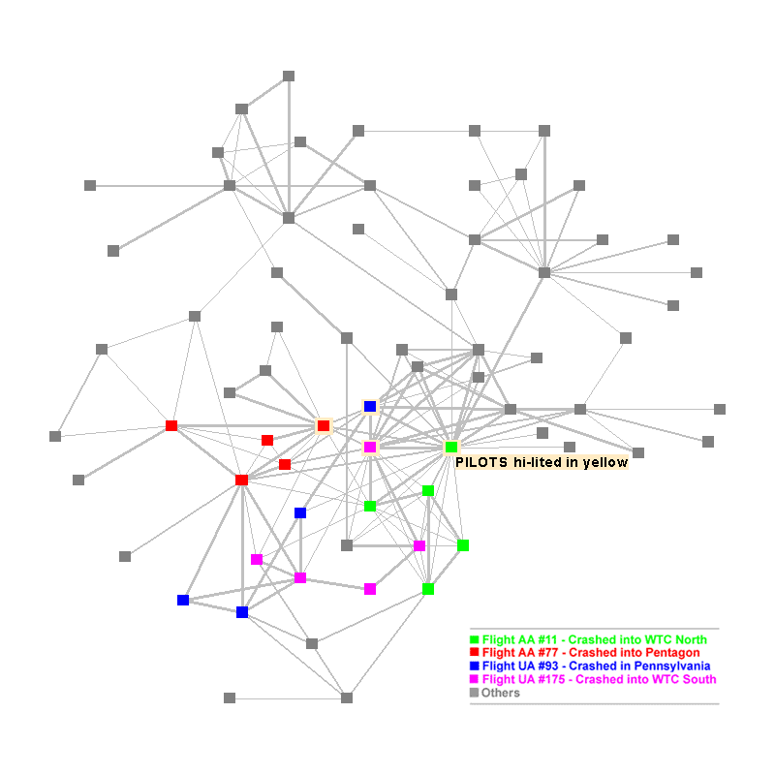
Terrorism network

Slide 9
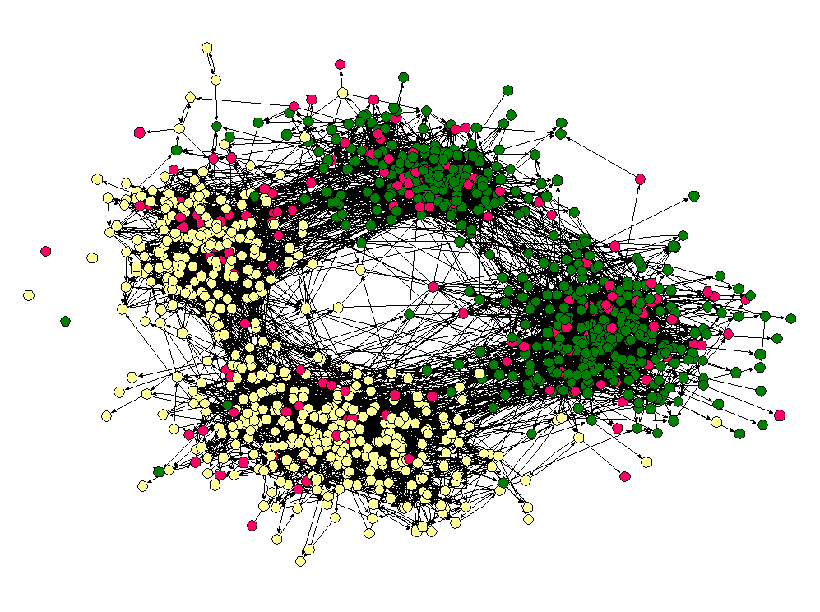
High School Friendship

Slide 10
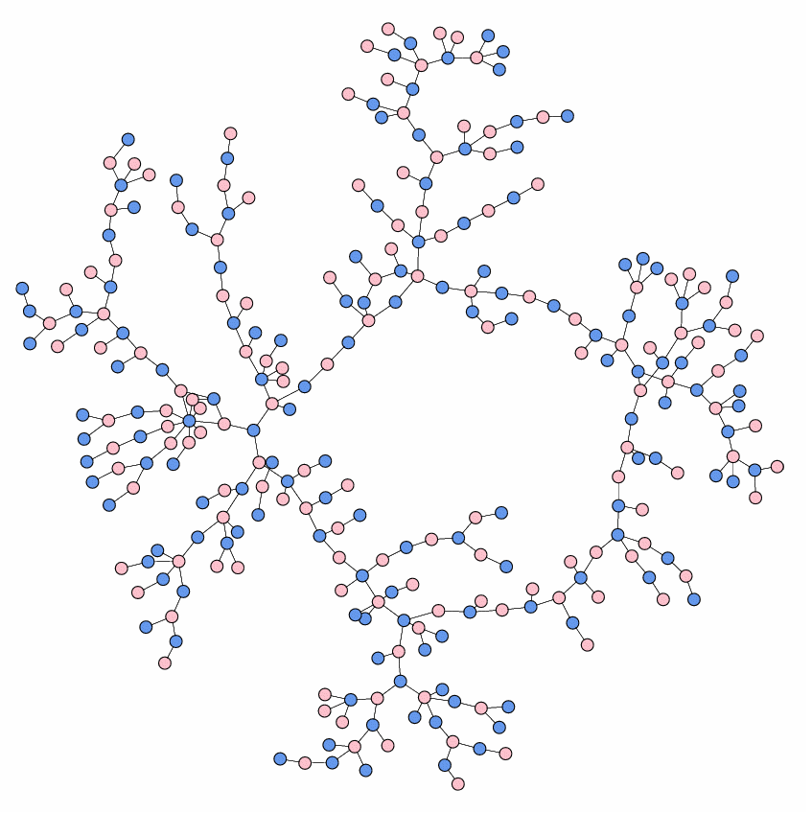
High School Dating

Slide 11
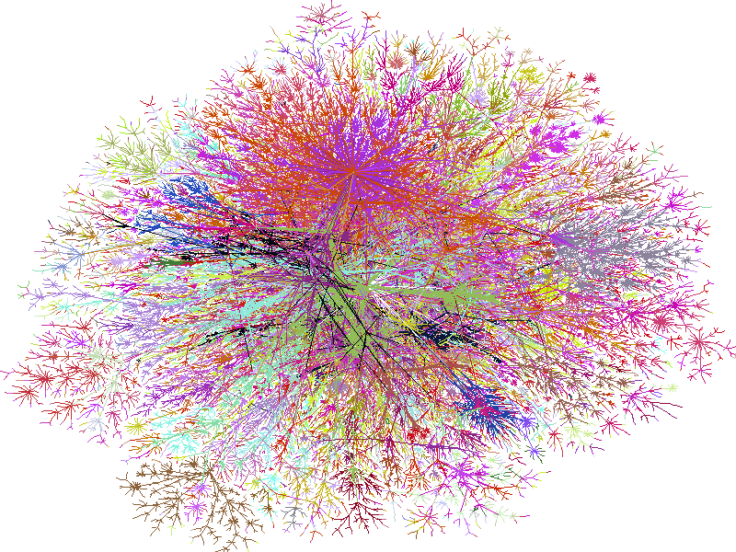
The Internet

Slide 12
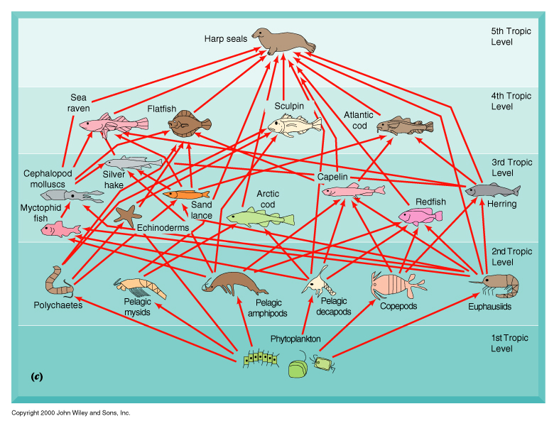
Ecological Food Web

Slide 13
Oyster Reef Model
Dame and Patten 1981 – flow is in kcal/(day m²), storage in kcal/m²

Slide 14
How to measure structure and indirectness
Example – digraph to adjacency matrix
x1
x3
x2

Slide 15
Matrix multiplication gives
Higher Order (Indirect) Pathways
A^{m}, where m > 1
x1
x3
x2

Slide 16
Powers of a matrix!!
The matrix A^{m} gives exactly the number of paths between two nodes of length m.
A¹ are the direct paths.
A² are the paths that take two steps
A³ are the paths that take three steps, etc.
Notice that some elements which were zero originally get filled in.
In other words we have a way to identify the indirect, i.e., m>1, walks in the matrix, and hence in the graph.

Slide 17
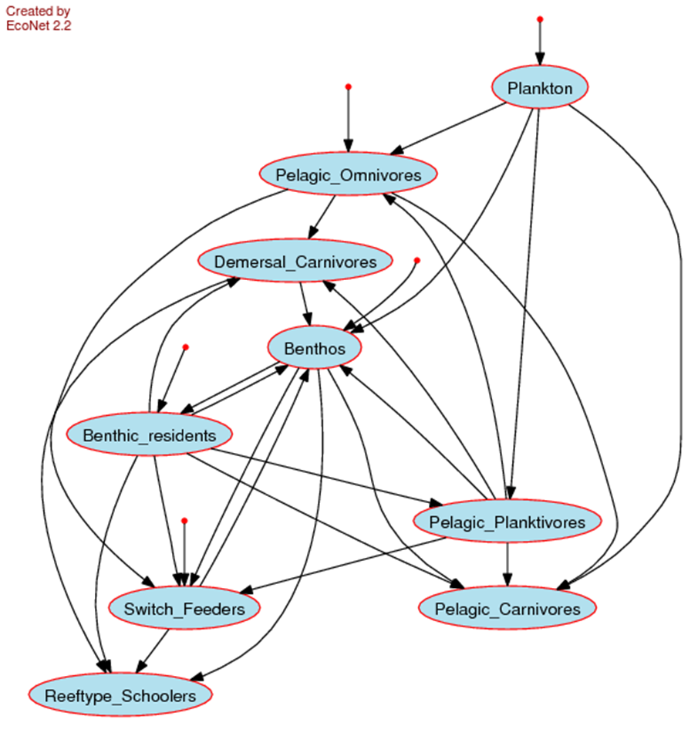
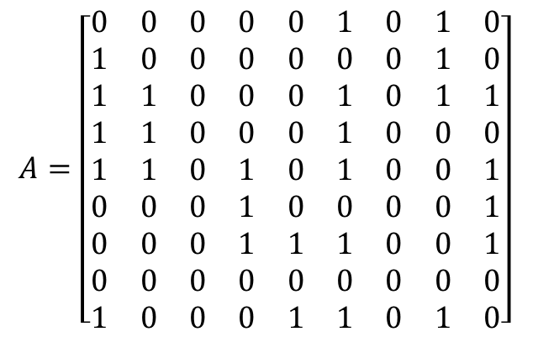
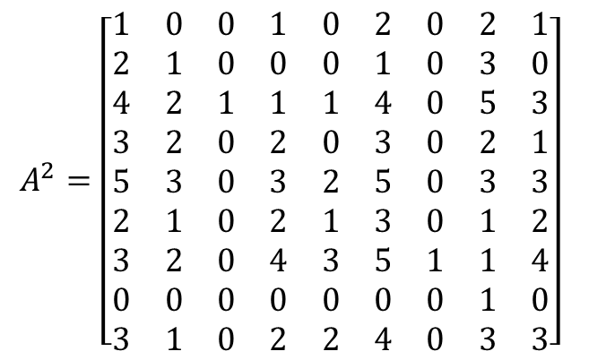
$$A=\left[\begin{matrix}0 & 0 & 0 & 0 & 0 & 1 & 0 & 1 & 0 \\ 1 & 0 & 0 & 0 & 0 & 0 & 0 & 1 & 0 \\ 1 & 1 & 0 & 0 & 0 & 1 & 0 & 1 & 1 \\ 1 & 1 & 0 & 0 & 0 & 1 & 0 & 0 & 0 \\ 1 & 1 & 0 & 1 & 0 & 1 & 0 & 0 & 1 \\ 0 & 0 & 0 & 1 & 0 & 0 & 0 & 0 & 1 \\ 0 & 0 & 0 & 1 & 1 & 1 & 0 & 0 & 1 \\ 0 & 0 & 0 & 0 & 0 & 0 & 0 & 0 & 0 \\ 1 & 0 & 0 & 0 & 1 & 1 & 0 & 1 & 0\end{matrix}\right]$$
$$A^{2}=\left[\begin{matrix}1 & 0 & 0 & 1 & 0 & 2 & 0 & 2 & 1 \\ 2 & 1 & 0 & 0 & 0 & 1 & 0 & 3 & 0 \\ 4 & 2 & 1 & 1 & 1 & 4 & 0 & 5 & 3 \\ 3 & 2 & 0 & 2 & 0 & 3 & 0 & 2 & 1 \\ 5 & 3 & 0 & 3 & 2 & 5 & 0 & 3 & 3 \\ 2 & 1 & 0 & 2 & 1 & 3 & 0 & 1 & 2 \\ 3 & 2 & 0 & 4 & 3 & 5 & 1 & 1 & 4 \\ 0 & 0 & 0 & 0 & 0 & 0 & 0 & 1 & 0 \\ 3 & 1 & 0 & 2 & 2 & 4 & 0 & 3 & 3\end{matrix}\right]$$
Food web model Gulf of Mexico ecosystem

Slide 18
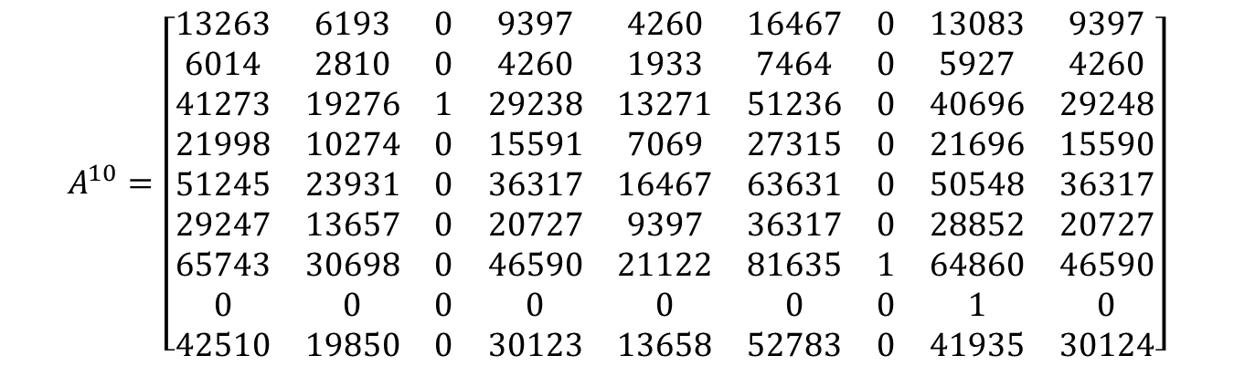
Very many pathways as path length increases
$$A^{10}=\left[\begin{matrix}13263 & 6193 & 0 & 9397 & 4260 & 16467 & 0 & 13083 & 9397 \\ 6014 & 2810 & 0 & 4260 & 1933 & 7464 & 0 & 5927 & 4260 \\ 41273 & 19276 & 1 & 29238 & 13271 & 51236 & 0 & 40696 & 29248 \\ 21998 & 10274 & 0 & 15591 & 7069 & 27315 & 0 & 21696 & 15590 \\ 51245 & 23931 & 0 & 36317 & 16467 & 63631 & 0 & 50548 & 36317 \\ 29247 & 13657 & 0 & 20727 & 9397 & 36317 & 0 & 28852 & 20727 \\ 65743 & 30698 & 0 & 46590 & 21122 & 81635 & 1 & 64860 & 46590 \\ 0 & 0 & 0 & 0 & 0 & 0 & 0 & 1 & 0 \\ 42510 & 19850 & 0 & 30123 & 13658 & 52783 & 0 & 41935 & 30124\end{matrix}\right]$$
As m increases, the number of paths typically increases greatly

Slide 19
100
x₁
20
x₂
2
x₃
Flow Analysis
80
18
2
Adjacency matrix
Inter-compartmental flows
inputs
outputs
Total flow through each compartment
The outflow (time forward, input driven) fractions are given by g_{ij} where

Slide 20
Just as powers of A gave higher order pathways,
Powers of G give flow transfers along higher order pathways.
G² gives the fraction of flow leaving j that took 2 steps to reach i.
100
x₁
20
x₂
2
x₃
80
18
2

Slide 21
Continuing:
G³ gives the fraction of flow leaving j that took 3 steps to reach i.
100
x₁
20
x₂
2
x₃
80
18
2

Slide 22
Summarizing:
G² gives transfers over pathways of length 2
G³ gives transfers over pathways of length 3, etc., i.e.,
G^{m} gives transfers over pathways of length m
Summing over m=1→∞ gives powers over all pathways
where
represent indirect transfers

Slide 23
Unlike like powers of A, powers of G get smaller and the series converges
N is the INTEGRAL output flow matrix since it includes direct and all indirect flows

Slide 24
Propagation of network indirect effects
Flow: | N | = | I | + | G | + | G² | + | G³ | + | G⁴ | +…
integral = initial + direct + indirect input
Key findings:
Quantify input and output flow
Indirect flows > direct flows
Flows are well mixed
Mutualistic relations dominate

Slide 25
L1: Coupled Complementary Life has Discrete and Sustained Aspects

Slide 26


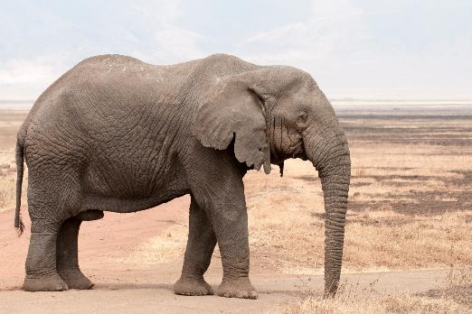
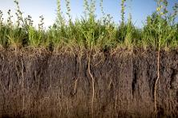
Environment and ecological interactions
Discrete Life
A single organism possesses all the necessary aspects to be alive

Slide 27
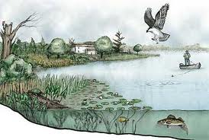
Interacting ecological community and its environment is an ecosystem
Sustained Life
An ecosystem possesses all the necessary aspects to sustain life

Slide 28


Life and environment are best understood and modeled as unified as a single “life–environment” system.
Bounty of the Commons
Humans win, environment improves
Fiscus D, Fath BD, Goerner S. 2012. E:CO 14(3), 44–88.

Slide 29
Evolution of an undifferentiated whole
“Biologists have rather been in the habit of reflecting upon the evolution of individual species. This point of view does not bear the promise of success, if our aim is to find expression for the fundamental law of evolution. We shall probably fare better if we constantly recall that the physical object before us is an undivided system, that the divisions we make therein are more or less arbitrary importations, psychological rather than physical, and as such, are likely to introduce complications into the expression of natural laws operating upon the system as a whole.” (Lotka p. 158)
And later:
“. . . the concept of evolution, to serve us in its full utility, must be applied, not to an individual species, but to groups of species which evolve in mutual interdependence; and further to the system as a whole, of which such groups form inseparable part.” (Lotka p. 277)

Slide 30
L2: Complementarity of Ecological Goal Functions
Ecological Goal Functions are assumed to measure given properties or tendencies of ecosystems, emerging as a result of self-organization processes in their development (Marques 1998).

Slide 31
Examples of Goal functions from the literature
1 Minimize specific entropy production (Prigogine 1947).
Decrease in the respiration to biomass ratio.
2 Maximize energy throughflow (Odum 1983).
Increase in the internal energy flow.
3 Maximize exergy degradation (Kay 1984). As the amount of exergy captured increases, so does the amount dissipated.
4 Maximize exergy storage (Jørgensen & Mejer 1977). Exergy storage (biomass) and information increase due to shift to more complex species composition.
5 Maximize retention time (Cheslak & Lamarra 1981). Biological components develop mechanisms to increase time lags to maintain the energy stores longer.

Slide 32
Environs form a partition of the system.
input
environ-
influencing
output
environ-
influenced
mode 2
recycle
mode 1
1st passage
mode 3
dissipation
H_{i}
H_{j}
H₁
H_{i}
H_{i}
H_{j}
H_{j}
system
mode 0 – boundary input
mode 4 – boundary output

Slide 33
Network representation of flow and storage partitioning for any (i,j) pair in the system.
 | FLOW pair-wise interactions | STORAGE pair-wise interactions
mode 1 (first passage)
mode 2 (cyclic)
mode 3 (dissipative)

Slide 34
Goal Function | Ecological Representation | Network Parameter | Network Analysis Formulation
max power | max(TST) | TST = f⁽¹⁾ + f⁽²⁾ | TST =∑∑ (n_{ij})z_{j}
max exergy storage | max(TSS) | TSS = x⁽¹⁾+x⁽²⁾ | TSS = ∑∑τ_{i}(n_{ij})z_{j}
max dissipation | max(TSE) | TSE = f⁽³⁾ | TSE = ∑ ∑ (n_{ij}/n_{ii})z_{j}
max cycling | max(TSC) | TSC = f⁽²⁾ | TSC =∑ ∑ (n_{ij}/n_{ii})(n_{ii}−1)z_{j}
min specific dissipation | min(TSE/TSS) | TSE/TSS = f⁽³⁾/(x⁽¹⁾+x⁽²⁾) | TSE/TSS = ∑ ∑ ((n_{ij}/n_{ii})z_{j})/x_{ij} = ∑∑1/(τ_{i}n_{ii})
max residence time | max(TSRT) | TSRT = τ | TSRT = ∑∑x_{i}/(n_{ij})z_{j} = ∑τ_{i}

Slide 35
Conclusion
Goal functions are consistent and mutually implicating
Three common properties:
First passage flow
Cycling
Retention time
Get as much as it can (maximize first passage flow);
Hold on to it for as long as it can (maximize retention time); and
If it must let it go, then try to get it back (maximize cycling).

Slide 36
L3: Dominance of Indirect Effects

Slide 37
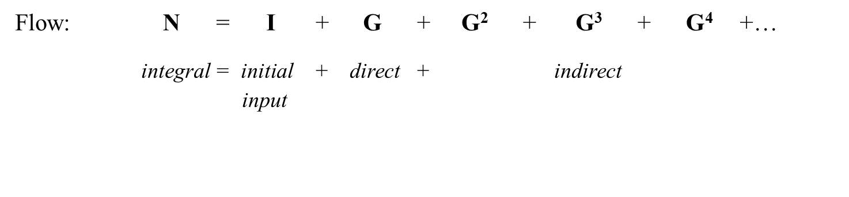
Measuring indirect flows

Slide 38
G =
0 0 0 0 0 0
0.3808 0 0 0.5000 0.7600 0.4758
0 0.3670 0 0 0 0
0 0.3267 0.1476 0 0 0
0 0.0289 0.1476 0.0779 0 0
0.0124 0 0 0 0.0686 0
G² =
0 0 0 0 0 0
0.0059 0.1853 0.1859 0.0592 0.0326 0
0.1398 0 0 0.1835 0.2789 0.1746
0.1244 0.0542 0 0.1634 0.2483 0.1554
0.0110 0.0796 0.0115 0.0144 0.0220 0.0137
0 0.0020 0.0101 0.0053 0 0
G³ =
0 0 0 0 0 0
0.0706 0.0885 0.0136 0.0952 0.1408 0.0882
0.0022 0.0680 0.0682 0.0217 0.0120 0
0.0226 0.0605 0.0608 0.0464 0.0518 0.0258
0.0305 0.0096 0.0054 0.0415 0.0615 0.0379
0.0008 0.0055 0.0008 0.0010 0.0015 0.0009
G⁴=
0 0 0 0 0 0
0.0348 0.0401 0.0348 0.0552 0.0733 0.0421
0.0259 0.0325 0.0050 0.0349 0.0517 0.0324
0.0234 0.0390 0.0145 0.0343 0.0478 0.0288
0.0041 0.0173 0.0152 0.0096 0.0099 0.0046
0.0021 0.0007 0.0004 0.0028 0.0042 0.0026
N =
1.0000 0 0 0 0 0
0.5369 1.3885 0.2775 0.7800 1.1006 0.6606
0.1971 0.5096 1.1019 0.2863 0.4039 0.2425
0.2045 0.5288 0.2533 1.2971 0.4192 0.2516
0.0605 0.1565 0.1904 0.1659 1.1241 0.0745
0.0165 0.0107 0.0131 0.0114 0.0771 1.0051
N-I-G =
0 0 0 0 0 0
0.1561 0.3885 0.2775 0.2800 0.3406 0.1848
0.1971 0.1426 0.1019 0.2863 0.4039 0.2425
0.2045 0.2021 0.1057 0.2971 0.4192 0.2516
0.0605 0.1276 0.0428 0.0879 0.1241 0.0745
0.0042 0.0107 0.0131 0.0114 0.0085 0.0051
DIRECT FLOWS
INTEGRAL FLOWS
TOTAL
INDIRECT FLOWS
Indirect/direct=
sum(sum(N–I–G))/sum(sum(G)) =
5.0523
3.2932
=1.5341

Slide 39
Dominance of Indirectness occurs when indirect contribution is greater than direct. This occurs in the majority of food web models studied so far and is one of the key results of ecological network analysis and insights into understanding the role of networks on system organization.
Indirectness increases with increasing:
connectivity
cycling
system order
direct effects
Make the direct observation, but analyze the whole system.
Direct observations give less than half the story.

Slide 40
L4: All Life is Physically and Relationally Connected
Relation – qualitative, value-oriented, direct or indirect interaction types. Nine possible interaction types
Transaction – transfer of energy or matter between two directly connected components

Slide 41
Utility Analysis
determines relationship types
demonstrates network synergism and mutualism
Let
Normalized net flow between components

Slide 42
Three compartment food chain
x₁
x₂
x₃
100
20
2
80
18
2
Network utility analysis uses net flow between components

Slide 43
100
x₁
20
x₂
2
x₃
Direct Sign Matrix
80
18
2
Direct relations – from comparing terms across the main diagonal:
(sd₂₁,sd₁₂) = (+, –) → predation
(sd₃₂,sd₂₃) = (+, –) → predation
(sd₃₁,sd₁₃) = (0, 0) → neutralism

Slide 44
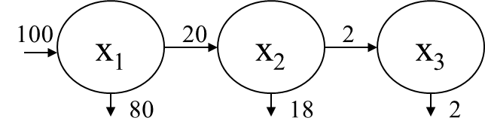
Integral Utility:
Utility: U = I + D + D² + D³ + D⁴ + … integral = initial + direct + indirect input
All terms are non-zero indicating relational connectivity

Slide 45

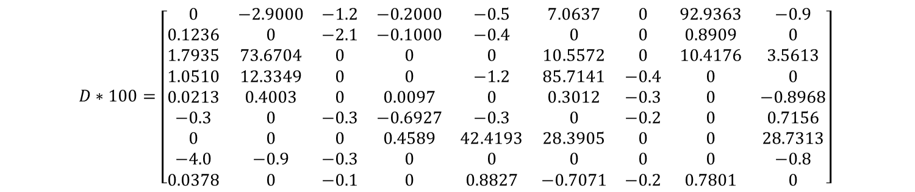
Direct interaction matrix, shows null (0,0) relations
$$D∗100=\left[\begin{matrix}0 & −2.9000 & −1.2 & −0.2000 & −0.5 & 7.0637 & 0 & 92.9363 & −0.9 \\ 0.1236 & 0 & −2.1 & −0.1000 & −0.4 & 0 & 0 & 0.8909 & 0 \\ 1.7935 & 73.6704 & 0 & 0 & 0 & 10.5572 & 0 & 10.4176 & 3.5613 \\ 1.0510 & 12.3349 & 0 & 0 & −1.2 & 85.7141 & −0.4 & 0 & 0 \\ 0.0213 & 0.4003 & 0 & 0.0097 & 0 & 0.3012 & −0.3 & 0 & −0.8968 \\ −0.3 & 0 & −0.3 & −0.6927 & −0.3 & 0 & −0.2 & 0 & 0.7156 \\ 0 & 0 & 0 & 0.4589 & 42.4193 & 28.3905 & 0 & 0 & 28.7313 \\ −4.0 & −0.9 & −0.3 & 0 & 0 & 0 & 0 & 0 & −0.8 \\ 0.0378 & 0 & −0.1 & 0 & 0.8827 & −0.7071 & −0.2 & 0.7801 & 0\end{matrix}\right]$$

Slide 46
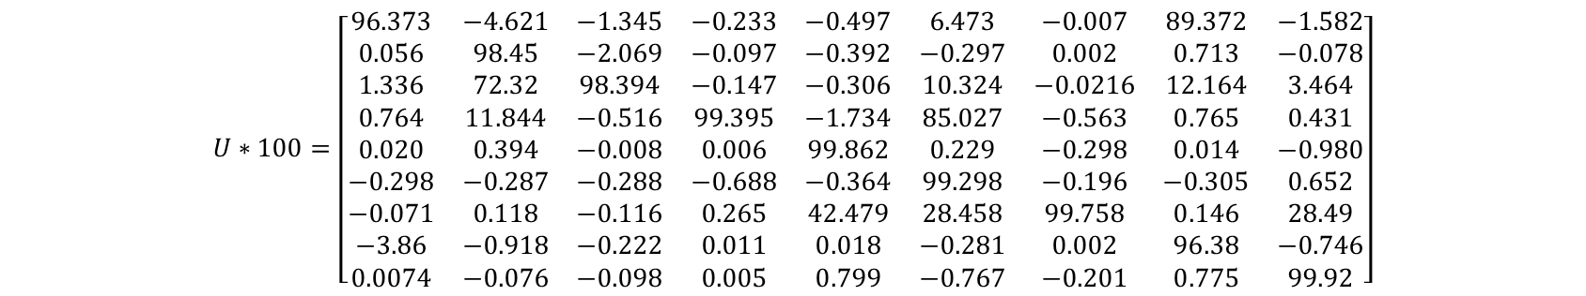
Integral (direct + indirect) relations are all non-zero, indicating everything affects everything, at least indirectly
$$U∗100=\left[\begin{matrix}96.373 & −4.621 & −1.345 & −0.233 & −0.497 & 6.473 & −0.007 & 89.372 & −1.582 \\ 0.056 & 98.45 & −2.069 & −0.097 & −0.392 & −0.297 & 0.002 & 0.713 & −0.078 \\ 1.336 & 72.32 & 98.394 & −0.147 & −0.306 & 10.324 & −0.0216 & 12.164 & 3.464 \\ 0.764 & 11.844 & −0.516 & 99.395 & −1.734 & 85.027 & −0.563 & 0.765 & 0.431 \\ 0.020 & 0.394 & −0.008 & 0.006 & 99.862 & 0.229 & −0.298 & 0.014 & −0.980 \\ −0.298 & −0.287 & −0.288 & −0.688 & −0.364 & 99.298 & −0.196 & −0.305 & 0.652 \\ −0.071 & 0.118 & −0.116 & 0.265 & 42.479 & 28.458 & 99.758 & 0.146 & 28.49 \\ −3.86 & −0.918 & −0.222 & 0.011 & 0.018 & −0.281 & 0.002 & 96.38 & −0.746 \\ 0.0074 & −0.076 & −0.098 & 0.005 & 0.799 & −0.767 & −0.201 & 0.775 & 99.92\end{matrix}\right]$$

Slide 47
L5: Mutualism is Common and Crucial

Slide 48
Integral Utility:
Utility: U = I + D + D² + D³ + D⁴ + … integral = initial + direct + indirect input
What is indirect relation between X1 and X3?
(sd₂₁,sd₁₂) = (+, –) → predation
(sd₃₂,sd₂₃) = (+, –) → predation
(sd₃₁,sd₁₃) = (+, +) → mutualism
Community-level relations are more positive than the direct
relations that produced them: This is network mutualism.

Slide 49
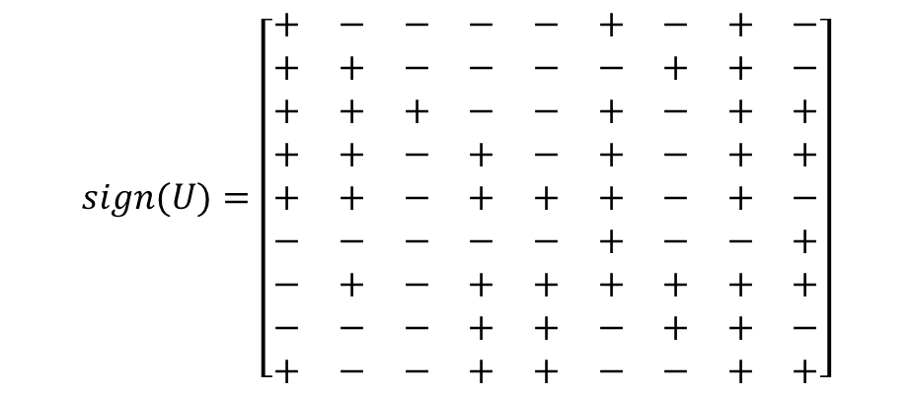
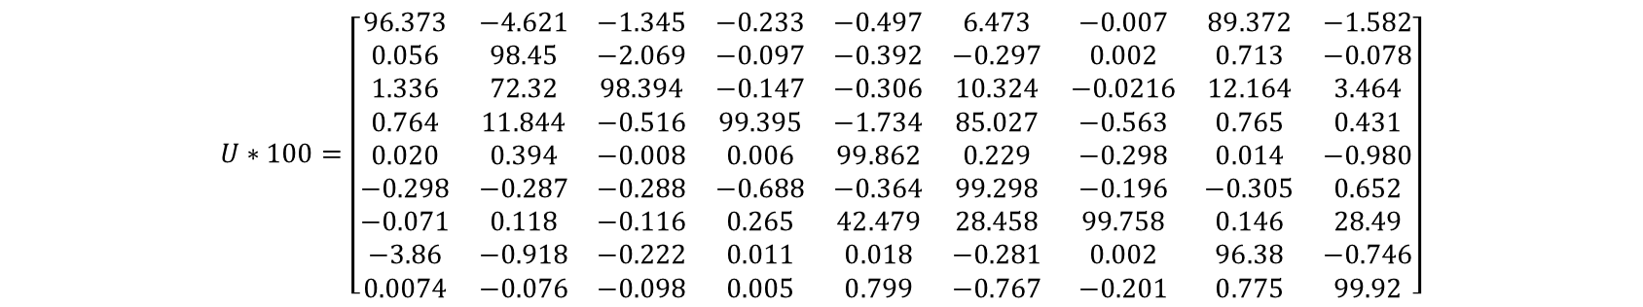
$$U∗100=\left[\begin{matrix}96.373 & −4.621 & −1.345 & −0.233 & −0.497 & 6.473 & −0.007 & 89.372 & −1.582 \\ 0.056 & 98.45 & −2.069 & −0.097 & −0.392 & −0.297 & 0.002 & 0.713 & −0.078 \\ 1.336 & 72.32 & 98.394 & −0.147 & −0.306 & 10.324 & −0.0216 & 12.164 & 3.464 \\ 0.764 & 11.844 & −0.516 & 99.395 & −1.734 & 85.027 & −0.563 & 0.765 & 0.431 \\ 0.020 & 0.394 & −0.008 & 0.006 & 99.862 & 0.229 & −0.298 & 0.014 & −0.980 \\ −0.298 & −0.287 & −0.288 & −0.688 & −0.364 & 99.298 & −0.196 & −0.305 & 0.652 \\ −0.071 & 0.118 & −0.116 & 0.265 & 42.479 & 28.458 & 99.758 & 0.146 & 28.49 \\ −3.86 & −0.918 & −0.222 & 0.011 & 0.018 & −0.281 & 0.002 & 96.38 & −0.746 \\ 0.0074 & −0.076 & −0.098 & 0.005 & 0.799 & −0.767 & −0.201 & 0.775 & 99.92\end{matrix}\right]$$
$$sign(U)=\left[\begin{matrix}+ & − & − & − & − & + & − & + & − \\ + & + & − & − & − & − & + & + & − \\ + & + & + & − & − & + & − & + & + \\ + & + & − & + & − & + & − & + & + \\ + & + & − & + & + & + & − & + & − \\ − & − & − & − & − & + & − & − & + \\ − & + & − & + & + & + & + & + & + \\ − & − & − & + & + & − & + & + & − \\ + & − & − & + & + & − & − & + & +\end{matrix}\right]$$
43 are positive and 38 are negative

Slide 50
Oyster Reef Model
neutralism
mutualism
predation
mutualism

Slide 51
Oyster Reef Model
predation
predation
Two relations “flipped”
mutualism
competition

Slide 52
L6: Ecosystems Balance Efficiency and Adaptability

Slide 53

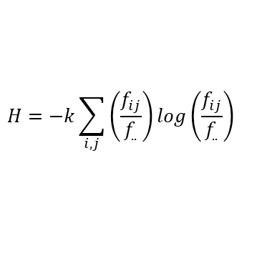

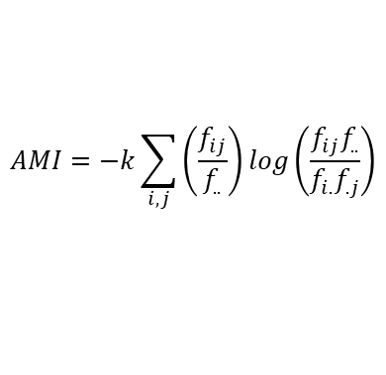


Information-based Ecological Network Analysis
Robustness as a trade-off between efficiency and diversity
$$H=−k\sum_{i,j}{\left(\frac{f_{ij}}{f_{..}}\right)}\log\left(\frac{f_{ij}}{f_{..}}\right)$$
Total system capacity
$$=AMI+H_{c}$$
$$AMI=−k\sum_{i,j}{\left(\frac{f_{ij}}{f_{..}}\right)}\log\left(\frac{f_{ij}f_{..}}{f_{i.}f_{.j}}\right)$$
Efficiency
Diversity
$$H_{c}=−k\sum_{i,j}{\left(\frac{f_{ij}}{f_{..}}\right)}\log\left(\frac{f_{ij}^{2}}{f_{i.}f_{.j}}\right)$$
Degree of order
$$a=\frac{AMI}{\left(AMI+H_{c}\right)}$$
Robustness
$$R=−a\ln\left(a\right)$$

Slide 54
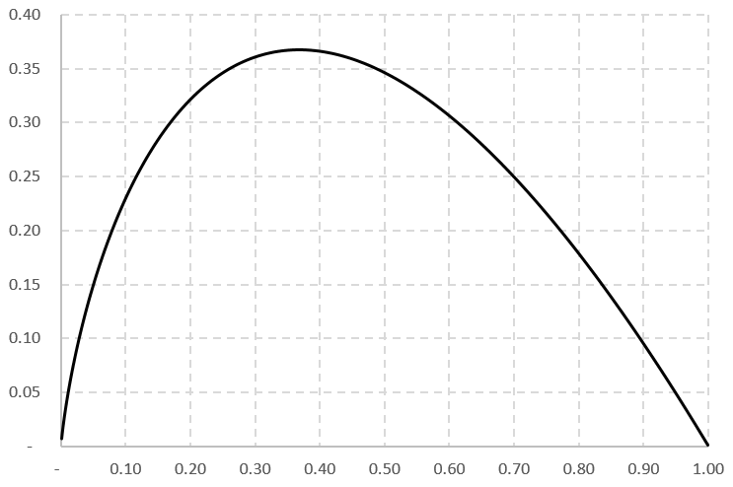
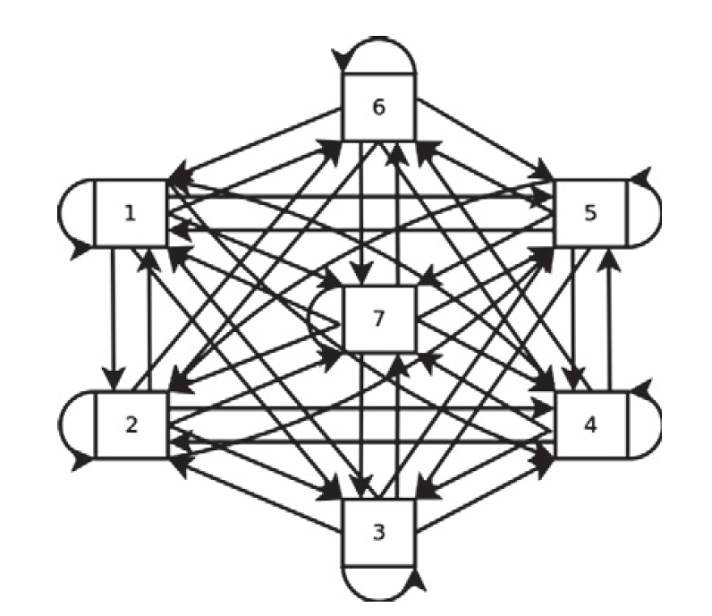
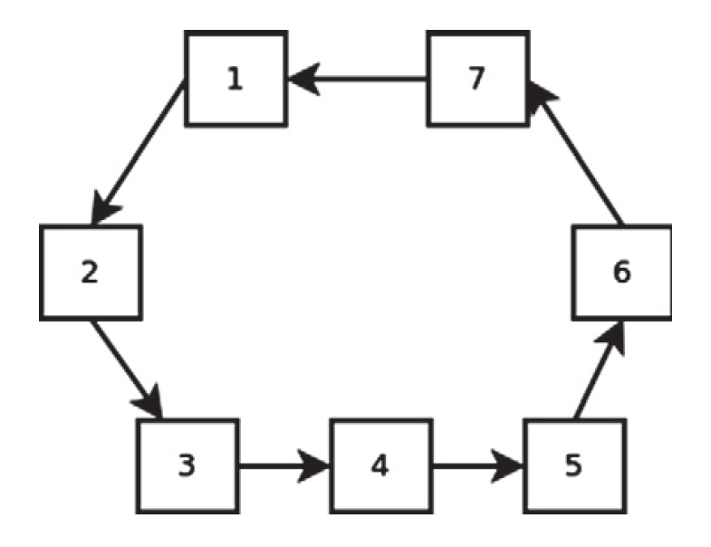


Two example networks
Fully connected
Minimally connected
Robustness = -a ln(a)
$$a= \frac{AMI}{AMI+H_{c}}= 0$$
$$a= \frac{AMI}{AMI+H_{c}}=1$$
Degree of order (a)

Slide 55
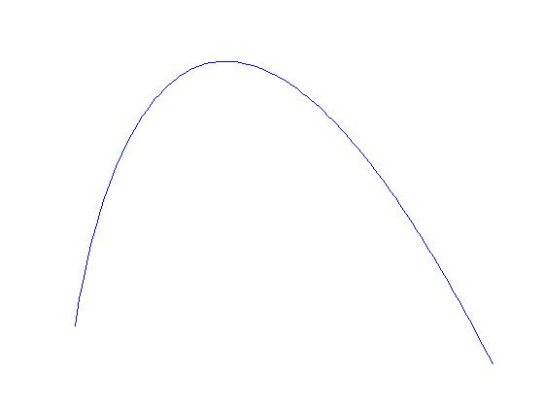
Robustness combines both efficiency and redundancy
“Window of Vitality”
Data from ecosystems
Optimal balance
Toward brittleness
(too little redundancy)
Toward
stagnation
(too little
efficiency)
Robustness
Greater
redundancy
Greater
efficiency
Degree of order
Ulanowicz 2009 A Third Window

Slide 56
L7: A Hyperset Formalism of Life Prohibits Fragmentation of Life from Environment

Slide 57
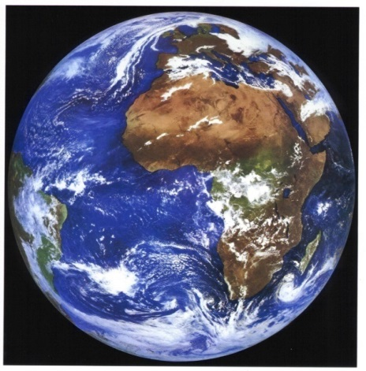
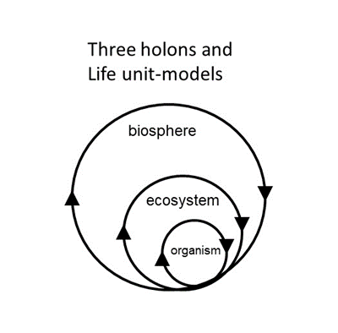
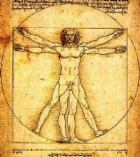
Recursive nature of nature
A hyperset equation explicitly and formally prohibits fragmentation of life from environment
Bounty of the Commons
Humans win, environment improves
life–environment =
{environment{ecosystems{organisms{environment}}}}
Fiscus D, Fath BD, Goerner S. 2012. E:CO 14(3), 44–88.

Slide 58
Summary of the six principles
Network insight and tools can give new understanding and contribute to a new holistic, interconnected, reflective science
“With an eco-mind, we move from ‘fixing something’ outside ourselves to realigning our relationships within our ecological home.” (Lappe 2011, p. 16)

Slide 59
Discussion questions
could a plant exist alone with a “very slow working cycle”
What if all organisms incorporated chloroplast cells? Is it sufficient?

Slide 60
Discussion questions
How can the hyperset formulation help us think like an ecosystem?
  Practical implementations of it?

