Slide 1
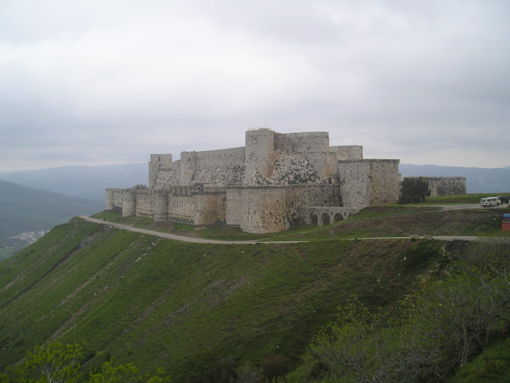
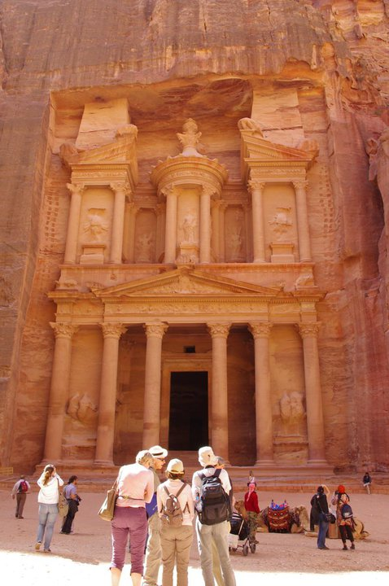
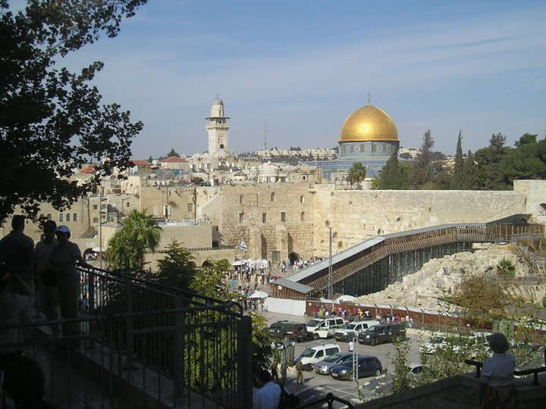
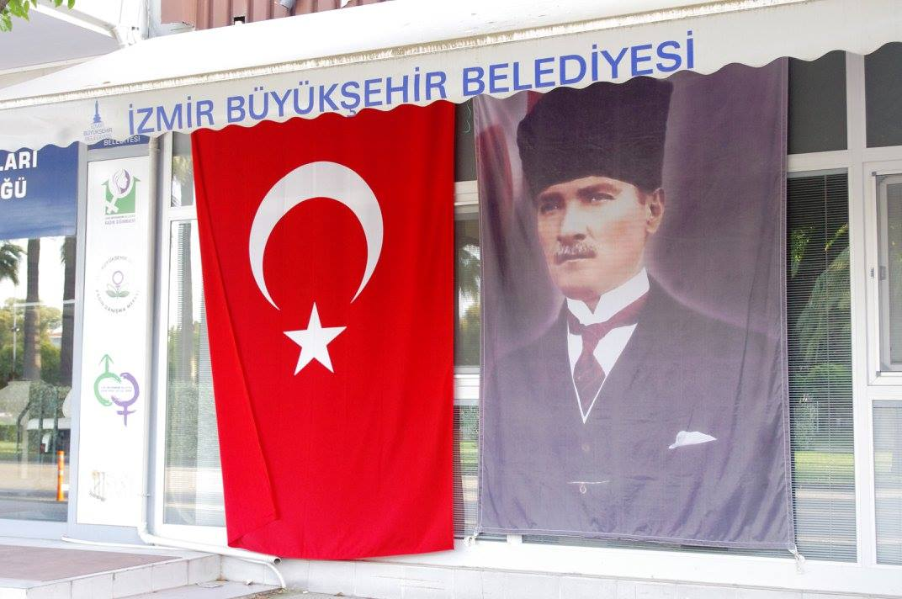
POLTICS AND SOCIETY IN THE MIDDLE EAST
Mgr. Eva Taterova, M.A., Ph.D.
Faculty of Social Studies
Masaryk University

Slide 2
COURSE OVERVIEW
Credits: 4 ECTS
Lecturer: Mgr. Eva Taterova, M.A., Ph.D. (evataterova@gmail.com)

Slide 3
COURSE SCHEDULE
September 16: Introduction. scope of the course, organization of the course, and course requirements
September 23: Middle East: the basic terminology, geography, demography
September 30: History of Middle East before 1945
October 7: Arab-Israeli Conflict I
October 14: Arab-Israeli conflict II
October 21: Iran: From Western Ally to Islamic Republic
October 28: National holiday – no class

Slide 4
COURSE SCHEDULE
November 4: Midterm
November 11: Political Development of Lebanon and Syria
November 18: Post Cold War Conflicts in the Middle East
November 25: EU and the Mediterranean region
December 2: Documentary movie – screening followed by a discussion
December 9: Final exam

Slide 5
COURSE ACTIVITIES
Midterm: November 4, 5 open questions, 40 points
Final Exam: December 9, 6 open questions, 60 points

Slide 6
GRADES
Passed 60-100 points
Failed less than 60 points

Slide 8
THANK YOU FOR YOUR ATTENTION

