Slide 1
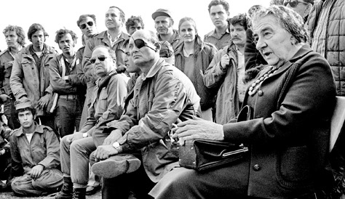
1973
The October War

Slide 2

Myth and Fact
Israel surprised
Israel knew of Egyptian mobilization
Traumatic event
Watershed moment
  1-4 ratio (family member)
  Charles Liebman, (July 1993). "The Myth of Defeat: The Memory of the Yom Kippur war in Israeli Society" Middle Eastern Studies 29 (3): 411.

Slide 3
Background
1967 Arab-Israeli War: unfulfilled dreams
  Six Days Of War: June 1967 and the making of the Middle East (2001) Michal Oren
  Six Days: How the 1967 war shaped the Middle East (2005) Jeremy Bowen
Domestic politics: U.S., Israel, Arab states
  All State Department documents related to the crisis
  Letters from David Ben-Gurion on the Six-Day War @ Shapell Manuscript Foundation
U.S.- Soviet proxy war(s)
  realism

Slide 4
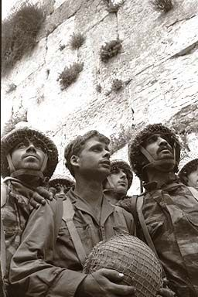
1967
Jerusalem united
Invincibility of Israeli armed forces
Further resentment of Arab nations

Slide 5
Background
Israel’s failure to detect the war plans in Cairo and Damascus was due to a combination of intelligence breakdown and political misperception.
The roots of the Israeli psyche which led to the October 1973 surprise can be traced to a large extent to their victory in the 1967 Six Day War.
Rhetoric coming from Arab capitals did not help to alter Israeli’s perception of isolation and rejection in the Middle East.
If Israel thought strategically in terms of defending herself from an absolute war aimed at her destruction, President Sadat planed with his Syrian allies a much more limited war in order to shake Israeli complacency and intransigence.

Slide 6
Background
Israel’s lack of trust in her neighboring countries was epitomized by the unfortunate saying of the powerful Defense Minister Moshe Dayan
  “Better Sharm el-Sheikh without peace than peace without Sharm el-Sheikh.”
This best explains why the advances by Egyptian President Anwar Sadat in 1971 to negotiate full peace with Israel, in return for the complete withdrawal from the Sinai Peninsula, were met with suspicion and were rejected by Israel.
The October War was the response to this status quo which was unacceptable to the Arab world.

Slide 7
Background
Since the humiliation of the Six Day War,“There was a devastating feeling of crisis and defeat,” explains Egyptian author and journalist Gamal El-Ghitani.
Four months after taking power, Sadat had offered the Israelis a peace deal if they would withdraw from Sinai. Golda Meir, the then Israeli prime minister, rebuffed the offer.
  buffer-zone

Slide 8
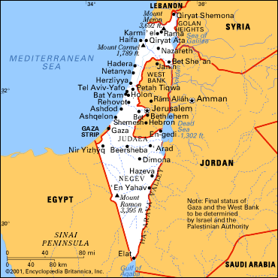
Buffer-zone(s)
National Security based on defensible borders

Slide 9
Background
So, left to contemplate a war, Sadat found an ally. Syrian President Hafez al-Assad had come to power through a coup d’etat in 1970, and he too had a point to prove to his people.
Hisham Jaber, the director of the Middle East Studies Centre in Beirut, explains: “Hafez al-Assad was the defence minister during the 1967 defeat, and was held mainly accountable …. So, since al-Assad came to power in Syria, he started to absolve himself of the 1967 defeat, and to prepare the Syrian army for the next battle.”
  http://www.aljazeera.com/indepth/interactive/2013/10/timeline-war-october-201310684341831534.html

Slide 10
Background
Sadat and Mubarak, Meir and Sharon, Nixon and Kissinger, Brezhnev and Dobyrnin.
It was a vicious war between Arab and Jew
  neoclassical realism
Israel almost unleashed her nuclear arsenal
Superpowers were on a course of nuclear escalation.
  neorealism
Peace fraught with delicate tensions, disputed borders, and a legacy of further bloodshed.

Slide 11
Timeline
6 October Egypt and Syria invade Israel
  archival evidence show extent of war
Holiest day of Jewish year
Soviet weapons
U.S. airlift
Israel rallied; won the military conflict
22 October; 25 October ceasefire agreements

Slide 12
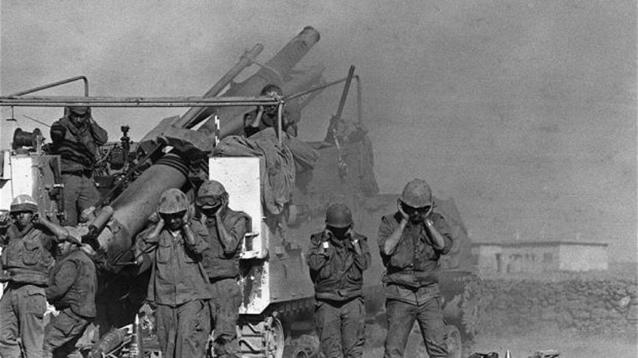
Israeli soldiers plug their ears as they fire shells from a French-made 155mm Horwitzer gun on Oct. 17, 1973 at the Syrian front lines on the Syrian Golan Heights, two weeks after the beginning of the Yom Kippur War 06 October 1973. (AFP)
Armaments

Slide 13
The War
Massive and successful Egyptian crossing the Suez Canal. After crossing the 1967 cease-fire lines, Egyptian forces advanced into the Sinai Peninsula .
  After three days, Israel had mobilized most of its forces and managed to halt the Egyptian offensive, settling into a stalemate.
The Syrians coordinated their attack on the Golan Heights to coincide with the Egyptian offensive and initially made threatening gains into Israeli-held territory.
  Within three days, Israeli forces had managed to push the Syrians back to the pre-war ceasefire lines.

Slide 14
The war
Israel then launched a four-day counter-offensive deep into Syria.
  Within a week, Israeli artillery began to shell the outskirts of Damascus.
As Egyptian president Anwar Sadat began to worry about the integrity of his major ally, he believed that capturing two strategic passes located deeper in the Sinai would make his position stronger during the negotiations. He therefore ordered the Egyptians to go back on the offensive, but the attack was quickly repulsed.
The Israelis then counterattacked at the seam between the two Egyptian armies, crossed the Suez Canal into Egypt, and began slowly advancing southward and westward towards Suez ^{[61][62]} in over a week of heavy fighting that inflicted heavy casualties on both sides.

Slide 15
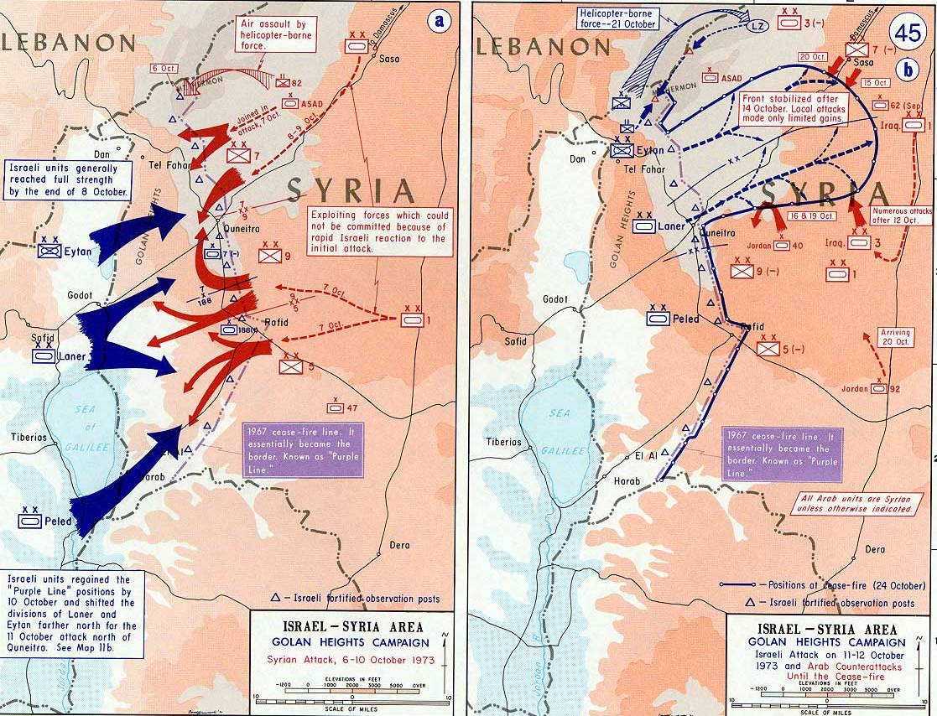
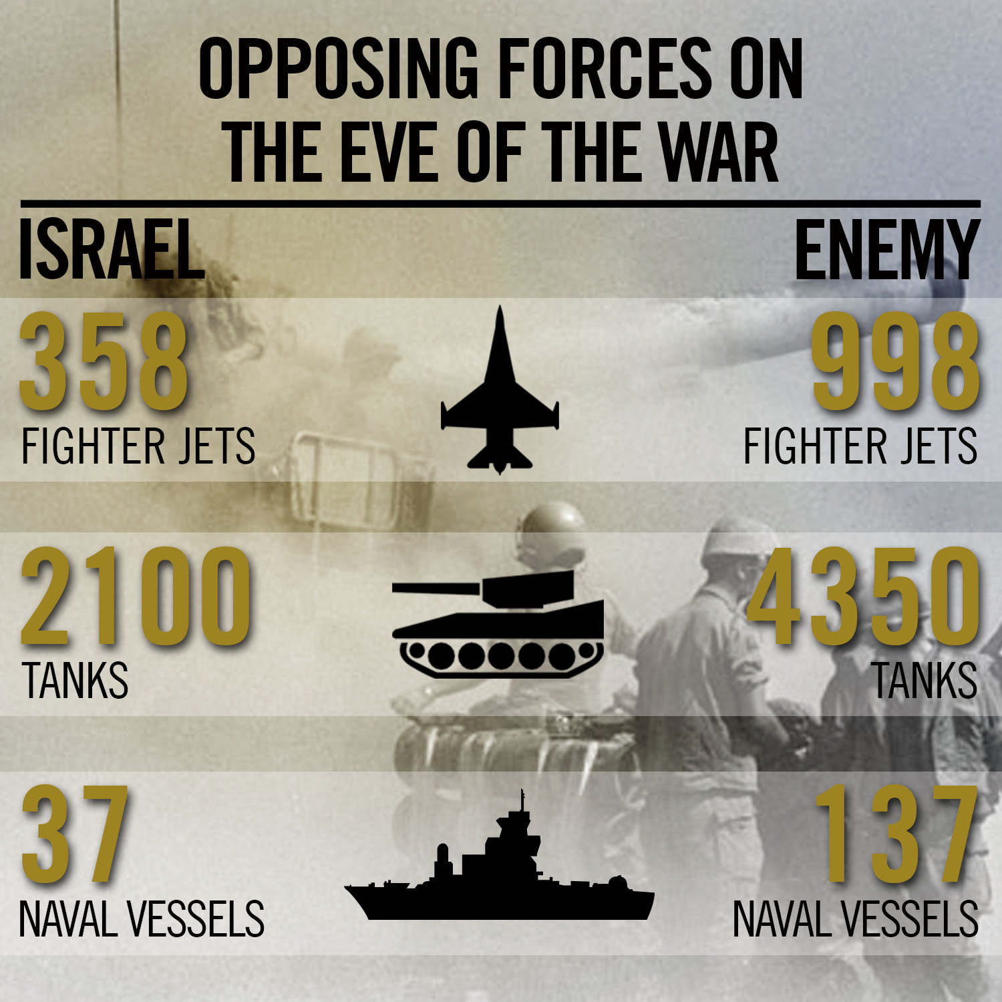

Slide 16
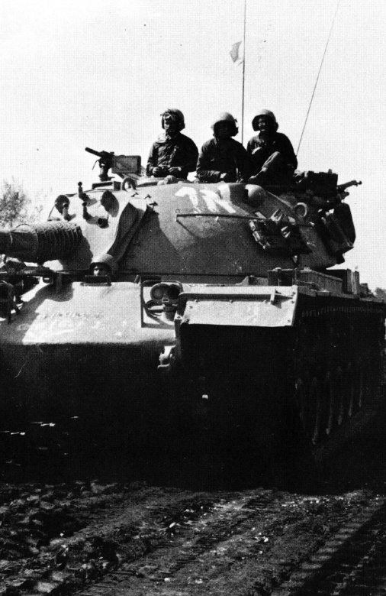
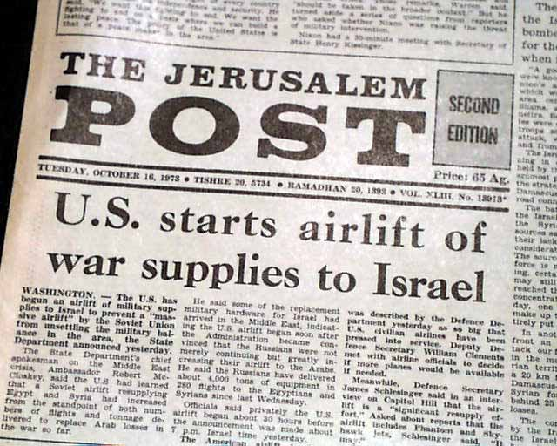
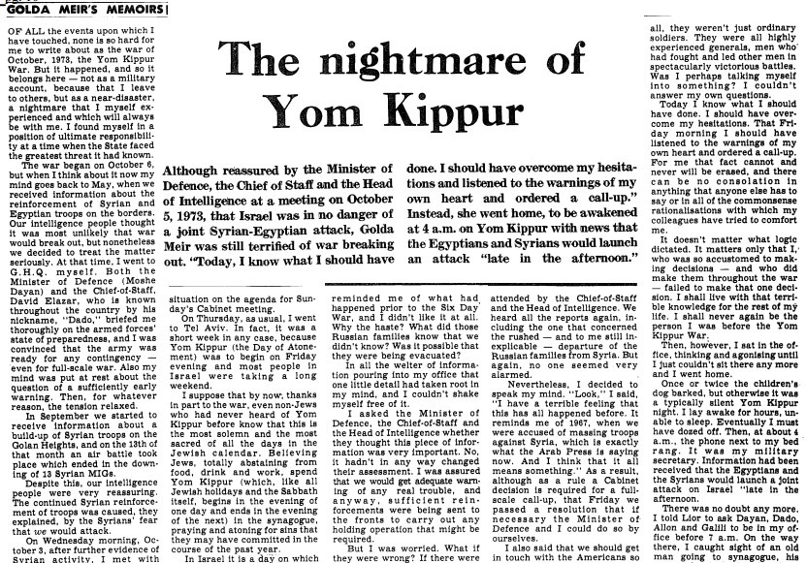

Slide 17
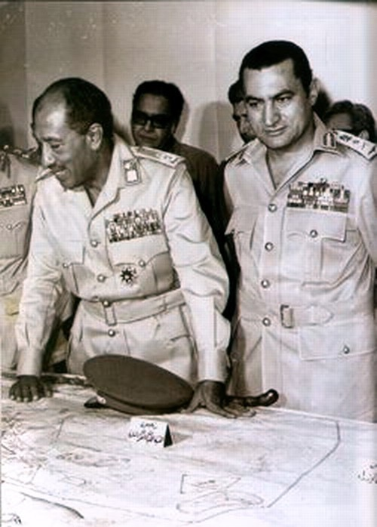
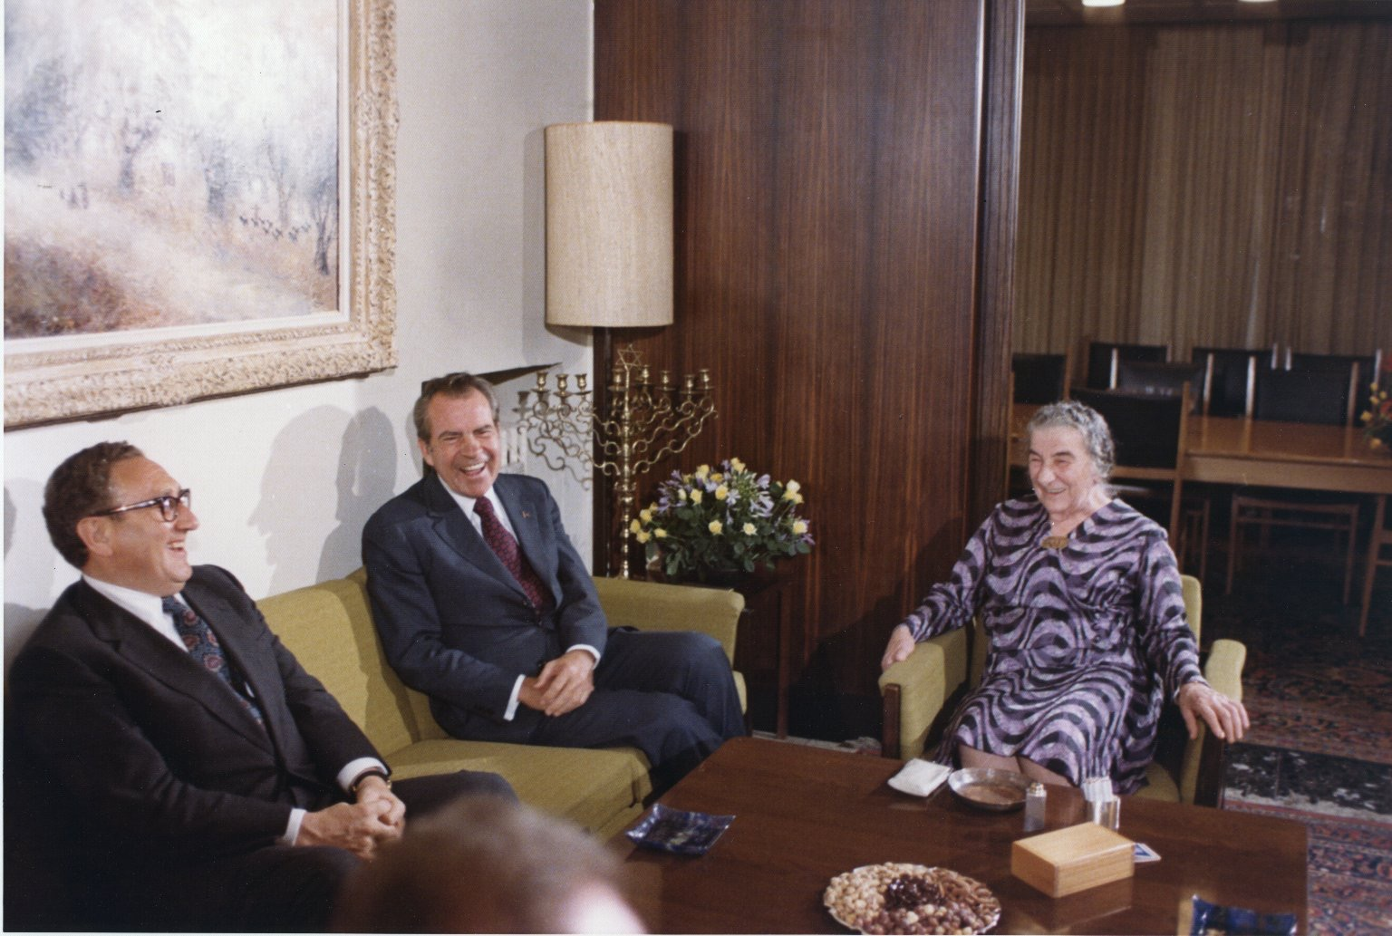
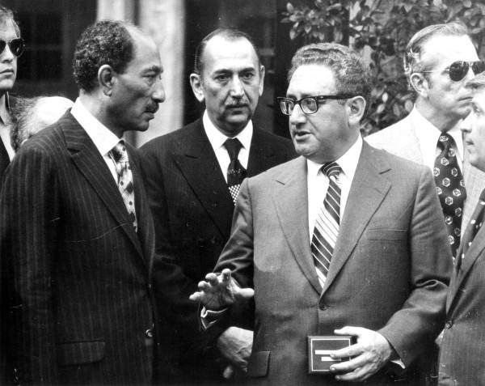

Slide 18
Nuclear Confrontation
The Yom Kippur War seriously damaged U.S.-Soviet relations including President Richard Nixon’s much publicized policy of detente.
The Syrians were driven back, with Israeli troops seizing the strategically important Golan Heights. Egyptian forces retreating back through the Sinai Desert, were surrounded and cut off by the Israeli army. Secretary of State Henry Kissinger, together with his Soviet counterparts, eventually arranged shaky cease-fire.
When Israel would not give up its siege of the Egyptian troops the Soviets threatened to take unilateral action to rescue them.
Tempers flared both in Washington and Moscow; U.S. military forces went to a Stage 3 alert (Stage 5 is the launch of nuclear attacks).

Slide 19
Both the United States and the Soviet Union initiated massive resupply efforts to their respective allies during the war (11,14.10)
U.S.-Soviet Union nuclear forces on alert
    first time since Cuban Missile Crisis
      Inside the Kremlin During the Yom Kippur War (1995) Victor Israelyan
OPEC oil embargo

Slide 20
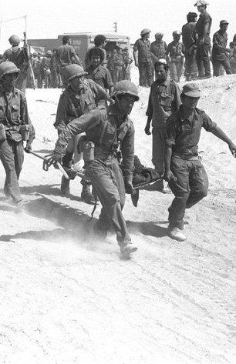
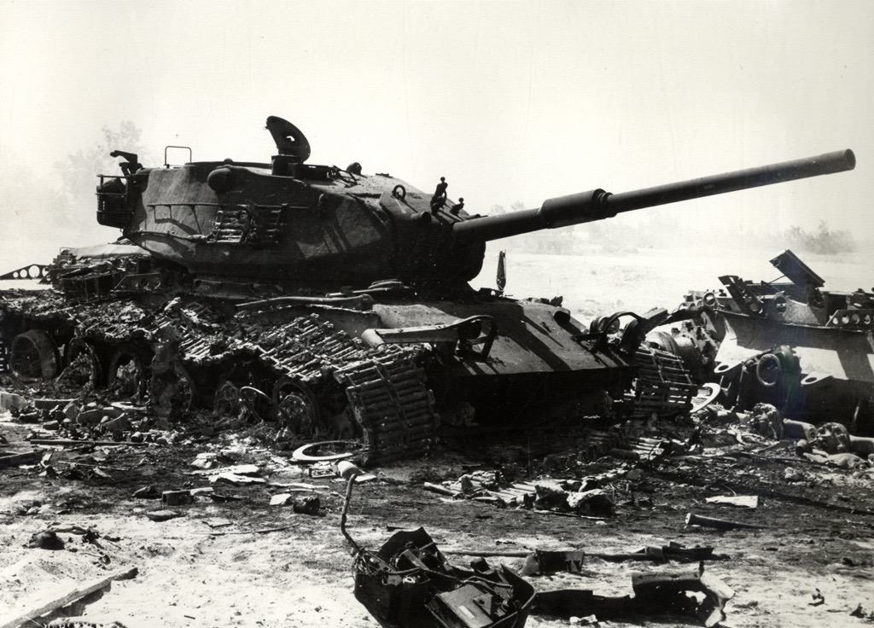
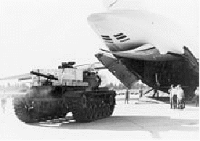

Slide 21
Outcome
Egypt (Sadat) achieves objective
Syria defeated
UN Res.340 (October 22 cease-fire line)
U.S.-Soviet detente ‘bruised not broken’

Slide 22
Outcome
Ceasefire
  Egyptian-Israeli peace
  Superpower balance in Middle East

Slide 23
Outcome
No war left the Israeli society more traumatized and in search of leadership and guidance than the October War
  resignation of Golda Meir = Yitzhak Rabin
Israel was caught by complete surprise, the lead up to this became known is as the “fiasco”.
The war shattered the perceptions of the Israeli decision making elite regarding their neighbors’ intentions and capabilities, and led to question of how to best guarantee the long term security of the country.
Israeli society lost its confidence in her leadership, and this loss would eventually end the dominance of the Labor party in Israeli politics.
  Likud electoral victory 1977

Slide 24
Legacy
Asaf Siniver (2013). The Yom Kippur War: Politics, Legacy, Diplomacy. Oxford University Press. p. 6. “For most Egyptians the war is remembered as an unquestionable victory- militarily as well as politically…(p.6) The fact that the war ended with Israeli troops stationed in the outskirts of Cairo and in complete encirclement of the Egyptian third army has not dampened the jubilant commemoration of the war in Egypt….(p.11) Ultimately, the conflict provided a military victory for Israel, but it is remembered as "the earthquake" or "the blunder"”

Slide 25
Legacy
P.R. Kumaraswamy (11 January 2013). Revisiting the Yom Kippur War. Routledge.“Yom kippur war...its final outcome was, without doubt, a military victory...(p. 185)
William B. Quandt (2005). Peace Process: American Diplomacy and the Arab-Israeli Conflict Since 1967. University of California Press. “it was of prime importance that the fighting should be ended...when all parties could still emerge from the conflict with their vital interests and self esteem intact..the airlift”(p. 112.)…”the Soviets must see that the united states could deliver more than they could”… “the U.S. would not permit the destruction of the 3rd army corps.” (p. 123)

Slide 26
Legacy
William B. Quandt (1977). Decade of Decisions: American Policy Toward the Arab–Israeli Conflict, 1967–1976.“Kissinger and Nixon consistently warned Israel that she must not be responsible for initiating a Middle east war” (p. 169).
  set stage for two milestones:
    1975 reassessment
    1982 Lebanon War

Slide 27
Outcome for U.S.-Israel
Airlift cemented shift from 2nd to 1st role of military hardware provider
Kissinger-Nixon-Meir played both domestic and f.p. roles
  Kissinger begins peak of influence (1973-75)
U.S. publicly no longer seen as neutral mediator
  U.S. confirmed as strategic partner to Israel since 1967

Slide 28
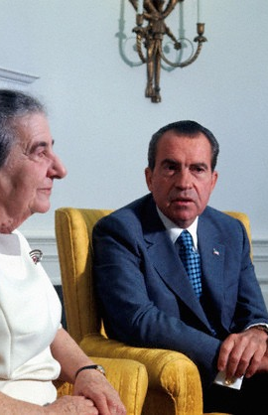
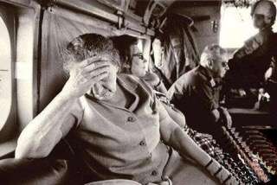
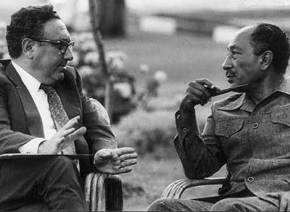

Slide 29
Recommendation
The Yom Kippur War: The Epic Encounter That Transformed the Middle East (2013) Abraham Rabinovich
1973 The Road to War (2013) Yigal Kipnis
Duel For The Golan – The 100-Hour Battle That Saved Israel (1987) Jeffrey Asher

