Slide 1
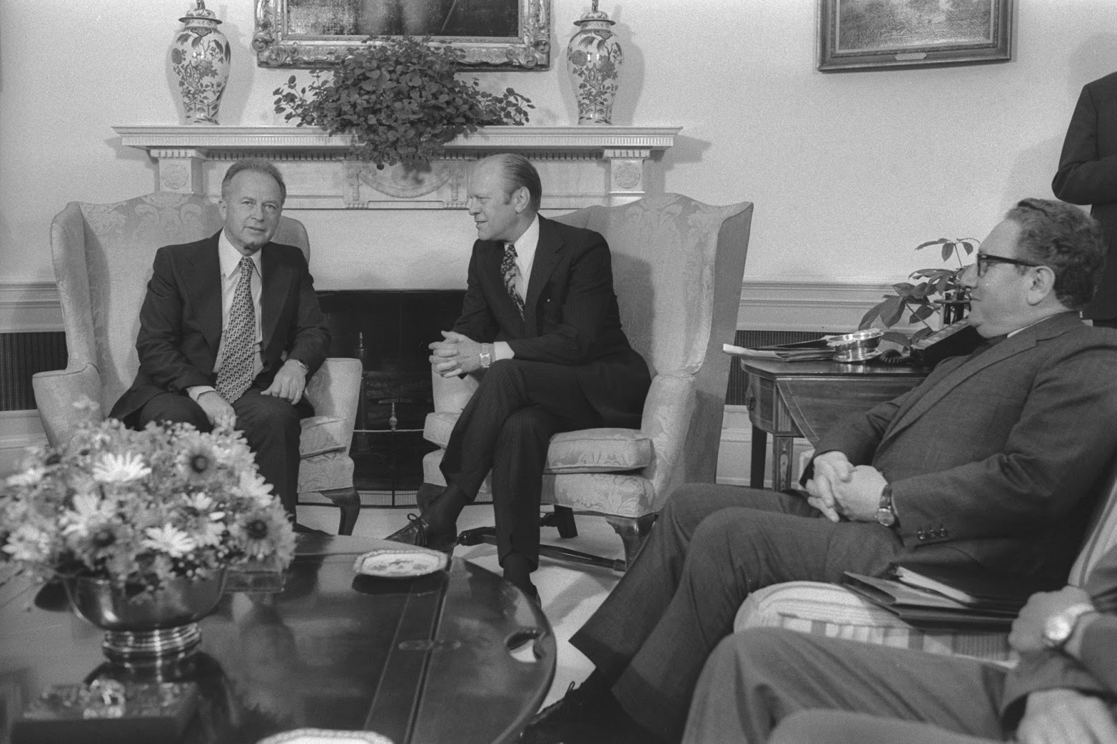
Limits of Influence
The Reassessment Crisis of 1975

Slide 2
Background
From March 1975 until late autumn 1975, the US undertook a “reassessment” of its relationship with Israel, creating enormous tension between the executive branch and the Israeli government
  Struggle of personalities
  neoclassical realism

Slide 3
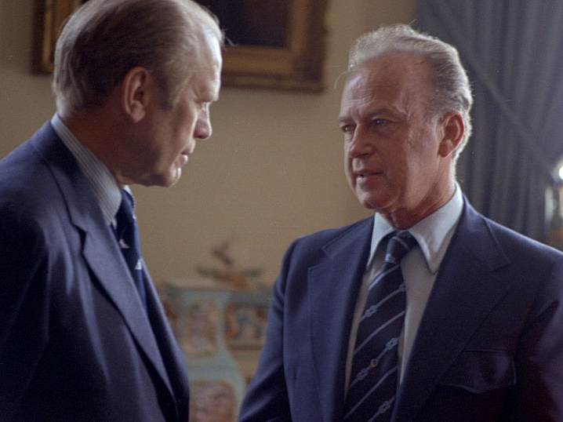

Slide 4
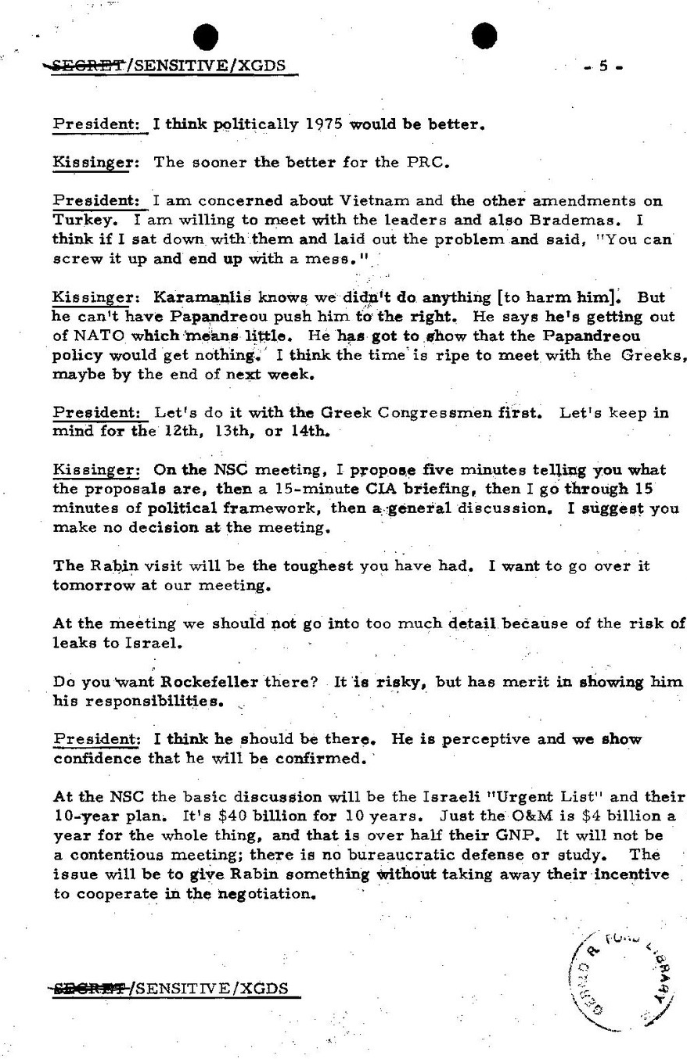
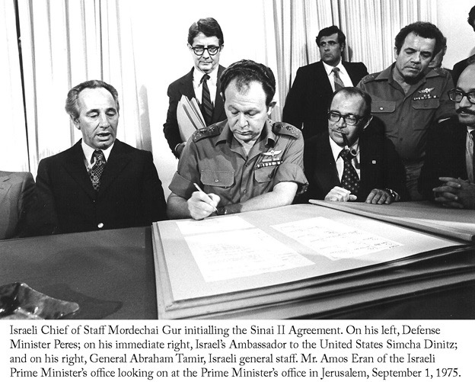
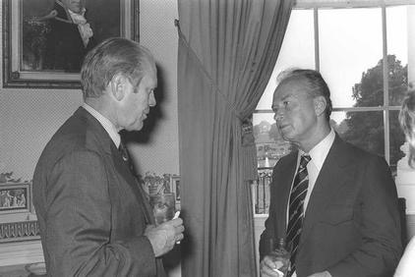

Slide 5
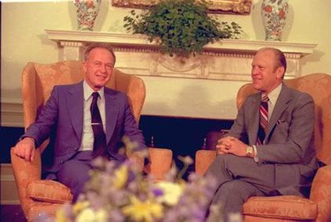
Friendships
Personality
Shared vision
Values

Slide 6
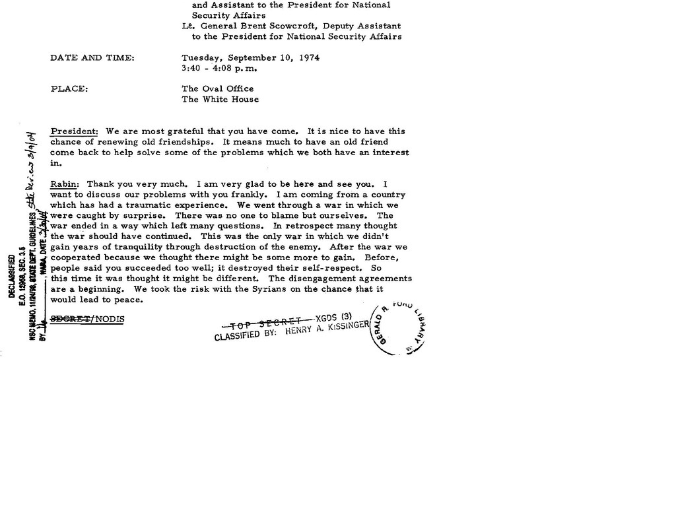

Slide 7
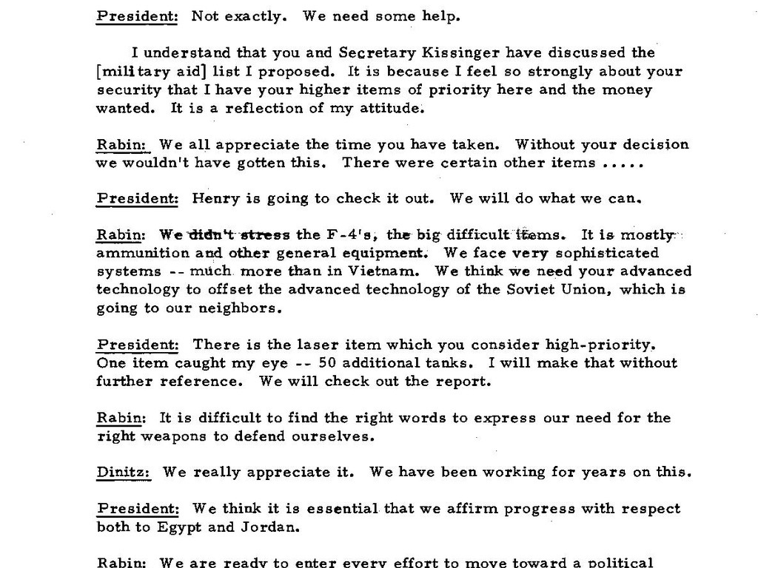

Slide 8
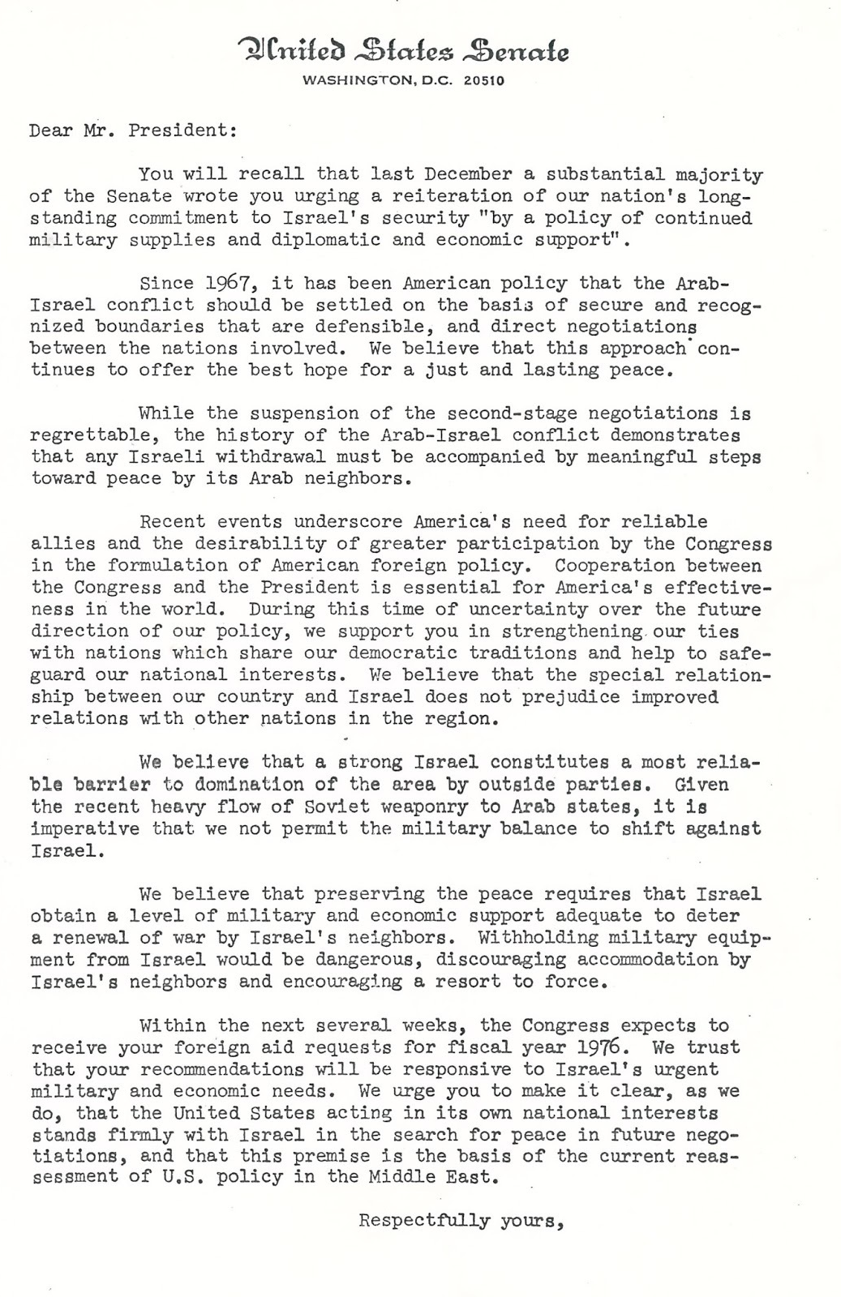
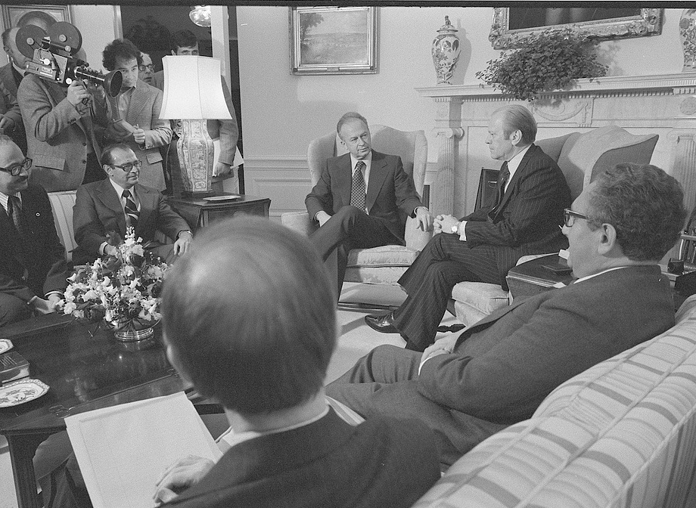
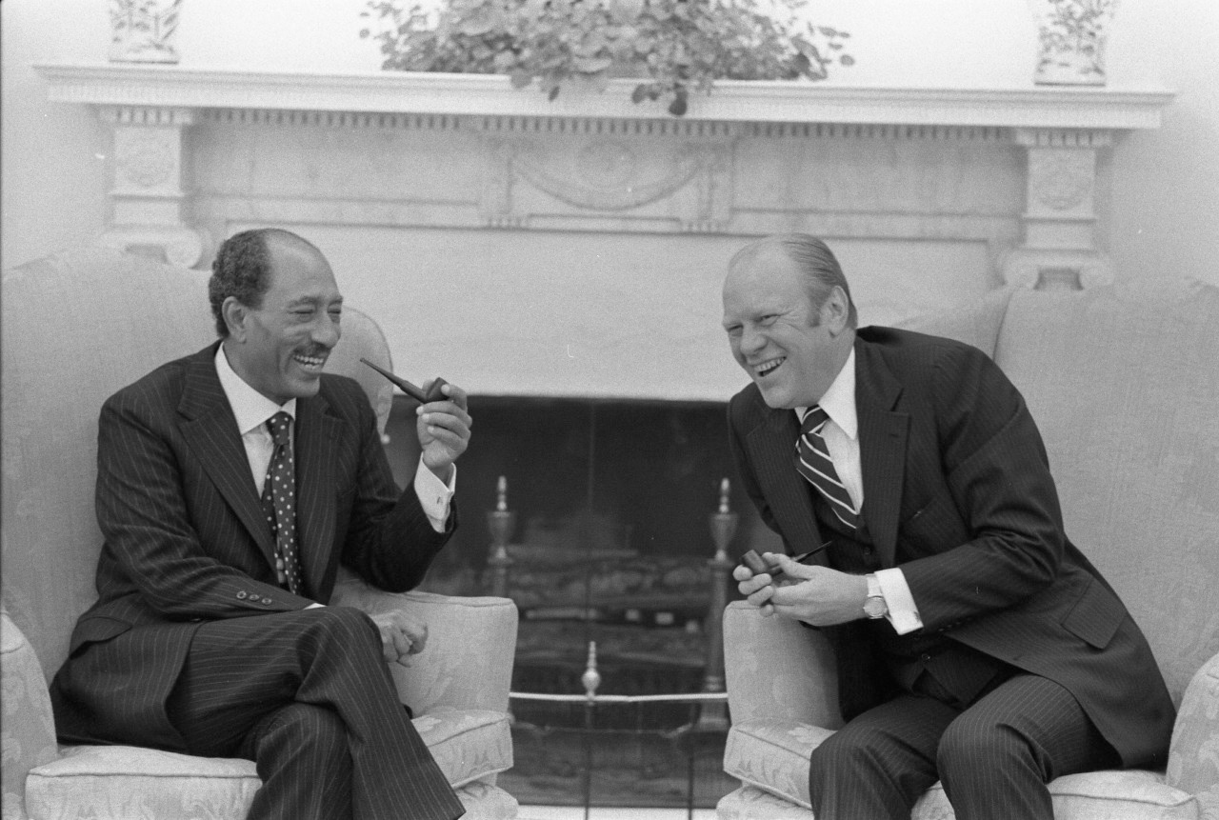

Slide 9
Principle Actors
Neoclassical Realism

Slide 10
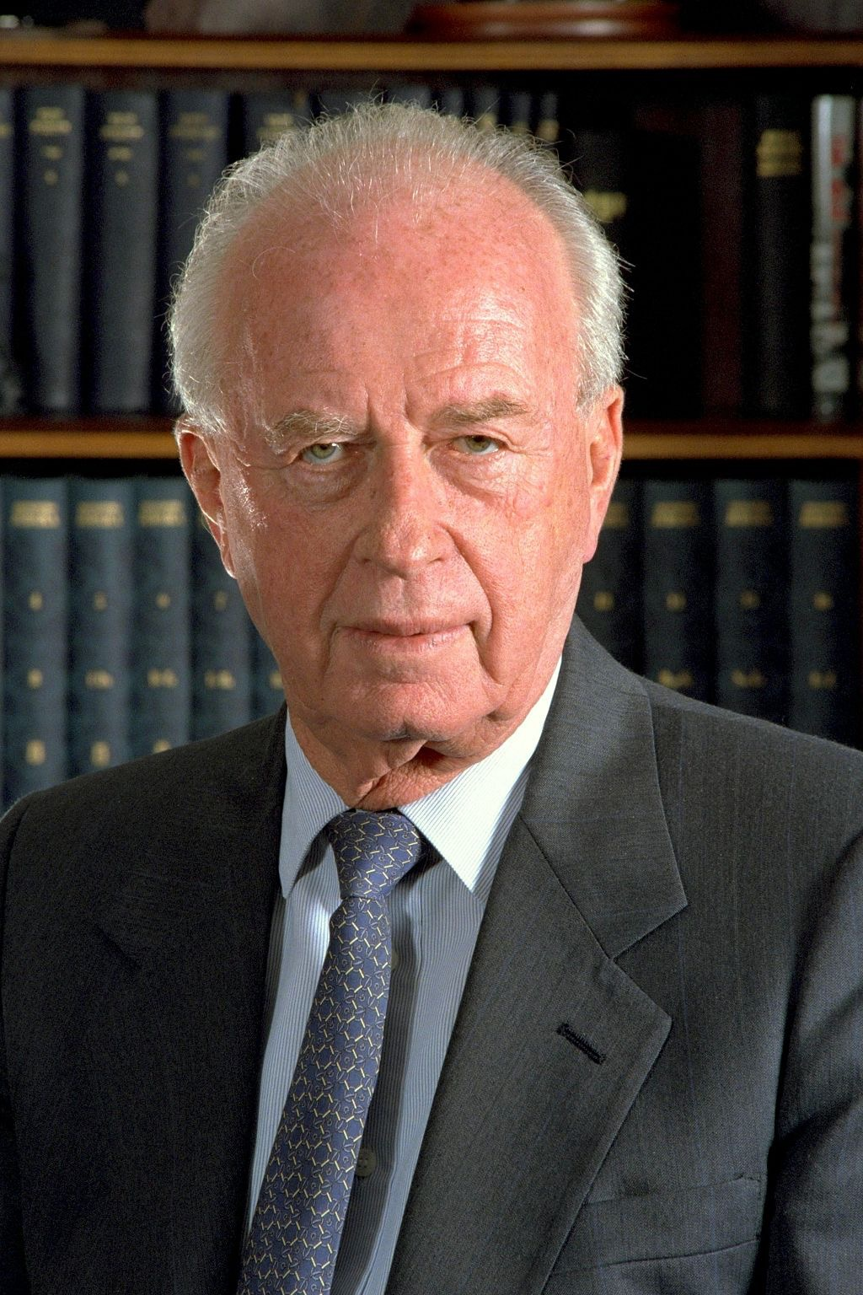
Y. Rabin
Fmr. Haganah and IDF officer
Fmr. U.S. Ambassador
Fmr. Israeli General (1967)
Israeli PM from 3 June 1974 – 22 April 1977

Slide 11
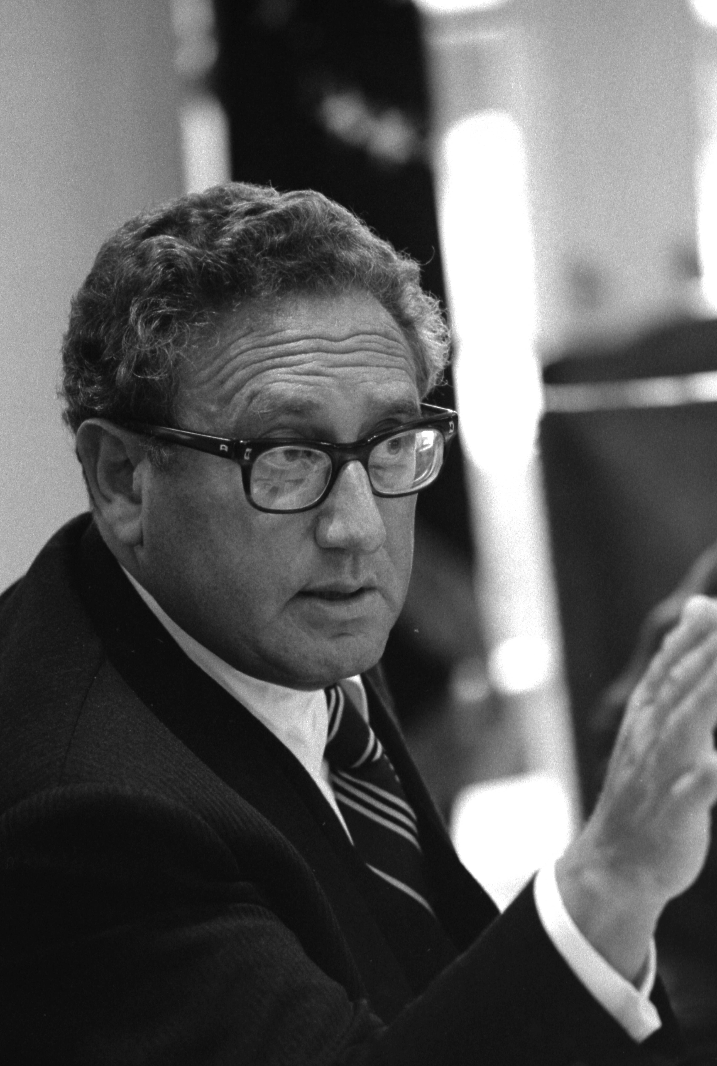
H. Kissinger
Prominent person in United States foreign policy between 1969 and 1977.
Strategist-Realist
Diplomat, respected statesman

Slide 12
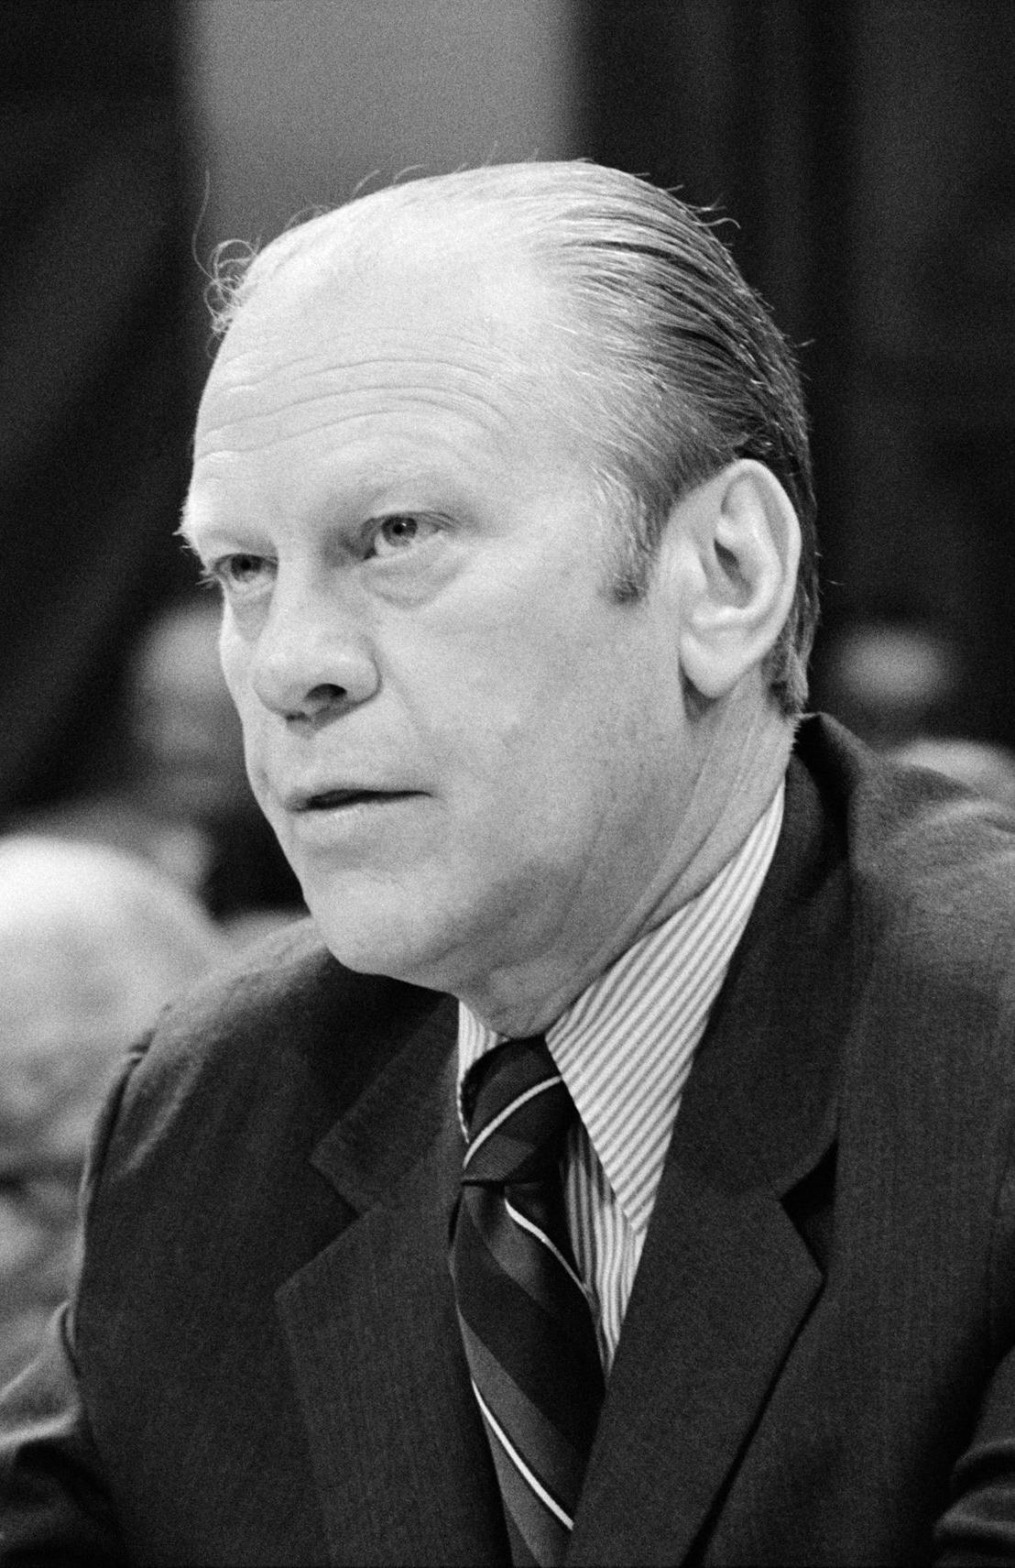
G. Ford
38th President (1974-1977)
Fmr. Vice-President
Fmr. Majority Leader
Fmr. Michigan Congressman

Slide 13
Background
Much of the 1975 reassessment period rests in the basic misunderstandings of personality and interpretation of national politics
President Ford, his Secretary of State Henry Kissinger and Yitzhak Rabin each tried to mold the political culture and influence each other in the process.
Besides the misunderstanding there is a sense that “reassessment” was an expression of frustration over Kissinger’s failure after his previous "diplomatic dialogues" were viewed as initial achievements in Arab-Israeli relations.

Slide 14
Background 1974
By the beginning of 1974, after the October 1973 war, the Israelis and Egyptians had been engaged in negotiations over the Sinai where Israeli troops had remained.
Egyptian President Sadat demanded that Israel withdraw from the critical Giddi and Mitla passes and the Um Hashiba alert station overlooking them in the Sinai.
Rabin was willing to withdraw from significant portions of the Sinai won in 1967 and defended in 1973 in return for a non-belligerency agreement. But Sadat was willing to offer only “non-use of force,” not a peace treaty, and Rabin was unwilling to relinquish the strategic passes for such a tepid guarantee.
Even so, he was ready to allow the Egyptians to advance to forward positions at the western entrances to the passes, and to give up the Abu Rodeis oil fields.

Slide 15
Background 1974
The Americans, as records of discussions between Kissinger and Ford show, support Sadat’s position.
That fact was what made the agreement in January 1974 so promising. It had assurances between the Israelis and Egyptians that if built upon, would demonstrate a corner had been turned in the Middle East in defiance of obstacles and was moving towards a final peace.
Thus, when the diplomatic efforts collapsed in October of 1974 it was so disappointing and served as an opening footnote to the reassessment period between the U.S. and Israel.

Slide 16
Background 1975
During March, 1975 the attempt to create a Sinai II with Egypt by convincing Rabin to withdraw from the Sinai mountain passes of Gidi and Mitla, was rejected.
The Middle East shuttle diplomacy that was so famed in producing the Egyptian-Israeli accord of 1974 and had potential for peace with other neighbors such as Jordan and Syria, hit a roadblock in the new Israeli government.
Prime Minister Yitzhak Rabin, according to a condescending Kissinger “went shivering in fear” every time Jordan was mentioned during previous meetings. Now, according to Kissinger, “Israeli actions had imposed on us a risk to our entire Middle East strategy making reassessment unavoidable.” The term, according to Kissinger, was part of a leak after Rabin had shared a letter written from Ford, to his cabinet.

Slide 17
National Security
To Prime Minister Rabin, and consequently to Israeli leaders since 1975, the dilemma is one not of absolutes, but rather balance “between security conceived as a military balance and security including a political and psychological component” (Kissinger)
national security is based upon defensible borders (Walter)
  buffer zones (Sinai, Golan) aka defensible borders
  peace treaties (Egypt and Jordan) recognized Israeli borders and most important ‘right’ to exist

Slide 18
Reassessment
Kissinger indicates Israeli’s used term first
Public records have President Ford using word first
Kissinger’s own biographers and autography indicates a mixed answer.

Slide 19
Opinion
“Rabin had, I many ways, the most difficult role to play. Rabin had more at stake than Ford and was far less in control of his domestic situation than Sadat, and above all, that his country’s margin of survival was by far the narrowest of any of the participants in the peace process. Battered by his domestic opposition, assailed by competitors for leadership within his cabinet, press by his American allies to move faster, Rabin held to his determination to bring about some progress toward peace and not simply a new military arrangement”
Kissinger, Years of Renewal, pg. 458.

Slide 20
Opinion
As to Rabin’s sentiment toward Kissinger, Rabin said, “though personal feelings are not preferred tools for managing an international negotiation that is both rigid and demanding, I still had a special regard for this unusual man. He felt that he was working for the benefit of Israel, even when we had doubts about it.”
Rabin, Memoirs, pg. 258; Golan,Secret Conversations of Henry Kissinger, pg. 241.

Slide 21
Reassessment
Therefore, Reassessment ushered in a tense phase in American-Israeli relations.
On one level, it stated a truism: “whatever the label, the failure of the shuttle obliged us to take another look at our Middle East diplomacy”.
At the same time, “the term could be read to imply that the basic relationship with Israel was up for review---which was not the American intention.” (Kissinger, Years of Renewal, pg. 424).
Regardless of intention the ensuing row began in earnest in March, immediately following the time that Kissinger had visited with Rabin. When Kissinger talked to President Ford laying the blame on the Israelis.

Slide 22
Reassessment
Ford saw the negotiations as part of the final deal; meanwhile the approach by the Israeli Prime Minister was decidedly short term.
The March negotiations were allowed to collapse, because of Rabin’s “belief that these could and would be picked up again before long without any undue damage and possibly with important benefits,” though the situation after March 22 showed the U.S. present a behavior that “castigated and penalized Israel and praised and supported” the Egyptian position causing the possibility of a further round of negotiations to be undercut, which meant that Rabin was give the position of seeking a limited agreement, “in favor another approach, or else of modifying what they wanted to achieve from a limited agreement in the light of what was possible.” (Safran, Israel: The Embattled Ally, pg. 552)
Unable to find a compromise, stalemate ensued

Slide 23
Timeline
March
April
June
July
September

Slide 24
Conclusion
Reassessment often took several forms, the most important of which was restriction of arms supply and suspension of consideration of economic assistance.
“The United States had often used this kind of informal sanction in the past to induce Israel to take some specific action; this time, however, the sanction appeared to be almost purely vindictive since it came after the fact. Moreover, the action was particularly painful and potentially damaging to American-Israeli relations because it came only a short time after Kissinger had committed the United States to increased and more regular military assistance to Israel in connection with the conclusion of the first Egyptian agreement…”
Safran, N. (1981). Israel: The Embattled Ally, pgs. 548-549.

Slide 25
Conclusion
Since the review of concepts and policy was necessary, one may claim, normal, part of policy making (late 1974, early 1975) there then was little significance of declaring a reassessment.
However, since Kissinger most likely needed time to reconsider available options and seek advice from President Ford, the unfolding “test of wills” as Ford mentions in his memoirs was meant to serve, “the purposes of gaining time and putting psychological pressure on Israel to soften it up for whatever next move might be made” Safran, N. (1981). Israel: The Embattled Ally, pgs. 548-549.

Slide 26
Conclusion
It did not require the theatrics, leaked information, stories, the articles, and advice seeking of scholars.
However, this episode offers a prologue to the kind of personal relationships Israeli and American leaders would experience in the decades since and nowadays the standard tactics utilized to influence each.
In fact, involvement of partisan politicos, long-hours of negotiations often conducted to maximize personal strengths and egos at the detriment of other parties has become the standard operational procedures in the alliance between the United States and Israel.

Slide 27
Conclusion
The Sinai II agreement was finally initialed on September 1, 1975.
“Sadat promised not to join a war if Syria attacked Israel, while Israel assured Egypt that Israel would not attack Syria and the U.S. agreed to a commitment not to deal with the PLO until it recognized Israel’s right to exist and accepted Security Council Resolution 242 and 338.”
Egypt turned towards a separate peace with Israel. When the historic Camp David Accords were signed between Egypt and Israel in 1979 the wars between Israel and an Arab neighbor since 1948 finally ended. The agreement also highlighted the importance of the Israeli-American relationship, in particular that between the chief executives.

Slide 28
Legacy
Sinai II Agreement allowed several things to occur.
Prime Minister Rabin closed “the hectic diplomatic movements triggered by the Yom Kipper War,” (Avner, The Prime Ministers pg. 286) and touched upon Israeli yearning for peace in his telephone call with Ford, “we really hope that it will be the beginning of something which we have not yet experienced in this area, and we hope that the other side, the Egyptian side, feels the same.”
Sadat generously spoke along similar nonbelligerent lines: “Let us create a new atmosphere…and let us reach the state of non-belligerency officially and with guarantees” ( Kissinger, Years of Renewal, pg. 454).
And in the highest praise possible from an aged diplomat on a former Israeli leader, Kissinger wrote, “Rabin was a significant strategist. His gradualist approach moved his fractious cabinet and wary public to the breakthrough that made the Camp David Accords of 1978 possible.” (Kissinger, Years of Renewal. pg. 458).

Slide 29
Legacy
President Ford served as the moral guarantor of Egyptian and Israeli assurances to each other.
Sadat took the decisive turn not only towards non-belligerency, but a turn away from the Soviet Union. Simply, he was tired of war and tired by Soviet promises.
For Rabin, his role in the Sinai II agreement was possibly the most difficult. His abrasive style reflected the reality of his domestic situation. He had to “pace his own fragile political base” (Kissinger, Years of Renewal. pg. 458) while holding onto his determination to bring progress towards peace.
As Kissinger writes, “had he moved too quickly, his cabinet would have fallen apart, and new elections would have had to be held; had he moved more slowly, he would have risked the American alliance” (Kissinger, Years of Renewal. pg. 458).
Rabin was a strategist and was successful in moving, through his gradualist approach, his fractious cabinet and wary public to peace.

Slide 30
Legacy
It was a security alliance in all but name, as Richard Valerian of NBC News quipped, “the best agreement money could buy” (Brinkley, Gerald R. Ford, pg. 117).
The Knesset ratified the Sinai II agreement on September 3, 1975, paving the way for the eventual peace treaty with Egypt in 1979—and transforming the U.S.-Israel relationship for all time.
However, just how it has been transformed is still very much open to discussion.
As Haaretz reported then, Israel used American desire for peace to ‘squeeze’ further aid thereby achieving the strategic goals Rabin and his Cabinet had held before the reassessment period took place.
The Americans used Israel and Egypt to block creeping influence of the Soviet Union in the region. And the reassessment period showed the cracks that have grown larger over the decades as American presidents and Israeli prime ministers have each tried to influence the other using public and private means.

Slide 31
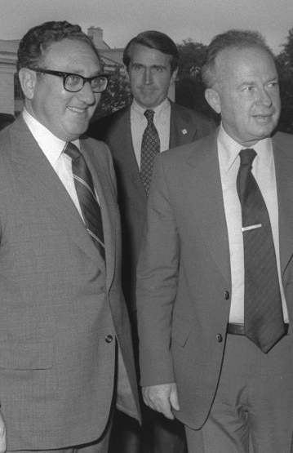
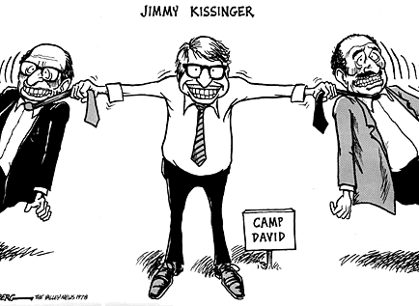

Slide 32
Readings
Yehuda Avner. (2010). The Prime Ministers: An Intimate Narrative of Israeli Leaders. The Toby Press.
Walter Isaacson. (2005). Kissinger: A Biography. Simon & Schuster.
Henry Kissinger. (1999). Years of Renewal. Simon & Schuster.
Dan Kurzman. (1998). Soldier of Peace: The Life of Yitzhak Rabin. Harper.
Nadan Safran (1978). Israel-The Embattled Ally. Belknap Press.

Slide 33
Readings
Berman & Sadot, (2012, April). “Israel & America: The Eternal Return”. Commentary. Retrieved from: http://www.commentarymagazine.com/article/israel-america-the-eternal-return/
Haaretz. (2006, December 28). Gerald Ford, the U.S. president who reassessed policy toward Israel, dies at 93. Retrieved from: http://www.haaretz.com/print-edition/news/gerald-ford-the-u-s-president-who-reassessed-policy-toward-israel-dies-at-93-1.208477)
Preston, T. & Hermann, M., “Presidential Leadership Style and the Foreign Policy Advisory Process,” in Wittkpf, E. & McCormick, J. (2004). The Domestic Sources of American Foreign Policy. Rowman & Littlefield.

