Slide 1
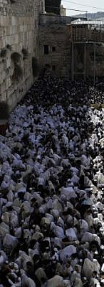
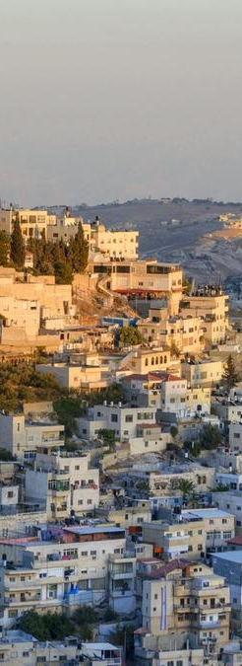
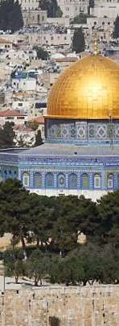
Peace Solution
MVZ244 • Exercise

Slide 2
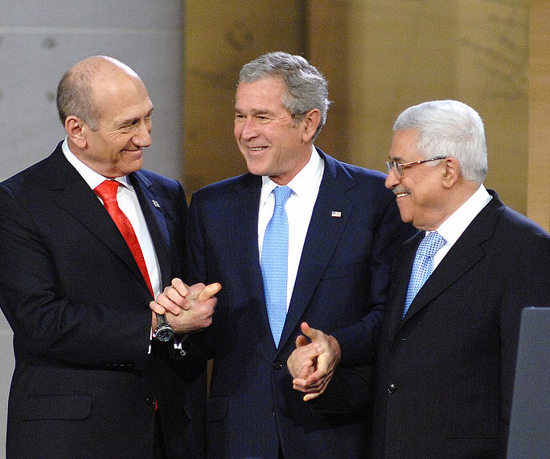
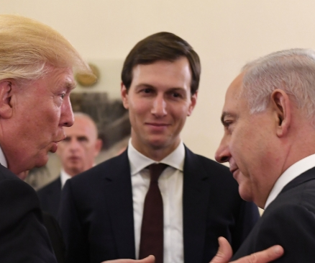
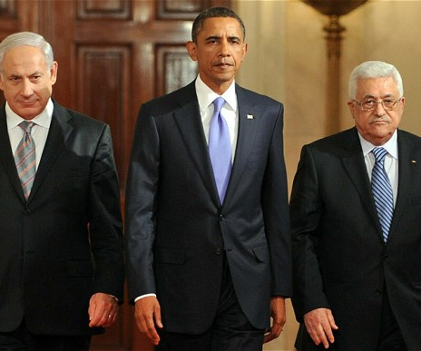

Slide 3
Current Challenges of Israeli-Palestinian Peace
Jerusalem
‘Right of Return’
Borders (Green/Blue/Black lines)
Gaza (Hamas & Islamic Jihad) + PA payments to martyrs
Water
Settlements
Corruption (PA and Hamas leaders)

Slide 4
3 Challenges and 3 Solutions
What are the three (3) challenges between Palestinian and Israeli negotiations?
List them
Develop a plan to solve these challenges
There is no ‘correct’ or ‘wrong’ ONLY Possible :-)

