Slide 1
The Cold War in Asia

Slide 2
Housekeeping
QUIZ:
PAPER
READING

Slide 3
THIS WEEK
THE SUEZ CRISIS
ASIA AFTER THE WAR
JAPAN
KOREA
VIETNAM
CHINA: Different Kind of Communism
100 Years of Humiliation
Communists and Nationalists
Mao’s Permanent Revolution

Slide 4
The Crisis in Suez: Background
The Suez Canal: Finished in 1869 by British
Key waterway connecting Indian Ocean and Mediterranean Sea
Gamel Abdel Nasser heads Egypt as Arab Nationalist
Looks to Soviet model for industrial development
Confrontation towards former imperialist countries
Stalin/Molotov ignores him
Khrushchev begins to court him in 1955 with arms sales, help with Aswan Dam

Slide 5
The Crisis Unfolds
July, 1956: Nasser nationalizes Suez Canal
October 26-28: Israel, Britain and France attack Egypt
October 30: US and USSR join in criticizing attack at UN
Eisenhower threatens economic sanctions, in particular selling British pounds, resulting in devaluation
Soviets threaten military action: Soviet volunteers, nuclear retaliation
Israel, Britain and France stop the attack
Khrushchev’s lesson: Nuclear threats work

Slide 6
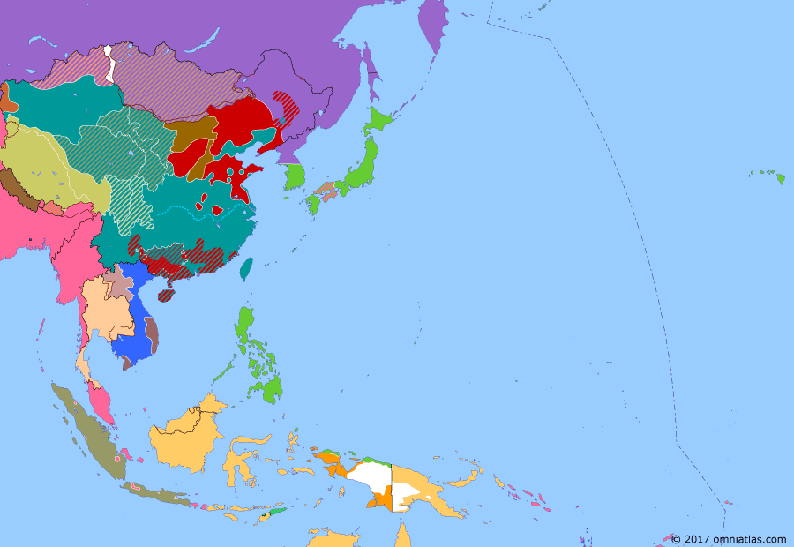
Asia after the War
The Reach of Japan
Civil wars in China, Southeast Asia
Soviet Union agrees to join war against Japan at Yalta
Soviet Union given control of Kurile Islands, Korea north of 38th parallel
Soviet Union gets economic advantages in Manchuria
Soviet Union Invades Manchuria, North Korea on August 9
Places communists in charge of Manchuria, North Korea
But US occupies South Korea, Japan, keeps rejects Kurile Island deal
With cold war, US reverses plans for Japanese occupation to allow rapid recovery
Vietnam: Ho Chi Minh fights Japanese, ties to communists but looks to United States
US decides to support France, which wants Indochina back
1942
1946

Slide 7
The Communists in China’s Civil War
China’s “100 Years of Humiliation”
The Republic of China—1912
Cooperation between Nationalists and Communists,1921-1927
Comparing the revolutions in China and the Soviet Union
The Bolshevik Revolution: a rapid coup d’etat, relatively few Bolshevik party members, no experience in government, civil war after holding power
The Chinese Communist Revolution: civil war lasting 21 years before gaining power, administered large territories, many party members
Chinese Revolution more nationalist, peasant-based, practical

Slide 8
Mao’s Vision of Communism
Mao looks more to peasant population than workers
More “voluntarist”: Believes human will can overcome material
constraints
Mao indicates notion of “permanent revolution”
Revolution not only struggle against external enemies
Also internal struggle
Struggle against bureaucracy
Land Reform, Collectivization, Hundred Flowers, the Three antis, the Great Leap Forward, the Cultural Revolution

Slide 9
The United States and Communist China
During the war, US actively supported Nationalist Chinese
Roosevelt pushes for China seat on UN Security Council
1949: Truman refuses to intervene to save Nationalists in 1949
Victory of Communists has huge result on US domestic politics
“The China Lobby” and a purge of Asianists in State Dept.
US refuses to recognize Chinese government until 1979
Provides promises support to Taiwan in 1950

Slide 10
Stalin and Mao
Stalin skeptical of Mao and Chinese Communist Party
Early on, Moscow had opposed Mao’s guerrilla war in the countryside in favor of strategy focused on cities
in 1945, Stalin signed a Friendship Treaty with Nationalists
During civil war, Stalin suggested Mao remain cautious
After civil war, Mao looks to Soviet Union as ally
“Lean to One Side”
Stalin suspects Mao of being another Tito: Mao suspects Stalin of Great
power chauvinism
1949: Mao waits for a month before an audience
Stalin maintains advantages in Manchuria
1950: Korean War (Which Mao embraces)

Slide 11
The Basic Problem:
Two Different Stages of Revolution
China: The Revolutionary Stage:
Massive changes, must mobilize population, huge campaigns,uses external enemies, “imperialism”, as a means to mobilize
Uses foreign policy as a means to mobilize: agressive
Soviet Union: “Mature” Post-Revolutionary Phase
Revolutionary changes already occurred
New Soviet elite interested in maintaining position
Gradual change rather than upheave
  More interested in Peaceful Coexistence rather than war

Slide 12
The Golden Age, 1954-1957
After Stalin dies, Khrushchev in charge of USSR-China
Offers more equal relationship
Changes Friendship Treaty so USSR no longer gets
special privileges
Offers large amount of economic assistance (7% of USSR
GDP)
Help with attaining atomic weapons
More status in consulting
WHY IS KHRUSHCHEV SO GENEROUS?
STILL, USSR still portrays itself as leader of communist movement
Mao is not impressed with Khrushchev’s theoretical vision

Slide 13
Destalinization and the
Beginning of Tension
Mao’s Response to Khrushchev’s Secret Speech
More negative than positive: why?
China gets involved in decisions about Eastern Europe
Defends Gomulka as national avenue to socialism
Argues for intervention in Hungary

Slide 14
Mao’s Brinksmanship and
Tension Escalates
Khrushchev wants to improve economy, Mao wants to transform it, coming up to Great Leap Forward
1957-1961: Soviet Union launches Sputnik; Khrushchev brags about nuclear capability
1958: USSR wants submarine bases in China; Mao considerate Great Power Chauvinism
Mao launches 2nd Taiwan Straits Crisis, Does not tell Soviets
Mao’s rhetoric on nuclear war escalates: “Paper Tiger”
1958: Khrushchev cancels nuclear help to China

Slide 15
Competition for Leader of
Communist Movement
1957: Two Communist giants going in two directions
USSR: rapid improvement in economy
China: Transformation of economy: Great Leap Forward
Mao believes USSR has lost revolutionary spirit, i
1957: USSR launches Sputnik, brags about capability
Khrushchev wants peaceful coexistence from position of equality, hopes to use nuclear capability to extract concession, but vows he doesn’t want war
1958 China begins 2nd Taiwan Straits crisis without telling USSR
Mao’s rhetoric suggests he doesn’t believe nuclear war would be the end
Soviet Union stops providing help with nuclear weapons

Slide 16
The Competition Continues
1959: Khrushchev visits US, brief easing of tensions
Mao privately accuses Khrushchev of favoring peace over socialism
The competition moves to Third World National Liberation movements: Khrushchev reluctant to help, says they can liberate selves, while demands more active support
1960: Khrushchev retracts aid from China
1962: China criticizes Khrushchev’s handling of Cuban Missile Crisis

Slide 17
The Open Feud
1963: The rift goes public
1968: Skirmish on border dispute on Amur River

