Slide 1
Managing collateral damage in PSOs, example of ISAF
Lucie Vernerová

Slide 2
Outline
ISAF
  Engagement of NATO
Collateral damage
  Definition
Case: Afghanistan
  Mission´s progress
  Collateral damage in Afghanistan

Slide 3
ISAF
The International Security Assistance Force (ISAF) is an operation led by the NATO whose primary mission is the support of the elected (post-Taliban) Afghan government
constructed to assist
August 11, 2003 – NATO the official lead organization
NATO was meant to be a solution to the complicated situation in Afghanistan
Become a big part of security problem
ISAF finished 2014
Afghanistan is not stable
Counterinsurgency was not eliminated

Slide 4
Collateral damage
Collateral damage during a war is the unintentional deaths and injuries of people who are not soldiers, and damage that is caused to their homes, hospitals, schools, etc.
In every mission you should try to keep it low
There are never perfect data of the collateral damage
What is considered as collateral damage differ
Collateral damage
  1) insurgents
  2) government force
  3) tool of intimidation e.g. genocide, mass killing
  4) resulting from war – death disease, starvation

Slide 5
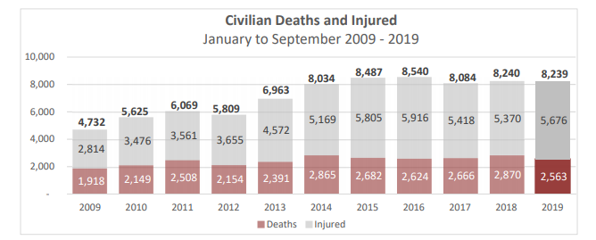
Resource: UNAMA report, 2019: https://unama.unmissions.org/sites/default/files/unama_protection_of_civilians_in_armed_conflict_-_3rd_quarter_update_2019.pdf

Slide 6
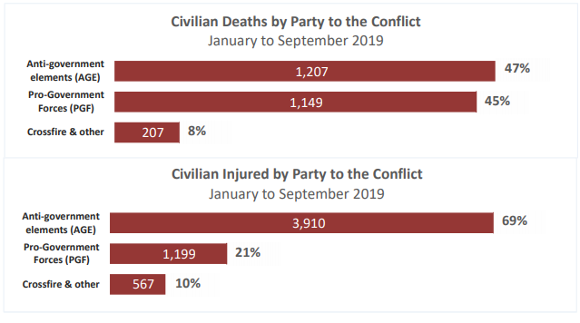
Resource: UNAMA report, 2019: https://unama.unmissions.org/sites/default/files/unama_protection_of_civilians_in_armed_conflict_-_3rd_quarter_update_2019.pdf

Slide 7
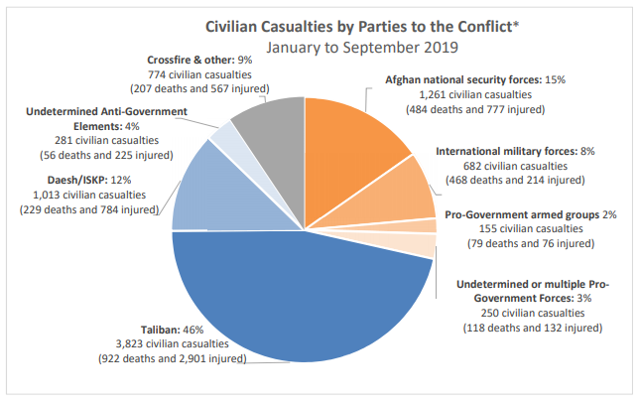
Resource: UNAMA report, 2019: https://unama.unmissions.org/sites/default/files/unama_protection_of_civilians_in_armed_conflict_-_3rd_quarter_update_2019.pdf

Slide 8
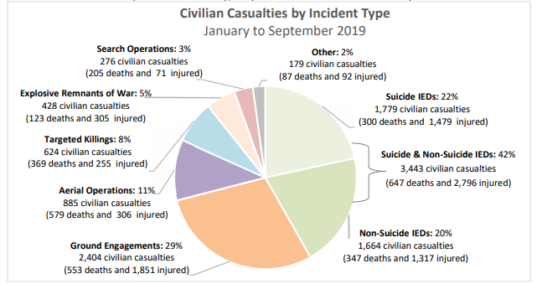
Resource: UNAMA report, 2019: https://unama.unmissions.org/sites/default/files/unama_protection_of_civilians_in_armed_conflict_-_3rd_quarter_update_2019.pdf

Slide 9
Case: Afghanistan
The goal of PSO in Afghanistan was to protect civilians during the military offence
The key to successful mission was winning hearts and minds of Afghanistan population
NATO had suffered from great dilemma
Around 2008 – change of the strategy of this mission
the conflict will be won by persuading the population, NOT destroying the enemy
Why is it so important to keep the number low?
    the revenge way of thinking

Slide 10
Managing the collateral damage
Building relations with the local people
helping them to reconstruct their own state
let the Afghanistan people to solve the Afghan problem
To get people involve as active participants in their communities
creating new viable local alternatives to insurgencies
be a positive force
to employ young men
Provincial reconstruction teams (PRT)

Slide 11
Recent development
2010 – troops started to leave Afghanistan
BUT 2015 – TALIBAN started to regain its lost position
  Only 70% of the state was under control of the government
The number of the death civilians in 2019 is one of the highest (2,563)
2019 Peace agreement ? (USA and Taliban)
Time for American soldiers to withdraw?
Would Taliban use this opportunity for the reincarnation of its power?

Slide 12
Conclusion
keep the number of collateral damage low
without support of local people and their trust the mission has hardly any chance to be successful
Due to the high number of collateral damage, it does not seem that the situation in Afghanistan would get better

Slide 13
Thank you for your attention

