Slide 1

New players in peacekeeping operations
Crisis Management Operations
Suzanne Otten 22-10-2019

Slide 2
Content
Traditional contributors
  Personnel
  Financial
Modern contributors
  Personnel
  Financial
BRICS
China
  How?
  Why?

Slide 3
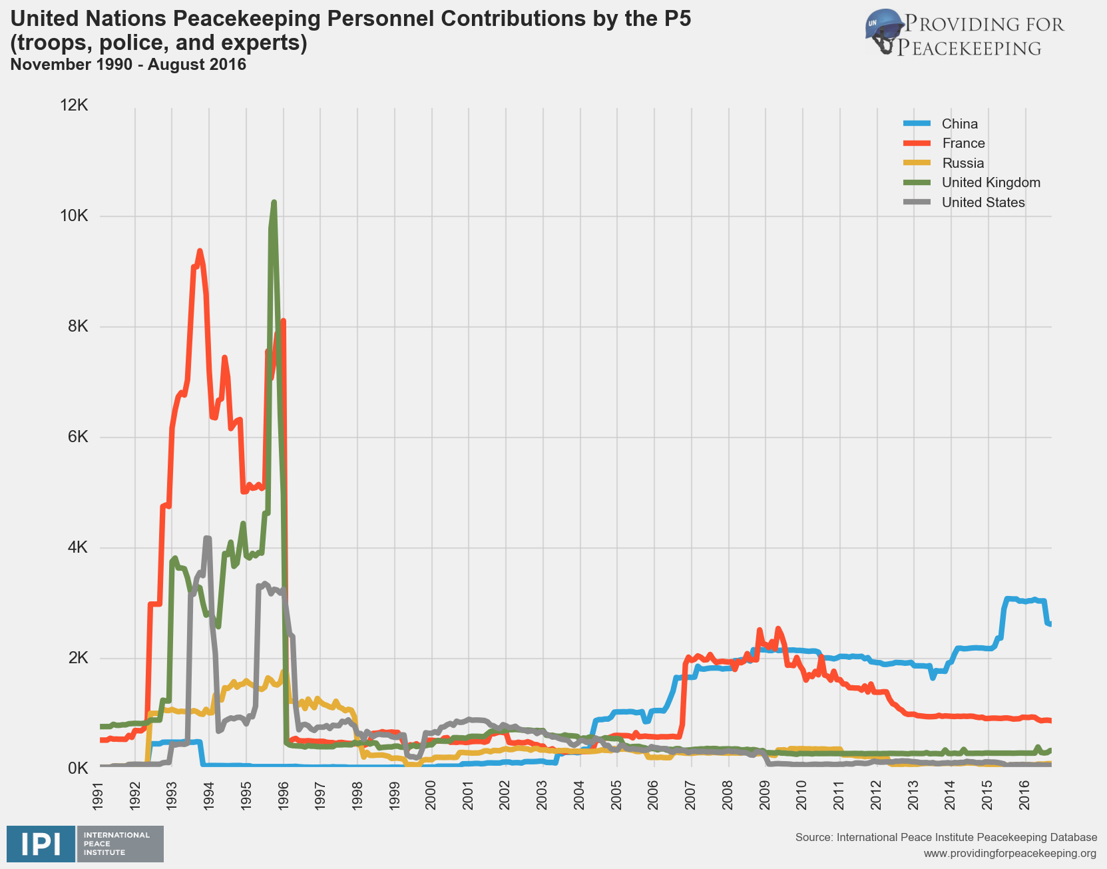
Traditional contributors- Personnel

Slide 4
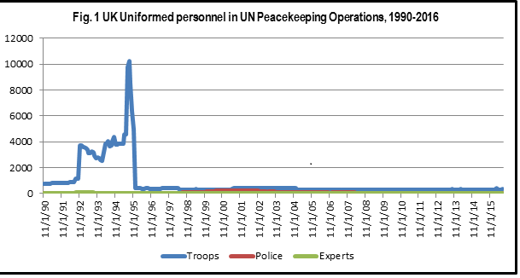
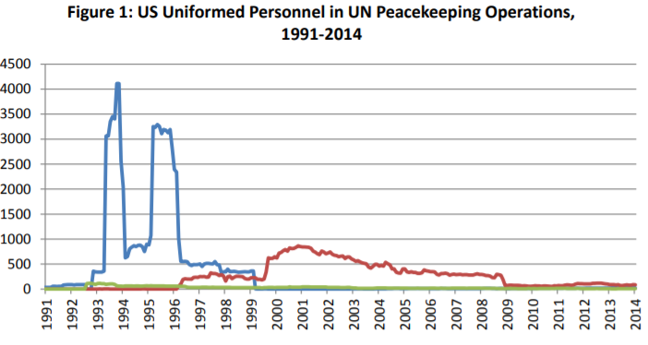
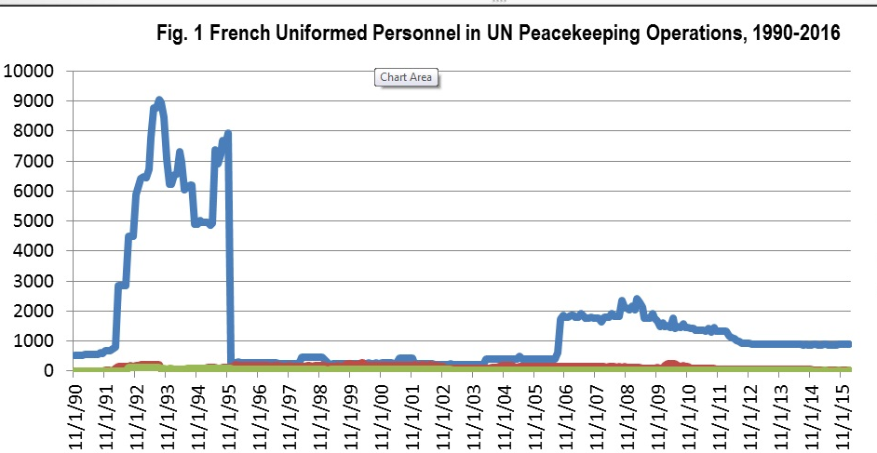
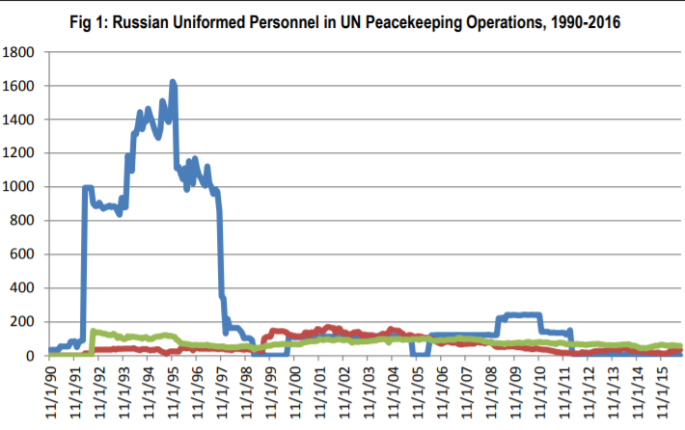

Slide 5
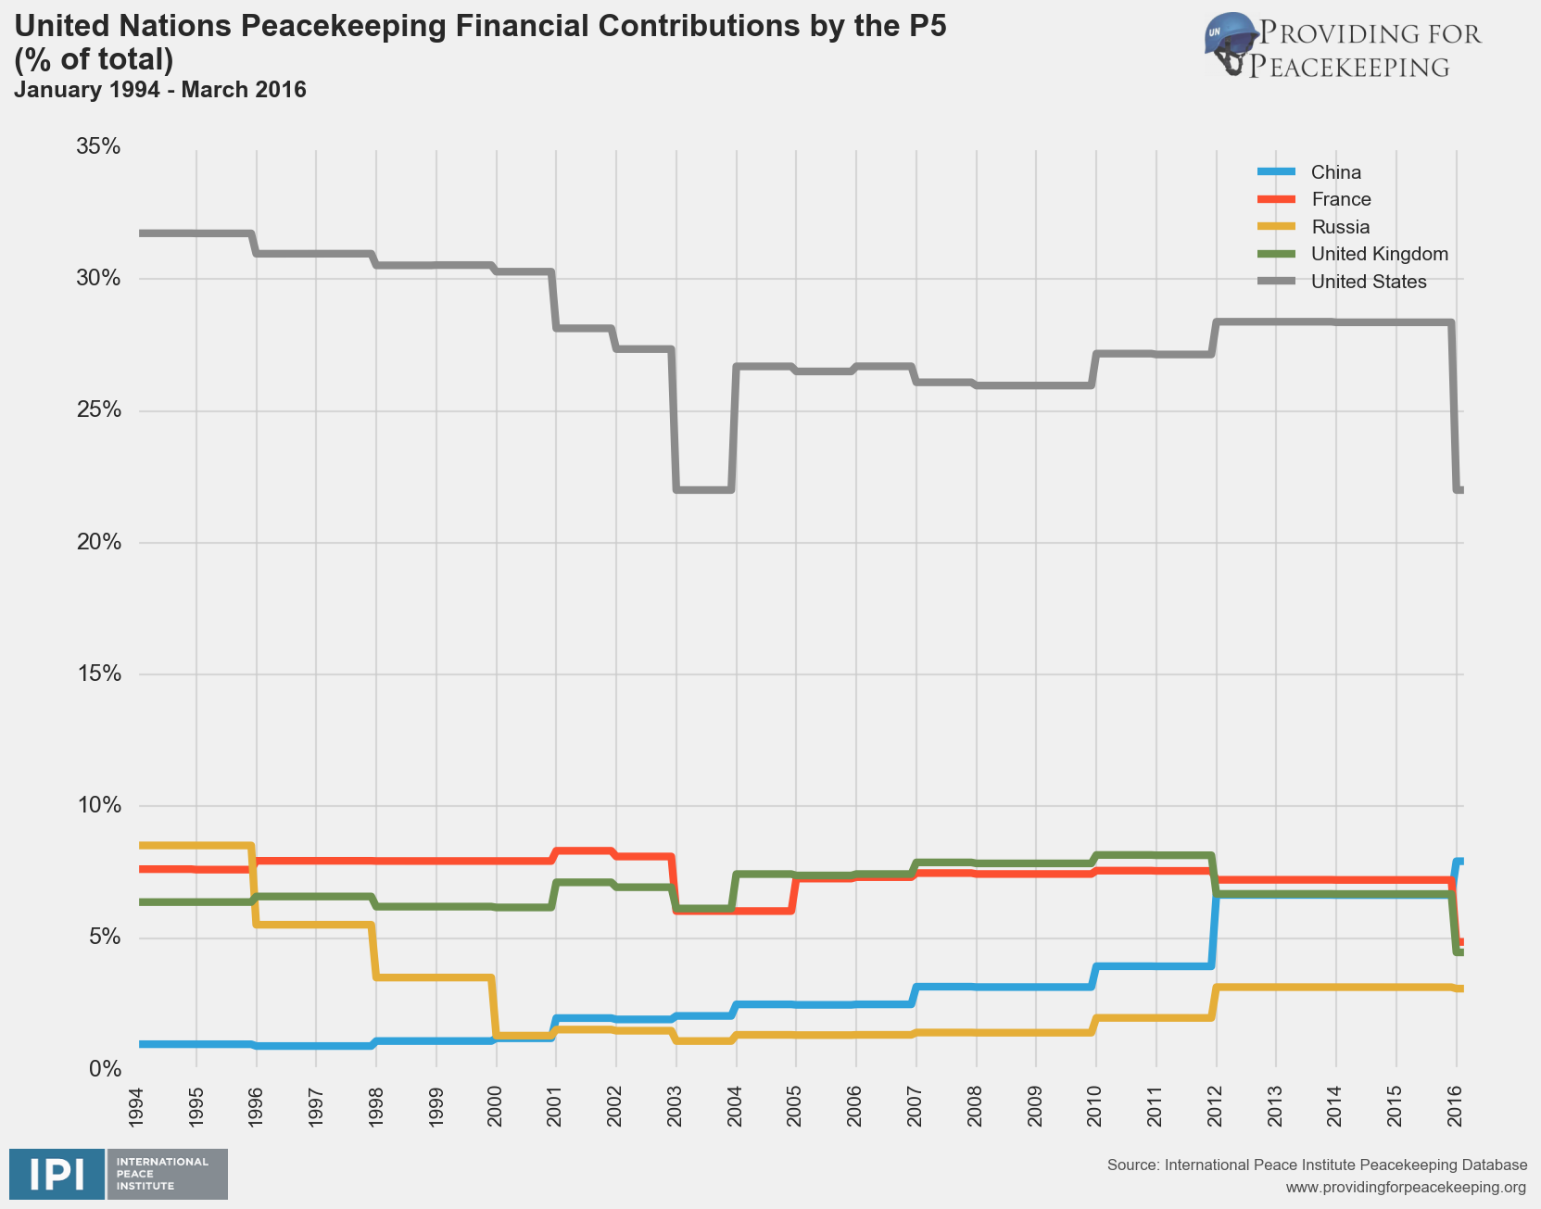
Traditional contributors - Financial

Slide 6
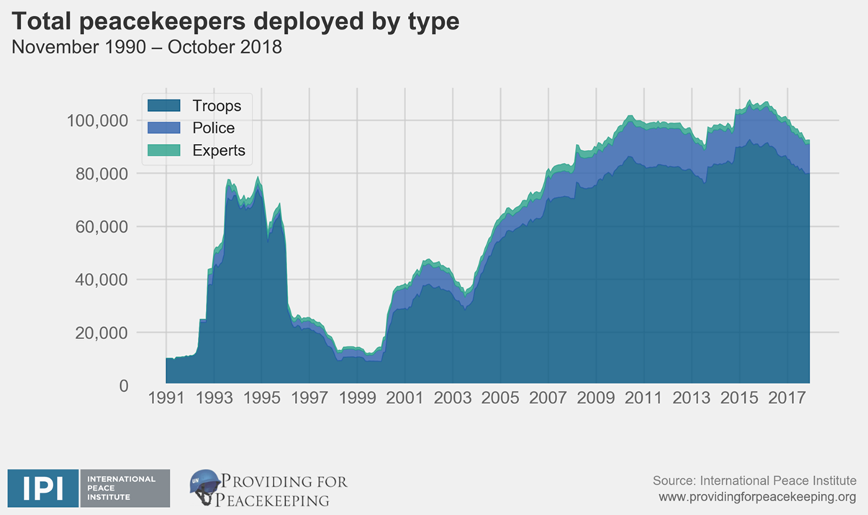
Modern contributors

Slide 7
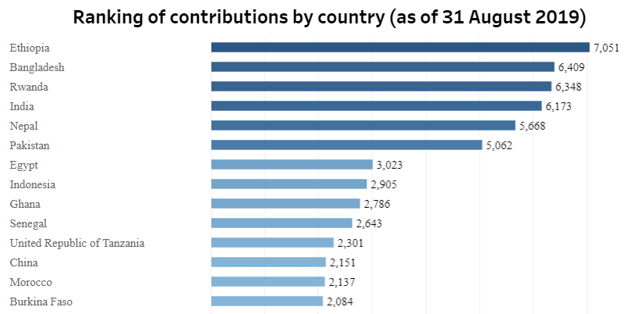
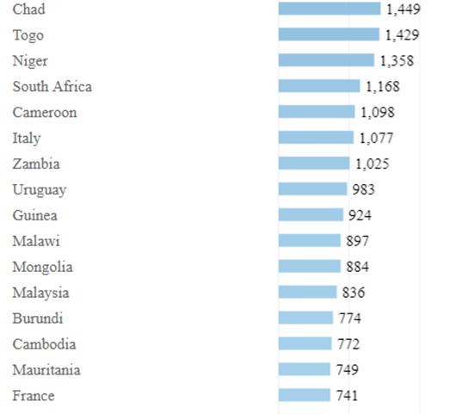
Modern contributors - Personnel

Slide 8
Modern contributors - Financial
United States (27.89%)
China (15.21%)
Japan (8.56%)
Germany (6.09%)
United Kingdom (5.79%)
France (5.61%)
Italy (3.30%)
Russian Federation (3.04%)
Canada (2.73%)
Republic of Korea (2.26%)

Slide 9
BRICS
Brazil, Russia, India, China and South Africa
2006
Prevent Western domination
12% of the personnel - India
15% of the funding - China

Slide 10

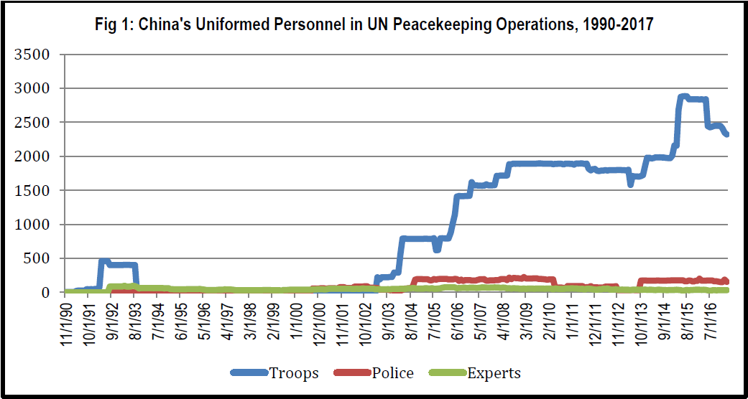
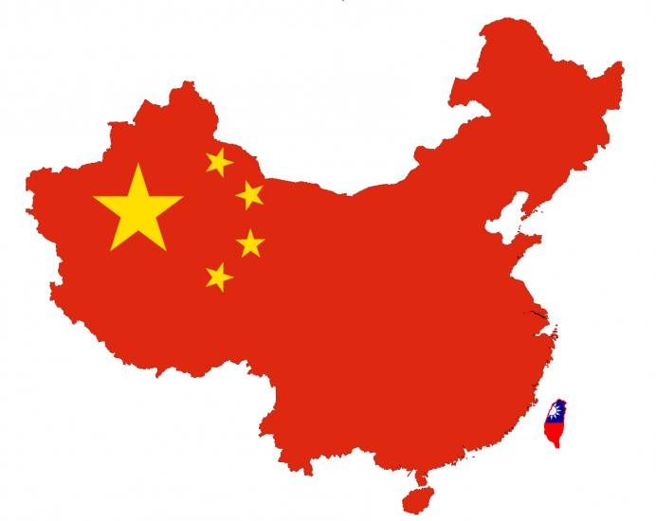
China

Slide 11
China – How?
Isolationism and detachment
Foreign policy lacked international engagement and participation in multilateral organizations
National identity has transformed since 1971
Semi-revolutionary state (70s) → Integrated member international community (80s/90s) → Rising power.
First military peacekeeping operation = 1990
First major peacekeeping operation = 1992.

Slide 12
China – Why?
Improve reputation
Exploit more resources
Increasing and strengthening trade
Result increased integration
Increased leadership
Correlation increase troops and decrease death tolls

Slide 13
Questions?

