Slide 1
New mode of interaction with outside un force cooperation – story of the regional protection force in south Sudan
Crisis Management Operation
Natalia Naboyshchikova
29.10.2019

Slide 2
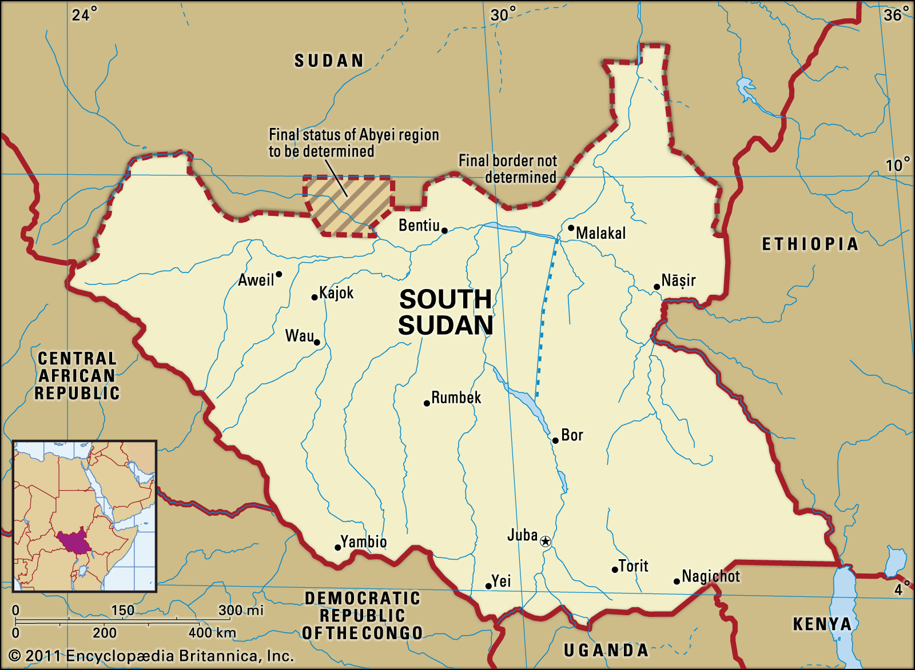

Slide 3

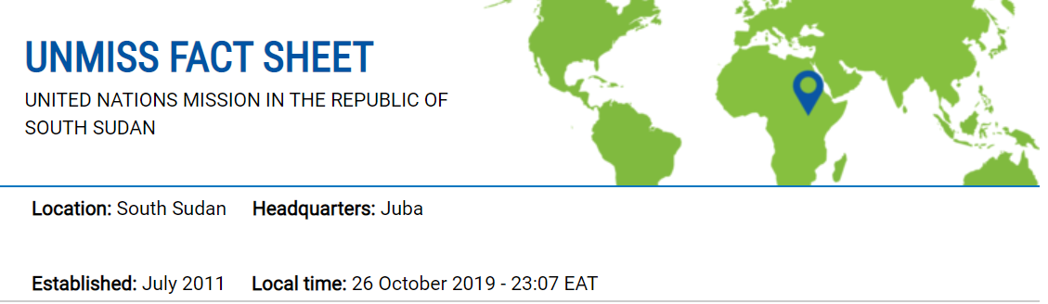
U.N. Mission in South Sudan (UNMISS)
The main aims of UNMISS is to consolidate peace and security and promote development in the Republic of South Sudan in order to strengthen the capacity of the Government of South Sudan to govern effectively and democratically and establish good relations with its neighbours.
Source: UN Peacekeeping https://peacekeeping.un.org/en/mission/unmiss

Slide 4
Unmiss mandate
Protect civilians under threat of physical violence
Deter violence against civilians
Implement a Mission-wide early warning strategy
Maintain public safety and security in regards to PoC sites
Exercise good offices, confidence building and facilitation” in regards to its protection strategy
Foster a secure environment for the eventual safe and voluntary return of (IDPs) and refugees

Slide 5
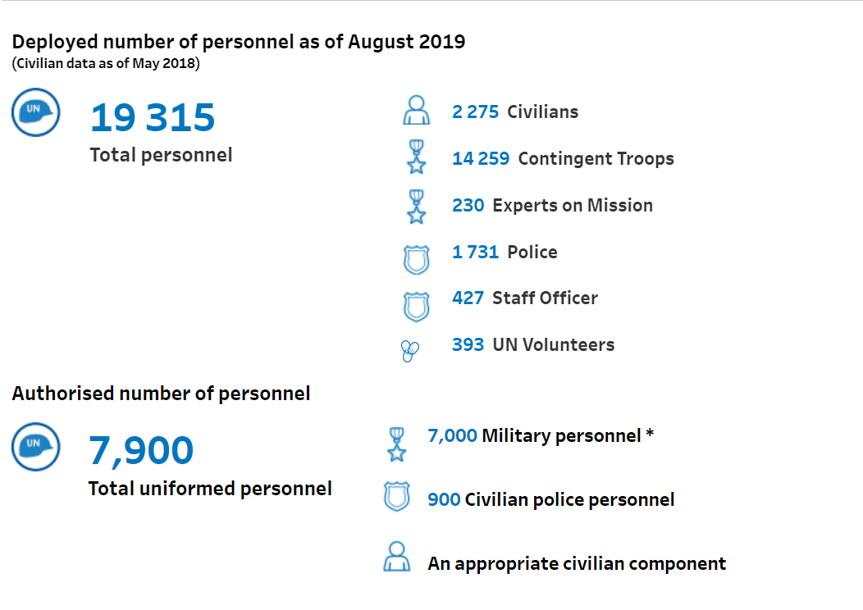
Strength

Slide 6
Crisis in South Sudan
Civil war in December 2013 was escalated and violence erupted between forces loyal to President Kiir, the ethnic Dinka
Armed conflict between the opposing armies and their allied military groups continued throughout 2014 and 2015
On 15 December 2013, violence broke out in Juba and spread later to to other parts of the country
Seven of the country's 10 states were affected by the conflict, with Central Equatoria, Jonglei, Lakes, Unity and Upper Nile states

Slide 7
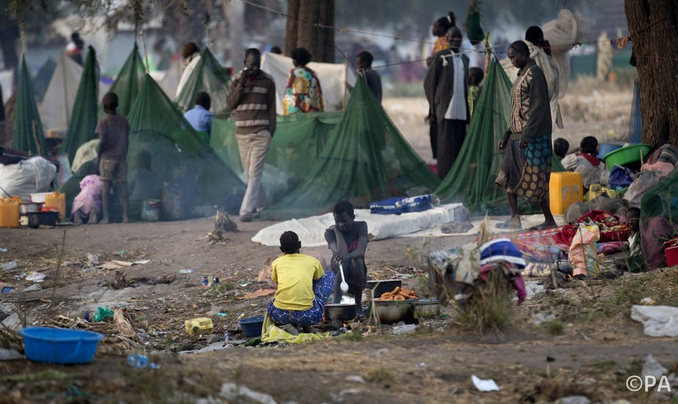
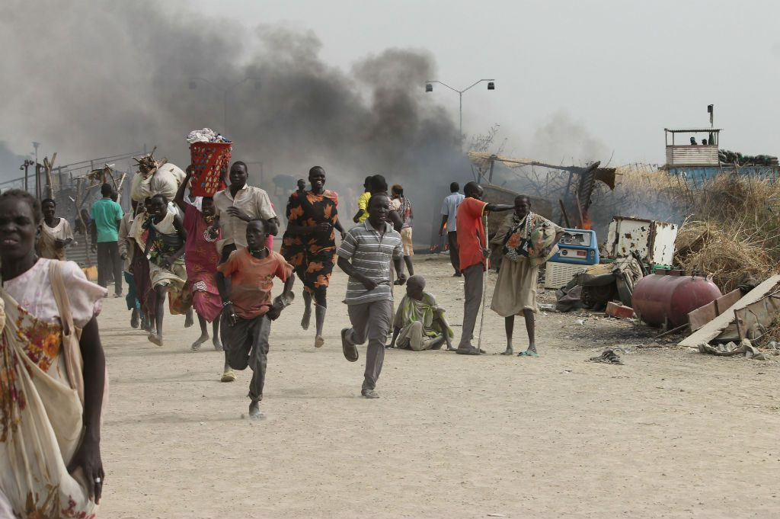
Crisis in south Sudan

Slide 8
Causes of the crisis
Violation of human rights
Total number of displaced persons had reached 900.000
The number of civilians affected by "acute" or "extraordinary" food
Insecurity increased from 1.1 million to 3.2 million
Warnings of a possible genocide
Rapes of civilians, including humanitarian aid workers and journalists

Slide 9
UNMISS Challenges I
The country is largely inaccessible, especially during the lengthy rainy season
The vulnerable population is dispersed, living mainly outside of major urban areas, often beyond the reach of State institutions
Massive human suffering and large-scale killings have left the social and economic fabric of the country in tatters, while manipulation of communal identity has created deep divisions and high levels of mistrust
The institutions of the State are nascent and often ill-governed, while patronage and flagrant corruption remain dominant modes of governance at all levels

Slide 10
UNMISS Challenges II
Protection challenge: In 2016 armed elements forcibly entered several PoC sites, killing dozens of civilians. The mission also failed to intervene when government soldiers attacked UN personnel and aid workers in a compound close to its premises.
Consent challenge: Insufficient host state support, Juba’s formal consent to its deployment notwithstanding. Government forces, for example, frequently obstruct the mission’s freedom of movement, limiting its ability to carry out mandated tasks.

Slide 11
UNMISS Challenges III
Performance challenge: UNMISS also struggles with varying levels of performance among its peacekeepers. Not all troops and police are willing to operate under dangerous conditions. During the crisis in July 2016, for instance, several European countries, including Germany, evacuated police officers - a unilateral decision, which not only compromised the mission’s operational capacity, but also dealt a serious blow to the morale of staff remaining on the ground.
Political challenge: Lack of progress on the political front has similarly impacted on the mission’s work. UNMISS has been charged with supporting the implementation of a peace agreement it did not broker, for a conflict, which the warring parties themselves do not seem ready to end.

Slide 12
UNMISS key failures
UNMISS leadership had followed the decision-making guidelines provided to them, there were issues in relaying and implementing this information among police and military personnel
UNMISS is depended on the support of locally contracted inter-ethnic security personnel, many of whom resided in the PoC camp, but were unable to assist in providing adequate security during the attack on the camp
The use of local contracted security guards drawn from the three tribes, many of them residing in the PoC site, was not conducive to properly securing the base and PoC site
Security personnel at all levels lacked clear information and adequate training on established UNMISS protocols designed for such breaches
Security personnel were helpful in managing tensions within the PoC site, however, they were not equipped or trained to deal with external attacks
Linguistic differences between forces from different countries exacerbated their inability to mobilize and act effectively
Source: UN Headquarters Board of Inquiry, 2016

Slide 13
Cooperation with the regional protection force in South Sudan
Although the conflict was officially ended in August 2015 and the parties to the conflict signed an Agreement on the Resolution of the Conflict in South Sudan (ARCSS) and the scope of the conflict has diminished, both parties regularly violate the terms of the agreement.
Following the riots, the UN Security Council adopted resolution 2304 on 12 August 2016. As a result, following the adoption of the resolution, the mandate of UNMISS was extended and the establishment of a new 4,000 RPF reporting to the UNMISS Force Commander was approved. A plan was outlined for RPF to provide a secure environment in and around Juba by means of a security plan.
Even after the ratification of the Resolution 2304, the Government of South Sudan refused to accept the deployment of a regional force.
At the 17 October meeting of the Security Council, it was discussed that the Government of South Sudan continued to obstruct UNMISS operations and delayed significant progress in the deployment of RPF.

Slide 14
Importance of UNMISS
Protection of Civilians: UNMISS has saved countless lives by sheltering hundreds of thousands of civilians since the conflict began. In 2016, UNMISS not only provided protection to more than 160,000 IDPs in its camps but also humanitarian assistance to millions more, in addition to its mandated tasks.
Creating Conditions Conducive to the Delivery of Humanitarian Assistance: The number of people receiving humanitarian assistance directly from UNMISS is difficult to quantify, with an estimated 100,000 people receiving assistance and 200 000 people in the PoC sites.

Slide 15
Importance of UNMISS
Monitoring and Investigating Human Rights: the Mission in collaboration with the United Nations Development Programme (UNDP) and other partners established a court in Juba to hear cases of sexual violence.
Supporting Implementation of the Agreement and Peace Process: the 2018 peacr process became more successful. The role of UNMISS in ensuring inclusiveness and supporting agreements at the local level in support of the agreement appears to have had a positive impact on the process.

Slide 16
Conclusion
UNMISS has done a great deal of work in protecting the population, creating PoC and protecting human rights. However, the ambitious wording of the mandate is not matched by limited resources. There is thus a large gap between what South Sudan expects from the United Nations and what the Mission can realistically deliver. Key political developments in South Sudan before and after the July 2016 violence meant that the current peace process had collapsed. Juba has already "stabilized" with the change in power relations in the city since July; however, this stability does not protect civilians.

Slide 17
List of References
de Resende Silva, Josias Marcos., The contribution of the United Nations Police to the protection of civilians in South Sudan., Conjuntura Austral, 2019
EPON Effectiveness of Peace Operation Networks. Assessing the Effectiveness of the United Nations Mission in South Sudan/UNMISS, Norwegian Institute of International Affairs, 2019
Johnson, Douglas H., South Sudan: A New History for a New Nation., Ohio University Press, 2016
Kindersley, Nicki and Rolandsen, Øystein H., Briefing: Prospects for peace and the UN regional protection force in South Sudan, African Affairs, 2016
Murphy, Ray., The United Nations Mission in South Sudan and the Protection of Civilians., Journal of Conﬂict & Security Law, Oxford University Press, 2017
Zambakari, Christopher; K. Kang, Tarnjeet and A. Sanders, Robert., The role of the UN Mission in South Sudan (UNMISS) in protecting civilians., SSRN, 2018

Slide 18
Thank you for your attention!

