Slide 1
Populists at elections
POLb1111 Populism and political parties

Slide 2
Main goals
1. Why are populist political parties successful?
2. Who votes for populists?
3. Empirical examples

Slide 3
Main goals
To show complexity of possible explanations behind the electoral success of/voting for populist parties
To introduce the most prominent/recently applied theoretical approaches

Slide 4
Supply side
Demand side
Electoral success

Slide 5
External and internal supply side

Slide 6
External supply side
= political opportunity structures: „consistent, but not necessarily formal or permanent, dimensions of the political environment that provide incentives for people to undertake collective action by affecting their expectations for success and failure“ (Tarrow 1988)
Study of social movements
„Translation“ into party politics language

Slide 7
POS
Institutional context
Cultural context
Media
Political context

Slide 8
Institutional context
Different political systems, different opportunities and limitations for the rise of populist parties (general applicability)
Electoral system – plurality/majority systems vs PR
  Specific effect of two-round majority system on „pariah parties“
  Lack of a clear evidence about the effects of electoral systems
Party law
Federalism – based on the SOE theory
Corporativism
  Lack of evidence
Conclusion: an opportunity rather than a persuasive explanation (e.g van Kessel 2015)

Slide 9
Political context
Context of party politics – relationship with and among other parties
Level of volatility – both supply and demand sides
Neglecting of new political issues (corruption, transparency, host ideology related issues)
Convergence in political space (e.g. NPD and Grosscoalition)
  Ignazi – a two step process: convergence after polarization
  Creation of niches in the political space
Copying populist issues – legitimization of populist parties + question of issue ownership (Le Pen – „voters prefer original over the copy“), issue salience

Slide 10
Cultural context
Specific characteristics across nations
Intellectual background (nouvelle droit in France, anti-partyism in the Czech Republic)
Ideational scheme as a part of the culture
Issue salience, organizational resources
An atmospere hostile to specific ideas (post-Frankist Spain, left-wing ideology in CEE, anti-partyism)
Ambivalent effect of stigmatization

Slide 11
Media
Agenda setters
Language of (some) media – tabloids
Media attention
The prominent effects:
Issue salience
Framing and cueing (Sheets et al. 2016)
Populist owners of the media (Italy, Slovakia, the Czech Republic)
Specifics of populim?

Slide 12
Internal supply side
Factors related to the party itself
Ideological choice, organization (leadership, internal disputes), financial resources, international cooperation
See more in the literature

Slide 13
Demand side – who votes for populists?
Rich literature dealing with voting behaviour in general (for a review see Pauwels 2015):
The sociological approach
Protest voting
The economic model of voting/ideological proximity
Issue voting
Valence voting

Slide 14
The sociological approach
The Columbia school (1940s) – The People`s Choice
Social determinism – how does social environment influence voting behaviour?
High correlation of social variables and vote choice
Cleavage theory – Rokkan, Lipset
Transposition of the existing social conflicts into politics (state – church, centre – periphery, urban – rural, class)
„defreezing“ of the European party systems from the 1960s

Slide 15
Social structural models – modernization thesis
Support for PRR among so-called losers of modernization
Based on negative perception of social transformation processes
Social breakdown and deprivation thesis – from industrial to postindustrial society; individualization + erosion of collective identities
New skills needed to cope with modern society (flexibility, entrepreuneurship)
Demand for PRR:
  return to traditional values
  protest vote against incompetent established parties
  dealignment and increasing importance of new issues (e.g. immigration)
Results: less educated, unemployed, less qualified, insecure male workers supporting RRP (Bezt, Luebbers, Ivarsflaten, Kriesi…)

Slide 16
Protest voting
Based on the anti-establishment part of populist appeals
Low level of trust and populist voting
Low trust in institutions, politicians tend to vote populist parties
Dissatisfaction with democracy explaining voting for all populist parties regardless their host ideology (Pauwels 2015, confirmed also by Hawkins /2010/ - Chavez in Venezuela)
BUT a more complicated relationship (Hooghe, Dassonville 2018):
  Low level of trust related to voting for populist parties
  Decrease of trust related to voting for PP
  Voting for PP decreases political trust

Slide 17
Economic model of voting, issue voting
Closely related to rational choice theory
Maximization of utility as the main theoretical assumption
Voters seeking as much information as possible – „perfectly informed voter“
Pure economic voting – pocket book, entropic (mixed results)
Proximity model – voting the political party with closest policy positions (Kitschelt et al. 1995 – the winning formula, but De Lange 2016)
Attitudes crucial for the host ideology correlates with support for PP (van der Brug et al. 2010, Pauwels 2015, March 2012 but also Smith 2010 – crime linked to immigration)

Slide 18
Psychological roots of populist voting
Bakker et al. (2018)
Congruence of voters` and politicians` personality (populist message)
Personal traits typical for voters of populist political parties
The Big Five model
Case selection
H: Low level of agreeableness increases the chance to voter for a populist party.
Effect founds across the researched cases (Tea Party, Die Linke, PVV)

Slide 19
Comparing voters of populist parties
Rooduijn (2018)
Little effort dedicated to comparative analysis of populist voters
Comparison of 15 cases from Western Europe
Testing the usual theoretical assumptions (economic voting, protest voting, losers of globalization)
Absence of solid common ground of electoral base across populist parties (political distrust but the size of the effect varies over the time)

Slide 20
Empirical example I.
Support for PRR in Central Europe

Slide 21
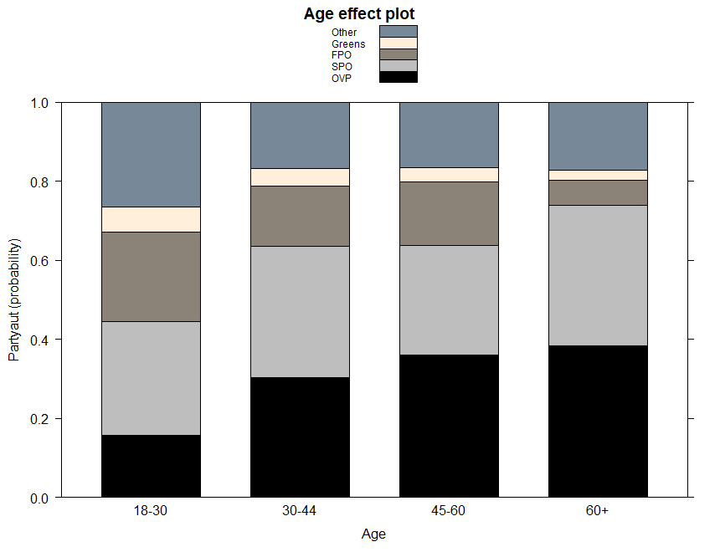
Austria

Slide 22
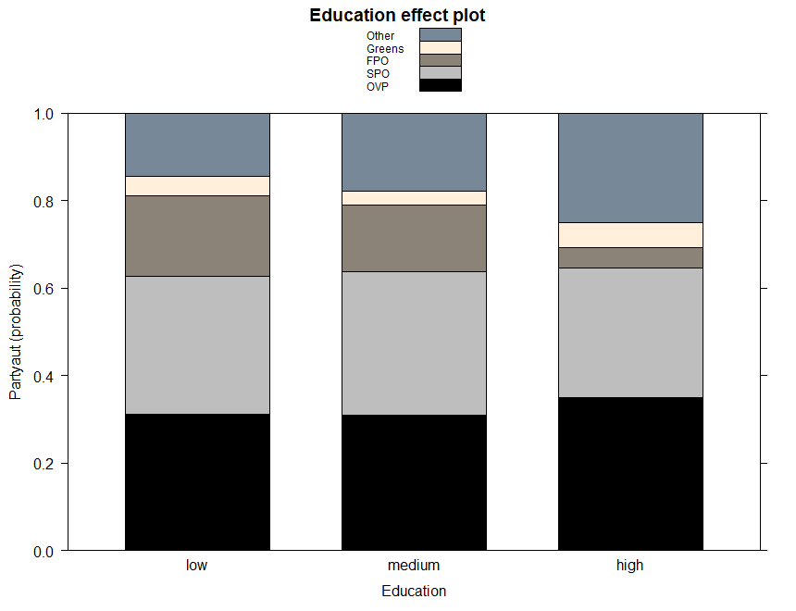

Slide 23
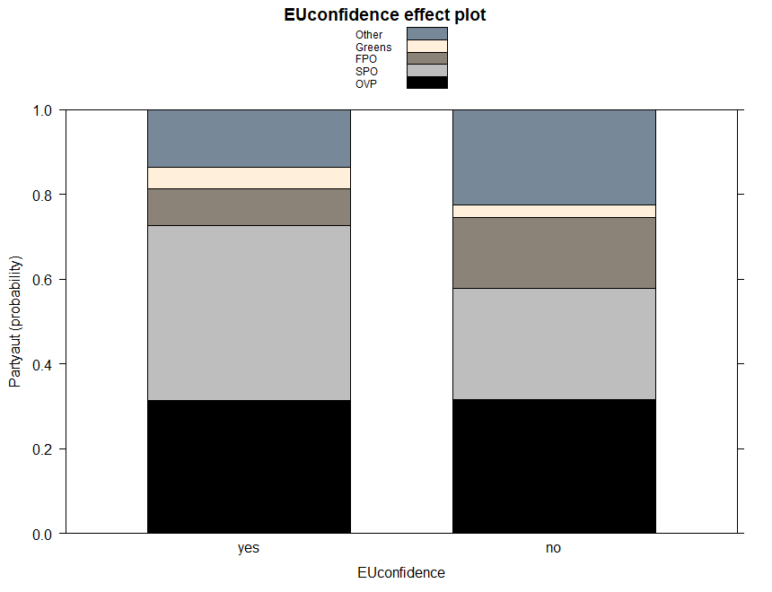

Slide 24
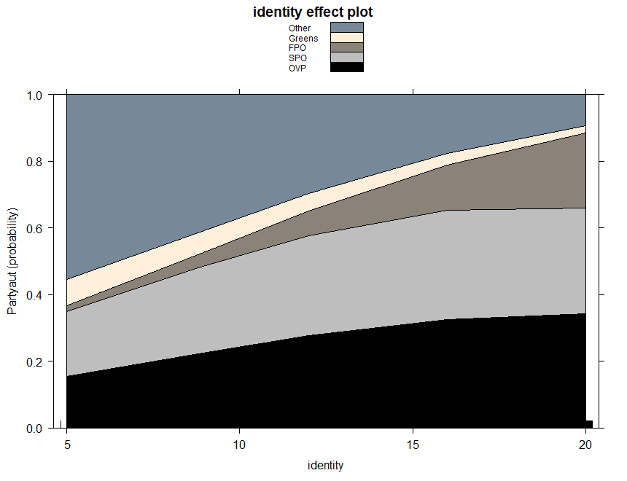

Slide 25
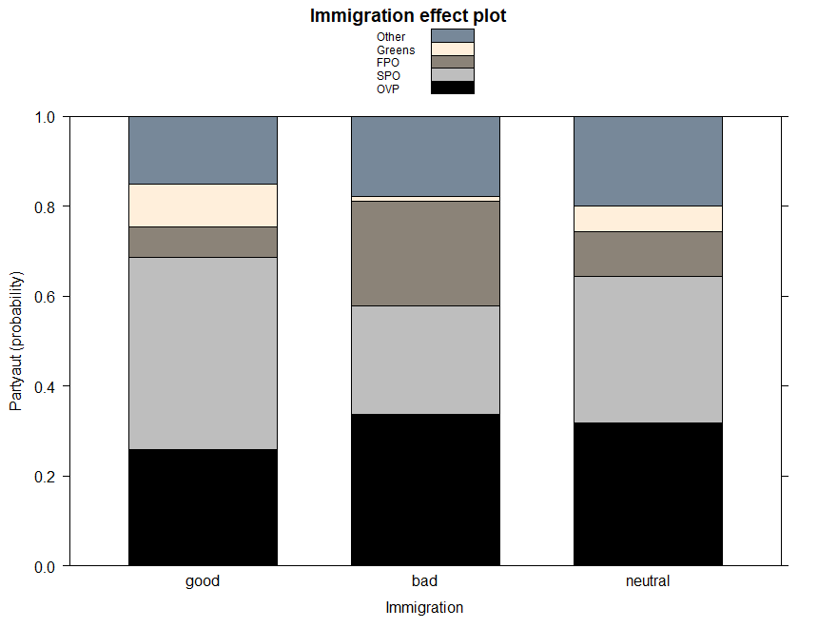

Slide 26
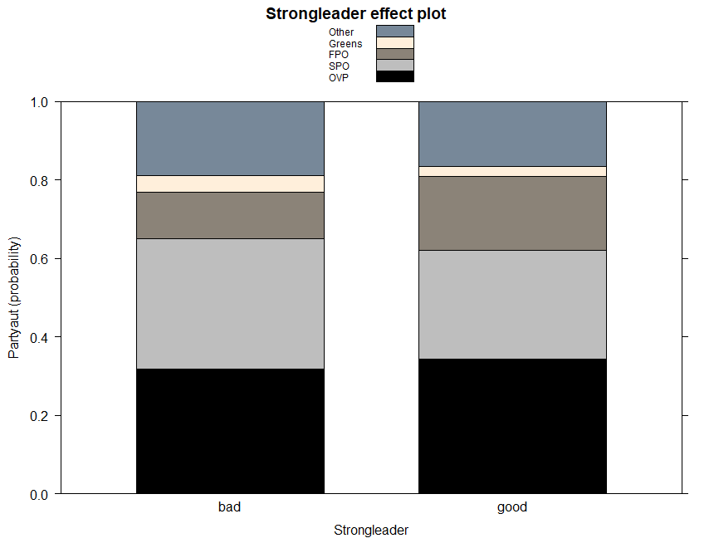

Slide 27
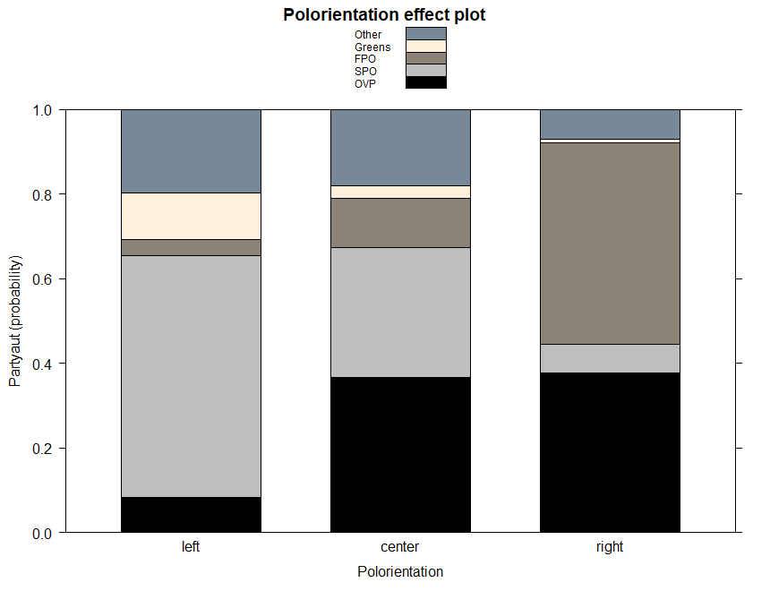

Slide 28
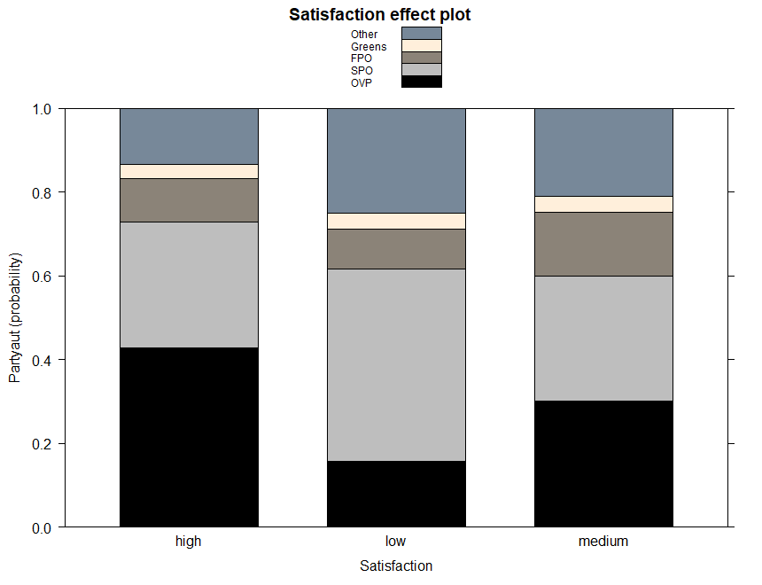

Slide 29
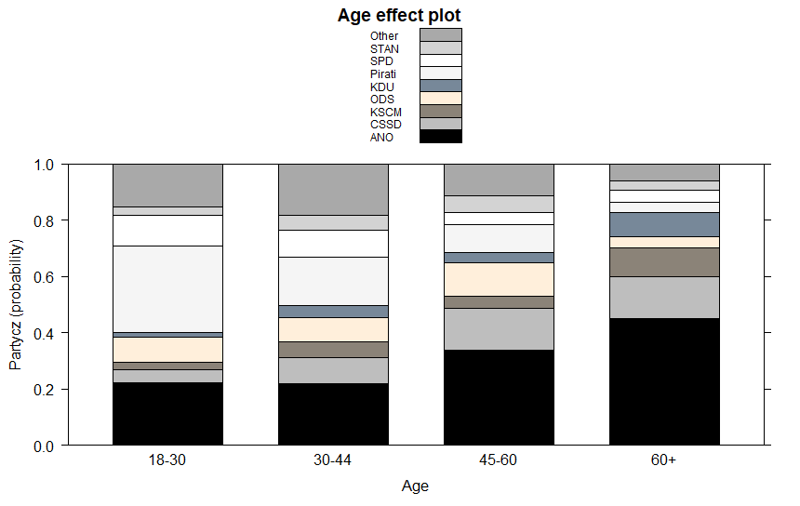
Czech Republic

Slide 30
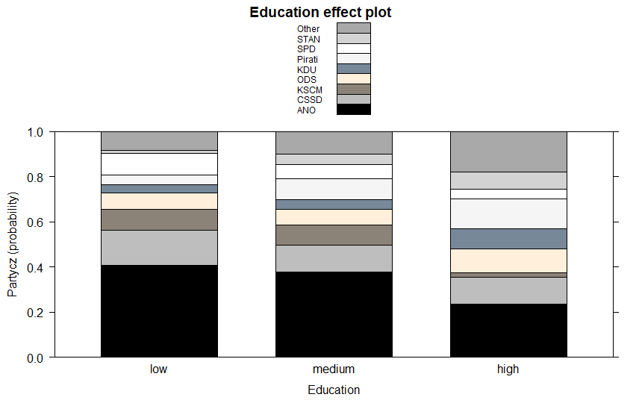

Slide 31
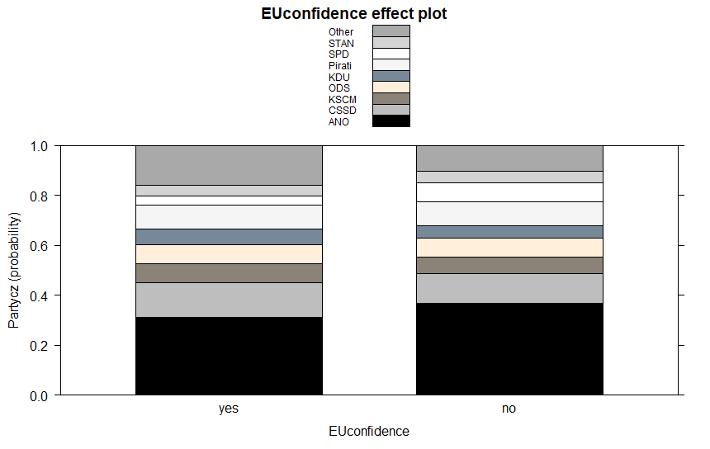

Slide 32
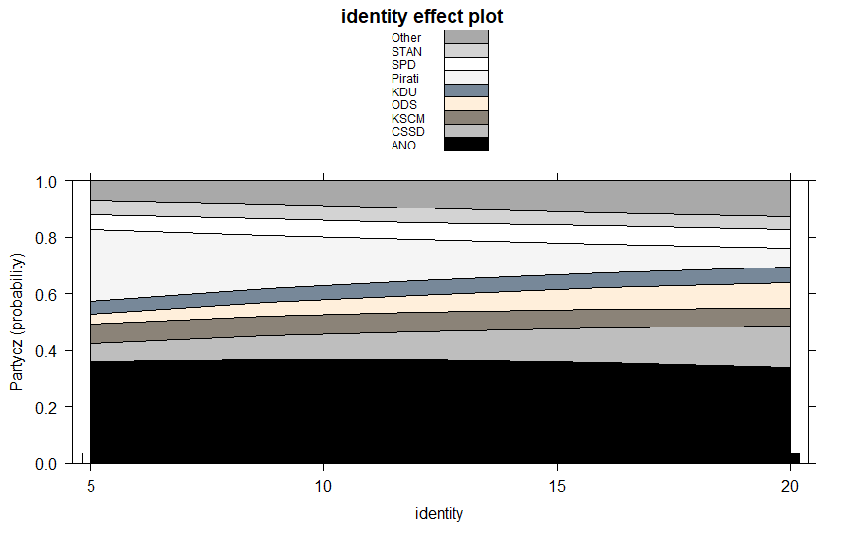

Slide 33
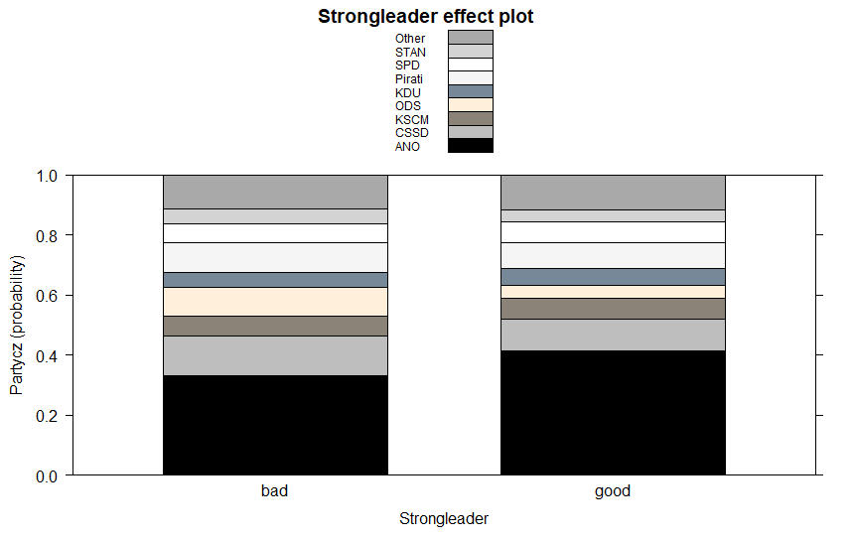

Slide 34
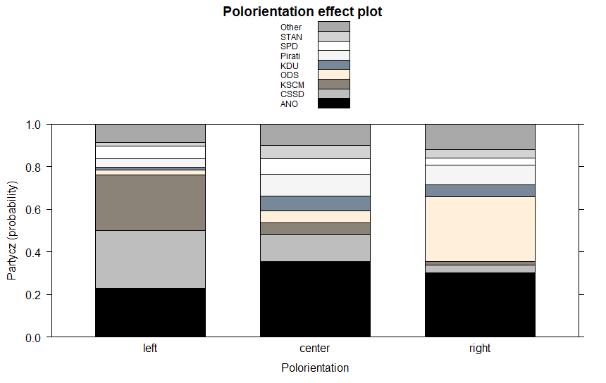

Slide 35
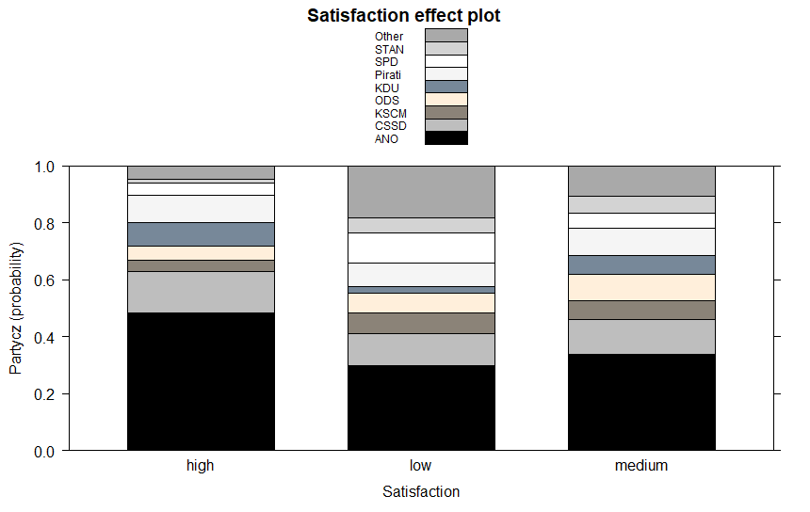

Slide 36
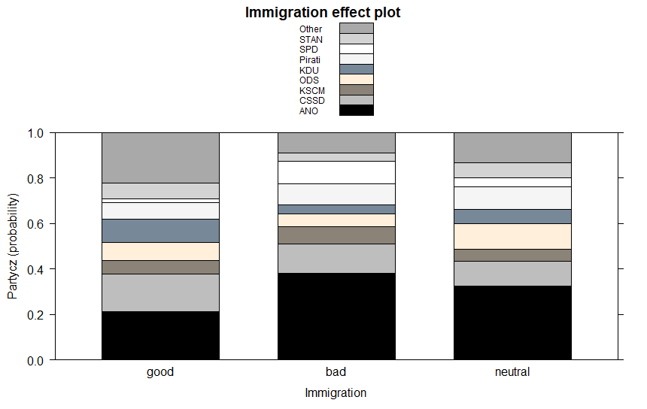

Slide 37
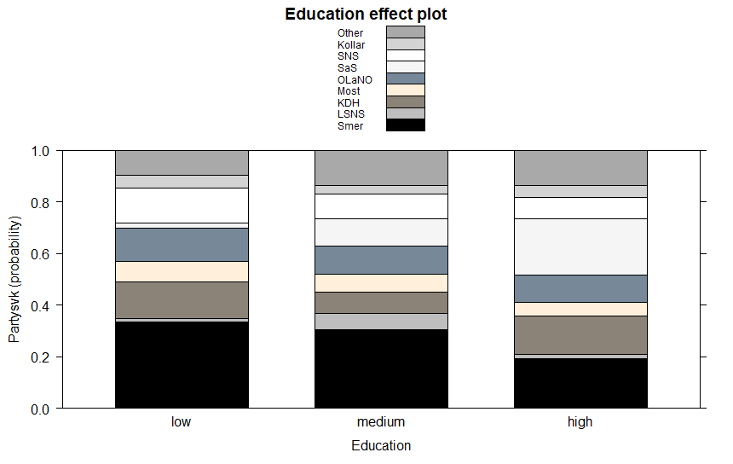
Slovakia

Slide 38
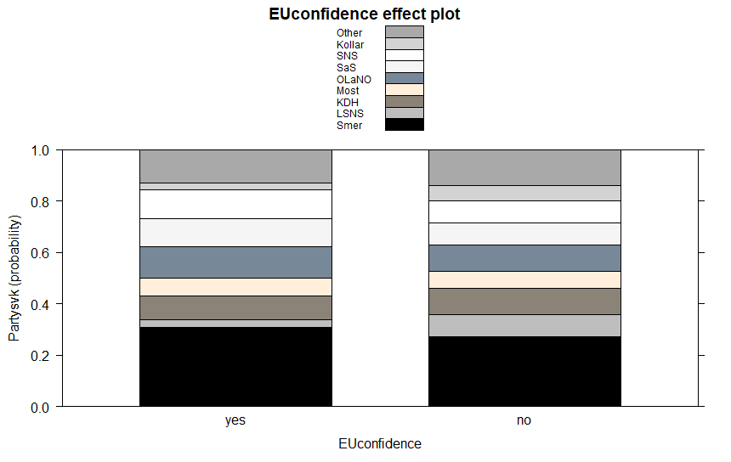

Slide 39
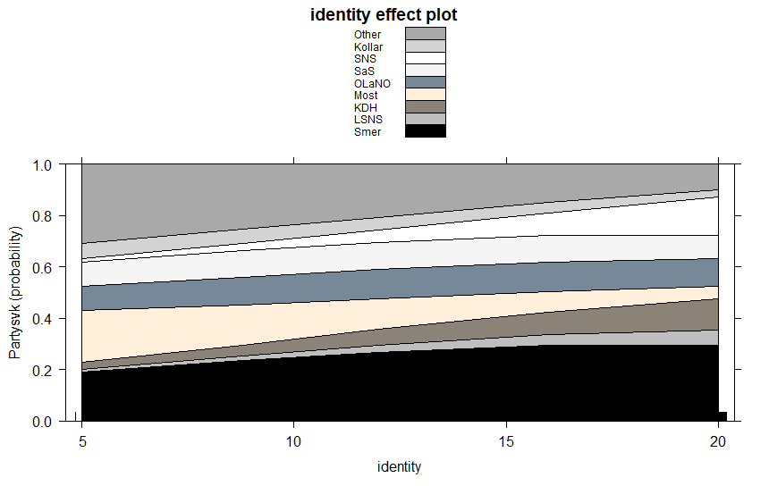

Slide 40
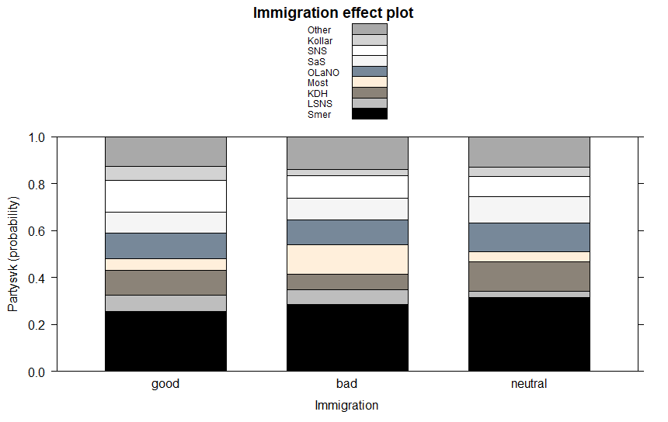

Slide 41
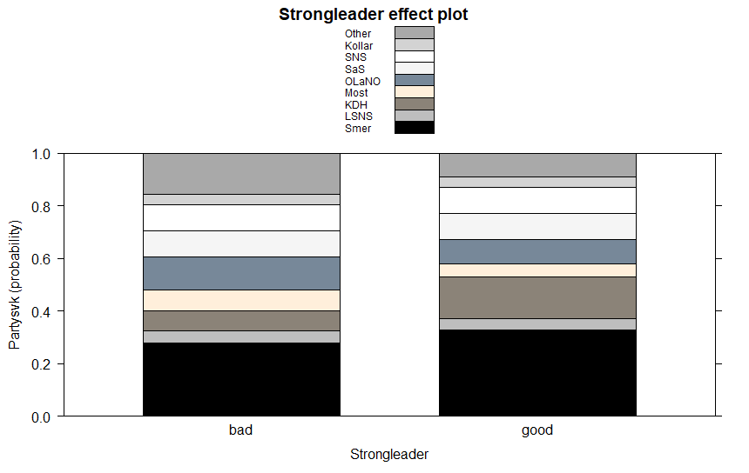

Slide 42
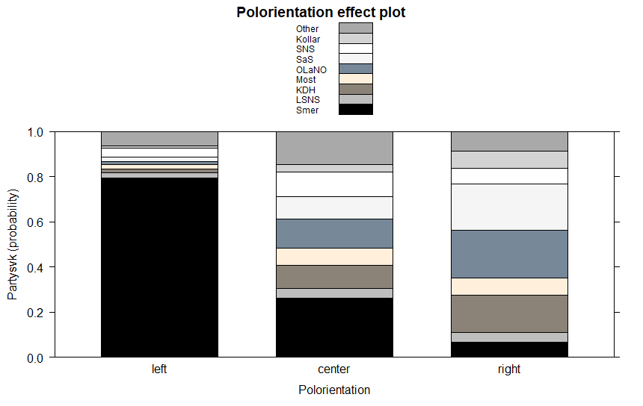

Slide 43
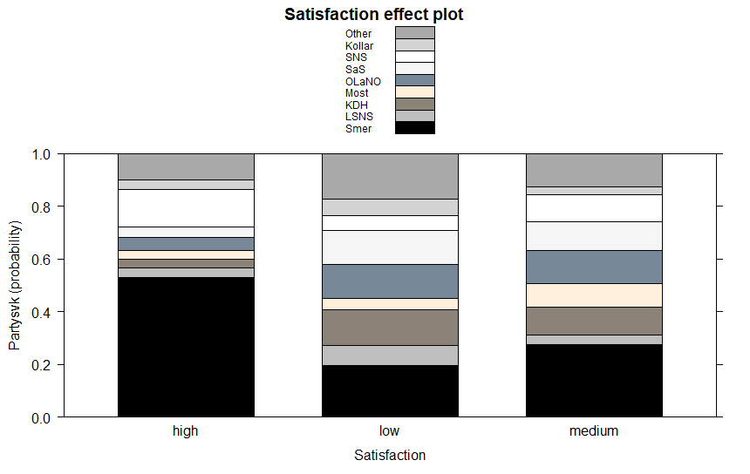

Slide 44
Empirical case II.

Slide 50
Valence voting
Havlík, Voda (2018)
Case study – hypotheses driven by both general and case driven expectation
Policy vs politics
Departure to issue ownership
Lack of effect in case of class voting, ideological voting, political trust (?) – competence to solve the most important issues
Similar results across cases (e.g. Dennison, Goodwin 2015)

Slide 51
Effects of populist attitudes
A new strand of research
(A) scale(s) of populist attitudes developed (used e.g. by Hauwaert and van Kessel 2018)

Slide 52
Conclusion
Chameleonic nature of populism
Number of explanatory factors – a complex explanation
Demand and supply side
Host ideology matters

