Slide 1

Matrix algebra
PSY544 – Introduction to Factor Analysis
Week 2

Slide 2
Prologue
Matrix algebra is a framework for manipulating collections of numbers or algebraic symbols.
Factor model is an algebraic system. If you understand the way it is communicated, you gain a better appreciation of what is going on.
We have already seen the common factor model representing the structure of score x_{ij} – this model applies to every x_{ij} in the data matrix X. Matrix algebra will allow us to express that.

Slide 3
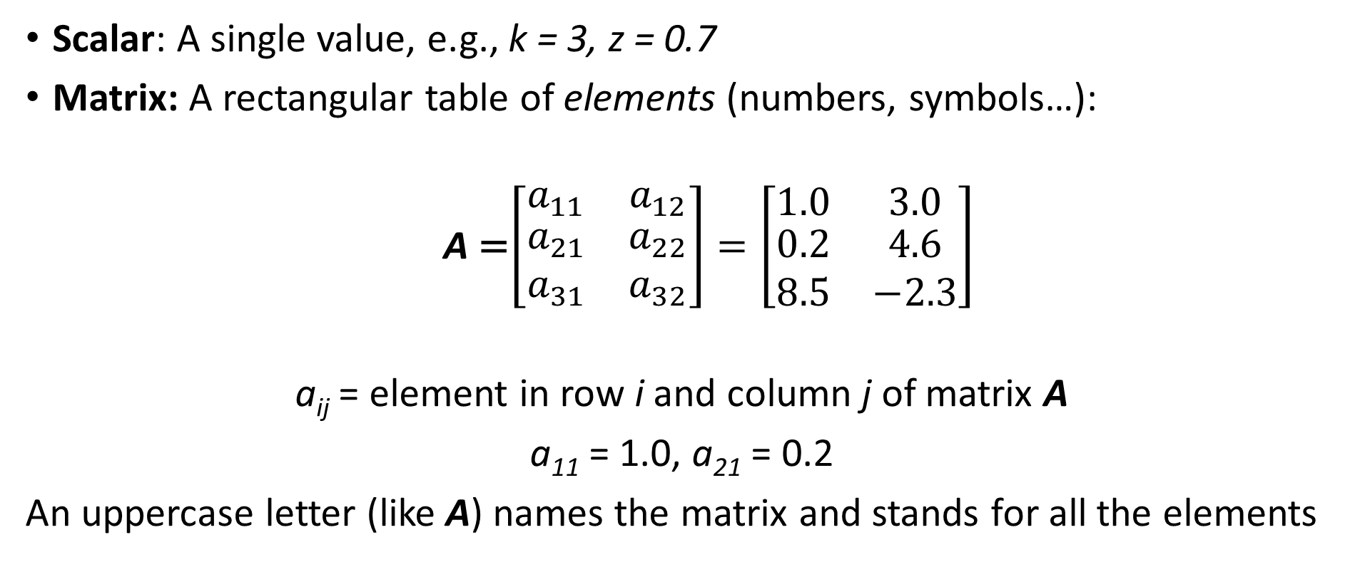
Definitions
Scalar: A single value, e.g., k = 3, z = 0.7
Matrix: A rectangular table of elements (numbers, symbols…):
  A =$\left[\begin{matrix}a_{11} & a_{12} \\ \begin{aligned}a_{21} \\ a_{31}\end{aligned} & \begin{aligned}a_{22} \\ a_{32}\end{aligned}\end{matrix}\right]=\left[\begin{matrix}1.0 & 3.0 \\ \begin{aligned}0.2 \\ 8.5\end{aligned} & \begin{aligned}4.6 \\ −2.3\end{aligned}\end{matrix}\right]$
a_{ij} = element in row i and column j of matrix A
a₁₁ = 1.0, a₂₁ = 0.2
An uppercase letter (like A) names the matrix and stands for all the elements

Slide 4
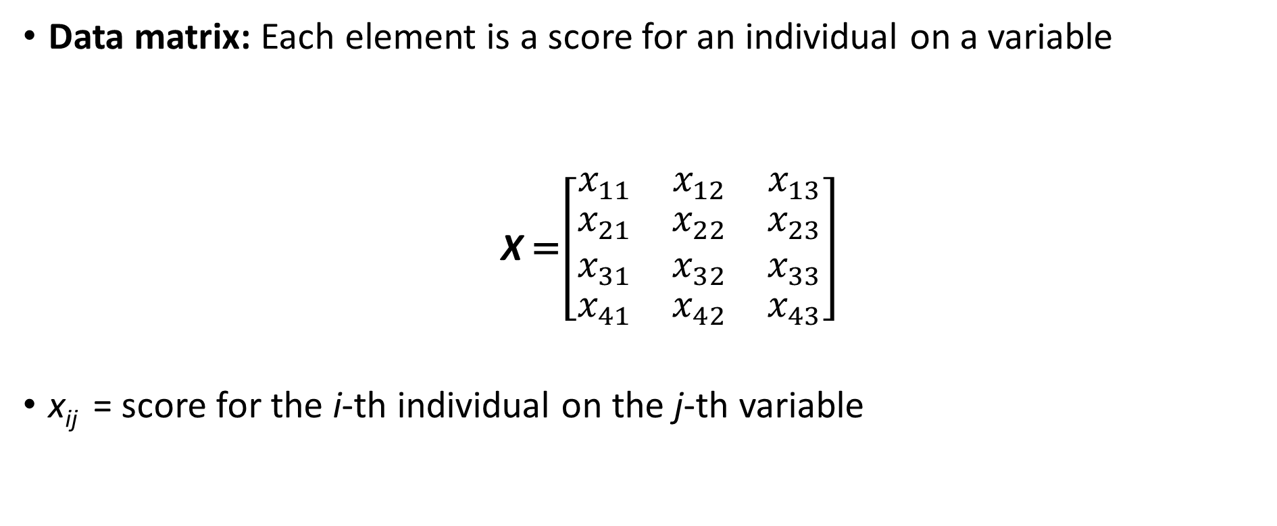
Definitions
Data matrix: Each element is a score for an individual on a variable
  X =$\left[\begin{matrix}x_{11} & x_{12} & x_{13} \\ \begin{aligned}x_{21} \\ x_{31}\end{aligned} & \begin{aligned}x_{22} \\ x_{32}\end{aligned} & \begin{aligned}x_{23} \\ x_{33}\end{aligned} \\ x_{41} & x_{42} & x_{43}\end{matrix}\right]$
x_{ij} = score for the i-th individual on the j-th variable
p = 3 manifest variables
N = 4 subjects

Slide 5
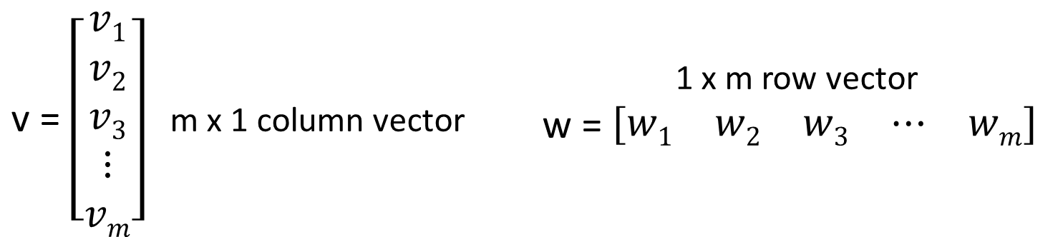
Definitions
Order: The size of a matrix.
A matrix with N rows and p columns is of order N x p
Square matrix: A matrix with the same number of rows and columns
Vector: A matrix with a single column (column vector) or a single row (row vector)
v = $\left[\begin{matrix}v1 \\ v2 \\ v3 \\ ⋮ \\ vm\end{matrix}\right]$ m x 1 column vector | 1 x m row vector w = $\left[\begin{matrix}w1 & w2 & w3 & ⋯ & wm\end{matrix}\right]$

Slide 6
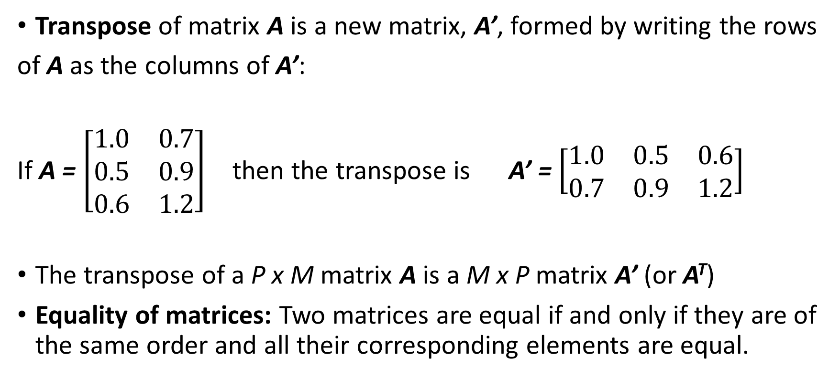
Definitions
Transpose of matrix A is a new matrix, A’, formed by writing the rows
of A as the columns of A’:
If A = $\left[\begin{matrix}1.0 & 0.7 \\ 0.5 & 0.9 \\ 0.6 & 1.2\end{matrix}\right]$ then the transpose is A’ = $\left[\begin{matrix}1.0 & 0.5 & 0.6 \\ 0.7 & 0.9 & 1.2\end{matrix}\right]$
The transpose of a P x M matrix A is a M x P matrix A’ (or A^{T})
Equality of matrices: Two matrices are equal if and only if they are of the same order and all their corresponding elements are equal.

Slide 7
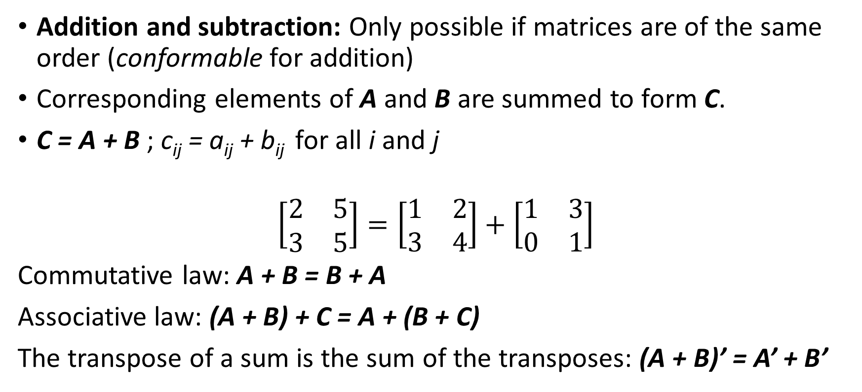
Arithmetic operations
Addition and subtraction: Only possible if matrices are of the same order (conformable for addition)
Corresponding elements of A and B are summed to form C.
C = A + B ; c_{ij} = a_{ij} + b_{ij} for all i and j
$$\left[\begin{matrix}2 & 5 \\ 3 & 5\end{matrix}\right]=\left[\begin{matrix}1 & 2 \\ 3 & 4\end{matrix}\right]+\left[\begin{matrix}1 & 3 \\ 0 & 1\end{matrix}\right]$$
Commutative law: A + B = B + A
Associative law: (A + B) + C = A + (B + C)
The transpose of a sum is the sum of the transposes: (A + B)’ = A’ + B’

Slide 8

Multiplication
Scalar multiplication:
C = Ba = aB ; c_{ij} = a∙b_{ij}
2$\left[\begin{matrix}2 & 4 \\ 1 & 0\end{matrix}\right]=\left[\begin{matrix}2 & 4 \\ 1 & 0\end{matrix}\right]2=\left[\begin{matrix}4 & 8 \\ 2 & 0\end{matrix}\right]$

Slide 9
Multiplication
Matrix multiplication is not what you might think it is!
Matrix multiplication: A and B have to be conformable for multiplication. Matrices are conformable if the number of columns in the first matrix equals the number of rows in the second.
A B = AB = C
n x p p x m n x m
The product matrix has as many rows as the first matrix and as many columns as the second matrix.
In this case, B was being pre-multiplied by A (and A was being post-multiplied by B)

Slide 10
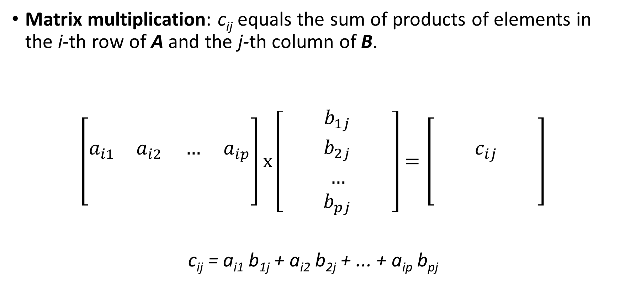
Multiplication
Matrix multiplication: c_{ij} equals the sum of products of elements in the i-th row of A and the j-th column of B.
$$\left[\begin{matrix} & & & \\ a_{i1} & a_{i2} & … & a_{ip} \\ & & & \\ & & & \end{matrix}\right]x\left[\begin{matrix} & b_{1j} & \\ & b_{2j} & \\ & … & \\ & b_{pj} & \end{matrix}\right]=\left[\begin{matrix} & & \\ & c_{ij} & \\ & & \\ & & \end{matrix}\right]$$
c_{ij} = a_{i1} b_{1j} + a_{i2} b_{2j} + ... + a_{ip} b_{pj}

Slide 11
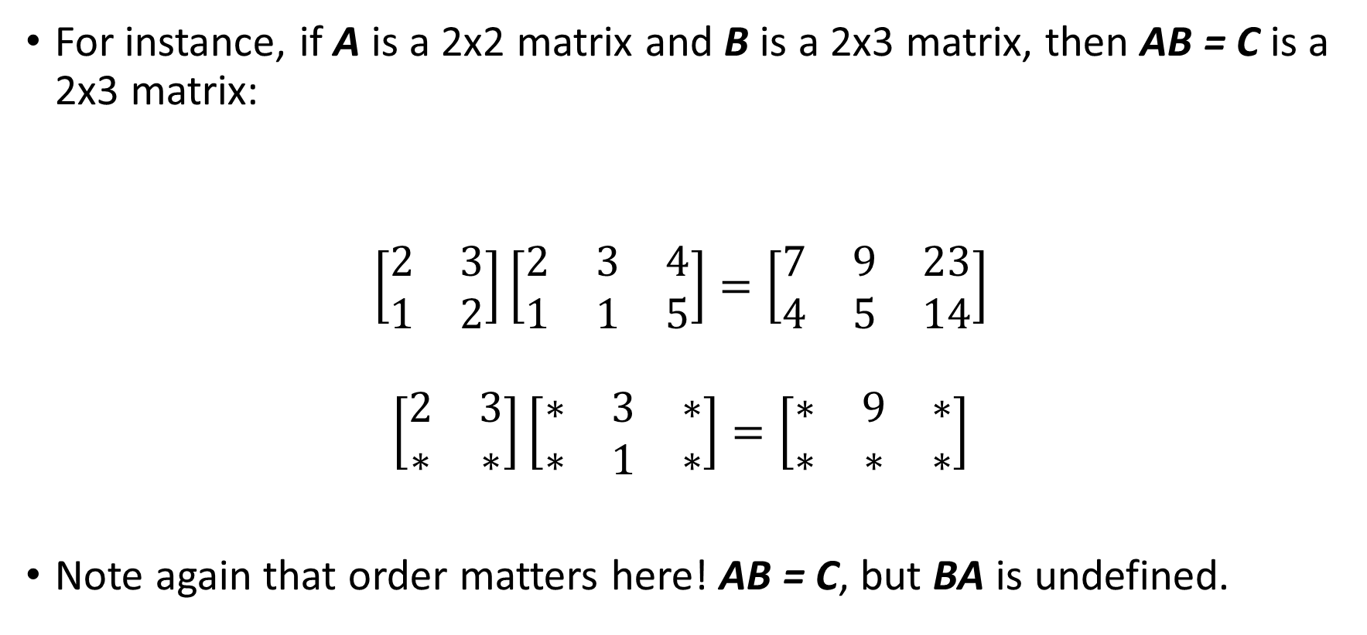
Multiplication
For instance, if A is a 2x2 matrix and B is a 2x3 matrix, then AB = C is a 2x3 matrix:
$$\left[\begin{matrix}2 & 3 \\ 1 & 2\end{matrix}\right]\left[\begin{matrix}2 & 3 & 4 \\ 1 & 1 & 5\end{matrix}\right]=\left[\begin{matrix}7 & 9 & 23 \\ 4 & 5 & 14\end{matrix}\right]$$
$$\left[\begin{matrix}2 & 3 \\ ∗ & ∗\end{matrix}\right]\left[\begin{matrix}∗ & 3 & ∗ \\ ∗ & 1 & ∗\end{matrix}\right]=\left[\begin{matrix}∗ & 9 & ∗ \\ ∗ & ∗ & ∗\end{matrix}\right]$$
Note again that order matters here! AB = C, but BA is undefined.
A B C

Slide 12
Multiplication
Matrix multiplication is associative: A(BC) = AB(C)
Matrix multiplication is not commutative: AB ≠ BA
Matrix multiplication is distributive: A(B+C) = AB + AC; (B+C)A = BA + CA
The transpose of a product of matrices equals the product of the transposes in reverse order: (AB)’ = B’ A’

Slide 13

Kinds of matrices
Symmetric matrix: A square matrix S is symmetric if it’s equal to its transpose
S = $\left[\begin{matrix}5 & 1 \\ 1 & 3\end{matrix}\right]$ = S’

Slide 14
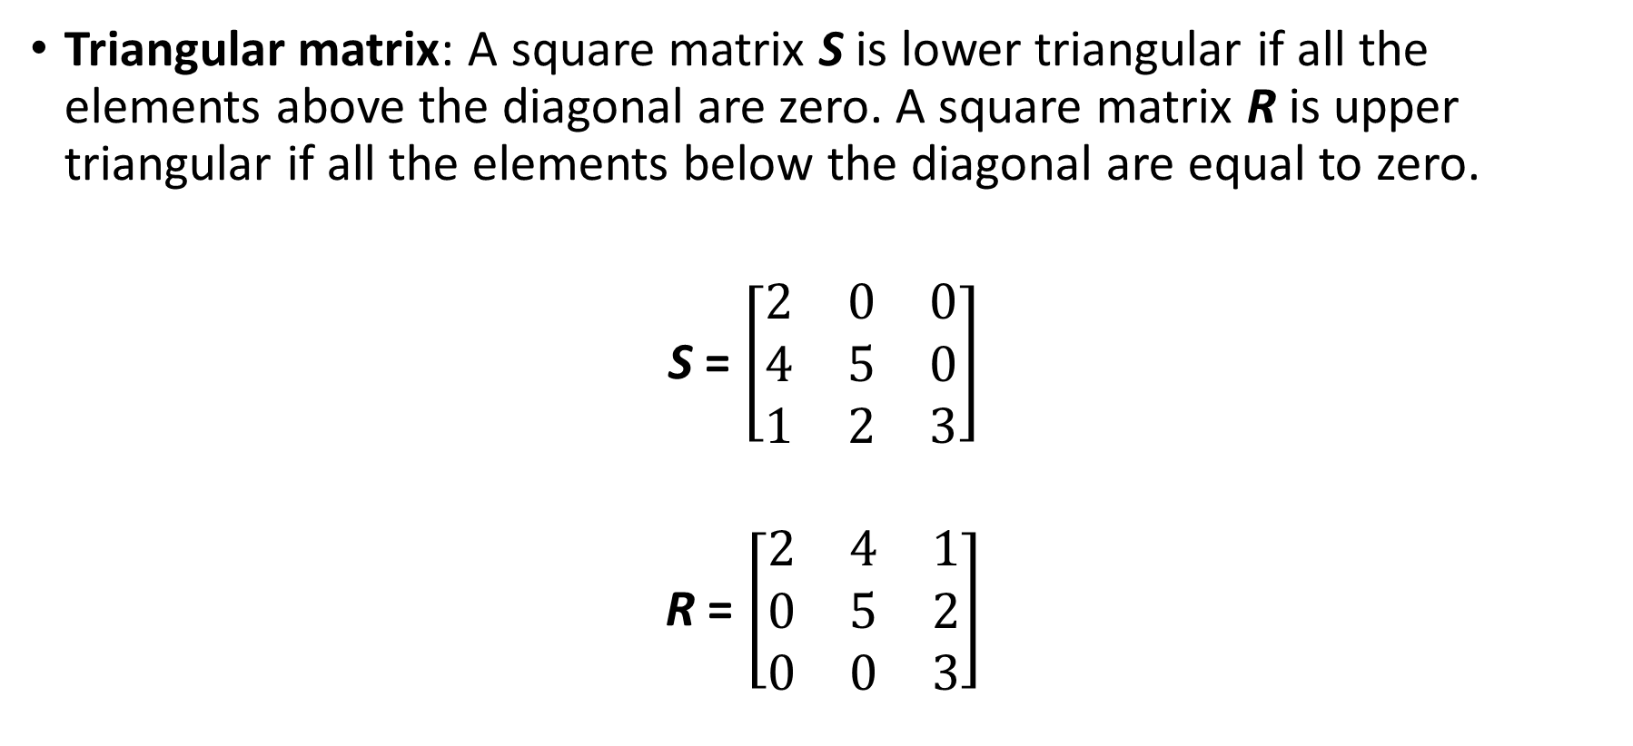
Kinds of matrices
Triangular matrix: A square matrix S is lower triangular if all the elements above the diagonal are zero. A square matrix R is upper triangular if all the elements below the diagonal are equal to zero.
S = $\left[\begin{matrix}2 & 0 & 0 \\ 4 & 5 & 0 \\ 1 & 2 & 3\end{matrix}\right]$
R = $\left[\begin{matrix}2 & 4 & 1 \\ 0 & 5 & 2 \\ 0 & 0 & 3\end{matrix}\right]$

Slide 15

Kinds of matrices
Diagonal matrix: A square matrix D is diagonal if all the off-diagonal elements are zero.
D = $\left[\begin{matrix}d_{11} & 0 & 0 \\ 0 & d_{22} & 0 \\ 0 & 0 & d_{33}\end{matrix}\right]$

Slide 16
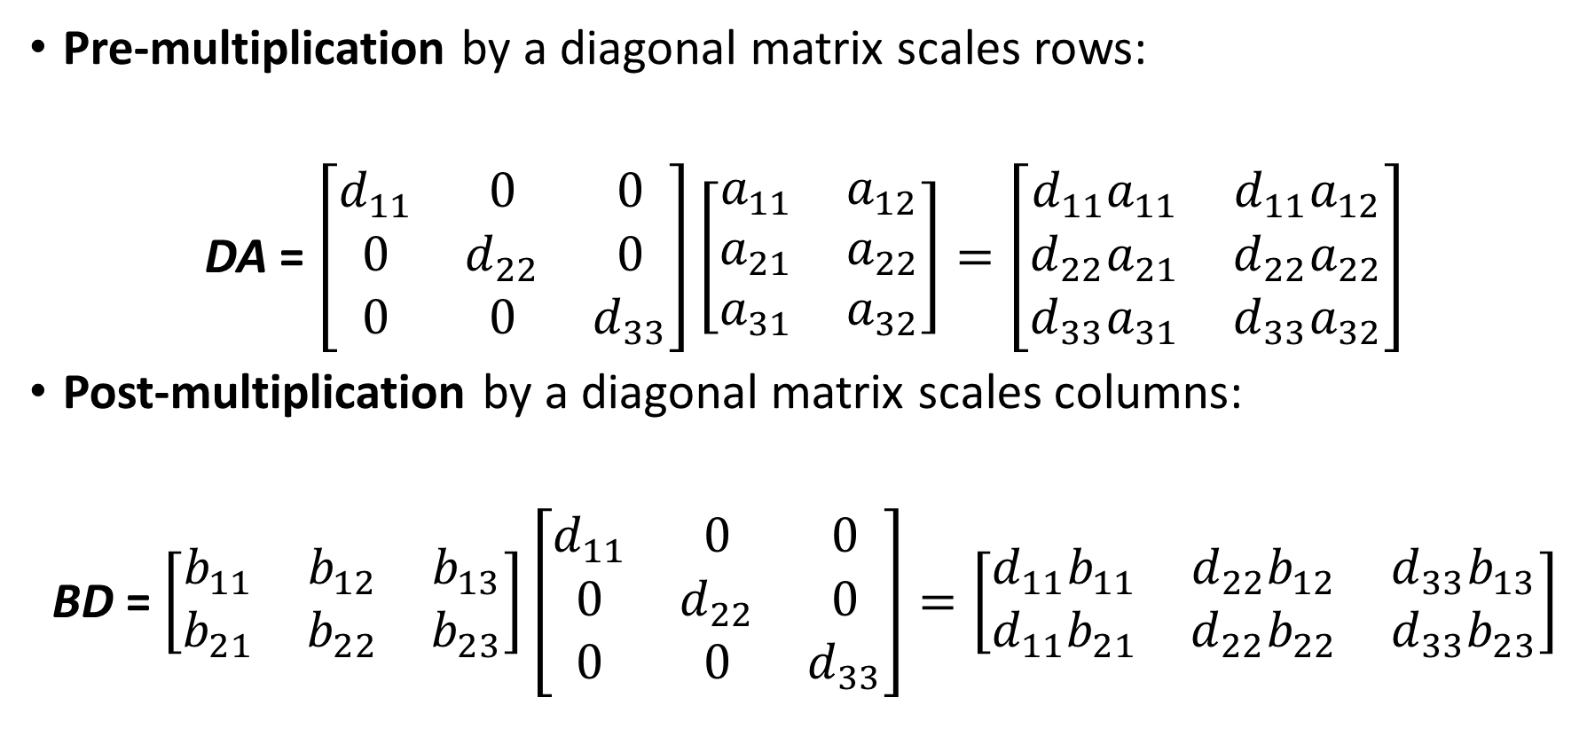
Kinds of matrices
Pre-multiplication by a diagonal matrix scales rows:
DA = $\left[\begin{matrix}d_{11} & 0 & 0 \\ 0 & d_{22} & 0 \\ 0 & 0 & d_{33}\end{matrix}\right]\left[\begin{matrix}a_{11} & a_{12} \\ a_{21} & a_{22} \\ a_{31} & a_{32}\end{matrix}\right]=\left[\begin{matrix}{d_{11}a}_{11} & {d_{11}a}_{12} \\ d_{22}a_{21} & d_{22}a_{22} \\ {d_{33}a}_{31} & {d_{33}a}_{32}\end{matrix}\right]$
Post-multiplication by a diagonal matrix scales columns:
BD = $\left[\begin{matrix}b_{11} & b_{12} & b_{13} \\ b_{21} & b_{22} & b_{23}\end{matrix}\right]\left[\begin{matrix}d_{11} & 0 & 0 \\ 0 & d_{22} & 0 \\ 0 & 0 & d_{33}\end{matrix}\right]=\left[\begin{matrix}{d_{11}b}_{11} & d_{22}b_{12} & {d_{33}b}_{13} \\ d_{11}b_{21} & {d_{22}b}_{22} & {d_{33}b}_{23}\end{matrix}\right]$

Slide 17
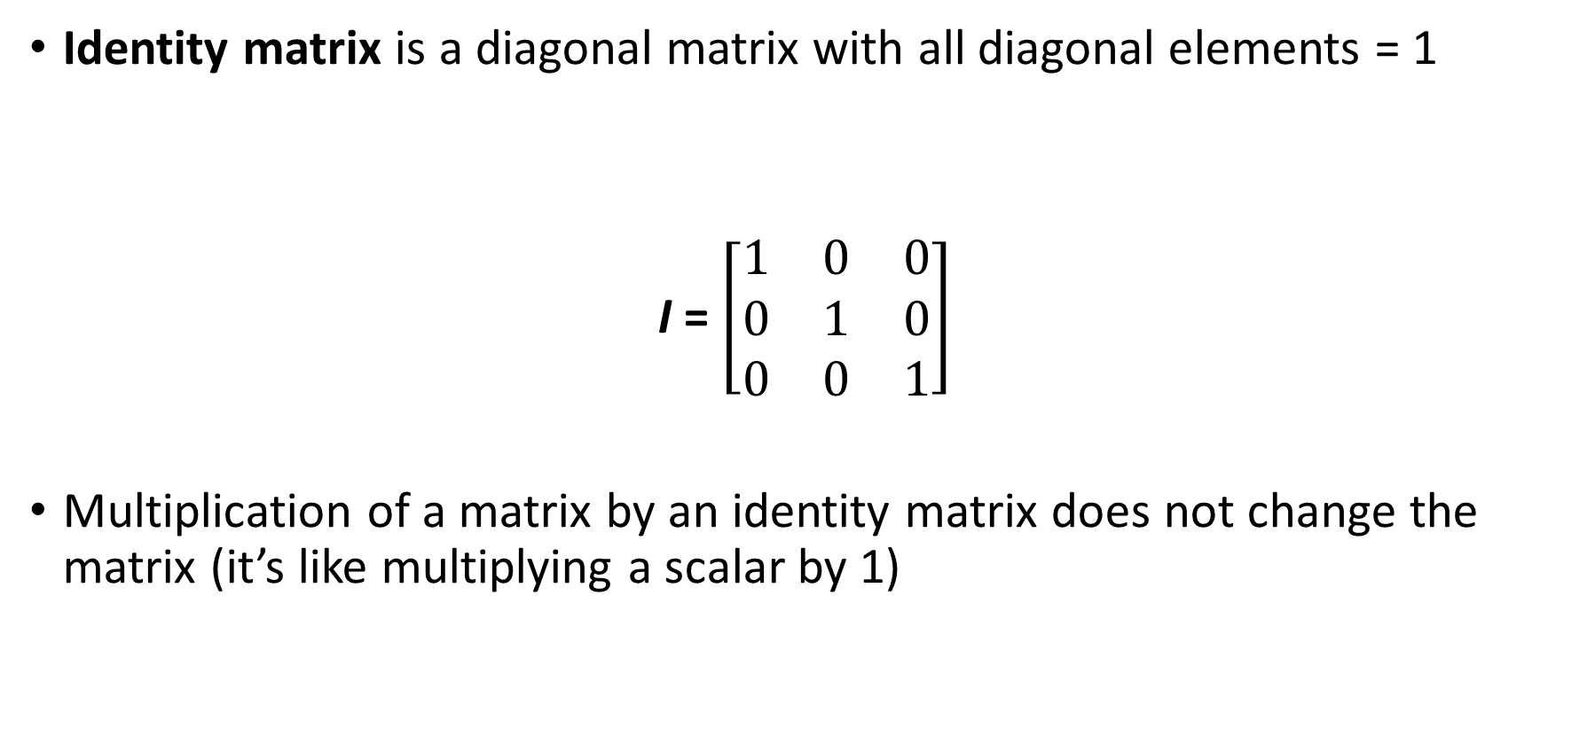
Kinds of matrices
Identity matrix is a diagonal matrix with all diagonal elements = 1
I = $\left[\begin{matrix}1 & 0 & 0 \\ 0 & 1 & 0 \\ 0 & 0 & 1\end{matrix}\right]$
Multiplication of a matrix by an identity matrix does not change the matrix (it’s like multiplying a scalar by 1)

Slide 18
Kinds of matrices
Orthogonal matrix: A square matrix T is orthogonal if TT’ = I or T’T = I
Correlation matrix is a square, symmetric matrix with unit diagonals and off-diagonal elements that satisfy -1 ≤ r_{ij} ≤ 1. Also, it has to be nonnegative definite (we will define that later)

Slide 19
Functions of matrices
The Determinant of a square matrix A is a scalar function of the elements of A. It is denoted as |A| or det(A) and is a single number (scalar).
The determinant has many functions which we will not cover here (neither will we cover the definition or computation)
If a matrix has determinant equal to zero, the matrix is called singular. This is an indication that there is redundancy among the rows / columns of the matrix – if the determinant is zero, some columns (or rows) of the matrix can be expressed as linear combinations of other columns (rows). In other words, the columns (rows) are linearly dependent.

Slide 20

Functions of matrices
A singular matrix:
A = $\left[\begin{matrix}3 & 1 & 4 \\ 4 & 1 & 5 \\ 2 & 3 & 5\end{matrix}\right]$
(The last column is the sum of the first two columns)

Slide 21
Functions of matrices
Trace: The trace of a square matrix A, tr(A), is the sum of its diagonal elements.
Rank: The column rank of A is equal to the total number of linearly independent columns of A. The row rank of A is equal to the total number of linearly independent rows of A.
The rank of an N x K matrix is at most the minimum of N or K, min(N,K)
A matrix whose rank is equal to min(N,K) is full rank
A matrix whose rank is less than min(N,K) is rank deficient

Slide 22
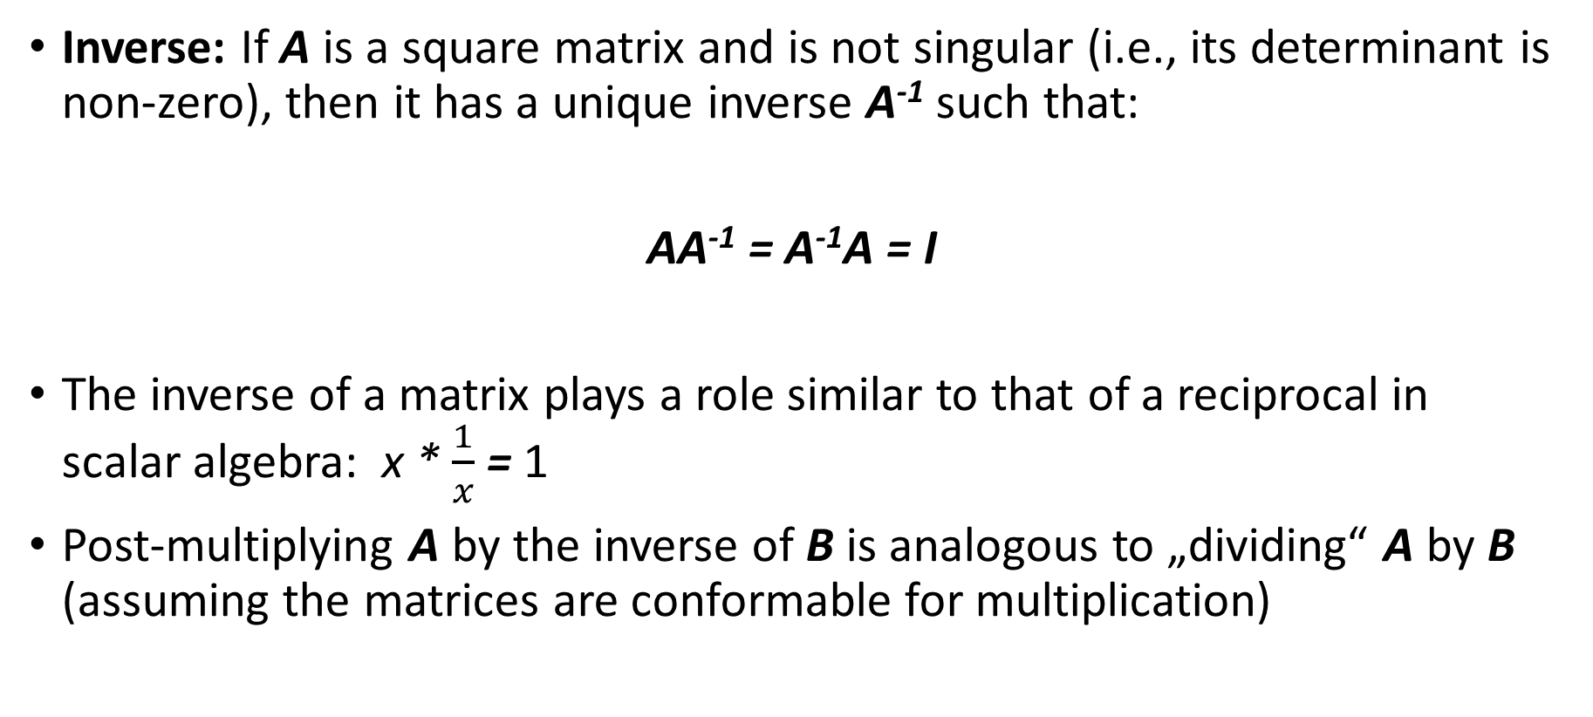
Functions of matrices
Inverse: If A is a square matrix and is not singular (i.e., its determinant is non-zero), then it has a unique inverse A⁻¹ such that:
AA⁻¹ = A⁻¹A = I
The inverse of a matrix plays a role similar to that of a reciprocal in scalar algebra: x * $\frac{1}{x}$ = 1
Post-multiplying A by the inverse of B is analogous to „dividing“ A by B (assuming the matrices are conformable for multiplication)

Slide 23
Functions of matrices
Solving equations:
Consider the equation Ax = b, where A is a N x N non-singular matrix, b is a N x 1 vector and x is a N x 1 vector. We know the elements of A and b and wish to solve for x:
Ax = b
A⁻¹Ax = A⁻¹b
Ix = A⁻¹b
x = A⁻¹b

Slide 24
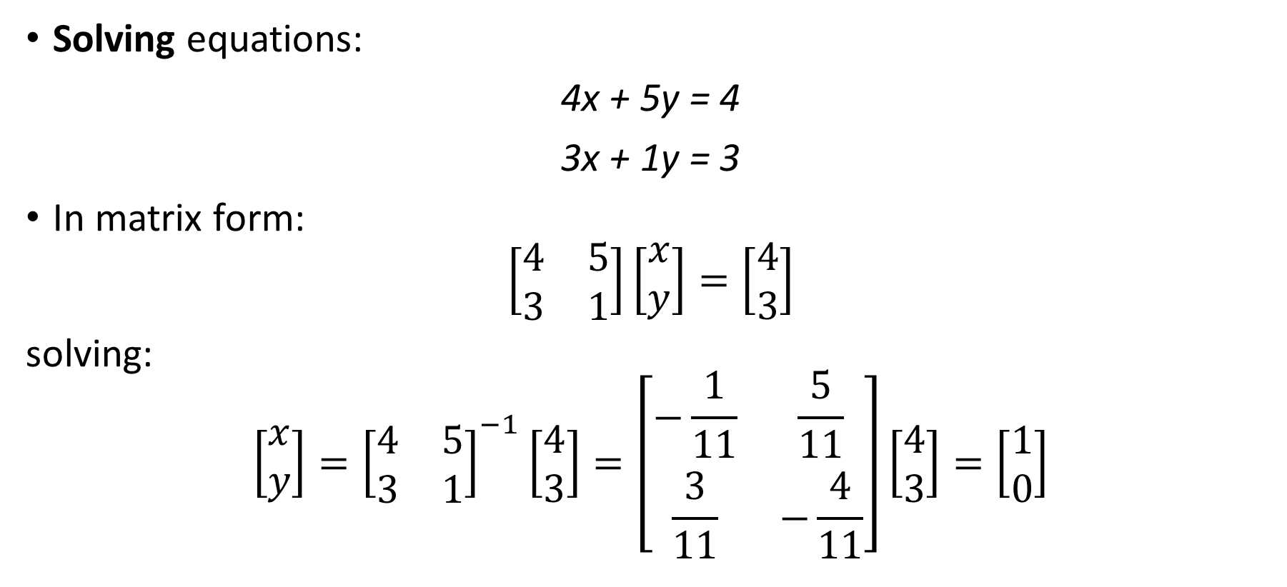
Functions of matrices
Solving equations:
4x + 5y = 4
3x + 1y = 3
In matrix form:
$$\left[\begin{matrix}4 & 5 \\ 3 & 1\end{matrix}\right]\left[\begin{matrix}x \\ y\end{matrix}\right]=\left[\begin{matrix}4 \\ 3\end{matrix}\right]$$
solving:
$$\left[\begin{matrix}x \\ y\end{matrix}\right]={\left[\begin{matrix}4 & 5 \\ 3 & 1\end{matrix}\right]}^{−1}\left[\begin{matrix}4 \\ 3\end{matrix}\right]=\left[\begin{matrix}−\frac{1}{11} & \frac{5}{11} \\ \frac{3}{11} & −\frac{4}{11}\end{matrix}\right]\left[\begin{matrix}4 \\ 3\end{matrix}\right]=\left[\begin{matrix}1 \\ 0\end{matrix}\right]$$

Slide 25
Functions of matrices
Eigenvalues and Eigenvectors
Suppose that S is a square symmetric matrix of order p. If u is a column vector of order p and v is a scalar, such that:
Su = vu
...then v is said to be an eigenvalue (or characteristic root) of S and u is said to be an eigenvector (or characteristic vector) of S.
S will have p eigenvalues and p associated eigenvectors.

Slide 26
Functions of matrices
Eigenvalues and Eigenvectors
If all p eigenvalues are positive, the matrix is positive definite. If one or more eigenvalues are zero and the rest is positive, the matrix is nonnegative definite. If one or more eigenvalues are negative, the matrix is negative definite.
The determinant of S, det(S), equals the product of the eigenvalues of S
Thus, if one or more eigenvalues are zero, the matrix is singular.

Slide 27
Functions of matrices
Eigenvalues and Eigenvectors
The eigenvalues can be arranged in descending order as the diagonal elements in a diagonal matrix D, and the corresponding eigenvectors can be arranged as columns of matrix U. Then:
U is orthogonal, that is, U’U = I
The “eigenstructure” of S can be given in this form: SU = UD
It also holds that S = UDU’

Slide 28
Linear combinations of random variables
Matrix equations are handy for representing linear combinations of random variables
Let x be a column vector of order p containing scores for a random individual on variables x₁, x₂, …, x_{p}
Let z be a column vector of order m containing scores for a random individual on variables z₁, z₂, …, z_{m}
We will represent the variables in x as linear functions of the variables in z.
Let A be a matrix of order p x m containing coefficients a_{jk} representing the linear effects of z_{k} on x_{j}
Let μ be a column vector of order p containing fixed constants μ₁, μ₂, …, μ_{p}

Slide 29
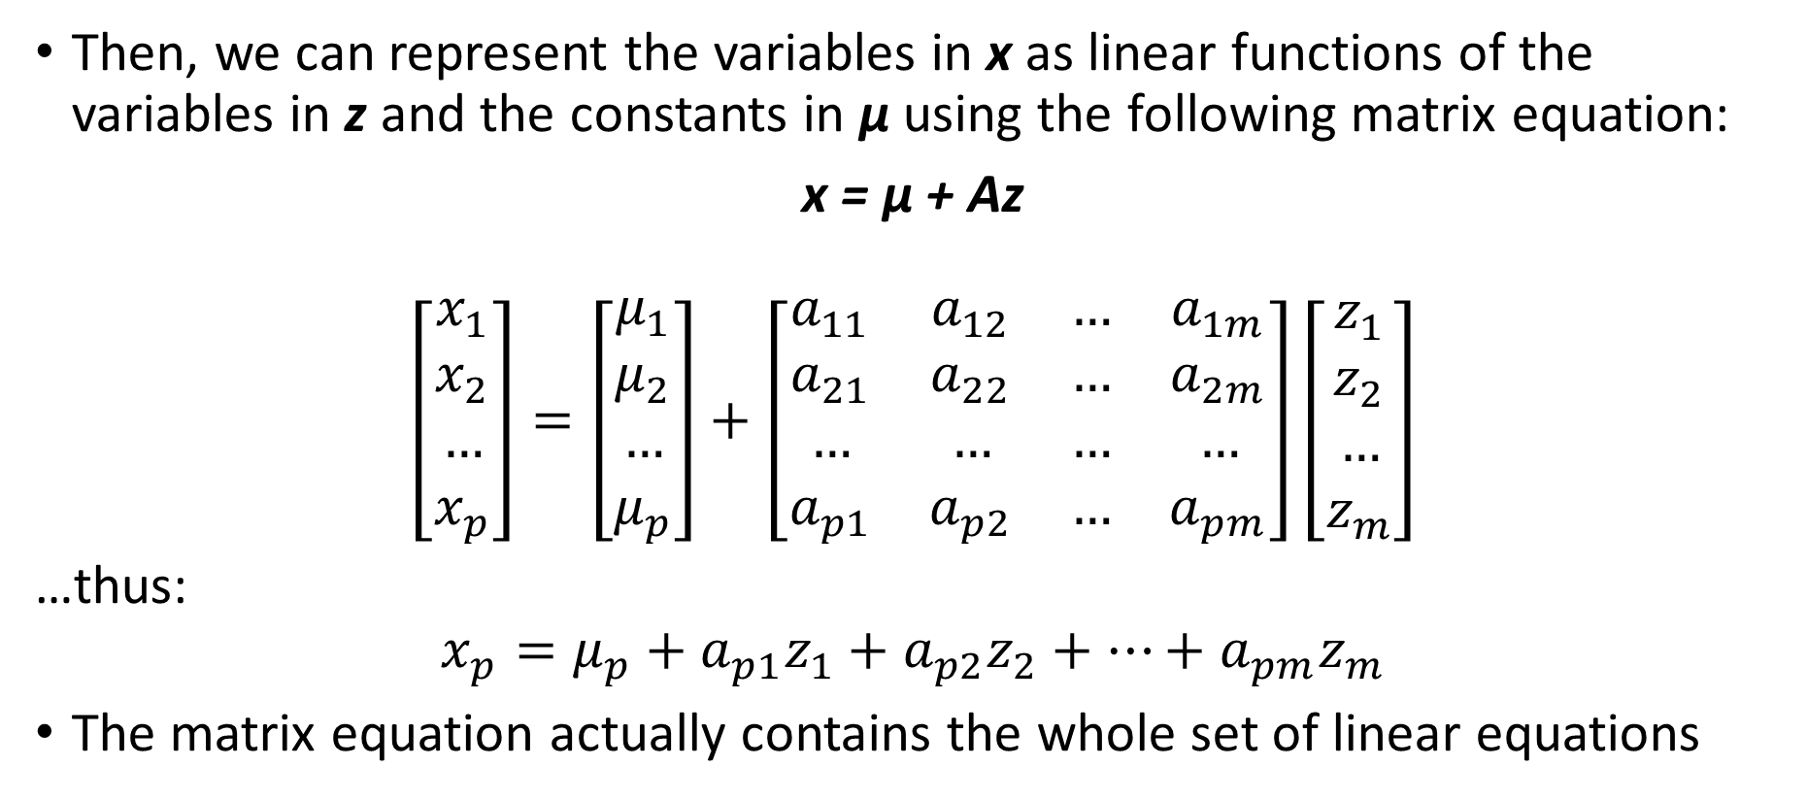
Linear combinations of random variables
Then, we can represent the variables in x as linear functions of the variables in z and the constants in μ using the following matrix equation:
x = μ + Az
$$\left[\begin{matrix}x_{1} \\ x_{2} \\ … \\ x_{p}\end{matrix}\right]=\left[\begin{matrix}μ_{1} \\ μ_{2} \\ … \\ μ_{p}\end{matrix}\right]+\left[\begin{matrix}a_{11} & a_{12} & … & a_{1m} \\ a_{21} & a_{22} & … & a_{2m} \\ … & … & … & … \\ a_{p1} & a_{p2} & … & a_{pm}\end{matrix}\right]\left[\begin{matrix}z_{1} \\ z_{2} \\ … \\ z_{m}\end{matrix}\right]$$
…thus:
$$x_{p}=μ_{p}+a_{p1}z_{1}+a_{p2}z_{2}+…+a_{pm}z_{m}$$
The matrix equation actually contains the whole set of linear equations

Slide 30
An intermezzo – expected values
Wiki: “The expected value of random variable is the long-run average value of repetitions of the experiment it represents”
...so, the expected value is the variable’s mean.
E[X] = μ

Slide 31
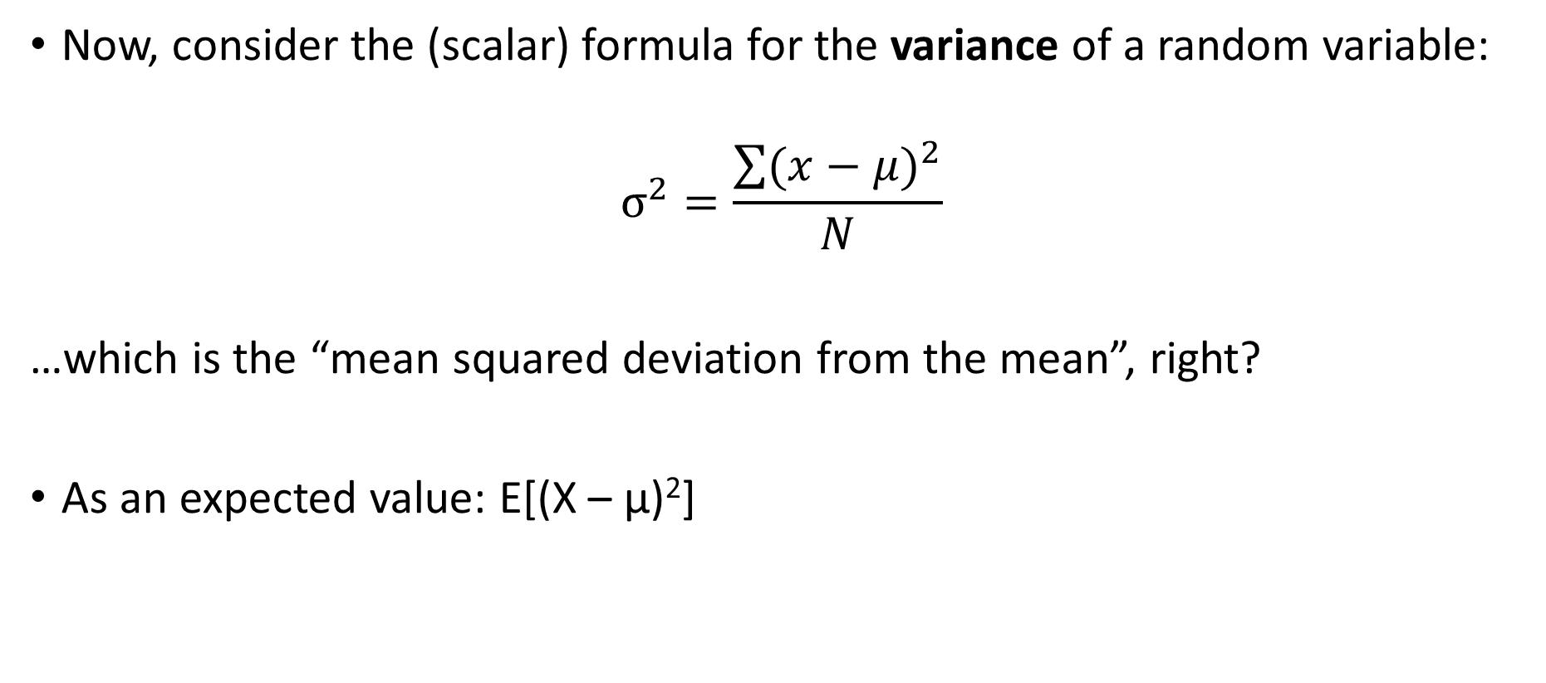
An intermezzo – expected values
Now, consider the (scalar) formula for the variance of a random variable:
$$σ^{2}=\frac{\sum{{(x−μ)}^{2}}}{N}$$
…which is the “mean squared deviation from the mean”, right?
As an expected value: E[(X – μ)²]

Slide 32
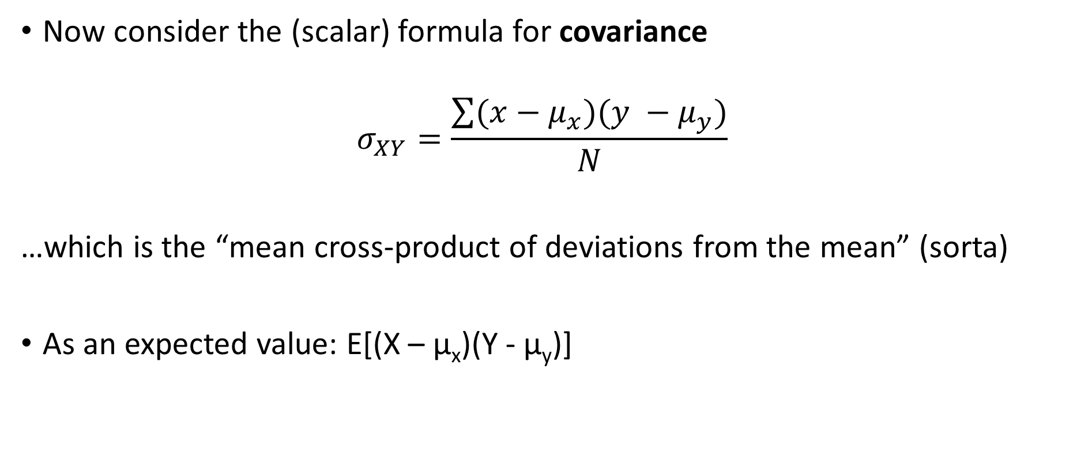
An intermezzo – expected values
Now consider the (scalar) formula for covariance
$$σ_{XY}=\frac{\sum{(x−μ_{x})(y −μ_{y})}}{N}$$
…which is the “mean cross-product of deviations from the mean” (sorta)
As an expected value: E[(X – μ_{x})(Y - μ_{y})]

Slide 33
Covariance matrix
Now suppose that x is a vector of order p containing scores on p variables for a random individual selected from some population, and μ is a vector of order p containing the population means of these p variables.
Then, vector (x – μ) stands for the vector x with the population means subtracted (it represents deviations from the mean)
Let’s multiply this vector by its transpose:
(x – μ) (x – μ)’

Slide 34
Covariance matrix
Let’s multiply this vector by its transpose:
(x – μ) (x – μ)’
…and take the expectation:
E[(x – μ) (x – μ)’]

Slide 35
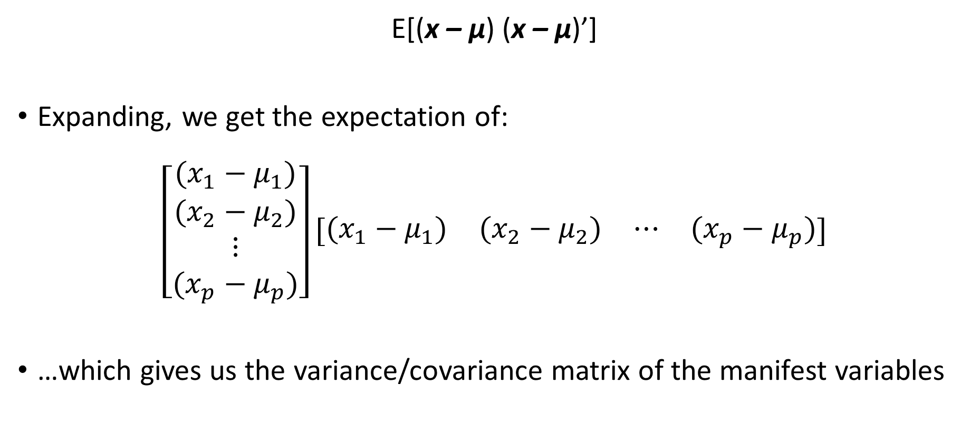
Covariance matrix
E[(x – μ) (x – μ)’]
Expanding, we get the expectation of:
$$\left[\begin{matrix}(x_{1}−μ_{1}) \\ (x_{2}−μ_{2}) \\ ⋮ \\ (x_{p}−μ_{p})\end{matrix}\right]\left[\begin{matrix}(x_{1}−μ_{1}) & (x_{2}−μ_{2}) & ⋯ & (x_{p}−μ_{p})\end{matrix}\right]$$
…which gives us the variance/covariance matrix of the manifest variables

Slide 36
Covariance matrix
E[(x – μ) (x – μ)’]
The variance-covariance matrix is a p x p symmetric matrix with variances on the diagonal and covariances off the diagonal

