Slide 1
Global Media Industries
Week 3

Slide 2
New Technologies
https://www.youtube.com/watch?v=Wf6omuz1MrM
https://www.youtube.com/watch?v=nPEn5k55g-o
https://www.youtube.com/watch?v=ZmFZTTz8IH0
https://www.youtube.com/watch?v=ZmFZTTz8IH0
https://www.youtube.com/watch?v=dkddSaOOZcs

Slide 3
What constitutes the media industry?
Print: Newspapers, Magazines… (Flipboard)
Film: Cinema & (Netflix)
Recordings: CD & (Spotify & Apple Music)
Broadcast: TV & Radio (Netflix)
PR and Advertising
World Wide Web
Mobile

Slide 4
Print Media
Mass Production: Movable type
Mass Distribution: Publishers and Periodicals
Mass Consumption: Public Education & Informed Publics
Consequences: Public Sphere, Imagined Communities, Mass Communication

Slide 5
Radio
Mass Production: Public Communication & Propaganda
Mass Distribution: Technological Availability
Mass Consumption: Lifestyle – Regular work and division of Labor & Automobile and Commuting
Consequances
Propaganda: Rise of Fascism
Mass music industry
Egalitarian Media: Emerging Community Media

Slide 6
Photography
Mass Production: Camera - Individualized Production
Mass Distribution: Mechanical Reproduction & Paper productions
Mass Consumption: From negative film to digital cameras
Consequences:
Arts in the age of Mechanical Reproduction – Dissociation of Time and Space (Benjamin)
photography entirely fulfils the aesthetic expectations of the working classes (Bourdieu)

Slide 7
Cinema
Mass Production: Hollywood System
Mass Distribution: Global Conglomeration & Multiplex
Mass Consumption: Capitalist lifestyle, Division of Labor, 9-5 System…
Consequences
New public gatherings vs Individual consumers
American cultural hegemony
Global Americanization
Industry!

Slide 8
Television
Mass Production: Media Conglomerates
Mass Distribution: Network, Cable, Satellite, and OTT
Mass Consumption: Egalitarian Network TV
Consequences
Disappearance of Childhood
No Sense of Place
Global Village
Modern Family

Slide 9
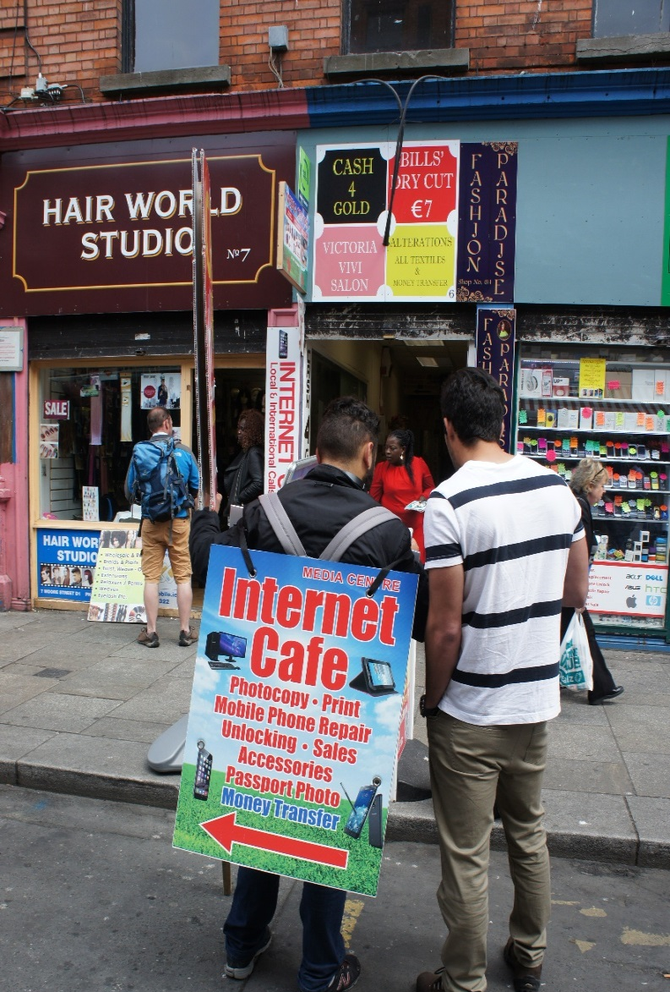
Internet
Mass Production:
Mass Distribution:
Mass Consumption:
Consequences:

