Slide 1

Big Data and Security
Moderní technologie a bezpečnost (BSSn4411)
Modern technologies and conflict (CDSn4003)
Jan Kleiner
2.11.2020

Slide 2
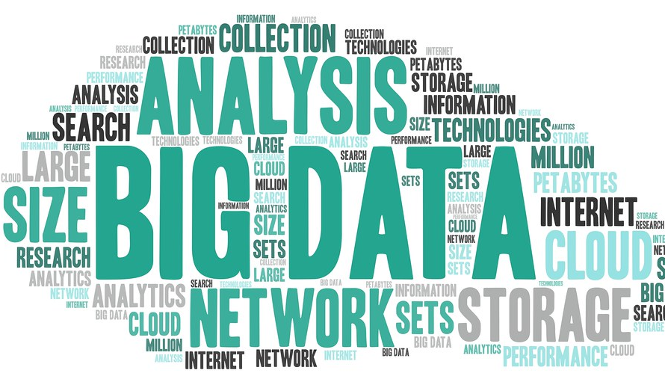
Presentation outline
Big Data – theoretical and methodological prism.
Legitimate ways of use.
Problematic ways of use.

Slide 3

Manyika et al. (2011, 1):
„Big Data refers to datasets, whose size is beyond the ability of typical database software tools to capture, store, manage, and analyse.“

Slide 4

Manyika et al. (2011, 1):
Definition intentionally subjective and moving.
It also depends on a software tools and usual data size in a given sector.
„… as technology advances over time, size of datasets that qualify as big data will also increase.“

Slide 5


Are data more valuable than oil?

Slide 6
Three approaches (PWC, 2019)
Market:
  Active markets for data are rare, mostly illegal.
  Shutterstock, Flicker.
Cost:
  Straight-forward, how much does the data currently cost (e.g. CPC).
  Fails to capture future revenues a holder can get from the data.
Income:
  Measure of cash flows the data are expected to generate.

Slide 7
Are data more valuable than oil? It depends on the data.

Slide 8
How to do research with Big Data?
The distinction from „normal“ research is in the data collection.
→ How to collect „Big Data“?
  Google – Trends, Keyword Planner, 3rd parties – SEMRush, Keywordtool
  Social media – Twitter API, scrapers (Octoparse)
  Wikileaks
  Pastebin
  Cyber security – Shodan (academic licence)
  Open science repositories
    https://openscience.muni.cz/
European legislation on open data and the re-use of public sector information
  https://ec.europa.eu/digital-single-market/en/european-legislation-reuse-public-sector-information

Slide 9
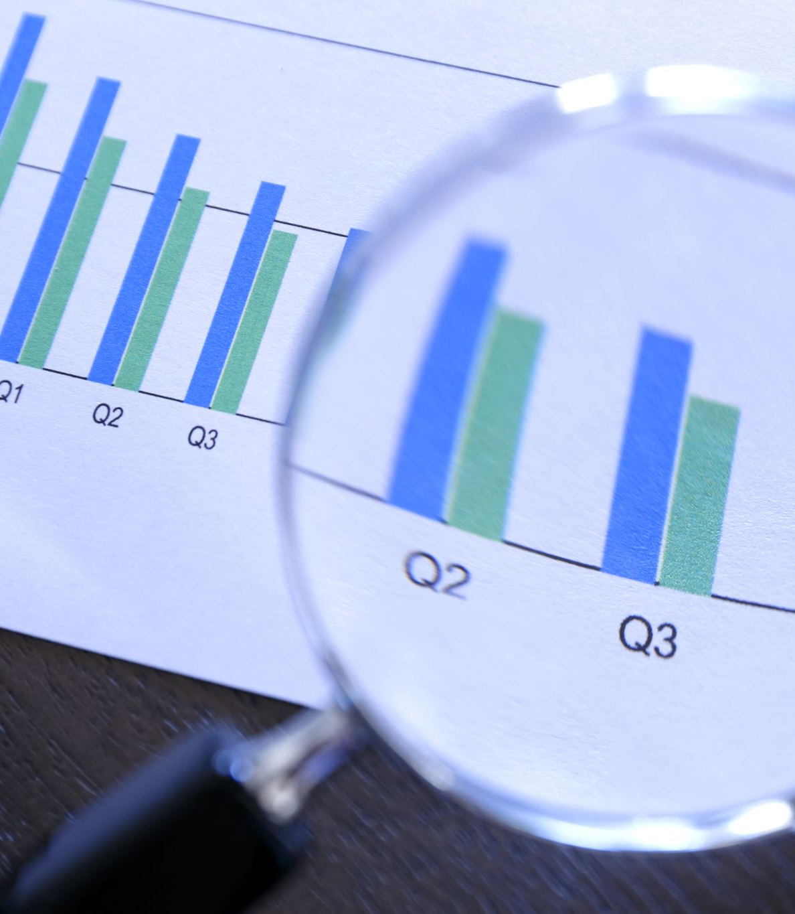
How is Big Data (e.g. searches from Google) different from „conventional“ survey/interview/experiment etc. data?

Slide 10

There are pros as well as cons (Davidowitz, 2015)
Overcome respondent bias (social desirability).
Efficiency. Wider and deeper insight.
Representativeness?
Population of searchers? How big is it?
Misformulated seed words.
We need to intepret results with explicit limits and deliberation in the relation with quantitative and qualitative methodologies.

Slide 11

Legitimate ways of use
Army and law enforcement recruitment (see Jahedi, Wenger and Yeung, 2016).
Studies on public perception (Kostakos, 2018).
And others…

Slide 12
Problematic ways of use
Cambridge Analytica (see Isaak and Hanna, 2018) – Facebook data.
Bulk surveillance (privacy vs. security debate) – e.g. PRISM programme exposed by Edward Snowden.
Wikileaks.

Slide 13
References
Manyika, J. et al. (2011). Executive summary: Big data: The next frontier for innovation, competition, and productivity. McKinsey Global Institute. Available from: https://www.mckinsey.com/business-functions/mckinsey-digital/our-insights/big-data-the-next-frontier-for-Innovation.
PWC. (2019). Putting a value on data. Available from: https://www.pwc.co.uk/data-analytics/documents/putting-value-on-data.pdf.
Jahedi, S., Wenger, J. W. a Yeung, D. (2016). Searching for Information online: Using Big Data to Identify the Concerns of Potential Army Recruits. RAND Corp. ISBN: 978-0-8330-9414-8. Available from: https://www.rand.org/pubs/research_reports/RR1197.html.
Isaak, J. and Hanna, M. J. (2018). User Data Privacy: Facebook, Cambridge Analytica, and Privacy Protection. Computer 51(8), pp. 56-59. DOI: 10.1109/MC.2018.3191268. Available from: https://ieeexplore.ieee.org/abstract/document/8436400
Davidowitz, S. S. a Varian, H. (2015). A Hands-on Guide to Google Data. pp. 9-25. (dostupné přes Google Scholar).
Kostakos, P. (2018). Public Perceptions on Organised Crime, Mafia,and Terrorism: A Big Data Analysis based onTwitter and Google Trends. International Journal of Cyber Criminology. 12(1). pp. 282-289. DOI: 10.5281/zenodo.1467919.

Slide 14

Thank you for the attention. Questions and your presentations.

