Slide 1
Democracy and democratization
Comparative Perspectives
Fall 2020
Marek Rybář

Slide 2
How to understand democracy
democracy is an “essentially contested concept”, i.e. a term with many definitions;
debates about how to define democracy are an important part of scholarly discussion of how democratic regimes functions
most theoreticians agree that political rights (elections) a basic freedoms are integral parts of democracy

Slide 3
What is democracy?
procedural (minimalist) definitions:
how the regime is organized and
what processes ensure citizen representation, accountability of elected representatives, and regime legitimacy
typical examples are definitions of J. Schumpeter a A. Przeworski

Slide 4
Schumpeter: a minimalist definition
free competition for votes
a mechanism used to select and deselect political leaders/rulers
"The democratic method is that institutional arrangement for arriving at political decisions in which individuals acquire the power to decide by means of a competitive struggle for the people's vote“

Slide 5
Minimalist exclusions
No social or economic aspects are included
No measure of accountability, responsibility, responsiveness or representation
No measure of freedom, liberties or human rights
No measure of participation e.g. universal franchise
No reference to civil‐military relations
What are ‘competitive’ elections?

Slide 6
Dahl: Polyarchy
For Dahl, modern democratic states can be understood in practice as ‘polyarchies’
These can be identified by the presence of certain key political institutions:
1) elected officials;
2) free and fair elections;
3) inclusive suffrage;
4) the right to run for office;
5) freedom of expression;
6) alternative information; and
7) associational autonomy

Slide 7
Pros and Cons?
Broader concept than simply elections
Expands range of civil liberties and political rights
Common basis for standard empirical measures (Freedom House and Polity IV)
Yet focuses only on negative freedoms – seeks to protect citizens from the power of the state
What of positive freedoms and social equality, cultural and economic rights?

Slide 8
Substantive definitions of democracy
reflect the depth and quality of democracy
democracy is not just about procedures, it is also about outputs
regimes can deepen the degree of their democracy
participation, social inclusion, the role of civil society, racial, gender and other types of equality, institutional performance, absence of corruption, poverty and social inequality

Slide 9
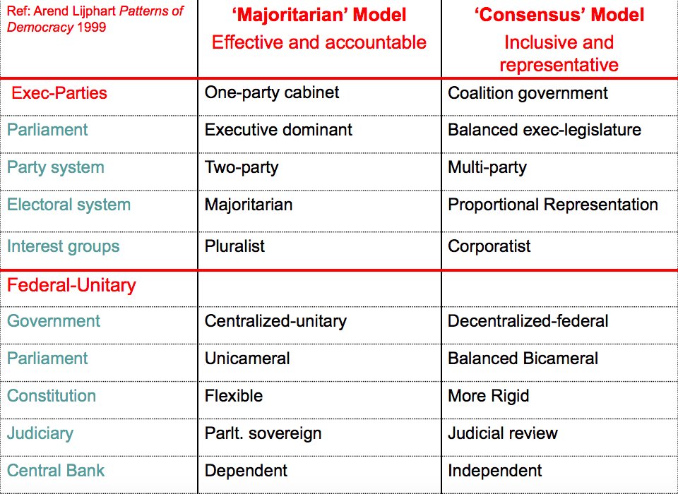
Differences between democracies
Lijphart (1984, 1999)

Slide 10
Huntington: waves of democratization
three waves of democratization followed by anti-democratic reversals
1. 1826-1926 (followed by a fascist reversal),
2. 1945-1960s/70s
3. 1974-1989 (followed by a wave of authoritarian reversal, around 2000)

Slide 11
Dimensions of democracy
one dimension concerns the role of the people (demos): freedom of association, free and fair elections, freedom of expression, government derived from the people
second dimension concerns constitutional limits on the executive, checks and balances
liberal democracies perform well on both dimensions
illiberal democracies organize democratic elections (formal guarantees in place)
however, they have problems to guarantee constitutional limits on the executive power and generally perform poorly on the second dimension

Slide 12
Huntington’s Waves of Democracy--first wave 1828-1926
    Before WWI: U.S., Britain and settler colonies, France, Scandinavia, Italy, Argentina
    Then after WWI, post-Imperial Europe:
    Weimar Germany, Poland, Austria, Baltics, Czechoslovakia, plus Spain, Chile
Notes:
Suffrage for majority of adult males

Slide 13
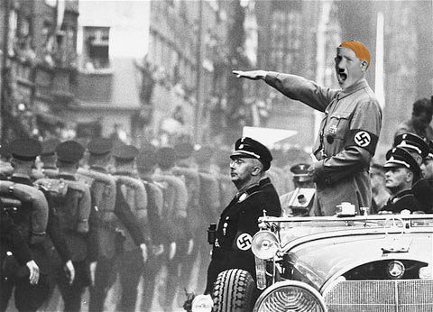
First reverse wave 1922-42
      Fascism, Soviet expansion

Slide 14
Second Wave 1943-62
    Fall of fascism
    Germany, Italy, Austria, Japan
    and many others--Korea, several in Latin America, India, Nigeria

Slide 15
Second reverse wave 1958-1973
    tensions of cold war, failures of new democracies, one-party model, rise of “bureaucratic authoritarianism”
    Greece, Turkey, Philippines, Korea, Indonesia, India, Africa, Latin America

Slide 16
Third Wave--1974-
    Last non-Communist European non-democracies fall--Spain, Portugal, Greece
    Latin American non-democracies transition out
    Asia--Taiwan, Korea, Philippines, India, etc.
    Fall of Communism
    South Africa, Nigeria

Slide 17
Third reverse wave?
    Brazil, Burundi, Russia, Hungary, Serbia, Turkey, Poland
    who is left?
    ___________________
    China and some of Asia
    Most of Africa
    Most Muslim nations

Slide 18
O’Donnell: Delegative democracy
Latin American, strongly majoritarian systems
free elections
after winning the executive office, few effective constraints
similar characteristics apply to other third-wave democracies:
in many countries, democratization effectively means free elections

Slide 19
Transformation of democracies over time
1. incorporation:
gradual incorporation of adult population into demos
limits on universal suffrage gradually lifted (sex, gender, property, education and race – the latter removed in South Africa only in 1994)

Slide 20
Incorporation
FRA, GER, SWI male universal suffrage since 1848, USA 1870
women’s right to vote spread slowly: - New Zealand1883, Australia 1902, Finland 1907, Switzerland 1971
age: typically from 25 to 21 and 18, in some countries 16

Slide 21
Transformation of democracies over time
2. representation: the right to form political organizations (parties) and gain parliamentary representation
in many countries effectively the same as introduction of PR electoral systems
PR typically introduced because the disenfranchised groups of voters/parties became stronger over time
Finland 1907, the Netherlands 1917, Germany 1918

Slide 22
Transformation of democracies over time
3. success of the organized opposition
situations in which all important democratic parties are accepted as legitimate governing alternatives
the Socialists in government: never in USA, Canada and Luxemburg
first Socialist breakthrough in Australia in 1904
Socialists in Europe gained power in the interwar period (Austria, Germany, Great Britain, Finland, Norway)

Slide 23
New transformations?
citizens are dissatisfied with some of the aspects of how democracies function
civic participation is in decline
turnout in elections declines, weakening of the identification of voters with their parties, decreasing levels of party membership
voters less interested in politics = ”nonpolitical"/expert solutions to public policy problems increases

Slide 24
New transformations?
independent agencies, regulátory bodies, central banks or external actors like the European Union
status of politicians and functioning of democratic institutions became the subjects of political competition
voters (referenda, participatory decision-making) or non-partisan institutions (regulatory bodies, agencies, the EU etc.) given more say
elections and parties are becoming less important than ever before

Slide 25
How democracies emerge?
Modernization
Lipset, Huntington, Przeworski:
modernization plays a key role in transition to, or consolidation of, democracy
Epstein et al (2006): besides democracies and non-democratic regimes, hybrid forms need to be taken into account
GDP per capita increases the likelihood of transition from authoritarian regime, however, a partial democracy/hybrid regime may emerge on its stead

Slide 26
How democracies emerge?
Dynamic models
D. Rustow: a dynamic model of transition
no social requisites, no democratic political culture required
the power equilibrium between competing groups of elites fighting for power and resources
if the balance of powers last for a long time, they may agree on a peaceful way to resolve their conflicts, i.e. elections
elite consensus on the rules of the game is crucial

Slide 27
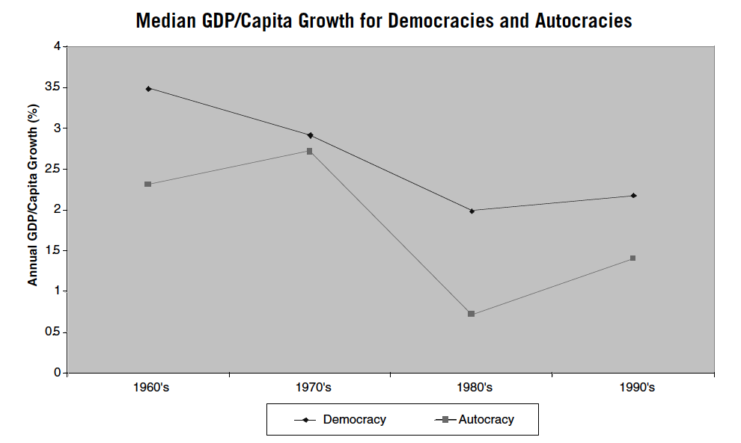
Consequences of democracies: Halperin et al 2010

Slide 28
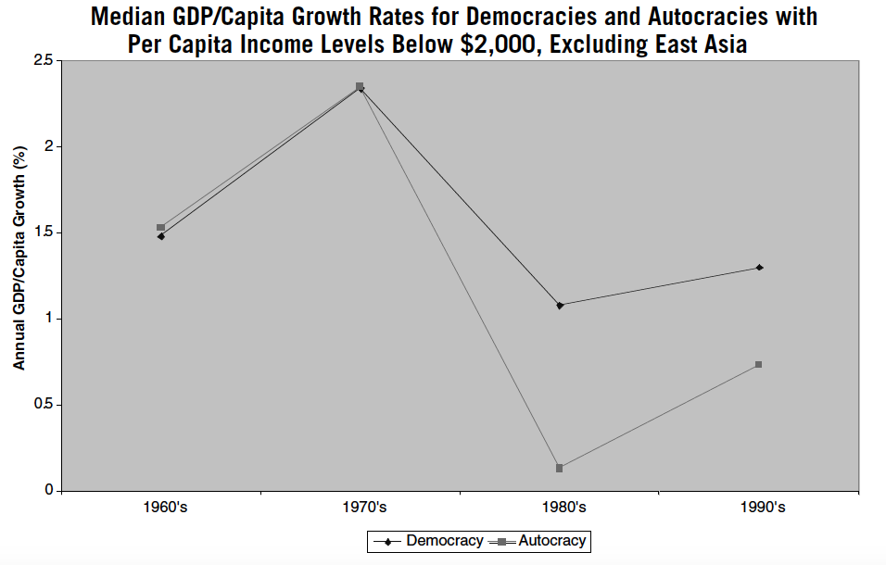
Low income democracies and autocracies

Slide 29
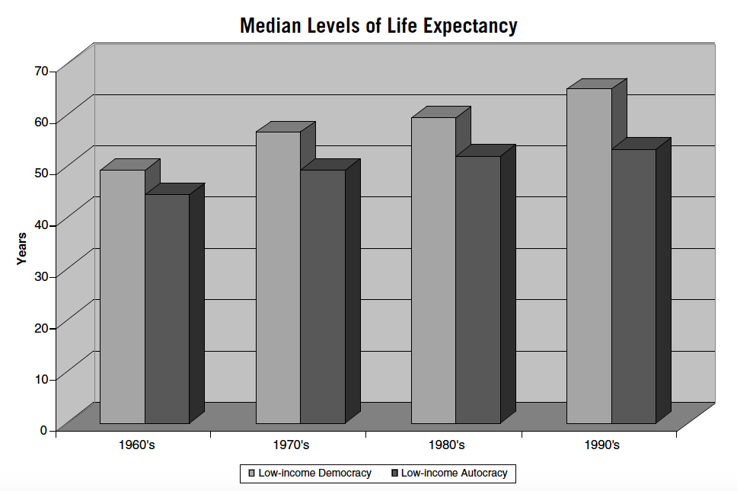
Other indicators 1/2

Slide 30
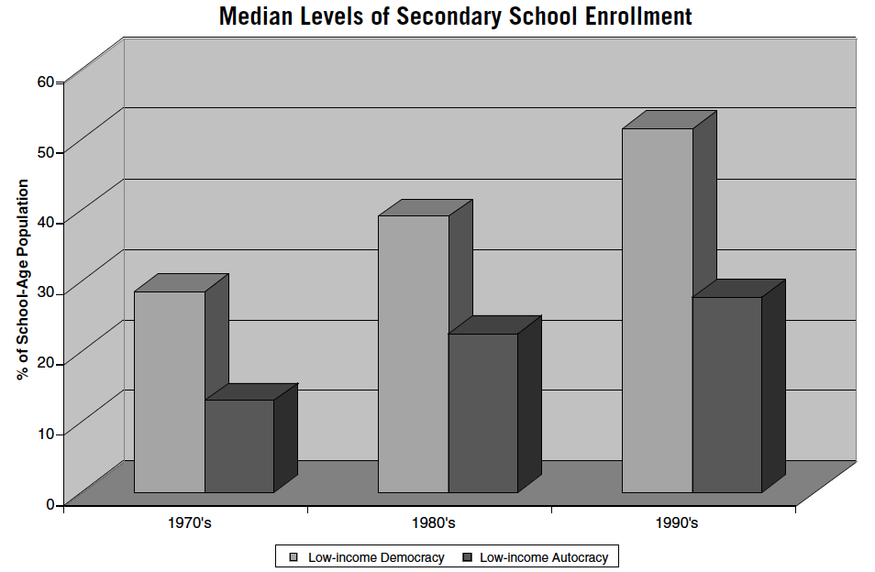
Other indicators 2/2

Slide 31
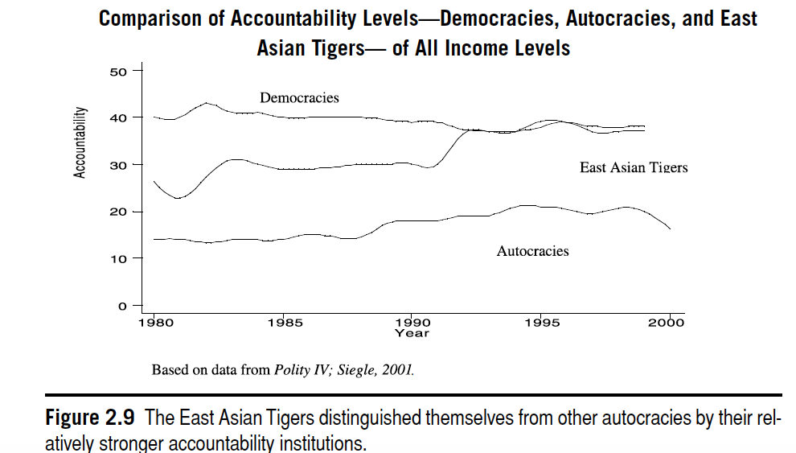
WHY?
Accountability institutions matter

