Slide 1
Class 1 Introduction: capitalist natures
Masters in Environmental Studies, 2020-21
Masaryk University, Brno, Czech Republic
Christos Zografos, PhD
Department of Political and Social Sciences, Universitat Pompeu Fabra, Barcelona, Spain
christos.zografos@upf.edu

Slide 2
Introductions: a bit about me
Senior Research Fellow
Background:
Studies
Jobs
Research interests
Notes:
Research Group on Health Inequalities, Environment - Employment Conditions Network
Profile | professional record
Tb. DEA History and Economic Institutions
Profile | professional record
Tb. Masaryk Visiting Prof
Tb. Edinburgh U, Invited Prof
Areas of research interest
Environmental conflicts
Climate change adaptation
Democracy (direct) and degrowth
Motivation for taking course
Usually, in smaller classes I ask each person individually, but this is large class..
So, some questions for those who would like to answer:
Why are you taking this course? Share
How relevant to your degree?
Other reasons?

Slide 3
Introductions: students introduce themselves
Name
Course you are doing at Masaryk Uni
Place of origin
First degree in … from … University
Notes:
INTRODUCE MYSELF
Profile: a bit about me
Current post
Background: studies
Professional record (work)
Areas of research interest

Slide 4
Class outline
Introduction to course:
Logistics
Evaluations, etc.
Introduction to some key terms for the course
Fields and sub-disciplines used in the course
Terms/ concepts: politics, power, political ecology, etc.
Class 1: Capitalism and environmental transformation
Notes:
16.05. Introductions. 1, 2
Me: 2 min
Them: 8 min (20 seconds per student)
16.15. The course. 3-8
16.25. Key terms. 10-20
16.50. Capitalist natures: why inevitable (the reasoning). 21-31
17.20. When policies fail: Privatising wetlands + Environmental movement. 42, 43
[17.30. 10-min LEEWAY]
17.40. BREAK – 20 mins
18.00. Evidence: the case of soil erosion. 32-35
18.20. Degradation as a condition for capitalism. Classroom activity. 45-46:
15 min: read
15 min: discuss and prepare answers
12 min: each group presents
3 min: I explain
19.10. Degradation as a condition for capitalism. 47-49
19.15. Summarising. 51
19.20. End
[19.30. 10-min LEEWAY]

Slide 5
1. Introduction to the course

Slide 6
Course structure
Course aims
How power influences environmental change and governance
Environmental social science (political ecology) + environmental history
Develop critical understanding of environmental change and relevance of power and politics in producing it
Course logic
Structure of classes
Reading and assignment (upload to IS: 2 hours before the class)
Answer assignment in class (individually, small groups, whole class)
Classroom activities
Lecturing: expand points from reading; summarise class
* Notes pages of ppt
Notes:
COURSE AIMS
How power influences environmental change and governance, from an environmental social science perspective.
The classes draw on disciplines of political ecology and environmental history that explain how environmental change is produced and what are its social implications.
COURSE LOGIC
Based on a political ecology explanation of environmental transformation (will describe what this means later in this class), the logic of this short course is:
The political economy is a major force in producing environmental change. Class 1 explains how this is
The exercise of power mediates, implements, facilitates that political economy-driven environmental change. Class 2 presents a mainstream understanding of how power works (power imposed from the outside), and Class 3 presents a more nuanced, less obvious way in which power operates to facilitate the political economy-driven production of environmental change
Of course this is political ecology at its ‘barest’, i.e. its most essential; missing are: power as agency; agency of nature (materiality); hybridity and marginalisation as opportunity; etc.
STRUCTURE OF CLASSES
Classes based on 1 reading (i.e. article or chapter) done by students before the class
Students will answer a question (max. 500 words) based on the reading and bring their answers in class where they are asked to discuss their answers individually, in small groups, or collectively (whole class) in the classroom.
The class is complemented with classroom activities
and a more ‘traditional’ lecture format in I explain further points related to the topic and concludes with a summary of main points raised with the class.
Participation in class: very important. I want the class to be participatory (not any type of participation☺)

Slide 7
Course evaluation
Essay (70%)
Deadline: Thursday 17 December 2020
Late submissions: ‘Fail’
If you get less than 50% overall mark, then chance for another short essay
Individual or Collective essay
Collective: maximum 2 students per group
Group will produce one essay
I mark the essay, i.e. both students get same mark
Topic: Klein, N. 2016. Let Them Drown. The Violence of Othering in a Warming World.
Answer 3 questions
max 1,000 words (excluding references)
I will explain into more detail what you need to do for this in Class 3
Class participation (30%)
Student commitment and performance in answering class assignment: 10% per assignment
You should upload (IS) each assignment 2 hours before class
I provide brief feedback to each class assignment (IS Notebook) and you can also ask me in person after the class
10%: eager to participate and constructive comments in classroom
Grades:
FAIL
PASS
DISTINCTION
But: for MUNI system purposes I can only assign ‘Pass’ or ‘Fail’
Evaluation tool | % of final mark
Assignments and participation in classroom | 30%
Final Essay | 70%
7

Slide 8
A note on answering assignments
File name of your assignments
Your_name_assignmentnumber
E.g. Zografos_Christos_2
NOTHING ELSE PLEASE!
How to answer your assignment:
First, answer the question, e.g. in one sentence
Then, substantiate, support your answer with arguments (reasoning) + evidence from the text
Avoid being descriptive: don’t answer by simply describing a situation and don’t re-state what the question says!
Finally, you can say whether you agree-disagree with author, and why
8

Slide 9
Other
Can reach me through my email christos.zografos@upf.edu
Help with English (unknown words): http://dictionary.cambridge.org/
Do you have any questions re: course programme, structure, outputs, etc.?
9

Slide 10
2. Introduction to key terms
Notes:
I will introduce those terms in a bit of a piecemeal way without linking them directly to something we will look at immediately in the course
But later on you will (hopefully) see why they are useful, as you will need to understand what I mean when I’m using them (e.g. environmental governance), and how I use some of them (e.g. politics, power)

Slide 11
ACTIVITY 1: pollution
Watch:
Questions, discuss:
India pollution: Air quality reaches 'hazardous' levels in Delhi https://m.youtube.com/watch?v=9E-aJeRLmW8
Ground Report: Why Farmers Are Burning Stubble In Punjab https://m.youtube.com/watch?v=6y8z5bw9GO4
Watch: What makes Delhi's air so deadly: https://www.youtube.com/watch?v=bVzvZxW5n2Q
What goes on here? Who suffers?
What are the causes of this?
Why are there such levels of pollution?
What can be done?
Notes:
1. What goes one: Winners and losers; but mixed also!
2. CAUSES
- Economic: farmers cannot afford non-polluting practices/ not polluting in the first place. Many of those farmers are smallholders
- Political decisions, and the political economy: urban expansion (more population and pollution); India’s breadbasket (intensive agriculture) and water consumption; the water law
- The role of geography: mountains and air
- All factors mix together
A key element of this environmental change (pollution) and conflict is the way in which policy (and its aimed for environmental change, i.e. water preservation) has generated winners and losers
Sub-soil Water Preservation Act losers: farmers
Winners: to identify, must ask "who benefits from groundwater savings?”
But also: “in the 2000s rice farming here took off”
Political ecology would ask: why did it take off? How? To whose benefit?
Relevance of political economy (key term)
[More info on stubble burning
Why farmers in Punjab and Haryana continue to burn rice stubble: https://www.youtube.com/watch?v=pqUHM3jZfk4]

Slide 12
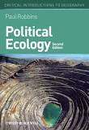
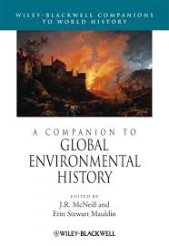
Fields and disciplines
Main ones used in course
Study: interaction humans – environment
Political ecology
Environmental change and its consequences
The causes of change
Power and politics: analytical concepts (more: later)
Environmental history
Human interaction with natural world over time
How humans shape their environment
How they are shaped by it: active role played by nature in human affairs (agency of nature)
Notes:
Political Ecology
Focus: explain environmental change (broadly speaking) and its consequences (e.g. environmental degradation such as pollution, environmental conflict, etc.)
By looking at its causes
By mobilizing power as an analytical concept to explain how and why change happens (will see later in this class)
Environmental change creates winners and losers
OR: POLITICAL ECOLOGY IN NUTSHELL
Environmental change (and its effects on human communities/ societies) is political
And so are:
environmental policy and governance (key social and political mechanism that manages and produces this change)
and the conflicts that ensue around it
Environmental change produces winners and losers
Some benefit (more) from such changes (e.g. Anglo-American settlers/ farmers)
Some benefit less or bear costs of change (e.g. Native Americans)
[* Note: broader understanding of governance, i.e. beyond formal/ regulatory, or normative “public decision-making” understanding]
Environmental History
Study of human interaction with natural world over time.
In contrast to other historical disciplines, it emphasizes the active role nature plays in influencing human affairs.
Environmental historians study how humans both shape their environment and are shaped by it.
Three components; study:
Nature itself and its change over time
Includes physical impact of humans on the Earth's land, water, atmosphere and biosphere
How humans use nature
the environmental consequences of increasing population, more effective technology and changing patterns of production and consumption
transition from nomadic hunter-gatherer communities to settled agriculture in the neolithic revolution
effects of colonial expansion and settlements, and the environmental and human consequences of the industrial and technological revolutions
Study how people think about nature - the way attitudes, beliefs and values influence interaction with nature, especially in the form of myths, religion and science
Examples of studies and books
Donald Worster ‘Dust Bowl’ - tells the story of the Dust Bowl in ecological as well as human terms. A story on the subject of the land and how humans interact with it
John McNeil ‘Mosquito Empires’ (we’ll see) – how mosquitoes have helped defend and then overthrow Spanish Empire in the Caribbean
Sam White ‘Climate of Rebellion’ - how imperial systems of provisioning and settlement that defined Ottoman power in the 1500s came unraveled in the face of ecological pressures and extreme cold and drought, leading to the outbreak of the destructive Celali Rebellion (1596–1610). This rebellion marked a turning point in Ottoman fortunes, as a combination of ongoing Little Ice Age climate fluctuations, nomad incursions, and rural disorder postponed Ottoman recovery over the following century, with enduring impacts on the region’s population, land use, and economy

Slide 13
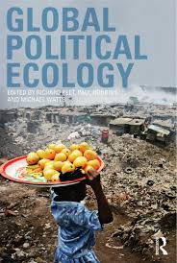
Political ecology (Simsik, 2007)
Field: to understand relationship human societies – nature
Environmental change is intrinsically political
Decisions (e.g. policy)
Consequences (e.g. environmental conflict)
Environmental change: unqueal distribution of ‘goods’ (benefits) and ‘bads’ (costs)
Winners and losers -> generation of conflict
Notes:
Instead of apolitical explanations of environmental change (e.g. there are conflicts around natural resources, because those resources are scarce)
Use political ecology to study environmental change
Academic field that seeks to understand relationship human societies – nature
Posits that environmental change is intrinsically political
And so are the decisions taken to produce environmental change (environmental governance)
And the implications or consequences of environmental change, e.g. conflict

Slide 14
Politics
Not confined to a particular sphere (e.g. government, the state)
Concerns production, distribution and use of resources in the course of social existence
At work in all social activities and every corner of human existence
Leftwich (1984): at heart of all collective social activity, formal and informal, public and private, in all human groups, institutions & societies
Takes place at every level of social interaction within families, amongst small groups of friends just as much as amongst nations and on the global stage
Radical feminist assertion: 'the personal is the political’
Notes:
FULL TEXT
The fourth definition of politics is both the broadest and the most radical. Rather than confining politics to a particular sphere (the government, the state or the 'public‘ realm) this view sees politics at work in all social activities and in every corner of human existence. As Adrian Leftwich proclaimed in What is Politics? The Activity and Its Study (1984:64), 'politics is at the heart of all collective social activity, formal and informal, public and private, in all human groups, institutions and societies'. In this sense, politics takes place at every level of social interaction; it can be found within families and amongst small groups of friends just as much as amongst nations and on the global stage.
At its broadest, politics concerns the production, distribution and use of
resources in the course of social existence. Politics is, in essence, power: the ability
to achieve a desired outcome, through whatever means.
This notion was neatly that 'the personal is the political'. This slogan neatly encapsulates the radicalfeminist
belief that what goes on in domestic, family and personal life is intensely
political, and indeed that it is the basis of all other political struggles. Clearly, a more
radical notion of politics underlies this position. This view was summed up by Kate
Millett in Sexual Politics (1969:23), in which she defined politics as 'powerstructured
relationships, arrangements whereby one group of persons is controlled
by another'. Feminists can therefore be said to be concerned with 'the politics of
everyday life'. In their view, relationships within the family, between husbands and
wives, and between parents and children, are every bit as political as relationships
between employers and workers, or between governments and citizens.
BP TEXT: RADICAL FEMINIST ASSERTION: 'THE PERSONAL IS THE POLITICAL’ means:
what goes on in domestic, family and personal life is intensely political - and indeed is the basis of all other political struggles
'the politics of everyday life’: relationships within family, between husbands and wives, and between parents and children, are every bit as political as relationships between employers and workers, or between governments and citizens

Slide 15
What do we mean by “political” in PE?
Politics as power
Power as a key analytical term for studying politics
In political ecology:
Power as a social relation built on asymmetrical distributions of resources and risks (Hornborg, 2001)
So, we study: practices and processes through which power is yielded and negotiated (Paulson et al., 2005)
Notes:
Yield: “give up control or responsibility of something” (Cambridge Dictionary)

Slide 16
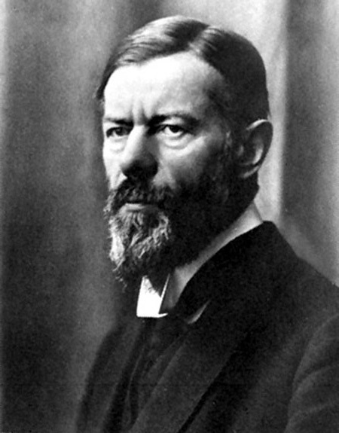
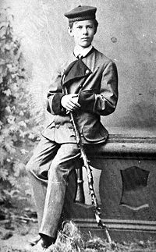
Defining Power
But what exactly is/ do we mean by power?
Max Weber: “chance of a man or a number of men to realise their own will in a social action even against the resistance of others”
In political ecology:
Two ways of understanding and studying power (how it operates)
Source: Public Domain

Slide 17
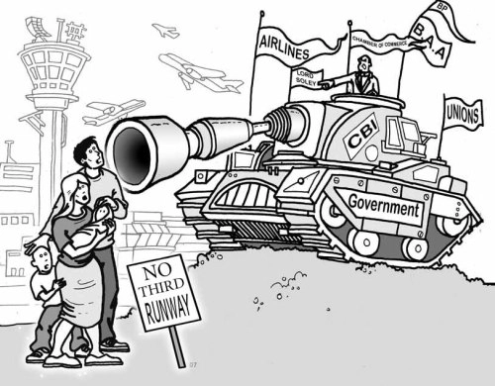
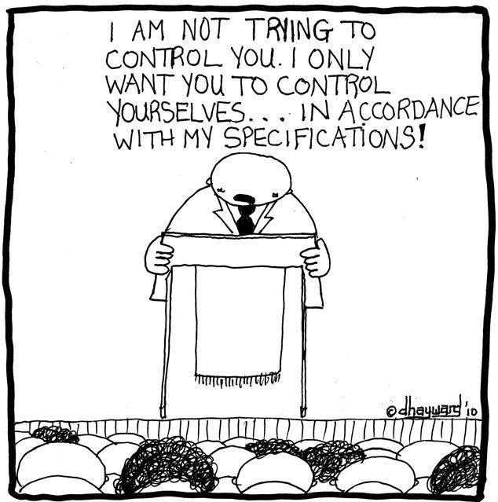
Two types of power
Sovereign power
Internalised power
Capacity (of state and its institutions) to legitimately impose will; e.g. enclose resources for conservation
Note 1: multiplies/ controls degradation
Note 2: non-legitimate force as well
Power also expressed on how individuals come to obey and take things as natural (e.g. enclosure; property)
Internalising control and authority as normal and natural
How power is exercised within individuals
Source: mechanicsofpower.wordpress.com
Copyright: David Hayward (source: geotimes.co.id)
Notes:
Classes 2 and 3 will show examples of both sovereign and internalised power

Slide 18
The political economy
Political economy
Study of: how political institutions, the political environment, and the economic system influence each other (Oxford Dictionary)
Environmental issues:
How these shape the environment
how they produce environmental change
How environmental change shapes them back

Slide 19
3. Capitalist natures: capitalism and environmental degradation
“Capitalism inevitably produces environmental degradation”

Slide 20
ACTIVITY 2: Debate
Watch those three videos (in that order):
Free Markets and the Environment. https://www.youtube.com/watch?v=bAgFHuFXvzc
Climate Change : What Do We Need To Do To Address It, George Monbiot? https://www.youtube.com/watch?v=Ir-XjQhOyNQ
Is capitalism sustainable? https://www.youtube.com/watch?v=DsyCD4duIzg
Answer the question: So, does capitalism have to necessarily be bad for the environment?

Slide 21
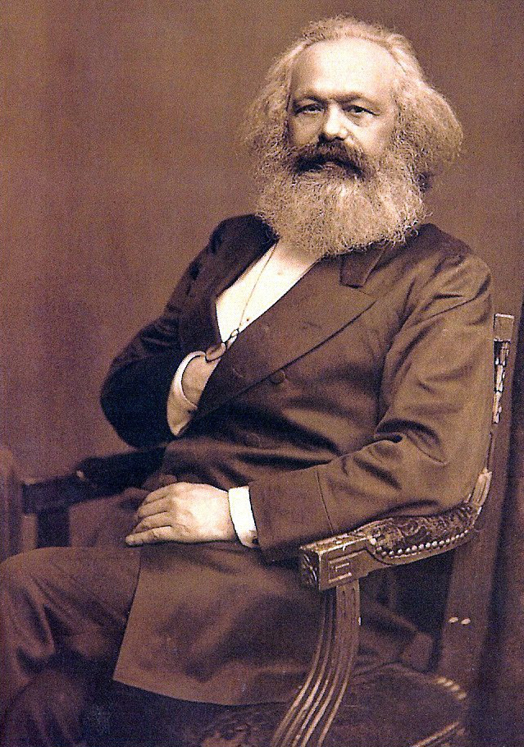
The green materialist claim
Robbins, 2004: environ degradation because
“all progress in capitalistic agriculture is the progress in the art, not only of robbing the labourer, but of robbing the soil; all progress in increasing the fertility of the soil for a given time, is a progress towards ruining the lasting sources of that fertility” (Marx, 1967)
Notes:
Because capitalism requires the extraction of value surplus from labour and nature
which involves extracting more than what you re-invest in nature (and compensate labour)

Slide 22
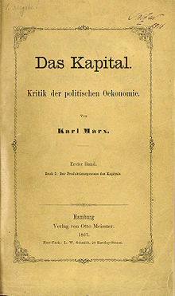
Value surplus: what is it?
Marx (1867)
“Yield, profit or return on production capital invested, i.e. amount of the increase in the value of capital…”
…after it goes through the production process
new value created by workers in excess of the cost of their own labour in the production process
excess:
appropriated by capitalist as profit when products are sold
not shared with worker/ labourer
Notes:
Value Surplus 1/4
surplus value = new value created by workers in excess of the cost of their own labour in the production process; excess: appropriated by capitalist as profit when products are sold
Surplus value = new value created by workers in excess of the cost of their own labour in the production process; excess: appropriated by capitalist as profit when products are sold
GENERAL FORMULA FOR CAPITAL (Spark Notes)
Marx says that capital's starting point is with the circulation of commodities. The ultimate product of this commodity circulation is money. We see this every day, when capital enters various markets in the form of money. Marx distinguishes two kinds of circulation. C-M-C (commodities transformed into money which is transformed back into commodities) is the direct form of circulation. In this case we sell commodities in order to buy more, and money acts as a kind of middle-man. However, there is also another form, M-C-M. In this case, we buy in order to sell; money is capital. The first phase transforms money into a commodity, the second transforms a commodity into money. Ultimately, then, we exchange money for money.
Use-value is the purpose of C-M-C, while exchange-value is the purpose of M-C-M. Money is indistinguishable, and it seems absurd to exchange it for itself. It is distinguishable only in amount. Thus, in M-C-M what really occurs is M-C-M', where M' = M + excess. This excess is called surplus-value. The original value adds to itself and converts the surplus value to capital.
In the end, money is again the starting point, and from M' we go to M'' and so on. Thus, the possessor of money becomes the capitalist. He is a capitalist in so far as the increase of wealth is the sole force behind his actions—in this role he is "capital personified and endowed with consciousness and a will." His aim is boundless enrichment. M-C-M' is the general formula for capital, as it appears in the sphere of circulation.

Slide 23
How is it generated?
Owner (shoe in mkt) = 40€
4 pairs (produced in 1h)= €160
Operational costs = 20€/ h
Worker prod (machine): 10€/ 15min = 40€/ hour
or: 4 pairs/ hour
Invest (put in prod) = 50€/ hour
Worker labour (wage) produces one shoe in 1h worth = 10€/ hour
Source: http://utama.info/
Profit (above value investment) = 80€/ hour
* not shared with labourer
Notes:
Example: shoe production with a machine that produces shoes
Worker wage: 10 €/ hour
Worker produces product worth = 10 € every 15 min = 40 €/hour
Because worker is productive, can produce an output value > what it costs to hire him
i.e. capitalist is paid 40 € when trading final product in market
Operational costs (e.g. machine depreciation, materials) = 20 €/ h
i.e. Investor puts 50 € in process (includes depreciation), e.g. to buy the factory buildings, machinery, etc. and gets 80 € out of process
Profit for capitalist: 80 €/ hour; i.e. has made 30 €> than value of his investment

Slide 24
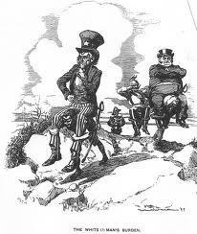
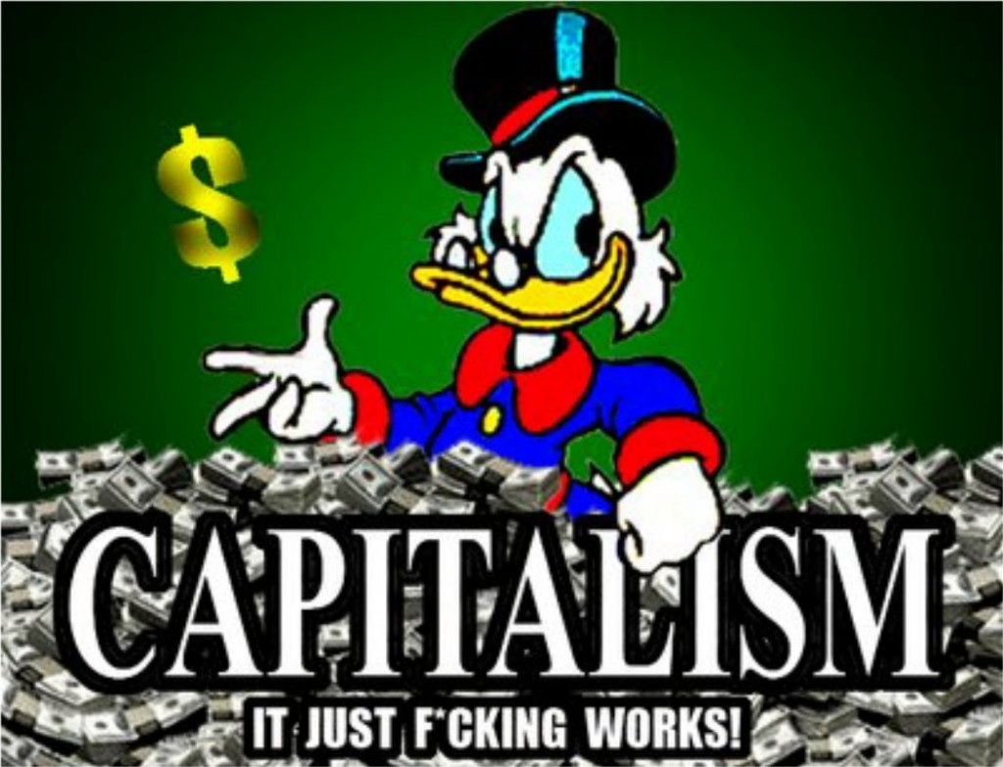
Why is it necessary?
Capital accumulation
http://weknowwhatsup.blogspot.com.es
Source: http://freedombunker.com
“Accumulate, accumulate! This is Moses and the Prophets!” (Marx, Capital, Vol 1)
Notes:
Value surplus 3/4
Making such easy money (appropriating work of others) is attractive for capitalist
But is also necessary for maintaining system (Kism)
It leads to capital accumulation = net addition to existing wealth + a re-distribution (from labourer to capitalist) of (created) wealth
New K is used to accumulate more K by re-investing in production process, financial assets, non-productive assets (e.g. works of art), human K, infrastructure, etc., i.e. on assets that permit creating more K
K accumulation is motor in engine of capitalist economy

Slide 25
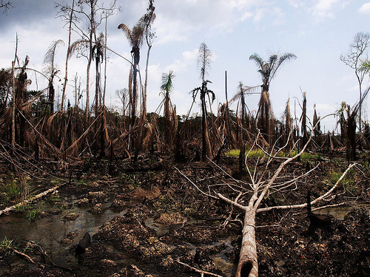
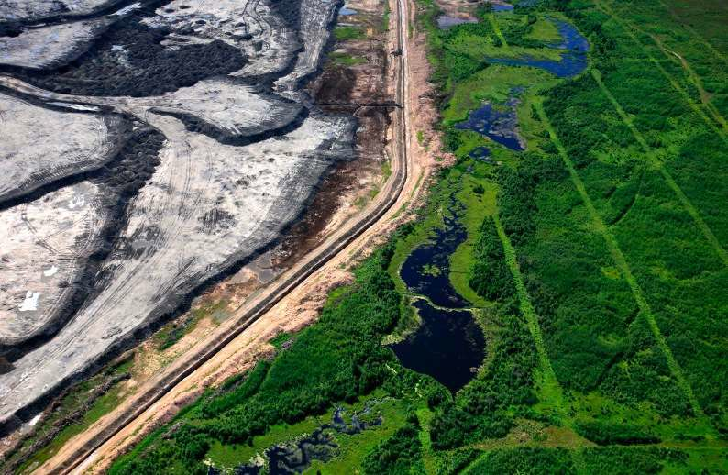
Extracting surplus from nature
Niger Delta (Nigeria) (Image: Sosialistisk Ungdom – SU/Flickr)
Tar Sands from space (source: http://stephenleahy.net)
Intensity of extraction > restoration
Notes:
REASONING
When (because) the rate and intensity of extraction > restoration
By expropriating nature’s capital and underinvesting in restoration or repair of impacted ecological systems
To make necessary profit (i.e. at the level needed for surplus accumulation):
Capitalist firm squeezes surplus from ecology – just as it squeezes surplus from labour (workers)
i.e. degradation is inevitable result of capital accumulation, when it becomes (as it regularly does) a necessary condition to achieve surplus (profit), and capital accumulation
* NOTE here how the “not shared with the labourer” example and condition for capitalism (accumulation) applies to nature: in order to ensure surplus, you don’t share it with nature in terms of “putting back” part of the surplus (or as much as it is necessary) for nature restoration

Slide 26
Second contradiction of capitalism
Capitalism degrades the material basis upon which it depends
James O’Connor (1988): contradiction capital accumulation vs. production conditions
Degrading production conditions is inevitable
Source: http://sovietrussianow.blogspot.com.es/
Notes:
What James O’Connor called second contradiction of capitalism
Which is a contradiction between K accumulation and production conditions
Marx says that there are THREE TYPES OF PRODUCTION CONDITIONS:
External physical conditions: viability of eco-systems, the adequacy of atmospheric ozone levels, the stability of coastlines and watersheds; soil, air and water quality
Labourpower: physical and mental well- being of workers; the kind and degree of socialization; toxicity of work relations and the workers' ability to cope; and human beings as social productive forces and biological organisms generally
Communal conditions: social capital," "infrastructure”
BACKGROUND INFO
The contradiction: Capitalism degrades the material basis (production conditions) upon which it depends
Acid rain; soil erosion; pesticide overuse; climate change, etc.
The health of workers, social K (e.g. community relation cohesion)
K makes use of those conditions, but it doesn’t produce them. The state either produces (e.g. infrastructure) or maintains (e.g. viability of ecosystems) them
Without those conditions in place, K cannot be accumulated.
Two implications
Capitalism carries within it, seeds of own destruction
Degrading production conditions is inevitable

Slide 27
Why Inevitable?
Why K degrades those conditions (Spence 2000)?
It is driven by individual capitals seeking to shore up [support and/or maintain] their profitability through cost-cutting which degrades, or fails to maintain, the material and social conditions of their own production
But these conditions are common to capitalist production as a whole, so capital-in-general is confronted with higher costs further down the road, in order to repair the damage done to the shared conditions of production by the short-termism of individual capitals (O'Connor, 1998)
Notes:
NOTE 1: O’Connor DESCRIBES A‘TRAGEDY OF COMMONS’ LOGIC
NOTE 2:
As concerns the system, i.e. capitalism, the second contradiction is thus a challenge of under-production (not producing enough to accumulate K) vs. the first contradiction which is a contradiction of over-production and over-accumulation
1st contradiction: not being able to realise (i.e. pocket) the surplus value which you have already extracted from workers
A problem, because (as a capitalist) you stay with K which you cannot put into ‘productive’ use, i.e. invest into something that will provide you with profit (surplus value), hence more K and so keep the treadmill (system) going
E.g. so the question (basic question in Km) becomes: where to find extra demand to sell product you need to extract in order to squeeze surplus of labour/ nature/ infrastructure, in a way that permits reproducing K?

Slide 28
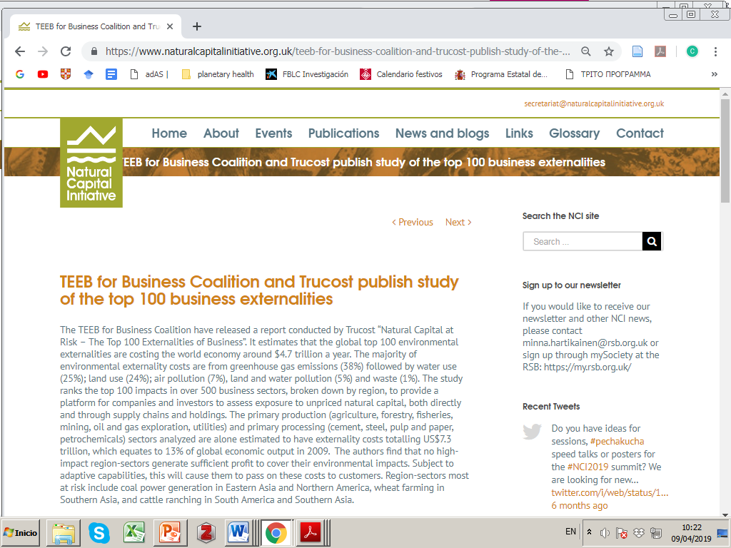
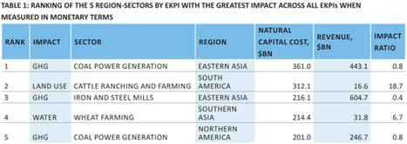
The 2nd contradiction in action (example): environmental impact and profit (surplus)
None of the world's top industries would be profitable if they paid for the natural capital they use
Source: grist.org - April 2, 2015 3:02 PM
A sobering new study finds that the world's biggest industries burn through $7.3 trillion worth of free natural capital a year. And it's the only reason they turn a profit.

Slide 29
[Contemporary experiences with enclosing NRs: privatising wetlands (Robertson, 2000)]
Source: http://www.biodiversityoffsets.net/
When wetlands stand in the way: “No Net Loss” by G. Bush Sr.
Solution: restoration wetlands
Robertson argues this is a case of “accumulation by dispossession” (next)
Privatision of public assets
That dispossesses public of its ecological wealth
Dispossess: how? Biodiversity-ecosystem perspective of restored wetlands
restored or created wetlands are often very different from natural
They are coarser + have less organic matter
Result: lower rate of colnisation by plants
Lower capacity for nutrient cycling: key wetland ecological function
Notes:
Exploitation of urban land (e.g. building malls, housing, etc.), a very lucrative (highly profit-making) economic activity
Capital accumulation opportunity of high value
Case of wetlands: loss of many million acres more, the extinction of species, the disappearance of wilderness and wildlife
THE NO NET LOSS POLICY
The solution (George HW Bush): restoration/ mitigation wetlands!
Need to sacrifice wetlands for K accumulation project
Urban development (malls)
Substitute natural wetlands with artificial ones
You buy (from state) wetland to use as land to build your mall
(I argue that) this is a case of both
Privatisation of public assets (wetlands)
But also: dispossession of wealth (ecological) from public
The first is relatively straightforward: with the justification of restoration, wetlands pass from being public property to become private (land to sell to e.g. build malls)
The second is a bit more complicated, and has to do with the ecological implications of restored vs. original wetlands
From a biodiversity and ecosystem perspective
Policies may not be working because restored or created wetlands are often very different from natural wetlands
Many restoration projects are fail to recognize that wetlands are parts of larger landscapes
Use design parameters that exclude important features of natural wetlands
E.g. invertebrate species assemblages different in coastal constructed vs. natural wetlands
Differences due to the fact that the substrates in the constructed wetland were coarser and had lower organic matter, which resulted in a lower rate of colonization by plants (lower capacity for nutrient cycling, key wetland ecological function)
https://www.researchgate.net/publication/309173119_Nutrient_Cycling_in_Wetlands_Supporting_Services: Nutrient cycling is a supporting ecosystem services. The supporting services are perhaps the most overlooked of all ecosystem services, relating largely to processes within ecosystems – also including soil formation, habitat for wildlife, photosynthetic productivity and oxygen generation, and water recycling – that though not directly consumed are fundamental for the resilience of ecosystems and their capacity to produce other, more directly consumed services
Wetland protection policies may be inadequate to preserve and restore ecological processes such as nutrient cycling
because they mostly focus on individual wetlands and ignore the fact that wetlands are integral parts of landscapes (Whigham 1999) - https://www.researchgate.net/publication/222497001_Ecological_Issues_Related_to_Wetland_Preservation_Restoration_Creation_and_Assessment
Wetland mitigation projects often result in the exchange of one type of wetland for another and result in a loss of wetland functions at the landscape level
No Net Loss: now with EU as well (“to a theatre near you”)!

Slide 30
Accumulation by dispossession
David Harvey (2004):
Neoliberal policies in western nations from 1970s onwards…
…result in centralization of wealth and power in the hands of a few…
…by dispossessing the public of their wealth or land (publicly-owned assets, e.g. water, forests, etc.)…
…that pass to become private property
Privatisation: main practice
Reuters: Roy Letkey (source: www.abc.net.au)
Notes:
Harvey, 2004: …
Four practices:
Privatization (major practice)
financialization
management and manipulation of crises
state redistributions
E.g. Thatcher’s privatisation of social housing UK
Idea: pass from rental to ownership-> control assets-> increase wealth (increase your assets = a house)
Housing speculation for central location housing
Pushes poorer populations in the periphery (long – and at cases: expensive – commuting to work, makes their lives more difficult)
New homeowners: borrowing money (bank)-> increased profits (housing prices) transferred to banks
COSTS: for both poorer populations + new homeowners (debt); BENEFITS banks (increased profits)

Slide 31
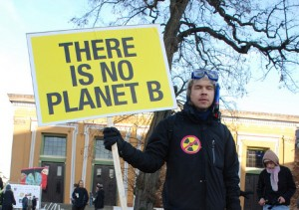
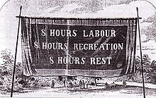
Implications: environmental movements
Labour movement
Environmental movement
Image credit: america.gov/Flickr
Notes:
Pillage of nature must [inevitably] result in political response
As labour movement = result of capital squeezing surplus out of labour’s work (worker’s exploitation)
Environmental movement = result of exploitation of nature
Paradox: in capitalism’s excesses lie the seeds of more sustainable and equitable practices

Slide 32
Accumulation by dispossession
The previous are contemporary examples of ways in which capitalism produces environmental degradation
Claim: capitalism degrades the environment to generate the necessary profit (surplus value) in order to maintain the capital accumulation project running which is essential for the preservation and continuation of the system (capitalism)
But there are also historical examples

Slide 33
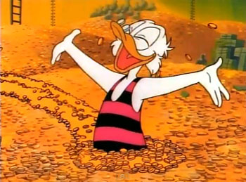
Primitive accumulation
Source: http://pixgood.com
The question: how did some people manage to accumulate capital in the first place?
Notes:
The question: how did some people managed to accumulate capital in the first place?
And become (the class of) capitalists, i.e. those who have amassed capital?
Harvey (2005) summarising Marx: PA entailed
taking land, e.g. enclosing it
expelling a resident population (creating landless proletariat, who became cheap industrial workers)
releasing land for private owners to buy and use it to accumulate K
Preferred materialist example of PA: European (English) enclosures (16th cent.)

Slide 34
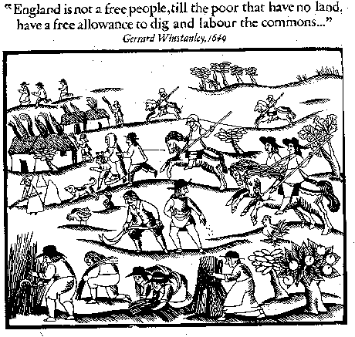
Primitive accumulation: example
Source: https://theliberi.wordpress.com
English 16th – 19th century enclosures
Notes:
English 16th – 19th century enclosures
Common lands: privately owned, but commonly used
Based on tradition of common rights
Practicing arable farming in open fields (subsistence farming)
Enclosure = the moment when fencing (enclosing) land entitled to private owners
Either by buying common rights or law-and-use-of-force to enclose
Dispossessed commoners become landless working force (class) used in industrial revolution (north England)
In the enclosed land: landowners adopt practices that generate more profit
Sheep that paid better for their wool (demand for English wool in 16th cent), tallow (fat for candles, etc.), and meat
When sheep prices declined (1650s): owners adopt “improved” agricultural practices (fertilisers, new crops) and economies of scale

Slide 35
Ecological effects of sheep overgrazing
Source: www.fs.fed.us
Ecological degradation: soil erosion and deforestation
Notes:
But those land practices generate environmental impact:
Sheep destroy soil: overgrazing leads to -> deforestation: i.e. destruction of trees themselves, as well as forest ecology and services (e.g. soil erosion, landslide barriers, etc.)
Consider: “Overgrazing typically increases soil erosion.
Reduction in soil depth, soil organic matter and soil fertility impair the land's future natural and agricultural productivity.
Soil fertility can sometimes be mitigated by applying the appropriate lime and organic fertilizers.
However, the loss of soil depth and organic matter takes centuries to correct. Their loss is critical in determining the soil's water-holding capacity and how well pasture plants do during dry weather.”
Overgrazing environmental impacts:
Overgrazing reduces usefulness, productivity, and biodiversity of land and is one cause of desertification and erosion
Desertification (Princeton University Dictionary): “process of fertile land transforming into desert typically as a result of deforestation, drought or improper/inappropriate agriculture”
What do you do as capitalist producer? Move to another, still fertile place to overgraze (Monbiot on Kenya land enclosures)
Another e.g. to also consider: substitution of coal for wood (lack of wood) as fuel->smoke and soot in London (1578: Queen Elizabeth asks brewers to swap back to wood which they cannot)

Slide 36
Take away points
Environmental change is political
Winners and losers from environmental change
Asymmetrical power relations (more, next classes)
Political economy: role in producing change and injustice
Political economy of capitalism (capitalist natures)
Capital accumulation and the quest for value surplus are bound to (inevitably) produce environmental degradation
Two forms of accumulation: primitive, by dispossession
Notes:
ENVIRONMENTAL CHANGE IS POLITICAL
And so are environmental governance and the conflicts that ensue around it
Despite apolitical narratives of change and solutions
Political analysis of environmental change looks for aspects made invisible by apolitical explanations:
Winners and losers from environmental change
Political economy: its role in producing change and injustices
Asymmetrical (yet: not immutable) power relations facilitate environmental transformations according to the needs of the political economy (more on this – i.e. how this occurs – in next two classes)
Green governance: diverse mechanisms of power
BUT ALSO: ENVIRONMENTAL DEGRADATION IS ITSELF A CONDITION FOR K ACCUMULATION (SURPLUS VALUE)
Commodity frontiers: when ecology (and manpower) are exhausted, capital moves on to use and exhaust those resources in other places
Note: a simple definition of what term political economy means/ involves (wikipedia):
Political economy is the study of production and trade and their relations with law, custom and government; and with the distribution of national income and wealth.
In the late 19th century, the term "economics" gradually began to replace the term "political economy" with the rise of mathematical modelling coinciding with the publication of an influential textbook by Alfred Marshall in 1890.
use of the term "economics" began to overshadow "political economy" around roughly 1910, becoming the preferred term for the discipline by 1920
Today, the term "economics" usually refers to the narrow study of the economy absent other political and social considerations while the term "political economy" represents a distinct and competing approach.

