Slide 1
Class 2: Racialised natures
Masters in Environmental Studies, 2020-21
Masaryk University, Brno, Czech Republic
Christos Zografos, PhD
christos.zografos@upf.edu

Slide 2
This class
Explain environmental racism
Explain environmental justice
  What it is
  Its main dimensions
Look at racism and injustice as ideology

Slide 3
Activity 1.
Racism and environmental degradation
“…the uncontrolled growth of weeds and their emerging dominance in the landscape do appear to symbolize disorder, decay, and the absence of control that accompany years of political and fiscal neglect. Socially speaking, the significance of weeds is not what they do but, rather, what they represent; the same can be said for the abandoned autos, heaps of garbage, discarded needles, condoms, and drug paraphernalia, and broken glass that are pervasive throughout the park”
Why, according to Brownlow, have disorder and decay fallen upon Cobbs Creek?
How is racism relevant for understanding the environmental degradation of the Cobbs Creek urban park?
Answer in class:

Slide 4
Disorder and decay in Cobbs Creek
Why?
  A key factor/ key change that brought about disorder and decay
Loss of social (community) control mechanisms that ensured park security for everyone
What reasons produced this phenomenon?
  Racist decisions of a man in power (Rizzo): Public Administration neglect of park, community, and its services
  Change in gang culture
3

Slide 5
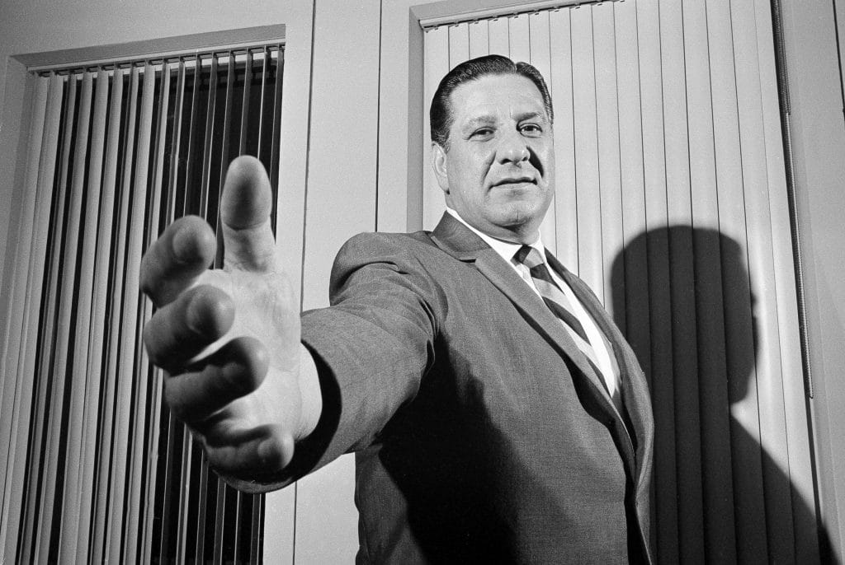
Decisions of a man in a seat of power
Frank (“The Big Bambino”) Rizzo: Police Commissioner turned Mayor
  Cuts park budget by 50%
  Reduces mounted Park Guard
  Removes park benches
Copyright: Bill Achatz/AP
Notes:
Police Commissioner & then Mayor Rizzo:
his actions led to a loss of surveillance (local community social control) mechanisms
Actions: Rizzo policies
1974: Mayor Rizzo cuts park budget by 50% (compared to previous admin)
reduce importance of mounted Park Guard (personal vendetta) through its reduction: from 500 guards to 24 and its integration with the Philadelphia Police Department,
removal of park benches upon which members of the community would sit and observe “the world passing by”. This also led to elimination of an important element of community self-surveillance (benches)

Slide 6
Park neglect and racial discrimination
Budget cuts started with Mayor Rizzo but continued: since early 80s (i.e. 3 decades = no increase)
budget cuts followed almost exact pattern as exodus of whites from the area

Slide 7
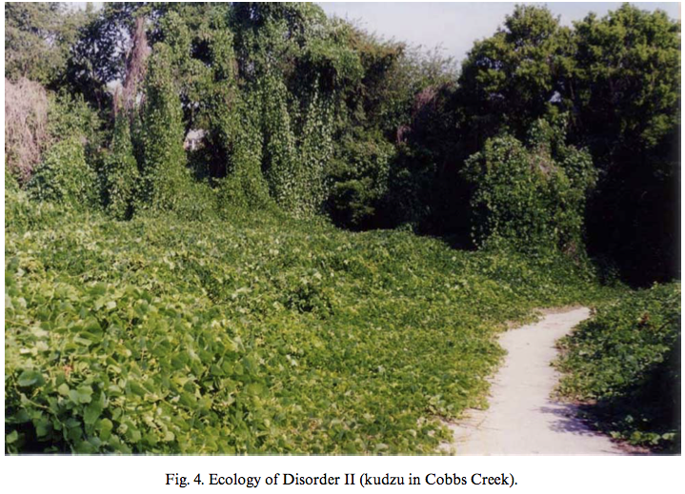
Changes in gang culture and US racial politics
The 50s: the “organic” gangs
  “Homegrown” gangs’ informal agreement over park's neutrality
Late 60s – early 70s: Black Power
  Cobbs Creek’s early gangs (and informal security) quietly disappear
Late 70s: the power vacuum
  Decline of black identity movement
  Outmigration
The 80s: end of the agreement
  Violent gangs: no agreements, unwritten or otherwise
John: “The park was sort of that neutral ground because everybody came to the park, and you had picnics out there and all kinds of things in that community – cook outs”
Tom: “It was an unwritten agreement that the park would be neutral”
Notes:
The 50s: Gangs' informal agreement over park's neutrality
Late60s +early70s:
growing pressure of black power movement to cease black-on-black violence and focus energy and anger on greater social and political wrongs
Cobbs Creek’s early gangs quietly disappear: informal park security they ensured also disappears
late 1970s:
decline of black identity movement
and outmigration of middle-class blacks leaves power vacuum
1980s: re-emergence of gangs
structure and membership not like “organic, homegrown gangs of the 1950s and 1960s”
more violent forms and structures mimicked gang activity in cities like L.A., Chicago, and New York, where there were no agreements, unwritten or otherwise
End of agreement: emergence of violence

Slide 8
Racism and the park: the bigger picture
Must analyse loss of social control mechanisms from wider perspective of evolution of power relations within city’s history
  civil rights movement, racial struggles, economic decay, etc.
  racist and racially explosive period: significant – but disproportionate – roles
Rizzo’s decisions to dismantle local social control mechanisms in Cobbs Creek: social control
  means to control social organization and activity of politically active
  removing primary public arena (the Park) of intercourse and exchange
7
Notes:
Loss of social control mechanisms must be analysed from a wider perspective of power relations' evolution within Philadelphia's recent history
civil rights movement, racial struggles, economic decay, etc.
the legacy of an overtly racist and racially explosive period in Philadelphia’s political history; one in which both the city’s governing, white elite and local black activists play significant, if disproportionate, roles.
Rizzo’s decisions to dismantle local social control mechanisms in Cobbs Creek can be seen as a form of social control
as a means of controlling social organization and activity among politically active black community during a period of racial upheaval
by removing/ controlling their primary public arena (the Park) of social intercourse and political exchange

Slide 9
Argument 1
Racism produces environmental degradation
Because: it offloads environmental ‘bads’ to non-white communities, by both
  depriving them of resources (park budgets)
  reducing their existing capacities to maintain a healthy environment (social control mechanisms)
Evidence:
  The racist-motivated actions of Mayor Rizzo
  The changes in gang culture
Notes:
EVIDENCE:
The racist-motivated actions of Mayor Rizzo in Philadelphia (60s-80s) that reduced city resources dedicated to maintaining the park and African American community’s social control mechanisms (park security)
The changes in gang culture, which were related to (result of) race struggles and which transformed the park (without social control mechanisms) into a space of illegality and violence

Slide 10
Environmental racism
From racism and degradation to environmental racism

Slide 11
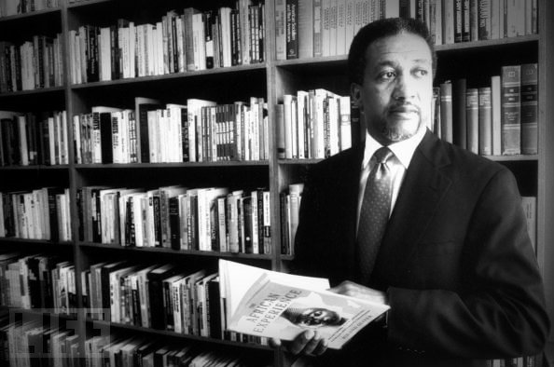
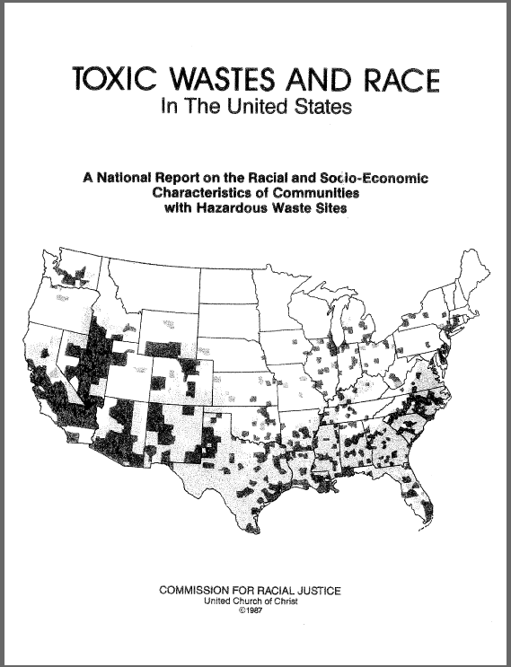
Environmental racism: The Term
The term
Reverend Dr. Benjamin F. Chavis Jr.
Toxic Waste and Race in the US (1987) report
First national study to document the strong correlation between race and hazardous landfill locations at a national level (USA)
Precedents
1982: popular protest and mobilization against a planned large hazardous waste dump in Warren County, a predominantly African-American community in North Carolina
Source: http://blackkudos.tumblr.com
Copyright: Jenny Labalme
Source: https://www.researchgate.net/figure/Environmental-justice-protests-against-dumping-PCB-contaminated-soil-in-an_fig1_260245549
Notes:
THE TERM
Civil rights leader Reverend Dr. Benjamin F. Chavis, Jr. first articulated the term environmental racism for a US audience during the presentation of the 1987 report Toxic Waste and Race in the United States (at the National Press Club in Washington D. C.)
THE REPORT done by the United Church of Christ Commission on Racial Justice (UCCCRJ) was the first national study to document the strong correlation between race and hazardous landfill locations at a national level.
In 1982, popular protest and mobilization against the planned hazardous waste dump for 40 thousand cubic yards of polychlorinated biphenyls (PCB)-contaminated soil in Warren County, a predominantly African-American community in North Carolina, is widely viewed the transformative event in the environmental justice movement.
During the Warren County struggle over the planned waste dump, church activists and Chavis, drew widespread attention to the unequal burden of African Americans to hazardous waste storage sites and the community’s marginalization in environmental decision making
ENDEMIC TO US HISTORY: Parallel story deeply rooted in ideological constructions of race, nature, and society
Colonial dispossession of Native American homelands to their expulsion from national parks and wilderness areas for the benefit of 19th century white, middle-class tourists and environmentalists, such as John Muir.
For the African-American community, slavery’s expropriation of environmental knowledge, reconstruction-era land loss, and consequent rural exodus to segregated urban centers, forcibly reconfiguring the community’s relationship to the natural world.
In the 20th century, racial and ethnic minorities [e.g. Hispanos] have faced increasing environmental hazards as they represent large percentages of the urban working class exposed to the toxic threats of industrial society in the workplace to neighborhoods yet excluded from the mainstream environmental movement.

Slide 12
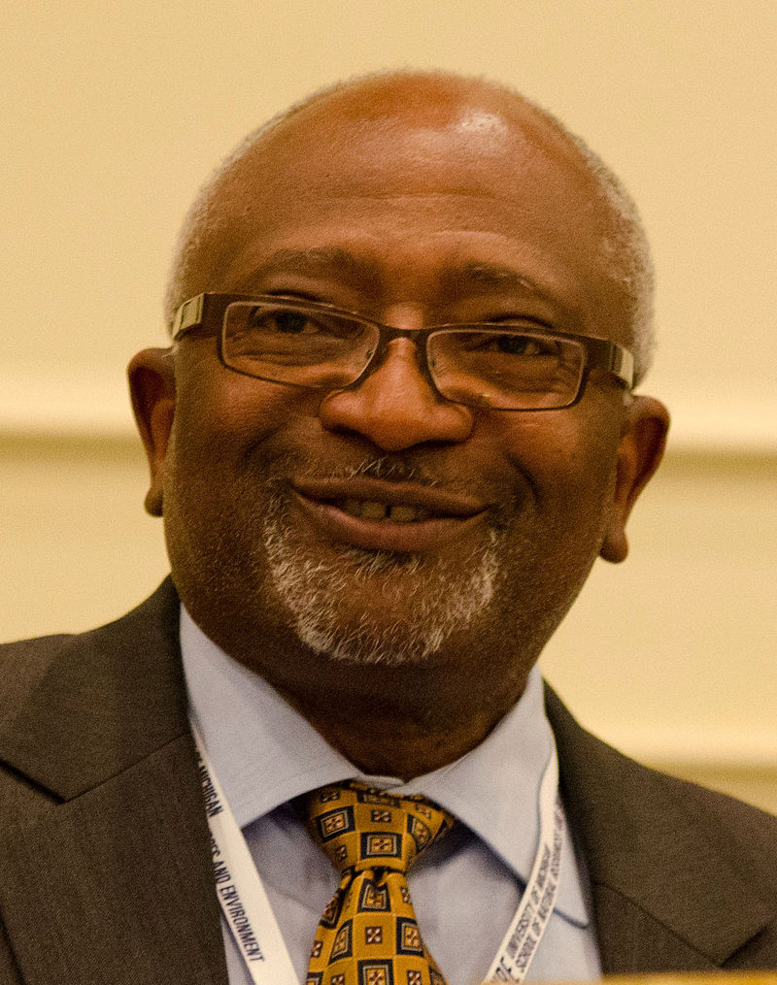
Environmental racism: example
Robert Bullard:
“even middle income African Americans are more likely to live in polluted neighbourghoods”
  Study: “African Americans making $50-60k income are more likely to live in polluted neighborhoods than White Americans who make just $10k/y
“minority neighborhoods (regardless of class) carrying a greater burden of localized costs than either affluent or poor white neighborhoods”
CC by 2.0
Copyright: Dave Brenner
Flickr - https://www.flickr.com/photos/snre/8057541429/

Slide 13
Environmental racism: definitions
Jepson, 2007: “intentional or unintentional…
  …racial discrimination in environmental decision-making, …
  …systematic exclusion of people of color from the mainstream environmental movement, …
  …negligent enforcement of environmental protections, laws and regulations along racial lines, …
  …and disproportionate distribution of environmental burdens on racial and ethnic minorities where they live, work, and play”
Notes:
DEFINITION (from encyclopeadia of Environment & Society): intentional or unintentional racial discrimination in environmental decision-making, systematic exclusion of people of color from the mainstream environmental movement negligent enforcement of environmental protections, laws and regulations along racial lines, and disproportionate distribution of environmental burdens on racial and ethnic minorities where they live, work, and play.

Slide 14
Environmental justice
Normative reaction to environmental racism
What should we do to ensure avoiding environmental racism
Activity 2. Watch the video: https://www.youtube.com/watch?v=dREtXUij6_c
Explain “What is environmental justice?” in your own words.
Imagine your mom, dad, sister, brother, etc. call you today and ask you “What did you learn at school today child?” Explain it to them on the phone!

Slide 15
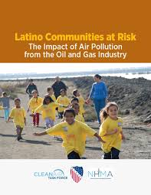
First, not only race
Expanding scope
  Initially: race
  Bullard: “Racism trumps class”
Expand to cover other groups and minorities
  Socio-economic status (the poor) and class
  Ethnic groups (Latinos in US)
  Other vulnerable groups: women, children and poor
Notes:
Expand to cover other groups and minorities that can be disproportionally burdened

Slide 16
Gender: women and climate change
(https://www.un.org/en/chronicle/article/womenin-shadow-climate-change)
Women: more vulnerable than men to the impacts of climate change
  because they represent the majority of the world's poor and are proportionally more dependent on threatened natural resources
Difference between men and women can also be seen in their differential roles, responsibilities, decision making, access to land and natural resources, opportunities and needs, which are held by both sexes
  Worldwide, women have less access than men to resources such as land, credit, agricultural inputs, decision-making structures, technology, training and extension services that would enhance their capacity to adapt to climate change
Notes:
Why women are more vulnerable
Women's vulnerability to climate change stems from a number of factors -- social, economic and cultural.
Seventy per cent of the 1.3 billion people living in conditions of poverty are women. In urban areas, 40 per cent of the poorest households are headed by women. Women predominate in the world's food production (50-80 per cent), but they own less than 10 per cent of the land.
Women represent a high percentage of poor communities that are highly dependent on local natural resources for their livelihood, particularly in rural areas where they shoulder the major responsibility for household water supply and energy for cooking and heating, as well as for food security.
Women have limited access to and control of environmental goods and services; they have negligible participation in decision-making, and are not involved in the distribution of environment management benefits. Consequently, women are less able to confront climate change.
During extreme weather such as droughts and floods, women tend to work more to secure household livelihoods. This will leave less time for women to access training and education, develop skills or earn income. In Africa, female illiteracy rates were over 55 per cent in 2000, compared to 41 per cent for men.⁴ When coupled with inaccessibility to resources and decision-making processes, limited mobility places women where they are disproportionately affected by climate change.
From UN(?) report:
Women in Africa that have to travel longer distances to pick up water because of drought
Gendered division of work implies that they bear the costs of climate change to a larger extend than men

Slide 17
EJ: distributive dimension
Distributive EJ: [right to] equal distribution of environmental risks and benefits
Such as in classic environmental racism cases (see before), when toxic environments are disproportionally experienced by African Americans, or for poor, or ethnic minorities, women, children, etc. (e.g. within the US)
US EPA definition:
  Environmental justice is the fair treatment and meaningful involvement of all people regardless of race, color, national origin, or income with respect to the development, implementation, and enforcement of environmental laws, regulations, and policies. EPA has this goal for all communities and persons across this Nation

Slide 18
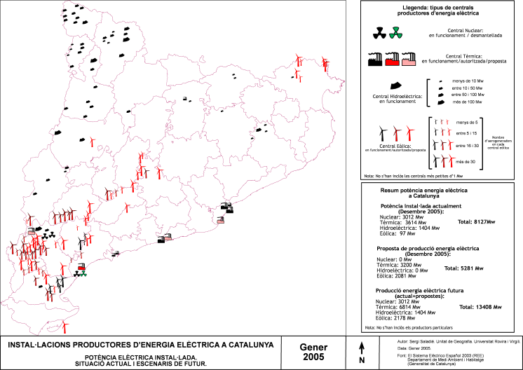
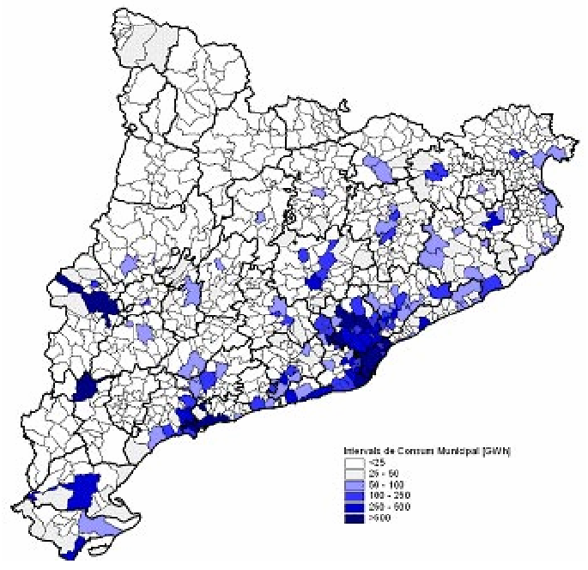
Distributive EJ at national level
National aspect: “not only within cities, but also urban-rural divide”
Terra Alta wind farms:
  Protests at macro-concentration
  Inequities: energy generation vs. energy consumption
    A neo-colonial relation between a centre and “extractive” periphery
  Procedural aspects: behind closed-doors agreements
Notes:
See: Zografos, C. and Martínez-Alier, J., 2009. The politics of landscape value: a case study of wind farm conflict in rural Catalonia. Environment and Planning A, 41(7), pp.1726-1744.

Slide 19
International dimension of EJ (distributive)
In a study published by the American journal PNAS in May 2019, climatologist Noah Diffenbaugh claimed that "most of the poor countries on Earth are considerably poorer than they would have been without global warming. At the same time, most of the rich countries are richer than they would have been.”
https://worldcrunch.com/culture-society/colonialism-the-hidden-cause-of-our-environmental-crisis
Notes:
https://germanwatch.org/download/klak/fb-tuv-e.pdf
Posed as posssibly the first country (nation) to disappear
NZ’s new Labor-Green Party coalition “Creates First Climate Change Refugee Visa Program” (2018)

Slide 20
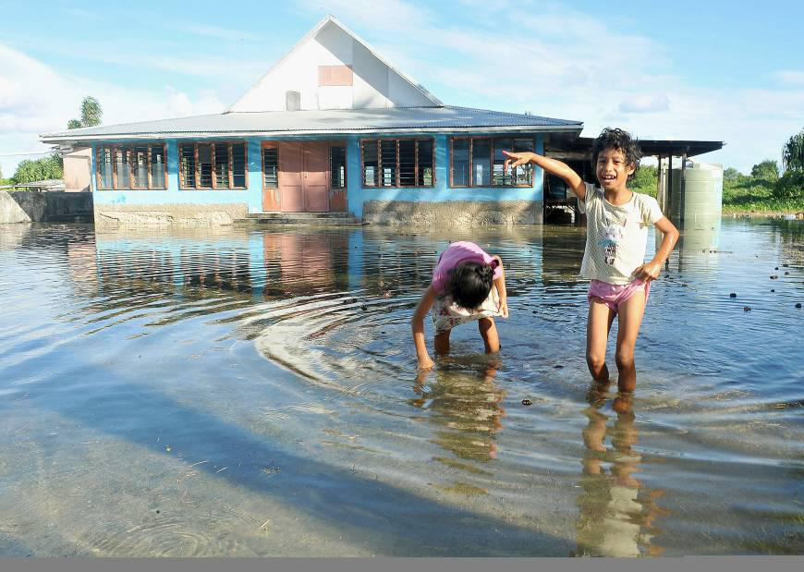
Distributive EJ: international dimension
“And even see that injustice on a global level”: small island nations forced to directly confront consequences to rising sea-levels but haven’t played any significant role in the industries that are causing climate change”
  Tuvalu:
  Possibly first country (nation) to disappear because of climate change effects
    SLR – lies only 2m above SL
  GDP: 135/175 (World Bank)
  Per capita CO₂ emissions (in metric tn, 2014) (knoema.com) = “0”
    Tuvalu = 0.06
    Spain = 5.31
    China = 7.82
    USA = 16.63
  Pacific Islands region = 0.03% of global CO2 emissions (germanwatch.org)
Source: KYODO/ www.japantimes.co
Notes:
https://germanwatch.org/download/klak/fb-tuv-e.pdf
Posed as posssibly the first country (nation) to disappear
CONSIDER: JUSTICE AS TREATMENT ACCORDING TO ONE’S ACTIONS
“And even see that injustice on a global level”: small island nations forced to directly confront consequences to rising sea-levels but haven’t played any significant role in the indurstries that are causing climate change”

Slide 21
Distributive EJ: uneven goods
Uneven bads but also uneven goods
  “poor urban planning policies…but those trees get planted in the neighbourhoods that are already green”
  “benefits of programmes enjoyed by communities that are doing just fine”
Unequal distribution of environmental goods
Heynen et al., 2006:
  “inequitable distribution of urban canopy cover within Milwaukee”
  “those … with higher median household income, non-Hispanic White residents, and low housing- vacancy rates are more likely to have greater total canopy cover”
Notes:
Heynen, N., Perkins, H.A. and Roy, P., 2006. The political ecology of uneven urban green space: the impact of political economy on race and ethnicity in producing environmental inequality in Milwaukee. Urban Affairs Review, 42(1), pp.3-25.

Slide 22
EJ: participation dimension
Procedural EJ : [right to] fair and meaningful participation
US EPA definition:
  …the fair treatment and meaningful involvement of all people regardless of race, color, national origin, or income with respect to the development, implementation, and enforcement of environmental laws, regulations, and policies
  It will be achieved when everyone enjoys the same degree of protection from environmental and health hazards and equal access to the decision-making process to have a healthy environment in which to live, learn, and work.

Slide 23
EJ: Recognition
Mabo Day: https://www.youtube.com/watch?v=OiQ8YHDfySA
European settlement of Australia and Terra Nullius
  No claim to the land of their ancestors
  1992: Recognition of continuing culture
  “We belong to this land, and this land belongs to us”
Recognition EJ: recognition of community ways of life, local knowledge, and cultural difference
  E.g. recognise rights to land (e.g. access to forest products) based on custom in the absence of “formal” (e.g. written) proof – e.g. also cases in other parts of the world (e.g. Latin America and Africa)
Recognition (Schlosberg, 2007):
  Look at cultural and racial barriers to individuals and communities getting a just distribution

Slide 24
Environmental justice and racism
Integrating recognition dimension of EJ helps address
Critique of environmental racism research
  Strong quantitative and geospatial approaches to “prove” statistically racial discrimination
  Assuming that racism and discrimination are discrete, overt acts that can be measured
  Instead: Study racism as an ideology
Notes:
Jepson, W. 2007 Environmental Racism. In: Robbins, P. Encyclopedia of Environment and Society. Sage:
Seminal publication of Robert Bullard’s Dumping in Dixie (1990).
Drawing from strong quantitative and geospatial approaches, social scientists have attempted to “prove” statistically racial discrimination.
However, critics have strongly underscored the “racial pitfalls” of highly empiricist approaches that assume racism and discrimination are discrete, overt acts or social artifacts that can be measured through quantitative analysis
Critics argue that this position belies any attempt to examine racism as an ideology operating in a particular political economic system.
[* belie: to show something to be false, or to hide something such as an emotion]
Racism as ideology: two key elements
“othering”
Coloniality of power

Slide 25
Activity 5: Watch those two videos
Context: aftermath of hurricanes in US (South)
Is hurricane looting inevitable? https://www.youtube.com/watch?v=qPmDITU9fqQ
Katrina's Hidden Race War https://www.youtube.com/watch?v=5r1X_G7cWak
Question:
What’s the problem with looting during Katrina?
Notes:
6.39 min = Is hurricane looting inevitable? https://www.youtube.com/watch?v=qPmDITU9fqQ
8.26 min = Katrina's Hidden Race War https://www.youtube.com/watch?v=5r1X_G7cWak

Slide 26
Naomi Klein
Environmental crises do discriminate […], leaving poor people of color the most vulnerable, while simultaneously promoting a culture based on othering.
This is evidenced by the aftermath of Hurricane Katrina in 2006, when African Americans were labeled as looters rather than refugees.
Notes:
Source: http://conference.otheringandbelonging.org/keynote-address-naomi-klein

Slide 27
Activity
1. Read:
  The Other and Othering - A short introduction: http://www.yiannisgabriel.com/2012/09/the-other-and-othering-short.html
2. Get into groups
  Try to explain to each other: What is othering? Is it relevant to the Katrina case, and if yes, how?

Slide 28
Othering (Oxford English Dictionary)
Image by @imogenfoxell)

Slide 29
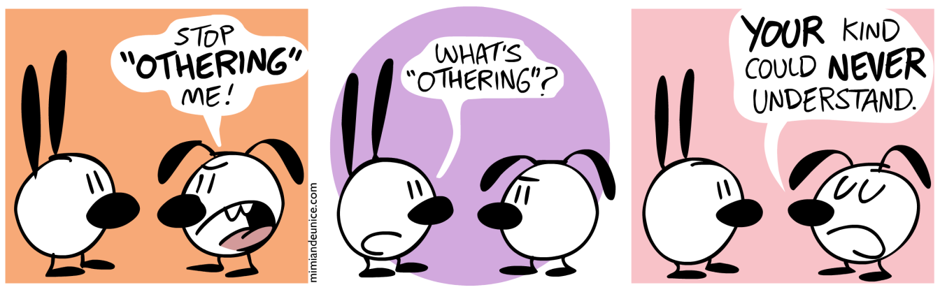
Othering (Gabriel, 2012)
Source: mimiandeunice.com/2010/07/29/othering/
Othering is a key element/ ideology at basis of racism: dominant ideology of colonial culture
Othering: based on binary relation: Self vs. (different, less valuable) Other
  Process: establish own identity through opposition to and vilification of Other
In othering, you deny Other those characteristics that define the Self
  E.g. reason, dignity, love, pride, heroism, nobility, human rights
  Deny their essential humanity-> Other: ready for exploitation, oppression, etc.
Othering: dominant ideology of colonial culture (Rieder, 2008) and rule
  Consistent dehumanisation/ devaluation of ‘Other’
  E.g. primitives, uncivilized, orientals, blacks, non-believers, women(like)
Also othering is about removing agency of Other
  Denying Other her own voice, i.e. opportunity to speak for herself
  Instead: attributing qualities, opinions of own culture and identity
Notes:
Source: http://www.yiannisgabriel.com/2012/09/the-other-and-othering-short.html
Othering is a key element/ Ideology at basis of racism: dominant ideology of colonialist culture
Explains Eastern world to the Western world, using the binary relationship of the European Self confronting the non–European Other from overseas (Rieder, 2008)
For example: medieval representations of Muslims as “men of blood and violence” – probably partly due to experiencing contact with them as conquerors (Fletcher, 2003)
OTHERING = The process of casting a group, an individual or an object into the role of the ‘other’ and establishing one’s own identity through opposition to and, frequently, vilification of this Other. The Greeks’ use of the word ‘barbarian’ to describe non-Greeks is a typical example of othering and an instance of nationalism avant la lèttre. The ease with which the adjective ‘other’ generated the verb ‘to other’ … is indicative of the usefulness, power and currency of a term that now occupies an important position in feminist, postcolonial, civil rights and sexual minority discourses.
Othering is a process that goes beyond ‘mere’ scapegoating and denigration – it denies the Other those defining characteristics of the ‘Same’, reason, dignity, love, pride, heroism, nobility, and ultimately any entitlement to human rights. Whether the Other is a racial or a religious group, a gender group, a sexual minority or a nation, it is made rife for exploitation, oppression and indeed genocide by denying its essential humanity, because, as the philosopher Richard Rorty put it, “everything turns on who counts as a fellow human being, as a rational agent in the only relevant sense – the sense in which rational agency is synonymous with membership of our moral community” (Rorty, 1993, p. 124).
Some authors (notably Said, 1985, 1994) have argued that Western identity and culture are fundamentally forged by an othering logic, one that dehumanizes or devalues other people, such as primitives, uncivilized, orientals, blacks, non-believers, women and so forth. An essential feature of othering is denying the Other his/her own voice, denying him/her the opportunity to speak for him/herself and instead attributing qualities, opinions and views that refer to one’s own identity and culture.

Slide 30
Othering and environmental justice
In the hurricane response case, othering (black American = looter) deepens the experiencing of unequal effects by certain populations (black American) along racial lines
  Their vulnerability is made more intense: they are even more exposed to hurricane effects
    Made more difficult (risking their lives) to reach relief efforts
  Face additional barriers and problems, not faced by white population
    Mobility barriers

Slide 31
Argument 2
Othering produces environmental injustice (and transformation)
Because: it allows mobilising or withholding resources that facilitate distributive/ procedural/ recognition injustice
  (Related to the use of/ access to nature and natural resources)
Racism as ideology: premised on practice of othering
  Othering serves to justify (“explain”) “reasonableness” of racism
Notes:
Othering produces environmental injustice
Because it allows to mobilise resources that facilitate distributive (unequal distribution of environmental goods and bads, e.g. toxic environments for the benefit of colonisers), and/or procedural and representational (e.g. no participation in decisions taken for the environment) injustice
EVIDENCE/ CASE/ EXAMPLE (Ashcroft, 2009, pp. 79-82, Terra Nullius): De-humanising indigenous populations (don’t belong to community of “men”) to facilitate (e.g. mobilise military resources for) land (and other NR) dispossession
Captain Cook names Australia ‘Terra Nullius’ (land belonging to nobody), i.e. empty land, meaning land not inhabited by humans
This means that white colonisers have the right (given by the Kind/ Queen of England) to occupy its lands by any means (incl. the use of force)
Why ‘Nullius’?
Because aborigines are not human
Aborigines are “part of nature”: European observers categorised them like that based on “noble savage” idea
Britannica: uncivilized man, who symbolizes the innate goodness of one not exposed to the corrupting influences of civilization” (i.e. part of nature/ not civilisation that is a human artifact – and corrupts)
There are no human communities: there is no established political system or existing code of law
(Claiming sovereignty = bringing aborigines under ‘civilizing’ protection of British Crown)
There is no recognisable tenure in the land
But what = tenure? Land claims and conflicts for two centuries
As inhabitants = animals, place is unpopulated (i.e. land can be occupied)
Of course this was a very humanised world; el.g. Aborigines manipulated landscapes/ ecosystems for hunting with fire
Rather than children of Nature, they made nature part of culture (via Dreaming, etc.): nature not polarised from its human inhabitants
What justifies invasion and take over of lands?
Othering nomadic life
Absence of agriculture = European mind = unable to comprehend owner’s relationship with land
Rights of occupation established by Bible. According to John Locke:
“God gave the World to Men to make use of it … [and] the Earth…for the support and comfort of their being”
Where there has been no improvement of nature, men had not acted according to Genesis (to create property)
Where there was no evidence of “use” such as agriculture, buildings, monuments, and temples, it was assumed that people did not have a concept of landed property, hence could not been seen as possessors
Example of this: Establishment of settler colonies in Australia, which impose the domination of agrarian culture, stealing the land belonging to hunter-gatherers
Also: grazing lands of African savannah (“lost Edens in need of protection and preservation” from indigenous human occupants)

Slide 32
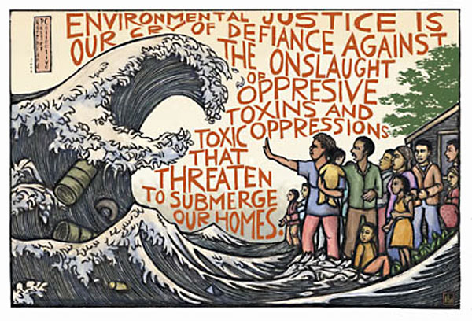
Take-away points
Othering
  Denies basic humanity of Other
  Naturalises discrimination
  Intensifies and facilitates environmental injustice
Environmental racism – environmental justice
        Not only race
        Also: ethnicity, socio-economics/ class, gender
  Distributive EJ
    Uneven bads; but also uneven goods
    At both nat’l and int’l level
  Distributive, but also procedural, and recognition EJ
Source: http://www.columbia.edu/cu/EJ/EJ_ricardolevinsmorales.jpg

Slide 33
Debate!
Is it equally ok to be any of those two?

